Slide 1

5-Minute Check on Section 5-1
If two events do not affect each other, then they are called?
What type of probabilities are probability models used for?
Starting with the first row of random digits in your book, simulate getting a snow day for 25 days; given that the probability of it snowing is 10% and the probability of a snow day given that it snowed is 50%.
independent
theoretical
Assignment: 0: snow; 1-9: no snow; 0-4: snow day; 5-9: school
↑↓ ↑↓ ↑↓
On the 8th day it snowed and we missed school; on the 10th day it snowed and we were in school and on the 22nd day it snowed and we were in school.
19223 95034 05756 28713 96409 12531 42544 82853
Click the mouse button or press the Space Bar to display the answers.

Slide 2
Lesson 5 – 2a
Probability Models

Slide 3
Objectives
Give a probability model for a chance process with equally likely outcomes and use it to find the probability of an event
Use basic probability rules, including the complement rule and the addition rule for mutually exclusive events
Use a two-way table or Venn diagram to model a chance process and calculate probabilities involving two events
Apply the general addition rule to calculate probabilities

Slide 4
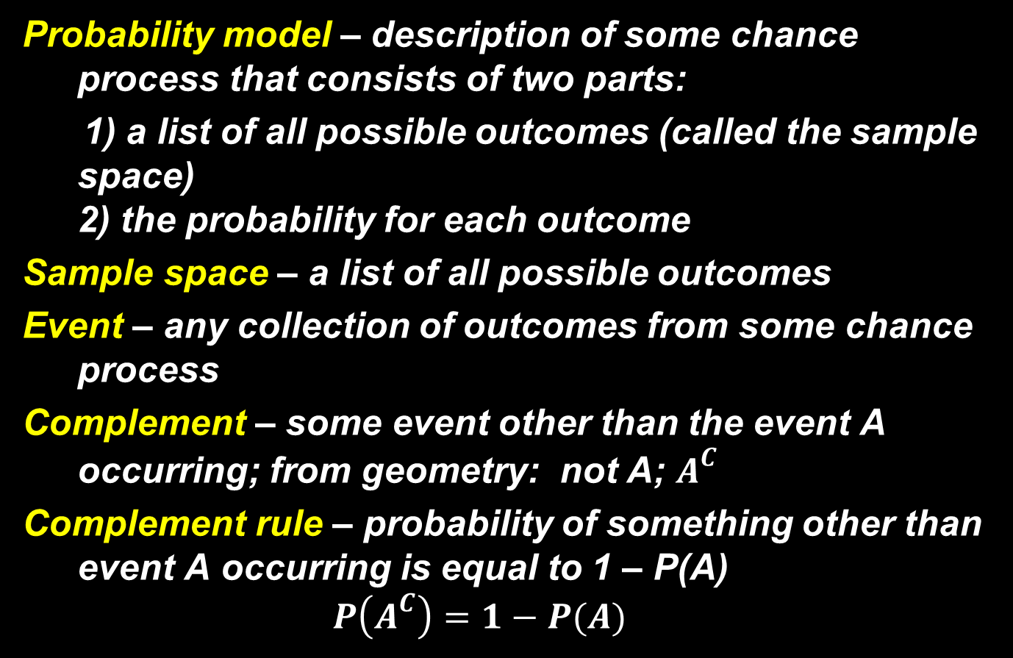
Vocabulary

Slide 5
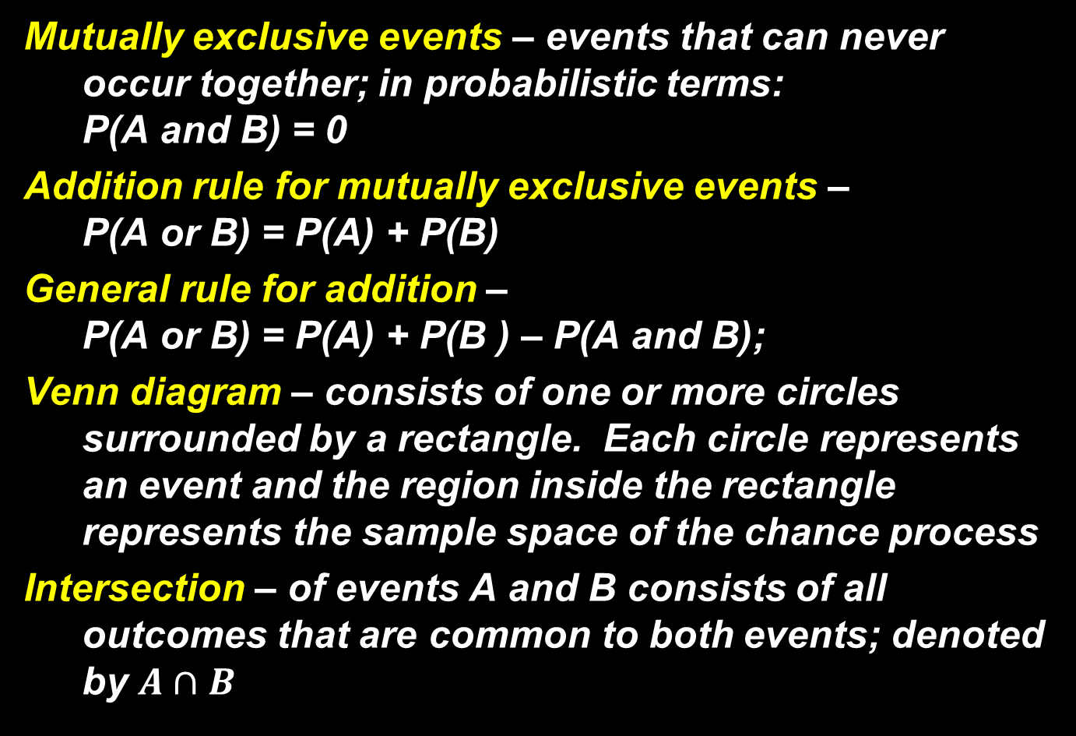
Vocabulary

Slide 6

Vocabulary

Slide 7
Idea of Probability
Chance behavior is unpredictable in the short run, but has a regular and predictable pattern in the long run
The unpredictability of the short run entices people to gamble and the regular and predictable pattern in the long run makes casinos very profitable.

Slide 8
Randomness and Probability
We call a phenomenon random if individual outcomes are uncertain but there is nonetheless a regular distribution of outcomes in a large number of repetitions
The probability of any outcome of a random phenomenon is the proportion of times the outcome would occur in a very long series of repetitions. That is, probability is long-term frequency.

Slide 9
Probability Models
In Section 5.1, we used simulation to imitate chance behavior. Fortunately, we don’t have to always rely on simulations to determine the probability of a particular outcome.
Descriptions of chance behavior contain two parts:
Definition:
The sample space S of a chance process is the set of all possible outcomes.
A probability model is a description of some chance process that consists of two parts: a sample space S and a probability for each outcome.

Slide 10
Example 1
Using the PROBSIM application on your calculator flip a coin 1 time and record the results? Now flip it 50 times and record the results. Now flip it 200 times and record the results. (Use the right and left arrow keys to get frequency counts from the graph)
Number of Rolls | Heads | Tails
1
51
251
0 1
33
117 134

Slide 11
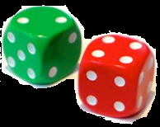
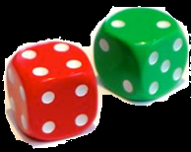
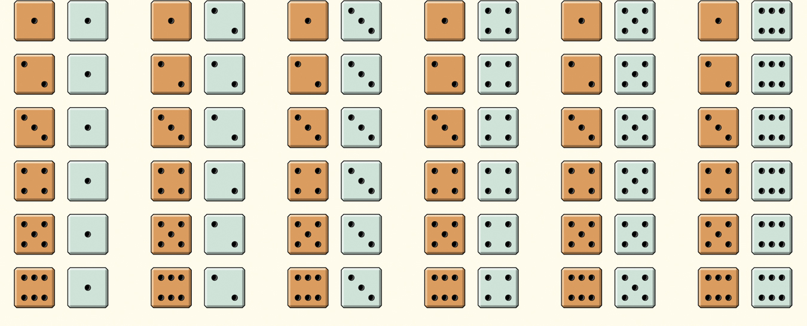
Example: Roll the Dice
Give a probability model for the chance process of rolling two fair, six-sided dice – one that’s red and one that’s green.
Since the dice are fair, each outcome is equally likely.
Each outcome has probability 1/36.
Sample Space
36 Outcomes

Slide 12
Probability Models
Probability models allow us to find the probability of any collection of outcomes
Definition:
An event is any collection of outcomes from some chance process. That is, an event is a subset of the sample space. Events are usually designated by capital letters, like A, B, C, and so on.
If A is any event, we write its probability as P(A).
In the dice-rolling example, suppose we define event A as “sum is 5.”
There are 4 outcomes that result in a sum of 5.
Since each outcome has probability 1/36, P(A) = 4/36.
Suppose event B is defined as “sum is not 5.” What is P(B)?
P(B) = 1 – 4/36
= 32/36

Slide 13
Probability Models
Probability model is a mathematical description of a random phenomenon consisting of two parts: a sample space S and a way of assigning probabilities to events
S
E
F
1
5
2
4
3
6
Sample Space S: possible outcomes in rolling a six-sided die
Event E: odd numbered outcomes
Event F: even numbered outcomes

Slide 14
Example 2
Draw a Venn diagram to illustrate the following probability problem: what is the probability of getting a 5 on two consecutive rolls of the dice?
S
E
F
4
1
1
2
2
5
4
6
3
6
3

Slide 15

Probability Rules
All probability models must obey the following rules:
The probability of any event is between 0 and 1.
All possible outcomes together must have probabilities whose sum is 1.
If all outcomes in the sample space are equally likely, the probability that event A occurs can be found using the formula

Slide 16
Probability Rules cont
All probability models must obey the following rules:
The probability that an event does not occur is 1 minus the probability that the event does occur.
(also known as the complement rule)
If two events have no outcomes in common, the probability that one or the other occurs is the sum of their individual probabilities.
Definition:
Two events are mutually exclusive (disjoint) if they have no outcomes in common and so can never occur together.

Slide 17

Probability Rules: Equations
For any event A, 0 ≤ P(A) ≤ 1.
If S is the sample space in a probability model, P(S) = 1.
In the case of equally likely outcomes,
Complement rule: P(A^{C}) = 1 – P(A)
Addition rule for mutually exclusive events: If A and B are mutually exclusive,
P(A or B) = P(A) + P(B).

Slide 18
Example 3
Identify the problems with each of the following
P(A) = .35, P(B) = .40, and P(C) = .35
P(E) = .20, P(F) = .50, P(G) = .25
P(A) = 1.2, P(B) = .20, and P(C) = .15
P(A) = .25, P(B) = -.20, and P(C) = .95
P(S) = 1.1 > 1
P(S) = 0.9 < 1
P(A) > 1
P(B) < 0

Slide 19
Example 4
Answer the following questions given a solution space consisting of A, B and C.
P(A) = .35, P(B) = .40, and P(C) = ??
P(A) = .20, P(B) = .50, P(C) = .30; P(~A) = ??
P(C) = 1 - .35 - .40 = 0.25
P(~A) = 1 – P(A) = 1 – 0.20 = 0.80

Slide 20
Basic Counting
If items are independent of each other, then we multiply the counts to get the total number of possibilities
If a buffet style meal has 3 appetizers, 5 entrees and 4 deserts, then how many different combinations can someone have?
They can have 3 × 5 × 4 = 60 different combinations

Slide 21
Example 4
How many different dinner combinations can we have if you have a choice of 3 appetizers, 2 salads, 4 entrees, and 5 deserts?
3 × 2 × 4 × 5 = 120 different dinner combinations

Slide 22
Replacement
With replacement maintains the original probability
  Draw a card and replace it and then draw another
  What are your odds of drawing two hearts?
  Events are independent
Without replacement changes the original probability
  Draw two cards
  What are you odds of drawing two hearts
  How have the odds changed?
  Events are now dependent

Slide 23
Example 5
Draw a card and replace it and then draw another. What are your odds of drawing two hearts?
With Replacement:
Without Replacement
(13/52) (13/52) = 1/16 = 0.0625
(13/52) (12/51) = 0.0588

Slide 24

Example: Distance Learning
Distance-learning courses are rapidly gaining popularity among college students. Randomly select an undergraduate student who is taking distance-learning courses for credit and record the student’s age. Here is the probability model:
Age group (yr): | 18 to 23 | 24 to 29 | 30 to 39 | 40 or over
Probability: | 0.57 | 0.17 | 0.14 | 0.12
Show that this is a legitimate probability model.
Find the probability that the chosen student is not in the traditional college age group (18 to 23 years).
Each probability is between 0 and 1 and 0.57 + 0.17 + 0.14 + 0.12 = 1
P(not 18 to 23 years) = 1 – P(18 to 23 years)
= 1 – 0.57 = 0.43

Slide 25
Summary and Homework
Summary
  Probability is the proportion of times an event occurs in many repeated trials
  Probability model consist of the entire space of outcomes and associated probabilities
  Sample space is the set of all possible outcomes
  Events are subsets of outcomes in the sample space
  Multiplication principle enumerates possible outcomes
  Sample with replacement keeps original probability
  Sample without replacement changes original probability
Homework
  Day One: 27, 31, 32, 43, 45, 47

Slide 26
5-Minute Check on Section 5-2a
If you have a choice from 6 shirts, 5 pants, 10 pairs of socks and 3 different pairs of shoes, how many different outfits could you wear to school?
What is the probability of drawing a pair of cards from a 52-card deck and getting a king and a queen?
If you have a 70% chance of passing the mile-run test the first time you run it and a 50% chance of passing if you have to run the test again, what are your chances of passing?
6 × 5 × 10 × 3 = 900 different outfits
(4/52) × (4/51) = (16/2652) = 0.006 or 0.6% chance
Pass Pass 0.7
0.85
test Fail test2 Pass Pass 0.15
Fail Fail 0.15
0.7
0.5
0.3
0.5
Click the mouse button or press the Space Bar to display the answers.

Slide 27
Lesson 5 – 2a
Probability Models

Slide 28
Objectives
DESCRIBE chance behavior with a probability model
DEFINE and APPLY basic rules of probability
DETERMINE probabilities from two-way tables
CONSTRUCT Venn diagrams and DETERMINE probabilities

Slide 29
Vocabulary
Empirical – based on observations rather than theorizing
Random – individuals outcomes are uncertain
Probability – long-term relative frequency
Sampling with replacement – samples from a solution set and puts the selected item back in before the next draw
Sampling without replacement – samples from a solution set and does not put the selected item back

Slide 30
Vocabulary Cont
Union – the set of all outcomes in both subsets combined (symbol: ∪)
Empty event – an event with no outcomes in it (symbol: ∅)
Intersect – the set of all in only both subsets (symbol: ∩)
Venn diagram – a rectangle with solution sets displayed within
Independent – knowing that one thing event has occurred does not change the probability that the other occurs
Disjoint – events that are mutually exclusive (both cannot occur at the same time)

Slide 31
Venn Diagrams in Probability
A ∪ B is read A union B
  is both events combined
  is the boolean word OR
A ∩ B is read A intersection B
  is the outcomes they have in common
  is the boolean word AND
Disjoint events have no outcomes in common and are also called mutually exclusive
  In set notation:
  A ∩ B = ∅ (empty set)
A
B

Slide 32
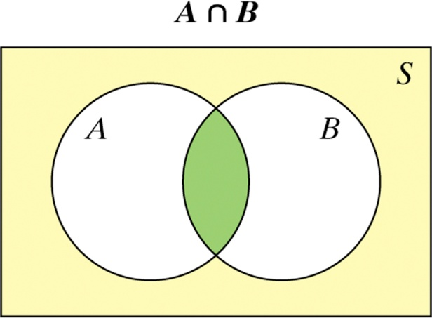
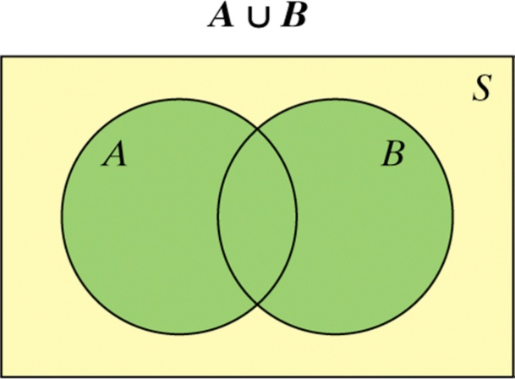
Venn Diagrams in Probability
The intersection of events A and B (A ∩ B) is the set of all outcomes in both events A and B.
The union of events A and B (A ∪ B) is the set of all outcomes in either event A or B.
Hint: To keep the symbols straight, remember ∪ for union and ∩ for intersection.

Slide 33
Addition Rule for Disjoint Events
If E and F are disjoint (mutually exclusive) events,
then P(E or F) = P(E) + P(F)
E
F
Probability for Disjoint Events
P(E or F) = P(E) + P(F)

Slide 34
Example 1
A card is chosen at random from a normal deck. What is the probability of choosing?
a) a king or a queen
b) a face card or a 2
P(K) + P(Q) = 4/52 + 4/52
= 8/52 ≈ 15.4%
P(K,Q,J or 2) = P(K, Q, or J) + :P(2)
= (12/52) + (4/52)
= 16/52 ≈ 30.8%

Slide 35
Complement Rule
If E represents any event and E^{c} represents the complement of E, then P(E^{c}) = 1 – P (E)
E
E^{c}
Probability for Complement Events
P(E^{c}) = 1 – P(E)

Slide 36
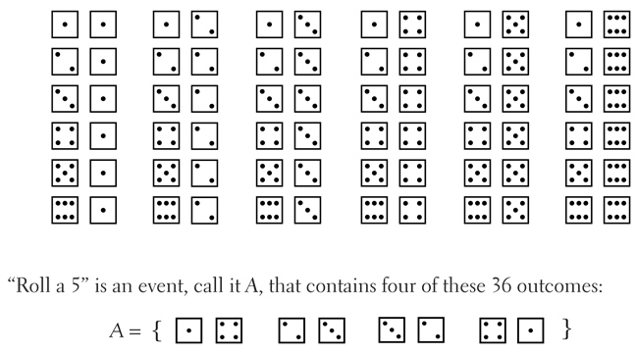
Example 2
What is the probability of rolling two dice and getting something other than a 5?
P (not a 5) = 1 – P(5) = 1 – 4/36 = 32/36 = 88.8%

Slide 37
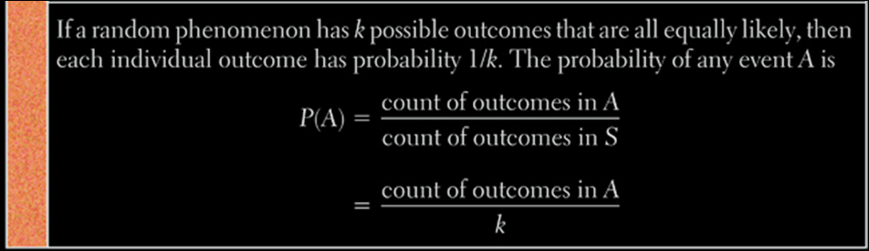
Equally Likely Outcomes
Discrete uniform probability distributions
  Dice
  Cards

Slide 38
Independent Events
Two events A and B are independent if knowing that one occurs does not change the probability that the other occurs.
Disjoint events cannot be independent
Examples:
Flipping a coin
Rolling dice
Drawing cards with replacement (and shuffling)
Not Independent:
Drawing cards without replacement

Slide 39
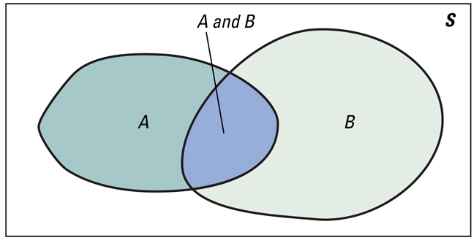
Multiplication Rules for Independent Events
If A and B are independent events,
then P(A and B) = P(A) ∙ P(B)
If events E, F, G, ….. are independent, then
P(E and F and G and …..) = P(E) ∙ P(F) ∙ P(G) ∙ ……

Slide 40
Example 3
A) P(rolling 2 sixes in a row) = ??
B) P(rolling 5 sixes in a row) = ??
1/6 × 1/6 = 1/(6²) = 1/36
1/6 × 1/6 × 1/6 × 1/6 × 1/6 = 1/(6⁵) = 1/7776

Slide 41
Example 4
A card is chosen at random from a normal deck. What is the probability of choosing?
a) a king or a jack b) a king and a queen
c) a king and red card d) a face card and a heart
P(K) + P(J) = 4/52 + 4/52
= 8/52 ≈ 15.4%
P(K+Q) = 0
P(K+red) = (4/52)•(26/52)
= 2/52 ≈ 3.8%
P(K,Q,J + heart)
= (12/52) •(13/52)
= 3/52 ≈ 5.8%

Slide 42
At least Probabilities
P(at least one) = 1 – P(complement of “at least one”)
= 1 – P(none)
0
1, 2, 3, ….

Slide 43
Example 5
P(rolling a least one six in three rolls) = ??
= 1 - P(none)
= 1 – (5/6)• (5/6)• (5/6)
= 1 – 0.5787 = 0.4213

Slide 44
Example 6
There are two traffic lights on the route used by Pikup Andropov to go from home to work. Let E denote the event that Pikup must stop at the first light and F in a similar manner for the second light. Suppose that P(E) = .4 and P(F) = .3 and P(E and F) = .15. What is the probability that he:
a) must stop for at least one light?
b) doesn't stop at either light?
c) must stop just at the first light?
= 1 - P(none) = 1 – (0.6)• (0.7) = 1 – 0.42 = 0.58
= (1-P(E)) • (1-P(F)) = 0.6 • 0.7 = 0.42
= 0.4

Slide 45
Example 6 – Venn Diagrams
There are two traffic lights on the route used by Pikup Andropov to go from home to work. Let E denote the event that Pikup must stop at the first light and F in a similar manner for the second light.
P(E and F) = P(E)×P(F)
if they are independent
= 0.4 (0.3) = 0.12 not 0.15
First
Light
Second
Light
0.28
0.12
0.18
0.42

Slide 46
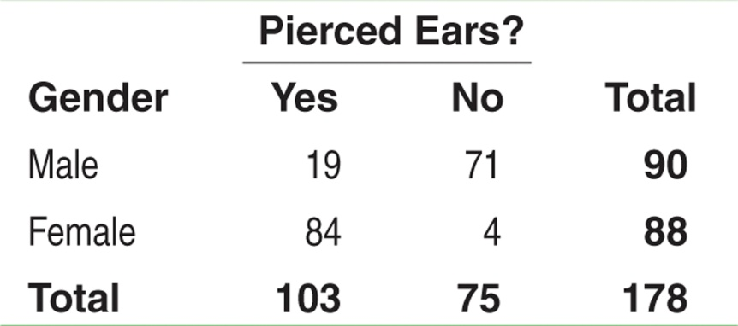
Two-Way Tables and Probability
When finding probabilities involving two events, a two-way table can display the sample space in a way that makes probability calculations easier.
Consider the example on page 303. Suppose we choose a student at random. Find the probability that the student
has pierced ears.
is a male with pierced ears.
is a male or has pierced ears.
Define events A: is male and B: has pierced ears.
(a) Each student is equally likely to be chosen. 103 students have pierced ears. So, P(pierced ears) = P(B) = 103/178.
(b) We want to find P(male and pierced ears), that is, P(A and B). Look at the intersection of the “Male” row and “Yes” column. There are 19 males with pierced ears. So, P(A and B) = 19/178.
(c) We want to find P(male or pierced ears), that is, P(A or B). There are 90 males in the class and 103 individuals with pierced ears. However, 19 males have pierced ears – don’t count them twice!
P(A or B) = (19 + 71 + 84)/178. So, P(A or B) = 174/178

Slide 47
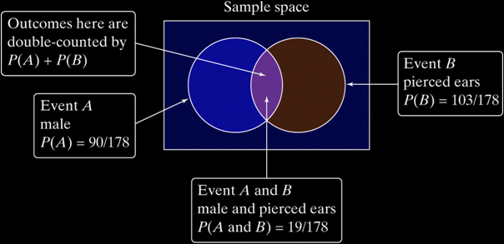
Two-Way Tables and Probability
Note, the previous example illustrates the fact that we can’t use the addition rule for mutually exclusive events unless the events have no outcomes in common.
The Venn diagram below illustrates why.
General Addition Rule for Two Events
If A and B are any two events resulting from some chance process, then
P(A or B) = P(A) + P(B) – P(A and B)

Slide 48
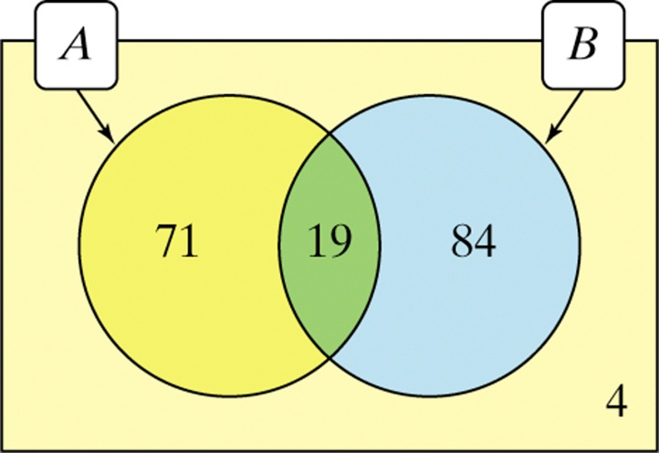
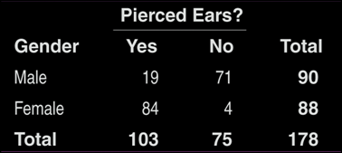
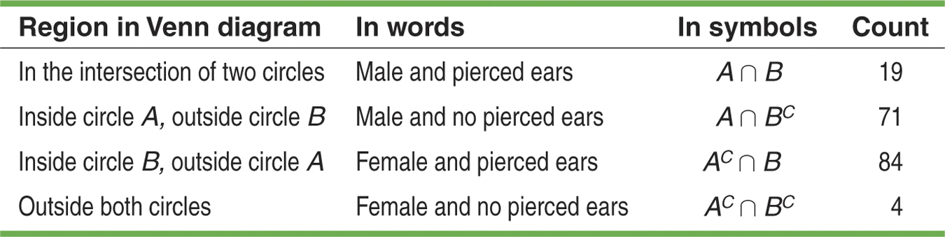
Venn Diagrams and Probability
Recall the example on gender and pierced ears. We can use a Venn diagram to display the information and determine probabilities.
Define events A: is male and B: has pierced ears.

Slide 49
Summary and Homework
Summary
  An event’s complement is all other outcomes
  Disjoint events are mutually exclusive
  Events are independent if knowing one event occurs does not change the probability of the other event
  Venn diagrams can help with probability problems
  Probability Rules
    0 ≤ P(X) ≤ 1 for any event X
    P(S) = 1 for the sample space S
    Addition Rule for Disjoint; P(A or B) = P(A) + P(B)
    Complement Rule: For any event A, P(A^{C}) = 1 – P(A)
    Multiplication Rule: If A and B are independent, the P(A and B) = P(A)×P(B)
Homework
  Day Two: 29, 33-6, 49, 51, 53, 55

