Slide 1

5-Minute Check on Section 5-2b
What is the P(three heads in a row)?
What is the P(at least one 4) on an eight-sided dice in 3 rolls?
What is the name of an equally likely probability distribution?
Give an example from #3.
Given a normal 52-card deck and selecting 1 card; find the following:
P(King or Jack)
P(Ace and Spade)
P(no face cards)
(1/2 ) × (1/2) × (1/2) = 0.125
(1/2 ) × (1/2) × (1/2) = 0.125
Uniform
fair dice
= P(K) + P(J) = 4/52 + 4/52 = 0.1538 ≈ 15%
= P(A) × P(S) = 4/52 × 13/52 = 0.0192 ≈ 2%
= 1 – P(FC) = 1 – 3×(4/52)
= 1 – 0.231 = 0.769 ≈ 77%
Click the mouse button or press the Space Bar to display the answers.

Slide 2
Lesson 5 – 3a
General Probability Rules

Slide 3
Objectives
DEFINE conditional probability
COMPUTE conditional probabilities
DESCRIBE chance behavior with a tree diagram
DEFINE independent events
DETERMINE whether two events are independent
APPLY the general multiplication rule to solve probability questions

Slide 4
Vocabulary
Personal Probabilities – reflect someone’s assessment (guess) of chance
Joint Event – simultaneous occurrence of two events
Joint Probability – probability of a joint event
Conditional Probabilities – probability of an event given that another event has occurred

Slide 5
Question to Ponder
Dan can hit the bulls eye ½ of the time
Daren can hit the bulls eye ⅓ of the time
Duane can hit the bulls eye ¼ of the time
Given that someone hits the bulls eye, what is the probability that it is Dan?

Slide 6
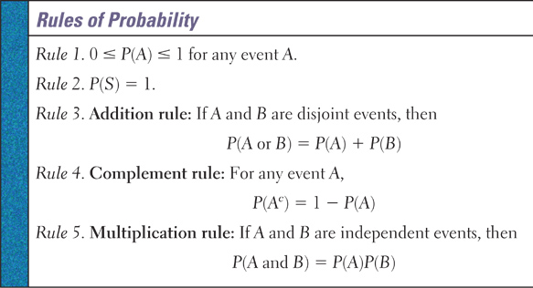
Rules of Probability

Slide 7
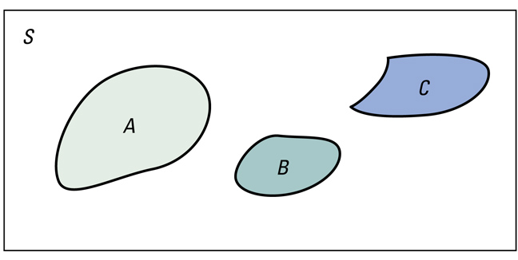
Addition Rule for Disjoint Events
If events A, B, and C are disjoint in the sense that no two have any outcomes in common, then
P(A or B or C) = P(A) + P(B) + P(C)
This rule extends to any number of disjoint events

Slide 8
General Addition Rule
For any two events E and F,
P(E or F) = P(E) + P(F) – P(E and F)
E
F
E and F
Probability for non-Disjoint Events
P(E or F) = P(E) + P(F) – P(E and F)

Slide 9
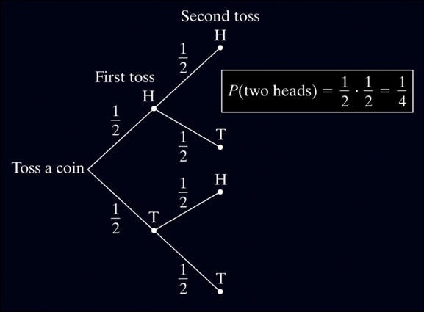
Tree Diagram
We learned how to describe the sample space S of a chance process in Section 5.2. Another way to model chance behavior that involves a sequence of outcomes is to construct a tree diagram.
Consider flipping a coin twice.
What is the probability of getting two heads?
Sample Space:
HH HT TH TT
So, P(two heads) = P(HH) = 1/4

Slide 10
Tree Diagrams
Tree Diagram makes the enumeration of possible outcomes easier to see and determine
N
HTT
HTH
HHT
HHH
N
Y
Y
N
Y
Y
Event 1
Event 2
Event 3
Outcomes
N
TTT
TTH
THT
THH
N
Y
N
Y
N
Y
Running the tree out details an individual outcome

Slide 11
Example 1
Given a survey with 4 “yes or no” type questions, list all possible outcomes using a tree diagram. Divide them into events (number of yes answers) regardless of order.

Slide 12
Example 1 cont
YNNN
YNNY
YNYN
YNYY
YYNN
YYNY
YYYN
YYYY
N
N
Y
N
N
Y
Y
Y
N
N
Y
Y
Y
N
Y
Q 1
Q 2
Q 3
Q 4
Outcomes
NNNN
NNNY
NNYN
NNYY
NYNN
NYNY
NYYN
NYYY
N
N
Y
N
N
Y
Y
N
N
N
Y
Y
Y
N
Y

Slide 13
Example 1 cont
YNNN 1
YNNY 2
YNYN 2
YNYY 3
YYNN 2
YYNY 3
YYYN 3
YYYY 4
NNNN 0
NNNY 1
NNYN 1
NNYY 2
NYNN 1
NYNY 2
NYYN 2
NYYY 3
Number of Yes’s
0 | 1 | 2 | 3 | 4
1 | 4 | 6 | 4 | 1
Outcomes

Slide 14
Example 2
Fifty animals are to be used in a stress study: 4 male and 6 female dogs, 9 male and 7 female cats, 5 male and 8 female monkeys, 6 male and 5 female rats. Find the probability of choosing:
a) a dog or a cat b) a cat or a female
c) a male d) a monkeys or a male
P(D) + P(C) = 10/50 + 16/50
= 26/50 = 52%
P(C) + P(F) = P(C) + P(F) – P(C & F)
= 16/50 + 26/50 – 7/50
= 35/50 = 70%
P(Male) = 24/50 = 48%
P(M)+P(male) = P(M) + P(m) – P(M&m)
= 13/50 + 24/50 - 5/50
= 32/50 = 64%

Slide 15
Example 2 cont
Fifty animals are to be used in a stress study: 4 male and 6 female dogs, 9 male and 7 female cats, 5 male and 8 female monkeys, 6 male and 5 female rats. Find the probability of choosing:
e) an animal other than a female monkey
f) a female or a rat
g) a female and a cat
h) a dog and a cat
1 – P(f&M) = 1 – 8/50
= 42/50 = 84%
P(f) + P(R) = P(f) + P(R) – P(f & R)
= 26/50 + 11/50 – 5/50
= 32/50 = 64%
P(female&C) = (7/16)•(16/50)
= 7/50 = 14%
P(D&C) = 0%

Slide 16
Example 3
A pollster surveys 100 subjects consisting of 40 Dems (of which half are female) and 60 Reps (half are female). What is the probability of randomly selecting one of these subjects of getting:
a) a Dem b) a female
c) a Dem and a female d) a Rep male
e) a Dem or a male e) a Rep or a female
P(f) = P(f&D) + P(f&R)
= 20/100 + 30/100 = 50%
P(D) = 40/100 = 40%
P(D&f) = 0.4 * 0.5
or 20/100 = 20%
P(R&m) = 0.6 * 0.5
or 30/100 = 30%
P(D) + P(m) =
= 40/100 + 50/100 – 20/100
= 70%
P(R)+P(f) = 60/100 + 50/100 – 30/100
= 80/100 = 80%

Slide 17
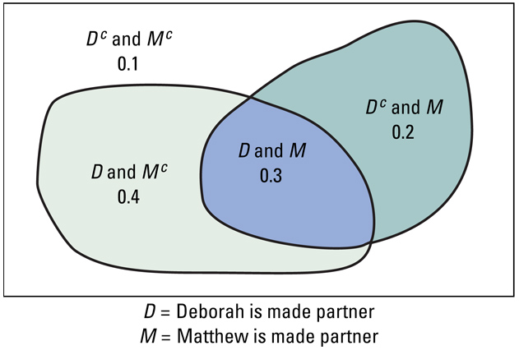
Joint Probabilities
Matthew
Deborah | Promoted | Not Promoted | Total
Promoted | 0.3 | 0.4 | 0.7
Not Promoted | 0.2 | 0.1 | 0.3
Total | 0.5 | 0.5 | 1

Slide 18
Summary and Homework
Summary
  Union contains all outcomes in A or in B
  Intersection contains only outcomes in both A and B
  General rules of probability
    Legitimate values: 0 ≤ P(A) ≤ 1 for any event A
    Total Probability: P(S) = 1
    Complement rule: P(A^{C}) = 1 – P(A)
    General Addition rule: P(A ∪ B) = P(A) + P(B) – P(A ∩ B)
    Multiplication rule: P(A ∩ B) = P(A) × P(B | A)
Homework
  Day One: 57-60, 63, 65, 67, 69, 73, 77, 79

Slide 19
5-Minute Check on Section 5-3a
Fifty animals are to be used in a stress study: 3 male and 6 female dogs, 9 male and 7 female cats, 5 male and 9 female monkeys, 6 male and 5 female rats. Find the probability of choosing:
P(female animal)
P(male or a cat)
P(female and a monkey)
P(animal other than a rat)
P(cat or a dog)
= females / total = 27 / 50 = 0.54 or 54%
= P(male) + p(cat) – P(male cat)
= 0.46 + 0.32 – 0.18 = 0.60 or 60%
= P(female monkey)
= 9 / 50 = 0.18 or 18%
= 1 – P(rat)
= 1 – 11 / 50 = 39 / 50 = 0.78 or 78%
= P(cat) + p(dog) – P(cat-dog)
= 0.32 + 0.18 – 0.00
= 0.50 or 50%
Click the mouse button or press the Space Bar to display the answers.

Slide 20
Lesson 5 – 3b
General Probability Rules

Slide 21
What is Conditional Probability
The probability we assign to an event can change if we know that some other event has occurred. This idea is the key to many applications of probability.
When we are trying to find the probability that one event will happen under the condition that some other event is already known to have occurred, we are trying to determine a conditional probability.
Definition:
The probability that one event happens given that another event is already known to have happened is called a conditional probability. Suppose we know that event A has happened. Then the probability that event B happens given that event A has happened is denoted by P(B | A).
Read | as “given that” or “under the condition that”

Slide 22
Conditional Probability Rule
If A and B are any two events, then
P(A and B) N(A and B)
P(B | A) = ----------------- = ----------------
P(A) N(A)
N is the number of outcomes

Slide 23
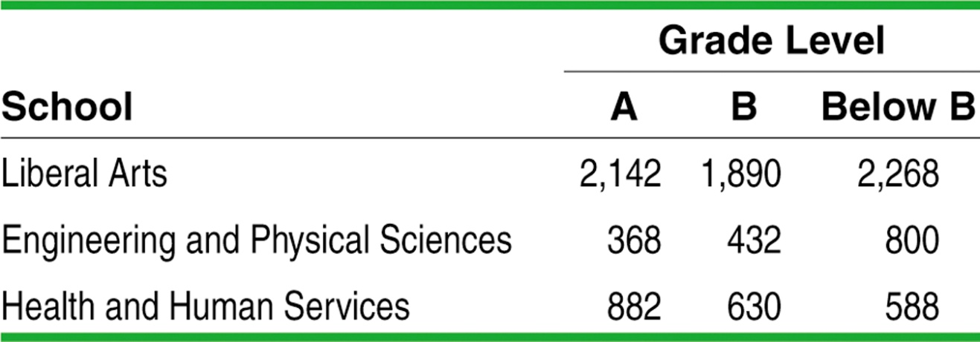
Example: Grade Distributions
Consider the two-way table on page 314. Define events
  E: the grade comes from an EngPhySci course, and
  L: the grade is lower than a B.
Total
6300
1600
2100
Total 3392 2952 3656 10000
Find P(L)
Find P(E | L)
Find P(L | E)
P(L) = 3656 / 10000 = 0.3656
P(E | L) = 800 / 3656 = 0.2188
P(L| E) = 800 / 1600 = 0.5000

Slide 24
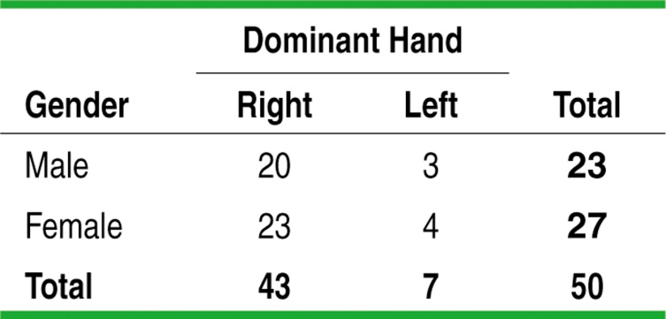
Conditional Probability & Independence
When knowledge that one event has happened does not change the likelihood that another event will happen, we say the two events are independent.
Definition:
Two events A and B are independent if the occurrence of one event has no effect on the chance that the other event will happen. In other words, events A and B are independent if
P(A | B) = P(A) and P(B | A) = P(B).
Example:
Are the events “male” and “left-handed” independent? Justify your answer.
P(left-handed | male) = 3/23 = 0.13
P(left-handed) = 7/50 = 0.14
These probabilities are not equal, therefore the events “male” and “left-handed” are not independent.

Slide 25
Space Shuttle Example
Following the Space Shuttle Challenger disaster, it was determined that the failure of O-ring joints in the shuttle’s booster rockets was to blame. Under cold conditions, it was estimated that the probability that an individual O-ring joint would function properly was 0.977. Assuming O-ring joints succeed or fail independently, what is the probability all six would function properly?
P(joint1 OK & joint 2 OK & joint 3 OK & joint 4 OK & joint 5 OK & joint 6 OK)
=P(joint 1 OK) • P(joint 2 OK) • … • P(joint 6 OK)
=(0.977)(0.977)(0.977)(0.977)(0.977)(0.977) = 0.87

Slide 26
General Multiplication Rule
The probability that two events A and B
both occur is
P(A and B) = P(A ∩ B) = P(A) ∙ P(B | A)
where P(B | A) is a conditional probability
read as the probability of B given that A has occurred

Slide 27
Independence:
A Special Multiplication Rule
When events A and B are independent, we can simplify the general multiplication rule since
P(B| A) = P(B).
Definition:
Multiplication rule for independent events
If A and B are independent events, then the probability that A and B both occur is
P(A ∩ B) = P(A) • P(B)

Slide 28
Calculating Conditional Probabilities
If we rearrange the terms in the general multiplication rule, we can get a formula for the conditional probability P(B | A).
General Multiplication Rule
P(A ∩ B) = P(A) • P(B | A)
P(A ∩ B)
P(A)
P(B | A)
Conditional Probability Formula
To find the conditional probability P(B | A), use the formula
=

Slide 29
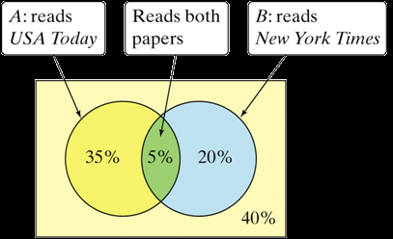



Who Reads the Newspaper?
In Section 5.2, we noted that residents of a large apartment complex can be classified based on the events A: reads USA Today and B: reads the New York Times. The Venn Diagram below describes the residents.
What is the probability that a randomly selected resident who reads USA Today also reads the New York Times?
There is a 12.5% chance that a randomly selected resident who reads USA Today also reads the New York Times.

Slide 30
Independence in Terms of Conditional Probability
Two events A and B are independent if P(B | A) = P(B)
Example: P(A = Rolling a six on a single die) = 1/6
P(B = Rolling a six on a second roll) = 1/6
no matter what was rolled on the first roll!!
So probability of rolling a 6 on the second roll, given you rolled a six on the first is still 1/6
P(B | A) = P(B) so A and B are independent

Slide 31
Contingency Tables
 | Male | Female | Total
Right handed | 48 | 42 | 90
Left handed | 12 | 8 | 20
Total | 60 | 50 | 110
What is the probability of left-handed given that
it is a male?
What is the probability of female given that they were right-handed?
What is the probability of being left-handed?
P(LH | M) = 12/60 = 0.20
P(F| RH) = 42/90 = 0.467
P(LH) = 20/110 = 0.182

Slide 32
Tree Diagram
0.8
Right-handed
0.44
Male
0.55
0.2
Left-handed
0.11
Sex
0.84
Right-handed
0.378
0.45
Female
0.16
Left-handed
0.072
How do we get the probabilities on the far right from the table?
Right-handed males: 0.44 = 48/110
Left-handed females: 0.072 = 8/110

Slide 33
General Multiplication Rule
The idea of multiplying along the branches in a tree diagram leads to a general method for finding the probability P(A ∩ B) that two events happen together.
General Multiplication Rule
The probability that events A and B both occur can be found using the general multiplication rule
P(A ∩ B) = P(A) • P(B | A)
where P(B | A) is the conditional probability that event B occurs given that event A has already occurred.

Slide 34
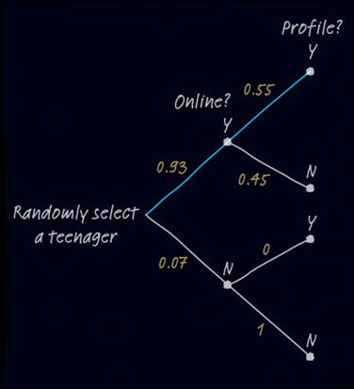


Teens with Online Profiles
The Pew Internet and American Life Project finds that 93% of teenagers (ages 12 to 17) use the Internet, and that 55% of online teens have posted a profile on a social-networking site.
What percent of teens are online and have posted a profile?
51.15% of teens are online and have posted a profile.

Slide 35
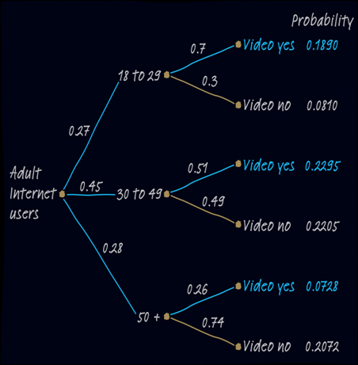
Who Visits YouTube?
See the example on page 320 regarding adult Internet users.
What percent of all adult Internet users visit video-sharing sites?
P(video yes ∩ 18 to 29) = 0.27 • 0.7
=0.1890
P(video yes ∩ 30 to 49) = 0.45 • 0.51
=0.2295
P(video yes ∩ 50 +) = 0.28 • 0.26
=0.0728
P(video yes) = 0.1890 + 0.2295 + 0.0728 = 0.4913

Slide 36
Example 1
A construction firm has bid on two different contracts. Let B₁ be the event that the first bid is successful and B₂, that the second bid is successful. Suppose that P(B₁) = .4, P(B₂) = .6 and that the bids are independent. What is the probability that:
a) both bids are successful?
b) neither bid is successful?
c) is successful in at least one of the bids?
Independent ➔ P(B₁) • P(B₂) = 0.4 • 0.6 = 0.24
Independent ➔ (1- P(B₁)) • (1 - P(B₂)) = 0.6 • 0.4 = 0.24
3 possible outcomes ➔ (1- P(a)- P(b)) = 1 – 0.24 – 0.24 = 0.52
or
P(B₁) • (1 – P(B₂)) + (1 – P(B₁)) • P(B₂) = 0.4 • 0.4 + 0.6 • 0.6 = 0.52

Slide 37
Example 2
Given that P(A) = .3 , P(B) = .6, and P(B|A) = .4 find:
a) P(A and B)
b) P(A or B)
c) P(A|B)
P(A and B)
P(B|A) = ----------------- so P(A and B) = P(B|A)•P(A)
P(A)
P(A and B) = 0.4 • 0.3 = 0.12
P(A or B) = P(A) + P(B) – P(A and B)
= 0.3 + 0.4 – 0.12
= 0.58
P(A and B) 0.12
P(A|B) = ----------------- = -------- = 0.2
P(B) 0.6

Slide 38
Example 3
Given P(A | B) = 0.55 and P(A or B) = 0.64 and P(B) = 0.3. Find P(A).
P(A and B)
P(A|B) = ----------------- so P(A and B) = P(A|B)•P(B)
P(B)
P(A and B) = 0.55 • 0.3 = 0.165
P(A or B) = P(A) + P(B) – P(A and B)
P(A) = P(A or B) – P(B) + P(A and B)
= 0.64 – 0.3 + 0.165
= 0.505

Slide 39
Example 4
If 60% of a department store’s customers are female and 75% of the female customers have a store charge card, what is the probability that a customer selected at random is female and had a store charge card?
Let A = female customer and
let B = customer has a store charge card
P(A and B)
P(B|A) = ----------------- so P(A and B) = P(B|A)•P(A)
P(A)
P(A and B) = 0.75 • 0.6 = 0.45

Slide 40
Example 5
Suppose 5% of a box of 100 light blubs are defective. If a store owner tests two light bulbs from the shipment and will accept the shipment only if both work. What is the probability that the owner rejects the shipment?
P(reject) = P(at least one failure)
= 1 – P(no failures)
= 1 – P(1st not defective) • P(2nd not defective | 1st not defective)
= 1 – (95/100) • (94/99)
= 1 – 0.9020
= 0.098 or 9.8% of the time

Slide 41
Question to Ponder
Dan can hit the bulls eye ½ of the time
Daren can hit the bulls eye ⅓ of the time
Duane can hit the bulls eye ¼ of the time
Given that someone hits the bulls eye, what is the probability that it is Dan?
Out of 36 throws, 13 hit the target. Dan had 6 of them, so
P(Dan | bulls eye) = 6/13
= 0.462
 | Hit | Miss
Dan (p=1/2) | 6 | 6
Daren (p=1/3) | 4 | 8
Duane (p=1/4) | 3 | 9

Slide 42
Summary and Homework
Summary
  Two events are independent if
    P(A|B) = P(A) and P(B|A) = P(B)
  P(at least one) = 1 – P(none) (complement rule)
Homework
  Day Two: 83, 85, 87, 91, 93, 95, 97, 99

