Slide 1

5-Minute Check on Chapter 5
Given: P(A) = 0.25; P(B) = 0.67, find the following:
If A and B are disjoint events, find P(A or B).
Find the probability of the complement of B.
If A and B are independent, find P(A and B).
Find the P(A | B).
If P(A and B) = 0.21 and A and B are nondisjoint events, find P(A or B).
P(A or B) = 0.25 + 0.67 = 0.92
P(B^{c}) = 1 – P(B) = 1 – 0.67 = 0.33
P(A and B) = P(A) × P(B) = 0.25 × 0.67 = 0.167
P(A | B) = P(A and B) ÷ P(B) = 0.167 ÷ 0.67 = 0.25
P(A or B) = P(A) + P(B) – P(A and B) = 0.25 + 0.67 – 0.21 = 0.71
Click the mouse button or press the Space Bar to display the answers.

Slide 2
Lesson 6 - 1
Discrete Versus Continuous
Random Variables

Slide 3
Objectives
Use the probability distribution of a discrete random variable to calculate the probability of an event
Make a histogram to display the probability distribution of a discrete random variable and describe its shape
Calculate and interpret the mean (expected value) of a discrete random variable
Calculate and interpret the standard deviation of a discrete random variable
Use the probability distribution of a continuous random variable (Uniform or Normal) to calculate the probability of an event

Slide 4
Vocabulary
Random Variable – takes numerical values that describe the outcomes of a chance process
Discrete Random Variable – takes a fixed set of possible values with gaps between the possible values
Probability Distribution – gives the possible values of a random variable and their probabilities
Mean (of a discrete random variable – also known as the expected value) – is the average value over many, many repetitions of the same chance process
Standard deviation (of a discrete random variable) – measures how much the values of the variable typically vary from the mean; remember standard deviation is the square root of the variance
Continuous Random Variable – can take any value in an interval on the number line
Probability Histogram – histogram of discrete outcomes versus their probabilities of occurrence

Slide 5
Probability Rules
0 ≤ P(X) ≤ 1 for any event X
P(S) = 1 for the sample space S
Addition Rule for Disjoint Events:
  P(A ∪ B) = P(A) + P(B)
Complement Rule:
  For any event A, P(A^{C}) = 1 – P(A)
Multiplication Rule:
  If A and B are independent, then P(A ∩ B) = P(A)×P(B)
General Addition Rule (for nondisjoint) Events:
  P(E ∪ F) = P(E) + P(F) – P(E ∩ F)
General Multiplication rule:
  P(A ∩ B) = P(A) × P(B | A)

Slide 6
Probability Terms
Disjoint Events:
  P(A ∩ B) = 0
  Events do not share any common outcomes
Independent Events:
  P(A ∩ B) = P(A) × P(B) (Rule for Independent events)
  P(A ∩ B) = P(A) × P(B | A) (General rule)
  P(B) = P(B|A) (lines 1 and 2 implications)
  Probability of B does not change knowing A
At Least One:
  P(at least one) = 1 – P(none)
  From the complement rule [ P(A^{C}) = 1 – P(A) ]
Impossibility: P(E) = 0
Certainty: P(E) = 1

Slide 7
Math Phrases in Probability
Math Symbol | Phrases
≥ | At least | No less than | Greater than or equal to
> | More than | Greater than
< | Fewer than | Less than
≤ | No more than | At most | Less than or equal to
= | Exactly | Equals | Is

Slide 8
Example 1
Write the following in probability format:
Exactly 6 bulbs are red
Fewer than 4 bulbs were blue
At least 2 bulbs were white
No more than 5 bulbs were purple
More than 3 bulbs were green
P(red bulbs = 6)
P(blue bulbs < 4)
P(white bulbs ≥ 2)
P(purple bulbs ≤ 5)
P(green bulbs > 3)

Slide 9
Random Variable and Probability Distribution
A probability model describes the possible outcomes of a chance process and the likelihood that those outcomes will occur.
A numerical variable that describes the outcomes of a chance process is called a random variable. The probability model for a random variable is its probability distribution
Definition:
A random variable takes numerical values that describe the outcomes of some chance process. The probability distribution of a random variable gives its possible values and their probabilities.

Slide 10
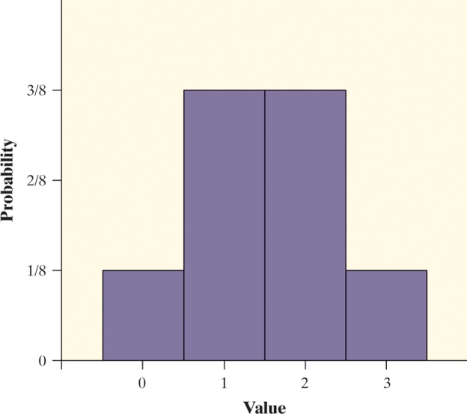
Coin Flip Example
Consider tossing a fair coin 3 times.
Define X = the number of heads obtained
X = 0: TTT
X = 1: HTT THT TTH
X = 2: HHT HTH THH
X = 3: HHH
Value | 0 | 1 | 2 | 3
Probability | 1/8 | 3/8 | 3/8 | 1/8

Slide 11
Discrete Random Variables
There are two main types of random variables: discrete and continuous. If we can find a way to list all possible outcomes for a random variable and assign probabilities to each one, we have a discrete random variable.
Discrete Random Variables and Their Probability Distributions
A discrete random variable X takes a fixed set of possible values with gaps between. The probability distribution of a discrete random variable X lists the values x_{i} and their probabilities p_{i}:
Value: x₁ x₂ x₃ …
Probability: p₁ p₂ p₃ …
The probabilities p_{i} must satisfy two requirements:
Every probability p_{i} is a number between 0 and 1.
The sum of the probabilities is 1.
To find the probability of any event, add the probabilities p_{i} of the particular values x_{i} that make up the event.

Slide 12
Discrete Random Variables
Variable’s values follow a probabilistic phenomenon
Values are countable
Examples:
  Rolling Die
  Drawing Cards
  Number of Children born into a family
  Number of TVs in a house
Distributions that we will study
  On AP Test Not on AP
  Uniform Poisson
  Binomial Negative Binomial
  Geometric Hypergeometric

Slide 13
Babies’ Health at Birth
Apgar scores measure a baby’s health at birth; rating skin color, heart rate, muscle tone, breathing and stimuli response on a 0-1-2 scale for each category
Show that the probability distribution for X is legitimate.
Make a histogram of the probability distribution. Describe what you see.
Apgar scores of 7 or higher indicate a healthy baby. What is P(X ≥ 7)?
Value: | 0 | 1 | 2 | 3 | 4 | 5 | 6 | 7 | 8 | 9 | 10
Probability: | 0.001 | 0.006 | 0.007 | 0.008 | 0.012 | 0.020 | 0.038 | 0.099 | 0.319 | 0.437 | 0.053

Slide 14
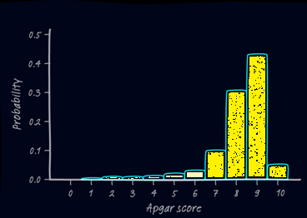
Babies’ Health at Birth
Show that the probability distribution for X is legitimate.
Make a histogram of the probability distribution. Describe what you see.
Apgar scores of 7 or higher indicate a healthy baby.
What is P(X ≥ 7)?
∑ p_{i} = 1
skewed left
P(x ≥ 7) = 0.1+.32+.44+.05 = .908
Value: | 0 | 1 | 2 | 3 | 4 | 5 | 6 | 7 | 8 | 9 | 10
Probability: | 0.001 | 0.006 | 0.007 | 0.008 | 0.012 | 0.020 | 0.038 | 0.099 | 0.319 | 0.437 | 0.053

Slide 15
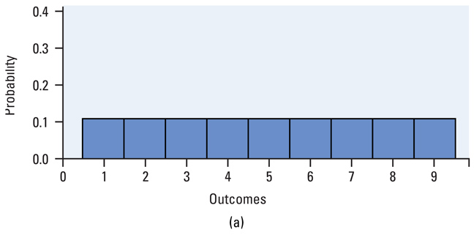
Discrete Example
Most people believe that each digit, 1-9, appears with equal frequency in the numbers we find

Slide 16
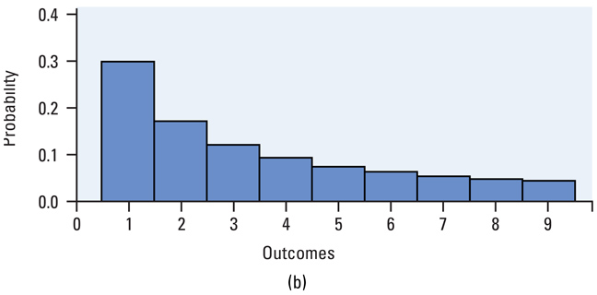
Discrete Example cont
Benford’s Law
  In 1938 Frank Benford, a physicist, found our assumption to be false
  Used to look at frauds

Slide 17
Example 4
 | 1 | 2 | 3 | 4 | 5 | 6 | 7 | 8 | 9
P(x) | 0.301 | 0.176 | 0.125 | 0.097 | 0.079 | 0.067 | 0.058 | 0.051 | 0.046
Verify Benford’s Law as a probability model
Use Benford’s Law to determine
  the probability that a randomly selected first digit is 1 or 2
  the probability that a randomly selected first digit is at least 6
Summation of P(x) = 1
P(1 or 2) = P(1) + P(2) = 0.301 + 0.176 = 0.477
P(≥6) = P(6) + P(7) + P(8) + P(9)
= 0.067 + 0.058 + 0.051 + 0.046 = 0.222

Slide 18
Example 5
Write the following in probability format with discrete RV (25 colored bulbs):
Exactly 6 bulbs are red
Fewer than 4 bulbs were blue
At least 2 bulbs were white
No more than 5 bulbs were purple
More than 3 bulbs were green
P(red bulbs = 6) = P(6)
P(blue bulbs < 4) = P(0) + P(1) + P(2) + P(3)
P(white bulbs ≥ 2) = P(≥ 2) = 1 – [P(0) + P(1)]
P(purple bulbs ≤ 5) = P(0) + P(1) + P(2) + P(3) + P(4) + P(5)
P(green bulbs > 3) = P(> 3) = 1 – [P(0) + P(1) + P(2)]

Slide 19
Summary
Summary
  Random variables (RV) values are a probabilistic
  RV follow probability rules
  Discrete RV have countable outcomes

Slide 20
5-Minute Check on section 6-1a
Convert these statements into discrete probability expressions
Probability of less than 4 green bulbs
Probability of more than 2 green lights
Probability of 3 or more
If x is a discrete variable x∈[1,3], P(x=1) = 0.23, and P(x=2) = 0.3
Find P(x<3)
Find P(x=3)
Find P(x>1)
P(x < 4) = P(0) + P(1) + P(2) + P(3)
P(x > 2) = P(3) + P(4) + P(5) + …
P(x ≥ 3) = P(3) + P(4) + P(5) + …
= P(1) + P(2) = 0.23 + 0.3 = 0.57
= 1 – (P(1) + P(2)) = 1 – 0.57 = 0.43
= P(2) + P(3) = 0.3 + 0.43 = 0.73
Click the mouse button or press the Space Bar to display the answers.

Slide 21
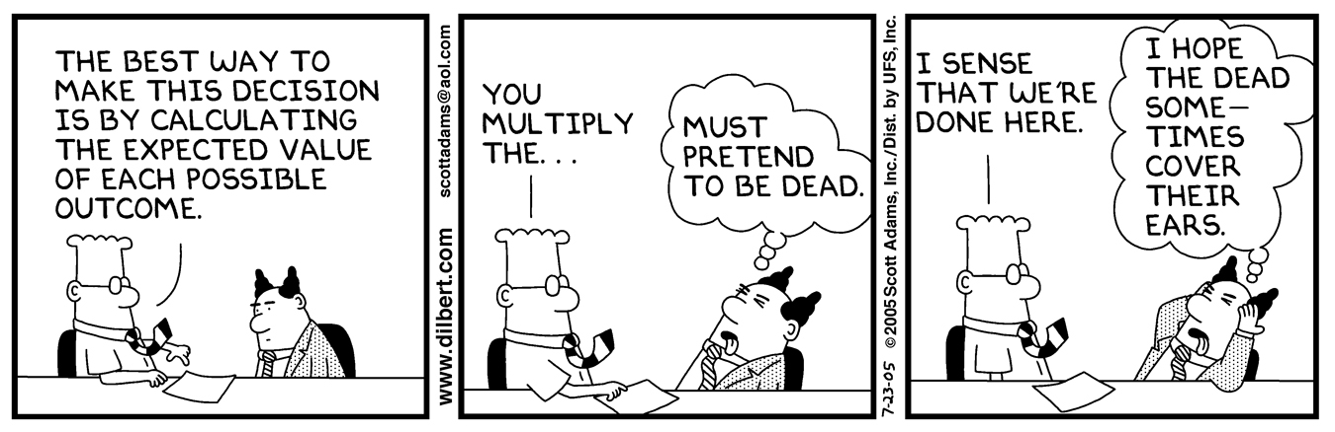
Warning!
Statistical analysis is not for the faint of heart

Slide 22
Mean of a Discrete Random Variable
When analyzing discrete random variables, we’ll follow the same strategy we used with quantitative data – describe the shape, center, and spread, and identify any outliers.
The mean of any discrete random variable is an average of the possible outcomes, with each outcome weighted by its probability.
Definition:
Suppose that X is a discrete random variable whose probability distribution is
Value: x₁ x₂ x₃ …
Probability: p₁ p₂ p₃ …
To find the mean (expected value) of X, multiply each possible value by its probability, then add all the products:

Slide 23

Apgar Scores – What’s Typical?
Consider the random variable X = Apgar Score
Compute the mean of the random variable X and interpret it in context.
The mean Apgar score of a randomly selected newborn is 8.128. This is the long-term average Agar score of many, many randomly chosen babies.
Note: The expected value does not need to be a possible value of X or an integer! It is a long-term average over many repetitions.

Slide 24
Standard Deviation of a Discrete Random Variable
Since we use the mean as the measure of center for a discrete random variable, we’ll use the standard deviation as our measure of spread. The definition of the variance of a random variable is similar to the definition of the variance for a set of quantitative data.
Definition:
Suppose that X is a discrete random variable whose probability distribution is
Value: x₁ x₂ x₃ …
Probability: p₁ p₂ p₃ …
and that µ_{X} is the mean of X. The variance of X is
To get the standard deviation of a random variable,
take the square root of the variance.

Slide 25


Apgar Scores – How Variable Are They?
Consider the random variable X = Apgar Score
Compute the standard deviation of the random variable X and interpret it in context.
Variance
The standard deviation of X is 1.437. On average, a randomly selected baby’s Apgar score will differ from the mean 8.128 by about 1.4 units.

Slide 26
Example 1
You have a fair 10-sided die with the number 1 to 10 on each of the faces.
Determine the mean and standard deviation.
Mean: ∑ [x ∙P(x)] = (1/10) (∑ x) = (1/10)(55) = 5.5
Var: ∑[x² ∙ P(x)] – μ²_{x} = (1/n) ∑ [x² ] – μ_{x}²
= (1/10) (385) - 30.25)
= (38.5 – 30.25)
= 8.25
St Dev = 2.8723

Slide 27
Calculator to the Rescue
We can use 1-Var-Stats to calculate the mean and standard deviation of a discrete random variable given it’s outcomes and probability
Type in outcomes (x values) in L1
Type in corresponding probabilities in L2
Use 1-Var-Stats L1, L2 to get statistics
We can graph the probability histograms by changing the frequency to L2

Slide 28
Example 2
Below is a distribution for number of visits to a dentist in one year.
X = # of visits to a dentist
x 0 1 2 3 4
P(x) .1 .3 .4 .15 .05
Determine the expected value, variance and standard deviation.
Mean: ∑ [x ∙P(x)] = (.1)(0) + (.3)(1) + (.4)(2) + (.15)(3) + (.05)(4)
= 0 + .3 + .8 + .45 +.2 = 1.75
Var: ∑[x² ∙ P(x)] – μ²_{x} = ∑ [x² ∙ P(x)] – μ_{x}²
= (0 + .3 + .4(4) + .15(9) + .05(16) ) – 3.0625)
= 4.05 – 3.8626
= 0.9875
St Dev = 0.9937

Slide 29
Example 3
What is the average size of an American family? Here is the distribution of family size according to the 1990 Census:
# in family 2 3 4 5 6 7
p(x) .413 .236 .211 .090 .032 .018
Mean: ∑ [x ∙P(x)] = (.413)(2) + (.236)(3) + (.211)(4) +
(.09)(5) + (.032)(6) + (.018)(7)
= .826 + .708 + .844 + .45 + .192 + .126
= 3.146

Slide 30
Continuous Random Variables
Discrete random variables commonly arise from situations that involve counting something. Situations that involve measuring something often result in a continuous random variable.
Definition:
A continuous random variable X takes on all values in an interval of numbers. The probability distribution of X is described by a density curve. The probability of any event is the area under the density curve and above the values of X that make up the event.
The probability model of a discrete random variable X assigns a probability between 0 and 1 to each possible value of X.
A continuous random variable Y has infinitely many possible values. All continuous probability models assign probability 0 to every individual outcome. Only intervals of values have positive probability.

Slide 31
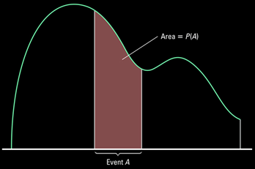
Continuous Random Variables
Variable’s values follow a probabilistic phenomenon
Values are uncountable (infinite)
P(X = any value) = 0 (area under curve at a point)
Examples:
  Plane’s arrival time -- minutes late (uniform)
  Calculator’s random number generator (uniform)
  Heights of children (apx normal)
  Birth Weights of children (apx normal)
Distributions that we will study
  Uniform
  Normal

Slide 32
Continuous Random Variables
We will use a normally distributed random variable in the majority of statistical tests that we will study this year
  Need to justify it (as a reasonable assumption) if is not given
  Normality graphs if we have raw data
We need to be able to
  Use z-values in Table A
  Use the normalcdf from our calculators
  Graph normal distribution curves

Slide 33
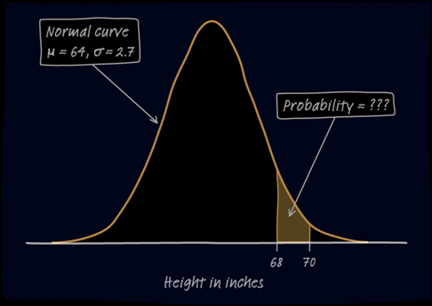
Example: Young Women’s Heights
Read the example on pg 351.
Define Y = height of a randomly chosen young woman.
Y is a continuous random variable whose probability distribution is N(64, 2.7).
What is the probability that a randomly chosen young woman has height between 68 and 70 inches?
P(68 ≤ Y ≤ 70) = ???
Use calculator: normcdf(68,70,64,2.7)
or use Z-tables by converting 68 and 72 into z-scores
P(68 ≤ Y ≤ 70) = .0562
There is about a 5.6% chance that a randomly chosen young woman has a height between 68 and 70 in.

Slide 34
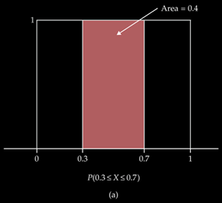
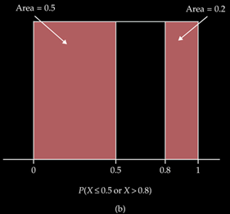
Example 4
Determine the probability of the following random number generator:
Generating a number equal to 0.5
Generating a number less than 0.5 or greater than 0.8
Generating a number bigger than 0.3 but less than 0.7
P(x = 0.5) = 0.0
P(x ≤ 0.5 or x ≥ 0.8) = 0.5 + 0.2 = 0.7
P(0.3 ≤ x ≤ 0.7) = 0.4

Slide 35
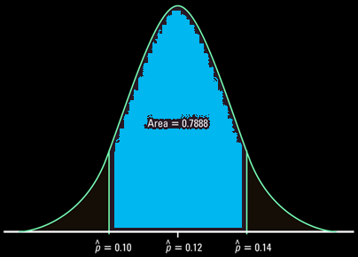
Example 5
In a survey the mean percentage of students who said that they would turn in a classmate they saw cheating on a test is distributed N(0.12, 0.016). If the survey has a margin of error of 2%, find the probability that the survey misses the percentage by more than 2% [P(x<0.1 or x>0.14)]
Change into z-scores to use table A
0.10 – 0.14
z = ---------------- = +/- 1.25
0.016
0.8944 – 0.1056 = 0.7888
1 – 0.7888 = 0.2112
ncdf(0.1, 0.14, 0.12, 0.016) = 0.7887
1 – 0.7887 = 0.2112

Slide 36
Summary and Homework
Summary
  Random variables (RV) values are a probabilistic
  RV follow probability rules
  Discrete RV have countable outcomes
  Continuous RV has an interval of outcomes (∞)
  Expected value is the mean ∑ [x ∙ P(x)]
  Variance is ∑[x² ∙ P(x)] – μ²_{x}
  Standard Deviation is √variance
Homework
  TBD

