Slide 1

5-Minute Check on section 6-1b
You have a fair 8-sided die with the number 1 to 8 on each of the faces; find the mean and standard deviation.
Given the following find the expected value and variance.
x 0 1 2 3 4
P(x) .2 .25 .35 .15 .05
What is the average number of TVs in a household?
TVs 0 1 2 3 4 5
P(x) .053 .556 .211 .130 .032 .018
From 1Varstats L1, L2: μ = 4.5 σ = 2.2913
From 1Varstats L1, L2: μ = 1.6 σ = 1.1136
variance = σ² = 1.24
From 1Varstats L1, L2: μ = 1.586
Click the mouse button or press the Space Bar to display the answers.

Slide 2
Lesson 6 - 2
Transforming and Combining Random Variables

Slide 3
Objectives
Describe the effect of adding or subtracting a constant or multiplying or dividing by a constant on the probability distribution of a random variable
Calculate the mean and standard deviation of the sum or difference of random variables
Find probabilities involving the sum or difference of independent Normal random variables

Slide 4
Vocabulary
Independent random variables – if knowing the value of random variable X does not help use predict the value of random variable Y
Mean – balance point of the probability histogram or density curve. Symbol: μ_{x}
Standard Deviation – square root of the variance. Symbol: σ_{x}
Variance – is the average squared deviation of the values of the variable from their mean. Symbol: σ²_{x}

Slide 5
Linear Transformations
In Section 6.1, we learned that the mean and standard deviation give us important information about a random variable. In this section, we’ll learn how the mean and standard deviation are affected by transformations on random variables.
In Chapter 2, we studied the effects of linear transformations on the shape, center, and spread of a distribution of data. Recall:
Adding (or subtracting) a constant, a, to each observation:
  Adds a to measures of center and location.
  Does not change the shape or measures of spread.
Multiplying (or dividing) each observation by a constant, b:
  Multiplies (divides) measures of center and location by b.
  Multiplies (divides) measures of spread by |b|.
  Does not change the shape of the distribution.

Slide 6
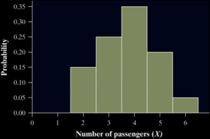
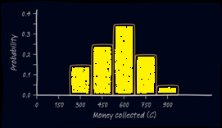
Jeep Tour Example
Pete’s Jeep Tours offers a popular half-day trip in a tourist area. There must be at least 2 passengers for the trip to run, and the vehicle will hold up to 6 passengers. Define X as the number of passengers on a randomly selected day.
Passengers x_{i} | 2 | 3 | 4 | 5 | 6
Probability p_{i} | 0.15 | 0.25 | 0.35 | 0.20 | 0.05
The μ_{X} is 3.75 and the σ_{X} is 1.090.
Pete charges $150 per passenger. The random variable C describes the amount Pete collects on a randomly selected day.
Collected c_{i} | 300 | 450 | 600 | 750 | 900
Probability p_{i} | 0.15 | 0.25 | 0.35 | 0.20 | 0.05
The μ_{C} is $562.50 and the σ_{C} is $163.50.
Compare the shape, center, and spread of the two probability distributions.
Shape: same; Center and Spread: × 150

Slide 7
Linear Transformations
How does multiplying or dividing by a constant affect a random variable?
Effect on a Random Variable of Multiplying (Dividing) by a Constant
Multiplying (or dividing) each value of a random variable by a number b:
Multiplies (divides) measures of center and location (mean, median, quartiles, percentiles) by b.
Multiplies (divides) measures of spread (range, IQR, standard deviation) by |b|.
Does not change the shape of the distribution.
Note: Multiplying a random variable by a constant b multiplies the variance by b².

Slide 8
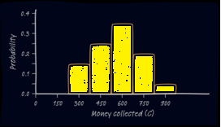
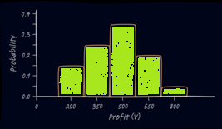
Jeep Tour Example Cont.
Consider Pete’s Jeep Tours again. We defined C as the amount of money Pete collects on a randomly selected day.
Collected c_{i} | 300 | 450 | 600 | 750 | 900
Probability p_{i} | 0.15 | 0.25 | 0.35 | 0.20 | 0.05
The μ_{C} is $562.50 and the σ_{C} is $163.50.
It costs Pete $100 per trip to buy permits, gas, and a ferry pass. The random variable V describes the profit Pete makes on a randomly selected day.
Profit v_{i} | 200 | 350 | 500 | 650 | 800
Probability p_{i} | 0.15 | 0.25 | 0.35 | 0.20 | 0.05
The μ_{V} is $462.50 and the σ_{V} is $163.50.
Compare the shape, center, and spread of the two probability distributions.
Shape and spread: same; Center: -100

Slide 9
Linear Transformations
How does adding or subtracting a constant affect a random variable?
Effect on a Random Variable of Adding (or Subtracting) a Constant
Adding the same number a (which could be negative) to each value of a random variable:
Adds a to measures of center and location (mean, median, quartiles, percentiles).
Does not change measures of spread (range, IQR, standard deviation).
Does not change the shape of the distribution.

Slide 10
Linear Transformations
Whether we are dealing with data or random variables, the effects of a linear transformation are the same.
Effect on a Linear Transformation on the Mean and Standard Deviation
If Y = a + bX is a linear transformation of the random variable X, then
The probability distribution of Y has the same shape as the probability distribution of X.
µ_{Y} = a + bµ_{X}.
σ_{Y} = |b|σ_{X} (since b could be a negative number).

Slide 11
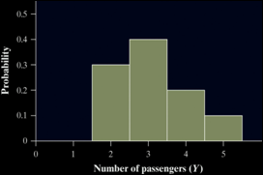
Combining Random Variables
So far, we have looked at settings that involve a single random variable. Many interesting statistics problems require us to examine two or more random variables.
Let’s investigate the result of adding and subtracting random variables. Let X = the number of passengers on a randomly selected trip with Pete’s Jeep Tours. Y = the number of passengers on a randomly selected trip with Erin’s Adventures.
Define T = X + Y. What are the mean and variance of T?
Passengers x_{i} | 2 | 3 | 4 | 5 | 6
Probability p_{i} | 0.15 | 0.25 | 0.35 | 0.20 | 0.05
Mean µ_{X} = 3.75 Standard Deviation σ_{X} = 1.090
Passengers y_{i} | 2 | 3 | 4 | 5
Probability p_{i} | 0.3 | 0.4 | 0.2 | 0.1
Mean µ_{Y} = 3.10 Standard Deviation σ_{Y} = 0.943

Slide 12
Combining Random Variables
How many total passengers can Pete and Erin expect on a randomly selected day?
Since Pete expects µ_{X} = 3.75 and Erin expects µ_{Y} = 3.10, they will average a total of 3.75 + 3.10 = 6.85 passengers per trip. We can generalize this result as follows:
Mean of the Sum of Random Variables
For any two random variables X and Y, if T = X + Y, then the expected value of T is
E(T) = µ_{T} = µ_{X} + µ_{Y}
In general, the mean of the sum of several random variables is the sum of their means.
How much variability is there in the total number of passengers who go on Pete’s and Erin’s tours on a randomly selected day? To determine this, we need to find the probability distribution of T.

Slide 13
Combining Random Variables
The only way to determine the probability for any value of T is if X and Y are independent random variables.
Definition:
If knowing whether any event involving X alone has occurred tells us nothing about the occurrence of any event involving Y alone, and vice versa, then X and Y are independent random variables.
Probability models often assume independence when the random variables describe outcomes that appear unrelated to each other.
You should always ask whether the assumption of independence seems reasonable.
In our investigation, it is reasonable to assume X and Y are independent since the siblings operate their tours in different parts of the country.

Slide 14
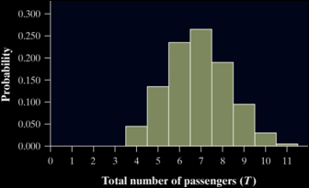
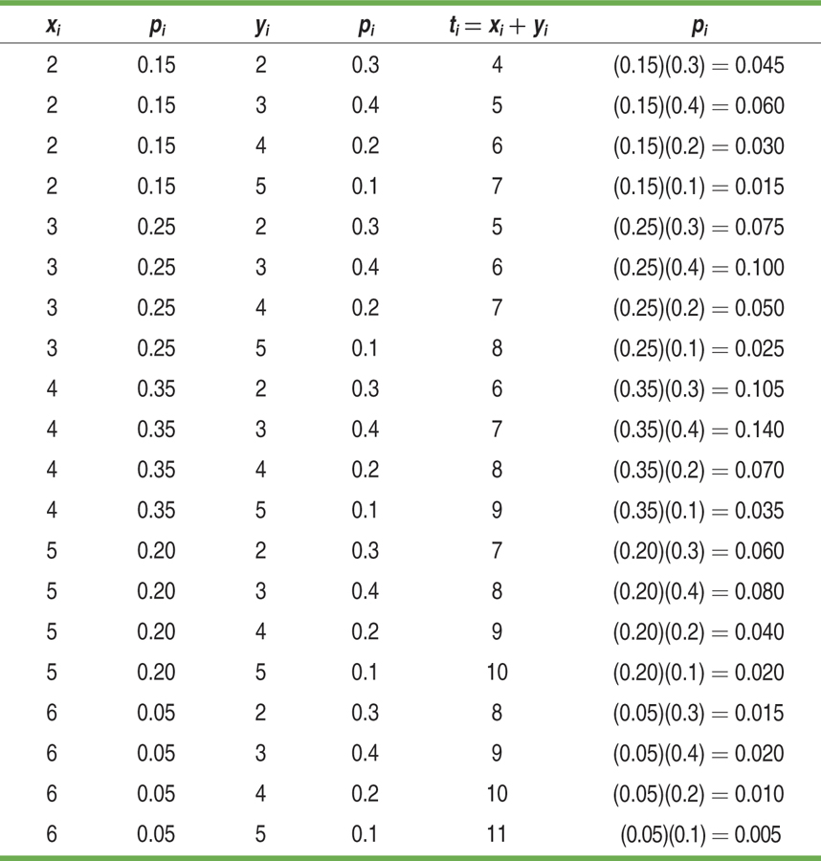

Combining Random Variables
Let T = X + Y. Consider all possible combinations of X and Y.
Recall: µ_{T} = µ_{X} + µ_{Y} = 6.85
= (4 – 6.85)²(0.045) + … +
(11 – 6.85)²(0.005) = 2.0775
Note:
What do you notice about the
variance of T?

Slide 15
Adding Random Variables
As the preceding example illustrates, when we add two independent random variables, their variances add. Standard deviations do not add
Variance of the Sum of Random Variables
For any two independent random variables X and Y, if T = X + Y, then the variance of T is
In general, the variance of the sum of several independent random variables is the sum of their variances.
Remember that you can add variances only if the two random variables are independent, and that you can NEVER add standard deviations!
Covariance is not an AP/DE topic; it is an upper-level STATS concept

Slide 16
Subtracting Random Variables
We can perform a similar investigation to determine what happens when we define a random variable as the difference of two random variables. In summary, we find the following:
Mean of the Difference of Random Variables
For any two random variables X and Y, if D = X - Y, then the expected value of D is
E(D) = µ_{D} = µ_{X} - µ_{Y}
In general, the mean of the difference of several random variables is the difference of their means. The order of subtraction is important!
Variance of the Difference of Random Variables
For any two independent random variables X and Y, if D = X - Y, then the variance of D is
In general, the variance of the difference of two independent random variables is the sum of their variances.

Slide 17
Example 1
Scores on a Math test have a distribution with μ = 519 and σ = 115. Scores on an English test have a distribution with μ = 507 and σ = 111. If we combine the scores
a) What is the combined mean?
b) What is the combined standard deviation?
μ_{M} + μ_{E} = 519 + 507 = 1016
Scores are not independent so the following is not correct!
σ²_{M+E} = σ²_{M} + σ²_{E} = 115² + 111² = 25546
σ_{M+E} = √25546 = 159.83

Slide 18
Example 2
Suppose you earn $12/hour tutoring but spend $8/hour on dance lessons. You save the difference between what you earn and the cost of your lessons. The number of hours you spend on each activity is independent. Find your expected weekly savings and the standard deviation of your weekly savings.
Hrs Dancing / week | Probability
0 | 0.4
1 | 0.3
2 | 0.3
Hrs Tutoring / week | Probability
1 | 0.3
2 | 0.3
3 | 0.2
4 | 0.2

Slide 19
Example 2 cont
Hrs Dancing / week | Probability
0 | 0.4
1 | 0.3
2 | 0.3
Expected value for Dancing, μ_{X}, is
0(0.4) + 1(0.3) + 2(0.3) = 0.9
Variance: ∑ [P(x) ∙ x²] – μ_{x}²
= (.4(0) + .3(1) + .3(4) ) – 0.9²)
= 1.5 – 0.81
= 0.69
St Dev = 0.8307

Slide 20
Example 2 cont
Hrs Tutoring / week | Probability
1 | 0.3
2 | 0.3
3 | 0.2
4 | 0.2
Expected value for Tutoring, μ_{Y}, is
1(0.3) + 2(0.3) + 3(0.2) + 4(0.2) = 2.3
Variance: ∑ [x² ∙ P(x)] – μ_{x}²
= (.3(1) + .3(4) + .2(9) + .2(16) ) – 2.3²)
= 6.5 – 5.29
= 1.21
St Dev = 1.1

Slide 21
Example 2 cont
Expected value for Weekly Savings, μ_{12Y-8X}, is
12 μ_{Y} - 8 μ_{X} = 12 (2.3) – 8 (0.9)
= 27.6 – 7.2 = $20.4
Variance of Weekly Savings, σ²_{12Y-8X}, is
σ²_{12Y} + σ²_{8X} = 12²(1.21) + 8²(0.69)
= 174.24 + 44.16 = 218.4
so standard deviation = $14.79

Slide 22

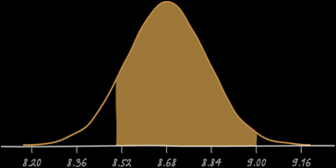

Tea Example
Mr. Starnes likes between 8.5 and 9 grams of sugar in his hot tea. Suppose the amount of sugar in a randomly selected packet follows a Normal distribution with mean 2.17 g and standard deviation 0.08 g. If Mr. Starnes selects 4 packets at random, what is the probability his tea will taste right?
Let X = the amount of sugar in a randomly selected packet.
Then, T = X₁ + X₂ + X₃ + X₄. We want to find P(8.5 ≤ T ≤ 9).
µ_{T} = µ_{X1} + µ_{X2} + µ_{X3} + µ_{X4} = 2.17 + 2.17 + 2.17 +2.17 = 8.68
$z=\frac{8.5−8.68}{0.16}=−1.13$ and $z=\frac{9−8.68}{0.16}=2.00$
P(-1.13 ≤ Z ≤ 2.00) = 0.9772 – 0.1292 = 0.8480
There is about an 85% chance Mr. Starnes’s tea will taste right.

Slide 23
Combining Normal Random Variables
Any linear combination of independent Normal random variables is also Normally distributed
For example: If X and Y are independent Normally distributed random variables and a and b are any fixed numbers, then aX + bY is also Normally distributed
Mean and standard deviations can be found by using the rules from previous slides

Slide 24
Example 4
Tom’s score for a round of golf has a N(110,10) distribution and George’s score for a round of golf has a N(100,8) distribution. If they play independently, what is the probability that Tom will have a better (lower) score than George?
Let X be Tom’s score and Y be George’s score
μ_{X-Y} = μ_{X} - μ_{Y} = 110 – 100 = 10
σ²_{X-Y} = σ²_{X} + σ²_{Y} = 10² + 8² = 164 ≈ (12.8)²
so X – Y is a N(10,12.8)
P(X-Y<0) = P(z < Z) with Z = (0 – 10) / 12.8 = -0.78

Slide 25
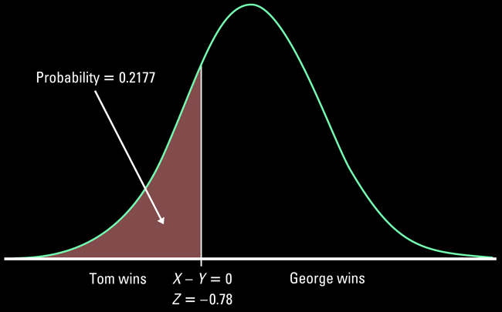
Example 4 cont
We could have used our calculator, ncdf(-E99,0,10,12.8), or Table A to get the probabilities illustrated in the graph below

Slide 26
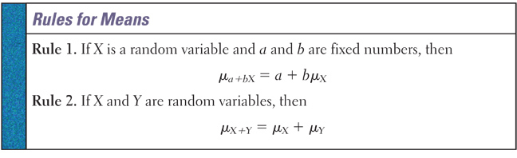
Rules for Means
Means follow the rules for linear combinations (from Algebra)
When you linearly combine two or more (rules give only the 2 case example) random variables, you combine their means in the same manner

Slide 27
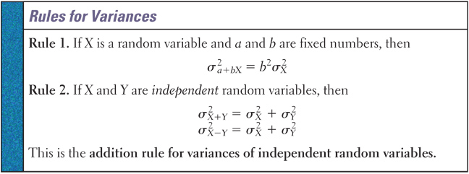
Rules for Variances
Adding a number to a random variable does not change its variance
Multiply a random variable by a number changes the variance by the square of that number
When you combine random variables, you always add the variances

Slide 28
Rules for Standard Deviations
Follow the rules for variances and then take the square root to find the standard deviation
In general standard deviations do not add
Note: independence is required for the calculations of combined variances, but not for means
  Methods for combining non-independent variables’ variances involve covariance terms and are not part of this course

Slide 29
Summary and Homework
Summary
  Mean:
    Means follow the rules for linear combinations (from Algebra)
  Variance:
    Adding a number to a random variable does not change its variance
    Multiply a random variable by a number changes the variance by the square of that number
    When you combine random variables, you always add the variances
  Standard Deviation:
    Follow the rules for variances and then take the square root to find the standard deviation
    In general standard deviations do not add
    Note: independence is required for the calculations of combined variances, but not for means
Homework:

