Slide 1
Lesson 7 - 1
Sampling Distributions

Slide 2
Objectives
Distinguish between a parameter and a statistic
Create a sampling distribution using all possible samples from a small population
Use the sampling distribution of a statistic to evaluate a claim about a parameter
Distinguish among the distribution of a population, the distribution of a sample, and the sampling distribution of a statistic
Determine if a statistic is an unbiased estimator of a population parameter
Describe the relationship between sample size and the variability of a statistic

Slide 3
Vocabulary
Parameter – a number that describes some characteristic of the population
Statistic – a number that describes some characteristic of a sample
Sampling variability – different random samples of the same size from the sample population will produce different values for a statistic
Sampling Distribution (of a statistic) – the distribution of values taken by the statistic in all possible samples of the same size from the same population

Slide 4
Vocabulary
Unbiased estimator – a statistic whose sampling distribution mean is equal to the true value of the parameter being estimated;
Variability (of a statistic) – a description of the spread of the statistic’s sampling distribution
Bias – the level of trustworthiness of a statistic

Slide 5
Introduction
The process of statistical inference involves using information from a sample to draw conclusions about a wider population.
Different random samples yield different statistics. We need to be able to describe the sampling distribution of possible statistic values in order to perform statistical inference.
We can think of a statistic as a random variable because it takes numerical values that describe the outcomes of the random sampling process. Therefore, we can examine its probability distribution using what we learned in Chapter 6.
Population
Sample
Collect data from a representative Sample...
Make an Inference about the Population.

Slide 6
Parameters and Statistics
As we begin to use sample data to draw conclusions about a wider population, we must be clear about whether a number describes a sample or a population.
Definition:
A parameter is a number that describes some characteristic of the population. In statistical practice, the value of a parameter is usually not known because we cannot examine the entire population.
A statistic is a number that describes some characteristic of a sample. The value of a statistic can be computed directly from the sample data. We often use a statistic to estimate an unknown parameter.
Remember s and p: statistics come from samples and
parameters come from populations

Slide 7
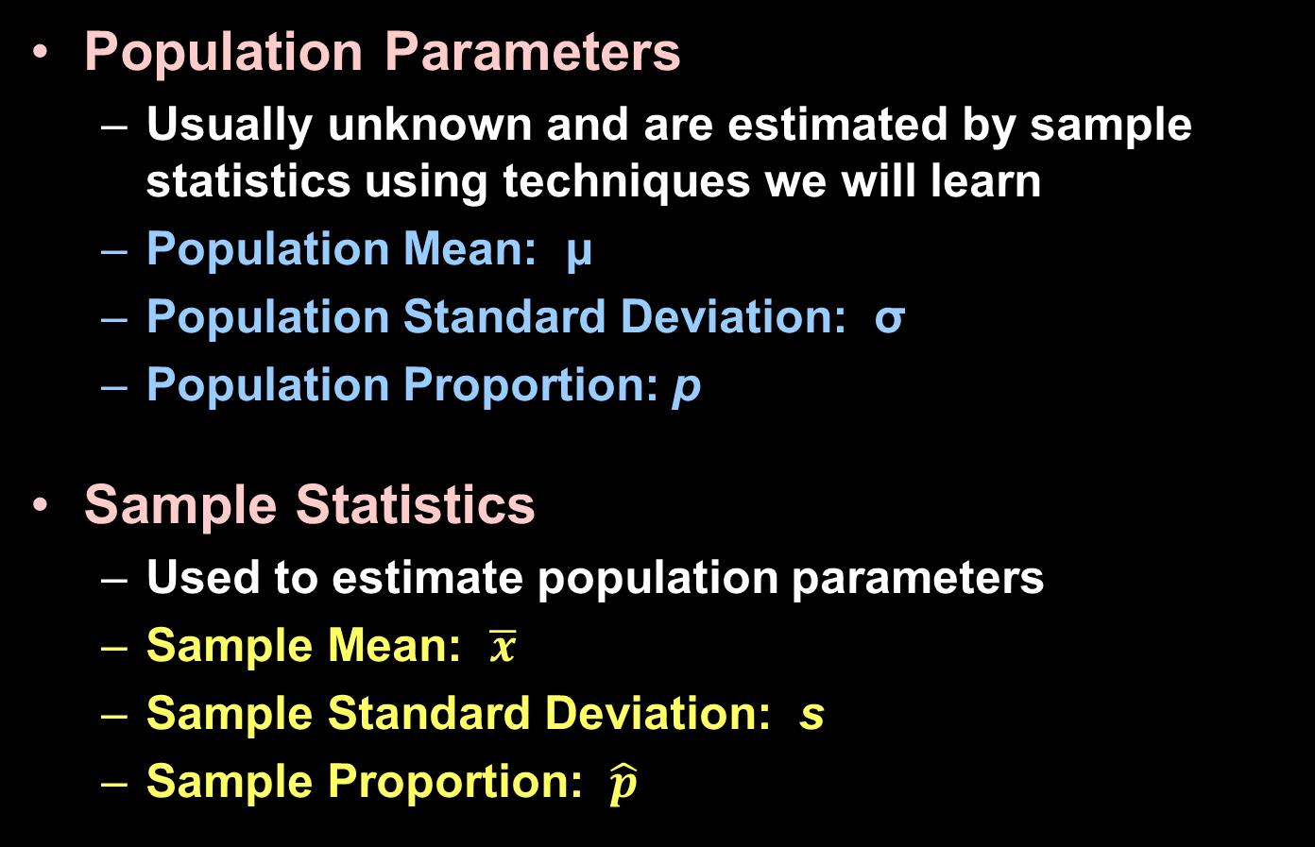
Population vs Samples
Population Parameters
  Usually unknown and are estimated by sample statistics using techniques we will learn
  Population Mean: μ
  Population Standard Deviation: σ
  Population Proportion: p
Sample Statistics
  Used to estimate population parameters
  Sample Mean: $\overline{x}$
  Sample Standard Deviation: s
  Sample Proportion: $\hat{p}$

Slide 8
Sampling Variability
This basic fact is called sampling variability: the value of a statistic varies in repeated random sampling.
To make sense of sampling variability, we ask, “What would happen if we took many samples?”
Population
Sample
Sample
Sample
?
Sample
Sample
Sample
Sample
Sample

Slide 9

Example 1
Upon entry to an airport’s customs area each passenger presses a button and either a green arrow comes on (directing the passenger on through) or a red arrow comes on (directing them to a customs agent) and they have the bags
searched. Homeland
Security sets the
“search” parameter at
30%.

Slide 10
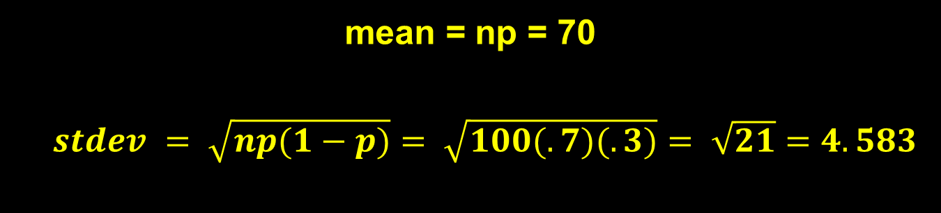
Example 1
What type of probability distribution applies here?
What are the mean and standard deviation of this distribution?
Binomial with n = 100 and p = 0.7
mean = np = 70
$stdev = \sqrt{np(1−p)}= \sqrt{100(.7)(.3)}= \sqrt{21}=4.583$

Slide 11
Example 1 cont
Each of you represents a day, 13 in total, that we are going to simulate a simple random sampling of 100 passengers passing through the airport. We want to know what your individual average proportion of those who got the green arrow. This we will refer to as p-hat or p̂. To do this we will use our calculator.
Run the PROBSIM app. Go to Toss Coins. Go to SET. Go to ADV – change the probability to 0.7 for a tail and hit OK. Change the trial Set to 100 and hit OK. Hit TOSS and write down your results. This simulated each of the 100 passengers getting green or red.

Slide 12
Example 1 cont
We can also use our calculator to simulate this and just get the total number, which represents p-hat or p̂.
Now to simulate our random sample of 100 go MATH, PROB, randBin(100,0.7,1) and ENTER. This gives us just the total number of passengers who got green.
randBin also has the capability of doing multiple samples – say one day with fifty flights coming into that airport,
randBin(100,0.7,50) STO → L1 this will take a while.
Using computers to do this makes more sense, as we can see in the following graph. What shape do we expect as we take 1000 days of 100 samples?

Slide 13
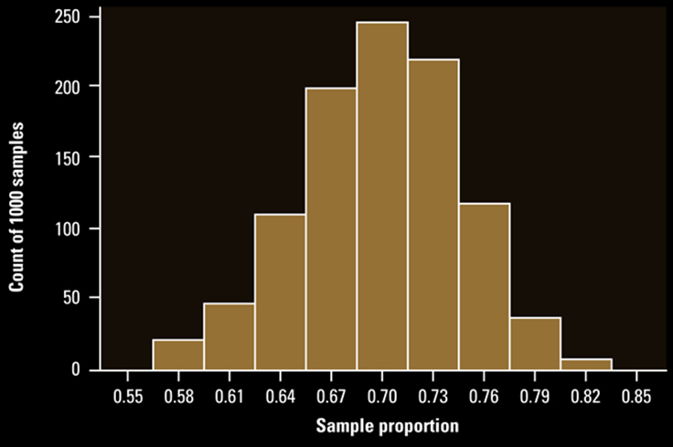
Example 1 – Sampling Distribution
Describe the distribution above
Shape: Symmetric, mound Center: apx 0.7,
Spread: 56.5 to 83.5 (range)

Slide 14
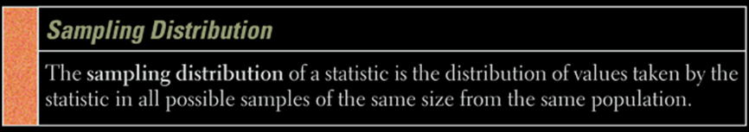


Sampling Distribution
In other words: a sampling distribution of proportions is using the proportion of an individual sample as the data point of the samples of $\hat{p}$ – the “bigger” sample.
Sampling Distribution of $\hat{p}$
Daily sample of 100
Daily sample of 100
Daily sample of 100
Daily sample of 100
Daily sample of 100
Daily sample of 100
Population of passengers going through the airport

Slide 15
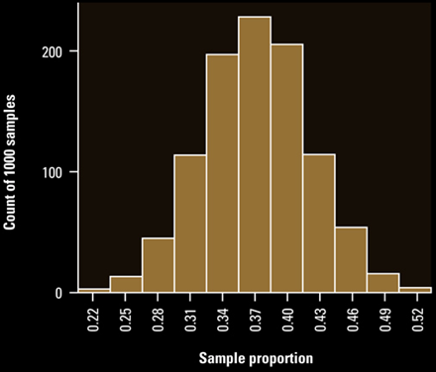
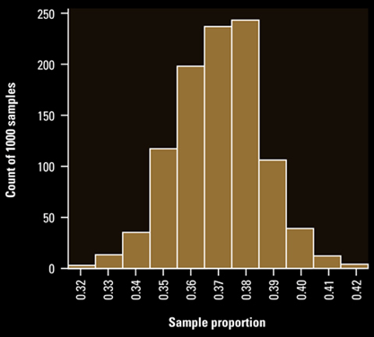
Sampling Distribution
What effect does the size of the samples we take have on the sampling distribution of our statistic?
Sample size = 100
Sample size = 1000
Compare the distributions above
Shape: both roughly symmetric mounds (100 more sym than 1000) Center: 1000’s mode slightly larger (0.37 to 0.38)
Spread: 100’s range of 30 much bigger than 1000’s range of 10

Slide 16
Random Sampling
By its very nature random samples are random. Your distribution for a sample of 100 will be close, but not the same as your neighbors.
The larger the sample size we have the less the spread (variance, range, IQR, etc) of the distribution
We know that some statistical measures are affected by outliers and some are not. Outliers will cause problems for some of the population inference tests we will learn shortly.
Bias (as we learned from surveys) is another problem that can affect statistical estimates

Slide 17
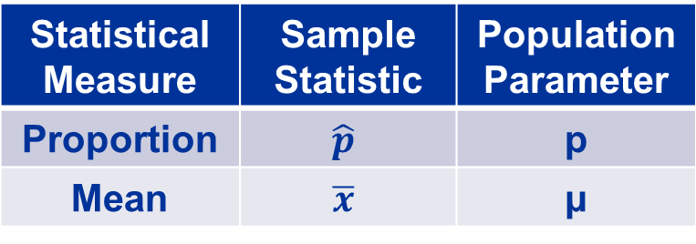
Sample Measures
Sample proportions and sample means are the two statistical measures studied in this chapter
Obviously the best estimates of population parameters will be unbiased and will have the smallest variability
Statistical Measure | Sample Statistic | Population Parameter
Proportion | $$\hat{p}$$ | p
Mean | $$\overline{x}$$ | μ

Slide 18
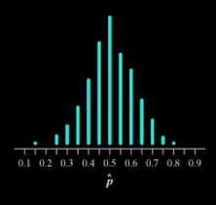
Describing Sampling Distributions
The fact that statistics from random samples have definite sampling distributions allows us to answer the question, “How trustworthy is a statistic as an estimator of the parameter?” To get a complete answer, we consider the center, spread, and shape.
Center: Biased and unbiased estimators
In the chips example, we collected many samples of size 20 and calculated the sample proportion of red chips. How well does the sample proportion estimate the true proportion of red chips, p = 0.5?
Note that the center of the approximate sampling distribution is close to 0.5. In fact, if we took ALL possible samples of size 20 and found the mean of those sample proportions, we’d get exactly 0.5.
Definition:
A statistic used to estimate a parameter is an unbiased estimator if the mean of its sampling distribution is equal to the true value of the parameter being estimated.

Slide 19
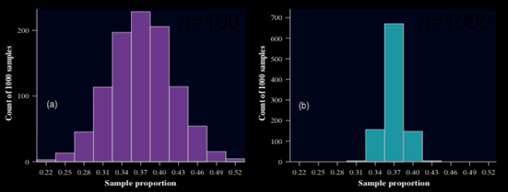
Describing Sampling Distributions
Spread: Low variability is better!
To get a trustworthy estimate of an unknown population parameter, start by using a statistic that’s an unbiased estimator. This ensures that you won’t tend to overestimate or underestimate. Unfortunately, using an unbiased estimator doesn’t guarantee that the value of your statistic will be close to the actual parameter value.
n=1000
n=100
Larger samples have a clear advantage over smaller samples. They are much more likely to produce an estimate close to the true value of the parameter.
Variability of a Statistic
The variability of a statistic is described by the spread of its sampling distribution. This spread is determined primarily by the size of the random sample. Larger samples give smaller spread. The spread of the sampling distribution does not depend on the size of the population, as long as the population is at least 10 times larger than the sample.

Slide 20
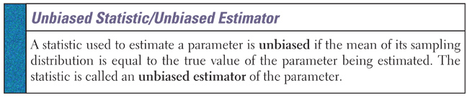
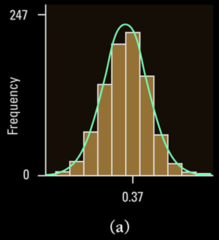
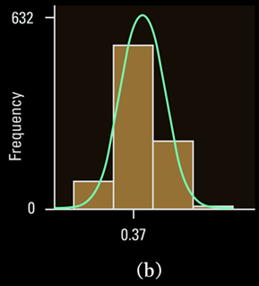
Bias of a Sample Statistic
Both distributions approximate the true population proportion of 0.37 and are unbiased
Which one is the n=100 and n=1000?

Slide 21
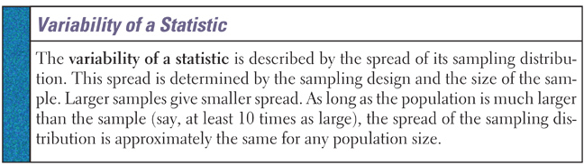
Variability of a Sample Statistic
As we stated before, the larger the sample size, the smaller the variance of the sample statistic; (size of the population is not a factor!)
Rule of thumb: the size of the population needs to be at least ten times larger than the sample to avoid a hyper-geometric situation (10% condition)

Slide 22
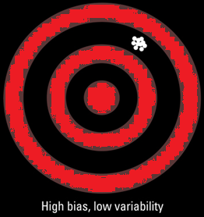
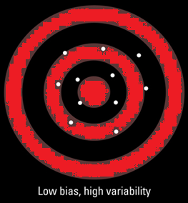
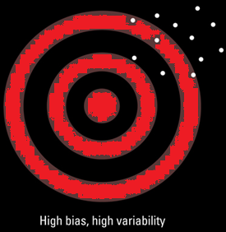

Variability / Bias of a Sample Statistic
Of the upper 3 which one would you choose and why?
The “statistical” choice is not what you might think!
Bias means that our aim is off and we consistently miss the bull’s-eye in the same direction. Our sample values do not center on the population value.
High variability means that repeated shots are widely scattered on the target. Repeated samples do not give very similar results.

Slide 23
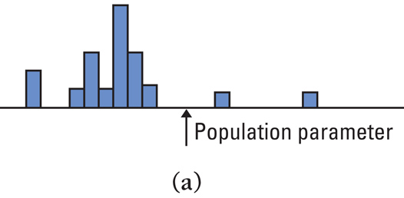
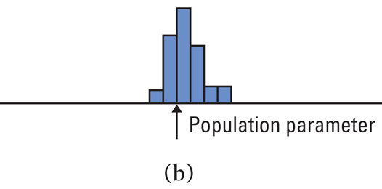
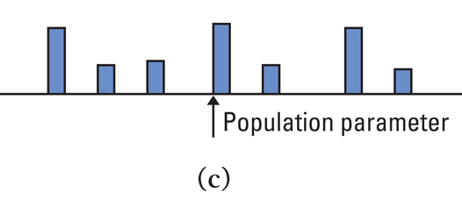
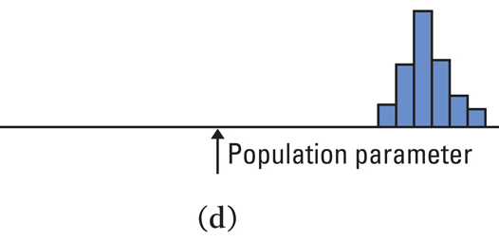
Example 2
Which of these sampling distributions displays large or small bias and large or small variability?
Small (?) bias, high variability
Small bias, low variability
Small bias, high variability
Large bias, low variability

Slide 24
Summary and Homework
Summary
  Parameters describe a population
  Statistics describe a sample
  We use statistics to estimate unknown parameters
  Samples of a statistic produce a sampling distribution
  Statistics should be unbiased and have low variability
Homework
  1, 3, 5, 7, 9, 11, 13

