Slide 1

5-Minute Check on Chapter 7-1
Answer the following
Mean and standard deviation of a sample are denoted by
Mean and standard deviation of a population are denoted by
Rule of thumb on sample size compared to population
As sample sizes increase, the variability of the mean ___________.
Which is better, low bias, high variability or high bias low variability?
x-bar is sample mean and s is sample standard deviation
Population – Greek; μ is the mean and σ is standard deviation
Sample times 10 needs to be smaller than population
decreases
neither is the best; but low bias and high variability still will contain the mean
Click the mouse button or press the Space Bar to display the answers.

Slide 2
Lesson 7 - 2
Sample Proportions

Slide 3

Objectives
Calculate the mean and standard deviation of the sampling distribution of a sample proportion $\hat{p}$ and interpret the standard deviation
Determine if the sampling distribution of $\hat{p}$ is approximately Normal
If appropriate, use a Normal distribution to calculate probabilities involving $\hat{p}$

Slide 4

Vocabulary
Population proportion – p, the percentage of people (or things) meeting a certain criteria or having a certain attribute
Sample proportion – $\hat{p}$, p-hat, is x / n ; where x is the number of individuals in the sample with the specified characteristic (x can be thought of as the number of successes in n trials of a binomial experiment). The sample proportion is a statistic that estimates the population portion, p.
Sample distribution of the sample proportion – $\hat{p}$ describes the distribution of values taken by the sample proportion $\hat{p}$ in all possible samples of the same size from the same population

Slide 5
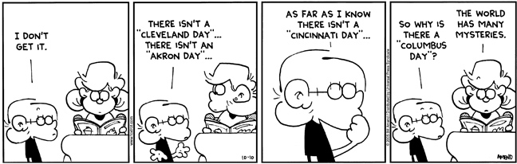
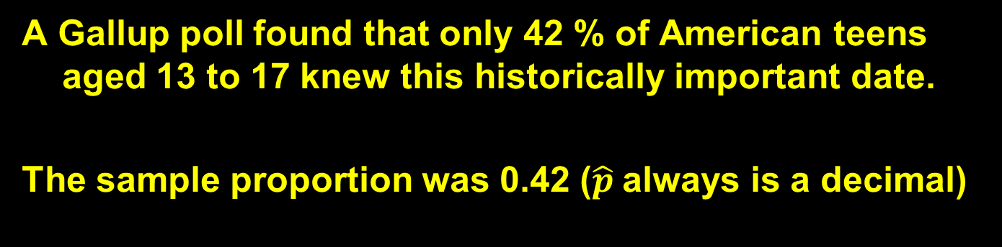
Question of the Day
In what year did Christopher Columbus “discover” America?
A Gallup poll found that only 42 % of American teens aged 13 to 17 knew this historically important date.
The sample proportion was 0.42 ($\hat{p}$always is a decimal)

Slide 6
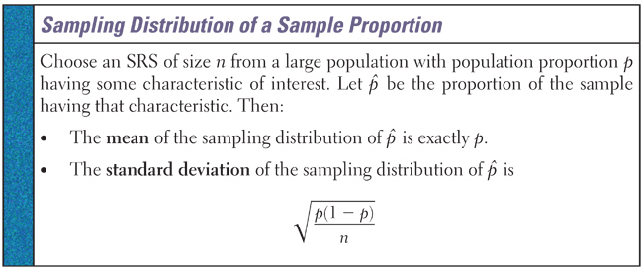
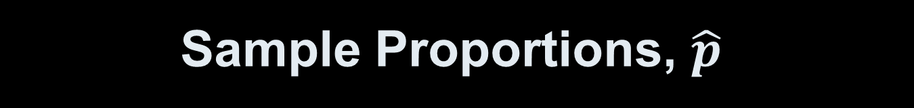
Sample Proportions, $\hat{p}$
Derived from a binomial random variable on page 582 of our text
In relationship to bias, what does the first bullet mean?

Slide 7
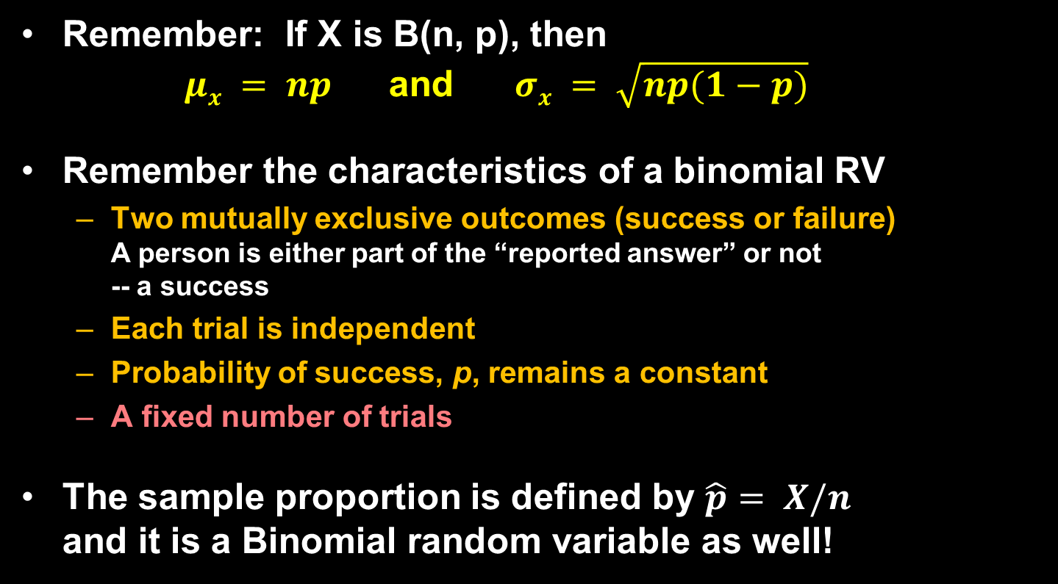
Binomial Review
Remember: If X is B(n, p), then
$μx = np$and $σx = \sqrt{np(1−p)}$
Remember the characteristics of a binomial RV
  Two mutually exclusive outcomes (success or failure)
  A person is either part of the “reported answer” or not
  -- a success
  Each trial is independent
  Probability of success, p, remains a constant
  A fixed number of trials
The sample proportion is defined by $\hat{p}= X/n$
and it is a Binomial random variable as well!
Note: p is the probability of success
and it’s the population proportion (the same number)

Slide 8
Linear Combinations Review
Remember: If Y = a + bX, then
E(Y) = E(a + bX) = a + b E(X)
μ_{Y} = E(Y) = a + b μ_{X}
V(Y) = V(a + bX) = b² V(X)
σ_{Y} = b σ_{X}

Slide 9
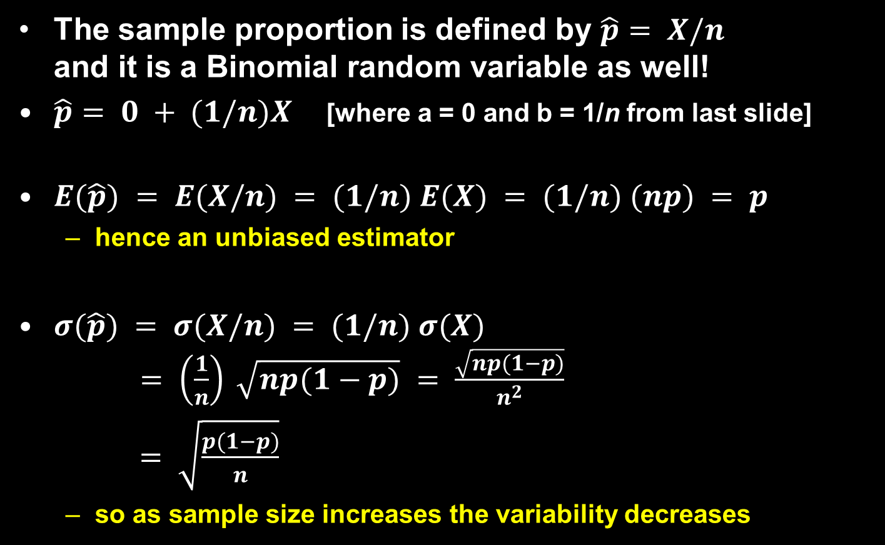
Binomial and Sample Proportion
The sample proportion is defined by $\hat{p}= X/n$
and it is a Binomial random variable as well!
$\hat{p}= 0 + (1/n)X$[where a = 0 and b = 1/n from last slide]
$E(\hat{p}) = E(X/n) = (1/n) E(X) = (1/n) (np) = p$
  hence an unbiased estimator
$σ(\hat{p}) = σ(X/n) = (1/n) σ(X)$
$= \left(\frac{1}{n}\right) \sqrt{np(1−p)} = \frac{\sqrt{np(1−p)}}{n^{2}}$
$= \sqrt{\frac{p(1−p)}{n}}$
  so as sample size increases the variability decreases

Slide 10
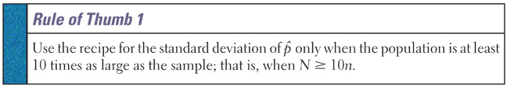
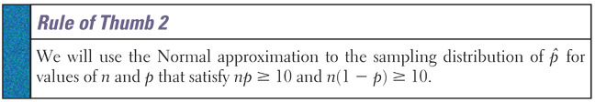

Rules of Thumb
For independence
This will be used throughout the rest of the book.
  We are interested in sampling only when the population is large enough to make taking a census impractical
  This keeps us out of hyper-geometric distributions
Allows us to use the normal distribution for $\hat{p}$
For normal approximation

Slide 11

Sample Proportions and Normality
The sampling distribution of $\hat{p}$can be estimated by a normal distribution as long as the following are true:
$N ≥ 10n$where N is the number in the population
  Sample, n, less than 10% of the population
  Small enough sample size to avoid hyper-geometric
  $np ≥ 10$and $n(1−p) ≥ 10$
  Which basically means for large or small values of p we need to have larger samples to maintain normality

Slide 12
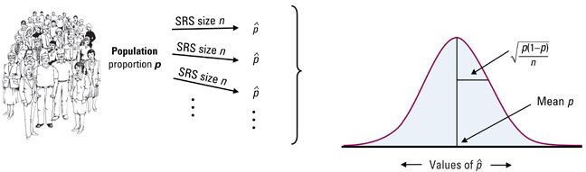

Sample Proportions, p̂
Remember to draw our normal curve and place the mean, $\hat{p}$and make note of the standard deviation
If using Z-tables:
  Use normal cdf for less than values
  Use complement rule [1 – P(x<)] for greater than values
Otherwise use Normalcdf (LB, UB, μ, σ)

Slide 13

Example 1
Assume that 80% of the people taking aerobics classes are female and a simple random sample of n = 100 students is taken What is the probability that at most 75% of the sample students are female?
P(p < 75%)
Conditions: 1000 < 10% of aerobics attendees
np = 80 n(1-p) = 20
.75
μ_{p} = 0.80 n = 100
$$σp = \sqrt{(0.8)(0.2)/100} = 0.04$$
$Z=\frac{p−μ_{p}}{σ_{p}}= \frac{0.75−0.8}{0.04}=−1.25$ normalcdf(-E99,-1.25) = 0.1056
normalcdf(0,0.75,0.8,0.04) = 0.1056
Bicdf(100,0.8,75) = 0.1314

Slide 14
Example 2
  Assume that 80% of the people taking aerobics classes are female and a simple random sample of n = 100 students is taken. If the sample had exactly 90 female students, would that be unusual?
Conditions: 1000 < 10% of aerobics attendees
np = 80 n(1-p) = 20
P(p > 90%)
.9
μ_{p} = 0.80 n = 100
$$σp = \sqrt{(0.8)(0.2)/100} = 0.04$$
$Z=\frac{p−μ_{p}}{σ_{p}}= \frac{0.90−0.8}{0.04}=2.5$ normalcdf(2.5,E99) = 0.0062
normalcdf(0.9,1,0.8,0.04) = 0.0062 less than 5% so it is unusual
Binomial: bipdf(100, 0.80, 90) = 0.0034

Slide 15
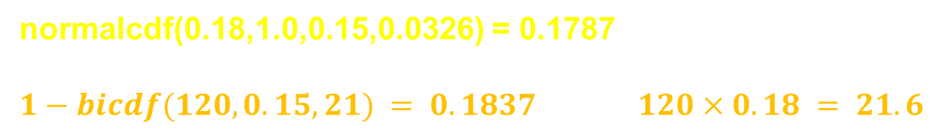

Example 3
According to the National Center for Health Statistics, 15% of all Americans have hearing trouble. In a random sample of 120 Americans, what is the probability at least 18% have hearing trouble?
Conditions: 1200 < 10% of adults
np = 18 n(1-p) = 102
P(p > 18%)
.18
μ_{p} = 0.15 n = 120
$$σp = \sqrt{(0.15)(0.85)/120} = 0.0326$$
$Z=\frac{p−μ_{p}}{σ_{p}}= \frac{0.18−0.15}{0.0326}=0.92$ normalcdf(0.92,E99) = 0.1787
normalcdf(0.18,1.0,0.15,0.0326) = 0.1787
$1−bicdf(120,0.15,21) = 0.1837$ $120×0.18 = 21.6$

Slide 16

Example 4
  According to the National Center for Health Statistics, 15% of all Americans have hearing trouble. Would it be unusual if the sample above had exactly 10 having hearing trouble?
Conditions: 1200 < 10% of adults
np = 18 n(1-p) = 102
P(x < 10)
μ_{p} = 0.15
p = 10/120 = 0.083
n = 120
10
$$σp = \sqrt{(0.15)(0.85)/120} = 0.0326$$
$Z=\frac{p−μ_{p}}{σ_{p}}= \frac{0.083−0.15}{0.0326}=−2.06$normalcdf(-E99,-2.06) = 0.0197
normalcdf(-E99,0.083,0.15,0.0326) = 0.01993 which is < 5% so unusual
Bipdf(120,0.15,10) = 0.01153

Slide 17
Example 5
  We can check for undercoverage or nonresponse by comparing the sample proportion to the population proportion. About 11% of American adults are black. The sample proportion in a national survey of 1500 was 9.2%. Were blacks underrepresented in the survey?
P(x < 0.092)
Conditions: 1500 < 10% of adults
np = 165 n(1-p) = 1335
μ_{p} = 0.11
p = 0.092
n = 1500
0.092
$$σp = \sqrt{(0.11)(0.89)/1500} = 0.00808$$
$Z=\frac{p−μ_{p}}{σ_{p}}= \frac{0.092−0.11}{0.00808}=−2.23$normalcdf(-E99,-2.23) = 0.0129
normalcdf(0,0.092,0.11,0.00808) = 0.0129
which is < 5% so underrepresented

Slide 18

Summary and Homework
Summary
  Take an SRS and use the sample proportion $\hat{p}$to estimate the unknown parameter p
  $\hat{p}$is an unbiased estimator of p
  Increase in sample size decreases the standard deviation of $\hat{p}$ (by a factor of $1/{\sqrt{n}}$)
  Normal distributions can be used for $\hat{p}$if the two rules of thumb are met
    10% rule for independence
    Successes and Failures ≥ 10 for normality
Homework
  27, 29, 33, 35, 37, 41

