Slide 1

5-Minute Check on Chapter 7-2
What is the unbiased estimator of the population proportion?
What is the distribution of population proportion random variable?
What are the two rules-of-thumb mentioned in last lesson?
What distribution do these ROT allow us to use?
If the sample size goes up by a factor of 4, what effect does it have on the sample portion standard deviation?
Assume that 80% of the people taking aerobics classes are female and a simple random sample of n = 100 students is taken. Find P(females>90).
p-hat = number that fit / number in sample
Binomial random variable
10n < N and np ≥ 10 and n(1-p) ≥ 10
Normal approximation
sample size up by 4 cuts standard deviation in half
P(F>90) = ncdf(0.90, 1.00, 0.80, 0.04) = 0.006
Click the mouse button or press the Space Bar to display the answers.

Slide 2
Lesson 7 - 3
Sample Means

Slide 3

Objectives
Calculate the mean and standard deviation of the sampling distribution of a sample mean $\overline{x}$ and interpret the standard deviation
Explain how the shape of the sampling distribution of $\overline{x}$ is affected by the shape of the population distribution and the sample size
If appropriate, use a Normal distribution to calculate probabilities involving $\overline{x}$

Slide 4

Vocabulary
Sampling distribution of the sample mean – describes the distribution of values taken by the sample mean x in all possible samples of the same size from the same population
Central Limit Theorem – (CLT) says that when n, the sample size, is large, the sampling distribution of the sample mean $\overline{x}$ is approximately Normal
Standard error of the mean – standard deviation of the sampling distribution of $\overline{x}$

Slide 5
Sample Means
Sample proportions arise most often when we are interested in categorical variables. When we record quantitative variables we are interested in other statistics such as the median or mean or standard deviation of the variable. Sample means are among the most common statistics.

Slide 6
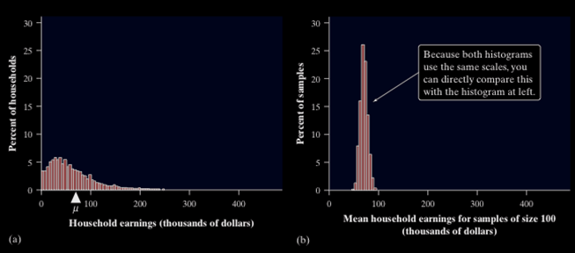
Sample Means
Consider the mean household earnings for samples of size 100. Compare the population distribution on the left with the sampling distribution on the right. What do you notice about the shape, center, and spread of each?
Skewed right, mean about 75K
Range 0 to 250K
Symmetric, mean about 75K
Range 50 to 100K

Slide 7
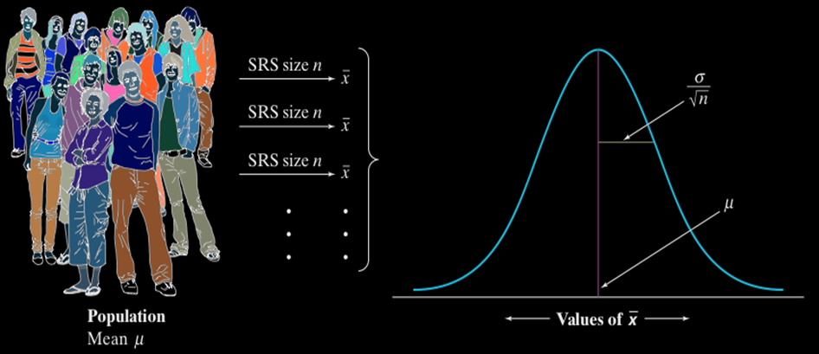
Sample Mean, x̄
When we choose many SRSs from a population, the sampling distribution of the sample mean is centered at the population mean µ and is less spread out than the population distribution. Here are the facts
Mean and Standard Deviation of the Sampling Distribution of Sample Means
as long as the 10% condition is satisfied: n ≤ (1/10)N.

Slide 8
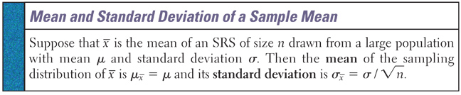


Sample Mean, $\overline{x}$
The behavior of $\overline{x}$in repeated sampling is much like that of the sample proportion, $\hat{p}$.
Sample mean $\overline{x}$is an unbiased estimator of the population mean μ
Spread is less than that of X.
Standard deviation of $\overline{x}$ is smaller than that of X by a factor of $1/\sqrt{n}$

Slide 9


Sample Spread of x̄
If the random variable X has a normal distribution with a mean of 20 and a standard deviation of 12
  If we choose samples of size n = 4, then the sample mean will have a normal distribution with a mean of 20 and a standard deviation of 6
  If we choose samples of size n = 9, then the sample mean will have a normal distribution with a mean of 20 and a standard deviation of 4
Mean unchanged; St Dev reduced by $\frac{1}{\sqrt{4}}=\frac{1}{2}$
Mean unchanged; St Dev reduced by $\frac{1}{\sqrt{9}}=\frac{1}{3}$

Slide 10

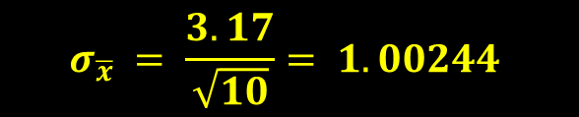
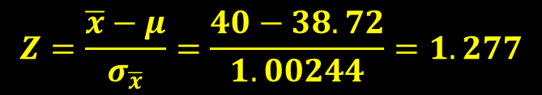
Example 1
The height of all 3-year-old females is approximately normally distributed with μ = 38.72 inches and σ = 3.17 inches. Compute the probability that a simple random sample of size n = 10 results in a sample mean greater than 40 inches.
P($\overline{x}$ > 40)
μ = 38.72 σ = 3.17 n = 10
$$σ_{\overline{x}} = \frac{3.17}{\sqrt{10}}= 1.00244$$
40
$$Z=\frac{\overline{x}−μ}{σ_{\overline{x}}}=\frac{40−38.72}{1.00244}=1.277$$
normalcdf(1.277,E99) = 0.1008
normalcdf(40,E99,38.72,1.002) = 0.1007

Slide 11
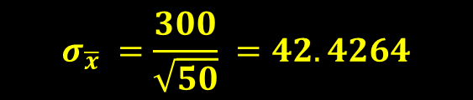

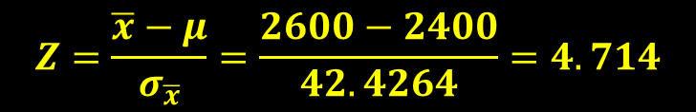
Example 2
We’ve been told that the average weight of giraffes is 2400 pounds with a standard deviation of 300 pounds. We’ve measured 50 giraffes and found that the sample mean was 2600 pounds. Is our data consistent with what we’ve been told?
P($\overline{x}$ > 2600)
μ = 2400 σ = 300 n = 50
$$σ_{\overline{x}} =\frac{300}{\sqrt{50}} =42.4264$$
2600
$$Z=\frac{\overline{x}−μ}{σ_{\overline{x}}}=\frac{2600−2400}{42.4264}=4.714$$
normalcdf(4.714,E99) = 0.000015
normalcdf(2600,E99,2400,42.4264) = 0.0000001
Statistical evidence against what we were told

Slide 12
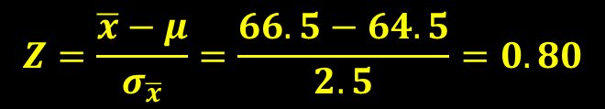

Example 3
Young women’s height is distributed as a N(64.5, 2.5), What is the probability that a randomly selected young woman is taller than 66.5 inches?
P(x > 66.5)
μ = 64.5 σ = 2.5 n = 1
$$σ_{\overline{x}} =\frac{2.5}{\sqrt{1}} =2.5$$
66.5
$$Z=\frac{\overline{x}−μ}{σ_{\overline{x}}}=\frac{66.5−64.5}{2.5}=0.80$$
normalcdf(0.80,E99) = 0.7881
= 1 – 0.7881
= 0.2119
normalcdf(66.5,E99,64.5,2.5) = 0.2119

Slide 13

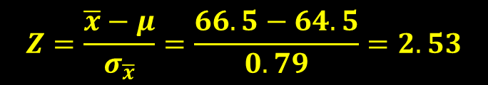
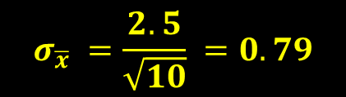
Example 4
Young women’s height is distributed as a N(64.5, 2.5), What is the probability that an SRS of 10 young women has a mean height greater than 66.5 inches?
P($\overline{x}$ > 66.5)
μ = 64.5 σ = 2.5 n = 1
$$σ_{\overline{x}} =\frac{2.5}{\sqrt{10}} =0.79$$
66.5
$$Z=\frac{\overline{x}−μ}{σ_{\overline{x}}}=\frac{66.5−64.5}{0.79}=2.53$$
normalcdf(2.53,E99) = 0.9943
= 1 – 0.9943
= 0.0057
normalcdf(66.5,E99,64.5,2.5/√10) = 0.0057

Slide 14
Central Limit Theorem
Most population distributions are not Normal. What is the shape of the sampling distribution of sample means when the population distribution isn’t Normal?
It is a remarkable fact that as the sample size increases, the distribution of sample means changes its shape: it looks less like that of the population and more like a Normal distribution! When the sample is large enough, the distribution of sample means is very close to Normal, no matter what shape the population distribution has, as long as the population has a finite standard deviation.
Definition:
Note: How large a sample size n is needed for the sampling distribution to be close to Normal depends on the shape of the population distribution. More observations are required if the population distribution is far from Normal.

Slide 15
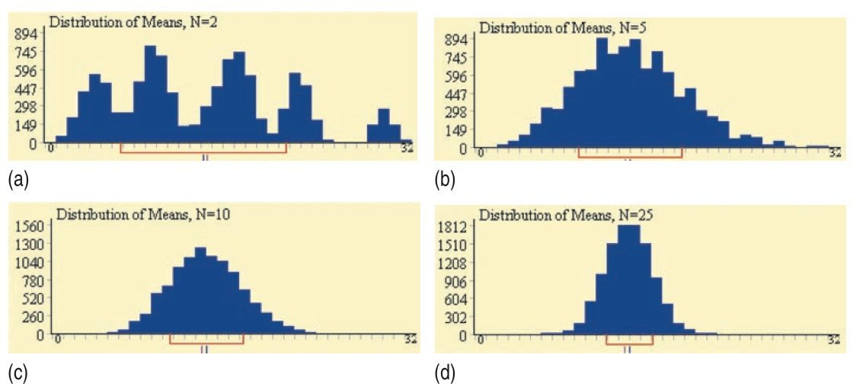
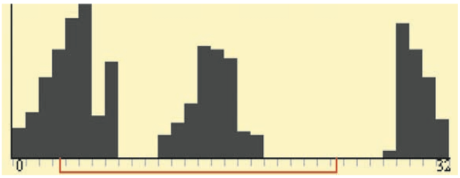
Central Limit Theorem
Consider the strange population distribution from the Rice University sampling distribution applet.
Describe the shape of the sampling distributions as n increases. What do you notice?
Normal Condition for Sample Means

Slide 16

Central Limit Theorem
$\overline{x}$ or x-bar
Distribution
Regardless of the shape of the population, the sampling distribution of
x-bar becomes approximately normal as the sample size n increases.
Caution: only applies to shape and not to the mean or standard deviation
x
x
x
x
x
x
x
x
x
x
x
x
x
x
x
x
Random Samples Drawn from Population
Population Distribution

Slide 17
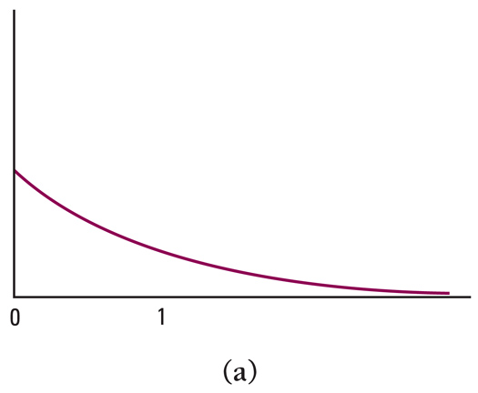
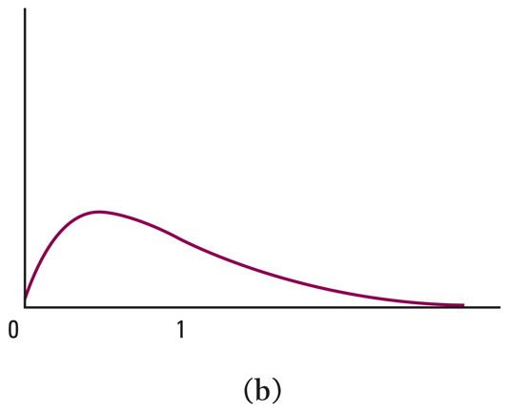
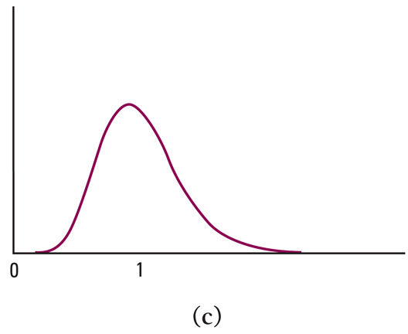
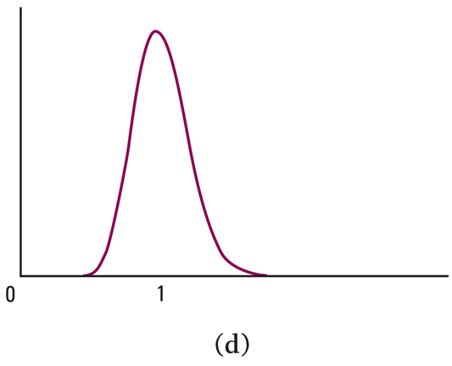
Central Limit Theorem in Action
n =1
n = 2
n = 10
n = 25

Slide 18
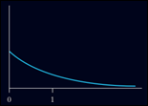

Example 5
The time a technician requires to perform preventive maintenance on an air conditioning unit is governed by the exponential distribution (similar to curve a from “in Action” slide). The mean time is $μ = 1$hour and $σ = 1$hour. Your company has a contract to maintain 70 of these units in an apartment building. In budgeting your technician’s time should you allow an average of 1.1 hours or 1.25 hours for each unit?

Slide 19
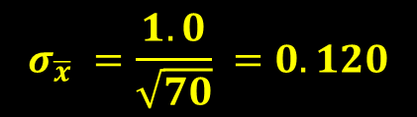


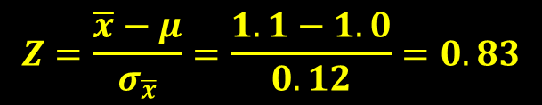
Example 5 - cont
In budgeting your technician’s time should you allow an average of 1.1 hours or 1.25 hours for each unit?
1.1 hours analysis
P($\overline{x}$ > 1.1) vs P($\overline{x}$ > 1.25)
P($\overline{x}$ > 1.1
μ = 1 σ = 1 n = 70
1.1
$$σ_{\overline{x}} =\frac{1.0}{\sqrt{70}} =0.120$$
$$Z=\frac{\overline{x}−μ}{σ_{\overline{x}}}=\frac{1.1−1.0}{0.12}=0.83$$
normalcdf(0.83,E99) = 0.7967
= 1 – 0.7967
= 0.2033
normalcdf(1.1,E99,1.0,0.12) = 0.2023

Slide 20
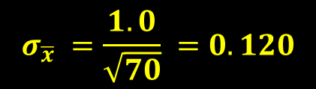

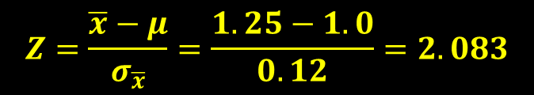
Example 5 - cont
In budgeting your technician’s time should you allow an average of 1.1 hours or 1.25 hours for each unit?
1.25 hours analysis
P($\overline{x}$ > 1.1) vs P($\overline{x}$ > 1.25)
P($\overline{x}$ > 1.25
μ = 1 σ = 1 n = 70
1.25
$$σ_{\overline{x}} =\frac{1.0}{\sqrt{70}} =0.120$$
$$Z=\frac{\overline{x}−μ}{σ_{\overline{x}}}=\frac{1.25−1.0}{0.12}=2.083$$
normalcdf(2.083,E99) = 0.9818
= 1 – 0.9818
= 0.0182
normalcdf(1.25,E99,1.0,0.12) = 0.0182

Slide 21
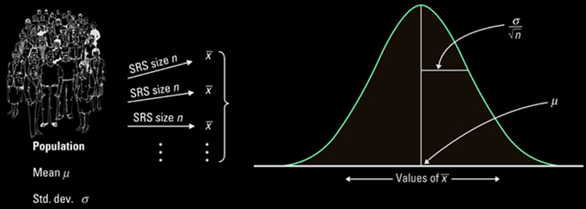

Summary of Distribution of x
Shape, Center and Spread of Population | Distribution of the Sample Means
 | Shape | Center | Spread
Normal with mean, μ and standard deviation, σ | Regardless of sample size, n, distribution of $\overline{x}$ is normal | μ_{x-bar} = μ | σ σ_{x-bar} = ------- √n
Population is not normal with mean, μ and standard deviation, σ | As sample size, n, increases, the distribution of $\overline{x}$ becomes approximately normal | μ_{x-bar} = μ | σ σ_{x-bar} = ------- √n

Slide 22

Summary and Homework
Summary
  Take an SRS and use the sample proportion $\overline{x}$ to estimate the unknown parameter μ
  $\overline{x}$ is an unbiased estimator of μ
  Increase in sample size decreases the standard deviation of $\overline{x}$ (by a factor of $1/\sqrt{n}$)
  If the population is normal, then so is $\overline{x}$
  Central Limit Theorem: for large n (ROT: n ≥ 30), the sampling distribution of $\overline{x}$is approximately normal for any population (with a finite σ)
Homework
  49, 51, 53, 55, 57, 59, 61, 63

