Slide 1
Lesson 8 - 1
Confidence Intervals: The Basics

Slide 2
Objectives
INTERPRET a confidence level
INTERPRET a confidence interval in context
DESCRIBE how a confidence interval gives a range of plausible values for the parameter
DESCRIBE the inference conditions necessary to construct confidence intervals
EXPLAIN practical issues that can affect the interpretation of a confidence interval

Slide 3
Vocabulary
Statistical Inference – provides methods for drawing conclusions about a population parameter from sample data
Point estimate – the unbiased estimator for the population parameter
Margin of error – MOE: critical value times standard error of the estimate; the
Critical Values – a value from z or t distributions corresponding to a level of confidence C
Level C – area between +/- critical values under the given test curve (a normal distribution or t-distribution)
Confidence Level – how confident we are that the population parameter lies inside the confidence interval

Slide 4
Reasoning of Statistical Estimation
Use unbiased estimator of population parameter. The unbiased estimator will always be “close” – so it will have some error in it
Central Limit theorem says with repeated samples, the sampling distribution will be apx Normal
Empirical Rule says that in 95% of all samples, the sample statistic will be within two standard deviations of the population parameter
Twisting it: the unknown parameter will lie between plus or minus two standard deviations of the unbiased estimator 95% of the time

Slide 5
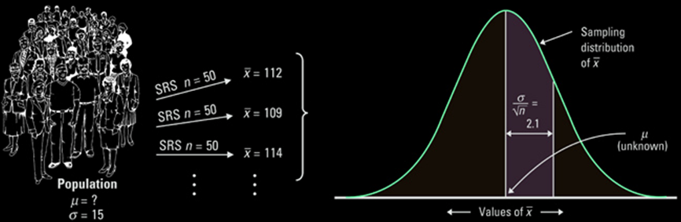
Example 1
We are trying to estimate the true mean IQ of a certain university’s freshmen. From previous data we know that the standard deviation is 16. We take several random samples of 50 and get the following data:
The sampling distribution of x-bar is shown to the right with one standard deviation (16/√50) marked.

Slide 6
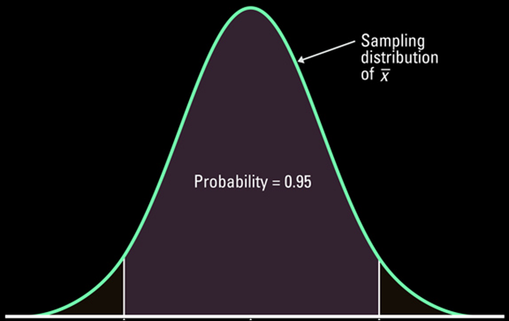
Graphical Interpretation
Based on the sampling distribution of x-bar, the unknown population mean will lie in the interval determined by the sample mean, x-bar, 95% of the time (where 95% is a set value).
0.025
0.025

Slide 7
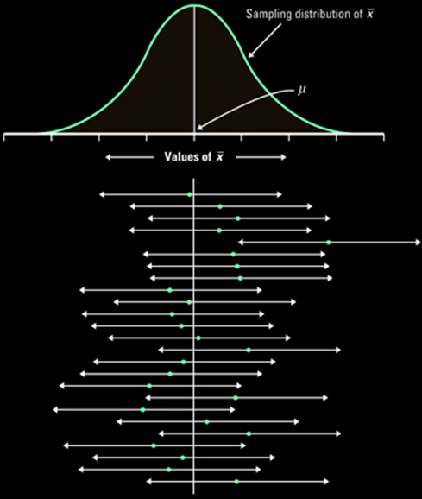
Graphical Interpretation Revisited
Based on the sampling distribution of x-bar, the unknown population mean will lie in the interval determined by the sample mean, x-bar, 95% of the time (where 95% is a set value).
In the example to the right, only 1 out of 25 confidence intervals formed by x-bar does the interval not include the unknown μ
Click here
μ

Slide 8
Confidence Interval Interpretation
One of the most common mistakes students make on the AP Exam is misinterpreting the information given by a confidence interval
Since it has a percentage, they want to attach a probabilistic meaning to the interval
The unknown population parameter is a fixed value, not a random variable. It either lies inside the given interval or it does not.
The method we employ implies a level of confidence – a percentage of time, based on our point estimate, x-bar (which is a random variable!), that the unknown population mean falls inside the interval

Slide 9
Confidence Interval Conditions
Sample comes from a SRS
Independence of observations
  Population large enough so sample is not from Hypergeometric distribution (N ≥ 10n)
Normality from either the
  Population is Normally distributed
  Sample size is large enough for CLT to apply for x-bar
  For p-hat: np ≥ 10 and n(1-p) ≥ 10
Must be checked for each CI problem

Slide 10
Confidence Interval Form
Point estimate (PE) ± margin of error (MOE)
Point Estimate
Sample Mean for Population Mean
Sample Proportion for Population Proportion
MOE
Confidence level (CL) × Standard Error (SE)
CL = critical value from an area under the curve
SE = sampling standard deviation (from ch 7)
Expressed numerically as an interval [LB, UB]
where LB = PE – MOE and UB = PE + MOE
Graphically:
PE
MOE
MOE
_
x

Slide 11
Margin of Error, E
The margin of error, E, in a (1 – α) * 100% confidence interval in which σ is known is given by
σ
E = z_{α/2} ------
√n
where n is the sample size
σ/√n is the standard error
and z_{α/2} is the critical value.
Note: The sample size must be large (n ≥ 30) or the population must be normally distributed.

Slide 12
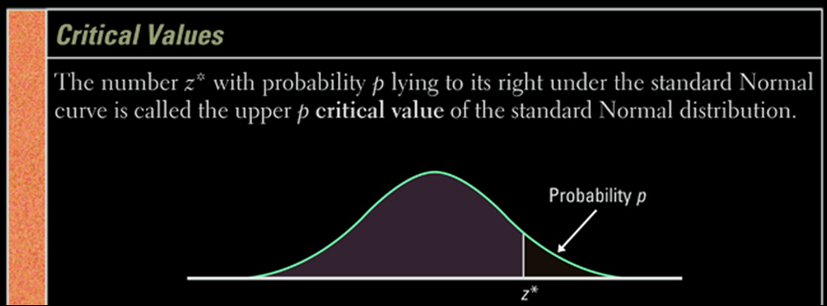
Z Critical Value
Level of Confidence (C) | Area in each Tail (1-C)/2 | Critical Value Z *
90% | 0.05 | 1.645
95% | 0.025 | 1.96
99% | 0.005 | 2.575

Slide 13
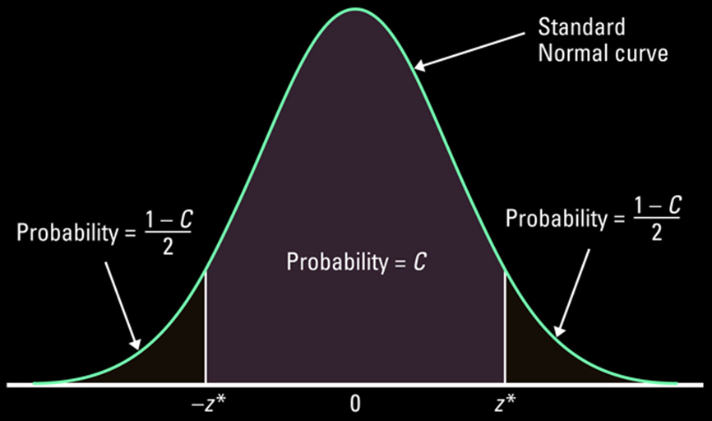
Using Standard Normal

Slide 14
Assumptions for Using Z CI
Sample: simple random sample
Sample Population: sample size must be large (n ≥ 30) or the population must be normally distributed.
Dot plots, histograms, normality plots and box plots of sample data can be used as evidence if population is not given as normal
Population σ: known (If this is not true on AP test you must use t-distribution!)
Notes:
14

Slide 15

5-Minute Check on Chapter 8-1a
What three conditions must be checked for each confidence interval?
What basic form does a confidence interval have?
What two parts make up the margin of error?
For a 95% confidence interval, what area lies to the right outside the interval?
What is the z-critical value for a 90% confidence interval?
Sample is an SRS; sample is independent; sample is (apx) normal
Point Estimate (Statistic) ± Margin of error
Confidence Level × standard error term
0.025 or 2.5%
Z_{0.90} = 1.645 [invnorm((1-0.9)/2,0,1)] look at the bottom of the t-table!
Click the mouse button or press the Space Bar to display the answers.

Slide 16
Inference Toolbox
Step 1: Parameter
  Identify the population of interest and the parameter you want to draw conclusions about
Step 2: Conditions
  Choose the appropriate inference procedure.
  Verify conditions for using it: SIN
Step 3: Calculations
  If conditions are met, carry out inference procedure
  Confidence Interval: PE ± MOE
Step 4: Interpretation
  Interpret you results in the context of the problem
  Three C’s: conclusion, connection, and context

Slide 17
Example 2
A HDTV manufacturer must control the tension on the mesh of wires behind the surface of the viewing screen. A careful study has shown that when the process is operating properly, the standard deviation of the tension readings is σ=43. Here are the tension readings from an SRS of 20 screens from a single day’s production. Construct and interpret a 90% confidence interval for the mean tension μ of all the screens produced on this day.
269.5 | 297.0 | 269.6 | 283.3
304.8 | 280.4 | 233.5 | 257.4
317.4 | 327.4 | 264.7 | 307.7
310.0 | 343.3 | 328.1 | 342.6
338.6 | 340.1 | 374.6 | 336.1

Slide 18
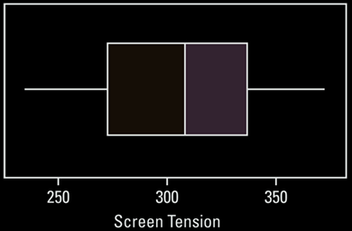
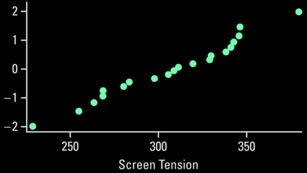
Example 2 cont
Parameter:
Conditions:
  SRS:
  Independence:
  Normality:
Population mean, μ
given to us in the problem description
  assume that more than 10(20) = 200 HDTVs produced during the day
not mentioned in the problem. See below.
No obvious outliers or skewness
No obvious linearity issues

Slide 19
Example 2 cont
Calculations:
Conclusions:
CI: x-bar ± MOE
= 306.3 ± 15.8
(290.5, 322.1)
σ = 43 (given)
C = 90% → Z* = 1.645
n = 20
x-bar = 306.3 (1-var-stats)
MOE = 1.645 × (43) / √20 = 15.8
We are 90% confident that the true mean tension in the entire batch of HDTVs produced that day lies between 290.5 and 322.1 mV.
3C’s: Conclusion, connection, context

Slide 20
Pocket Interpretation Needed
Interpretation of level of confidence
  A 95% [or actual value from the context of the problem if different from 95] confidence level means that if we took repeated simple random samples of the same size, from the [population in the context of the problem], 95% of the intervals constructed using this method would capture the true [population parameter from context of the problem].
Interpretation of confidence interval
  We are 95% [or actual value from the context of the problem if different from 95] confident that the true [population parameter from context of the problem] is between [lower bound estimate] and [upper bound estimate].

Slide 21
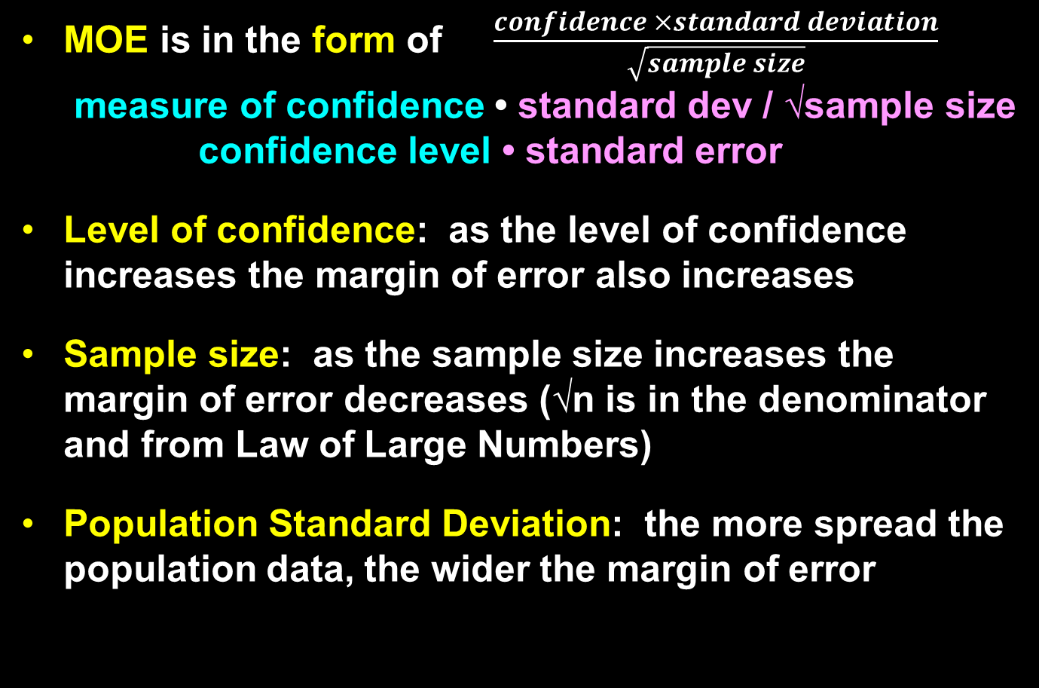
Margin of Error Factors
PE
MOE
MOE
_
x

Slide 22
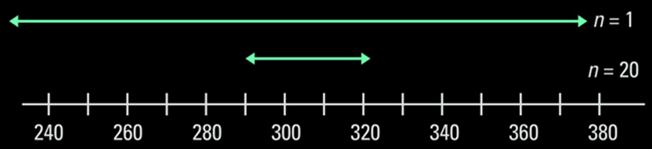
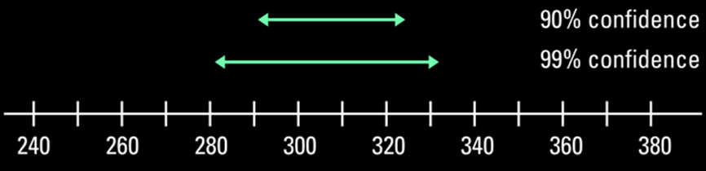
Size and Confidence Effects
Effect of sample size on Confidence Interval
Effect of confidence level on Interval

Slide 23
Example 3
We tested a random sample of 40 new hybrid SUVs that GM is resting its future on. GM told us that the gas mileage was normally distributed with a standard deviation of 6 and we found that they averaged 27 mpg highway. What would a 95% confidence interval about average miles per gallon be?
Parameter: μ PE ± MOE
Conditions: 1) SRS ✓ 2) Normality ✓ 3) Independence ✓
given assumed > 400 produced
Calculations: X-bar ± Z _{1-α/2} σ / √n
27 ± (1.96) (6) / √40
LB = 25.141 < μ < 28.859 = UB
Interpretation: We are 95% confident that the true average mpg (μ) lies between 25.14 and 28.86 for these new hybrid SUVs

Slide 24
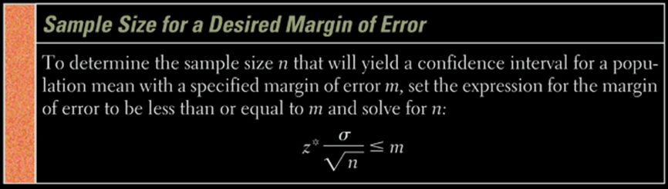
Sample Size Estimates
Given a desired margin of error (like in a newspaper poll) a required sample size can be calculated. We use the formula from the MOE in a confidence interval.
Solving for n gives us:
z*σ 2
n ≥ -------
MOE

Slide 25
Example 4
GM told us the standard deviation for their new hybrid SUV was 6 and we wanted our margin of error in estimating its average mpg highway to be within 1 mpg. How big would our sample size need to be?
(Z _{1-α/2} σ)²
n ≥ -------------
MOE²
MOE = 1
n ≥ (Z _{1-α/2} σ )²
n ≥ (1.96∙ 6 )² = 138.3
n = 139 always round up to integer

Slide 26
Cautions
The data must be an SRS from the population
Different methods are needed for different sampling designs
No correct method for inference from haphazardly collected data (with unknown bias)
Outliers can distort results
Shape of the population distribution matters
You must know the standard deviation of the population (hardly ever true)
The MOE in a confidence interval covers only random sampling errors

Slide 27
TI Calculator Help on Z-Interval
Press STATS, choose TESTS, and then scroll down to Zinterval
Select Data, if you have raw data (in a list)
Enter the list the raw data is in
Leave Freq: 1 alone
or select stats, if you have summary stats
Enter x-bar, σ, and n
Enter your confidence level
Choose calculate

Slide 28
TI Calculator Help on Z-Critical
Press 2nd DISTR and choose invNorm
Enter (1+C)/2 (in decimal form)
This will give you the z-critical (z*) value you need

Slide 29
Summary and Homework
Summary
  CI form: PE ± MOE
  Z critical values: 90% - 1.645; 95% - 1.96; 99% - 2.575
  Confidence level gives the probability that the method will have the true parameter in the interval
  Conditions: SRS, Independence, Normality
  Sample size required:
Homework
  Day 1: 5, 7, 9, 11, 13
  Day 2: 17, 19-24, 27, 31, 33
μ ± z*σ / √n
z*σ 2
n ≥ -------
MOE

