Slide 1

5-Minute Check on Chapter 8-2
What is used for the parameter in a proportion?
Which formula(s) assures independence of the sample?
Which formula(s) assures normality of the distribution?
What distribution is our confidence level expressed as?
What are the formulas used to solve for sample size required in a proportion problem?
P-hat
10n ≤ N
np ≥ 10 and n(1 – p) ≥ 10
Z
For initial study
For previously studied
2
z*
n = 0.25 ------
E
z*
n = p(1 - p) ------
E
2
Click the mouse button or press the Space Bar to display the answers.

Slide 2
Lesson 8 - 3
Estimating a Population Mean

Slide 3
Objectives
CONSTRUCT and INTERPRET a confidence interval for a population mean
DETERMINE the sample size required to obtain a level C confidence interval for a population mean with a specified margin of error
DESCRIBE how the margin of error of a confidence interval changes with the sample size and the level of confidence C
DETERMINE sample statistics from a confidence interval

Slide 4
Vocabulary
Standard Error of the Mean – standard deviation from sampling distributions (σ/√n)
t-distribution – a symmetric distribution, similar to the normal, but with more area in the tails of the distribution
Degrees of Freedom – the sample size n minus the number of estimated values in the procedure (n – 1 for most cases)
Z distribution – standard normal curves
Paired t procedures – before and after observations on the same subject
Robust – a procedure is considered robust if small departures from (normality) requirements do not affect the validity of the procedure

Slide 5
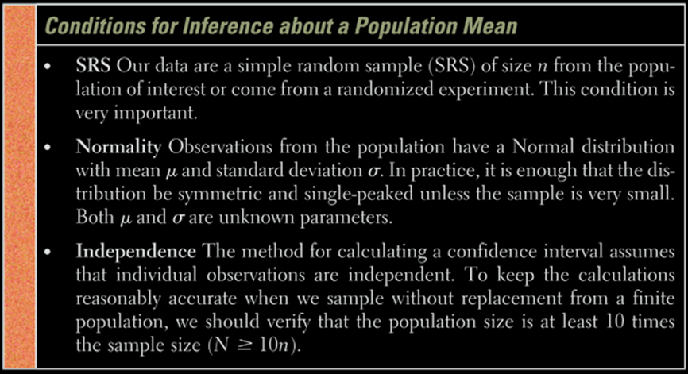
Conditions with σ Unknown
Note: the same as what we saw before

Slide 6
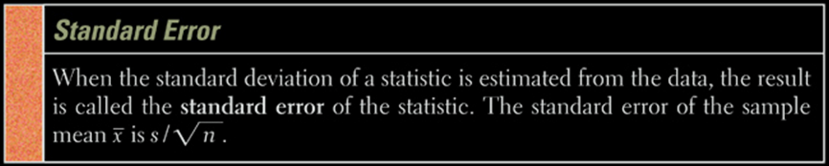
Standard Error of the Statistic
Note: the standard error of the sample mean is two parts of the MOE component to confidence intervals
The z-critical value will be replaced with a t-critical value.

Slide 7
Properties of the t-Distribution
The t-distribution is different for different degrees of freedom
The t-distribution is centered at 0 and is symmetric about 0
The area under the curve is 1. The area under the curve to the right of 0 equals the area under the curve to the left of 0, which is ½.
As t increases without bound (gets larger and larger), the graph approaches, but never reaches zero (like an asymptote). As t decreases without bound (gets larger and larger in the negative direction) the graph approaches, but never reaches, zero.
The area in the tails of the t-distribution is a little greater than the area in the tails of the standard normal distribution, because we are using s as an estimate of σ, thereby introducing further variability.
As the sample size n increases the density of the curve of t get closer to the standard normal density curve. This result occurs because as the sample size n increases, the values of s get closer to σ, by the Law of Large numbers.

Slide 8
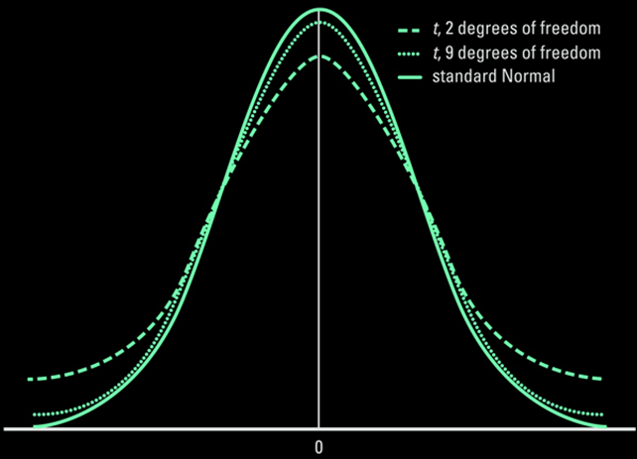
T-Distribution & Degrees of Freedom
Note: as the degrees of freedom increases (n -1 gets larger), the t-distribution approaches the standard normal distribution

Slide 9
T-critical Values
Critical values for various degrees of freedom for the
t-distribution are (compared to the normal)
When does the t-distribution and normal differ by a lot?
In either of two situations
  The sample size n is small (particularly if n ≤ 10 ), or
  The confidence level needs to be high (particularly if α ≤ 0.005)
n | Degrees of Freedom | t_{0.025}
6 | 5 | 2.571
16 | 15 | 2.131
31 | 30 | 2.042
101 | 100 | 1.984
1001 | 1000 | 1.962
Normal | “Infinite” | 1.960

Slide 10
Confidence Interval about μ, σ Unknown
Suppose a simple random sample of size n is taken from a population with an unknown mean μ and unknown standard deviation σ. A C confidence interval for μ is given by PE ± MOE
s
LB = x – t* ---
n
s
UB = x + t* ---
n
where t* is computed with n – 1 degrees of freedom
Note: The interval is exact when population is normal and is approximately correct for nonnormal populations, provided n is large enough (t is robust)

Slide 11
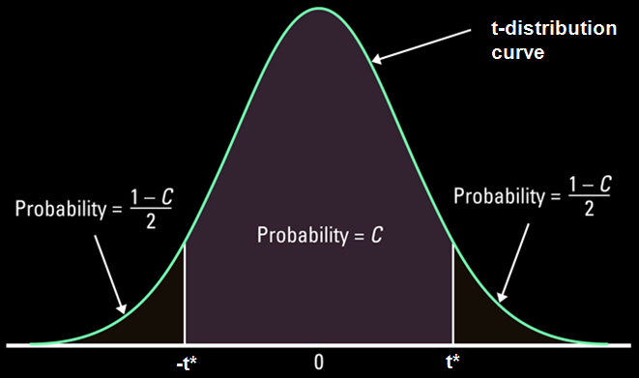
T-Critical Values
We find t* the same way we found z*
t* = t( [1+C]/2, n-1) where n-1 is the Degrees of Freedom (df), based on sample size, n
When the actual df does not appear in Table C, use the greatest df available that is less than your desired df

Slide 12
Effects of Outliers
Outliers are always a concern, but they are even
more of a concern for confidence intervals using
the t-distribution
  Sample mean is not resistant; hence the sample mean is larger or smaller (drawn toward the outlier)
  (small numbers of n in t-distribution!)
  Sample standard deviation is not resistant; hence the sample standard deviation is larger
  Confidence intervals are much wider with an outlier included
  Options:
    Make sure data is not a typo (data entry error)
    Increase sample size beyond 30 observations
    Use nonparametric procedures (discussed in Chapter 15)

Slide 13
5-Minute Check on Chapter 8-3a
When do we use a t-distribution (versus a z-distribution)?
What is the major difference between z- and t-distributions?
What are degrees of freedom and their formula in a t-distribution?
What does a t-distribution approach as degrees of freedom approach infinity?
What do we have to be very careful of with t-distribution problems?
When σ is unknown
T-distribution has greater area in the tails of the distribution
DOF = n – 1 and you lose a DOF for every parameter estimated
Z-distribution
Outliers
Click the mouse button or press the Space Bar to display the answers.

Slide 14
Example 1
We need to estimate the average weight of a particular type of very rare fish. We are only able to borrow 7 specimens of this fish and their average weight was 1.38 kg and they had a standard deviation of 0.29 kg. What is a 95% confidence interval for the true mean weight?
Parameter: μ PE ± MOE
Conditions: 1) SRS ✓ 2) Normality ✓ 3) Independence ✓
shaky assumed shaky
Calculations: X-bar ± t_{α/2,n-1} s / √n
1.38 ± (2.4469) (0.29) / √7
LB = 1.1118 < μ < 1.6482 = UB
Interpretation: We are 95% confident that the true average wt of the fish (μ) lies between 1.11 & 1.65 kg for this type of fish

Slide 15
Example 2
We need to estimate the average weight of stray cats coming in for treatment to order medicine. We only have 12 cats currently and their average weight was 9.3 lbs and they had a standard deviation of 1.1 lbs. What is a 95% confidence interval for the true mean weight?
Parameter: μ PE ± MOE
Conditions: 1) SRS ✓ 2) Normality ✓ 3) Independence ✓
shaky assumed > 240 strays
Calculations: X-bar ± t_{α/2,n-1} s / √n
9.3 ± (2.2001) (1.1) / √12
LB = 8.6014 < μ < 9.9986 = UB
Interpretation: We are 95% confident that the true average wt of the cats (μ) lies between 8.6 & 10 lbs at our clinic

Slide 16
Quick Review
All confidence intervals (CI) looked at so far have been in form of
Point Estimate (PE) ± Margin of Error (MOE)
PEs have been x-bar for μ and p-hat for p
MOEs have been in form of CL ● ‘σ_{x-bar or p-hat}’
If σ is known we use it and Z_{1-α/2} for CL
If σ is not known we use s to estimate σ and t_{α/2} for CL
We use Z_{1-α/2} for CL when dealing with p-hat
Note: CL is Confidence Level

Slide 17
Confidence Intervals
Form:
  Point Estimate (PE) ± Margin of Error (MOE)
  PE is an unbiased estimator of the population parameter
  MOE is confidence level × standard error (SE) of the estimator
  SE is in the form of standard deviation / √sample size
Specifics:
Parameter | PE | MOE C-level Standard Error |  | Number needed
μ, with σ known | x-bar | z* | σ / √n | n = [z*σ/MOE]²
μ, with σ unknown | x-bar | t* | s / √n | n = [z*σ/MOE]²
p | p-hat | z* | √p(1-p)/n | n = p(1-p) [z*/MOE]² n = 0.25[z*/MOE]²

Slide 18
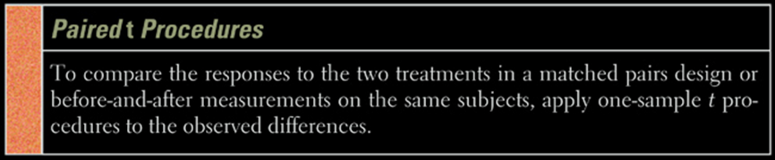
Match Pair Analysis
The parameter, μ, in a paired t procedure is the mean differences in the responses to the
two treatments within matched pairs
two treatments when the same subject receives both treatments
before and after measurements with a treatment applied to the same individuals

Slide 19
Example 3
11 people addicted to caffeine went through a study measuring their depression levels using the Beck Depression Inventory. Higher scores show more symptoms of depression. During the study each person was given either a caffeine pill or a placebo. The order that they received them was randomized. Construct a 90% confidence interval for the mean change in depression score.
Subject | 1 | 2 | 3 | 4 | 5 | 6 | 7 | 8 | 9 | 10 | 11
P-BDI | 16 | 23 | 5 | 7 | 14 | 24 | 6 | 3 | 15 | 12 | 0
C-BDI | 5 | 5 | 4 | 3 | 8 | 5 | 0 | 0 | 2 | 11 | 1
Diff 11 18 1 4 6 19 6 3 13 1 -1
Enter the differences into List1 in your calculator

Slide 20
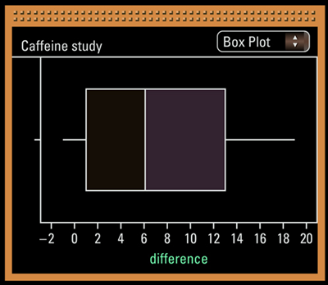
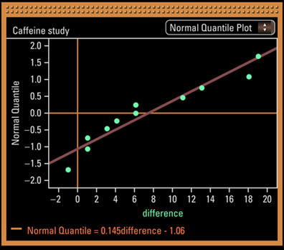
Example 3 cont
Parameter: μ_{diff} PE ± MOE
Conditions: 1) SRS ✓ 2) Normality ✓ 3) Independence ✓
Not see output below > DOE helps
Output from Fathom: similar to our output from the TI

Slide 21
Example 3 cont
Calculations: x-bar_{diff} = 7.364 and s_{diff} = 6.918
X-bar ± t_{α/2,n-1} s / √n
7.364 ± (1.812) (6.918) / √11
7.364 ± 3.780
LB = 3.584 < μ_{diff} < 11.144 = UB
Interpretation: We are 90% confident that the true mean difference in depression score for the population lies between 3.6 & 11.1 points (on BDI).
That is, we estimate that caffeine-dependent individuals would score, on average, between 3.6 and 11.1 points higher on the BDI when they are given a placebo instead of caffeine. Lack of SRS prevents generalization any further.

Slide 22
Random Reminders
Random selection of individuals for a statistical study allows us to generalize the results of the study to the population of interest
Random assignment of treatments to subjects in an experiment lets us investigate whether there is evidence of a treatment effect (caused by observed differences)
Inference procedures for two samples assume that the samples are selected independently of each other. This assumption does not hold when the same subjects are measured twice. The proper analysis depends on the design used to produce the data.

Slide 23
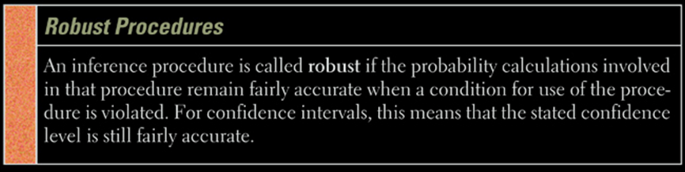
Inference Robustness
Both t and z procedures for confidence intervals are robust for minor departures from Normality
Since both x-bar and s are affected by outliers, the t procedures are not robust against outliers

Slide 24
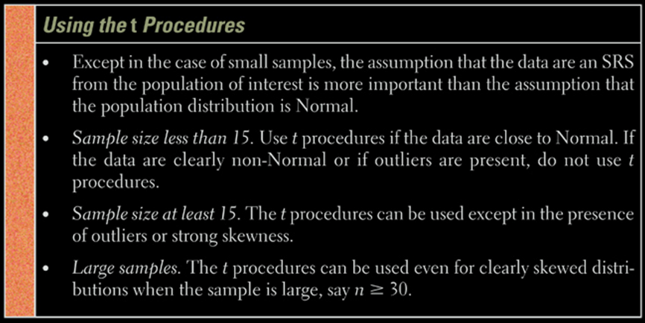
Z versus t in Reality
When σ is unknown we use t-procedures no matter the sample size (always hit on AP exam somewhere)

Slide 25
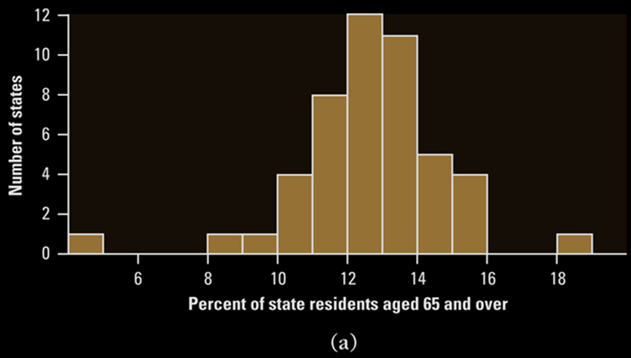
Can t-Procedures be Used?
No: this is an entire population, not a sample

Slide 26
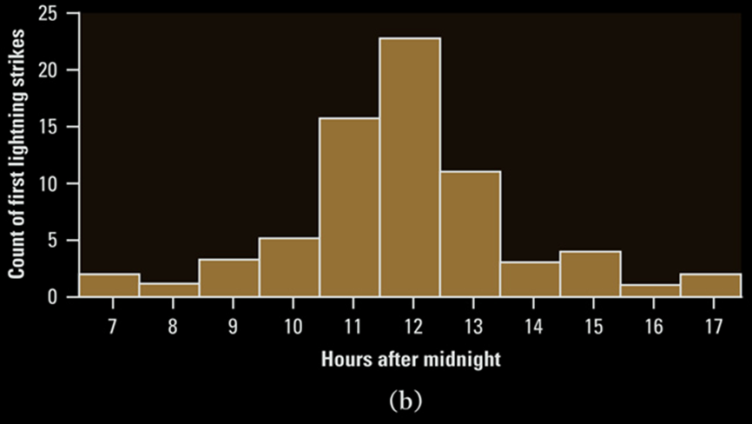
Can t-Procedures be Used?
Yes: there are 70 observations with a symmetric distribution

Slide 27
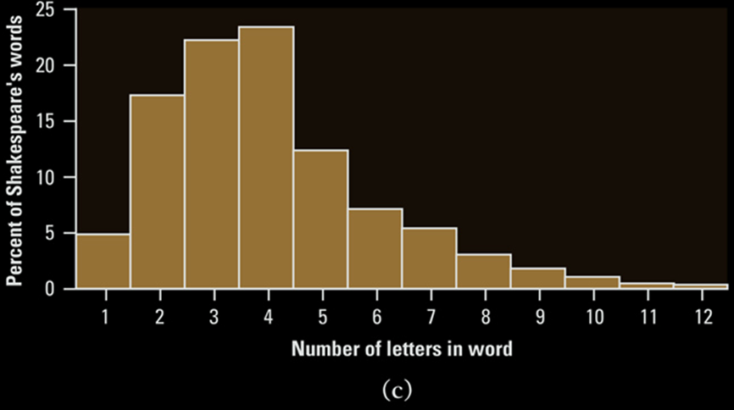
Can t-Procedures be Used?
Yes: if the sample size is large enough to overcome
the right-skewness

Slide 28
TI Calculator Help on t-Interval
Press STATS, choose TESTS, and then scroll down to Tinterval
Select Data, if you have raw data (in a list)
Enter the list the raw data is in
Leave Freq: 1 alone
or select stats, if you have summary stats
Enter x-bar, s, and n
Enter your confidence level
Choose calculate

Slide 29
TI Calculator Help on Paired t-Interval
Press STATS, choose TESTS, and then scroll down to 2-SampTInt
Select Data, if you have raw data (in 2 lists)
Enter the lists the raw data is in
Leave Freq: 1 alone
or select stats, if you have summary stats
Enter x-bar, s, and n for each sample
Enter your confidence level
Choose calculate

Slide 30
TI Calculator Help on T-Critical
On the TI-84 a new function exists invT
This will give you the t-critical (t*) value you need

Slide 31
Summary and Homework
Summary
  In practice we do not know σ and therefore use t-procedures to estimate confidence intervals
  t-distribution approaches Standard Normal distribution as the sample size gets very large
  Use difference data to analyze paired data using same t-procedures
  t-procedures are relatively robust, unless the data shows outliers or strong skewness
Homework
  Day One: 49-52, 55, 57, 59, 63
  Day Two: 65, 67, 71, 73, 75-78

