Slide 1

5-Minute Check on Chapter 8-3b
What are the components of a confidence interval?
When we have a match pair design, how do we form the confidence interval?
What allows generalization to populations in DOE?
What focuses on treatment effects in DOE?
What does it mean for procedures to be “robust”?
Point estimate and a margin of error (confidence level standard error)
Form CI on the difference data
Random selection of test subjects
Random assignment of treatments to test subjects
Minor departures from normality will not effect results
Click the mouse button or press the Space Bar to display the answers.

Slide 2
Lesson 8 - R
Review of Chapter 8
Confidence Intervals

Slide 3
Objectives
Describe statistical inference
Describe the basic form of all confidence intervals
Construct and interpret a confidence interval for a population mean (including paired data) and for a population proportion
Describe a margin of error, and explain ways in which you can control the size of the margin of error

Slide 4
Objectives
Determine the sample size necessary to construct a confidence interval for a fixed margin of error
Compare and contrast the t distribution and the Normal distribution
List the conditions that must be present to construct a confidence interval for a population mean or a population proportion
Explain what is meant by the standard error, and determine the standard error of x-bar and the standard error of p-hat

Slide 5
Vocabulary
None new

Slide 6
Inference Toolbox
Step 1: Parameter
  Indentify the population of interest and the parameter you want to draw conclusions about
Step 2: Conditions
  Choose the appropriate inference procedure. Verify conditions for using it
Step 3: Calculations
  If conditions are met, carry out inference procedure
  Confidence Interval: PE ± MOE
Step 4: Interpretation or Conclusion
  Interpret you results in the context of the problem
  Three C’s: conclusion, connection, and context

Slide 7
Confidence Intervals
Form:
  Point Estimate (PE) ± Margin of Error (MOE)
  PE is an unbiased estimator of the population parameter
  MOE is confidence level × standard error (SE) of the estimator
  SE is in the form of standard deviation / √sample size
Specifics:
Parameter | PE | MOE C-level Standard Error |  | Number needed
μ, with σ known | x-bar | z* | σ / √n | n = [z*σ/MOE]²
μ, with σ unknown | x-bar | t* | s / √n | n = [z*s/MOE]²
p | p-hat | z* | √p(1-p)/n | n = p(1-p) [z*/MOE]² n = 0.25[z*/MOE]²

Slide 8
Conditions for CI Inference
Sample comes from a SRS
Independence of observations
  Population large enough so sample is not from Hypergeometric distribution (N ≥ 10n)
Normality from either the
  Population is Normally distributed
  Sample size is large enough for CLT to apply
  t-distribution or small sample size:
  shape and outliers (killer!) checked
  population proportion: np ≥ 10 and n(1-p) ≥ 10
Must be checked for each CI problem

Slide 9
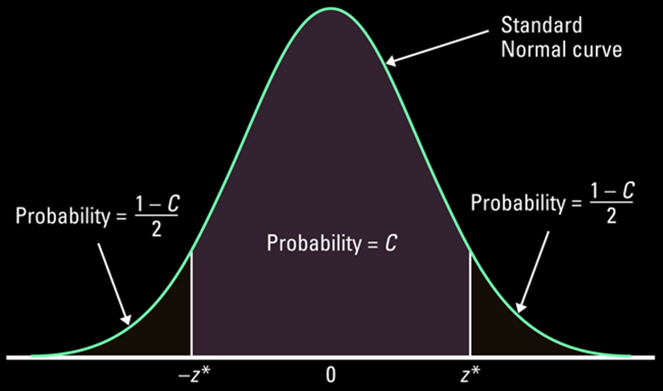
Using Confidence Level
t-distribution
(more area in tails)
-t* or
or t*
Remember: t-distribution has more area in the tails and as the degrees-of-freedom (n – 1) gets very large the distribution approaches the Standard Normal distribution

Slide 10
Margin of Error Factors
Level of confidence: as the level of confidence increases the margin of error also increases
Sample size: as the sample size increases the margin of error decreases (√n is in the denominator and from Law of Large Numbers)
Population Standard Deviation: the more spread the population data, the wider the margin of error
MOE is in the form of
measure of confidence • standard dev / √sample size
PE
MOE
MOE

Slide 11
TI Calculator Help on C-Interval
Press STATS, choose TESTS, and then scroll down to
ZInterval, TInterval, 1-PropZInt, 2-SampTInt
Select Data, if you have raw data (in a list)
Enter the list the raw data is in
Leave Freq: 1 alone
or select stats, if you have summary stats
Enter x-bar, σ (or s), and n
Enter your confidence level
Choose calculate

Slide 12
Summary and Homework
Summary
  Confidence Interval: PE ± MOE
  MOE: Confidence Level × Standard Error
  MOE affected by sample size (⇓),
  Confidence level (⇑), and standard deviation (⇑)
  t-distribution has more area in tails than z (σ estimated by s; more potential for error)
  Confidence Level not a probability on population parameter, but on the interval (the random variable)
Homework
  Pg 681-682 10.66, 68, 69, 71, 72, 73

Slide 13
Problem 1
A simple random sample of 50 bottles of a particular brand of cough medicine is selected and the alcohol content of each bottle is determined. Based on this sample, a 95% confidence interval is computed for the mean alcohol content for the population of all bottles of the brand under study. This interval is 7.8 to 9.4 percent alcohol.
(a) How large would the sample need to be to reduce the length of the given 95% confidence interval to half its current size? ____________
50×4 = 200

Slide 14
Problem 1 continued
A simple random sample of 50 bottles of a particular brand of cough medicine is selected and the alcohol content of each bottle is determined. Based on this sample, a 95% confidence interval is computed for the mean alcohol content for the population of all bottles of the brand under study. This interval is 7.8 to 9.4 percent alcohol.
T or F There is a 95% chance that the true population mean is between 7.8 and 9.4 percent.
(c) T or F If the process of selecting a sample of 50 bottles and then computing the corresponding 95% confidence interval is repeated 100 times, approximately 95 of the resulting intervals should include the true population mean alcohol content.

Slide 15
Problem 1 continued
A simple random sample of 50 bottles of a particular brand of cough medicine is selected and the alcohol content of each bottle is determined. Based on this sample, a 95% confidence interval is computed for the mean alcohol content for the population of all bottles of the brand under study. This interval is 7.8 to 9.4 percent alcohol.
(d) T or F If the process of selecting a sample of 50 bottles and then computing the corresponding 95% confidence interval is repeated 100 times, approximately 95 of the resulting sample means will be between 7.8 and 9.4.

Slide 16
Problem 2
A sample of 100 postal employees found that the mean time these employees had worked for the postal service was 8 years. Assume that we know that the standard deviation of the population of times postal service employees have spent with the postal service is 5 years. A 95% confidence interval for the mean time μ the population of postal employees has spent with the postal service is computed. Which one of the following would produce a confidence interval with larger margin of error?
A. Using a sample of 1000 postal employees.
B. Using a confidence level of 90%
C. Using a confidence level of 99%.
D. Using a different sample of 100 employees, ignoring the results of the previous sample.

Slide 17
Problem 3
A z-confidence interval was based on several underlying assumptions. One of these is the generally unrealistic assumption that we know the value of the population standard deviation σ. What other assumptions must be satisfied for the procedures you have learned to be valid?
Simple Random Sample
Normality
n > 30 for CLT
population normally distributed
Independence (N > 10n)

Slide 18
Problem 4 a
A random sample of 25 seniors from a large metropolitan school district had a mean Math SAT score of 450. Suppose we know that the population of Math SAT scores for seniors in the district is normally distributed with standard deviation σ = 100.
Find a 92% confidence interval for the mean Math SAT score for the population of seniors. Show work to support your answer.
Parameter: μ Math SAT scores
Conditions: SRS ✓; Normality: ✓ Independence:✓
Calculations: PE=450, CL=Z*=1.75, SE=100/√25=20
450 ± 1.75(20) ➔ [415,485]
Interpretation: We are 92% confident that the true mean Math SAT score for seniors in this school district lies between 415 and 485

Slide 19
Problem 4 b
A random sample of 25 seniors from a large metropolitan school district had a mean Math SAT score of 450. Suppose we know that the population of Math SAT scores for seniors in the district is normally distributed with standard deviation σ = 100.
Using the information provided above, what is the smallest sample size we can take to achieve a 90% confidence interval for μ with margin of error ±25? Show work to support your answer. (Be sure to note that parts (a) and (b) have different confidence levels.)
Z* = 1.645 σ = 100 n = [Z*σ/MOE]² = [(1.645(100)/25]²
= [6.48]² = 41.99, so 42

