Slide 1
Lesson 9 - 1
Significance Tests:
The Basics

Slide 2
Objectives
STATE correct hypotheses for a significance test about a population proportion or mean.
INTERPRET P-values in context.
INTERPRET a Type I error and a Type II error in context, and give the consequences of each.
DESCRIBE the relationship between the significance level of a test, P(Type II error), and power.

Slide 3
Vocabulary
Null Hypothesis – H₀, the claim that we weigh evidence against
Alternative Hypothesis – H_{a}, or H₁, the claim that we are trying to find evidence for
One-sided alternative hypothesis – states that a parameter is greater than or less than the null value
Two-sided alternative hypothesis – states that a parameter is not equal to (or different from) the null value
P-value – the probability of getting evidence for the alternative hypothesis H_{a} as strong as or stronger than the observed evidence when the null hypothesis H₀ is true
Significance Level – the value that we use as a boundary for deciding whether an observed result is unlikely to happen by chance alone when the null hypothesis is true

Slide 4
Vocabulary (cont)
Type I error – occurs if a test rejects H₀ when H₀ is true. That is, the test finds convincing evidence that H_{a} is true, when it really isn’t; P(Type I) = α
Type II error – occurs if a test fails to rejects H₀ when H_{a} is true. That is, the test does not find convincing evidence that H_{a} is true, when it really is; P(Type II) = β
Level of Significance – probability of making a Type I error, α
Power of the test – value of 1 – β
Power curve – a graph that shows the power of the test against values of the population mean that make the null hypothesis false.

Slide 5
Introduction
Confidence intervals are one of the two most common types of statistical inference. Use a confidence interval when your goal is to estimate a population parameter.
The second common type of inference, called significance tests, has a different goal: to assess the evidence provided by data about some claim concerning a population.
As we saw on some quiz and test questions confidence intervals can also do some significance testing like things

Slide 6
Steps in Hypothesis Testing
A claim is made (an alternative hypothesis)
Evidence (sample data) is collected to test the claim
The data are analyzed to assess the plausibility (not proof!!) of the claim
Note: Hypothesis testing is also called Significance testing or Inference testing

Slide 7
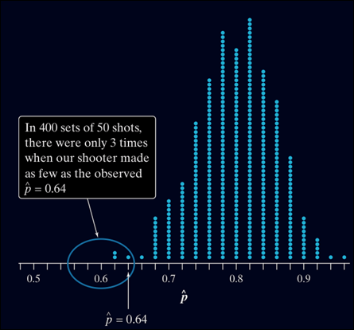
The Reasoning of Significance Tests
Suppose a basketball player claimed to be an 80% free-throw shooter. To test this claim, we have him attempt 50 free-throws. He makes 32 of them. His sample proportion of made shots is 32/50 = 0.64.
What can we conclude about the claim based on this sample data?
We can use software to simulate 400 sets of 50 shots assuming that the player is really an 80% shooter.
You can say how strong the evidence against the player’s claim is by giving the probability that he would make as few as 32 out of 50 free throws if he really makes 80% in the long run.
The observed statistic is so unlikely if the actual parameter value is p = 0.80 that it gives convincing evidence that the player’s claim is not true.

Slide 8
Reasoning continued
Based on the evidence, we might conclude the player’s claim is incorrect.
In reality, there are two possible explanations for the fact that he made only 64% of his free throws.
1) The player’s claim is correct (p = 0.8), and by bad luck, a very unlikely outcome occurred.
2) The population proportion is actually less than 0.8, so the sample result is not an unlikely outcome.
Basic Idea
An outcome that would rarely happen if a claim were true is good evidence that the claim is not true.

Slide 9
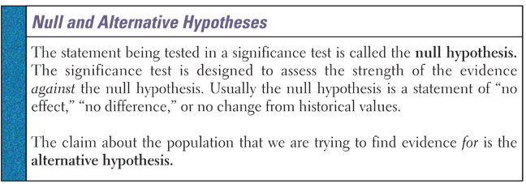
Hypotheses: Null H₀ & Alternative H_{a}
Think of the null hypothesis as the status quo
Think of the alternative hypothesis as something has changed or is different than expected -- a new claim
We can not prove the null hypothesis! We only can find enough evidence to reject the null hypothesis or not.

Slide 10
Hypotheses Cont
Our hypotheses will only involve population parameters [μ or ρ]
(we know the sample statistics from the data!)
  In the free-throw shooter example, our hypotheses are
H₀ : p = 0.80
H_{a} : p < 0.80
  where p is the long-run proportion of made free throws.
The alternative hypothesis can be
  one-sided: μ > 0 or μ < 0 (which allows a statistician to detect movement in a specific direction)
  two-sided: μ ≠ 0 (things have changed or are different)
Read the problem statement carefully to decide which is appropriate
The null hypothesis is usually “=“; but in real-life, if the alternative is one-sided, then the null hypothesis could be as well

Slide 11
Stating Hypotheses
In any significance test, the null hypothesis has the form
H₀ : parameter = value
The alternative hypothesis has one of the forms
H_{a} : parameter < value
H_{a} : parameter > value
H_{a} : parameter ≠ value
To determine the correct form of H_{a}, read problem carefully.
Definition:
The alternative hypothesis is one-sided if it states that a parameter is larger than the null hypothesis value or if it states that the parameter is smaller than the null value.
It is two-sided if it states that the parameter is different from the null hypothesis value (it could be either larger or smaller).

Slide 12
Three Ways – H_{o} versus H_{a}
1
2
3
a
a
b
b
Critical Regions
1. Equal versus less than (left-tailed test)
H₀: the parameter = some value (or more)
H₁: the parameter < some value
2. Equal hypothesis versus not equal hypothesis (two-tailed test)
H₀: the parameter = some value
H₁: the parameter ≠ some value
3. Equal versus greater than (right-tailed test)
H₀: the parameter = some value (or less)
H₁: the parameter > some value

Slide 13
English Phrases Revisited
Math Symbol | English Phrases
≥ | At least | No less than | Greater than or equal to
> | More than | Greater than
< | Fewer than | Less than
≤ | No more than | At most | Less than or equal to
= | Exactly | Equals | Is
≠ | Different from

Slide 14
Example 1
A manufacturer claims that there are at least two scoops of cranberries in each box of cereal
Parameter to be tested:
Test Type:
H₀:
H_{a}:
number of scoops of cranberries in each box of cereal
  If the sample mean is too low, that is a problem
  If the sample mean is too high, that is not a problem
left-tailed test
  The “bad case” is when there are too few
Scoops = 2 (or more) (s ≥ 2)
Less than two scoops (s < 2)

Slide 15
Example 2
A manufacturer claims that there are exactly 500 mg of a medication in each tablet
Parameter to be tested:
Test Type:
H₀:
H_{a}:
  amount of a medication
  in each tablet
  If the sample mean is too low, that is a problem
  If the sample mean is too high, that is a problem too
Two-tailed test
  A “bad case” is when there are too few
  A “bad case” is also where there are too many
Amount = 500 mg
Amount ≠ 500 mg

Slide 16
Example 3
A pollster claims that there are at most 56% of all Americans are in favor of an issue
Parameter to be tested:
Test Type:
H₀:
H_{a}:
  population proportion in favor of the issue
  If p-hat is too low, that is not a problem
  If p-hat is too high, that is a problem
right-tailed test
  The “bad case” is when sample proportion is too high
P-hat = 56% (or less)
P-hat > 56%

Slide 17
P-values
The null hypothesis H₀ states the claim that we are seeking evidence against. The probability that measures the strength of the evidence against a null hypothesis is called a P-value
Definition:
The probability, computed assuming H₀ is true, that the statistic would take a value as extreme as or more extreme than the one actually observed is called the P-value of the test. The smaller the P-value, the stronger the evidence against H₀ provided by the data.
Small P-values are evidence against H₀ because they say that the observed result is unlikely to occur when H₀ is true.
Large P-values fail to give convincing evidence against H₀ because they say that the observed result is likely to occur by chance when H₀ is true.

Slide 18
Example: Studying Job Satisfaction
For the job satisfaction study, the hypotheses are
H₀: µ = 0
H_{a}: µ ≠ 0
Explain what it means for the null hypothesis to be true in this setting.
In this setting, H₀: µ = 0 says that the mean difference in satisfaction scores (self-paced - machine-paced) for the entire population of assembly-line workers at the company is 0. If H₀ is true, then the workers don’t favor one work environment over the other, on average.
b) Interpret the P-value in context.
An outcome that would occur so often just by chance (almost 1 in every 4 random samples of 18 workers) when H₀ is true is not convincing evidence against H₀.
We fail to reject H₀: µ = 0.

Slide 19
Conditions for Significance Tests
SRS
  simple random sample from population of interest
Independence
  Population, N, such that N > 10n
Normality
  For means: population normal or large enough sample size for CLT to apply or use t-procedures
  t-procedures: boxplot or normality plot to check for shape and any outliers (outliers is a killer)
  For proportions: np ≥ 10 and n(1-p) ≥ 10

Slide 20
Test Statistics
Principles that apply to most tests:
The test is based on a statistic that compares the value of the parameter as stated in H₀ with an estimate of the parameter from the sample data
Values of the estimate far from the parameter value in the direction specified by H_{a} give evidence against H₀
To assess how far the estimate is from the parameter, standardize the estimate. In many common situations, the test statistic has the form:
estimate – hypothesized value
test statistic = ------------------------------------------------------------
standard deviation of the estimate (ie SE)

Slide 21
Example 4
Several cities have begun to monitor paramedic response times. In one such city, the mean response time to all accidents involving life-threatening injuries last year was μ=6.7 minutes with σ=2 minutes. The city manager shares this info with the emergency personnel and encourages them to “do better” next year. At the end of the following year, the city manager selects a SRS of 400 calls involving life-threatening injuries and examines response times. For this sample the mean response time was x-bar = 6.48 minutes. Do these data provide good evidence that the response times have decreased since last year?
List parameter, hypotheses and conditions check

Slide 22
Example 4 cont
Parameter:
H₀:
H_{a}:
Conditions Check:
1) :
2) :
3) :
μ = 6.7 minutes (unchanged)
μ < 6.7 minutes (they got “better”)
SRS
stated in problem statement
Independence
n = 400 means we must assume over 4000 calls
each year that involve life-threatening injuries
Normality
n = 400 suggest CLT would apply to x-bar

Slide 23

5-Minute Check on Chapter 9-1a
The null Hypothesis is
The alternative Hypothesis is
What different types of alternative Hypotheses do we have?
What conditions do we check for before a significance test?
What is the p-value?
Which types of p-values provide evidence against null hypothesis?
The status quo; what is currently believed to be true
What we are testing; the proposed idea
Single-sided (> or <); or double-sided (≠)
SIN: SRS, independence (10n < N), and normality (same as CI)
P-value is the probability of getting this or more extreme value; given that the null hypothesis is true
Small p-values give evidence against H0.
Click the mouse button or press the Space Bar to display the answers.

Slide 24
Hypothesis Testing Approaches
P-Value
  Logic: Assuming H₀ is true, if the probability of getting a sample mean as extreme or more extreme than the one obtained is small, then we reject the null hypothesis (accept the alternative).
Classical (Statistical Significance)
  Logic: If the sample mean is too many standard deviations from the mean stated in the null hypothesis, then we reject the null hypothesis (accept the alternative)
Confidence Intervals
  Logic: If the sample mean lies in the confidence interval about the status quo, then we fail to reject the null hypothesis

Slide 25
Confidence Interval Approach
FTR Region
LB
UB
-z*_{α/2}
z*_{α/2}
μ₀
Reject Regions
Reject Regions
x – μ₀
Test Statistic: z₀ = ------------- z* = invnorm(1-α/2)
σ/√n
Reject null hypothesis, if
Left-Tailed | Two-Tailed | Right-Tailed
Not usually done | z₀ < - z* or z₀ > z* | Not usually done

Slide 26
Classical Approach
-z_{α}
-z_{α/2}
z_{α/2}
z_{α}
Reject Regions
x – μ₀
Test Statistic: z₀ = -------------
σ/√n
Reject null hypothesis, if
Left-Tailed | Two-Tailed | Right-Tailed
z₀ < - z_{α} | z₀ < - z_{α/2} or z₀ > z _{α/2} | z₀ > z_{α}

Slide 27
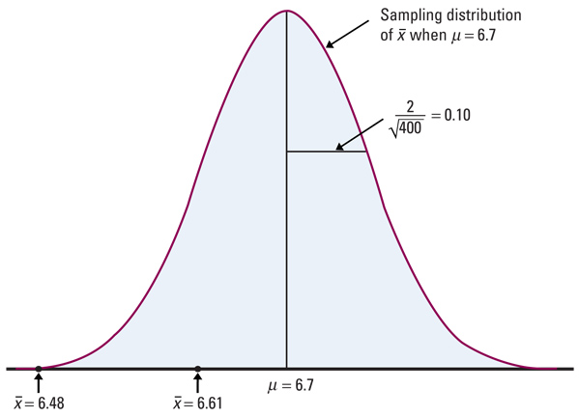
Example 4 cont
What is the P-value associated with the data in example 4?
What if the sample mean was 6.61?
x – μ₀ 6.48 – 6.7
Z₀ = ----------- = --------------
σ/√n 0.10
= -2.2
P(z < Z₀) = P(z < -2.2)
= 0.0139 (unusual !)
x – μ₀ 6.61 – 6.7
Z₀ = ----------- = -------------- = - 0.9
σ/√n 0.10
P(z < Z₀) = P(z < -0.9)
= 0.1841 (not unusual !)

Slide 28
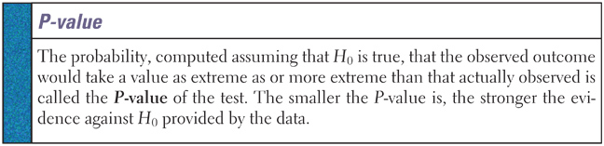
P-value
P-value is the probability of getting a more extreme value if H₀ is true (measures the tails)
Small P-values are evidence against H₀
  observed value is unlikely to occur if H₀ is true
Large P-values fail to give evidence against H₀

Slide 29
P-Value Approach
z₀
-|z₀|
|z₀|
z₀
P-Value is the
area highlighted
x – μ₀
Test Statistic: z₀ = -------------
σ/√n
Reject null hypothesis, if P-Value < α
Probability(getting a result further away from the point estimate) = p-value
P-value is the area in the tails!!

Slide 30
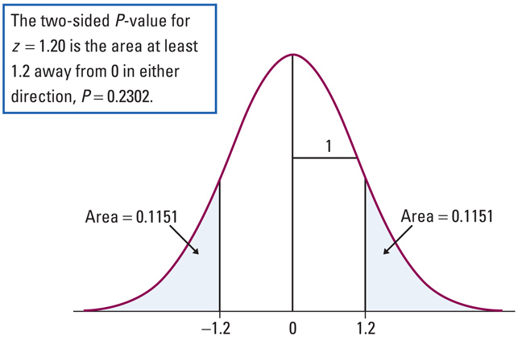
Two-sided Test P-value
P-value is the sum of both tail areas in the two sided test case

Slide 31
Statistical Significance
The final step in performing a significance test is to draw a conclusion about the competing claims you were testing. We will make one of two decisions based on the strength of the evidence against the null hypothesis (and in favor of the alternative hypothesis) -- reject H₀ or fail to reject H₀.
If our sample result is too unlikely to have happened by chance assuming H₀ is true, then we’ll reject H₀.
Otherwise, we will fail to reject H₀.
Note: A fail-to-reject H₀ decision in a significance test doesn’t mean that H₀ is true. For that reason, you should never “accept H₀” or use language implying that you believe H₀ is true.
In a nutshell, our conclusion in a significance test comes down to
P-value small → reject H₀ → conclude H_{a} (in context)
P-value large → fail to reject H₀ → cannot conclude H_{a} (in context)

Slide 32
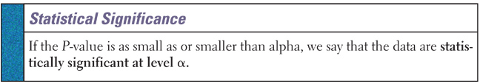
Statistical Significance Dfn
Statistically significant means simply that it is not likely to happen just by chance
Significant in the statistical sense does not mean important
Very large samples can make very small differences statistically significant, but not practically important

Slide 33
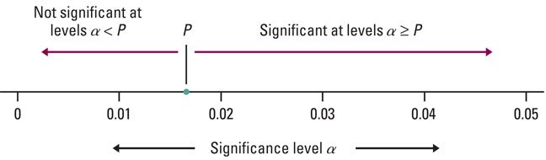
Statistical Significance – P-value
When using a P-value, we compare it with a level of significance, α, decided at the start of the test.
Not significant when α < P
Significant when α ≥ P
Fail to Reject H₀
Reject H₀

Slide 34
Example 5: P-Values
For each α and observed significance level (p-value) pair, indicate whether the null hypothesis would be rejected.
α = . 05, p = .10
α = .10, p = .05
α = .01 , p = .001
α = .025 , p = .05
e) α = .10, p = .45
α < P ∴ fail to reject H_{o}
P < α ∴ reject H_{o}
P < α ∴ reject H_{o}
α < P ∴ fail to reject H_{o}
α < P ∴ fail to reject H_{o}

Slide 35
Statistical Significance Interpretation
Remember the three C’s:
Conclusion, connection, context
Conclusion: Either we have evidence to reject H₀ in favor of H_{a} or we fail to reject
Connection: connect your calculated values to your conclusion
Context: Always put it in terms of the problem (don’t use generalized statements)

Slide 36
Statistical Significance Warnings
If you are going to draw a conclusion base on statistical significance, then the significance level α should be stated before the data are produced
  Deceptive users of statistics might set an α level after the data have been analyzed to manipulate the conclusion
  P-values give a better sense of how strong the evidence against H₀ is
This is just as inappropriate as choosing an alternative hypothesis to be one-sided in a particular direction after looking at the data

Slide 37
Hypothesis Testing: Four Outcomes
 |  | Reality
 |  | H₀ is True | H₁ is True
Conclusion | Do Not Reject H₀ | Correct Conclusion | Type II Error
 | Reject H₀ | Type I Error | Correct Conclusion
decrease α → increase β
increase α → decrease β
H₀: the defendant is innocent
H₁: the defendant is guilty
Type I Error (α): convict an innocent person
Type II Error (β): let a guilty person go free
Note: a defendant is never declared innocent; just not guilty

Slide 38
Hypothesis Testing: Four Outcomes
We reject the null hypothesis when the alternative hypothesis is true (Correct Decision)
We do not reject the null hypothesis when the null hypothesis is true (Correct Decision)
We reject the null hypothesis when the null hypothesis is true (Incorrect Decision – Type I error)
We do not reject the null hypothesis when the alternative hypothesis is true
(Incorrect Decision – Type II error)

Slide 39
Example 1
You have created a new manufacturing method for producing widgets, which you claim will reduce the time necessary for assembling the parts. Currently it takes 75 seconds to produce a widget. The retooling of the plant for this change is very expensive and will involve a lot of downtime.
H_{o} :
H_{a}:
TYPE I:
TYPE II:

Slide 40
Example 1 cont
H_{o} : µ = 75 (no difference with the new method)
H_{a}: µ < 75 (time will be reduced)
TYPE I: Determine that the new process reduces time when it actually does not. You end up spending lots of money retooling when there will be no savings. The plant is shut unnecessarily and production is lost.
TYPE II: Determine that the new process does not reduce when it actually does lead to a reduction. You end up not improving the situation, you don't save money, and you don't reduce manufacturing time.

Slide 41
Example 2
A potato chip producer wants to test the hypothesis
H₀: p = 0.08 proportion of potatoes with blemishes
H_{a}: p < 0.08
Let’s examine the two types of errors that the producer could make and the consequences of each
Type I Error:
Type II Error:
Description: producer concludes that the p < 8% when its actually greater
Consequence: producer accepts shipment with sub-standard potatoes; consumers may choose not to come back to the product after a bad bag
Description: producer concludes that the p > 8% when its actually less
Consequence: producer rejects shipment with acceptable potatoes; possible damage to supplier relationship and to production schedule

Slide 42
Summary and Homework
Summary
  Significance test assesses evidence provided by data against H₀ in favor of H_{a}
  H_{a} can be two-sided (different, ≠) or one-sided (specific direction, < or >)
  Same three conditions as with confidence intervals
  Test statistic is usually a standardized value
  P-value, the probability of getting a more extreme value given that H₀ is true → is small we reject H₀
Homework
  Day One: problems 1, 3, 5, 7, 9, 11, 13
  Day Two: problems 17, 19-24, 27, 31, 33

