Slide 1

5-Minute Check on Chapter 9-1b
What three approaches do we have to inference testing and give their logic?
Which ones can be done on our calculator?
Can results be statistically significant, but not worth much?
What are the two errors that can be done in inference testing and explain when they occur?
Classical: too many standard deviations from the mean
P-value: probability of getting this or more extreme is unusual
C-Interval: null hypothesis value outside CI formed on point estimate
P-value and confidence interval
Extremely large sample sizes can lead to results that are statistical significant, but have no practical significance
Type I: Reject H0, when H0 is really true
Type II: Fail to reject H0, when H0 is really not true (Ha is true!)
Click the mouse button or press the Space Bar to display the answers.

Slide 2
Lesson 9 - 2
Tests about a
Population Proportion

Slide 3
Objectives
State and check the Random, 10% and Large Counts conditions for performing a significance test about a population proportion
Calculate the standardized test statistic and P-value for a test about a population proportion
Perform a significance test about a population proportion

Slide 4
Vocabulary
Standardized test statistic – measures how far a sample statistic is from what we would expect if the null hypothesis H₀ were true, in standard deviation units.

Slide 5
Introduction
Confidence intervals and significance tests are based on the sampling distributions of statistics. That is, both use probability to say what would happen if we applied the inference method many times.
Section 9.1 presented the reasoning of significance tests, including the idea of a P-value. In this section, we focus on the details of testing a claim about a population proportion.
We’ll learn how to perform one-sided and two-sided tests about a population proportion. We’ll also see how confidence intervals and two-sided tests are related

Slide 6
Inference Toolbox
Step 1: Hypothesis
  Identify population of interest and parameter
  State H₀ and H_{a}
Step 2: Conditions
  Check appropriate conditions
Step 3: Calculations
  State test or test statistic
  Use calculator to calculate test statistic and p-value
Step 4: Interpretation
  Interpret the p-value (fail-to-reject or reject)
  Don’t forget 3 C’s: conclusion, connection and context

Slide 7
Requirements to test, population proportion
Simple random sample
Independence: n ≤ 0.10N
[to keep binomial vs hypergeometric]
Normality: np₀ ≥ 10 and n(1-p₀) ≥ 10
[for normal approximation of binomial]
Unlike with confidence intervals where we used p-hat in all calculations, in this test with use p₀, the hypothesized value (assumed to be correct in H₀)

Slide 8
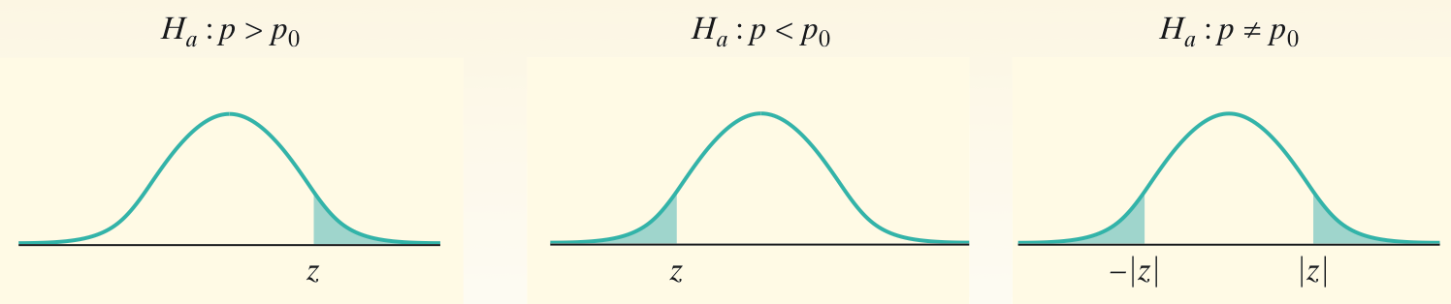
One-Sample z Test for a Proportion
The z statistic has approximately the standard Normal distribution when H₀ is true. P-values therefore come from the standard Normal distribution. Here is a summary of the details for a one-sample z test for a proportion.
One-Sample z Test for a Proportion
Choose an SRS of size n from a large population that contains an unknown proportion p of successes. To test the hypothesis H₀ : p = p₀, compute the z statistic
Find the P-value by calculating the probability of getting a z statistic this large or larger in the direction specified by the alternative hypothesis H_{a}:
Use this test only when
the expected numbers of successes and failures np₀ and n(1 - p₀) are both at least 10 and the population is at least 10 times as large as the sample.

Slide 9
P-Value is the
area highlighted
z₀
-|z₀|
|z₀|
z₀
-z_{α}
-z_{α/2}
z_{α/2}
z_{α}
Critical Region
p – p₀
Test Statistic: z₀ = --------------------
p₀ (1 – p₀)
n
Reject null hypothesis, if
P-value < α
Left-Tailed | Two-Tailed | Right-Tailed
z₀ < - z_{α} | z₀ < - z_{α/2} or z₀ > z_{α/2} | z₀ > z_{α}

Slide 10
Example 1
According to OSHA, job stress poses a major threat to the health of workers. A national survey of restaurant employees found that 75% said that work stress had a negative impact on their personal lives. A random sample of 100 employees form a large restaurant chain finds 68 answered “Yes” to the work stress question. Does this offer evidence that this company’s employees are different from the national average?
p₀ = proportion of restaurant workers with negative impacts on personal lives from work stress
H₀: p₀ = .75 These employees are not different
H_{a}: p₀ ≠ .75 These employees are different
Two-sided One sample proportion z-test (from H_{a})

Slide 11
Example 1 cont
Conditions:
1) SRS 2) Independence 3) Normality
Stated in
problem
n < 0.10P assumed
(P > 1000 in US!!)
np ≥ 10
100(.75)=75 ≥ 10
n(1-p) ≥ 10
100(.25)=25 ≥ 10
Calculations:
p – p₀ 0.68 – 0.75
Test Statistic: z₀ = -------------------- = -------------------- = -1.62
√0.75(0.25)/100
p₀ (1 – p₀)
n

Slide 12
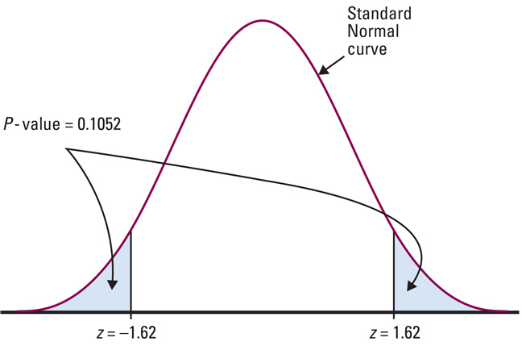
Example 1 cont
Calculations:
p – p₀ 0.68 – 0.75
Test Statistic: z₀ = -------------------- = -------------------- = -1.62
√0.75(0.25)/100
p₀ (1 – p₀)
n
Interpretation:
Since there is over a 10% chance of obtaining a result as unusual or more than 68%, we have insufficient evidence to reject H₀.
These restaurant employees are no different than the national average as far as work stress is concerned.

Slide 13
Using Your Calculator
Press STAT
  Tab over to TESTS
  Select 1-PropZTest and ENTER
    Entry p₀, x, and n from given data
    Highlight test type (two-sided, left, or right)
    Highlight Calculate and ENTER
Read z-critical and p-value off screen
From first problem:
z₀ = 0.686 and p-value = 0.2462
Since p > α, then we fail to reject H₀ – insufficient evidence to support manufacturer’s claim.

Slide 14
Example 2
Nexium is a drug that can be used to reduce the acid produced by the body and heal damage to the esophagus due to acid reflux. Suppose the manufacturer of Nexium claims that more than 94% of patients taking Nexium are healed within 8 weeks. In clinical trials, 213 of 224 patients suffering from acid reflux disease were healed after 8 weeks. Test the manufacturers claim at the α=0.01 level of significance.
Assume SRS done in trial
H₀: % healed = .94
n < 0.10N assumed
(N > 2240 in US!!)
H_{a}: % healed > .94
One-sided test
np > 10 224(.94) = 210.6
n(1-p) > 10 224(.06) = 13.4
checked

Slide 15
Example 2
p – p₀
Test Statistic: z₀ = --------------------
p₀ (1 – p₀)
n
0.950893 – 0.94
Test Statistic: z₀ = ------------------------- = 0.6865
√0.94(0.06)/224
α = 0.01 so one-sided test yields Z_{α} = 2.33
Calculator: p-value = 0.246 p-value > α
Since p-value > α, we fail to reject H₀ – therefore there is insufficient evidence to support manufacturer’s claim

Slide 16
Confidence Interval Approach
Confidence Interval:
p – z_{α/2} ·√(p(1-p)/n p + z_{α/2} · √(p(1-p)/n
<
<
<
<
<
<
Lower
Bound
Upper
Bound
p₀
Reject null hypothesis, if p₀ is not in the confidence interval
P-value associated with lower bound must be doubled!

Slide 17
Why Confidence Intervals Give More Information
The result of a significance test is basically a decision to reject H₀ or fail to reject H₀. When we reject H₀, we’re left wondering what the actual proportion p might be. A confidence interval might shed some light on this issue.
Taeyeon found that 90 of an SRS of 150 students said that they had never smoked a cigarette. Before we construct a confidence interval for the population proportion p, we should check that both the number of successes and failures are at least 10.
  The number of successes and the number of failures in the sample are 90 and 60, respectively, so we can proceed with calculations.
Our 95% confidence interval is:
We are 95% confident that the interval from 0.522 to 0.678 captures the true proportion of students at Taeyeon’s high school who would say that they have never smoked a cigarette.

Slide 18
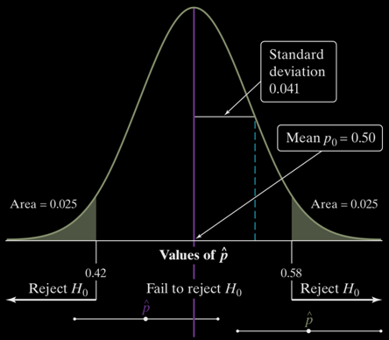
Confidence Intervals / Two-Sided Tests
There is a link between confidence intervals and two-sided tests. The 95% confidence interval gives an approximate range of p₀’s that would not be rejected by a two-sided test at the α = 0.05 significance level. The link isn’t perfect because the standard error used for the confidence interval is based on the sample proportion, while the denominator of the test statistic is based on the value p₀ from the null hypothesis.
A two-sided test at significance level α (say, α = 0.05) and a 100(1 –α)% confidence interval (a 95% confidence interval if α = 0.05) give similar info about the population parameter.
If the sample proportion falls in the “fail to reject H₀” region, like the green value in the figure, the resulting 95% confidence interval would include p₀. In that case, both the significance test and the confidence interval would be unable to rule out p₀ as a plausible parameter value.
However, if the sample proportion falls in the “reject H₀” region, the resulting 95% confidence interval would not include p₀. In that case, both the significance test and the confidence interval would provide evidence that p₀ is not the parameter value.

Slide 19
What if Normal Apx Conditions Fail?
Not all Statistics books use np ≥ 10 and n(1-p) ≥ 10 as their criteria to check if a normal approximation to the Binomial distribution of the population proportion is appropriate.
Sullivan’s books, WCC book when this class started, uses a more conservative value of np(1 – p) ≥ 10 to check for normality
Following problem demonstrates how we can use the underlying binomial distribution to get a p-value if our normality assumption fails.

Slide 20
Example 3
According to USDA, 48.9% of males between 20 and 39 years of age consume the minimum daily requirement of calcium. After an aggressive “Got Milk” campaign, the USDA conducts a survey of 35 randomly selected males between 20 and 39 and find that 21 of them consume the min daily requirement of calcium. At the α = 0.1 level of significance, is there evidence to conclude that the percentage consuming the min daily requirement has increased?
H₀: % min daily = 0.489
n < 0.05P assumed
(P > 700 in US!!)
H_{a}: % min daily > 0.489
np(1-p) > 10 failed 35(.489)(.511) = 8.75
One-sided test

Slide 21
Example 3
Since the sample size is too small to estimate the binomial with a z-distribution, we must fall back to the binomial distribution and calculate the probability of getting this increase purely by chance.
P-value = P(x ≥ 21)
= 1 – P(x < 21)
= 1 – P(x ≤ 20) (since its discrete)
1 – P(x ≤ 20) is 1 – binomcdf(35, 0.489, 20) (n, p, x)
P-value = 0.1261 which is greater than α, so we fail to reject the null hypothesis (H₀) – insufficient evidence to conclude that the percentage has increased

Slide 22
Comments about Proportion Tests
Changing our definition of success or failure (swapping the percentages) only changes the sign of the z-test statistic. The p-value remains the same.
If the sample is sufficiently large, we will have sufficient power to detect a very small difference
On the other hand, if a sample size is very small, we may be unable to detect differences that could be important
Standard error used with confidence intervals is estimated from the sample, whereas in this test it uses p₀, the hypothesized value (assumed to be correct in H₀)

Slide 23
Summary and Homework
Summary
  We can perform hypothesis tests of proportions in similar ways as hypothesis tests of means
    Two-tailed, left-tailed, and right-tailed tests
  Normal distribution or binomial distribution should be used to compute the critical values for this test
  Confidence intervals provide additional information that significance tests do not – namely a range of plausible values for the true population parameter
Homework
  Day 1: 27-30, 41, 43, 45
  Day 2: 47, 49, 51, 53, 55

