Slide 1

5-Minute Check on Chapter 9-2
With proportions, when do we reject the null hypothesis?
If our normality conditions fail, can we still calculate a p-value? How?
What does the confidence interval approach provide that the p-value approach does not?
We reject HO is p-value is < alpha (P(type I error)
Yes; we have to use underlying binomial distribution to calculate the p-value
Confidence interval gives a range of values that the population proportion may fall in. P-value approach rejects or fails to reject a specific proportion.
Click the mouse button or press the Space Bar to display the answers.

Slide 2
Lesson 9 - 3
Tests about a
Population Mean

Slide 3
Objectives
State and check the Random, 10% and Normal/Large Counts conditions for performing a significance test about a population mean.
Calculate the standardized test statistic and P-value for a test about a population mean
Perform a significance test about a population mean
Use a confidence interval to make a conclusion for a two-sided test about a population
Interpret the power of a significance test and describe what factors affect the power of a test

Slide 4
Vocabulary
t-distribution – is described by a symmetric, single-peaked, bell-shaped density curve. Any t-distribution is completely specified by its degrees of freedom (df). When performing inference about a population mean based on a random sample of size n when the population standard deviation σ is unknown, use a t-distribution with df = n – 1
power – the probability that the test will find convincing evidence for H_{a} when a specific alternative value of the parameter is true; also found by power = 1 – β (probability of type II error)

Slide 5
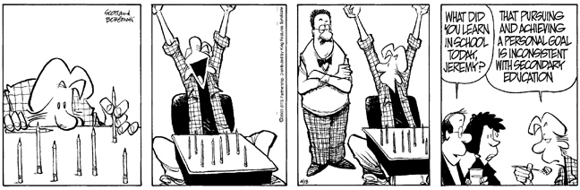
How Students See the World
In Stats
Class
At Home

Slide 6
Introduction
Confidence intervals and significance tests for a population proportion p are based on z-values from the standard Normal distribution.
Inference about a population mean µ uses a t distribution with n - 1 degrees of freedom, except in the rare case when the population standard deviation σ is known.
We learned how to construct confidence intervals for a population mean in Section 8.3. Now we’ll examine the details of testing a claim about an unknown parameter µ.

Slide 7
Inference Toolbox
Step 1: Hypothesis
  Identify population of interest and parameter
  State H₀ and H_{a}
Step 2: Conditions
  Check appropriate conditions
Step 3: Calculations
  State test or test statistic
  Use calculator to calculate test statistic and p-value
Step 4: Interpretation
  Interpret the p-value (fail-to-reject or reject)
  Don’t forget 3 C’s: conclusion, connection and context

Slide 8
Real Life
What happens if we don’t know the population parameters (variance)?
Use student-t test statistic
With previously learned methods
If n < 30 (CLT doesn’t apply), then check normality with boxplot (and for outliers) or with normality plot
x – μ₀
t₀ = --------------
s / √n

Slide 9
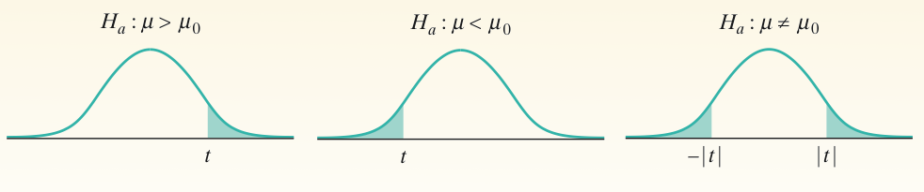
The One-Sample t Test
When the conditions are met, we can test a claim about a population mean µ using a one-sample t test.
One-Sample t Test
Choose an SRS of size n from a large population that contains an unknown mean µ. To test the hypothesis H₀ : µ = µ₀, compute the one-sample t statistic
Find the P-value by calculating the probability of getting a t statistic this large or larger in the direction specified by the alternative hypothesis H_{a} in a t-distribution with df = n - 1
Use this test only when
(1) the population distribution is Normal or the sample is large
(n ≥ 30), and (2) the population is at least 10 times as large as the sample.

Slide 10
P-Value is the
area highlighted
t₀
-|t₀|
|t₀|
t₀
-t_{α}
-t_{α/2}
t_{α/2}
t_{α}
Critical Region
x – μ₀
Test Statistic: t₀ = -------------
s/√n
Reject null hypothesis, if
P-value < α
Left-Tailed | Two-Tailed | Right-Tailed
t₀ < - t_{α} | t₀ < - t_{α/2} or t₀ > t_{α/2} | t₀ > t_{α}

Slide 11
Using Table B (t-table) Wisely
Table B gives a range of possible P-values for a significance. We can still draw a conclusion from the test in much the same way as if we had a single probability by comparing the range of possible P-values to our desired significance level.
Table B has other limitations for finding P-values. It includes probabilities only for t distributions with degrees of freedom from 1 to 30 and then skips to df = 40, 50, 60, 80, 100, and 1000. (The bottom row gives probabilities for df = ∞, which corresponds to the standard Normal curve.) Note: If the df you need isn’t provided in Table B, use the next lower df that is available.
Table B shows probabilities only for positive values of t. To find a P-value for a negative value of t, we use the symmetry of the t distributions.

Slide 12
Example 1
Diet colas use artificial sweeteners to avoid sugar. These sweeteners gradually lose their sweetness over time. Trained tasters sip the cola along with drinks of standard sweetness and score the cola on a “sweetness scale” of 1 to 10. The data below is the difference after 4 months of storage in the taster’s scores. The bigger these differences, the bigger the loss of sweetness. Negative values are “gains” in sweetness.
2.0 0.4 0.7 2.0 -0.4 2.2 -1.3 1.2 1.1 2.3
Are these data good evidence that the cola lost sweetness in storage?

Slide 13
Example 1
Using L1 and 1Var-Stats: x-bar = 1.02, s_{x} = 1.196
Normality plot: roughly linear
Box plot: skewed left (proceed with caution); no outliers
μ is mean difference of sweetness before and after
H₀: μ_{diff} = 0 No loss of sweetness during storage
H_{a}: μ_{diff} > 0 Loss of sweetness during storage
Test type: one-sided test, t-test with n-1, or 11 degrees of freedom (no alpha listed!)
Conditions:
SRS: big assumption, matter of judgement
Independence: before and after not independent (matched pairs), but tasters would be independent
Normality: CLT doesn’t apply; plots above help

Slide 14
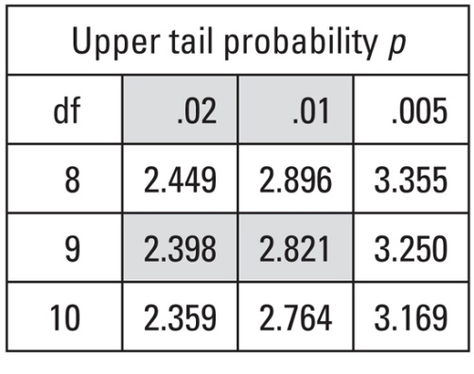
Example 1
Using L1 and 1Var-Stats: x-bar = 1.02, s_{x} = 1.196
one-sided test, t-test with n-1, or 11 degrees of freedom and α/2 = 0.025.
Calculations:
X-bar – μ₀ 1.02 – 0 1.02
t₀ = --------------- = ------------------ = ------------- = 2.697
s / √n 1.196/√10 .37821
From Table C: P-value between 0.02 and 0.01
Interpretation:
There is less than a 2% chance of getting this value or more extreme; so we reject H₀ in favor of H_{a} – storage of the diet cola decreases its sweetness.

Slide 15
Example 2
A simple random sample of 12 cell phone bills finds x-bar = $65.014 and s= $18.49. The mean in 2004 was $50.64. Test if the average bill is different today at the α = 0.05 level.
H₀: ave cell phone bill, μ = $50.64
H_{a}: ave bill ≠ $50.64
Two-sided test and σ unknown so we use a t-test with 11 degrees of freedom (n-1) and α/2 = 0.025 (2-sided test).
SRS – stated
Independence – easy to believe > 120 cell phone bills
Normality – Have to assume normality (no data to graph)

Slide 16
Example 2 cont
A simple random sample of 12 cell phone bills finds x-bar = $65.014. The mean in 2004 was $50.64. Sample standard deviation is $18.49. Test if the average bill is different today at the α = 0.05 level.
not equal ➔ two-tailed
X-bar – μ₀ 65.014 – 50.64 14.374
t₀ = --------------- = ---------------------- = ------------- = 2.69
s / √n 18.49/√12 5.3376
2.69
Using alpha, α = 0.05 the shaded region are the rejection regions. The sample mean would be too many standard deviations away from the population mean. Since t₀ lies in the rejection region, we would reject H₀.
t_{c} = 2.201
t_{c} (α/2, n-1) = t(0.025, 11) = 2.201 Calculator: p-value = 0.0209

Slide 17
Using Your Calculator: T-Test
Press STAT
  Tab over to TESTS
  Select T-Test and ENTER
    Highlight Stats or if Data (id the list its in)
    Entry μ₀,
    x-bar,
    st-dev,
    and n from summary stats
    Highlight test type (two-sided, left, or right)
    Highlight Calculate and ENTER
Read t-critical and p-value off screen

Slide 18
Example 3
A simple random sample of 40 stay-at-home women finds they watch TV an average of 16.8 hours/week with s = 4.7 hours/week. The mean in 2004 was 18.1 hours/week. Test if the average is different today at α = 0.05 level.
μ = ave time stay-at-home women watch TV
H₀: μ = 18.1 hours per week
H_{a}: ave TV ≠ 18.1
Two-sided test, SRS and σ is unknown so we can use a t-test with n-1, or 39 degrees of freedom and α/2 = 0.025.

Slide 19
Example 3 cont
A simple random sample of 40 stay-at-home women finds they watch TV an average of 16.8 hours/week with s = 4.7 hours/week. The mean in 2004 was 18.1 hours/week. Test if the average is different today at α = 0.05 level.
not equal ➔ two-tailed
X-bar – μ₀ 16.8 – 18.1 -1.3
t₀ = --------------- = ---------------------- = ------------- = -1.7494
s / √n 4.7/√40 0.74314
-1.75
Using alpha, α = 0.05 the shaded region are the rejection regions. The sample mean would not be too many standard deviations away from the population mean. Since t₀ does not lie in the rejection region, we would fail to reject H₀: no evidence of change from 2004 habits.
t_{c} = -2.02
t_{c} (α/2, n-1) = t(0.025, 39) = -2.023 Calculator: p-value = 0.088

Slide 20
Summary and Homework
Summary
  A hypothesis test of means, with σ unknown, has the same general structure as a hypothesis test of means with σ known
  Any one of our three methods can be used, with the following two changes to all the calculations
    Use the sample standard deviation s in place of the population standard deviation σ
    Use the Student’s t-distribution in place of the normal distribution
Homework
  problems 57-60, 71, 73

Slide 21
5-Minute Check on Chapter 9-3a
What advantage does using our calculator have over using the t-tables to work the inference test?
In a two-sided test, what do we do with alpha (α)?
If they do not list an alpha value in the problem, what do we do?
If CLT does not apply, what do we do?
What do we always watch out for when using a t-distribution?
  Calculator will figure out an exact t*, where the table may just be an estimate t*
  Have to divide alpha in two (for both tails!)
  Use α = 0.05 (our 1/20 unusual ROT)
  With data: box-plot or normality plot; W/O data: assume
  Outliers or extreme distribution can kill a t-distribution apx
Click the mouse button or press the Space Bar to display the answers.

Slide 22
Inference for Means: Paired Data
Comparative studies are more convincing than single-sample investigations. For that reason, one-sample inference is less common than comparative inference. Study designs that involve making two observations on the same individual, or one observation on each of two similar individuals, result in paired data.
When paired data result from measuring the same quantitative variable twice, as in the job satisfaction study, we can make comparisons by analyzing the differences in each pair. If the conditions for inference are met, we can use one-sample t procedures to perform inference about the mean difference µ_{diff}.
These methods are sometimes called paired t procedures.

Slide 23
Using t-Test on Differences
What happens if we have a match pair experiment?
Use the difference data as the sample
Use student-t test statistic
With previously learned methods
x_{diff} – μ₀
t₀ = --------------
s_{diff} / √n

Slide 24
Example 4
To test if pleasant odors improve student performance on tests, 21 subjects worked a paper-and-pencil maze while wearing a mask. The mask was either unscented or carried a floral scent. The response variable is their average time on three trials. Each subject worked the maze with both masks, in a random order (since they tended to improve their times as they worked a maze repeatedly). Assess whether the floral scent significantly improved performance.

Slide 25
Example 4 – The Data
Subject | Unscented | Scented |  | Subject | Unscented | Scented
1 | 30.60 | 37.97 |  | 12 | 58.93 | 83.50
2 | 48.43 | 51.57 |  | 13 | 54.47 | 38.30
3 | 60.77 | 56.67 |  | 14 | 43.53 | 51.37
4 | 36.07 | 40.47 |  | 15 | 37.93 | 29.33
5 | 68.47 | 49.00 |  | 16 | 43.50 | 54.27
6 | 32.43 | 43.23 |  | 17 | 87.70 | 62.73
7 | 43.70 | 44.57 |  | 18 | 53.53 | 58.00
8 | 37.10 | 28.40 |  | 19 | 64.30 | 52.40
9 | 31.17 | 28.23 |  | 20 | 47.37 | 53.63
10 | 51.23 | 68.47 |  | 21 | 53.67 | 47.00
11 | 65.40 | 51.10

Slide 26
Example 4 – The Data
Subject | Unscented | Scented | Diff | Subject | Unscented | Scented | Diff
1 | 30.60 | 37.97 | -7.37 | 12 | 58.93 | 83.50 | -24.57
2 | 48.43 | 51.57 | -3.14 | 13 | 54.47 | 38.30 | 16.17
3 | 60.77 | 56.67 | 4.10 | 14 | 43.53 | 51.37 | -7.84
4 | 36.07 | 40.47 | -4.40 | 15 | 37.93 | 29.33 | 8.60
5 | 68.47 | 49.00 | 19.47 | 16 | 43.50 | 54.27 | -10.77
6 | 32.43 | 43.23 | -10.80 | 17 | 87.70 | 62.73 | 24.97
7 | 43.70 | 44.57 | -0.87 | 18 | 53.53 | 58.00 | -4.47
8 | 37.10 | 28.40 | 8.70 | 19 | 64.30 | 52.40 | 11.90
9 | 31.17 | 28.23 | 2.94 | 20 | 47.37 | 53.63 | -6.26
10 | 51.23 | 68.47 | -17.24 | 21 | 53.67 | 47.00 | 6.67
11 | 65.40 | 51.10 | 14.30
Positive differences show that the subject did better wearing the scented mask.

Slide 27
Example 4
Use your calculator to complete calculations using diff data
μ_{diff} = difference of ave time to complete 3 mazes
in the population the subjects came from
H₀: μ_{diff} = 0 seconds (no difference in completion times)
H_{a}: μ_{diff} > 0 seconds (scented masks helped)
one-sided test and σ is unknown so we use a t-test on the difference data with n-1, or 20 degrees of freedom

Slide 28
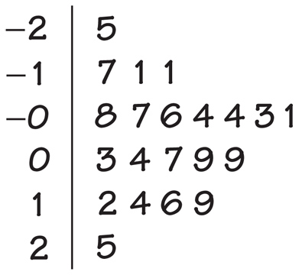
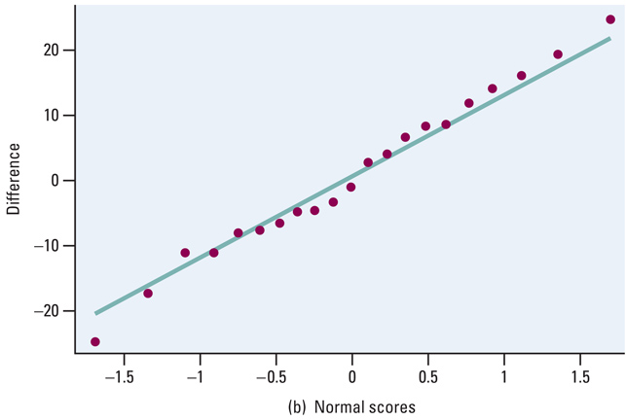
Example 4
Use your calculator to complete calculations using diff data
Conditions:
SRS: If the 21 subjects can be construed to be an SRS of the underlying population, then we are ok.
Independence: More than 210 in population. Note: the differences between subjects are independent, but the times of an individual are a matched pair and therefore not independent.
Normality: Stemplot and Normality plot don’t show any problems

Slide 29
Example 4
Use your calculator to complete calculations using diff data
X-bar – μ₀ 0.9567 – 0 0.9567
t₀ = --------------- = ---------------------- = ------------- = 0.3494
s / √n 12.548/√21 0.74314
Calculations:
from calculator (data mode) t = 0.3494 p-value = 0.3652
Interpretation:
With a p-value = 0.3652, the 96 second average improvement with the floral scent is not statistically significant. There is not enough evidence to reject H₀. → there is no improvement in performance due to pleasant odors.

Slide 30


Confidence Intervals / Two-Sided Tests
The connection between two-sided tests and confidence intervals is even stronger for means than it was for proportions. That’s because both inference methods for means use the standard error of the sample mean in the calculations.
A two-sided test at significance level α (say, α = 0.05) and a 100(1 – α)% confidence interval (a 95% confidence interval if α = 0.05) give similar information about the population parameter.
When the two-sided significance test at level α rejects H₀: µ = µ₀, the 100(1 – α)% confidence interval for µ will not contain the hypothesized value µ₀ .
When the two-sided significance test at level α fails to reject the null hypothesis, the confidence interval for µ will contain µ₀ .

Slide 31
Confidence Interval Approach
Confidence Interval:
x – t_{α/2} · s/√n x + t_{α/2} · s/√n
Lower
Bound
Upper
Bound
μ₀
Reject null hypothesis, if μ₀ is not in the confidence interval
P-value associated with lower bound must be doubled!

Slide 32
Using Your Calculator: t-Interval
Press STAT
  Tab over to TESTS
  Select t-Interval and ENTER
    Highlight Stats
    Entry s, x-bar, and n from summary stats
    Entry your confidence level (1- α)
    Highlight Calculate and ENTER
Read confidence interval off of screen
  If μ₀ is in the interval, then FTR
  If μ₀ is outside the interval, then REJ

Slide 33
One-sample t-Test
Recall from our first discussions about t-procedures: they are robust in terms of Normality (with the exception of outliers or strong skewness)
Power of a statistical test (1 - β) measures its ability to detect deviations from H₀. In the real world, we usually are trying to show H₀ false, so higher power is important
Power applet on YMS Student web-site

Slide 34
Inference for Means: Paired Data
Comparative studies are more convincing than single-sample investigations. For that reason, one-sample inference is less common than comparative inference. Study designs that involve making two observations on the same individual, or one observation on each of two similar individuals, result in paired data
When paired data result from measuring the same quantitative variable twice, as in the job satisfaction study, we can make comparisons by analyzing the differences in each pair. If the conditions for inference are met, we can use one-sample t procedures to perform inference about the mean difference µ_{d}.
These methods are sometimes called paired t procedures.

Slide 35
Using Tests Wisely
Significance tests are widely used in reporting the results of research in many fields. New drugs require significant evidence of effectiveness and safety. Courts ask about statistical significance in hearing discrimination cases. Marketers want to know whether a new ad campaign significantly outperforms the old one, and medical researchers want to know whether a new therapy performs significantly better. In all these uses, statistical significance is valued because it points to an effect that is unlikely to occur simply by chance.
Carrying out a significance test is often quite simple, especially if you use a calculator or computer. Using tests wisely is not so simple. Here are some points to keep in mind when using or interpreting significance tests.

Slide 36
Using Tests Wisely
Statistical Significance and Practical Importance
When a null hypothesis (“no effect” or “no difference”) can be rejected at the usual levels (α = 0.05 or α = 0.01), there is good evidence of a difference. But that difference may be very small. When large samples are available, even tiny deviations from the null hypothesis will be significant.
Don’t Ignore Lack of Significance
There is a tendency to infer that there is no difference whenever a P-value fails to attain the usual 5% standard. In some areas of research, small differences that are detectable only with large sample sizes can be of great practical significance. When planning a study, verify that the test you plan to use has a high probability (power) of detecting a difference of the size you hope to find.
Statistical Inference Is Not Valid for All Sets of Data
Badly designed surveys or experiments often produce invalid results. Formal statistical inference cannot correct basic flaws in the design. Each test is valid only in certain circumstances, with properly produced data being particularly important.
Beware of Multiple Analyses
Statistical significance ought to mean that you have found a difference that you were looking for. The reasoning behind statistical significance works well if you decide what difference you are seeking, design a study to search for it, and use a significance test to weigh the evidence you get. In other settings, significance may have little meaning.

Slide 37
Summary and Homework
Summary
  A hypothesis test of means, with σ unknown, has the same general structure as a hypothesis test of means with σ known
  Any one of our three methods can be used, with the following two changes to all the calculations
    Use the sample standard deviation s in place of the population standard deviation σ
    Use the Student’s t-distribution in place of the normal distribution
Homework
  problems 75, 77, 89, 94-97, 99-104

