Slide 1


Slide 2
POINT OF VIEW

Slide 3
First Person Point of View
A character narrates the story with I-me-my-mine in his or her speech. The advantage of this point of view is that you get to hear the thoughts of the narrator and see the world depicted in the story through his or her eyes.

Slide 4
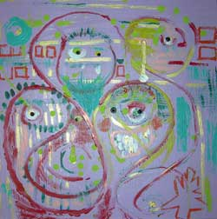
Nick in Great Gatsby
"Gatsby turned out all right at the end; it is what preyed on Gatsby, what foul dust floated in the wake of his dreams that temporarily closed out my interest in the abortive sorrows and short-winded elations of men."

Slide 5
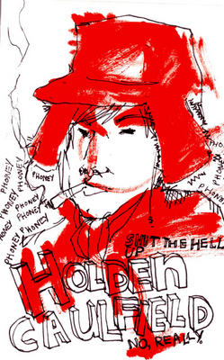
Holden in Catcher in the Rye
“If you really want to hear about it, the first thing you'll probably want to know is where I was born and what my lousy childhood was like, and how my parents were occupied and all before they had me, and all that David Copperfield kind of crap, but I don't feel like going into it, if you want to know the truth.”

Slide 6
Second-person Point of View
The author use of you and your, is rare; authors seldom speak directly to the reader. When you encounter this point of view, pay attention. Why? The author has made a daring choice, probably with a specific purpose in mind. Most times, second-person point of view draws the reader into the story, almost making the reader a participant in the action.

Slide 7
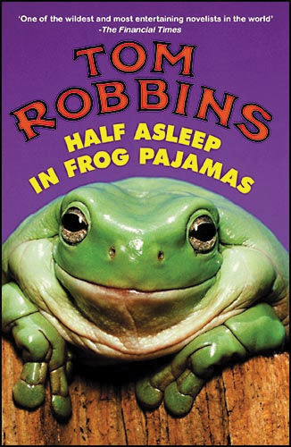
"The day the stock market falls out of bed and breaks its back is the worst day of your life. Or so you think. It isn't the worst day of your life, but you think it is."

Slide 8
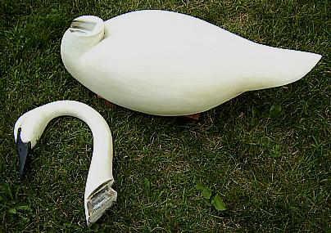
Objective Point of View
With the objective point of view, the writer tells
what happens without stating more than can be
inferred from the story's action and dialogue.
The narrator never discloses anything about
what the characters think or feel, remaining a
detached observer.

Slide 9
German police have detained a Berlin woman who screamed she was a vampire and thirsty as she attempted to bite people.
"She tried to bite the necks of three people within a few minutes," police spokesman Hansjoerg Draeger said on Thursday. "She screamed out that she was a vampire and was thirsty."
The 21-year-old woman, identified only as Laura E., was put under psychiatric observation after she also tried to bite her fingers off, police said.
She first tried to bite the neck of a 20-year-old woman at a doctor's surgery, however the victim managed to escape. She then went into a fast-food restaurant and bit the neck of a 40-year-old waiter.
Police said she then ran out onto the street where she first cut the neck of an 88-year-old pensioner with a piece of broken glass and then bit the elderly woman's ear. Two police officers called to the scene managed to detain her, but she repeatedly bit their hands and arms.

Slide 10
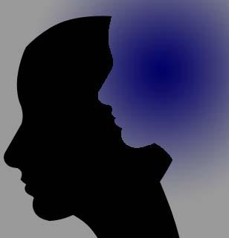
Third Person Point of View
Here the narrator
does not participate
in the action of the
story as one of the
characters, but
lets us know
exactly how the
characters feel.
We learn about the
characters through
this outside voice.

Slide 11

Omniscient Point of View
A narrator who knows everything about all the characters is all knowing, or omniscient.

Slide 12
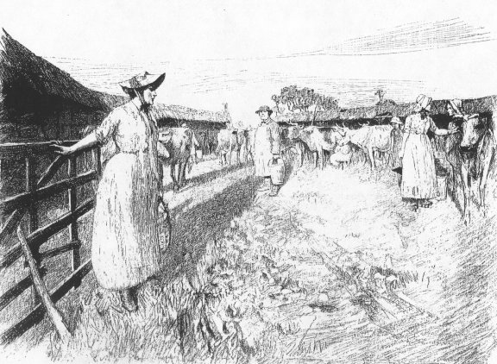
Thomas Hardy - Tess of the d'Urberville
“…his original Tess had spiritually ceased to recognize the body before him as hers - allowing it to drift, like a corpse upon the current, in a direction disassociated from its living will.“

Slide 13
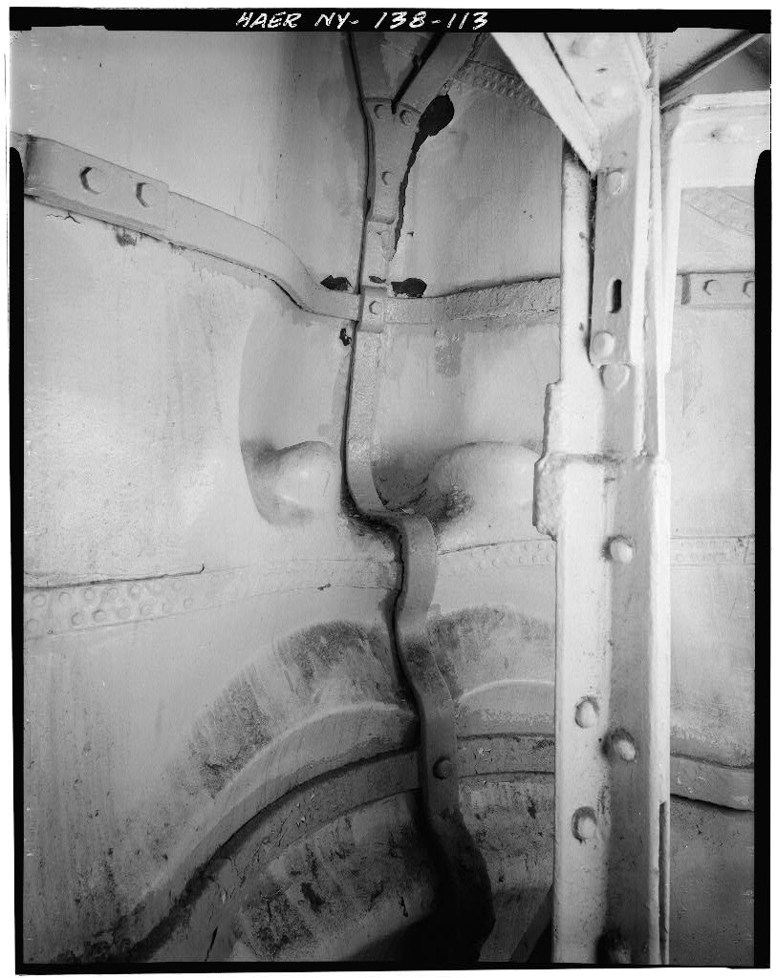
Limited Omniscient Point of View
A narrator whose
knowledge is
limited to one
character, either
major or minor, has a
limited omniscient
point of view.

Slide 14
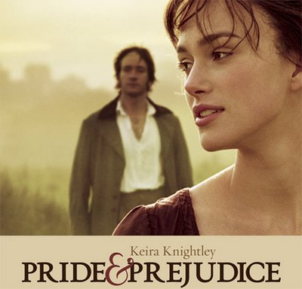
Jane Austen – Pride and Prejudice
“The tumult of her mind, was now painfully great. She knew not how to support herself, and from actual weakness sat down and cried for half-an-hour. Her astonishment, as she reflected on what had passed, was increased by every review of it. That she should receive an offer of marriage from Mr. Darcy! That he should have been in love with her for so many months!”

Slide 15
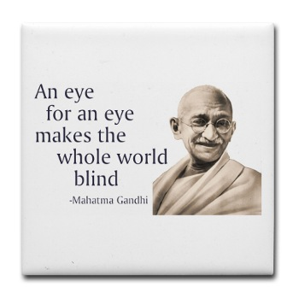
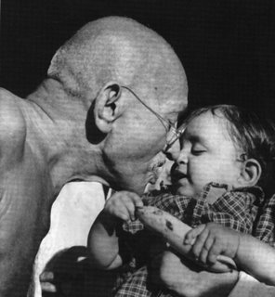
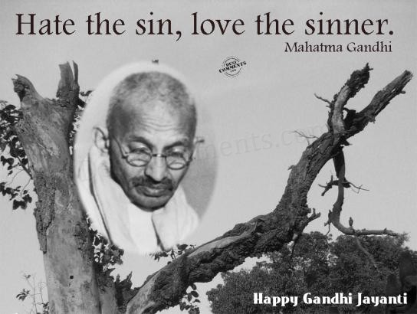
“Three quarters of the miseries and misunderstandings in the world would finish if people were to put on the shoes of their adversaries and understood their points of view.” – Mahatma Gandhi

