Slide 1
GREEK THEATER
Background Information

Slide 2
Origins of Greek Drama
Drama emerged during Greece’s Golden Age (5th century B.C.)
Greeks gathered in the spring during the Festival of Dionysus (god of wine) and performed plays in his honor
Drama was at the center of civic life—i.e. attending the plays was part of what it meant to be “Greek”
First plays were lyrical recitations in which a chorus of fifty men would dance and sing in Dionysus’ honor

Slide 3

PURPOSE OF GREEK DRAMA
Dramas were presented by the state at annual religious festivals.
Plays were supposed to be presented for the purpose of ethical and moral improvement of the spectators and to ensure the spiritual survival of the community.
Winners (playwrights) of prizes were selected by ten citizens chosen by lots (lottery) for the duty.

Slide 4
First Dramatists
Thespis = (thespian), father of drama, introduced first actor (separate from chorus)
Aeschylus = elevated drama to what it is today by introducing a second actor, diminishing the size of the chorus
Euripides = one of the three great Greek tragedians
Sophocles = added a third actor and defeated Aeschylus in dramatic competition (held during the Festival of Dionysus in which dramatists presented a tetrology of three tragedies and one comedy)
  Famous for his Oedipus Trilogy: Oedipus Rex, Antigone, and Oedipus at Colonus

Slide 5
MECHANICS OF GREEK DRAMA
Actors were all male. They wore masks.
Scenes of the drama were always outdoors; indoor actions were reported by messengers.
There was no violence on stage
There was “unity” in plot -- no subplots or irrelevancies.
The action always took place in one day.
There were no curtains or intermissions.

Slide 6
Greek Worldview
Worldview = a person’s understanding of the meaning of life
Greeks believed in many gods (polytheistic)
They could not rely on the gods to rescue them because the gods were unreliable and changed their minds
Offered sacrifices to the gods in order to appease or “bribe” them for help
Greeks relied on wisdom and the power of the human spirit in order to succeed in life
Humanism = the belief that man is the center of the universe (as opposed to God or the gods); glorification of the human body and human intelligence
Fate = an impersonal force stronger than both the gods and men

Slide 7
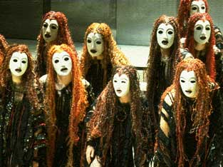
CHORUS IN GREEK DRAMA
The function of the chorus was to :
  set the mood of the drama
  interpret events
  relieve the tension
  generalize meaning of the action
  converse with and give advice to the actors
  give background information
  emphasize the beauty of poetry and dancing
  leader acted as spokesman for the group

Slide 8
Greek Masks
The use of masks in ancient Greek theater draw their origin from the ancient Dionysian cult.
The members of the chorus wore masks, usually similar to each other but completely different from the leading actors
Because the number of actors varied from one to three, they had to put on different masks, in order to play more roles.
The actors were all men. The mask was therefore necessary to let them play the female roles.

Slide 9
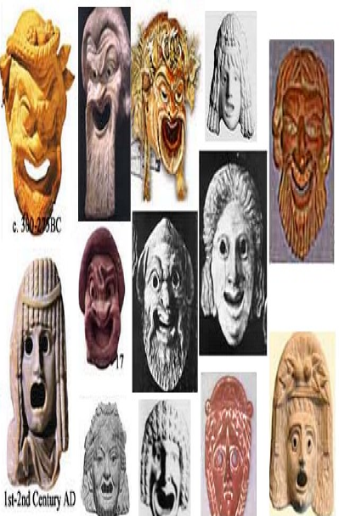
Greek Masks

Slide 10
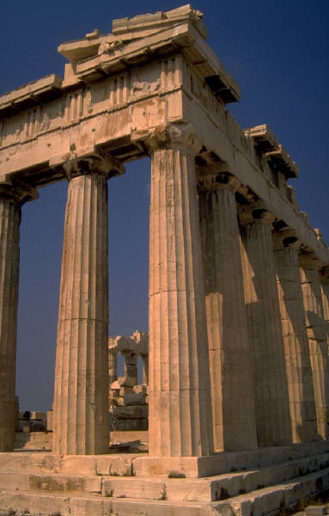
SUBJECT OF PLAYS
The subject was almost exclusively taken from well-known myths.
The plays explored the mysteries of life and the role of the gods in human affairs.
The main purpose was ethical and religious instruction.

Slide 11
STYLE IN PLAYS
There are long, wordy speeches (sometimes about current events or contemporary people).

Slide 12
Comedy and Tragedy
In the Poetics, Aristotle defined comedy as a mode of drama that ridicules the vice of a certain character; in the end, the character and order of the community is restored.
He defines tragedy as a mode of drama in which a tragic hero is brought low due to his own weakness or failing (tragic flaw). In the end, the audience ought to experience a catharsis (purging of emotions) consisting of feelings of pity and fear.

Slide 13
CONCEPT OF TRAGIC HERO AND TRAGEDY (from Aristotle)
Tragedy arouses the emotions of pity, fear, wonder and awe.
A tragic hero must be a man or woman capable of great suffering.
Tragedy explores the question of the ways of God to man.
Tragedy purifies the emotions (catharsis)
Tragedy shows how man is brought to disaster by a single flaw in his own character.

Slide 14
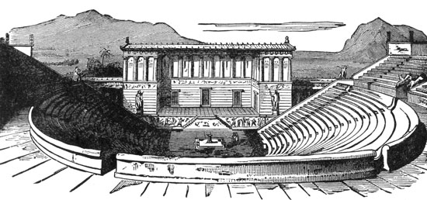
Greek Theatre

Slide 15
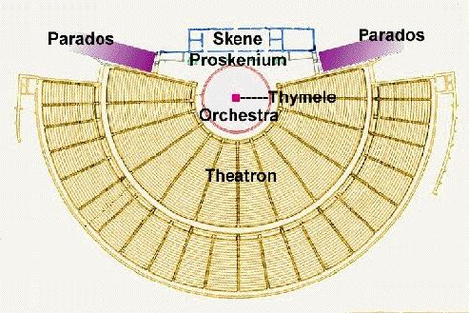

Slide 16
The orchestra (literally, "dancing space") was normally circular. It was a level space where the chorus would dance, sing, and interact with the actors who were on the stage near the skene. The earliest orchestras were simply made of hard earth, but in the Classical period some orchestras began to be paved with marble and other materials.
In the center of the orchestra there was often a thymele, or altar, on which the Greeks sacrificed to Dionysus, the god of wine.
The theatron (literally, "viewing-place") is where the spectators sat. The theatron was usually part of hillside overlooking the orchestra, and often wrapped around a large portion of the orchestra. Spectators in the fifth century BC probably sat on cushions or boards, but by the fourth century the theatron of many Greek theaters had marble seats.

Slide 17
The skene (literally, "tent") was the building directly behind the stage. The skene was directly in back of the stage, and was usually decorated as a palace, temple, or other building, depending on the needs of the play. It had at least one set of doors, and actors could make entrances and exits through them.
The parodoi (literally, "passageways") are the paths by which the chorus and some actors (such as those representing messengers or people returning from abroad) made their entrances and exits. The audience also used them to enter and exit the theater before and after the performance.
The chorus was a group of men who functioned as the nucleus of the play, were the voice of the people, performed odes, introduced new characters and scenes, and commented on the action of the play.

Slide 18
Conventions of the play
Aristotelian unities = time, place, action
  Time = the play must occur in one day’s time
  Place = the play must take place in one location (Thebes)
  Action = the play must focus on one central action (discovering the reason for the plague in Thebes)
Irony
  Dramatic = the audience knows something the actors do not know
  Situational = what occurs is the opposite of what is expected
  Verbal = what is said is the opposite of what is true

Slide 19
Greek Theatre Terms
exodus -- final action of the play
Dionysus -- God of drama
parados -- chorus marching in from the left or right
catharsis-- beneficial effect the tragedy has on the audience.

Slide 20
prologue -- opening scene (introduction)
episode -- act or scene
stasimon -- choral ode (end of each episode)
proscenium -- level area in front of the skene on which most of the plays action took place
choral ode -- lyric sung by the chorus which develops the importance of the action
sphinx -- a female monster, usually represented as having the head and breast of a woman, the body of a lion, and the wings of an eagle

Slide 21
strophe -- a turning, right to left, by chorus
antistrophe -- a turning, left to right, by chorus
choragas -- leader of the chorus
epode -- the part of a lyric ode following the strophe and antistrophe
hubris -- Greek word for excessive pride or arrogance
hamartia -- Greek word for error in judgment, especially resulting from a defect in the character of a tragic hero; the tragic flaw

Slide 22
rhetoric– in speech, an argument; bombastic statement
character foil– a character that emphasizes opposite traits in another character
aphorism– a brief statement which expresses an observation intended to be wise
understatement– a statement which lessens or minimizes the importance of what is meant
hyperbole– figure of speech in which an overstatement or exaggeration occurs

Slide 23
in media res – beginning a story in the middle
allegory – part of a story illustrating an idea or moral principle in which objects take on symbolic meanings
archetype – an inherited unconscious idea, pattern of thought, etc present in individual psyches
epiphany – a sudden, intuitive perception or insight into the reality or meaning of something – usually initiated by a simple experience
euphemism – a substitute or mild expression for one thought to be offensive or harsh

Slide 24
Essential Questions
  1. Is it more important to be right than to be happy?
  2. What price should a person be willing to pay if he/she breaks an unjust law?
3. Can a leader show uncertainty and maintain leadership?

Slide 25
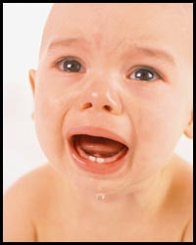
Pathos
Pathos appeals rely on emotions and feelings to persuade the audience
They are often direct, simple, and very powerful

Slide 26
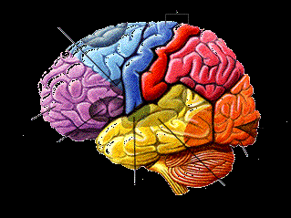
Logos
“Logos appeals” rely on the audience’s intelligence to persuade them.
Education causes audiences to be more skeptical of emotional arguments and more receptive to logos

Slide 27
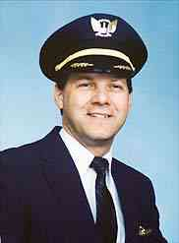
Ethos
Ethos is a person’s credibility with a given audience. It can mean sincerity, authority, expertise, faithful, or any adjective that describes someone you can trust to do the right thing.

Slide 28
What is rhetoric?
Aristotle defines rhetoric as
  The faculty or ability to discover all available means of persuasion in a given situation.
Rhetoric is the counterpart of “dialectic,” a type of formal reasoning that leads to truth. Rhetoric is what allows us to communicate these truths.

Slide 29
