Slide 1
UNDERSTANDING ANALYSIS
Interpretation Techniques for Looking Below the Surface

Slide 2
Analysis is…
“More than just a set of skills, analysis is a frame of mind, an attitude toward experience. It is a form of detective work that typically pursues something puzzling, something you are seeking to understand rather than something you are already sure you have the answers to. Analysis finds questions where there seemed not to be any, and it makes connections that might not have been evident at first.”
(Rosenwasser and Stephen, 4)

Slide 3
Preview
Rationale
Defining analysis
Analysis Thought Processes
Achieving Analysis
Practicing Analysis
Conclusion

Slide 4
Rationale: Academic Situations
Analysis Skills
Literary Texts
Visual Texts
Social Phenomenon
Historical Experiences
Data & Statistics
Other classwork will require you to use analysis

Slide 5
Rationale: Beyond the Classroom
We are surrounded by texts that send an ideological message. That message takes place within, is shaped by, and serves to shape social and political existence. That existence is based on relations of power involving gender, race, sexuality, class, inequality, etc. Critical literacy involves recognizing the variety of texts that require an exploration of power and ideology. Critical literacy requires analysis skills and means awareness and the ability to negotiate cultural circumstances that define our lives.

Slide 6
Rationale: Beyond the Classroom
Ideological Messages
Society
Power Relations
Critical Literacy

Slide 7
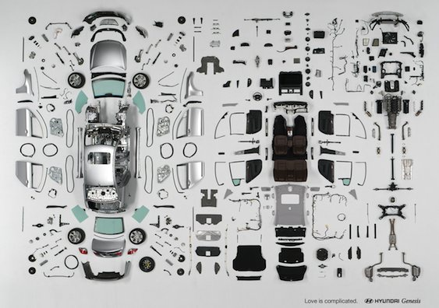

DEFINING ANALYSIS
Breaking a text down into its varied components to see how each piece works and contributes to the text’s meaning or purpose.

Slide 8
ANALYSIS THOUGHT PROCESSES
Language comprehension occurs on two
interconnected levels:
Literal
Figurative

Slide 9
ANALYSIS THOUGHT PROCESSES
On some levels, we analyze automatically, as part of our basic comprehension, whenever we use language. If we break down this process using language as an example, we can see how analysis works and apply that to any type of text.

Slide 10
Analysis thought processes
LITERAL: the explicit, surface meaning based on the denotative purpose of words (the dictionary definition that does not change by circumstance).
A literal reading =
a summary, stating what a text says or does outright.
    “I am hungry” says “I am in need of food”
Remember to use your critical reading skills. Before you can analyze, you summarize to show you comprehend the message.

Slide 11
What is “critical reading?”
“Critical” is not intended to have a negative meaning in the context of “critical reading.”
Definition: An active approach to reading that involves an in depth examination of the text. Memorization and understanding of the text is achieved. Additionally, the text is broken down into its components and examined critically in order to achieve a meaningful understanding of the material.

Slide 12
Analysis Thought processes
FIGURATIVE: the implicit, underlying or obscured meaning based on the connotative purpose of words (the symbolic definition based on specific circumstances).
A figurative reading =
interpretation, explaining the inferred or implied message.
    “I am hungry” implies “I want to eat right now”
Figurative description requires thinking through to understand the connection between the ideas.

Slide 13
ANALYSIS THOUGHT PROCESSES
Slowing things down a bit…
Let’s see how this works by
imagining you are a non-native English speaker
newly arrived in an English-speaking country.

Slide 14
ANALYSIS THOUGHT PROCESSES
You hear…
“She totally nailed that PowerPoint presentation”

Slide 15

ANALYSIS THOUGHT PROCESSES
You might imagine…
A young woman wielding a hammer and
hanging a picture
that is called a PowerPoint presentation
to a wall, using a nail.
Why?

Slide 16
ANALYSIS THOUGHT PROCESSES
Because you have the skills to comprehend the literal meaning, but you lack the experience and cultural knowledge that helped you make the analytical leap that native English speakers would have made without having to think about it. For non-native English speakers, that process from literal meaning to implicit message can be slower, depending on their level of fluency and cultural background. This is why understanding jokes in a language we are studying can be difficult. We lack the context.

Slide 17

ANALYSIS THOUGHT PROCESSES
Another example:

Slide 18
ANALYSIS THOUGHT PROCESSES
Literally, we have a woman strewn on a staircase, which looks like an accident, a tragic fall for one who doesn’t have the context. For all an uninformed viewer might think, Versace could translate into caution or tragedy. But then, figuratively, this is an advertisement to sell Versace clothing. One could look even deeper into this and interpret a message about fashion an violence toward women, as do viewers who argue about controversial photos like this whenever campaigns use them. No matter your interpretation, when we see photos like this in our everyday lives, we make analytical leaps almost automatically.

Slide 19
ANALYSIS THOUGHT PROCESSES
Sounds easy, right?
For people like us, the comprehension process becomes much more apparent when we read more complicated messages, like those in academic texts, because our comprehension skills work harder, and we have to slow down to consider the message. If we don’t, we might not get the real meaning.

Slide 20
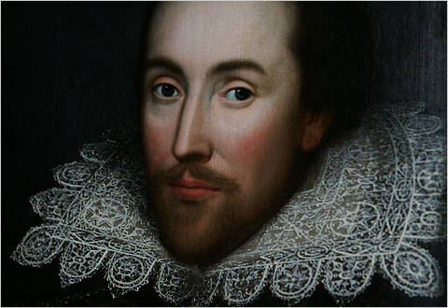

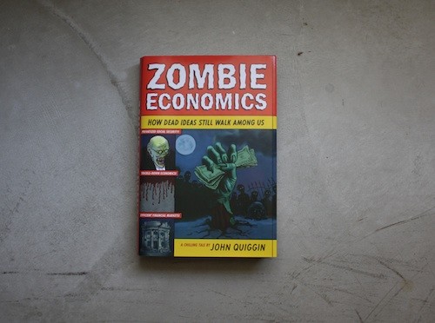
Analysis Thought Process
More complicated texts…

Slide 21
Achieving analysis
There are five moves that analysis involves:
Suspend judgment
    Avoid evaluation
    Recognize and account for bias

Slide 22
Achieving analysis
There are five moves that analysis involves:
Suspend judgment
Look for patterns to discern context
  Within the text
  Outside the text

Slide 23
Achieving analysis
There are five moves that analysis involves:
Suspend judgment
Look for patterns to discern context
Define significant parts and how they’re related
    Pinpoint key objects, details, examples
    Organize their relationship around analytical claims
    Relate the connections to the patterns and context

Slide 24
Achieving analysis
There are five moves that analysis involves:
Suspend judgment
Look for patterns to discern context
Define significant parts and how they’re related
Make the implicit explicit
    Look beneath the surface
    Explain the what, the how, and the why
    Leave breadcrumbs from the literal to the figurative

Slide 25
Achieving analysis
There are five moves that analysis involves:
Suspend judgment
Look for patterns to discern context
Define significant parts and how they’re related
Make the implicit explicit
Keep reformulating questions and explanations

Slide 26
Achieving Analysis: Tips
Analysis can be seen as an argument in that it makes a claim or gives an opinion about the communicator’s interpretation. With any good argument, then, you must prove your point with reasons and evidence that support the claim. In other words, you have to show the audience how you came to this interpretation in a way they can follow and, hopefully, come to the same interpretation or at least believe yours.
There are many different ways to interpret, ranging from the obvious to the outlandish. If you try to think of a few different ways that something could be interpreted, and address or refute those ways in your own analysis, you will make a stronger point and also prove a more credible analyzer.

Slide 27
PRACTICING ANALYSIS
Breaking down the process of breaking down texts:
Receive (be open, non-evaluative)
Notes:
27

Slide 28
PRACTICING ANALYSIS
Breaking down the process of breaking down texts:
Receive
Collect (details and information)
  Preview (consider)
  Observe (read or view)
  Note (list details and record impressions)
Notes:
28

Slide 29
PRACTICING ANALYSIS
Breaking down the process of breaking down texts:
Receive
Collect
Summarize (for literal meanings): this is where you note what things explicitly say and do
  Details
  Overall
  Look for the obvious
Notes:
29

Slide 30
PRACTICING ANALYSIS
Breaking down the process of breaking down texts:
Receive
Collect
Summarize
Interpret (for figurative messages): this is where you explain the implicit
  Details
  Overall
  The what, how, and why
Notes:
30

Slide 31
PRACTICING ANALYSIS
Breaking down the process of breaking down texts:
Receive
Collect
Summarize
Interpret
Engage (develop your claims)
  The text’s message(s)
  The relevance of your interpretation
Notes:
31

Slide 32
PRACTICING ANALYSIS: EXAMPLE
Poem title: Get Drunk
At this point, I will preview. I look at the title and think about what I might expect. A party call? An imperative after a hard day’s work? The title seems contemporary, or at least, the language it relevant to contemporary lifestyles.
Then, I will collect, reading the poem through twice, once out loud, taking it all in, once to myself noting specific details, repetition, key points.
Notes:
32

Slide 33
PRACTICING ANALYSIS: EXAMPLE
Get Drunk
One should always be drunk. That's all that matters;
that's our one imperative need. So as not to feel Time's
horrible burden, one which breaks your shoulders & bows
you down, you must get drunk without cease.
But with what?
With wine, poetry, or virtue
as you choose.
But get drunk.
And if, at some time, on steps of a palace,
in the green grass of a ditch,
in the bleak solitude of your room,
you are waking & the drunkenness has already abated,
ask the wind, the wave, the stars, the clock,
all that which flees,
all that which groans,
all that which rolls,
all that which sings,
all that which speaks,
ask them, what time it is;
& the wind, the wave, the stars, the birds, & the clock,
they will all reply:
"It is time to get drunk!
So that you may not be the martyred slaves of Time, get drunk, get drunk,
and never pause for rest!
With wine, poetry, or virtue,
as you choose!”
Charles Baudelaire
Notes:
33

Slide 34
PRACTICING ANALYSIS: Example
Collection:
  Repetition: “drunk,” “time,” types of drunkenness
  Lists of different places and situations
  The style of language seems older, less contemporary than I thought

Slide 35
PRACTICING ANALYSIS: Example
Collection:
Summary: the literal statements, what it says and does
    This poem says how important it is to be in a constant state of inebriation, no matter how that inebriation comes about: from drinking, from women, from being a good person. It says that everything around us in our lives wants us to be inebriated at all times and tells us that.
This is literally, a direct translation, without reading into any of the words or ideas. Don’t skip this stage even if interpretation seems automatic. Getting the literal first helps you pick the best examples or textual components with the most meaning, when you finally get to the analysis.

Slide 36
PRACTICING ANALYSIS: Example
Collection:
Summary:
Interpretation: the figurative message, what it means
    This poem reminds people about the importance of living with passion and excitement, the importance of finding what makes you deliriously happy, whether it’s partying, loving, or spirituality. The main thing is that this passion takes us out of our everyday mind, the mind that feels sadness or loneliness. And if we listen to the world around us, it, too, reminds us of being passionate.

Slide 37
PRACTICING ANALYSIS: Example
Collection:
Summary:
Interpretation: the figurative message, how we know what it means
    We know that it’s not just regular pleasure that Baudelaire prompts us to feel because he says we should “get drunk.” Being drunk means being filled, overcome with headiness, which seems more like delirious pleasure, passion, to the point of not caring or worrying. I think it’s passion he means because his examples of “wine, women, or virtue, as you please” stand for common examples of sources of pleasure, in terms of having fun (drinking), being in love or experiencing intimacy (women), or following some spiritual value (virtue).

Slide 38
PRACTICING ANALYSIS: Example
Collection:
Summary:
Interpretation: the figurative message, why we think the communicator sends this message
    For Baudelaire, experiencing this deep passion helps us deal with the weight of our humanity, our mortality. That’s why he keeps repeating references to time and “Time’s burden,” which is the clock, the habitual passing of days toward the end of our lives which can only be broken up, dealt with, or even ignored, by getting drunk with something we truly enjoy.

Slide 39
PRACTICING ANALYSIS: Example
Collection:
Summary:
Interpretation:
Engagement: how does knowing what this text offers contribute something useful or relevant to the audience?
    For all intents and purposes, Baudelaire’s advice to find a way to live a life of delirious passion seems negatively self-involved. I mean, after all, shall we--so inextricably linked to our social circumstances and unable to really live for ourselves without touching the lives of others--really live only for our own pleasures? But looking deeper into his message, the answer seems not to be in “wine, women, or virtue” (emphasis added) but rather in all three, in finding one’s pleasure in fun, in love, and in a deeper connection to goodness that will make a better life for all, in the long run.

Slide 40
Analysis: Tip
Engagement,
or making the message meaningful for others,
is as integral to an analysis of a 19th century French poem
as it is for a 21st century film or video or
book or article analysis.

Slide 41

PRACTICING ANALYSIS: EXAMPLE
Collect:
  Sleek, modern, colorful
  Natural elements
  Plenty of seating
  Open space and cool lighting
Summarize:
  Where hotel guests check in
  Places for people to sit
Interpret:
  Encourages people to get out of their rooms, be social, enjoy the space
  Give people access to the calm atmosphere of nature

Slide 42

PRACTICING ANALYSIS: EXAMPLE
Collect:
  Wood paneling
  Clean
  Large check-in desk
  Tourist pamphlets
Summarize:
  To check in guests
  Give them information for sight-seeing
Interpret:
  Get people in and out, to encourage spending time outside of the motel
  A rustic feel of a country house, the feel of nature close by

Slide 43

conclusion
The world is full of texts to interpret, and there are myriad ways to interpret each and every one. Being critically literate just means engaging with that world and those texts in thoughtful ways to understand just how many possible ways of being and thinking there are.

