Slide 1
poetry
Unit for 10-1: miss kinderthain

Slide 2
What is poetry

Slide 3
literary work in which special intensity is given to the expression of feelings and ideas by the use of distinctive style and rhythm

Slide 4
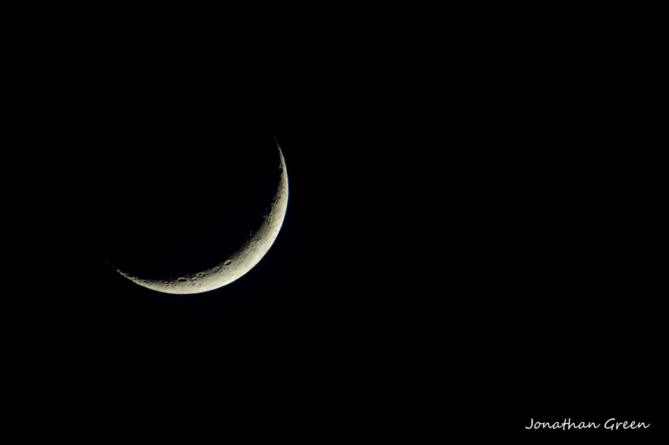
How could we describe this picture?

Slide 5
It’s just that easy
How thin and sharp is the moon tonight!
How thin and sharp and ghostly white
Is the slim curved crook of the moon tonight!
Winter Moon by Langston Hughes

Slide 6
Poem parts
Poet: author of the poem
Speaker: the narrator of the poem. While the speaker is usually a person, it can also be an animal, object, or an idea
Subject: what the poem is about, the topic
Theme: what the poem’s overall message is

Slide 7
Poetic form
Form: the way the words are arranged on the page

Slide 8
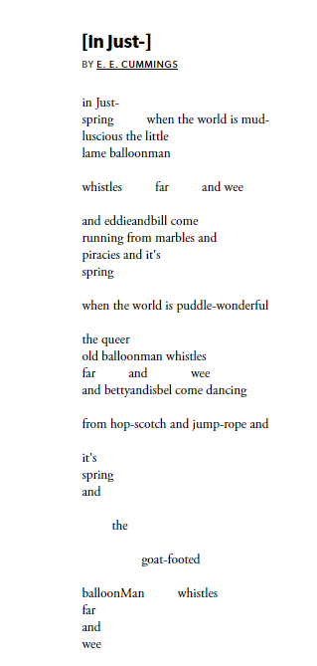


Slide 9
What makes up a poem
The sea creeps to pillage,
She leaps on her prey;
A child of the village
Was murdered today.
She came up to meet him
In a smooth golden cloak,
She choked him and beat him
To death, for a joke.
Her bright locks were tangled,
She shouted for joy,
With one hand she strangled
A strong little boy.
Now in silence she lingers
Beside him all night
To wash her long fingers
In silvery light.
Lines: individual lines of a poem
Stanzas: Groups of lines arranged together

Slide 10
meter
Some poems have meter, which is the pattern of the beats.
If a poem is written in meter, the author will count the number of beats in each line to follow a specific pattern
These beats will be a mixture of stressed and unstressed syllables.
We will discuss meter more later

Slide 11
verse
While some poems are written in meter with a structured rhyme scheme, a poem doesn’t always have to look the same
Free Verse
  A poem written with a more casual feel, with no rhyme pattern and no meter.
Verse can be used for humor as well

Slide 12
Metered vs. free verse
My funny shop teacher Mr. Carr
Dropped on his head a heavy crow bar
He began to curse and yell
Telling the hammer to go straight to hell
Mr. Carr was hit on the head with a hammer. He was upset and exploded with profanity.

Slide 13
Free verse makes poetry accessible to everyone
In the late 1800s to early 1900s, literature began to take a turn form aristocratic to public
Uneducated individuals can write and read poetry
Pioneers of free verse
  Walt Whitman
  William Carlos Williams
  Hilda Doolittle

Slide 14

Old people aren’t the only ones who write poetry
Rupi Kaur
Born October 5, 1992
From Canada
Published two poetry books
  Milk and Honey
  The Sun and Her Flowers
Utilized visual poetry
Social media had a huge impact on Kaur’s career

Slide 15
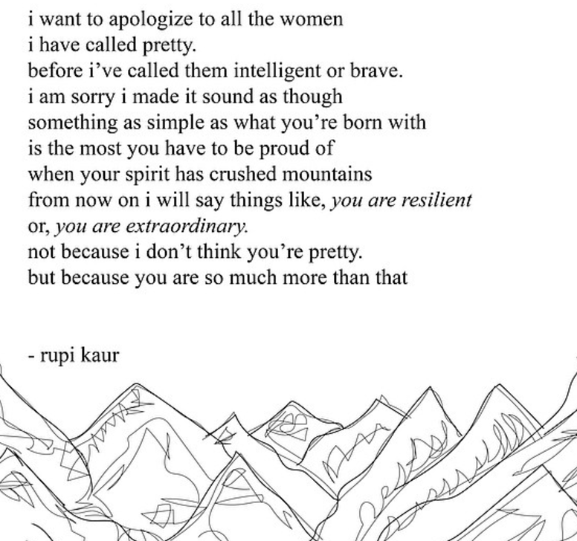

Slide 16
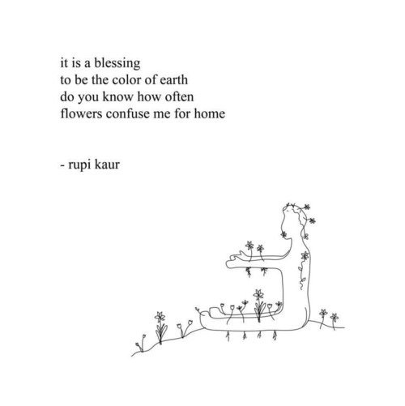

Slide 17
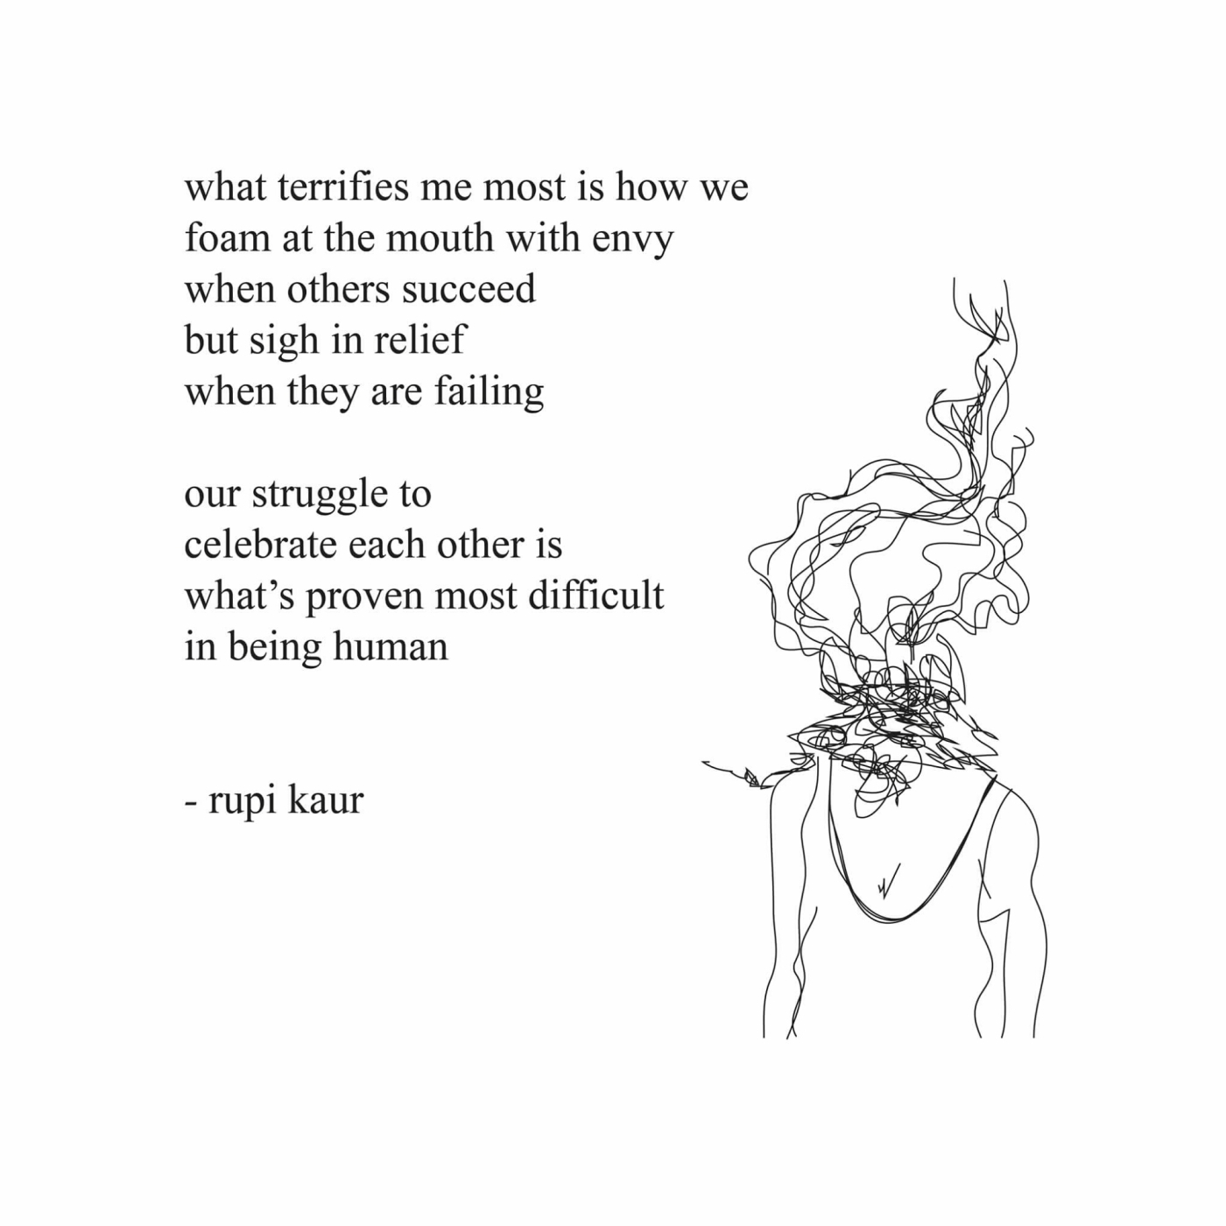

Slide 18

Spoken poetry
Poetry Slams
Spoken Word Nights
Open Mic Nights

Slide 19
Group time!!

Slide 20
Spoken word
https://www.youtube.com/watch?v=_Il70mlj38o

