Slide 1
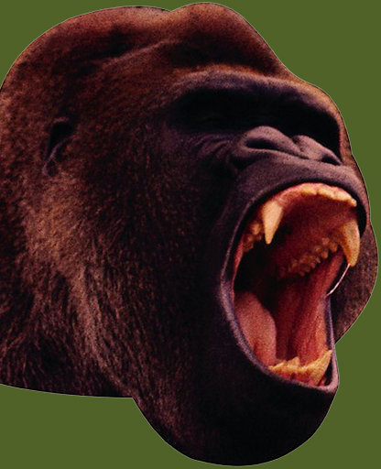
This presentation is brought to you by Grammar Bytes!, ©2011 by Robin L. Simmons.
chomp!
chomp!

Slide 2
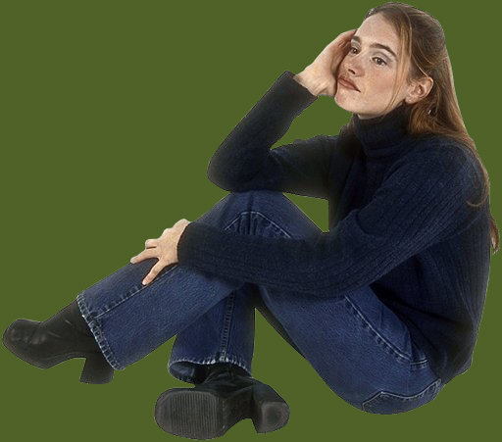
Pronoun Case
Do I need the pronoun they?
Or do I need the pronoun them instead?

Slide 3
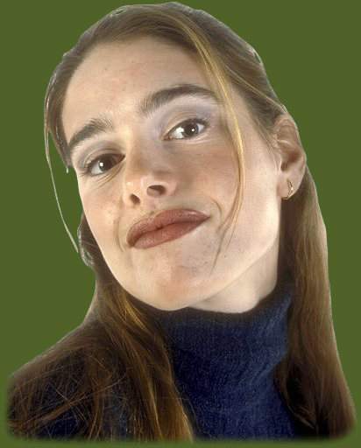
This presentation covers when to use subjective, objective, and possessive pronoun forms.

Slide 4
A pronoun case item on an objective test might look like this . . .

Slide 5
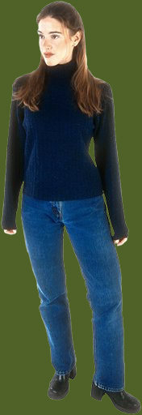
Sample Item
  Stan and I offered to help move the furniture, but
  the new residents rolled their eyes when they
  saw that us two had skinny arms.
  Me and Stan
  theirs
  we
  No change is necessary.
  Stan and I offered to help move the furniture, but
  A
  the new residents rolled their eyes when they
  B
  saw that us two had skinny arms.
  C
  Me and Stan
  theirs
  we
  No change is necessary.
  Stan and I offered to help move the furniture, but
  A
  the new residents rolled their eyes when they
  B
  saw that we two had skinny arms.
  C
  Me and Stan
  theirs
  we
  No change is necessary.
Is Stan and I, their, or us a problem?
Us needs to become we, a change option C makes.

Slide 6
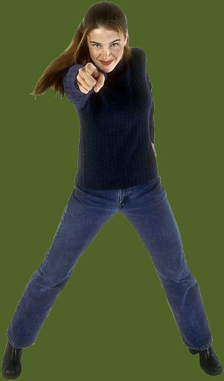
Subjective Pronouns
Forms include I, you, she, he, it, we, and they.
A subject pronoun functions as the subject of a verb.
Me and Meredith threw mashed potatoes at Henry.
Meredith and I threw mashed potatoes at Henry.
Me threw mashed potatoes? I don’t think so!

Slide 7
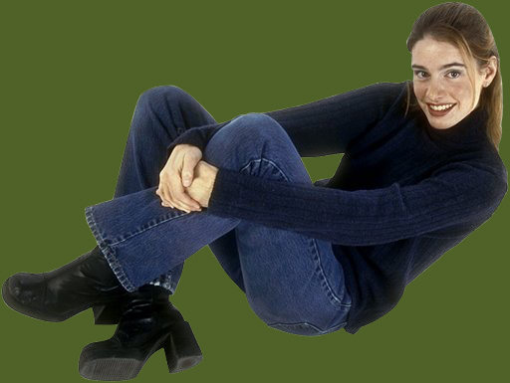
Objective Pronouns
Forms include me, you, her, him, it, us, and them.
An objective pronoun functions as a direct object, indirect object, or object of a preposition.
Just between you and I, Stevie shouldn’t try to kiss Grace with spinach in his teeth!
Just between you and me, Stevie shouldn’t try to kiss Grace with spinach in his teeth!
After a preposition like between, always use the objective pronoun!

Slide 8
Direct vs. Indirect Objects
To find a direct object, use this formula: subject + verb + what? or who?
The indirect object is whoever or whatever receives the direct object.
Crystal gave Stevie a toothbrush before the kissing began.
Crystal gave Stevie a toothbrush before the kissing began.
Crystal gave Stevie a toothbrush before the kissing began.
Crystal gave him it before the kissing began.
Crystal gave what? The toothbrush = the direct object!
Who received the toothbrush? Stevie = the indirect object!
Always use objective pronouns like him and it to replace objects.

Slide 9
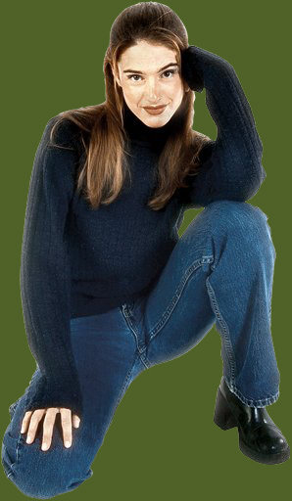
Possessive Pronouns
Forms include my, mine, your, yours, her, hers, his, its, our, ours, their, and theirs.
Possessive pronouns do not require an apostrophe; adjective forms do not agree with the nouns that follow.
When Johnnie stepped to the plate and hit a home run, we rubbed ours eyes in disbelief.
When Johnnie stepped to the plate and hit a home run, we rubbed our eyes in disbelief.
Your, her, our, and their = adjectives.
Yours, hers, ours, and theirs = nouns.

Slide 10
Quick Test
Directions: In the items that follow, choose the option that corrects an error in the underlined portion(s). If no error exists, choose “No change is necessary.”
Show me what you know.

Slide 11
Item 1
  Tiesha is good at math. See if she and Sam will
  join our study group. Clueless students like we
  can use all the help we can get!
  her
  ours
  us
  No change is necessary.
  Tiesha is good at math. See if she and Sam will
  A
  join our study group. Clueless students like we
  B C
  can use all the help we can get!
  her
  ours
  us
  No change is necessary.
  Tiesha is good at math. See if she and Sam will
  A
  join our study group. Clueless students like us
  B C
  can use all the help we can get!
  her
  ours
  us
  No change is necessary.

Slide 12
Item 2
  Marvin got an aisle seat. Cherise sat between
  Byron and he. Together they slurped their
  sodas as the guest lecturer droned on about the
  Roman Empire.
  Byron and him
  them
  theirs
  No change is necessary.
  Marvin got an aisle seat. Cherise sat between
  Byron and he. Together they slurped their
  A B C
  sodas as the guest lecturer droned on about the
  Roman Empire.
  Byron and him
  them
  theirs
  No change is necessary.
  Marvin got an aisle seat. Cherise sat between
  Byron and him. Together they slurped their
  A B C
  sodas as the guest lecturer droned on about the
  Roman Empire.
  Byron and him
  them
  theirs
  No change is necessary.

Slide 13
Item 3
  Me and Tonya prefer morning classes. Our
  roommates like to stay up late playing loud video
  games. We hope to kick them out of the
  apartment next semester.
  Tonya and I
  Ours
  they two
  No change is necessary.
  Me and Tonya prefer morning classes. Our
  A B
  roommates like to stay up late playing loud video
  games. We hope to kick them out of the
  C
  apartment next semester.
  Tonya and I
  Ours
  they two
  No change is necessary.
  Tonya and I prefer morning classes. Our
  A B
  roommates like to stay up late playing loud video
  games. We hope to kick them out of the
  C
  apartment next semester.
  Tonya and I
  Ours
  they two
  No change is necessary.

Slide 14
Item 4
  Sheila has a golden retriever. Perhaps that hair in
  your green beans comes from she or the dog.
  Since the strand is dark in color, I’ll bet it’s hers.
  yours
  her
  her’s
  No change is necessary.
  Sheila has a golden retriever. Perhaps that hair in
  your green beans comes from she or the dog.
  A B
  Since the strand is dark in color, I’ll bet it’s hers.
  C
  yours
  her
  her’s
  No change is necessary.
  Sheila has a golden retriever. Perhaps that hair in
  your green beans comes from her or the dog.
  A B
  Since the strand is dark in color, I’ll bet it’s hers.
  C
  yours
  her
  her’s
  No change is necessary.

Slide 15
Item 5
  Abigail studied six hours for the chemistry exam.
  When she and her lab partner saw the test, they
  both knew their hard work would protect their
  high averages.
  her
  them
  theirs
  No change is necessary.
  Abigail studied six hours for the chemistry exam.
  When she and her lab partner saw the test, they
  A B
  both knew their hard work would protect their
  C
  high averages.
  her
  them
  theirs
  No change is necessary.
  Abigail studied six hours for the chemistry exam.
  When she and her lab partner saw the test, they
  A B
  both knew their hard work would protect their
  C
  high averages.
  her
  them
  theirs
  No change is necessary.

Slide 16
Item 6
  Nicholas likes to gossip. Be careful what you say
  around Julie and him. They both believe that your
  news—whether good or bad—is their’s to spread.
  he and Julie
  Them
  theirs
  No change is necessary.
  Nicholas likes to gossip. Be careful what you say
  around Julie and him. They both believe that your
  A B
  news—whether good or bad—is their’s to spread.
  C
  he and Julie
  Them
  theirs
  No change is necessary.
  Nicholas likes to gossip. Be careful what you say
  around Julie and him. They both believe that your
  A B
  news—whether good or bad—is theirs to spread.
  C
  he and Julie
  Them
  theirs
  No change is necessary.

Slide 17
Item 7
  Even though Grandma and I brought a calculator
  and coupons, we spent too much money grocery
  shopping. The fault is mainly her’s, as she
  insisted on ice cream that neither of us needed.
  me and Grandma
  hers
  we
  No change is necessary.
  Even though Grandma and I brought a calculator
  A
  and coupons, we spent too much money grocery
  shopping. The fault is mainly her’s, as she
  B
  insisted on ice cream that neither of us needed.
  C
  me and Grandma
  hers
  we
  No change is necessary.
  Even though Grandma and I brought a calculator
  A
  and coupons, we spent too much money grocery
  shopping. The fault is mainly hers, as she
  B
  insisted on ice cream that neither of us needed.
  C
  me and Grandma
  hers
  we
  No change is necessary.

Slide 18
Item 8
  Mom gave me and Sheila a lecture about good
  manners. Mom had heard that me and Sheila
  forgot to send Aunt Louise a thank-you card for our
  Christmas presents.
  Sheila and I
  Sheila and I
  ours
  No change is necessary.
  Mom gave me and Sheila a lecture about good
  A
  manners. Mom had heard that me and Sheila
  B
  forgot to send Aunt Louise a thank-you card for our
  C
  Christmas presents.
  Sheila and I
  Sheila and I
  ours
  No change is necessary.
  Mom gave me and Sheila a lecture about good
  A
  manners. Mom had heard that Sheila and I
  B
  forgot to send Aunt Louise a thank-you card for our
  C
  Christmas presents.
  Sheila and I
  Sheila and I
  ours
  No change is necessary.

Slide 19
Item 9
  My friends and I spent biology lab eating popcorn
  and giggling. After lab, Mr. Rivera threatened we
  three with withdrawal. He insisted that our
  behavior and attitude must change.
  Me and my friends
  us
  ours
  No change is necessary.
  My friends and I spent biology lab eating popcorn
  A
  and giggling. After lab, Mr. Rivera threatened we
  B
  three with withdrawal. He insisted that our
  C
  behavior and attitude must change.
  Me and my friends
  us
  ours
  No change is necessary.
  My friends and I spent biology lab eating popcorn
  A
  and giggling. After lab, Mr. Rivera threatened us
  B
  three with withdrawal. He insisted that our
  C
  behavior and attitude must change.
  Me and my friends
  us
  ours
  No change is necessary.

Slide 20
Item 10
  We gave our calculus notes to Diego and she.
  They lent us theirs. Before the big exam,
  we students need to make sure that we have
  every word Dr. Nguyen delivered in lecture.
  her
  theirs’
  us students
  No change is necessary.
  We gave our calculus notes to Diego and she.
  A
  They lent us theirs. Before the big exam,
  B
  we students need to make sure that we have
  C
  every word Dr. Nguyen delivered in lecture.
  her
  theirs’
  us students
  No change is necessary.
  We gave our calculus notes to Diego and her.
  A
  They lent us theirs. Before the big exam,
  B
  we students need to make sure that we have
  C
  every word Dr. Nguyen delivered in lecture.
  her
  theirs’
  us students
  No change is necessary.

Slide 21
Grammar Bytes! provides additional handouts and exercises on pronoun case. Go to chompchomp.com!
chomp!
chomp!

Slide 22
The End.

