Slide 1


Irony and Humor

Slide 2
Irony
Irony is about expectations
Irony is a statement that intends to express the opposite of what was stated.

Slide 3

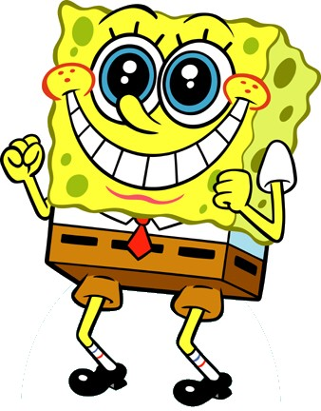

Types of Irony

Slide 4
Verbal Irony
A character says one thing but means the opposite
Also called sarcasm or being sarcastic.
Examples
The locker room smells really good.

Slide 5
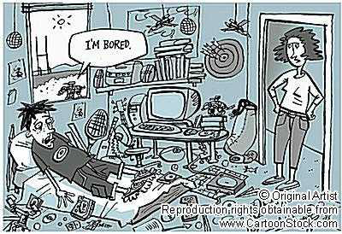
Honey, your room is absolutely beautiful. I’ve never been prouder of you than right now!

Slide 6
Dramatic Irony
When the reader understands more about the events of a story than a character.
You know something that a character doesn’t.
Example
Tim’s parents are proud of the “A” he got on the test, but we know he cheated.

Slide 7
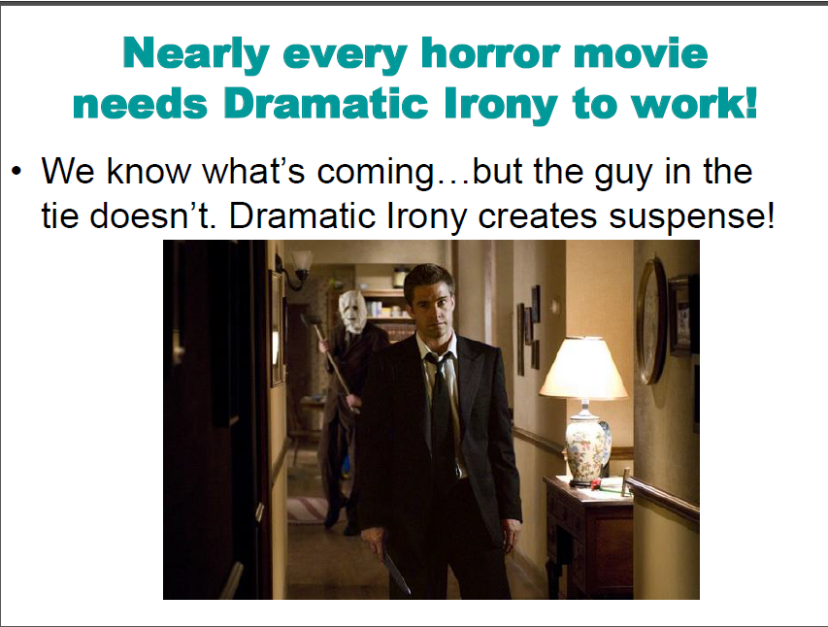

Slide 8
Situational Irony
When what actually happens is the opposite of what is expected.
Something about the situation is completely unexpected.

Slide 9
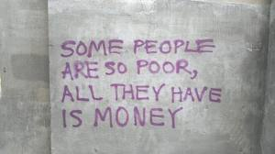

Slide 10
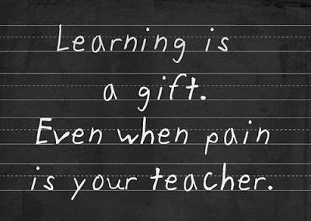

Slide 11
You break a date with your girlfriend so you can go to the ball game with the guys. When you go to the concession stand, you run into your date who is with another guy.

Slide 12
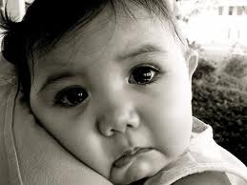
Other terms you need to know:
Sentimentality – stories that try to elicit easy or unearned emotional responses as genuine emotion.

Slide 13
Sentimental Writers
Editorialize – comment on the story and, in a manner, instruct us how to feel.
Poeticize – use an immoderately heightened and distended language to accomplish their effects.
Make excessively selective use of detail.
  For example, the most innocent and sweet characters always die or suffer, rather than the more complicated or unlikeable characters.
Rely heavily on stock response – an emotion that has at its source the facts established by the story.
  For example, babies, grandmothers, young love, patriotism, worship, etc.

Slide 14
Review
Review
Something that is ironic is unexpected.
If unexpected by a character, it’s dramatic.
If unexpected by everyone, it’s situational.
If it’s sarcasm, it’s verbal.

Slide 15
