Slide 1
Unit 1: Early American Writing
(The Colonial Age)
1600-1800

Slide 2


Slide 3
Also recognized as the
“Age of Faith”
America
  The Discovery - 1492 by Christopher Columbus
  Exploration – Alvar Nunez Cabeza de Vaca
    36 years after Columbus
    landed at what is now Tampa Bay, Florida
    left ship with group to explore and report
    after a year, the ship gave them up for dead and left
    8 years spent wandering (lost) through the Southwest (Texas, New Mexico, Arizona)

Slide 4
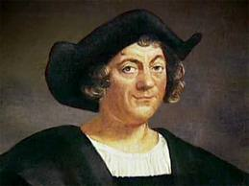
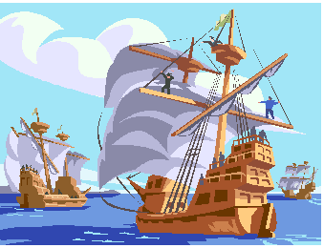

Slide 5
  Discoveries – De Vaca recorded meetings with Native Indians and information on tribal life
    foods
    housing materials and structures
    traditions and ceremonies/culture
    New foods/plants and animals (like the opossum)

Slide 6
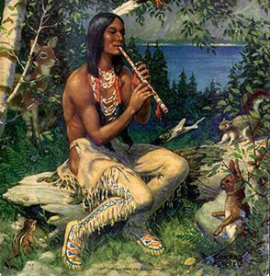
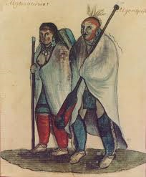
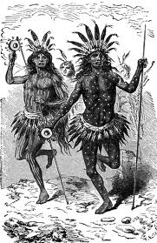
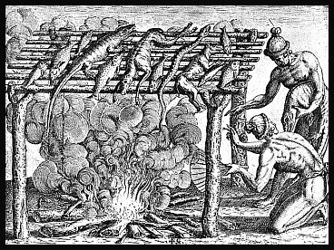
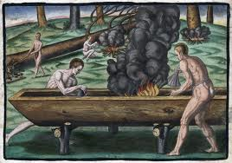

Slide 7
Puritans – any number of Protestant sects that sought to “purify” the established church of England”
Also called “non-conformists” or “dissenters”
  Originated with two ships: The Mayflower and The Speedwell
    2 month journey
    they turned back because of bad weather and difficulties twice
    Speedwell was finally abandoned after numerous problems with leaks
    Mayflower finally landed with approximately 100 people on board.

Slide 8
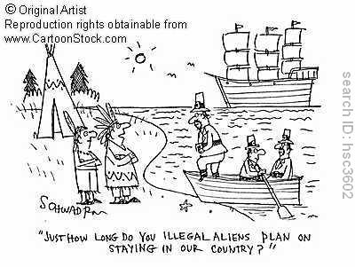

Slide 9
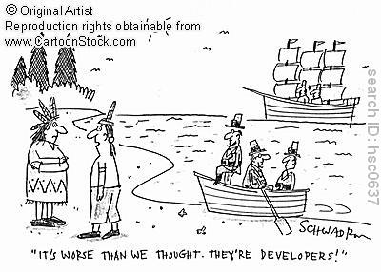

Slide 10
  Puritan Beliefs
    Described as: practical, committed, convinced of the rightness of their purpose.
    Puritans taught that all mankind had sinned against God because of Adam’s “Original Sin”
    But God sent his son as an act of mercy to allow “some” to be saved
    The question then became: How did you know if you were saved or damned?

Slide 11
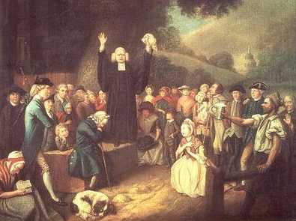

Slide 12
  Predestination
    In theory – a person’s fate was determined by God, even before he was born.
    A person had no control or influence over whether he was one of the lucky few, therefore Puritans lived their lives with the hope that they were worthy of being saved if they were one of those lucky few.
    The worse fate that could befall a person was to be one of the few, but be rejected by God because of an unholy life.

Slide 13
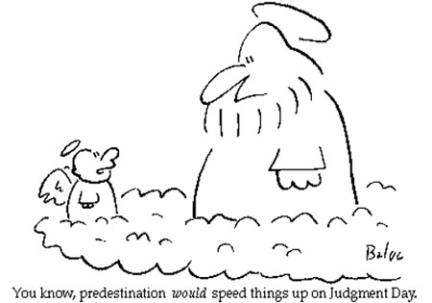

Slide 14
    According to their theology – there were two principal indicators of the state of your soul, neither certain.
      Saved by Grace and you could feel its arrival in your body in an intensely emotional fashion. It was most likely demonstrated through your behavior. You would behave like a “saint”.
      Living a life of value – industriousness, temperance, sobriety, and simplicity.

Slide 15
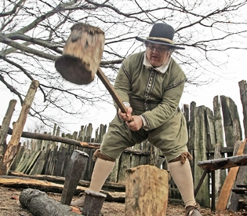
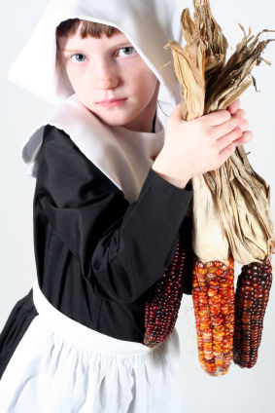
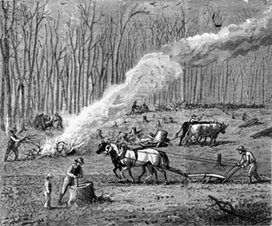

Slide 16
  Government
    Because of past experiences (in England) Puritans rejected the idea of a national church.
    They did believe that the sinful nature of man made government absolutely necessary.
    Government was viewed as a contract between man and God.
    They believed that the laws should be based on the inflexible laws of God.
    To commit a crime was also to commit a sin; therefore punishment was designed to bring about repentance.

Slide 17
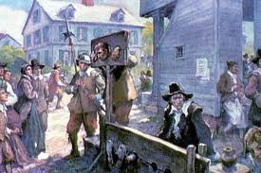
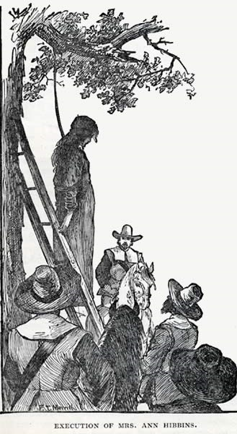
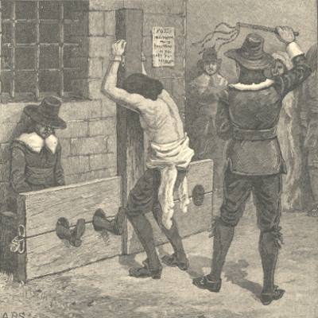

Slide 18
The Pilgrim
  One who makes a journey to a holy place. For Puritans, this was more than just a journey to a new land, but was also a journey towards salvation.
  Symbols existed everywhere and in every thing and were frequently interpreted within the context of their lives.

Slide 19
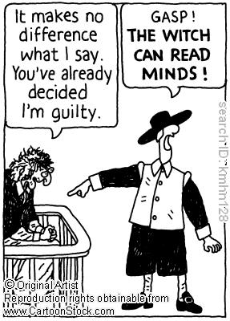

Slide 20
Education – Puritans believed that the Bible was the literal word of God and that being able to read that word was absolutely necessary for everyone.
  Great emphasis on education for both men and women, even slaves and servants.
  People were educated not just for literacy, but for higher education (denied to them in England) like philosophy and analysis.
  Harvard College was founded in 1636
    6 years after the Massachusetts Bay colony
    16 years after the first Pilgrims

Slide 21
Puritan Writings
  The Bible was the foundation of Puritan literature
  They focused on plain style with no ceremonies or celebrations
  Because of the reflective nature of their faith and the significance of the symbols in their lives, people frequently kept journals of their experiences as a way of reflecting on the life lessons they were learning.
    Journals allowed people to examine God’s communication with mankind
    Journals became excellent resources into the lives of the people from this time
    Common themes were: revelations, lessons learned, and spiritual truths.

Slide 22
