Slide 1
Research Paper Note Cards
Step #3 On the Path to Success!

Slide 2
PLAGIARISM
It's like lip-synching to someone else's voice and accepting the applause and rewards for yourself.
IF YOU PLAGIARIZE, YOU WILL FAIL!!! …any time you take a writer’s words and use them as your own, you are plagiarizing

Slide 3
Using another writer’s words as your own… the right way!
Paraphrase/Summarize
Quote
Include your own thoughts about what the writer has to say
ALWAYS GIVE THE CREDIT TO THE REAL AUTHOR!

Slide 4
STEP #1
Locate information that you think will be valuable in your research paper.

Slide 5
STEP #2
Create a source card to record the author’s publication information.

Slide 6
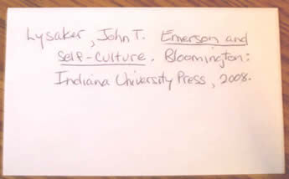
Don’t forget your punctuation.
A
Author’s name
Indent
SOURCE CARD

Slide 7
STEP #3
Begin taking notes on your notecards. Remember---
one thought = one card.

Slide 8
WHAT GOES ON A NOTE CARD?
Any information that is not common knowledge (ie. Your author was born on Earth).

Slide 9
HOW TO TAKE ANOTHER AUTHOR’S INFORMATION??
Paraphrase
Summarize
Quote

Slide 10
PARAPHRASE/ SUMMARIZE
Summarize (compress/shrink down) in your own words
Translate and rewrite what the author is saying·

Slide 11
PARAPHRASE Example of what you read:
"I had to explain to him that I was deaf. I said, 'Wait; I can't hear; please talk slowly.' He looked at me and said, 'What?' I told him again I was deaf, and he said, 'Oh.' He pointed to a door and told me to go through that door. I followed his instructions. I opened the door and walked through it, closing the door behind me. I found that I was in the hallway near the elevator where I had just come up. I was shocked! He had rejected me without any explanation. I got into the elevator, and as it descended, I felt very letdown. I couldn't understand why he didn't give me a chance to explain that I could do the job well. It didn't require hearing!"
-- Bernard Bragg, My First Summer Job, A Handful of Stories, 19

Slide 12
PARAPHRASE An Example of paraphrasing what you read
In A Handful of Stories, Bernard Bragg tells a story of trying to get a job. One time he told a potential employer he was deaf, and the man just pointed to the door. Mr. Bragg, not realizing the man was telling him to leave, opened the door and stepped out. Not until he went out the door did he realize he had been rejected because he was deaf (19).

Slide 13
QUOTE
Use quotation marks “ “ to show EXACTLY what the author was saying
Quotes that are more than four lines should be set apart by double indenting your text.
Include Author’s Last Name and Page Number on which you found the information, directly after the quote
For example,
According to Hughes, “poetry rocks!” (Hughes p. 2)

Slide 14
Stay organized…
In order to keep your ideas in order, and to remember where you found the ideas, there are four items that you should include on the index card

Slide 15
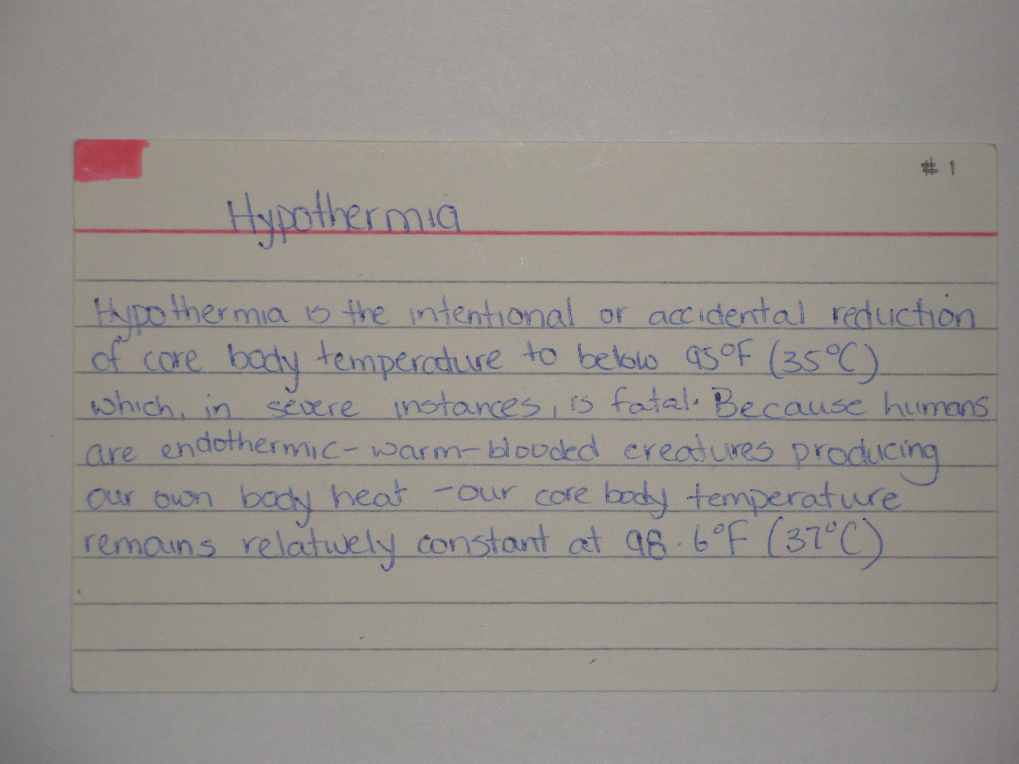
Source and Card #
Topic
A
Note/Quote
John Smith p.212
Author and Page #

Slide 16
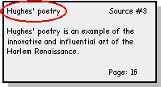
1. Card Topic
Topic is the kind of information on the card.
Think of it as the title, or main idea of the card. After writing down the information, figure out how you could briefly categorize, or title it.

Slide 17
Card Topic
For example, if you are writing a paper on the life and works of the poet, Langston Hughes, you may have cards with topics such as:
Hughes' upbringing
Hughes' influences
Hughes' poetry
Hughes' political beliefs
Hughes' influence on America

Slide 18
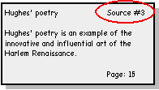
2. Source Title
The source title is the name of the book, magazine, website, etc., in which you found the information.
You will want to make a separate card and list ALL Catalog Card information (publisher, etc.).

Slide 19
Giving Your Source a Number
In the previous example, the source was given a number, instead of writing out the entire title, author, etc.
Remember that your novel is always your primary source and should be identified a “A”.

Slide 20

A
B
Letter your sources on this list
Use the letters on the note cards to specify which source provided which fact.

Slide 21
3. Paraphrased information
It is helpful to paraphrase, or summarize, your research on the index cards while you are taking notes. If you are consistent in paraphrasing at this stage, then you will be certain not to accidentally plagiarize someone else's work. You will also have less work to do when you are actually writing the paper.

Slide 22
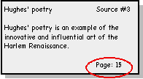
4. page numbers
It is important to be accurate with the page numbers on your note cards, as you will need them for citations throughout your research paper.

Slide 23
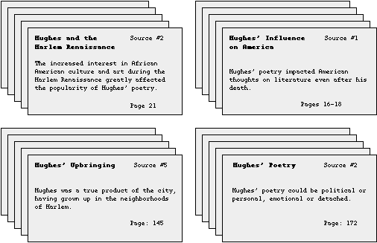
Sample Note Cards
Organized by Card Topic

Slide 24
Requirements
A minimum of 5 source cards. Make sure that your sources are valid (ie. NO Wikipedia!)
A minimum of 50 note cards. You may have more. The more you have, generally the easier it is to write your paper.

Slide 25
THE END!

