Slide 1
GREEK THEATER
Background Information for “Antigone”

Slide 2

PURPOSE OF GREEK DRAMA
Dramas presented by the state at annual religious festivals.
Plays were supposed to be presented for the purpose of ethical and moral improvement of the spectators and to ensure the spiritual survival of the community.
Winners of prizes were selected by ten citizens chosen by lots for the duty.

Slide 3
MECHANICS OF GREEK DRAMA
Actors were all male. They wore masks.
Scenes of the drama were always outdoors; indoor actions were reported by messengers.
There was no violence on stage
There was “unity” in plot -- no subplots or irrelevancies.
The action always took place in one day.
There were no curtains or intermissions.

Slide 4
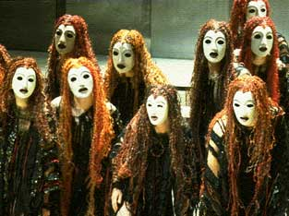
CHORUS IN GREEK DRAMA
The function of the chorus was to :
  set the mood of the drama
  interpret events
  relieve the tension
  generalize meaning of the action
  converse with and give advice to the actors
  give background information
  emphasize the beauty of poetry and dancing
  leader acted as spokesman for the group

Slide 5
Greek Masks
The use of masks in ancient Greek theater draw their origin from the ancient Dionysian cult.
The members of the chorus wore masks, usually similar to each other but completely different from the leading actors
Because the number of actors varied from one to three, they had to put on different masks, in order to play more roles.
The actors were all men. The mask was therefore necessary to let them play the female roles.

Slide 6
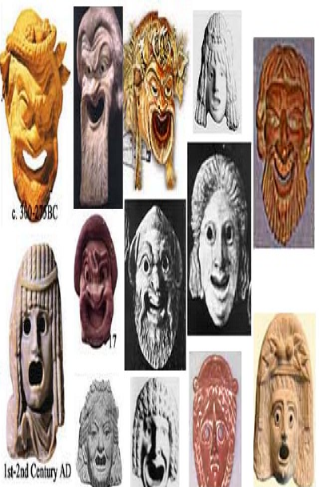
Greek Masks

Slide 7
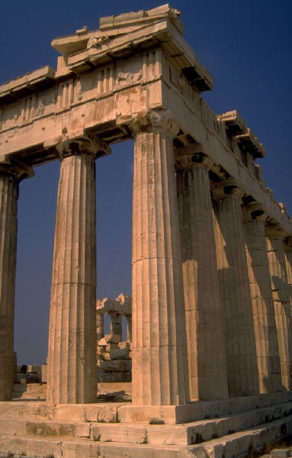
SUBJECT OF PLAYS
The subject was almost exclusively taken from well-known myths.
The plays explored the mysteries of life and the role of the gods in human affairs.
The main purpose was ethical and religious instruction.

Slide 8
STYLE IN PLAYS
There are long, wordy speeches (sometimes about current events or contemporary people).

Slide 9
MESSAGE FROM TRAGEDIES
Out of great tragedy comes wisdom.

Slide 10
CONCEPT OF TRAGIC HERO AND TRAGEDY (from Aristotle)
Tragedy arouses the emotions of pity, fear, wonder and awe.
A tragic hero must be a man or woman capable of great suffering.
Tragedy explores the question of the ways of God to man.
Tragedy purifies the emotions (catharsis)
Tragedy shows how man is brought to disaster by a single flaw in his own character.

Slide 11
Antigone and Greek Theatre Terms
exodus --
Dionysus --
skene --
theatron or
orchestra --
parados --
catharsis--
prologue –
episode/scene --
stasimon --
chorus –
choragas --
proscenium --
choral ode --
strophe --
antistrophe –
epode --
hubris –
humartia --
sphinx --
unities --

Slide 12
Antigone and Greek Theatre Terms
exodus -- final action of the play
Dionysus -- God of drama
skene -- wooden building with three doors through which actors made their entrances and exits
theatron or orchestra -- dancing place of the chorus
parados -- chorus marching in from the left or right
catharsis-- beneficial effect the tragedy has on the audience.

Slide 13
prologue -- opening scene (introduction)
episode -- act or scene
stasimon -- choral ode (end of each episode)
chorus -- clarifies experiences and feelings of the characters and expresses conventional attitude toward development in the story; also sets the mood
proscenium -- level area in front of the skene on which most of the plays action took place
choral ode -- lyric sung by the chorus which develops the importance of the action

Slide 14
strophe -- a turning, right to left, by chorus
antistrophe -- a turning, left to right, by chorus
choragas -- leader of the chorus
epode -- the part of a lyric ode following the strophe and antistrophe
hubris -- Greek word for excessive pride or arrogance

Slide 15
humartia -- Greek word for error in judgment, especially resulting from a defect in the character of a tragic hero; the tragic flaw
sphinx -- a female monster, usually represented as having the head and breast of a woman, the body of a lion, and the wings of an eagle
unities -- time, place, action; a play should have no subplot, should not cover more than 24 hours and should not have more than one locale

Slide 16
Antigone by Sophocles

Slide 17
Background on Antigone
Antigone is one of series of 3 plays: Oedipus Rex and Oedipus at Colonus complete the trilogy
All 3 deal with the curse of Oedipus and how it affects his family for generations
Curse:
Prophecy to the king and queen of Thebes that their son will kill his father and marry his mother
“Oedipus Complex”

Slide 18
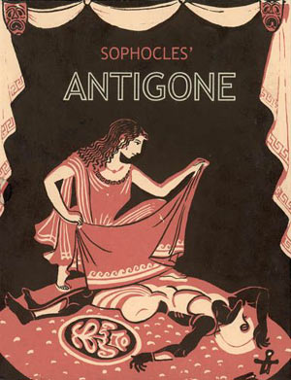
a tragedy written in 442 BC by Sophocles
chronologically the third of the three Theban plays but was written first
  Oedipus the King
  Oedipus at Colonus
  Antigone

Slide 19
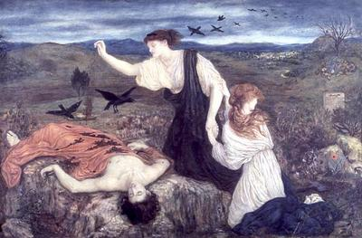
After Oedipus is exiled, he leaves the ruling rights of Thebes to his two sons, Eteocles and Polynieces who must take it in turns to rule.
Eteocles rules first but the two becomes enemies after Eteocles refuses to give up the throne, and Polynieces is exiled.
At the beginning of the play, both brothers are dead, apparently slain by the other's hand.

Slide 20
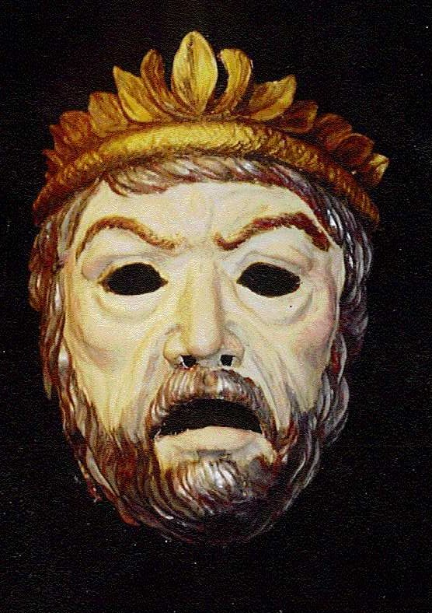
The current ruler, Creon, has made a decree: Since Polynieces fought against Thebes, he shall not be buried. Meanwhile, Eteocles is to be buried with full military honors.

Slide 21
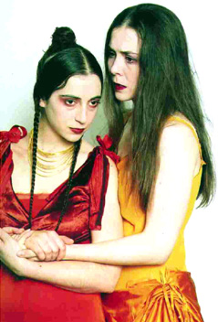
Antigone, the daughter of Oedipus and the sister of the dead brothers, believes this proclamation to be against the gods' orders.
She confides her plan to bury Polynices herself to her sister Ismene. The more timid of the two, Ismene refuses to take part out of fear, but agrees with her motive.

Slide 22
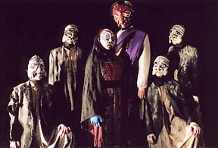
Why study Antigone?
Ancient Greek Drama is the basis for all modern drama and film
The story gives many important clues to the Ancient Greek culture and character
Tragedies still contain the basic elements that they originated with

Slide 23
Relevance of Antigone
Sympathy for Antigone and Haemon
Woman with audacity to challenge a male dominated world
Vindictiveness of the King
Right of a human being to dispute an unjust law
Broader political allegory of Sophocles

Slide 24
Enduring Understanding
  To what degree will you go to preserve self-interest versus acting on behalf of the common good?

Slide 25
Essential Questions
  1. Is it more important to be right than to be happy?
  2. Is it our responsibility to rebel against and break an unjust law?
  3. What price should a person be willing to pay if he/she breaks an unjust law?
4. Can a leader show uncertainty and maintain leadership?

Slide 26
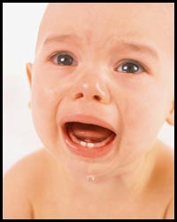
Pathos
Pathos appeals rely on emotions and feelings to persuade the audience
They are often direct, simple, and very powerful

Slide 27
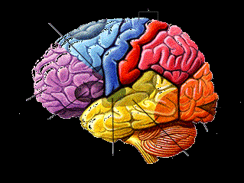
Logos
“Logos appeals” rely on the audience’s intelligence to persuade them.
Education causes audiences to be more skeptical of emotional arguments and more receptive to logos

Slide 28
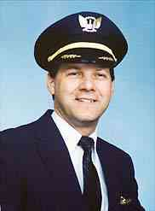
Ethos
Ethos is a person’s credibility with a given audience. It can mean sincerity, authority, expertise, faithful, or any adjective that describes someone you can trust to do the right thing.

Slide 29
What is rhetoric?
Aristotle defines rhetoric as
  The faculty or ability to discover all available means of persuasion in a given situation.
Rhetoric is the counterpart of “dialectic,” a type of formal reasoning that leads to truth. Rhetoric is what allows us to communicate these truths.

Slide 30
