Slide 1

Nonfiction Notes

Slide 2
7 Types of Nonfiction
Autobiography or Biography
Encyclopedia
Essay
Feature Story
Interview
Newspaper Articles
Textbook

Slide 3
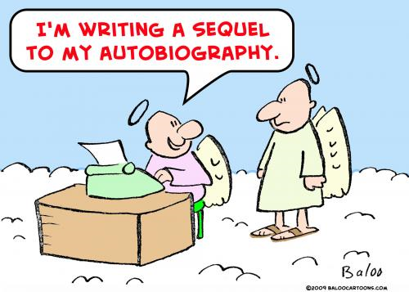

Slide 4
Autobiography or Biography
Written about a person’s life or one main event
Has a plot to inform
Can be read in one sitting or have many chapters

Slide 5


Slide 6
Encyclopedia
Information organized by topic
Topics organized alphabetically to inform
The entries are short
Used for research

Slide 7
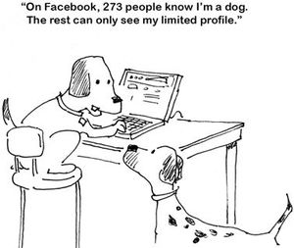

Slide 8
Essay
Can be based on research or personal experience to inform
Can be read in one sitting to persuade
Written in paragraph form, usually five or more to entertain

Slide 9
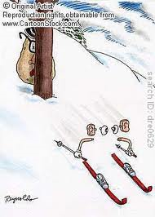

Slide 10
Feature Story
Focuses on one topic or main idea to inform
Has a plot to entertain

Slide 11


Slide 12
Interview
Recorded word for word to inform
Can be read in one sitting to entertain
May be written in bullet format or like a drama

Slide 13
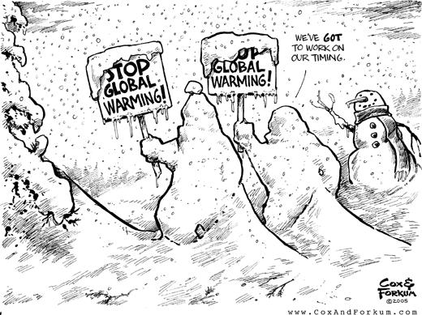

Slide 14
Newspaper Articles
Short to inform
Can be read in one sitting to persuade
Focuses on one topic or main idea

Slide 15


Slide 16
Textbook
Information organized by topic
Used for reference to inform
Organized chronologically (by time) or by topic

Slide 17


Slide 18
What is nonfiction? Nonfiction is a form of literature based primarily on facts.
It is prose writing that presents and explains ideas or tells about real people, places, objects, or events.

Slide 19
The Five Main Purposes of Nonfiction Writing
Entertain
Inform
Reflect
Describe
Persuade

Slide 20
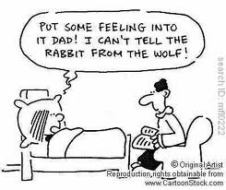

Slide 21
Types of Nonfiction Writing
Narrative – written as a story.
  Biographies – a life story written by another person.
  Autobiographies – the writer’s account of his or her own life.
  Memoirs and Journals – contain personal thoughts and reflections.
  Travel Literature – records journeys in the world, which are often journeys within yourself.
  Letters – written texts addressed to a particular person or organization.
  Blogs – (a.k.a. web logs) journals posted and frequently updated for an online audience.

Slide 22
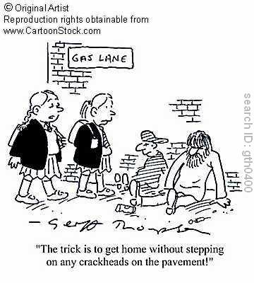

Slide 23
Expository – writing that explains or informs. It presents facts and ideas, or explains a process. Essays, speeches, and textbooks are all examples of expository writing.

Slide 24
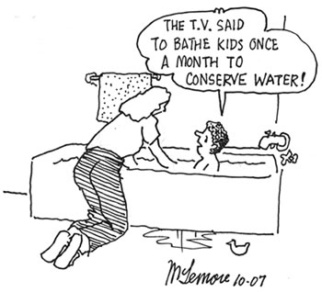

Slide 25
Persuasive – writing that is intended to convince the reader to adopt a particular point of view or take a particular course of action. Newspaper editorials, letters to the editor, speeches, essays, and advertisements are all forms of persuasive writing.

Slide 26
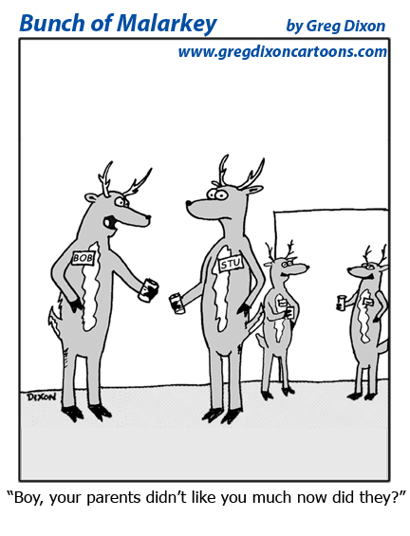

Slide 27
Descriptive – writing that is a portrait, in words, of a person, place, or object. Descriptive writing uses images that appeal to the five senses. Most forms of writing can be descriptive.

Slide 28
For each of these types of nonfiction, the writing may be objective, based on facts, or subjective, based on opinion. Sometimes the writing is a combination of the two, but, more often than not, a reader can identify which is more common.

Slide 29
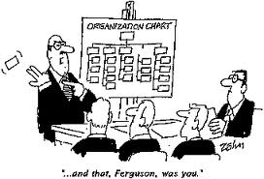

Slide 30
Elements of Nonfiction Writing
Organization – the way a writer chooses to arrange and present information in a single piece of writing.
  Chronological – presents information in time order, from first to last or last to first.
  Compare-and-Contrast – shows the ways in which two or more subjects are similar and different.
  Cause-and-Effect – shows the relationship among events.
  Problem-and-Solution – identifies a problem and then offers a solution.

Slide 31


Slide 32

Tone – the writer’s attitude toward his or her audience and subject.
  Formal – uses formal language, no slang. Everything is grammatically correct.
  Informal – written as though you were writing to a friend.
Voice – the writer’s way of “speaking” in his or her writing.

Slide 33


Slide 34

Objective vs. Subjective Writing –
  Objective – facts that can be proved true by the senses.
  Subjective – verifiable (true) only by reference to your own state of mind and experiences. Nobody knows the truth of that state except the writer.

Slide 35


