Slide 1
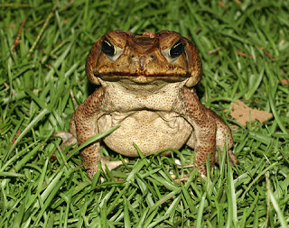

Marianne Moore
“A poem is an imaginary garden with real toads in it.”
Notes:
What did Marianne mean?

Slide 2

Poetry
What do we Know?

Slide 3
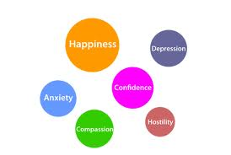
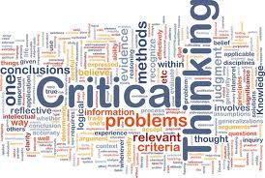
Two Ways to Read Poetry
For the emotional impact
For the analytical impact

Slide 4
Poetry
A type of literature that expresses ideas, feelings, or tells a story in a specific form using lines and stanzas.

Slide 5

Poetry
How thin and sharp is the moon tonight!
How thin and sharp and ghostly white
Is the slim curved crook of the moon tonight!
Notes:
What things do we usually associate with words like thin and sharp?

Slide 6
We know….
Poet
Speaker
The poet is the author of the poem
The speaker in the poem is the narrator of the poem. The speaker may be human but just as often, it may be an animal or object

Slide 7
Poetry Form
My dad
Taught me
How to fight
He would
Always tell
Me to stick
And move
Never put your
Guard down
Every weekend
We Would do my
Morning chores
Form is the way the words are arranged on the page.
Notes:
How many stanzas? 4 Line count? triplet

Slide 8
Stanza
The sea creeps to pillage,
She leaps on her prey;
A child of the village
Was murdered today.
She came up to meet him
In a smooth golden cloak,
She choked him and beat him
To death, for a joke.
Her bright locks were tangled,
She shouted for joy,
With one hand she strangled
A strong little boy.
Now in silence she lingers
Beside him all night
To wash her long fingers
In silvery light.
A group of lines arranged together.
Notes:
Who is the murderer? The sea How was the murder committed?

Slide 9

Kinds of Stanzas
Couplet = a two line stanza
Triplet = A three line stanza
Quatrain = a four line stanza
Cinquain = a five line stanza
Sestet = A SIX LINE STANZA
SEXTET = A SEVEN LINE STANZA
OCTAVE = AN EIGHT LINE STANZA
SONNET = A FOURTEEN LINE STANZA

Slide 10


Kinds of Stanzas
Couplet = a two line stanza A couplet is a pair of lines of verse. It usually consists of two lines that rhyme and have the same meter.
  Where-e'er you find "the cooling western breeze,"
  In the next line, it "whispers through the trees;"
  If crystal streams "with pleasing murmurs creep,"
  The readers threatened (not in vain) with "sleep."

Slide 11

Kinds of Stanzas
Quatrain = a four line stanza a quatrain is a poem or a stanza within a poem that consists of four lines, in which the lines 2 and 4 must rhyme. Lines 1 and 3 may or may not rhyme. Quatrain usually follows an abab, abba, abcb, aabb, or aaba ( More about this later)
    The Curfew tolls the knell of parting day,
    The lowing herd wind slowly o'er the lea,
    The plowman homeward plods his weary way,
    And leaves the world to darkness and to me.

Slide 12
Rhythm
The beat created by the sounds of the words in a poem. Rhythm can be created by meter, rhyme, alliteration, and repetition.
I’m through, Can you sing a song for me Boo?

Slide 13
Meter
A pattern of stressed and unstressed syllables.
Meter occurs when the stressed (strong) syllables and unstressed (weak) syllables of the words in a poem are arranged in a repeating patterns
amBER amBER amBER amBER
kyUH kyUH kyUH kyUH
jorDAN jorDAN jorDAN jorDAN
ˇ ′ ˇ ′ ˇ ′ ˇ ′

Slide 14
Meter
A pattern of stressed and unstressed syllables.
When poets write in meter, they count out the number of stressed (strong) syllables and unstressed (weak) syllables for each line.
amBER amBER amBER amBER
kyUH kyUH kyUH kyUH
jorDAN jorDAN jorDAN jorDAN
ˇ ′ ˇ ′ ˇ ′ ˇ ′

Slide 15
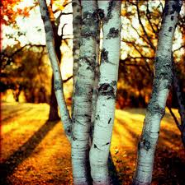
Blank Verse
Unrhymed poetry with meter.
When I see birches bend to left and right
Across the lines of straighter darker trees,
I like to think some boy’s been swinging them.

Slide 16
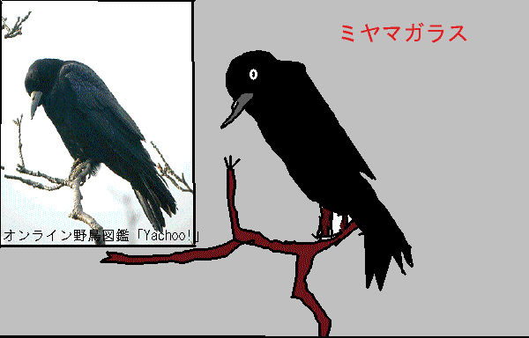
Free Verse
Free Verse poetry is very conversational. It sounds like someone talking to you.
It does not have any repeating patterns of stressed and unstressed syllables
It does not rhyme.

Slide 17
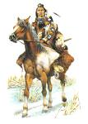

Free Verse
My Enemy Was Dreaming
1 when I found my enemy sleeping
i stood over him as still
as the owl at night
as the heron waiting for fish
i raised my knife to kill him
6 then I saw my enemy was dreaming
his mouth made a little smile
his legs trembled
he made small sleep sounds
10 only I will have this memory
i will show the others
only the horse of my enemy
i will not tell the others
i left my enemy dreaming

Slide 18
Narrative Poetry tells a story
Richard Cory
Whenever Richard Cory went down town,
We people on the pavement looked at him:
He was a gentleman from sole to crown
Clean favored and imperially slim.
And he was always quietly arrayed,
And he was always human when he talked;
But still he fluttered pulses when he said,
“Good-morning,” and he glittered when he walked

Slide 19
Narrative Poetry tells a story
And he was rich - yes, richer than a king-
And admirably schooled in every grace:
In fine, we thought he was everything
To make us wish that we were in his place.
So on we worked, and waited for the light,
And went without the meat, and cursed the bread;
And Richard Cory, one calm summer night,
Went home and put a bullet through his head.
There is a plot, there is a conflict, and there are characters in Narrative poetry.

Slide 20


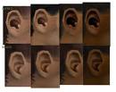

The Sounds of Poetry
the devices poets use to make their poems pleasing to the ear.

Slide 21
Rhyme
Type Definition Example
True/Perfect | last stressed vowel sound and everything following in the words are identical | shining and whining
Internal | the rhyming sounds are within the lines of a poem, rather than at the ends | The sun shone high its brilliant eye
Off/Near/Slant | words in which the final consonant sounds are alike and the words echo each other | cough and huff

Slide 22
END RHYME
is of course the rhyming of words at the ends of two or more lines of poetry.
Whose woods these are I think I know.
His house is in the village though;

Slide 23
Internal RHYMe
The rhyming of words in the middle of lines.
After he had made an out,
A pout rattled around his mouth

Slide 24
Internal RHYMe
The rhyming of words in the middle of lines.
I'm a lean dog, a keen dog, a wild dog, and lone;
I'm a rough dog, a tough dog, hunting on my own;
I'm a bad dog, a mad dog, teasing silly sheep;
I love to sit and bay the moon, to keep fat souls
from sleep.

Slide 25
Rhyme Scheme
Pattern of rhyme in a stanza or poem. You can identify the rhyme scheme in stanzas by looking at the last word in the line and assigning letters to the rhyming words
Example
Like the sun behind the clouds A
Like the darkness of the night B
Like the grass beneath the trees C
You stepped into the light… B

Slide 26
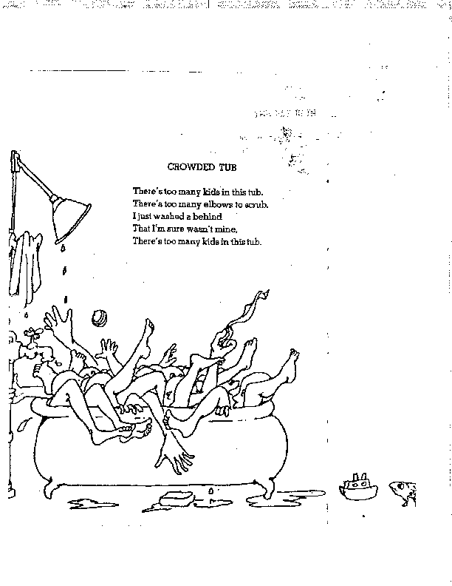
Shel Silverstein
A
A
B
B
A
What is the line count form?
cinquain

Slide 27
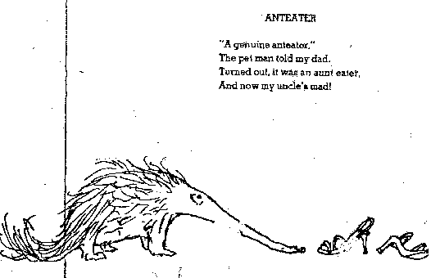
Shel Silverstein
A
B
A
B
What is the line count form?
quatrain

Slide 28
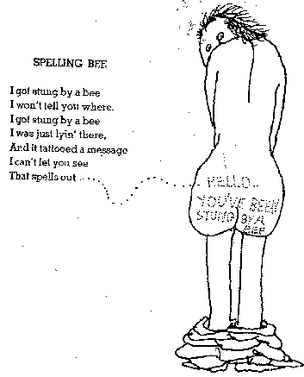
Shel Silverstein
A
B
A
B
C
A
D
A
What is the line count form?
octave

Slide 29
Rhyme Scheme Practice
1.
I knew I’d have to grow up sometime, ______
That my childhood memories would end, ______
But a spark within me died, ______
When I lost my imaginary friend. ______
2.
As the sun set and the moon came, ______
I looked out the window in dread and shame. _____
The sound of birds rose from the sky, ______
I waved my hand and bid goodbye. ______

Slide 30
Rhyme Scheme Practice
3.
When I look into his eyes, ______
I see the deep blue sea. ______
I hope my love never dies, ______
That he’ll always be there for me. ______
4.
And here ends the saga ______
Of writers who have grown. ______
We’re successful authors, ______
Now we will be unknown. ______

Slide 31
We Real Cool
by Gwendolyn Brooks
5.
The Pool Players.
Seven at the Golden Shovel.
We real cool. ______
We left school. ______
We lurk late. ______
We strike straight. ______
We sing sin. ______
We thin gin. ______
We Jazz June. ______
We die soon. ______
Find an example of internal rhyme.
thin and gin

Slide 32

Sadie and Maud
6.
by Gwendolyn Brooks
Maud went to college. ______
Sadie stayed at home. ______
Sadie scraped life ______
With a fine-tooth comb. ______
She didn’t leave a tangle in. ______
Her comb found every strand. ______
Sadie was one of the livingest
chits ______
In all the land. ______
Sadie bore two babies ______
Under her maiden name. ______
Maud and Ma and Papa ______
Nearly died of shame. ______
When Sadie said her last so-long _____
Her girls struck out from home. _____
(Sadie had left as heritage _____
Her fine-tooth comb.) _____
Maud, who went to college, _____
Is a thin brown mouse. _____
She is living all alone _____
In this old house. _____

Slide 33
Alliteration
the devices poets use to make their poems pleasing to the ear.
Alliteration The repeating of the beginning consonant sound in words like
dance, dare, and drop
or
Peter Piper picked a peck of pickled peppers

Slide 34
Assonance
the devices poets use to make their poems pleasing to the ear.
Assonance The repetition of vowel sound in words like rain, makes, pavement, and wavy.
Our noses, Our toes, take hold on the loam”

Slide 35
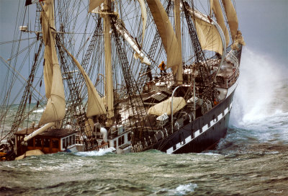
Consonance
The sailor sings of ropes and things
In ships upon the seas.
The repetition of consonant sounds found in or at the end of words in a line of poetry.

Slide 36
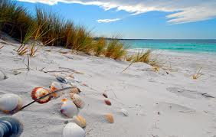
& Alliteration
Assonance
& Consonance
She sells seashells by the seashore

Slide 37
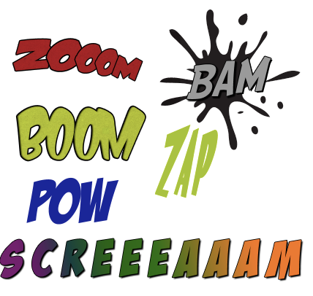
Onamatopoeia
A word whose pronunciation suggests its meaning.

Slide 38
Onomatopoeia
Use of words that sound like the noises they describe.
Poets choose words not just for what they mean, but what they sound like.
Poets use onomatopoeia to liven up their writing and add fun sounds to it.
On the
Fourth of July
you hear:
Crashes
Bashes
Bangs
Zangs
Whooshs
Barooms
Whews
“The Fourth”
by Shel Silverstein
Oh
CRASH!
my
BASH!
it’s
BANG!
the
ZANG!
Fourth
WHOOSH!
Of
BAROOM!
July
WHEW!

Slide 39
Personification
Type of figure of speech that gives human qualities to animals, objects, or ideas.
Adds life to a poem and helps the reader view a familiar thing in a new way.
“Snowy Benches”
by Aileen Fisher
Do parks get lonely
in winter, perhaps,
when benches have only
snow on their laps?
Parks have feelings and benches have laps.
The poet asks whether the parks feel lonely
in winter, like people sometimes do.

Slide 40
Idiom
“Last Night”
by David L. Harrison
Last night I knew the answers.
Last night I had them pat.
Last night I could have told you
Every answer, just like that!
Last night my brain was cooking.
Last night I got them right.
Last night I was a genius.
So where were you last night!
An everyday saying that doesn’t exactly mean what the words say.
Poet’s use idioms because that’s the way people talk to each other.
Example: “easy as pie” means you are able to do something without difficulty
“I had them pat” - knowing something well.
“My brain is cooking” - it was working fast
and bubbling over with ideas.

Slide 41
Mood
“Poor”
by Myra Livingston
I heard of poor.
It means hungry, no food.
No shoes, no place to live,
Nothing good.
It means winter nights
And being cold,
It is lonely, alone.
Feeling old.
Poor is a tired face.
Poor is thin.
Poor is standing outside
Looking in.
Short words
and lines
create a
serious mood.
Feeling that a poem creates in the reader.
Can be positive or negative.
Poet creates the mood with the length of sentences, the words chosen, punctuation, and the sounds of the words.
Words create
a feeling of sadness.

Slide 42

Repetition
The repeating of a word or phrase to add rhythm or to emphasize a certain idea.
The wind hissed, hissed down the alley.

Slide 43

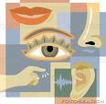

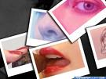
Imagery
comes to us through our five senses.

Slide 44
Imagery
comes to us through our five senses.
They allow us to see, hear, smell, taste, and touch. Poets use special language to create mental pictures or sounds or smells. Imagery is the name we give to the use of this special language.

Slide 45

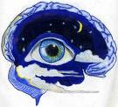
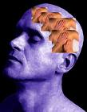
Imagery
comes to us through our five senses.
Most imagery is visual. It creates pictures in the reader’s mind by appealing to the sense of sight. .

Slide 46



Imagery
comes to us through our five senses.
Images can also appeal to the senses of sound, touch, taste, and smell.

Slide 47
Imagery
comes to us through our five senses.
While imagery is an element of all types of writing, it is especially important in poetry.

Slide 48

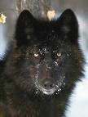
Imagery
Wolves
Last night I heard wolves howling,
their voices coming from afar
over the wind-polished ice – so much
brave solitude in that sound
They are death’s snowbound sailors;
they know only a continual
drifting between moonlit islands,
their tongues licking the stars.

Slide 49
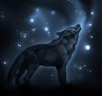
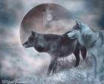
Imagery
But they sing as good seamen should,
and tomorrow the sun will find them,
yawning and blinking
the snow from their eyelashes.
Their voices rang through the frozen
water of my human sleep.
blown by the wind
with the moon for an icy sail

Slide 50
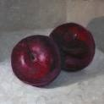

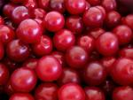
Imagery
I have eaten
the plums
that were in
the icebox
and which
you were probably
saving
for breakfast
Forgive me
they were delicious
so sweet
and so cold

Slide 51
Practice Quiz
I’ll put some lines of poetry on the board.
Write down which techniques are used:
Alliteration, consonance, rhythm, rhyme, and onomatopoeia.
Some poems use more than one technique.

Slide 52
1
The cuckoo in our cuckoo clock
was wedded to an octopus.
She laid a single wooden egg
and hatched a cuckoocloctopus.

Slide 53
2
They are building a house
half a block down
and I sit up here
with the shades down
listening to the sounds,
the hammers pounding in nails,
thack thack thack thack,
and then I hear birds,
and thack thack thack,

Slide 54
3
very little love is not so bad
or very little life
what counts
is waiting on walls
I was born for this
I was born to hustle roses down the
avenues of the dead.

Slide 55
4
The whiskey on your breath
Could make a small boy dizzy;
But I hung on like death:
Such waltzing was not easy.

Slide 56
5
Homework! Oh, homework!
I hate you! You stink!
I wish I could wash you
away in the sink.

Slide 57
Answers
1. Repetition, rhythm, rhyme, consonance, and light alliteration.
2. Onomatopoeia, consonance, repetition
Alliteration, repetition
Rhythm, rhyme, light alliteration
Repetition, rhyme, rhythm

Slide 58
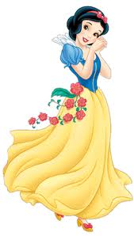
Snow White's Acne by Denise Duhamel
At first she was sure it was just a bit of dried strawberry juice,
or a fleck of her mother's red nail polish that had flaked off
when she'd patted her daughter to sleep the night before.
But as she scrubbed, Snow felt a bump, something festering
under the surface, like a tapeworm curled up and living
in her left cheek.
Doc the Dwarf was no dermatologist
and besides Snow doesn't get to meet him in this version
because the mint leaves the tall doctor puts over her face
only make matters worse. Snow and the Queen hope
against hope for chicken pox, measles, something
that would be gone quickly and not plague Snow's whole
adolescence.

Slide 59
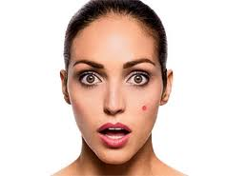
Snow White's Acne by Denise Duhamel
If only freckles were red, she cried, if only
concealer really worked. Soon came the pus, the yellow dots,
multiplying like pins in a pin cushion. Soon came
the greasy hair. The Queen gave her daughter a razor
for her legs and a stick of underarm deodorant.
Snow
doodled through her teenage years—"Snow + ?" in Magic
Markered hearts all over her notebooks. She was an average
student, a daydreamer who might have been a scholar
if she'd only applied herself. She liked sappy music
and romance novels. She liked pies and cake
instead of fruit.
The Queen remained the fairest in the land.
It was hard on Snow, having such a glamorous mom.
She rebelled by wearing torn shawls and baggy gowns.
Her mother would sometimes say, "Snow darling,
why don't you pull back your hair? Show those pretty eyes?"
or "Come on, I'll take you shopping."

Slide 60
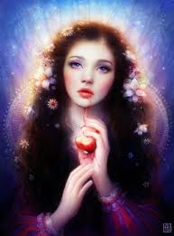
Snow White's Acne by Denise Duhamel
Snow preferred
staying in her safe room, looking out of her window
at the deer leaping across the lawn. Or she'd practice
her dance moves with invisible princes. And the Queen,
busy being Queen, didn't like to push it.

Slide 61
