Slide 1

Short Story Notes

Slide 2
Plot
Plot is what happens and how it happens in a narrative. A narrative is any work that tells a story, such as a short story, a novel, a drama, or a narrative poem.

Slide 3
Plot – the sequence of events that make up a story.
Exposition – introduces characters and setting.
Rising action – development of the story that leads to a climax.
Climax – the highest point of intensity.
Falling action – the story moves toward resolution.
Denouement – the conflict is resolved and the story ends.
Conflict – the problem in the story.

Slide 4
Diagram of Plot
Climax
Rising Action
Falling Action
Introduction
Denouement
Characters
Setting
Conflict

Slide 5
Special Techniques of Plot
Suspense- excitement or tension
Foreshadowing- hint or clue about what will happen in story
Flashback- interrupts the normal sequence of events to tell about something that happened in the past
Surprise Ending- conclusion that reader does not expect

Slide 6

Conflict – a struggle between opposing forces.
Internal – the problem is moral or intellectual.
Man vs. self
For example: Sue’s friend stole from a store and now Sue must decide whether she should tell on her friend or not.

Slide 7

Conflict – a struggle between opposing forces.
External – the problem is outside of the character’s mind.
Man vs. man
For example: Bob is angry with Mark for breaking his truck.
Man vs. nature
For example: Ranger Rick must fight an angry bear.
Man vs. society
For example: Arnold, the lawyer, must fight the legislature to repeal an unfair law.
Man vs. fate/God
For example: Even though the soldier knows detonating the explosives will kill him, he does so to save his platoon.

Slide 8


Symbol – a physical object or event that represents something else.
red = passion or danger.
white = purity or innocence

Slide 9
Character – people (or animals) who appear in a story and impact the plot.
Flat – one sided; stereotypes.
For example: Steven Erchol as the nerd.
Round – well developed; multidimensional.
For example: Antigone as a sister who cares for her family and the laws of the gods.

Slide 10




Character – people (or animals) who appear in a story and impact the plot.
Static – characters do not change during the course of the story. They remain the same no matter what happens to them.
For example: Shaggy and Scooby Doo as the lovable dorks.
Dynamic – characters change or learn something. The changes they undergo affect their attitudes, beliefs, or behavior.
For example: Fonzie from Happy Days who changes from a gang member to a college professor.

Slide 11

Factors in Analyzing Characters
Physical appearance of character
Personality
Background/personal history
Motivation
Relationships
Conflict
Does character change?

Slide 12
Characterization – the ways in which characters appear or are described in a story.
Direct – the author tells you how the character looks and behaves.
Indirect – the author shows you through the actions and reactions of other characters the way a character looks or behaves.

Slide 13
Direct Characterization
…And I don’t play the dozens or believe in standing around with somebody in my face doing a lot of talking. I much rather just knock you down and take my chances even if I’m a little girl with skinny arms and a squeaky voice, which is how I got the name Squeaky.
From “Raymond’s Run” by T. Bambara

Slide 14
Elements of Character

Slide 15
Indirect Characterization
The old man bowed to all of us in the room. Then he removed his hat and gloves, slowly and carefully. Chaplin once did that in a picture, in a bank--he was the janitor.
From “Gentleman of Rio en Medio” by J. Sedillo

Slide 16

Theme
A central message, concern, or insight into life expressed through a literary work
Can be expressed by one or two sentence statement about human beings or about life
May be stated directly or implied
Interpretation uncovers the theme

Slide 17
Theme – the message or general idea about life that the author hopes to convey.
For example: love, courage, honor, doing the right thing, bravery in the face of danger, etc.

Slide 18
Example of Theme
“Every man needs to feel allegiance to his native country, whether he always appreciates that country or not.”
From “A Man Without a Country” by Edward Hale
pg. 185 in Prentice Hall Literature book

Slide 19
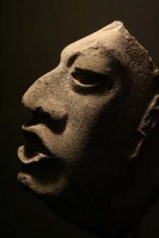


Setting – the time and place a story takes place.
The location: town, the city, the state, the country
The terrain: country, city, natural, urban
The time: past, present, future
The circumstances: new beginning, post war, etc.

Slide 20

Setting
Time and place are where the action occurs
Details that describe:
  Furniture
  Scenery
  Customs
  Transportation
  Clothing
  Dialects
  Weather
  Time of day
  Time of year

Slide 21
Elements of a Setting

Slide 22
The Functions of a Setting
To create a mood or atmosphere
To show a reader a different way of life
To make action seem more real
To be the source of conflict or struggle
To symbolize an idea
We left the home place behind, mile by slow mile, heading for the mountains, across the prairie where the wind blew forever.
At first there were four of us with one horse wagon and its skimpy load. Pa and I walked, because I was a big boy of eleven. My two little sisters romped and trotted until they got tired and had to be boosted up to the wagon bed.
That was no covered Conestoga, like Pa’s folks came West in, but just an old farm wagon, drawn by one weary horse, creaking and rumbling westward to the mountains, toward the little woods town where Pa thought he had an old uncle who owned a little two-bit sawmill.
Taken from “The Day the Sun Came Out” by D. Johnson

Slide 23


Point of View – the perspective from which a story is told.
First person – the narrator is one of the characters and refers to himself with the pronoun “I”.
Third person – the narrator does not participate in the action.

Slide 24

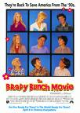
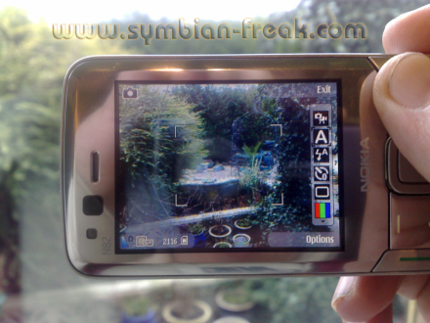
Point of View – the perspective from which a story is told.
Limited – the audience knows the thoughts and feelings of one character in a story.
For example: The Wonder Years
Omniscient – the audience is “god-like”, knowing the thoughts and feelings of numerous characters.
For example: The Brady Bunch Movie
Objective – also known as the “camera-view”; the audience only sees and hears the story as it occurs. They have no knowledge of internal dialogue or emotions.

