Slide 1
Science
The Nervous System

Slide 2
“The Path of a Nerve Impulse”
Do you think you responded quickly to the falling meter stick? No matter how fast you grabbed the meter stick, there was still a little time that passed after you saw it fall. This time-your reaction time- was the time it took for a nerve impulse to make its way through your nervous sytem.

Slide 3
Nerve Impulse:
A nerve impulse is a message carried through your body by nerve cells, or neurons. Neurons are found throughout your body.

Slide 4
Neurons:
Certain neurons, the sensory neurons, pick up signals from the environment. These signals, or stimuli, start a nerve impulse. Your muscles move in reaction to the messages carried to them by another type of neuron, the motor neurons.

Slide 5
Stimulus and response:
What happens between a stimulus and your response? To answer this question, follow the path of the nerve impulse in the illustration.

Slide 6
Continued…..
Now you know the path of a nerve impulse. These impulses are similar to electrical signals and are caused by changes in chemicals in the neurons. A nerve impulse can travel through your nervous system at speeds from 10 to 120 m/s. That’s why you can respond so quickly to a stimulus.

Slide 7
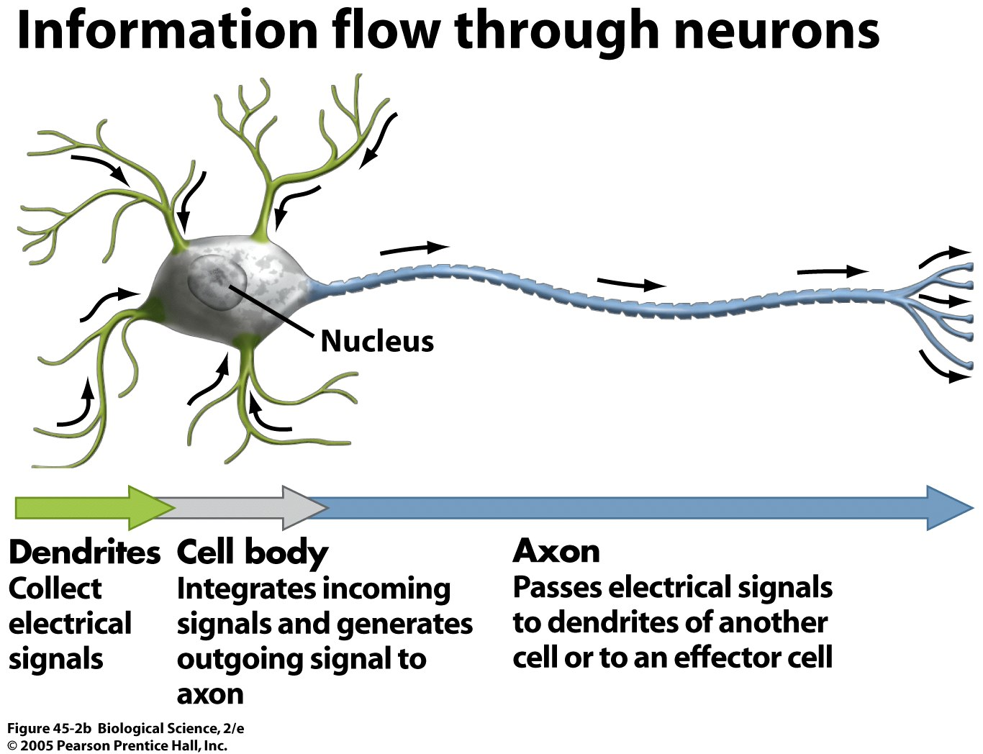
Neuron

Slide 8
Following the nerve impulse:
The nerve impulse begins with a stimulus. The impulse travels through sensory neurons either directly to the brain, or to the spinal column and then to the brain. The brain analyzes the message and decides what action to take. Then the brain sends an impulse back down the spinal column and out through motor neurons to the muscles. As the muscles contract, the body makes the proper responses.

Slide 9
Falling Meter Stick:
The stimulus is the falling meter stick.
The stimulus activates a nerve impulse in sensory neurons in the student’s eyes. The impulse travels through the neurons to the brain.
The brain which contains millions of neurons, analyzes the message. It then sends a message about what to do back through the nervous system by way of the spinal cord.

Slide 10
The spinal cord, a mass of neurons, serves as a path to and from the brain. The spinal cord sends the message to the motor neurons.
The motor neurons pass the message to the muscles of the hand, which provide the response needed to catch the falling meter stick.

Slide 11
Walk straight and tall…
Describe step by step the work of neurons in a person who is trying to walk while balancing a book on his or her head.

Slide 12
Answer…..
The stimulus (the feel of the book on the head) activates nerve impulses that travel to the brain. The brain analyzes the messages and sends messages via the spinal cord about how the body should shift to continue balancing the book.

Slide 13
Spinal Cord….
Suppose part of a person’s spinal cord was damaged. How might this condition affect that person?

Slide 14
Answer:
Damage to the spinal cord could affect a person’s abilities to move parts of his or her body. Messages may not be able to get to a person’s legs, for example. The legs would be unable to move even though nothing is wrong with the legs themselves.

Slide 15
Neurons…..
Describe the difference between a sensory neuron and a motor neuron. Why do we need both kinds?

Slide 16
Answer:
A sensory neuron carries messages from the source of the stimulus to the brain; the motor neuron carries messages from the brain to muscles and other pats of the body. Both are needed to respond to stimuli.

Slide 17
A Tour of the Brain
“All Aboard for a tour of the brain! Check all sharp objects at the gate. Once we get past the skull, we must ensure that the soft tissue of the brain remains uninjured by our journey. Take your seats, please. Here we go!”

Slide 18
Bony Start….
What if you could take a tour of the brain? You’d have to shrink yourself down to board a miniature inner-space ship that will make its way through the complex structure of this control center of the nervous system.
Your first obstacle will be getting through the brain’s protective covering, the skull.

Slide 19
Continued……
The brain is composed of very soft tissue. Without the skull the brain could be seriously injured by the slightest bump. In addition to the bony covering, the brain is protected by three layers of membranes, one of which is tough and leathery. Finally, a watery fluid surrounds the brain, cushioning it from any impact.

Slide 20
Continued…...
Once inside, you’ll find an extremely complex organ containing about 15 billion neurons-not surprising-, considering the important role the brain plays in the body! You’ll see that the brain has three main parts: The cerebrum, the cerebellum, and the medulla.

Slide 21
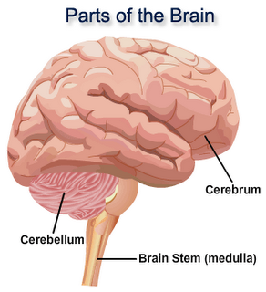

Slide 22
Discussion…
What does the brain allow you to do?

Slide 23
Answer:
Your brain allows you to think, feel, direct movement of muscles, limbs, and activities of major organs.

Slide 24
Rolling Gray Hills and Valleys
Once inside the skull, you’ll find yourself in the cerebrum the largest part of the brain. You can easily get lost in the cerebrum, since its outer layer-the cortex-contains many folds and grooves. These folds give the brain an increased surface area-more thinking space. Your first impression will be one of total grayness. The outer part of the cerebrum contains the gray matter of the brain.

Slide 25
Cerebrum
The cerebrum is divided into two halves, or hemispheres. A band of neurons connects the halves, carrying nerve impulses from one to the other. Thinking takes place in your cerebrum. It is where you store memories and make decisions. The cerebrum is also the place where your emotions and attitudes originate.

Slide 26
South of the Cerebrum:
After exploring the gray matter, you’ll go to the cerebellum, below and to the rear of the cerebrum. The cerebellum , the second largest part of the brain, coordinates the body’s muscles. Your sense of balance comes from the cerebellum. When you first learn a physical activity-a dance routine of swim stroke-you are really training the cerebellum. The nerve impulses that direct your muscles start in the cerebrum but pass through the cerebellum on their way to your muscles. The cerebellum makes sure your movements are smooth and coordinated.

Slide 27
Last Stop:
No trip to the brain would be complete without a stop at the medulla. The medulla connects the brain to the spinal column. You’ll probably notice that, in addition to some gray neuron groups, the medulla contains white matter. The medulla controls the involuntary actions of the body-the actions that you don’t think about. These include heart rate, blood pressure, breathing, blinking, and coughing. Imagine if you had to think about all those actions all the time.

Slide 28
Question:
You’re standing at the free-throw line with the basketball in your hands. How are you using the different parts of your brain as you shoot the free throw?

Slide 29
Answer:
Your cerebrum makes you aware of the environment and has the memory of how to throw the ball. Your cerebellum coordinates the movements of your hands and arms so that you can carry out the actions that you know how to do. The medulla directs your breathing, heart rate, and other life functions that have to be performed for you to be shooting the free throw in the first place.

Slide 30
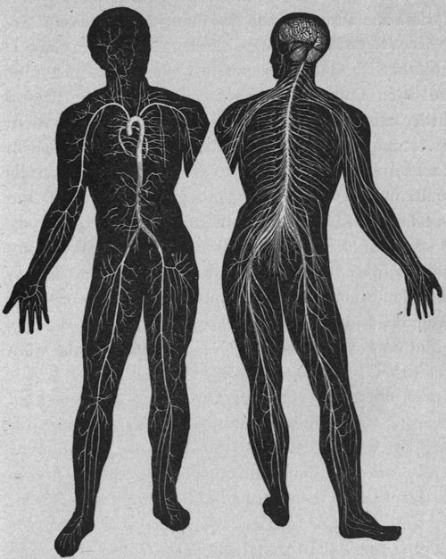

Slide 31
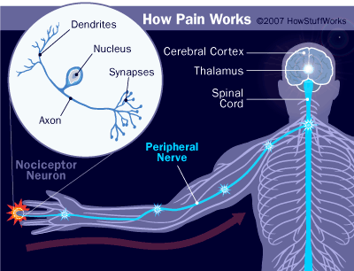

Slide 32
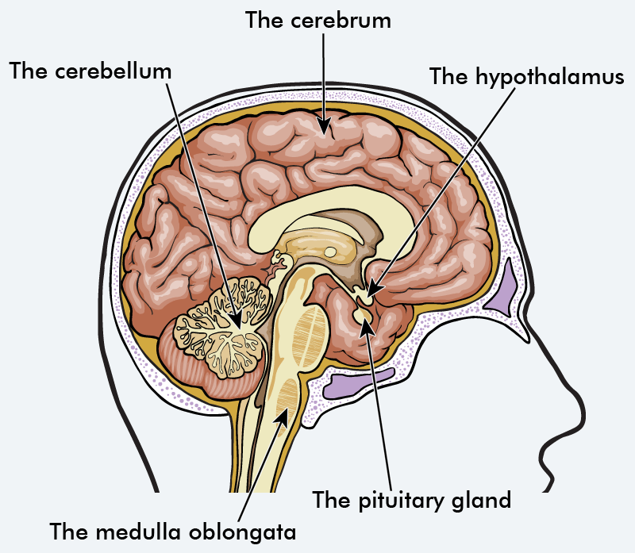

Slide 33
