Slide 1
Chapter 11
Capital Budgeting Cash
Flows and Risk Refinements

Slide 2
Learning Goals
LG1 Discuss relevant cash flows and the three major cash flow components.
LG2 Discuss expansion versus replacement decisions, sunk costs, and opportunity costs.
LG3 Calculate the initial investment, operating cash inflows, and terminal cash flow associated with a proposed capital expenditure.

Slide 3
Learning Goals
LG4 Understand the importance of recognizing risk in the analysis of capital budgeting projects, and discuss risk and cash inflows, scenario analysis, and simulation as behavioral approaches for dealing with risk.
LG5 Describe the determination and use of risk-adjusted discount rates (RADRs), portfolio effects, and the practical aspects of RADRs.
LG6 Select the best of a group of unequal-lived, mutually exclusive projects using annualized net present values (ANPVs), and explain the role of real options and the objective and procedures for selecting projects under capital rationing.

Slide 4
Relevant Cash Flows
To evaluate investment opportunities, financial managers must determine the relevant cash flows—the incremental cash outflow (investment) and resulting subsequent inflows associated with a proposed capital expenditure.
Incremental cash flows are the additional cash flows—outflows or inflows—expected to result from a proposed capital expenditure.

Slide 5
Focus on Ethics
A Question of Accuracy
  Because estimates of the cash flows from an investment project involve making assumptions about the future, they may be subject to considerable error.
  Complications arise with longer and more unique projects, as well as underestimating the costs of litigation or disposing of assets upon completion of the project.
  All too often, mergers and acquisitions do not create much value, in spite of increased government scrutiny and the threat of shareholder lawsuits.
  Improvements in valuation techniques can be negated when the process deteriorates into a game of tweaking the numbers to justify a deal the CEO wants to do, regardless of price.
What would your options be when faced with the demands of an imperial CEO who expects you to “make it work”? Brainstorm several options.

Slide 6
Relevant Cash Flows:
Major Cash Flow Components
The cash flows of any project may include three basic components:
  Initial investment: the relevant cash outflow for a proposed project at time zero.
  Operating cash inflows: the incremental after-tax cash inflows resulting from implementation of a project during its life.
  Terminal cash flow: the after-tax non-operating cash flow occurring in the final year of a project. It is usually attributable to liquidation of the project.

Slide 7
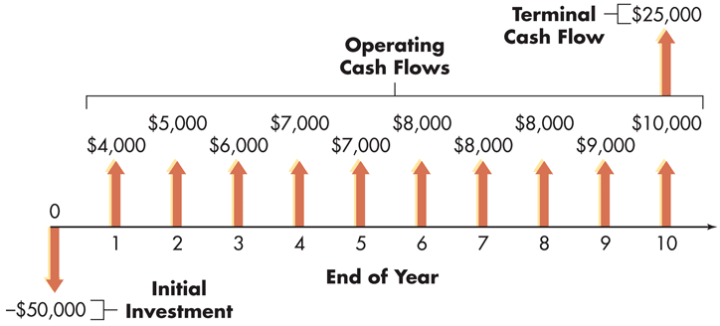
Figure 11.1
Cash Flow Components

Slide 8
Relevant Cash Flows: Expansion versus Replacement Decisions
Developing relevant cash flow estimates is most straightforward in the case of expansion decisions.
In this case, the initial investment, operating cash inflows, and terminal cash flow are merely the after-tax cash outflow and inflows associated with the proposed capital expenditure.
Identifying relevant cash flows for replacement decisions is more complicated, because the firm must identify the incremental cash outflow and inflows that would result from the proposed replacement.

Slide 9
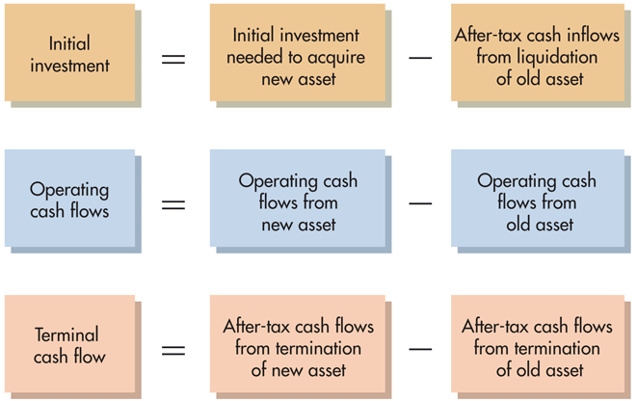
Figure 11.2 Relevant Cash Flows for Replacement Decisions

Slide 10
Relevant Cash Flows: Sunk Costs and Opportunity Costs
Sunk costs are cash outlays that have already been made (past outlays) and therefore have no effect on the cash flows relevant to a current decision.
  Sunk costs should not be included in a project’s incremental cash flows.
Opportunity costs are cash flows that could be realized from the best alternative use of an owned asset.
  Opportunity costs should be included as cash outflows when one is determining a project’s incremental cash flows.

Slide 11
Relevant Cash Flows: Sunk Costs and Opportunity Costs
Jankow Equipment is considering renewing its drill press X12, which it purchased 3 years earlier for $237,000, by retrofitting it with the computerized control system from an obsolete piece of equipment it owns. The obsolete equipment could be sold today for a high bid of $42,000, but without its computerized control system, it would be worth nothing.
  The $237,000 cost of drill press X12 is a sunk cost because it represents an earlier cash outlay.
  Although Jankow owns the obsolete piece of equipment, the proposed use of its computerized control system represents an opportunity cost of $42,000—the highest price at which it could be sold today.

Slide 12
Matter of Fact
Who Receives the Most FDI?
  In 2012, the United States was the world’s largest recipient of FDI, receiving $174.7 billion.
  However, that figure represented a decrease from the record $234 billion in FDI received in 2011.
  Not surprisingly, China is not far behind the United States. In fact, for the first half of 2012, more FDI flowed into China than into any other country.

Slide 13
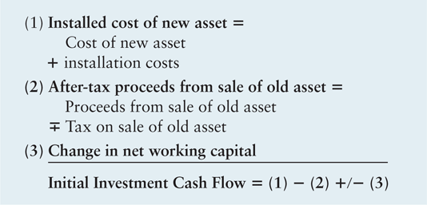
Table 11.1 The Basic Format for Determining Initial Investment

Slide 14
Finding the Initial Investment:
Installed Cost of New Asset
The cost of new asset is the net outflow necessary to acquire a new asset.
Installation costs are any added costs that are necessary to place an asset into operation.
The installed cost of new asset is the cost of new asset plus its installation costs; equals the asset’s depreciable value.

Slide 15
Finding the Initial Investment: After-Tax Proceeds from Sale of Old Asset
The after-tax proceeds from sale of old asset are the difference between the old asset’s sale proceeds and any applicable taxes or tax refunds related to its sale.
The proceeds from sale of old asset are the cash inflows, net of any removal or cleanup costs, resulting from the sale of an existing asset.
The tax on sale of old asset is the tax that depends on the relationship between the old asset’s sale price and book value, and on existing government tax rules.
Book value is the strict accounting value of an asset, calculated by subtracting its accumulated depreciation from its installed cost.

Slide 16
Finding the Initial Investment: After-Tax Proceeds from Sale of Old Asset
Hudson Industries, a small electronics company, 2 years ago acquired a machine tool with an installed cost of $100,000.
Under MACRS for a 5-year recovery period, 20% and 32% of the installed cost would be depreciated in years 1 and 2, respectively.
In other words, 52% (20% + 32%) of the $100,000 cost, or $52,000 (0.52 × $100,000), would represent the accumulated depreciation at the end of year 2.
The book value of Hudson’s asset at the end of year 2 is therefore $100,000 – $52,000 = $48,000.

Slide 17
Finding the Initial Investment: After-Tax Proceeds from Sale of Old Asset
If Hudson sells the old asset for $110,000, it realizes a gain of $62,000 ($110,000 – $48,000).
    This gain is made up of two parts—a capital gain and recaptured depreciation, which is the portion of an asset’s sale price that is above book value and below its initial purchase price.
The capital gain is $10,000 ($110,000 sale price – $100,000 initial purchase price)
The recaptured depreciation is $52,000 (the $100,000 initial purchase price – $48,000 book value).
The total gain above book value of $62,000 is taxed as ordinary income at the 40% rate, resulting in taxes of $24,800 (0.40 × $62,000).

Slide 18
Finding the Initial Investment: After-Tax Proceeds from Sale of Old Asset
If the asset is sold for $48,000, its book value, the firm breaks even.
Because no tax results from selling an asset for its book value, there is no tax effect on the initial investment in the new asset.

Slide 19
Finding the Initial Investment: After-Tax Proceeds from Sale of Old Asset
If Hudson sells the asset for $30,000, it experiences a loss of $18,000 ($48,000 – $30,000).
If this is a depreciable asset used in the business, the firm may use the loss to offset ordinary operating income.
If the asset is not depreciable or is not used in the business, the firm can use the loss only to offset capital gains.
In either case, the loss will save the firm $7,200 (0.40 × $18,000) in taxes.
If current operating earnings or capital gains are not sufficient to offset the loss, the firm may be able to apply these losses to prior or future years’ taxes.

Slide 20
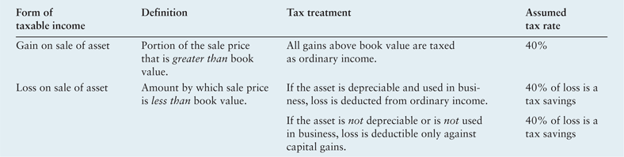
Table 11.2 Tax Treatment on Sale of Assets

Slide 21
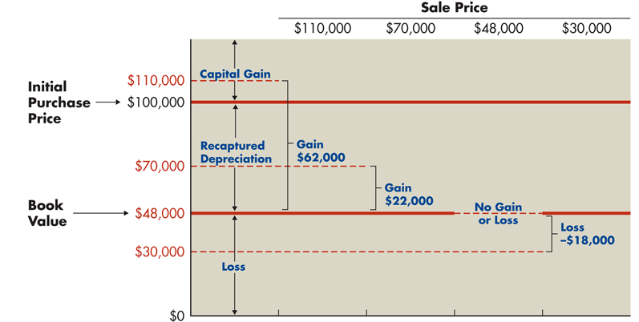
Figure 11.3 Taxable Income from Sale of Asset

Slide 22
Finding the Initial Investment:
Change in Net Working Capital
Net working capital is the amount by which a firm’s current assets exceed its current liabilities.
The change in net working capital is the difference between a change in current assets and a change in current liabilities.
  Generally, current assets increase by more than current liabilities, resulting in an increased investment in net working capital. This increased investment is treated as an initial outflow.
  If the change in net working capital were negative, it would be shown as an initial inflow.

Slide 23
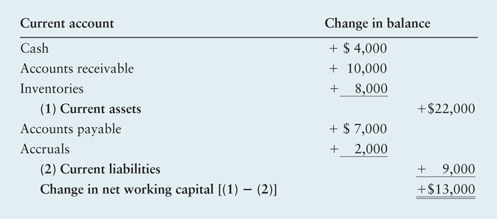
Table 11.3 Calculation of Net Working Capital for Danson Company
Danson Company, a metal products manufacturer, is contemplating expanding its operations. The table below summarizes the expected changes in current accounts.

Slide 24
Matter of Fact
Europeans Squeeze Working Capital
  Companies around the world work hard to economize on their working capital requirements.
  A PWC study of European companies found that working capital was at an all-time low in 2011.
  According to the study, the companies that were most efficient in their use of working capital had a strong focus on process optimization and worked hard to instill a cash-based culture among their employees.
  In addition, these companies tended to be early adopters of new technologies, which facilitated reduced working capital needs.

Slide 25
Table 11.1 The Basic Format for Determining Initial Investment

Slide 26
Finding the Initial Investment:
Calculating the Initial Investment
Powell Corporation is trying to determine the initial investment required to replace an old machine with a new, more sophisticated model. The proposed machine’s purchase price is $380,000, and an additional $20,000 will be necessary to install it. It will be depreciated under MACRS using a 5-year recovery period. The present (old) machine was purchased 3 years ago at a cost of $240,000 and was being depreciated under MACRS using a 5-year recovery period. The firm has found a buyer willing to pay $280,000 for the present machine and to remove it at the buyer’s expense. The firm expects that a $35,000 increase in current assets and an $18,000 increase in current liabilities will accompany the replacement. The firm pays taxes at a rate of 40%.

Slide 27
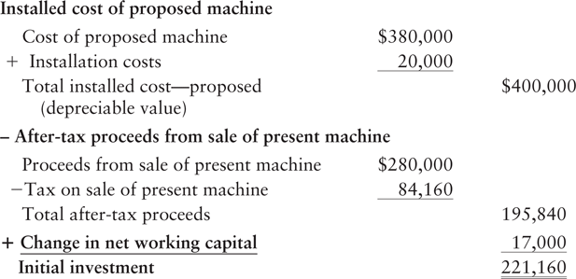
Finding the Initial Investment:
Calculating the Initial Investment

Slide 28
Finding the Operating Cash Flows
Benefits expected to result from proposed capital expenditures must be measured on an after-tax basis, because the firm will not have the use of any benefits until it has satisfied the government’s tax claims.
All benefits expected from a proposed project must be measured on a cash flow basis.
  Cash inflows represent dollars that can be spent, not merely “accounting profits.”
  The basic calculation for converting after-tax net profits into operating cash inflows requires adding depreciation and any other noncash charges (amortization and depletion) deducted as expenses on the firm’s income statement back to net profits after taxes.

Slide 29
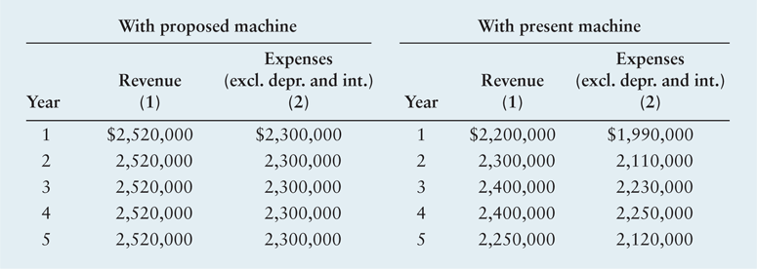
Table 11.4 Powell Corporation’s Revenue and Expenses for Proposed and Present Machines

Slide 30
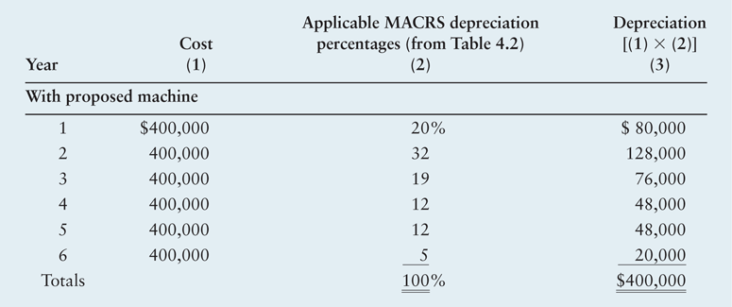
Table 11.5a Depreciation Expense for Proposed and Present Machines for Powell Corporation

Slide 31
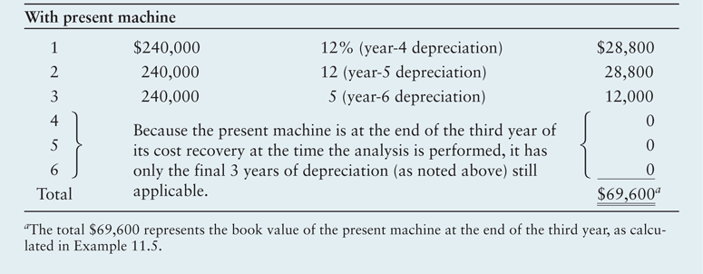
Table 11.5b Depreciation Expense for Proposed and Present Machines for Powell Corporation

Slide 32
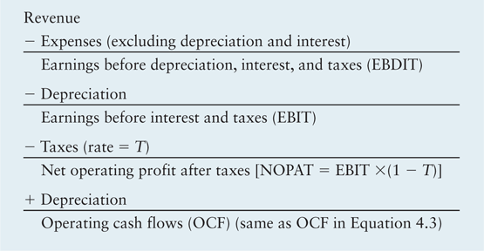
Table 11.6 Calculation of Operating Cash Flows Using the Income Statement Format

Slide 33
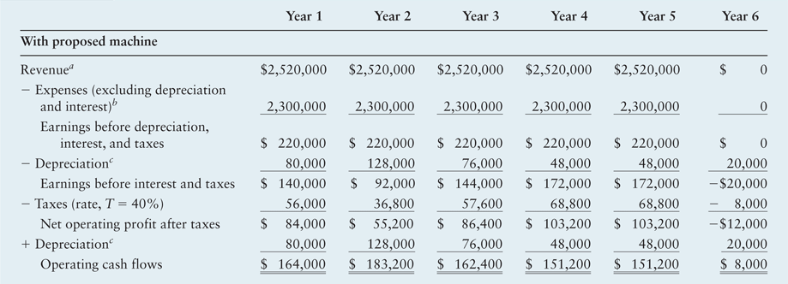
Table 11.7a Calculation of Operating Cash Inflows for Powell Corporation’s Proposed and Present Machines

Slide 34
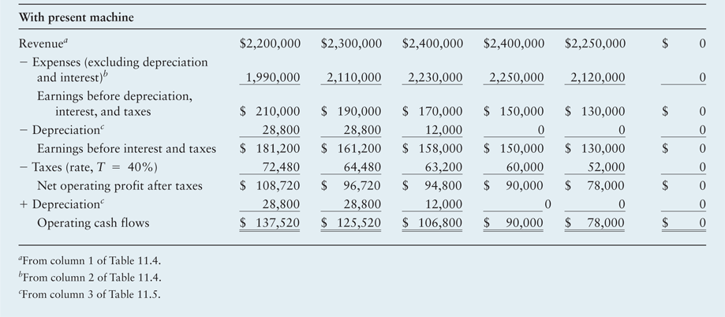
Table 11.7b Calculation of Operating Cash Inflows for Powell Corporation’s Proposed and Present Machines

Slide 35
Finding the Operating Cash Flows
The final step in estimating the operating cash inflows for a proposed replacement project is to calculate the incremental (relevant) cash inflows.
Incremental operating cash inflows are needed because our concern is only with the change in operating cash inflows that result from the proposed project.

Slide 36
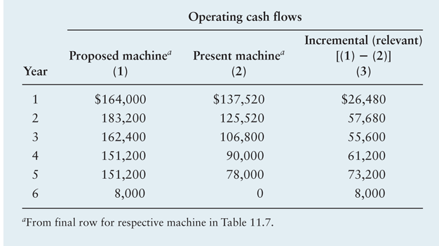
Table 11.8 Incremental (Relevant) Operating Cash Inflows for Powell Corporation

Slide 37
Finding the Terminal Cash Flow
Terminal cash flow is the cash flow resulting from termination and liquidation of a project at the end of its economic life.
It represents the after-tax cash flow, exclusive of operating cash inflows, that occurs in the final year of the project.
The proceeds from sale of the new and the old asset, often called “salvage value,” represent the amount net of any removal or cleanup costs expected upon termination of the project.
  If the net proceeds from the sale are expected to exceed book value, a tax payment shown as an outflow (deduction from sale proceeds) will occur.
  When the net proceeds from the sale are less than book value, a tax rebate shown as a cash inflow (addition to sale proceeds) will result.

Slide 38
Finding the Terminal Cash Flow
When we calculate the terminal cash flow, the change in net working capital represents the reversion of any initial net working capital investment.
Most often, this will show up as a cash inflow due to the reduction in net working capital; with termination of the project, the need for the increased net working capital investment is assumed to end.

Slide 39
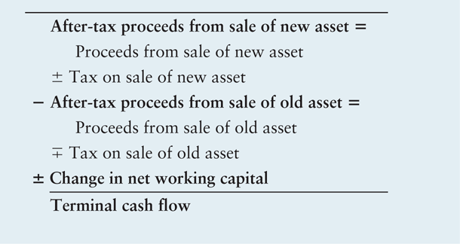
Table 11.9 The Basic Format for Determining Terminal Cash Flow

Slide 40
Finding the Terminal Cash Flow
Powell Corporation expects to be able to liquidate the new machine at the end of its 5-year usable life to net $50,000 after paying removal and cleanup costs. The old machine can be liquidated at the end of the 5 years to net $10,000. The firm expects to recover its $17,000 net working capital investment upon termination of the project. The firm pays taxes at a rate of 40%.

Slide 41
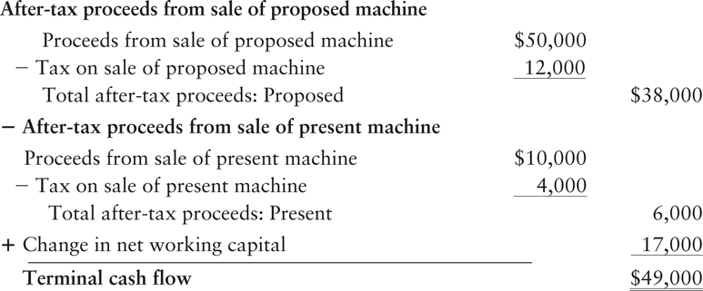
Finding the Terminal Cash Flow

Slide 42
Summarizing the Relevant Cash Flows
The initial investment, operating cash inflows, and terminal cash flow together represent a project’s relevant cash flows.
These cash flows can be viewed as the incremental after-tax cash flows attributable to the proposed project.
They represent, in a cash flow sense, how much better or worse off the firm will be if it chooses to implement the proposal.

Slide 43
Introduction to Risk in Capital Budgeting
Thus far, we have assumed that all investment projects have the same level of risk as the firm.
In other words, we assumed that all projects are equally risky, and the acceptance of any project would not change the firm’s overall risk.
In actuality, these situations are rare—projects are not equally risky, and the acceptance of a project can affect the firm’s overall risk.

Slide 44
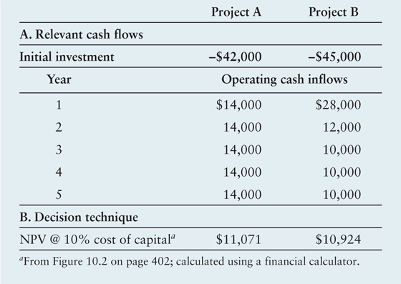
Table 11.10 Relevant Cash Flows and NPVs for Bennett Company’s Projects

Slide 45
Behavioral Approaches for Dealing with Risk: Risk and Cash Inflows
Risk (in capital budgeting) refers to the uncertainty surrounding the cash flows that a project will generate or, more formally, the degree of variability of cash flows.
In many projects, risk stems almost entirely from the cash flows that a project will generate several years in the future, because the initial investment is generally known with relative certainty.
Behavioral approaches can be used to get a “feel” for the level of project risk, whereas other approaches try to quantify and measure project risk.
  Breakeven analysis
  Scenario analysis
  Simulation

Slide 46

Behavioral Approaches for Dealing with Risk: Risk and Cash Inflows
Treadwell Tire Company, a tire retailer with a 10% cost of capital, is considering investing in either of two mutually exclusive projects, A and B. Each requires a $10,000 initial investment, and both are expected to provide constant annual cash inflows over their 15-year lives. For either project to be acceptable its NPV must be greater than zero.

Slide 47
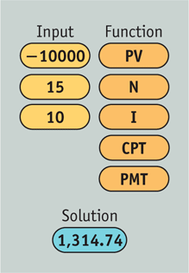
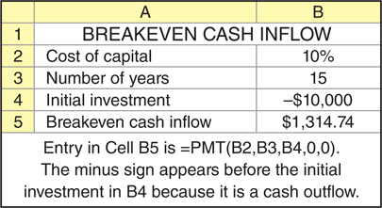
Behavioral Approaches for Dealing with Risk: Risk and Cash Inflows

Slide 48
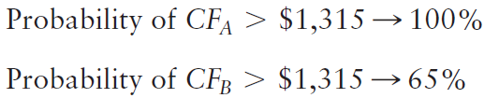
Behavioral Approaches for Dealing with Risk: Risk and Cash Inflows
For the projects to be acceptable, they must have annual cash flows of at least $1,315. The risk of each project can be assessed by determining the probability that the project’s cash flows will equal or exceed this breakeven level. Assume that a statistical analysis results in the following:
Because project A is certain to have a positive net present value, whereas there is only a 65% change that project B will have a positive NPV, project A seems less risky than project B.

Slide 49
Behavioral Approaches for Dealing with Risk: Scenario Analysis
Scenario analysis is a behavioral approach that uses several possible alternative outcomes (scenarios), to obtain a sense of the variability of returns, measured here by NPV.
In capital budgeting, one of the most common scenario approaches is to estimate the NPVs associated with pessimistic (worst), most likely (expected), and optimistic (best) estimates of cash inflow.
The range can be determined by subtracting the pessimistic-outcome NPV from the optimistic-outcome NPV.

Slide 50
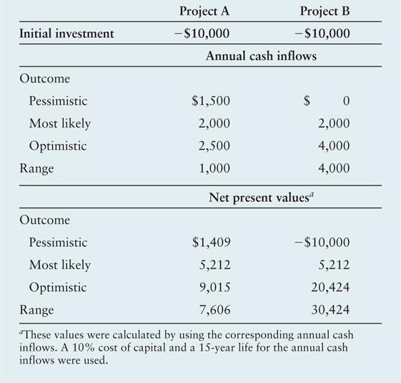
Table 11.11 Scenario Analysis of Treadwell’s Projects A and B

Slide 51
Behavioral Approaches for Dealing with Risk: Simulation
Simulation is a statistics-based behavioral approach that applies predetermined probability distributions and random numbers to estimate risky outcomes.
By trying the various cash flow components together in a mathematical model and repeating the process numerous times, the financial manager can develop a probability distribution of project returns.

Slide 52
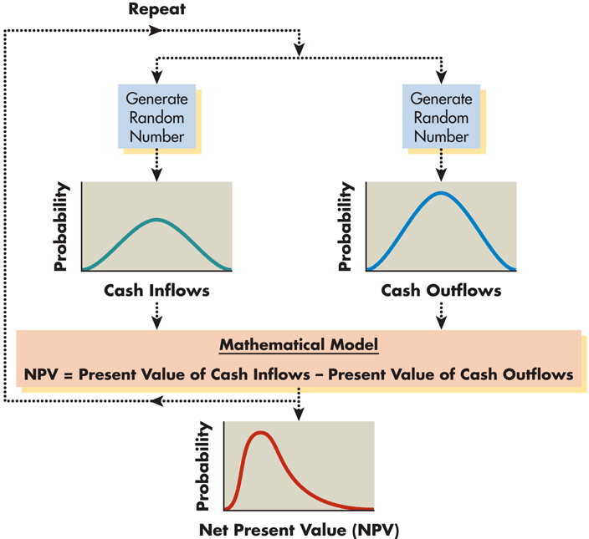
Figure 11.4 NPV Simulation

Slide 53

Risk-Adjusted Discount Rates
Risk-adjusted discount rates (RADR) are rates of return that must be earned on a given project to compensate the firm’s owners adequately—that is, to maintain or improve the firm’s share price.

Slide 54
Personal Finance Example
Talor Namtig is considering investing $1,000 in either of two stocks—A or B. She plans to hold the stock for exactly 5 years and expects both stocks to pay $80 in annual end-of-year cash dividends. At the end of the year 5 she estimates that stock A can be sold to net $1,200 and stock B can be sold to net $1,500. Her research indicates that she should earn an annual return on an average risk stock of 11%. Because stock B is considerably riskier, she will require a 14% return from it. Talor makes the following calculations to find the risk-adjusted net present values (NPVs) for the two stocks:

Slide 55
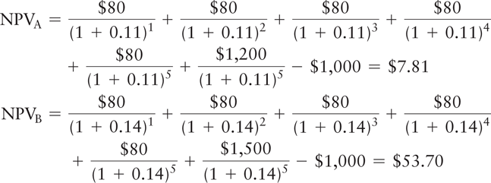
Personal Finance Example
Although Talor’s calculations indicate that both stock investments are acceptable (NPVs > $0), on a risk-adjusted basis, she should invest in Stock B because it has a higher NPV.

Slide 56
Risk-Adjusted Discount Rates:
Review of CAPM
The Capital Asset Pricing Model defines total risk as:
For assets traded in an efficient market, the diversifiable risk, which results from uncontrollable or random events, can be eliminated through diversification.
The relevant risk is therefore the nondiversifiable risk, the risk for which owners of these assets are rewarded.
Nondiverifiable risk for securities is commonly measured using beta, which is an index of the degree of movement of an asset’s return in response to a change in the market return.

Slide 57
Risk-Adjusted Discount Rates:
Review of CAPM
Using beta, b_{j}, to measure the relevant risk of any asset j, the CAPM is
r_{j} = R_{F} + [b_{j} × (r_{m} – R_{F})]
where
r_{j} | = | required return on asset j
R_{F} | = | risk-free rate of return
b_{j} | = | beta coefficient for asset j
r_{m} | = | return on the market portfolio of assets

Slide 58
Risk-Adjusted Discount Rates:
Using CAPM to Find RADRs
Figure 11.5 shows two projects, L and R.
Project L has a beta, b_{L}, and generates an internal rate of return, IRR_{L}. The required return for a project with risk b_{L} is r_{L}.
  Because project L generates a return greater than that required (IRR_{L} > r_{L}), project L is acceptable.
  Project L will have a positive NPV when its cash inflows are discounted at its required return, r_{L}.
Project R, on the other hand, generates an IRR below that required for its risk, b_{R} (IRR_{R} < r_{R}).
  This project will have a negative NPV when its cash inflows are discounted at its required return, r_{R}.
  Project R should be rejected.

Slide 59
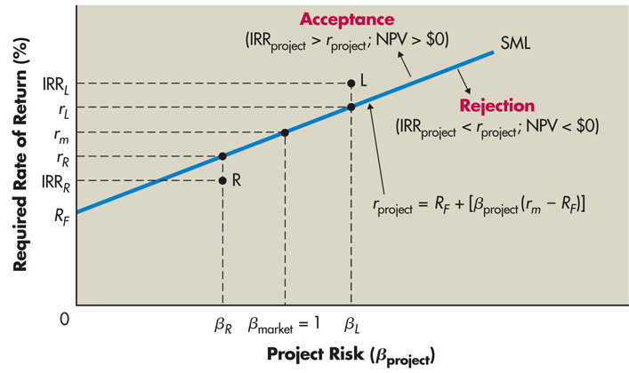
Figure 11.5
CAPM and SML

Slide 60
Risk-Adjusted Discount Rates:
Applying RADRs
Bennett Company wishes to apply the Risk-Adjusted Discount Rate (RADR) approach to determine whether to implement Project A or B. In addition to the data presented earlier, Bennett’s management assigned a “risk index” of 1.6 to project A and 1.0 to project B as indicated in the following table. The required rates of return associated with these indexes are then applied as the discount rates to the two projects to determine NPV.

Slide 61
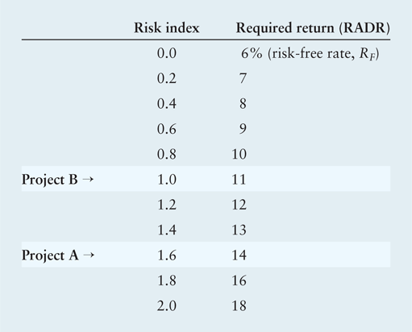
Risk-Adjusted Discount Rates:
Applying RADRs

Slide 62
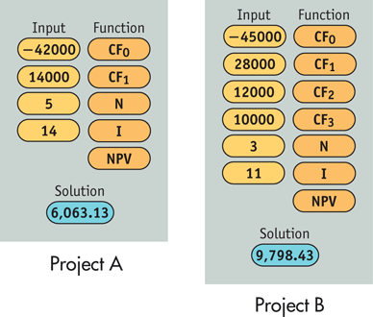
Risk-Adjusted Discount Rates:
Applying RADRs

Slide 63
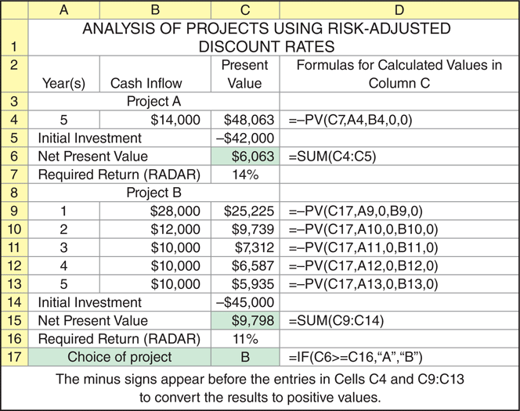
Risk-Adjusted Discount Rates:
Applying RADRs

Slide 64
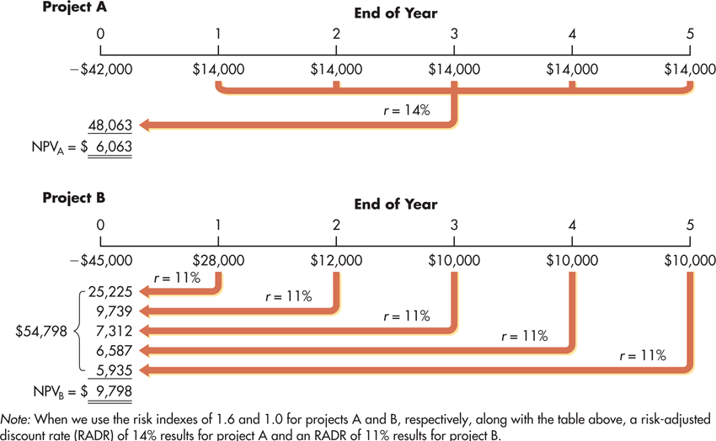
Figure 11.6 Calculation of NPVs for Bennett Company’s Capital Expenditure Alternatives Using RADRs

Slide 65
Risk-Adjusted Discount Rates:
Applying RADRs
Because project A is riskier than project B, its RADR of 14% is greater than project B’s 11%. The net present value of each reflect that project B is preferable because its risk-adjusted NPV is greater than the risk-adjusted NPV for project A.

Slide 66
Risk-Adjusted Discount Rates:
Portfolio Effects
As noted earlier, individual investors must hold diversified portfolios because they are not rewarded for assuming diversifiable risk.
Because business firms can be viewed as portfolios of assets, it would seem that it is also important that they too hold diversified portfolios.
Surprisingly, however, empirical evidence suggests that firm value is not affected by diversification.
In other words, diversification is not normally rewarded and therefore is generally not necessary.
Firms are not rewarded for diversification because investors can diversify by holding securities in a variety of firms.

Slide 67
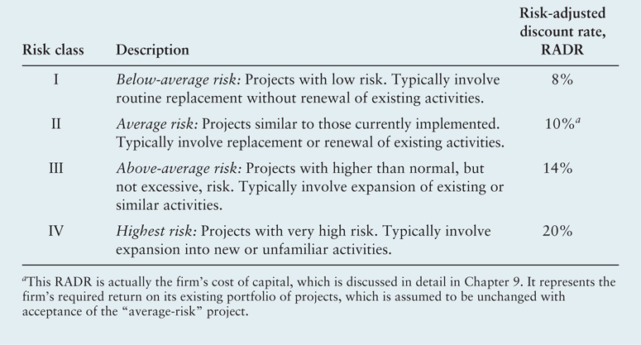
Table 11.12 Bennett Company’s Risk Classes and RADRs
Assume that the management of Bennett Company decided to use risk classes to analyze projects and so placed each project in one of four risk classes according to its perceived risk. The classes ranged from I for the lowest-risk projects to IV for the highest-risk projects.

Slide 68
Risk-Adjusted Discount Rates:
RADRs in Practice
The financial manager of Bennett has assigned project A to class III and project B to class II. The cash flows for project A would be evaluated using a 14% RADR, and project B’s would be evaluated using a 10% RADR. The NPV of project A at 14% was calculated in Figure 11.6 to be $6,063, and the NPV for project B at a 10% RADR was shown in Table 11.10 to be $10,924.
Clearly, with RADRs based on the use of risk classes, project B is preferred over project A.

Slide 69
Capital Budgeting Refinements: Comparing Projects With Unequal Lives
The financial manager must often select the best of a group of unequal-lived projects.
If the projects are independent, the length of the project lives is not critical.
But when unequal-lived projects are mutually exclusive, the impact of differing lives must be considered because the projects do not provide service over comparable time periods.

Slide 70
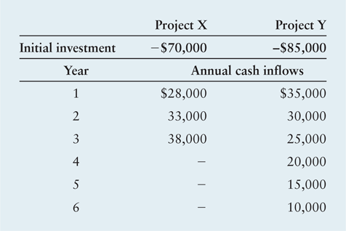
Capital Budgeting Refinements: Comparing Projects With Unequal Lives
The AT Company, a regional cable-TV firm, is evaluating two projects, X and Y. The projects’ cash flows and resulting NPVs at a cost of capital of 10% are given below.

Slide 71
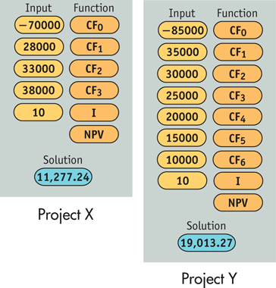
Capital Budgeting Refinements: Comparing Projects With Unequal Lives

Slide 72
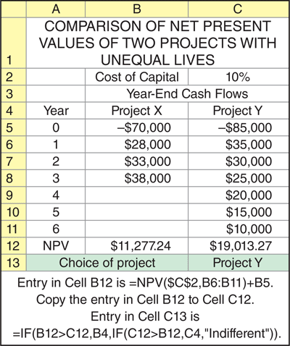
Capital Budgeting Refinements: Comparing Projects With Unequal Lives

Slide 73
Capital Budgeting Refinements: Comparing Projects With Unequal Lives
Ignoring the difference in their useful lives, both projects are acceptable (have positive NPVs). Furthermore, if the projects were mutually exclusive, project Y would be preferred over project X.

Slide 74
Capital Budgeting Refinements: Comparing Projects With Unequal Lives
The annualized net present value (ANPV) approach is an approach to evaluating unequal-lived projects that converts the net present value of unequal-lived, mutually exclusive projects into an equivalent annual amount (in NPV terms).
  Step 1 Calculate the net present value of each project j, NPV_{j}, over its life, n_{j}, using the appropriate cost of capital, r.
  Step 2 Convert the NPV_{j} into an annuity having life n_{j}. That is, find an annuity that has the same life and the same NPV as the project.
  Step 3 Select the project that has the highest ANPV.

Slide 75
Capital Budgeting Refinements: Comparing Projects With Unequal Lives
By using the AT Company data presented earlier for projects X and Y, we can apply the three-step ANPV approach as follows:
  Step 1 The net present values of projects X and Y discounted at 10%—as calculated in the preceding example for a single purchase of each asset—are
  NPV_{X} = $11,277.24
  NPV_{Y} = $19,013.27

Slide 76
Capital Budgeting Refinements: Comparing Projects With Unequal Lives
  Step 2 In this step, we want to convert the NPVs from Step 1 into annuities. For project X, we are trying to find the answer to the question, what 3-year annuity (equal to the life of project X) has a present value of $11,277.24 (the NPV of project X)? Likewise, for project Y we want to know what 6-year annuity has a present value of $19,013.27. Once we have these values, we can determine which project, X or Y, delivers a higher annual cash flow on a present value basis.

Slide 77
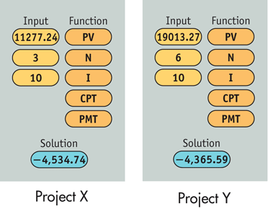
Capital Budgeting Refinements: Comparing Projects With Unequal Lives

Slide 78
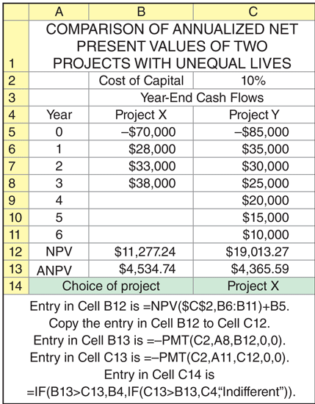
Capital Budgeting Refinements: Comparing Projects With Unequal Lives

Slide 79
Capital Budgeting Refinements: Comparing Projects With Unequal Lives
  Step 3 Reviewing the ANPVs calculated in Step 2, we can see that project X would be preferred over project Y. Given that projects X and Y are mutually exclusive, project X would be the recommended project because it provides the higher annualized net present value.

Slide 80
Recognizing Real Options
Real options are opportunities that are embedded in capital projects that enable managers to alter their cash flows and risk in a way that affects project acceptability (NPV).
  Also called strategic options.
By explicitly recognizing these options when making capital budgeting decisions, managers can make improved, more strategic decisions that consider in advance the economic impact of certain contingent actions on project cash flow and risk.
NPV_{strategic} = NPV_{traditional} + Value of real options

Slide 81
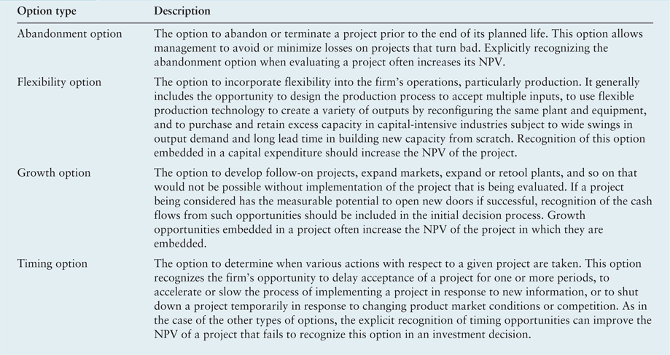
Table 11.13
Major Types of Real Options

Slide 82
Recognizing Real Options
Assume that a strategic analysis of Bennett Company’s projects A and B finds no real options embedded in Project A but two real options embedded in B:
  During it’s first two years, B would have downtime that results in unused production capacity that could be used to perform contract manufacturing;
  Project B’s computerized control system could control two other machines, thereby reducing labor costs.

Slide 83
Recognizing Real Options
Bennett’s management estimated the NPV of the contract manufacturing over the two years following implementation of project B to be $1,500 and the NPV of the computer control sharing to be $2,000. Management felt there was a 60% chance that the contract manufacturing option would be exercised and only a 30% chance that the computer control sharing option would be exercised. The combined value of these two real options would be the sum of their expected values.
Value of real options for project B
= (0.60 × $1,500) + (0.30 × $2,000)
= $900 + $600 = $1,500

Slide 84
Recognizing Real Options
Adding the $1,500 real options value to the traditional NPV of $10,924 for project B, we get the strategic NPV for project B.
NPV_{strategic} = $10,924 + $1,500 = $12,424
Bennett Company’s project B therefore has a strategic NPV of $12,424, which is above its traditional NPV and now exceeds project A’s NPV of $11,071.
Clearly, recognition of project B’s real options improved its NPV (from $10,924 to $12,424) and causes it to be preferred over project A (NPV of $12,424 for B > NPV of $11,071 for A), which has no real options embedded in it.

Slide 85
Capital Rationing
Firm’s often operate under conditions of capital rationing—they have more acceptable independent projects than they can fund.
In theory, capital rationing should not exist—firms should accept all projects that have positive NPVs.
However, in practice, most firms operate under capital rationing.
Generally, firms attempt to isolate and select the best acceptable projects subject to a capital expenditure budget set by management.

Slide 86
Capital Rationing
The internal rate of return approach is an approach to capital rationing that involves graphing project IRRs in descending order against the total dollar investment to determine the group of acceptable projects.
The graph that plots project IRRs in descending order against the total dollar investment is called the investment opportunities schedule (IOS).
The problem with this technique is that it does not guarantee the maximum dollar return to the firm.

Slide 87
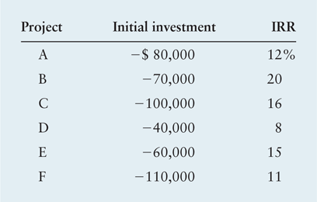
Capital Rationing
Tate Company, a fast growing plastics company with a cost of capital of 10%, is confronted with six projects competing for its fixed budget of $250,000.

Slide 88
Capital Rationing
According to the schedule, only projects B, C, and E should be accepted. Together, they will absorb $230,000 of the $250,000 budget. Projects A and F are acceptable but cannot be chosen because of the budget constraint. Project D is not worthy of consideration because its IRR is less than the firm’s 10% cost of capital.

Slide 89
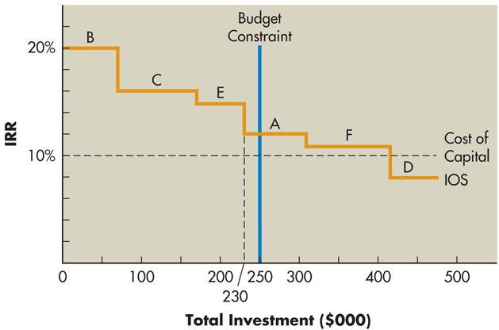
Figure 11.7 Investment Opportunities Schedule

Slide 90
Capital Rationing
The net present value approach is an approach to capital rationing that is based on the use of present values to determine the group of projects that will maximize owners’ wealth.
It is implemented by ranking projects on the basis of IRRs and then evaluating the present value of the benefits from each potential project to determine the combination of projects with the highest overall present value.

Slide 91
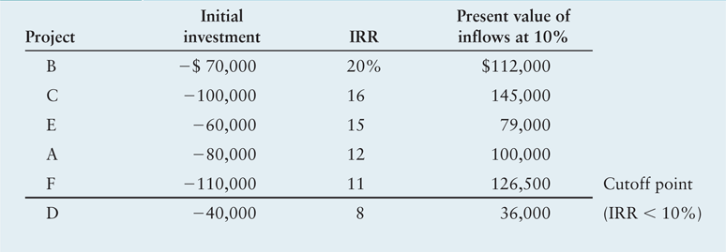
Table 11.14 Rankings for Tate Company Projects

Slide 92
Capital Rationing
Projects B, C, and E together yield a present value of $336,000. However, if projects B, C, and A were implemented, the total budget of $250,000 would be used and the present value of the cash flows would be $357,000.
Implementing B, C, and A is preferable because they maximize the present value for the given budget. The firm’s objective is to use its budget to generate the highest present value of inflows.

Slide 93
Review of Learning Goals
LG1 Discuss relevant cash flows and the three major cash flow components.
  The relevant cash flows for capital budgeting decisions are the incremental cash outflow (investment) and resulting subsequent inflows associated with any proposed capital expenditure. The three major cash flow components of any project can include: (1) an initial investment, (2) operating cash inflows, and (3) terminal cash flow. The initial investment occurs at time zero, the operating cash inflows occur during the project life, and the terminal cash flow occurs at the end of the project.

Slide 94
Review of Learning Goals
LG2 Discuss expansion versus replacement decisions, sunk costs, and opportunity costs.
  For replacement decisions, these flows are the difference between the cash flows of the new asset and the old asset. Expansion decisions are viewed as replacement decisions in which all cash flows from the old asset are zero. When estimating relevant cash flows, ignore sunk costs and include opportunity costs as cash outflows.

Slide 95
Review of Learning Goals
LG3 Calculate the initial investment, operating cash inflows, and terminal cash flows associated with a proposed capital expenditure.
  The initial investment is the initial outflow required, taking into account the installed cost of the new asset, the after-tax proceeds from the sale of the old asset, and any change in net working capital. The operating cash flows are the incremental after-tax cash flows expected to result from the project. The relevant (incremental) cash flows for a replacement project are the difference between the operating cash flows of the proposed project and those of the present project. The terminal cash flow represents the after-tax cash flow (exclusive of operating cash flows) that is expected from liquidation of a project. It is calculated for replacement projects by finding the difference between the after-tax proceeds from sales of the new and the old asset at termination and adjusting this difference for any change in net working capital.

Slide 96
Review of Learning Goals
LG4 Understand the importance of recognizing risk in the analysis of capital budgeting projects, and discuss risk and cash inflows, scenario analysis, and simulation as behavioral approaches for dealing with risk.
  The cash flows associated with capital budgeting typically have different levels of risk, and the acceptance of a project generally affects the firm’s overall risk. Risk in capital budgeting is the degree of variability of cash flows, which for conventional capital budgeting projects stems almost entirely from net cash flows. Finding the breakeven cash inflow and estimating the probability that it will be realized make up one behavioral approach for assessing capital budgeting risk. Scenario analysis is another behavioral approach for capturing the variability of cash inflows and NPVs. Simulation is a statistically based approach that results in a probability distribution of project returns.

Slide 97
Review of Learning Goals
LG5 Describe the determination and use of risk-adjusted discount rates (RADRs), portfolio effects, and the practical aspects of RADRs.
  The risk of a project whose initial investment is known with certainty is embodied in the present value of its cash inflows, using NPV. Two opportunities to adjust the present value of cash inflows for risk exist—adjust the cash inflows or adjust the discount rate. Because adjusting the cash inflows is highly subjective, adjusting discount rates is more popular. RADRs use a market-based adjustment of the discount rate to calculate NPV. The RADR is closely linked to CAPM, but because real corporate assets are generally not traded in an efficient market, the CAPM cannot be applied directly to capital budgeting. Instead, firms develop some CAPM-type relationship to link a project’s risk to its required return, which is used as the discount rate. Often, for convenience, firms will rely on total risk as an approximation for relevant risk when estimating required project returns. RADRs are commonly used in practice because decision makers find rates of return easy to estimate and apply.

Slide 98
Review of Learning Goals
LG6 Select the best of a group of unequal-lived, mutually exclusive projects using annualized net present values (ANPVs), and explain the role of real options and the objective and procedures for selecting projects under capital rationing.
  The ANPV approach is the most efficient method of comparing ongoing, mutually exclusive projects that have unequal usable lives. It converts the NPV of each unequal-lived project into an equivalent annual amount, its ANPV. Real options are opportunities that are embedded in capital projects and that allow managers to alter their cash flow and risk in a way that affects project acceptability (NPV). By explicitly recognizing real options, the financial manager can find a project’s strategic NPV. Capital rationing exists when firms have more acceptable independent projects than they can fund. Capital rationing commonly occurs in practice. Its objective is to select from all acceptable projects the group that provides the highest overall net present value and does not require more dollars than are budgeted. The two basic approaches for choosing projects under capital rationing are the internal rate of return approach and the net present value approach.

Slide 99

Capital Budgeting Cash Flows and Risk Refinements
Questions?
Homework
  Ch11, pp 448-456
  P11-6, 7, 15, 24

Slide 100
Chapter Resources on MyFinanceLab
Chapter Cases
Group Exercises
Critical Thinking Problems

