Slide 1
Chapter 14
Working Capital
and Current Assets
Management

Slide 2
Learning Goals
LG1 Understand working capital management, net working capital, and the related trade-off between profitability and risk.
LG2 Describe the cash conversion cycle, its funding requirements, and the key strategies for managing it.
LG3 Discuss inventory management: differing views, common techniques, and international concerns.

Slide 3
Learning Goals
LG4 Explain the credit selection process and the quantitative procedure for evaluating changes in credit standards.
LG5 Review the procedures for quantitatively considering cash discount changes, other aspects of credit terms, and credit monitoring.
LG6 Understand the management of receipts and disbursements, including float, speeding up collections, slowing down payments, cash concentration, zero-balance accounts, and investing in marketable securities.

Slide 4
Net Working Capital Fundamentals: Working Capital Management
Working capital (or short-term financial) management is the management of current assets and current liabilities.
  Current assets include inventory, accounts receivable, marketable securities, and cash.
  Current liabilities include notes payable, accruals, and accounts payable.
  Firms are able to reduce financing costs or increase the funds available for expansion by minimizing the amount of funds tied up in working capital.

Slide 5
Matter of Fact
CFOs Value Working Capital Management
  A survey of CFOs from firms around the world suggests that working capital management is at the top of the list of most valued finance functions.
  Among 19 different finance functions, CFOs surveyed viewed working capital management as equally important as capital structure, debt issuance and management, bank relationships, and tax management.
  CFOs viewed the performance of working capital management as only being better than the performance of pension management.
  Consistent with their view that working capital management is a high value but low satisfaction activity, it was identified as the finance function second most in need of additional resources.

Slide 6
Net Working Capital Fundamentals:
Net Working Capital
Working capital refers to current assets, which represent the portion of investment that circulates from one form to another in the ordinary conduct of business.
Net working capital is the difference between the firm’s current assets and its current liabilities; can be positive or negative.

Slide 7
Net Working Capital Fundamentals:
Trade-off between Profitability and Risk
Profitability is the relationship between revenues and costs generated by using the firm’s assets—both current and fixed—in productive activities.
  A firm can increase its profits by (1) increasing revenues or (2) decreasing costs.
Risk (of insolvency) is the probability that a firm will be unable to pay its bills as they come due.
  A firm that is insolvent is unable to pay its bills as they come due.

Slide 8
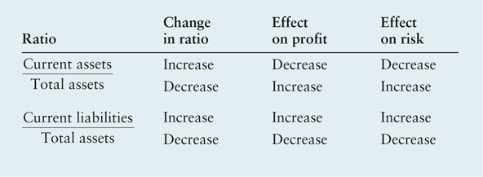
Table 14.1 Effects of Changing Ratios on Profits and Risk

Slide 9
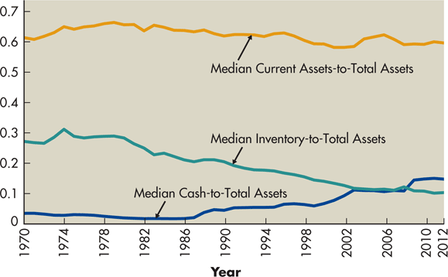
Figure 14.1 Yearly Medians for All U.S.-Listed Manufacturing Companies

Slide 10
Cash Conversion Cycle
The cash conversion cycle (CCC) is the length of time required for a company to convert cash invested in its operations to cash received as a result of its operations.

Slide 11
Cash Conversion Cycle:
Calculating the Cash Conversion Cycle
A firm’s operating cycle (OC) is the time from the beginning of the production process to collection of cash from the sale of the finished product.
It is measured in elapsed time by summing the average age of inventory (AAI) and the average collection period (ACP).
OC = AAI + ACP

Slide 12
Cash Conversion Cycle:
Calculating the Cash Conversion Cycle
However, the process of producing and selling a product also includes the purchase of production inputs (raw materials) on account, which results in accounts payable.
The time it takes to pay the accounts payable, measured in days, is the average payment period (APP). The operating cycle less the average payment period yields the cash conversion cycle. The formula for the cash conversion cycle is:
CCC = OC – APP

Slide 13
Cash Conversion Cycle:
Calculating the Cash Conversion Cycle
Substituting for OC, we can see that the cash conversion cycle has three main components, as shown in the following equation: (1) average age of the inventory, (2) average collection period, and (3) average payment period.
CCC = AAI + ACP – APP

Slide 14
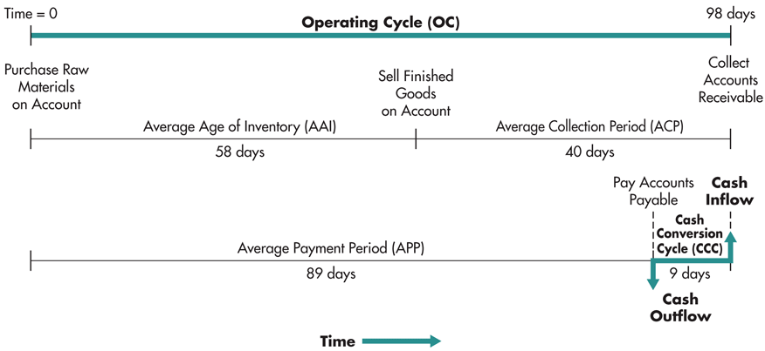
Figure 14.2 Timeline for Whirlpool’s Cash Conversion Cycle
In its 2012 annual report, Whirlpool Corporation reported that it had revenues of $18.1 billion, cost of goods sold of $15.2 billion, accounts receivable of $2.0 billion, and inventory of $2.4 billion.

Slide 15
Cash Conversion Cycle: Calculating the Cash Conversion Cycle
The resources Whirlpool had invested in this cash conversion cycle (assuming a 365-day year) were:
    Inventory = $15.2 billion x (58/365) = $2.4
  + Accounts receivable = 18.1 billion x (40/365) = 2.0
  - Accounts payable = 15.2 billion x (89/365) = 3.7
  = Resources invested = $0.7
With roughly $700 million committed to working capital, Whirlpool was surely motivated to make improvements.

Slide 16
Matter of Fact
Increasing speed lowers working capital
  A firm can lower its working capital if it can speed up its operating cycle.
  For example, if a firm accepts bank credit (like a Visa card), it will receive cash sooner after the sale is transacted than if it has to wait until the customer pays its accounts receivable.

Slide 17
Cash Conversion Cycle: Funding Requirements of the Cash Conversion Cycle
A permanent funding requirement is a constant investment in operating assets resulting from constant sales over time.
A seasonal funding requirement is an investment in operating assets that varies over time as a result of cyclic sales.

Slide 18
Cash Conversion Cycle: Funding Requirements of the Cash Conversion Cycle
Nicholson Company holds, on average, $50,000 in cash and marketable securities, $1,250,000 in inventory, and $750,000 in accounts receivable. Nicholson’s business is very stable over time, so its operating assets can be viewed as permanent. In addition, Nicholson’s accounts payable of $425,000 are stable over time. Thus, Nicholson has a permanent investment in operating assets of $1,625,000 ($50,000 + $1,250,000 + $750,000 - $425,000). That amount would also equal its permanent funding requirement.

Slide 19
Cash Conversion Cycle: Funding Requirements of the Cash Conversion Cycle
Semper Pump Company has seasonal funding needs. Semper holds, at minimum, $25,000 in cash and marketable securities, $100,000 in inventory, and $60,000 in accounts receivable. At peak times Semper’s inventory increases to $750,000, and its accounts receivable increase to $400,000. Accounts payable remain at $50,000.
Permanent funding_{min} = $25,000 + $100,000 + $60,000 - $50,000 = $135,000
Seasonal funding_{max} = ($25,000 + $750,000 + $400,000 - $50,000) - $135,000 = $990,000.
Total funding varies from $135,000 to $1,125,000

Slide 20
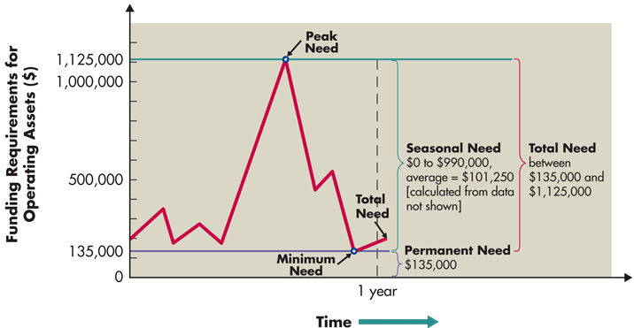
Figure 14.3 Semper Pump Company’s Total Funding Requirements
Semper Pump Company has seasonal funding needs. Semper has seasonal sales, with its peak sales being driven by the summertime purchases of bicycle pumps.

Slide 21
Cash Conversion Cycle: Aggressive versus Conservative Seasonal Funding Strategies
An aggressive funding strategy is a funding strategy under which the firm funds its seasonal requirements with short-term debt and its permanent requirements with long-term debt.
A conservative funding strategy is a funding strategy under which the firm funds both its seasonal and its permanent requirements with long-term debt.

Slide 22
Cash Conversion Cycle: Aggressive versus Conservative Seasonal Funding Strategies
 | Cost of short-term financing | = | 0.0625 × $101,250 | = | $ 6,328.13
+ | Cost of long-term financing | = | 0.0800 × 135,000 | = | 10,800.00
– | Earnings on surplus balances | = | 0.0500 × 0 | = | 0
 | Total cost of aggressive strategy |  |  | = | $17,128.13
Semper Pump Company has a permanent funding requirement of $135,000 in operating assets and seasonal funding requirements that vary between $0 and $990,000 and average $101,250. If Semper can borrow short-term funds at 6.25% and long-term funds at 8%, and if it can earn 5% on the investment of any surplus balances, then the annual cost of an aggressive strategy for seasonal funding will be:

Slide 23
Cash Conversion Cycle: Aggressive versus Conservative Seasonal Funding Strategies
Alternatively, Semper can choose a conservative strategy, under which surplus cash balances are fully invested. (In Figure 14.3, this surplus will be the difference between the peak need of $1,125,000 and the total need, which varies between $135,000 and $1,125,000 during the year.) The cost of the conservative strategy will be:
 | Cost of short-term financing | = | 0.0625 × $ 0 | = | $ 0
+ | Cost of long-term financing | = | 0.0800 × 1,125,000 | = | 90,000.00
– | Earnings on surplus balances | = | 0.0500 × 888,750 | = | 44,437.50
 | Total cost of conservative strategy |  |  | = | $45,562.50

Slide 24
Cash Conversion Cycle: Strategies for Managing the Cash Conversion Cycle
The goal is to minimize the length of the cash conversion cycle, which minimizes negotiated liabilities. This goal can be realized through use of the following strategies:
  Turn over inventory as quickly as possible without stockouts that result in lost sales.
  Collect accounts receivable as quickly as possible without losing sales from high-pressure collection techniques.
  Manage mail, processing, and clearing time to reduce them when collecting from customers and to increase them when paying suppliers.
  Pay accounts payable as slowly as possible without damaging the firm’s credit rating.

Slide 25
Inventory Management
Differing viewpoints about appropriate inventory levels commonly exist among a firm’s finance, marketing, manufacturing, and purchasing managers.
  The financial manager’s general disposition toward inventory levels is to keep them low, to ensure that the firm’s money is not being unwisely invested in excess resources.
  The marketing manager, on the other hand, would like to have large inventories of the firm’s finished products.
  The manufacturing manager’s major responsibility is to implement the production plan so that it results in the desired amount of finished goods of acceptable quality available on time at a low cost.
  The purchasing manager is concerned solely with the raw materials inventories.

Slide 26
Inventory Management: Common Techniques for Managing Inventory
The ABC inventory system is an inventory management technique that divides inventory into three groups—A, B, and C, in descending order of importance and level of monitoring, on the basis of the dollar investment in each.
  The A group includes those items with the largest dollar investment. Typically, this group consists of 20 percent of the firm’s inventory items but 80 percent of its investment in inventory.
  The B group consists of items that account for the next largest investment in inventory.
  The C group consists of a large number of items that require a relatively small investment.

Slide 27
Inventory Management: Common Techniques for Managing Inventory
The inventory group of each item determines the item’s level of monitoring.
  The A group items receive the most intense monitoring because of the high dollar investment. Typically, A group items are tracked on a perpetual inventory system that allows daily verification of each item’s inventory level.
  B group items are frequently controlled through periodic, perhaps weekly, checking of their levels.
  C group items are monitored with unsophisticated techniques, such as the two-bin method; an unsophisticated inventory-monitoring technique that involves reordering inventory when one of two bins is empty.

Slide 28
Inventory Management: Common Techniques for Managing Inventory
The large dollar investment in A and B group items suggests the need for a better method of inventory management than the ABC system.
The Economic Order Quantity (EOQ) Model is an inventory management technique for determining an item’s optimal order size, which is the size that minimizes the total of its order costs and carrying costs.
  The EOQ model is an appropriate model for the management of A and B group items.

Slide 29
Inventory Management: Common Techniques for Managing Inventory
EOQ assumes that the relevant costs of inventory can be divided into order costs and carrying costs.
  Order costs are the fixed clerical costs of placing and receiving an inventory order.
  Carrying costs are the variable costs per unit of holding an item in inventory for a specific period of time.
The EOQ model analyzes the tradeoff between order costs and carrying costs to determine the order quantity that minimizes the total inventory cost.

Slide 30
Inventory Management: Common Techniques for Managing Inventory
A formula can be developed for determining the firm’s EOQ for a given inventory item, where
  S = usage in units per period
  O = order cost per order
  C = carrying cost per unit per period
  Q = order quantity in units
The order cost can be expressed as the product of the cost per order and the number of orders. Because the number of orders equals the usage during the period divided by the order quantity (S/Q), the order cost can be expressed as follows:
Order cost = O × S/Q

Slide 31
Inventory Management: Common Techniques for Managing Inventory
The carrying cost is defined as the cost of carrying a unit of inventory per period multiplied by the firm’s average inventory. The average inventory is the order quantity divided by 2 (Q/2), because inventory is assumed to be depleted at a constant rate. Thus carrying cost can be expressed as follows:
Carrying cost = C × Q/2
The firm’s total cost of inventory is found by summing the order cost and the carrying cost. Thus the total cost function is
Total cost = (O × S/Q) + (C × Q/2)

Slide 32

Inventory Management: Common Techniques for Managing Inventory
Because the EOQ is defined as the order quantity that minimizes the total cost function, we must solve the total cost function for the EOQ. EOQ occurs where order cost = carrying cost. The resulting equation is

Slide 33
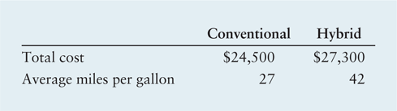
Personal Finance Example
The von Dammes are trying to decide whether a conventional car or a hybrid car would be more cost effective. The von Dammes plan to keep whichever car they choose for 3 years and expect to drive it 12,000 miles in each of those years. They will use the same dollar amount of financing repaid under the same terms for either car and they expect the cars to have identical repair costs over the 3-year ownership period. They also assume that the trade-in value of the two cars at the end of 3 years will be identical. Both cars use regular unleaded gas, which they estimate will cost, on average, $3.20 per gallon over the 3 years. The key data for each car follows:

Slide 34
Personal Finance Example
We can begin by calculating the total fuel cost for each car over the 3-year ownership period:
Conventional: [(3 years × 12,000 miles per year)/27 miles per gallon]
× $3.20 per gallon
= 1,333.33 gallons × $3.20 per gallon = $4,267
Hybrid: [(3 years × 12,000 miles per year)/42 miles per gallon]
× $3.20 per gallon
= 857.14 gallons × $3.20 per gallon = $2,743

Slide 35
Personal Finance Example
To buy the hybrid car, the von Dammes will have to pay $2,800 more ($27,300 - $24,500) than the cost of the conventional car, but they will save about $1,524 ($4,267 - $2,743) in fuel costs over the 3-year ownership period. Ignoring differences in timing, on a strict economic basis they should buy the conventional car because the $2,800 marginal cost of the hybrid results in a marginal fuel cost savings of only $1,524.

Slide 36
Inventory Management: Common Techniques for Managing Inventory
The reorder point is the point at which to reorder inventory, expressed as days of lead time × daily usage.
Because lead times and usage rates are not precise, most firms hold safety stock—extra inventory that is held to prevent stockouts of important items.

Slide 37

Inventory Management: Common Techniques for Managing Inventory
MAX Company, a producer of dinnerware, has an A group inventory item that is vital to the production process. This item costs $1,500, and MAX uses 1,100 units of the item per year. MAX wants to determine its optimal order strategy for the item. To calculate the EOQ, we need the following inputs:
  Order cost per order = $150
  Carrying cost per unit per year = $200
  Thus,

Slide 38
Inventory Management: Common Techniques for Managing Inventory
The reorder point for MAX depends on the number of days MAX operates per year.
  Assuming that MAX operates 250 days per year and uses 1,100 units of this item, its daily usage is 4.4 units (1,100 ÷ 250).
  If its lead time is 2 days and MAX wants to maintain a safety stock of 4 units, the reorder point for this item is 12.8 units [(2 × 4.4) + 4].
  However, orders are made only in whole units, so the order is placed when the inventory falls to 13 units.

Slide 39
Inventory Management: Common Techniques for Managing Inventory
A just-in-time (JIT) system is an inventory management technique that minimizes inventory investment by having materials arrive at exactly the time they are needed for production.
  Because its objective is to minimize inventory investment, a JIT system uses no (or very little) safety stock.
  Extensive coordination among the firm’s employees, its suppliers, and shipping companies must exist to ensure that material inputs arrive on time.
  Failure of materials to arrive on time results in a shutdown of the production line until the materials arrive.
  Likewise, a JIT system requires high-quality parts from suppliers.

Slide 40
Focus on Practice
RFID: The Wave of the Future
  Wal-Mart began to use radio frequency identification (RFID) technology to improve its inventory management in 2004, but the high cost of the tags has slowed its implementation.
  Wal-Mart will then share the benefits and best practices with its suppliers, which might want to achieve the same benefits from the technology.

Slide 41
Inventory Management: Computerized Systems for Resource Control
A materials requirement planning (MRP) system is an inventory management technique that applies EOQ concepts and a computer to compare production needs to available inventory balances and determine when orders should be placed for various items on a product’s bill of materials.
Manufacturing resource planning II (MRP II) is a sophisticated computerized system that integrates data from numerous areas such as finance, accounting, marketing, engineering, and manufacturing and generates production plans as well as numerous financial and management reports.

Slide 42
Inventory Management: Computerized Systems for Resource Control
Enterprise resource planning (ERP) is a computerized system that electronically integrates external information about the firm’s suppliers and customers with the firm’s departmental data so that information on all available resources—human and material—can be instantly obtained in a fashion that eliminates production delays and controls costs.

Slide 43
Accounts Receivable Management
The second component of the cash conversion cycle is the average collection period. The average collection period has two parts:
  The time from the sale until the customer mails the payment.
  The time from when the payment is mailed until the firm has the collected funds in its bank account.
The objective for managing accounts receivable is to collect accounts receivable as quickly as possible without losing sales from high-pressure collection techniques. Accomplishing this goal encompasses three topics:
  credit selection and standards
  credit terms
  credit monitoring.

Slide 44
Accounts Receivable Management:
Credit Selection and Standards
Credit standards are a firm’s minimum requirements for extending credit to a customer.
The five C’s of credit are as follows:
  Character: The applicant’s record of meeting past obligations.
  Capacity: The applicant’s ability to repay the requested credit.
  Capital: The applicant’s debt relative to equity.
  Collateral: The amount of assets the applicant has available for use in securing the credit.
  Conditions: Current general and industry-specific economic conditions, and any unique conditions surrounding a specific transaction.

Slide 45
Accounts Receivable Management:
Credit Selection and Standards
Credit scoring is a credit selection method commonly used with high-volume/small-dollar credit requests; relies on a credit score determined by applying statistically derived weights to a credit applicant’s scores on key financial and credit characteristics.

Slide 46
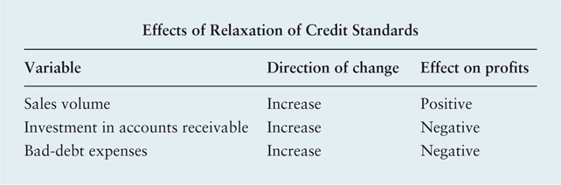
Accounts Receivable Management:
Credit Selection and Standards
The firm sometimes will contemplate changing its credit standards in an effort to improve its returns and create greater value for its owners. To demonstrate, consider the following changes and effects on profits expected to result from the relaxation of credit standards.

Slide 47
Accounts Receivable Management:
Credit Selection and Standards
Dodd Tool is currently selling a product for $10 per unit. Sales (all on credit) for last year were 60,000 units. The variable cost per unit is $6. The firm’s total fixed costs are $120,000.The firm is currently contemplating a relaxation of credit standards that is expected to result in the following:
  a 5% increase in unit sales to 63,000 units;
  an increase in the average collection period from 30 days (the current level) to 45 days;
  an increase in bad-debt expenses from 1% of sales (the current level) to 2%.
The firm’s required return on equal-risk investments, which is the opportunity cost of tying up funds in accounts receivable, is 15%.

Slide 48
Accounts Receivable Management:
Credit Selection and Standards
Because fixed costs are “sunk” and therefore are unaffected by a change in the sales level, the only cost relevant to a change in sales is variable costs. Sales are expected to increase by 5%, or 3,000 units. The profit contribution per unit will equal the difference between the sale price per unit ($10) and the variable cost per unit ($6). The profit contribution per unit therefore will be $4. The total additional profit contribution from sales will be $12,000 (3,000 units × $4 per unit).

Slide 49

Accounts Receivable Management:
Credit Selection and Standards
To determine the cost of the marginal investment in accounts receivable, Dodd must find the difference between the cost of carrying receivables under the two credit standards. Because its concern is only with the out-of-pocket costs, the relevant cost is the variable cost. The average investment in accounts receivable can be calculated by using the following formula:

Slide 50
Accounts Receivable Management:
Credit Selection and Standards
Total variable cost of annual sales
  Under present plan: ($6 × 60,000 units) = $360,000
  Under proposed plan: ($6 × 63,000 units) = $378,000
The turnover of accounts receivable is the number of times each year that the firm’s accounts receivable are actually turned into cash. It is found by dividing the average collection period into 365 (the number of days assumed in a year).

Slide 51
Accounts Receivable Management:
Credit Selection and Standards
Turnover of accounts receivable
  Under present plan: (365/30) = 12.2
  Under proposed plan: (365/45) = 8.1
By substituting the cost and turnover data just calculated into the average investment in accounts receivable equation for each case, we get the following average investments in accounts receivable:
  Under present plan: ($360,000/12.2) = $29,508
  Under proposed plan: ($378,000/8.1) = $46,667

Slide 52
Accounts Receivable Management:
Credit Selection and Standards
Cost of marginal investment in accounts receivable
  Average investment under proposed plan $46,667
  – Average investment under present plan 29,508
  Marginal investment in accounts receivable $17,159
  × Required return on investment 0.15
  Cost of marginal investment in A/R $ 2,574
The resulting value of $2,574 is considered a cost because it represents the maximum amount that could have been earned on the $17,159 had it been placed in the best equal-risk investment alternative available at the firm’s required return on investment of 15%.

Slide 53
Accounts Receivable Management:
Credit Selection and Standards
Cost of marginal bad debts
  Proposed plan: (0.02 × $10/unit × 63,000 units) = $12,600
  Present plan: (0.01 × $10/unit × 60,000 units) = 6,000
  Cost of marginal bad debts $ 6,600

Slide 54
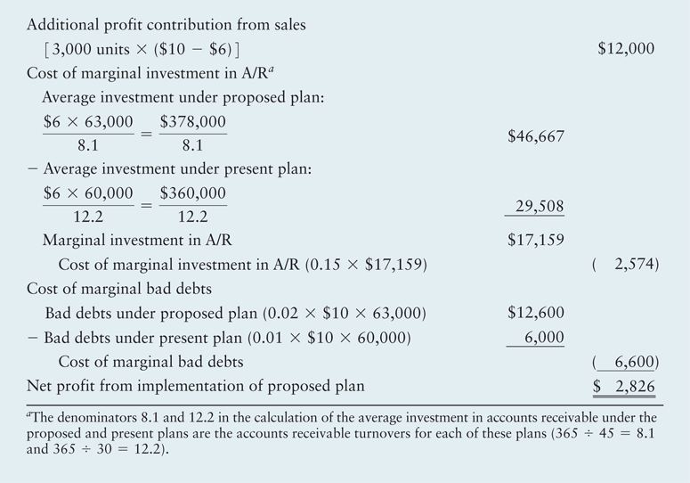
Table 14.2 Effects on Dodd Tool of a Relaxation in Credit Standards
The net addition to total profits resulting from relaxing credit standards would be $2,826 per year. Therefore, Dodd Tool should relax its credit standards.

Slide 55
Accounts Receivable Management:
Credit Selection and Standards
Credit management is difficult enough for managers of purely domestic companies, and these tasks become much more complex for companies that operate internationally.
  This is partly because international operations typically expose a firm to exchange rate risk.
  It is also due to the dangers and delays involved in shipping goods long distances and in having to cross at least two international borders.

Slide 56
Accounts Receivable Management:
Credit Terms
Credit terms are the terms of sale for customers who have been extended credit by the firm.
A cash discount is a percentage deduction from the purchase price; available to the credit customer who pays its account within a specified time.
  For example, terms of 2/10 net 30 mean the customer can take a 2 percent discount from the invoice amount if the payment is made within 10 days of the beginning of the credit period or can pay the full amount of the invoice within 30 days.

Slide 57
Accounts Receivable Management:
Credit Terms
MAX Company has annual sales of $10 million and an average collection period of 40 days (turnover = 365/40 = 9.1). In accordance with the firm’s credit terms of net 30, this period is divided into 32 days until the customers place their payments in the mail (not everyone pays within 30 days) and 8 days to receive, process, and collect payments once they are mailed. MAX is considering initiating a cash discount by changing its credit terms from net 30 to 2/10 net 30. The firm expects this change to reduce the amount of time until the payments are placed in the mail, resulting in an average collection period of 25 days (turnover = 365/25 = 14.6).
Should MAX institute the change?

Slide 58
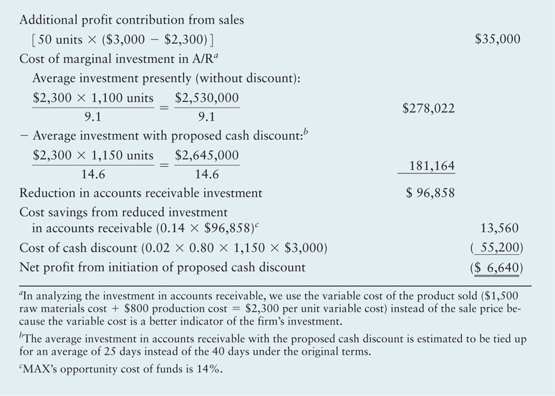
Table 14.3 Analysis of Initiating a Cash Discount for MAX Company

Slide 59
Accounts Receivable Management:
Credit Terms
A cash discount period is the number of days after the beginning of the credit period during which the cash discount is available.
The net effect of changes in this period is difficult to analyze because of the nature of the forces involved.
  For example, if a firm were to increase its cash discount period by 10 days (for example, changing its credit terms from 2/10 net 30 to 2/20 net 30), the following changes would be expected to occur: (1) Sales would increase, positively affecting profit. (2) Bad-debt expenses would decrease, positively affecting profit. (3) The profit per unit would decrease as a result of more people taking the discount, negatively affecting profit.

Slide 60
Accounts Receivable Management:
Credit Terms
The credit period is the number of days after the beginning of the credit period until full payment of the account is due.
Changes in the credit period, the number of days after the beginning of the credit period until full payment of the account is due, also affect a firm’s profitability.
  For example, increasing a firm’s credit period from net 30 days to net 45 days should increase sales, positively affecting profit. But both the investment in accounts receivable and bad-debt expenses would also increase, negatively affecting profit.

Slide 61
Accounts Receivable Management:
Credit Terms
Credit monitoring is the ongoing review of a firm’s accounts receivable to determine whether customers are paying according to the stated credit terms.
  If they are not paying in a timely manner, credit monitoring will alert the firm to the problem.
  Slow payments are costly to a firm because they lengthen the average collection period and thus increase the firm’s investment in accounts receivable.
  Two frequently used techniques for credit monitoring are average collection period and aging of accounts receivable.

Slide 62

Accounts Receivable Management:
Credit Terms
The average collection period has two components: (1) the time from sale until the customer places the payment in the mail and (2) the time to receive, process, and collect the payment once it has been mailed by the customer. The formula for finding the average collection period is:
Assuming receipt, processing, and collection time is constant, the average collection period tells the firm, on average, when its customers pay their accounts.

Slide 63
Accounts Receivable Management:
Credit Terms
An aging schedule is a credit-monitoring technique that breaks down accounts receivable into groups on the basis of their time of origin; it indicates the percentages of the total accounts receivable balance that have been outstanding for specified periods of time.

Slide 64
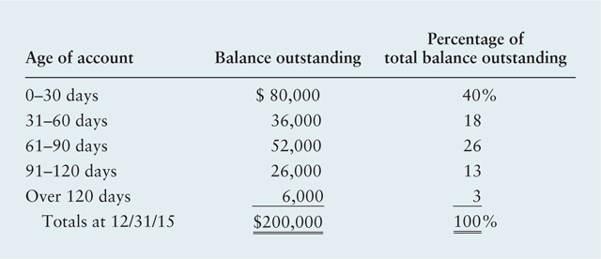
Accounts Receivable Management:
Credit Terms
To gain insight into the firm’s relatively lengthy—51.3-day—average collection period, Dodd prepared the following aging schedule.

Slide 65
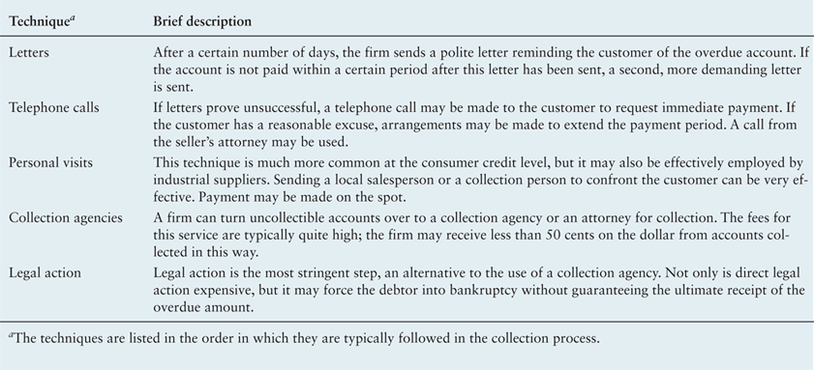
Table 14.4
Popular Collection Techniques

Slide 66
Management of Receipts and Disbursements
The third component of the cash conversion cycle is the average payment period. The average payment period has two parts:
  The time from purchase of goods on account until the firm mails its payment.
  The receipt, processing, and collection time required by the firm’s suppliers.

Slide 67
Management of Receipts and Disbursements: Float
Float refers to funds that have been sent by the payer but are not yet usable funds to the payee. Float has three component parts:
  Mail float is the time delay between when payment is placed in the mail and when it is received.
  Processing float is the time between receipt of a payment and its deposit into the firm’s account.
  Clearing float is the time between deposit of a payment and when spendable funds become available to the firm.

Slide 68
Management of Receipts and Disbursements: Speeding Up Collections
Speeding up collections reduces customer collection float time and thus reduces the firm’s average collection period, which reduces the investment the firm must make in its cash conversion cycle.
A popular technique for speeding up collections is a lockbox system, which is a collection procedure in which customers mail payments to a post office box that is emptied regularly by the firm’s bank, which processes the payments and deposits them in the firm’s account. This system speeds up collection time by reducing processing time as well as mail and clearing time.

Slide 69
Management of Receipts and Disbursements: Slowing Down Payments
Float is also a component of the firm’s average payment period.
Controlled disbursing is the strategic use of mailing points and bank accounts to lengthen mail float and clearing float, respectively.

Slide 70
Matter of fact
U.S.P.S. Problems Create Opportunities for Banks
  For decades, the United States Postal Service has been struggling financially.
  In 2012, the USPS announced that to cut costs it would dramatically reduce the number of mail processing facilities that it operated.
  For companies, this meant an increase in mail float.
  For Fifth Third Bank, it was an opportunity. The bank announced a new remote lockbox capture program in which business-to-business payments would be retrieved at local post offices around the country.
  Next, Fifth Third would make electronic images of those payments, and the images would be processed at the bank’s Cincinnati processing hub.
  Fifth Third promised customers that it would reduce mail float and speed up the collection process for its clients.

Slide 71
Management of Receipts and Disbursements: Cash Concentration
Cash concentration is the process used by the firm to bring lockbox and other deposits together into one bank, often called the concentration bank. Cash concentration has three main advantages.
  First, it creates a large pool of funds for use in making short-term cash investments. Because there is a fixed-cost component in the transaction cost associated with such investments, investing a single pool of funds reduces the firm’s transaction costs. The larger investment pool also allows the firm to choose from a greater variety of short-term investment vehicles.
  Second, concentrating the firm’s cash in one account improves the tracking and internal control of the firm’s cash.
  Third, having one concentration bank enables the firm to implement payment strategies that reduce idle cash balances.

Slide 72
Management of Receipts and Disbursements: Cash Concentration
A depository transfer check (DTC) is an unsigned check drawn on one of a firm’s bank accounts and deposited in another.
An ACH (automated clearinghouse) transfer is a preauthorized electronic withdrawal from the payer’s account and deposit into the payee’s account via a settlement among banks by the automated clearinghouse, or ACH.
A wire transfer is an electronic communication that, via bookkeeping entries, removes funds from the payer’s bank and deposits them in the payee’s bank.

Slide 73
Management of Receipts and Disbursements: Zero-Balance Accounts
A zero-balance account (ZBA) is a disbursement account that always has an end-of-day balance of zero because the firm deposits money to cover checks drawn on the account only as they are presented for payment each day.

Slide 74
Personal Finance Example
Megan Laurie, a 25-year-old nurse, works at a hospital that pays her every 2 weeks by direct deposit into her checking account, which pays no interest and has no minimum balance requirement. She takes home about $1,800 every 2 weeks—or about $3,600 per month. She maintains a checking account balance of around $1,500. Whenever it exceeds that amount she transfers the excess into her savings account, which currently pays 1.5% annual interest. She currently has a savings account balance of $17,000 and estimates that she transfers about $600 per month from her checking account into her savings account.

Slide 75
Personal Finance Example
Megan pays her bills immediately when she receives them. Her monthly bills average about $1,900, and her monthly cash outlays for food and gas total about $900. An analysis of Megan’s bill payments indicates that on average she pays her bills 8 days early. Most marketable securities are currently yielding about 4.2% annual interest. Megan is interested in learning how she might better manage her cash balances.

Slide 76
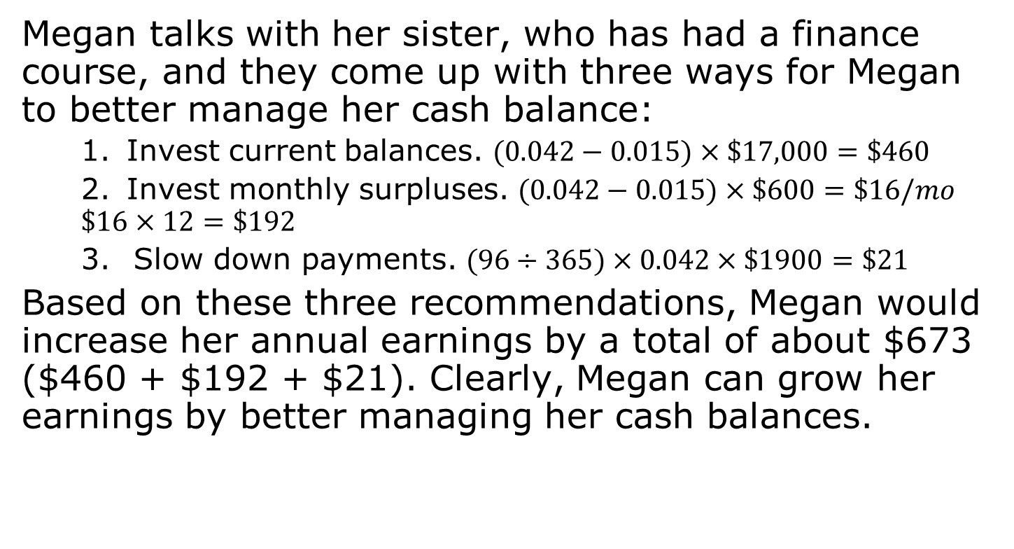
Personal Finance Example
Megan talks with her sister, who has had a finance course, and they come up with three ways for Megan to better manage her cash balance:
  Invest current balances. $(0.042−0.015)×\$17,000=\$460$
  Invest monthly surpluses. $(0.042−0.015)×\$600=\$16/mo$
  $$\$16×12=\$192$$
  Slow down payments. $(96÷365)×0.042×\$1900=\$21$
Based on these three recommendations, Megan would increase her annual earnings by a total of about $673 ($460 + $192 + $21). Clearly, Megan can grow her earnings by better managing her cash balances.

Slide 77
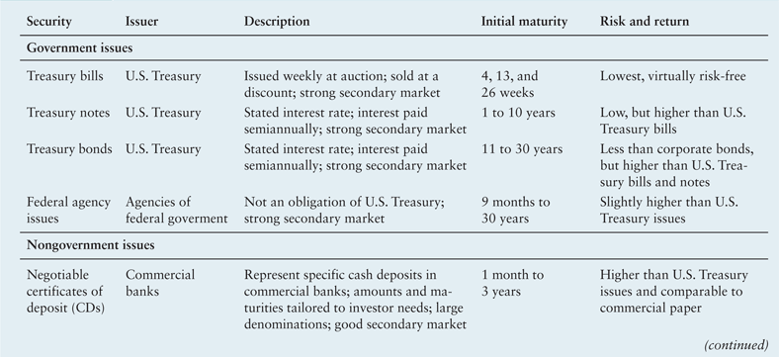
Table 14.5a Features of Popular Marketable Securities

Slide 78
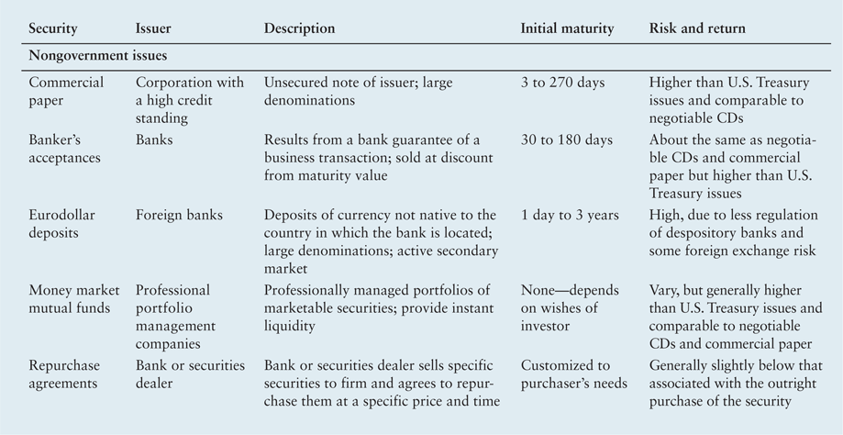
Table 14.5b Features of Popular Marketable Securities

Slide 79
Review of Learning Goals
LG1 Understand working capital management, net working capital, and the related trade-off between profitability and risk.
  Working capital management focuses on managing each of the firm’s current assets and current liabilities in a manner that positively contributes to the firm’s value. Net working capital is the difference between current assets and current liabilities. Risk, in the context of short-term financial decisions, is the probability that a firm will be unable to pay its bills as they come due. Assuming a constant level of total assets, the higher a firm’s ratio of current assets to total assets, the less profitable the firm, and the less risky it is. The converse is also true. With constant total assets, the higher a firm’s ratio of current liabilities to total assets, the more profitable and the more risky the firm is. The converse of this statement is also true.

Slide 80
Review of Learning Goals
LG2 Describe the cash conversion cycle, its funding requirements, and the key strategies for managing it.
  The cash conversion cycle has three components: (1) average age of inventory, (2) average collection period, and (3) average payment period. The length of the cash conversion cycle determines the amount of time resources are tied up in the firm’s day-to-day operations. The firm’s funding decision for its cash conversion cycle ultimately depends on management’s disposition toward risk and the strength of the firm’s banking relationships. To minimize its reliance on negotiated liabilities, the financial manager seeks to (1) turn over inventory as quickly as possible, (2) collect accounts receivable as quickly as possible, (3) manage mail, processing, and clearing time, and (4) pay accounts payable as slowly as possible. Use of these strategies should minimize the length of the cash conversion cycle.

Slide 81
Review of Learning Goals
LG3 Discuss inventory management: differing views, common techniques, and international concerns.
  The viewpoints of marketing, manufacturing, and purchasing managers about the appropriate levels of inventory tend to cause higher inventories than those deemed appropriate by the financial manager. Four commonly used techniques for effectively managing inventory to keep its level low are (1) the ABC system, (2) the economic order quantity (EOQ) model, (3) the just-in-time (JIT) system, and (4) computerized systems for resource control—MRP, MRP II, and ERP. International inventory managers place greater emphasis on making sure that sufficient quantities of inventory are delivered where and when needed, and in the right condition, than on ordering the economically optimal quantities.

Slide 82
Review of Learning Goals
LG4 Explain the credit selection process and the quantitative procedure for evaluating changes in credit standards.
  Credit selection techniques determine which customers’ creditworthiness is consistent with the firm’s credit standards. Two popular credit selection techniques are the five C’s of credit and credit scoring. Changes in credit standards can be evaluated mathematically by assessing the effects of a proposed change on profits from sales, the cost of accounts receivable investment, and bad-debt costs.

Slide 83
Review of Learning Goals
LG5 Review the procedures for quantitatively considering cash discount changes, other aspects of credit terms, and credit monitoring.
  Changes in credit terms—the cash discount, the cash discount period, and the credit period—can be quantified similarly to changes in credit standards. Credit monitoring, the ongoing review of accounts receivable, frequently involves use of the average collection period and an aging schedule. Firms use a number of popular collection techniques.

Slide 84
Review of Learning Goals
LG6 Understand the management of receipts and disbursements, including float, speeding up collections, slowing down payments, cash concentration, zero-balance accounts, and investing in marketable securities.
  Float refers to funds that have been sent by the payer but are not yet usable funds to the payee. The components of float are mail time, processing time, and clearing time. Float occurs in both the average collection period and the average payment period. One technique for speeding up collections is a lockbox system. A popular technique for slowing payments is controlled disbursing.
  The goal for managing operating cash is to balance the opportunity cost of nonearning balances against the transaction cost of temporary investments. Firms commonly use depository transfer checks (DTCs), ACH transfers, and wire transfers to transfer lock box receipts to their concentration banks quickly. Zero-balance accounts (ZBAs) can be used to eliminate nonearning cash balances in corporate checking accounts. Marketable securities are short-term, interest-earning, money market instruments used by the firm to earn a return on temporarily idle funds. They may be government or nongovernment issues.

Slide 85

Working Capital and Current Assets
Management
Questions?

Slide 86
Chapter Resources on MyFinanceLab
Chapter Cases
Group Exercises
Critical Thinking Problems

