Slide 1
Chapter 3
Financial Statements and Ratio Analysis

Slide 2
Learning Goals
LG1 Review the contents of the stockholders’ report and the procedures for consolidating international financial statements.
LG2 Understand who uses financial ratios and how.
LG3 Use ratios to analyze a firm’s liquidity and activity.

Slide 3
Learning Goals
LG4 Discuss the relationship between debt and financial leverage and the ratios used to analyze a firm’s debt.
LG5 Use ratios to analyze a firm’s profitability and its market value.
LG6 Use a summary of financial ratios and the DuPont system of analysis to perform a complete ratio analysis.

Slide 4
The Stockholders’ Report
Generally accepted accounting principles (GAAP) are the practice and procedure guidelines used to prepare and maintain financial records and reports; authorized by the Financial Accounting Standards Board (FASB).

Slide 5
The Stockholders’ Report
The Sarbanes-Oxley Act of 2002, passed to eliminate the many disclosure and conflict of interest problems of corporations, established the Public Company Accounting Oversight Board (PCAOB), which is a not-for-profit corporation that overseas auditors.
The PCAOB is charged with protecting the interests of investors and furthering the public interest in the preparation of informative, fair, and independent audit reports.

Slide 6
The Stockholders’ Report
Public corporations with more than $5 million in assets and more than 500 stockholders are required by the Securities and Exchange Commission (SEC) to provide their stockholders with an annual stockholders’ report, which summarizes and documents the firm’s financial activities during the past year.

Slide 7
Focus on Ethics
Take Earnings Reports at Face Value
  Near the end of each quarter, many companies unveil their quarterly performance.
  Firms that beat analyst estimates often see their share prices jump, while those that miss estimates by even a small amount, tend to suffer price declines.
  The practice of manipulating earnings in order to mislead investors is known as earnings management.
Why might financial managers be tempted to manage earnings?
Is it unethical for managers to manage earnings if they disclose their activities to investors?

Slide 8
The Four Key Financial Statements
Required by SEC for reporting to shareholders
  Income Statement
  Balance Sheet
  Statement of Stockholders’ Equity
  Statement of Cash Flows

Slide 9
The Four Key Financial Statements: The Income Statement
The income statement provides a financial summary of a company’s operating results during a specified period.
Although they are prepared quarterly for reporting purposes, they are generally computed monthly by management and quarterly for tax purposes.

Slide 10
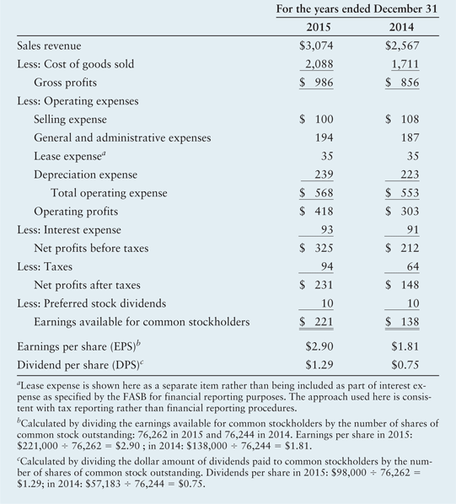
Table 3.1 Bartlett Company Income Statements

Slide 11
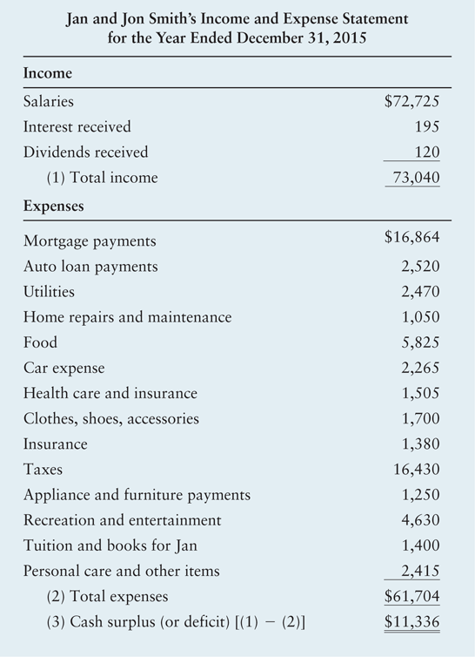
Personal Finance Example

Slide 12
The Four Key Financial Statements: The Balance Sheet
The balance sheet presents a summary of a firm’s financial position at a given point in time.
The statement balances the firm’s assets (what it owns) against its financing, which can be either debt (what it owes) or equity (what was provided by owners).

Slide 13
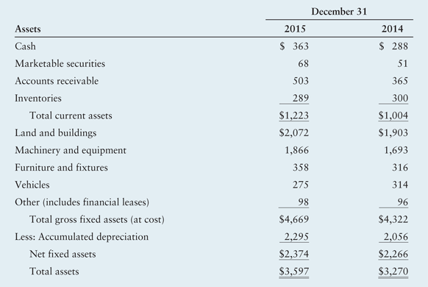
Table 3.2a Bartlett Company Balance Sheets

Slide 14
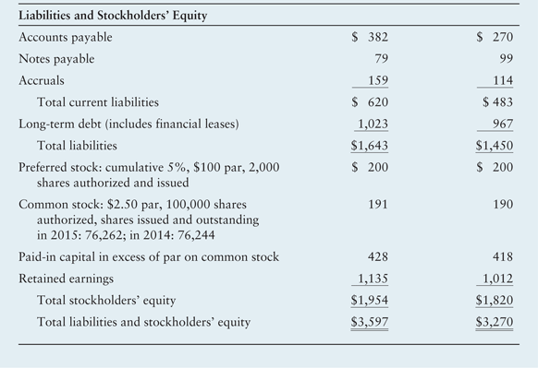
Table 3.2b Bartlett Company Balance Sheets

Slide 15
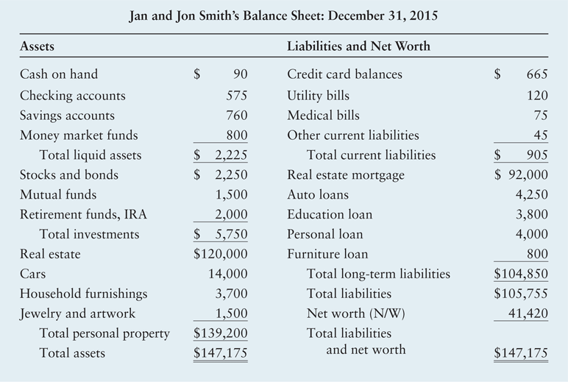
Personal Finance Example

Slide 16
The Four Key Financial Statements: Statement of Retained Earnings
The statement of retained earnings reconciles the net income earned during a given year, and any cash dividends paid, with the change in retained earnings between the start and the end of that year.

Slide 17
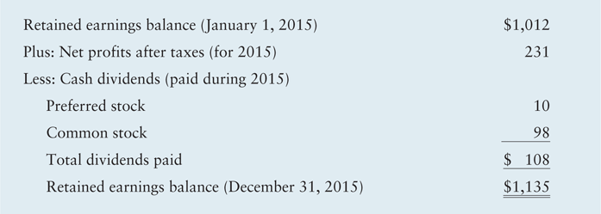
Table 3.3 Bartlett Company Statement of Retained Earnings for the Year Ended December 31, 2015

Slide 18
The Four Key Financial Statements: Statement of Cash Flows
The statement of cash flows provides a summary of the firm’s operating, investment, and financing cash flows and reconciles them with changes in its cash and marketable securities during the period.
This statement not only provides insight into a company’s investment, financing and operating activities, but also ties together the income statement and previous and current balance sheets.

Slide 19
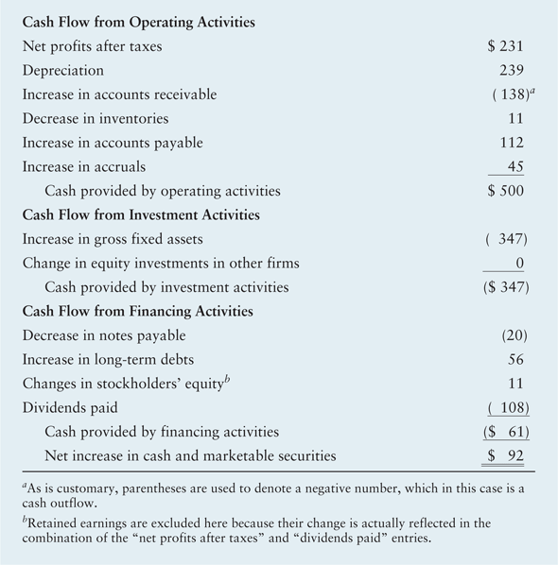
Table 3.4 Bartlett Company Statement of Cash Flows for the Year Ended December 31, 2015

Slide 20
Consolidating International Financial Statements
FASB 52 mandates that U.S.-based companies translate their foreign-currency-denominated assets and liabilities into dollars, for consolidation with the parent company’s financial statements. This is done by using the current rate (translation) method.
  The year-end (current) exchange rate.
Income statement items (revenues and expenses) are usually treated similarly.

Slide 21
Consolidating International Financial Statements
Equity accounts are translated into dollars by using the exchange rate that prevailed when the parent’s equity investment was made (the historical rate).
Retained earnings are adjusted to reflect each year’s operating profits (or losses).

Slide 22
Using Financial Ratios:
Interested Parties
Ratio analysis involves methods of calculating and interpreting financial ratios to analyze and monitor the firm’s performance.
Interested parties:
  Current and prospective shareholders are interested in the firm’s current and future level of risk and return, which directly affect share price.
  Creditors are interested in the short-term liquidity of the company and its ability to make interest and principal payments.
  Management is concerned with all aspects of the firm’s financial situation, and it attempts to produce financial ratios that will be considered favorable by both owners and creditors.

Slide 23
Using Financial Ratios:
Types of Ratio Comparisons
Cross-sectional analysis is the comparison of different firms’ financial ratios at the same point in time; involves comparing the firm’s ratios to those of other firms in its industry or to industry averages
Benchmarking is a type of cross-sectional analysis in which the firm’s ratio values are compared to those of a key competitor or group of competitors that it wishes to emulate.
Comparison to industry averages is also popular.

Slide 24
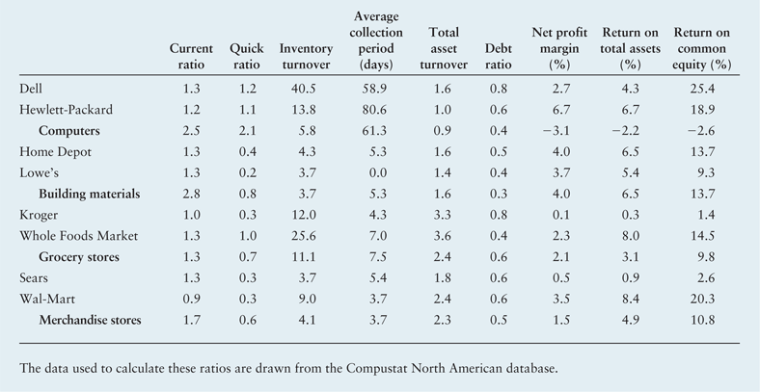
Table 3.5 Financial Ratios for Select Firms and Their Industry Median Values

Slide 25
Using Financial Ratios:
Types of Ratio Comparisons
Caldwell Manufacturing’s calculated inventory turnover for 2015 and the average inventory turnover were as follows:
Inventory turnover, 2015
Caldwell Manufacturing 14.8
Industry average 9.7

Slide 26
Using Financial Ratios: Types of Ratio Comparisons
Time-series analysis is the evaluation of the firm’s financial performance over time using financial ratio analysis
  Comparison of current to past performance, using ratios, enables analysts to assess the firm’s progress.
  Developing trends can be seen by using multiyear comparisons.
Combined analysis is the most informative approach to ratio analysis.
  Combines cross-sectional and time-series analyses.

Slide 27
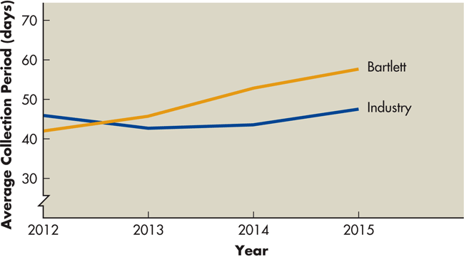
Figure 3.1 Combined Analysis

Slide 28
Using Financial Ratios: Cautions about Using Ratio Analysis
Ratios that reveal large deviations from the norm merely indicate the possibility of a problem.
A single ratio does not generally provide sufficient information from which to judge the overall performance of the firm.
The ratios being compared should be calculated using financial statements dated at the same point in time during the year.
It is preferable to use audited financial statements.
The financial data being compared should have been developed in the same way.
Results can be distorted by inflation.

Slide 29
Using Financial Ratios: Categories of Financial Ratios
Liquidity
Activity
Debt
Profitability
Market
Liquidity, activity, and debt measure risk
Profitability measures return
Market measures both

Slide 30
Ratio Analysis Example
We will illustrate the use of financial ratios for analyzing financial statements using the Bartlett Company Income Statements and Balance Sheets presented earlier in
Tables 3.1 and 3.2.

Slide 31
Liquidity Ratios
The current ratio measures the ability of the firm to meet its short-term obligations.
  Current ratio = Current assets ÷ Current liabilities
  $1,223,000 ÷ $620,000 = 1.97

Slide 32
Matter of Fact
Determinants of Liquidity Needs
  Large enterprises generally have well established relationships with banks that can provide lines of credit and other short-term loan products in the event that the firm has a need for liquidity.
  Smaller firms may not have the same access to credit, and therefore they tend to operate with more liquidity.
  Firms with high sensitivity to business cycles require higher levels of liquidity.

Slide 33
Personal Finance Example
The personal liquidity ratio is calculated by dividing total liquid assets by total current debt. It indicates the percent of annual debt obligations that an individual can meet using current liquid assets.
Calculate Jan and Jon Smith’s liquidity ratio for calendar year 2015:
$2,225/$21,539=0.1033=10.3%
The Smiths can cover only about 10 percent of their existing 1-year debt obligations with their current liquid assets.

Slide 34
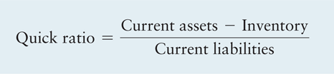

Liquidity Ratios
The quick (acid-test) ratio excludes inventory, which is generally the least liquid current asset.
  The quick ratio for Bartlett Company in 2015 is:

Slide 35
Matter of Fact
The importance of inventories:
  From Table 3.5:
  All three firms have current ratios of 1.3. However, the quick ratios for Home Depot and Lowes are dramatically lower than their current ratios, but for Dell the two ratios are nearly the same. Why?
Company | Current ratio | Quick ratio
Dell | 1.3 | 1.2
Home Depot | 1.3 | 0.4
Lowes | 1.3 | 0.2

Slide 36
Activity Ratios
Inventory turnover measures the activity, or liquidity, of a firm’s inventory.
  Inventory turnover = Cost of goods sold ÷ Inventory
  Applying this relationship to Bartlett Company in 2015 yields:
  $2,088,000 ÷ $289,000 = 7.2

Slide 37
Activity Ratios
The average age of inventory is the average number of days’ sales in inventory.
  Average Age of Inventory = 365 ÷ Inventory turnover
  For Bartlett Company, the average age of inventory in 2015 is:
  365 ÷ 7.2 = 50.7 days

Slide 38
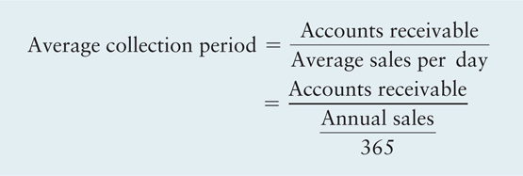
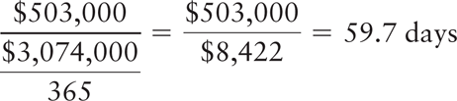
Activity Ratios
The average collection period is the average amount of time needed to collect accounts receivable.
  The average collection period for Bartlett Company in 2015 is:

Slide 39
Matter of Fact
Who Gets Credit?
  Notice in Table 3.5 the vast differences across industries in the average collection periods.
  Companies in the building materials, grocery, and merchandise store industries collect in just a few days, whereas firms in the computer industry take roughly two months to collect on their sales.
  The difference is primarily due to the fact that these industries serve very different customers.

Slide 40
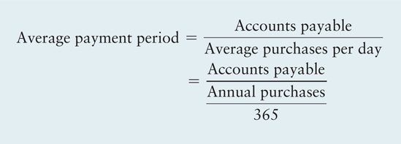

Activity Ratios
The average payment period is the average amount of time needed to pay accounts payable.
  If we assume that Bartlett Company’s purchases equaled 70 percent of its cost of goods sold in 2015, its average payment period is:

Slide 41
Activity Ratios
Total asset turnover indicates the efficiency with which the firm uses its assets to generate sales.
  Total asset turnover = Sales ÷ Total assets
  The value of Bartlett Company’s total asset turnover in 2015 is:
  $3,074,000 ÷ $3,597,000 = 0.85

Slide 42
Matter of Fact
Sell It Fast
  Observe in Table 3.5 that the grocery business turns over assets faster than any of the other industries listed.
  That makes sense because inventory is among the most valuable assets held by these firms, and grocery stores have to sell baked goods, dairy products, and produce quickly or throw them away when they spoil.
  On average, a grocery stores has to replace its entire inventory in just a few days or weeks, and that contributes to the rapid turnover of the firms total assets.

Slide 43
Debt Ratios
Debt position indicates the amount of someone else’s money is being used to generate profits.
The more debt, the greater risk of default
Financial leverage is the magnification of risk and return though use of fixed-cost financing such as debt and preferred stock.
Two types of leverage measures
  Degree of indebtedness measures amount of debt in relation to some other significant balance sheet amount
  Ability to service debt reflects firm’s ability to make scheduled payments over life of debt
Coverage ratios measure a firm’s ability to pay certain fixed charges.

Slide 44
Debt Ratios
Example 3.5
Patty Akers in incorporating her new business. She needs an initial investment of $50,000. She is considering a no-debt plan, under which she would invest the full amount without borrowing. The second option, the debt plan, involves investing $25,000 and balancing the remainder at 12%.
Patty expects $30,000 in sales and $18,000 in operating expenses and has a tax rate of 40%.

Slide 45
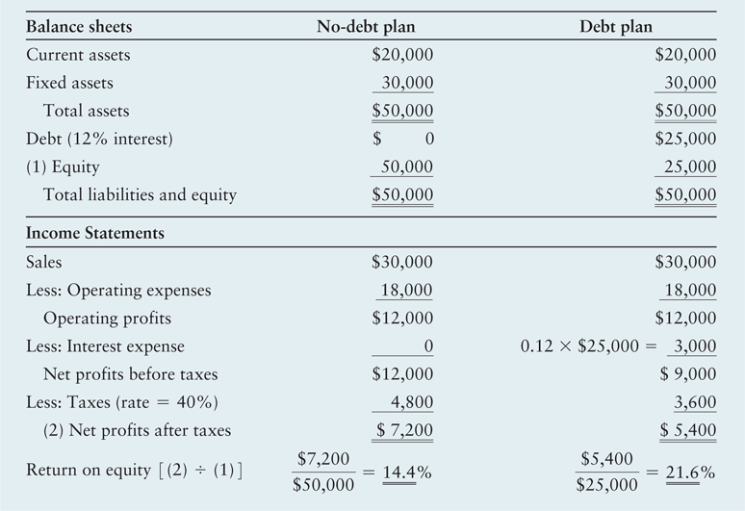
Table 3.6 Financial Statements Associated with Patty’s Alternatives

Slide 46
Debt Ratios
The debt ratio measures the proportion of total assets financed by the firm’s creditors.
  Debt ratio = Total liabilities ÷ Total assets
  The debt ratio for Bartlett Company in 2015 is
  $1,643,000 ÷ $3,597,000 = 0.457 = 45.7%

Slide 47
Debt Ratios
The debt-to-equity ratio measures the relative proportion of total liabilities and common stock equity used to finance the firm’s total assets.
  Debt to equity = Total liabilities ÷ Common stock equity
  The debt-to-equity ratio for Bartlett Company in 2015 is
  $1,643,000 ÷ $1,754,000 = 0.937 = 93.7%
  For every $1.00 invested in common stock, the company owes 4.94 to creditors.

Slide 48
Debt Ratios
The times interest earned ratio measures the firm’s ability to make contractual interest payments; sometimes called the interest coverage ratio.
  Times interest earned ratio = EBIT ÷ taxes
  The figure for earnings before interest and taxes (EBIT) is the same as that for operating profits shown in the income statement.
  Applying this ratio to Bartlett Company yields the following
  2015 value:
  $418,000 ÷ $93,000 = 4.49

Slide 49
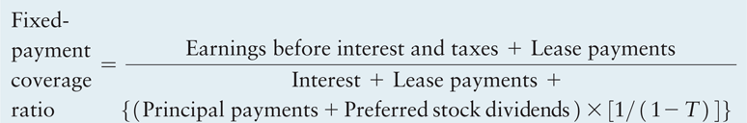
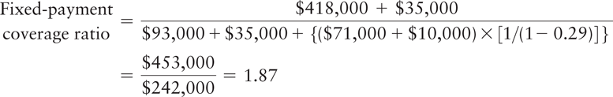
Debt Ratios (cont.)
The fixed-payment coverage ratio measures the firm’s ability to meet all fixed-payment obligations.
  Fixed-Payment coverage Ratio (FPCR)
  Applying the formula to Bartlett Company’s 2015 data yields:

Slide 50
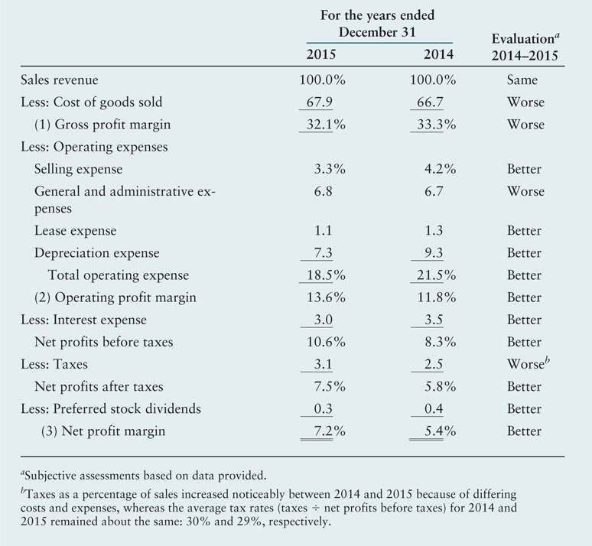
Table 3.7 Bartlett Company
Common-Size Income Statements

Slide 51

Profitability Ratios
Gross profit margin measures the percentage of each sales dollar remaining after the firm has paid for its goods.
  Bartlett Company’s gross profit margin for 2015 is:

Slide 52
Profitability Ratios
Operating profit margin measures the percentage of each sales dollar remaining after all costs and expenses other than interest, taxes, and preferred stock dividends are deducted.
  Operating profit margin = Operating profits ÷ sales
  Bartlett Company’s operating profit margin for 2015 is:
  $418,000 ÷ $3,074,000 = 13.6%

Slide 53
Profitability Ratios
Net profit margin measures the percentage of each sales dollar remaining after all costs and expenses, including interest, taxes, and preferred stock dividends, have been deducted.
  Net profit margin = Earnings available for common
  stockholders ÷ Sales
  Bartlett Company’s net profit margin for 2015 is:
  $221,000 ÷ $3,074,000 = 0.072 = 7.2%

Slide 54
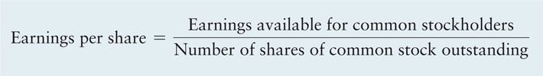
Profitability Ratios
Earnings per share represents the number of dollars earned during the period on the behalf of each outstanding share of common stock.
  Bartlett Company’s earnings per share (EPS) in 2015 is:
      $221,000 ÷ 76,262 = $2.90

Slide 55
Profitability Ratios
The return on total assets measures the overall effectiveness of management in generating profits with its available assets.
  Return on total assets (ROA) = Earnings available for common stockholders ÷ Total assets
  Bartlett Company’s return on total assets in 2015 is:
  $221,000 ÷ $3,597,000 = 0.061 = 6.1%

Slide 56
Profitability Ratios
The return on equity measures the return earned on common stockholders’ investment in the firm.
  Return on Equity (ROE) = Earnings available for common stockholders ÷ Common stock equity
  This ratio for Bartlett Company in 2015 is:
  $221,000 ÷ $1,754,000 = 0.126 = 12.6%

Slide 57
Market Ratios
The price/earnings (P/E) ratio measures the amount that investors are willing to pay for each dollar of a firm’s earnings.
  Price Earnings (P/E) Ratio = Market price per share of common stock ÷ Earnings per share
  If Bartlett Company’s common stock at the end of 2015 was selling at $32.25, using the EPS of $2.90, the P/E ratio at
  year-end 2015 is:
  $32.25 ÷ $2.90 = 11.12

Slide 58


Market Ratios
The market/book (M/B) ratio provides an assessment of how investors view the firm’s performance.
  where,

Slide 59

Market Ratios
Substituting the appropriate values for Bartlett Company from its 2015 balance sheet, we get:
Substituting Bartlett Company’s end of 2015 common stock price of $32.25 and its $23.00 book value per share of common stock (calculated above) into the M/B ratio formula, we get:
$32.25 ÷ $23.00 = 1.40

Slide 60
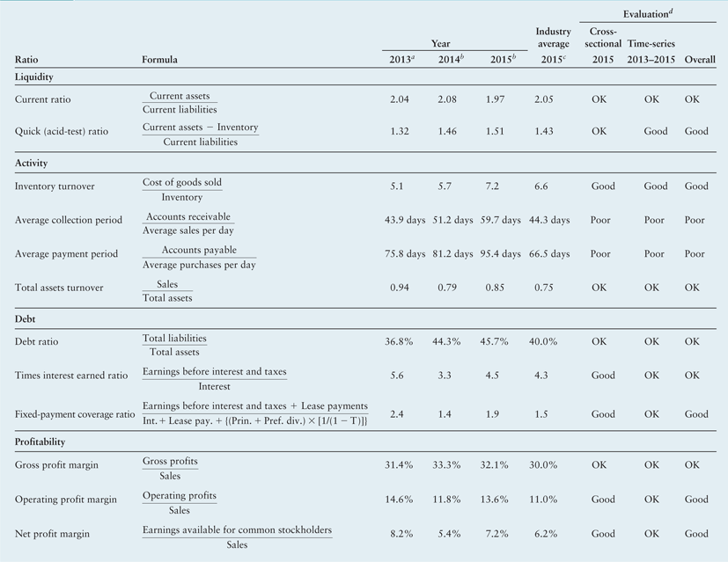
Table 3.8a Summary of Bartlett Company Ratios

Slide 61
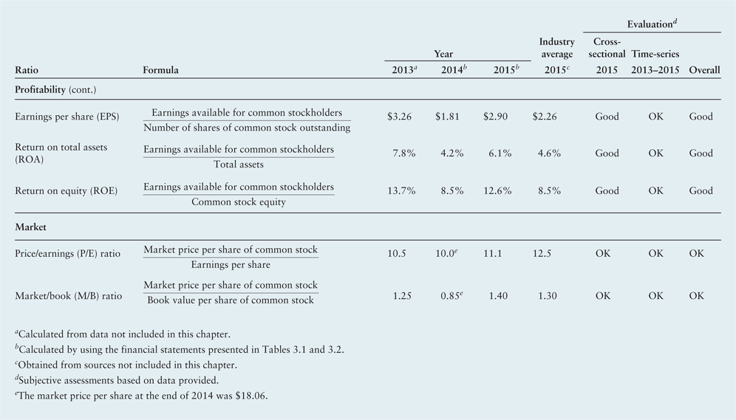
Table 3.8b Summary of Bartlett Company Ratios

Slide 62
DuPont System of Analysis
The DuPont system of analysis is used to dissect the firm’s financial statements and to assess its financial condition.
It merges the income statement and balance sheet into two summary measures of profitability.
The Modified DuPont Formula relates the firm’s ROA to its ROE using the financial leverage multiplier (FLM), which is the ratio of total assets to common stock equity:
ROA and ROE as shown in the series of equations on the following slide.

Slide 63

DuPont System of Analysis
The DuPont system first brings together the net profit margin, which measures the firm’s profitability on sales, with its total asset turnover, which indicates how efficiently the firm has used its assets to generate sales.
ROA = Net profit margin × Total asset turnover
Substituting the appropriate formulas into the equation and simplifying results in the formula given earlier,

Slide 64
DuPont System of Analysis
When the 2015 values of the net profit margin and total asset turnover for Bartlett Company, calculated earlier, are substituted into the DuPont formula, the result is:
ROA = 7.2% × 0.85 = 6.1%

Slide 65
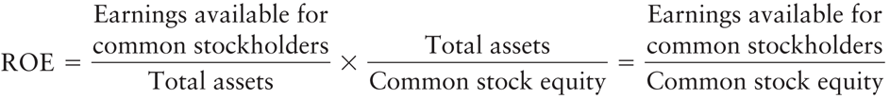
DuPont System of Analysis:
Modified DuPont Formula
The modified DuPont Formula relates the firm’s return on total assets to its return on common equity. The latter is calculated by multiplying the return on total assets (ROA) by the financial leverage multiplier (FLM), which is the ratio of total assets to common stock equity:
ROE = ROA × FLM
Substituting the appropriate formulas into the equation and simplifying results in the formula given earlier,

Slide 66
DuPont System of Analysis:
Modified DuPont Formula (cont.)
Substituting the values for Bartlett Company’s ROA of 6.1 percent, calculated earlier, and Bartlett’s FLM of 2.051 ($3,597,000 total assets ÷ $1,754,000 common stock equity) into the modified DuPont formula yields:
ROE = 6.1% × 2.051 = 12.5%

Slide 67
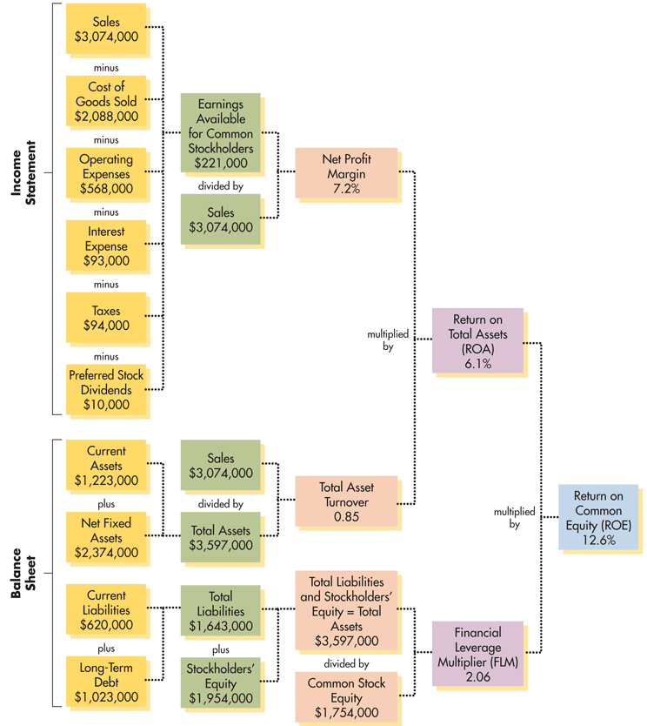
Figure 3.2
DuPont System of Analysis

Slide 68
Review of Learning Goals
LG1 Review the contents of the stockholders’ report and the procedures for consolidating international financial statements.
  The annual stockholders’ report, which publicly owned corporations must provide to stockholders, documents the firm’s financial activities of the past year. It includes the letter to stockholders and various subjective and factual information. It also contains four key financial statements: the income statement, the balance sheet, the statement of stockholders’ equity (or its abbreviated form, the statement of retained earnings), and the statement of cash flows. Notes describing the technical aspects of the financial statements follow. Financial statements of companies that have operations whose cash flows are denominated in one or more foreign currencies must be translated into dollars in accordance with FASB Standard No. 52.

Slide 69
Review of Learning Goals
LG2 Understand who uses financial ratios and how.
  Ratio analysis enables stockholders, lenders, and the firm’s managers to evaluate the firm’s financial performance. It can be performed on a cross-sectional or a time-series basis. Benchmarking is a popular type of cross-sectional analysis. Users of ratios should understand the cautions that apply to their use.
LG3 Use ratios to analyze a firm’s liquidity and activity.
  Liquidity, or the ability of the firm to pay its bills as they come due, can be measured by the current ratio and the quick (acid-test) ratio. Activity ratios measure the speed with which accounts are converted into sales or cash—inflows or outflows. The activity of inventory can be measured by its turnover, that of accounts receivable by the average collection period and that of accounts payable by the average payment period. Total asset turnover measures the efficiency with which the firm uses its assets to generate sales.

Slide 70
Review of Learning Goals
LG4 Discuss the relationship between debt and financial leverage and the ratios used to analyze a firm’s debt.
  The more debt a firm uses, the greater its financial leverage, which magnifies both risk and return. A common measure of indebtedness is the debt ratio. The ability to pay fixed charges can be measured by times interest earned and fixed-payment coverage ratios.
LG5 Use ratios to analyze a firm’s profitability and its market value.
  The common-size income statement, which shows all items as a percentage of sales, can be used to determine gross profit margin, operating profit margin, and net profit margin. Other measures of profitability include earnings per share, return on total assets, and return on common equity. Market ratios include the price/earnings ratio and the market/book ratio.

Slide 71
Review of Learning Goals
LG6 Use a summary of financial ratios and the DuPont system of analysis to perform a complete ratio analysis.
  A summary of all ratios can be used to perform a complete ratio analysis using cross-sectional and time-series analysis. The DuPont system of analysis is a diagnostic tool used to find the key areas responsible for the firm’s financial performance. It enables the firm to break the return on common equity into three components: profit on sales, efficiency of asset use, and use of financial leverage.

Slide 72
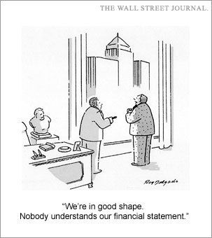
Financial Statements and Ratio Analysis
Questions?

