Slide 1
Groundhog Day
Pennsylvania/German custom with roots in the old world
  Some critter emerges from hibernation and predicts arrival of spring
Largest celebration in Punxsutawney, PA (since at least 1886)
  Punxsutawney Phil
  Ground hog sees his shadow, retreats to his burrow and portends 6 more weeks of winter
  Ground hog doesn’t see his shadow, expect an early spring

Slide 2
Groundhog Day
Groundhog, wooodchuck, whistlepig
  Marmota monax
  Large ground squirrels

Slide 3
Preserving Your Credit
Chapter 8

Slide 4
Identifying Financial Issues
Shared responsibilities – an agreement between two or more people to bear a portion of an obligation

Slide 5
Identifying Financial Issues
Living Arrangements
  Roommate
  Living Habits
Financial Issues
  Logistics
  Security Deposit
  Group Budgeting

Slide 6
Identifying Financial Issues
Contractual Rights & Duties
  Lease
  Tenant Rights & Responsibilities
    Rent
  Landlord Rights & Responsibilities
    Rent
    Property Manager

Slide 7
Long-Term Debt Repayment
Long-Term Debt- loan repayable over a period longer than a year
  Automobile
  Student
  Home mortgage
  Business
Amortization – process of dividing up debt plus interest into equal monthly payments over a set period of time

Slide 8


Slide 9
Buying a Car
Installment Loan – regular payments over a set period of time
Down Payment
Trade-in
Depreciation

Slide 10
Buying a Car
Financing Options
  Pre-approval
  Loan term
  Leasing
Refinancing

Slide 11
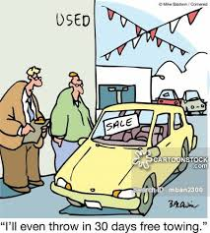

Slide 12
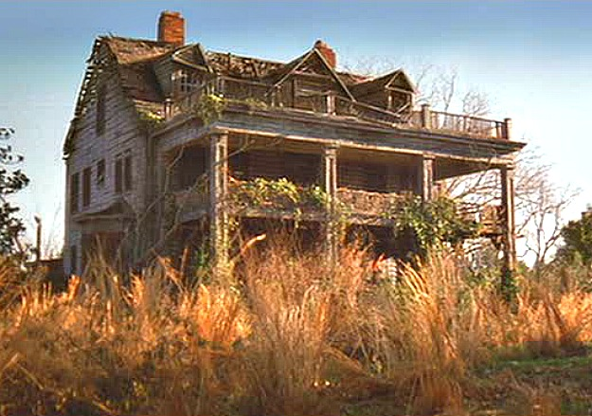

Slide 13
Buying a House
Buy vs Rent
  Appreciation/Equity
  Tax Advantage

Slide 14
Buying a House
Financing Options
  Down payment requirements
  Mortgage
    Conventional/Exotic products
    FHA
    VA
  Closing costs

Slide 15
Estimating Mortgage Loan Payments* for P and I
Rate 15 yrs 20 yrs 25 yrs 30 yrs
5.0 7.9079 6.5996 5.8459 5.3682
5.5 8.1708 6.8789 6.1409 5.6779
6.0 8.4386 7.1643 6.4430 5.9955
6.5 8.7111 7.4557 6.7521 6.3207
7.0 8.9883 7.7530 7.0678 6.6530
*$ per $1000 borrowed

Slide 16
Rate 15 yrs 20 yrs 25 yrs. 30 yrs
5.0 7.9079 6.5996 5.8459 5.3682
5.5 8.1708 6.8789 6.1409 5.6779
6.0 8.4386 7.1643 6.4430 5.9955
6.5 8.7111 7.4557 6.7521 6.3207
7.0 8.9883 7.7530 7.0678 6.6530
*$ per $1000 borrowed

Slide 17
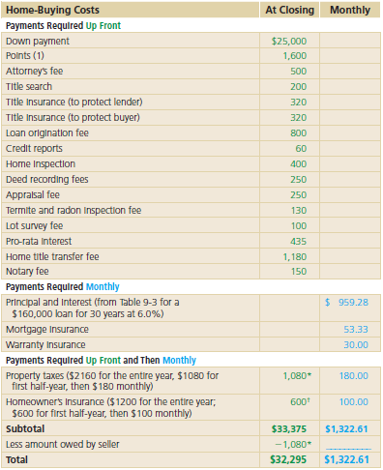

Slide 18
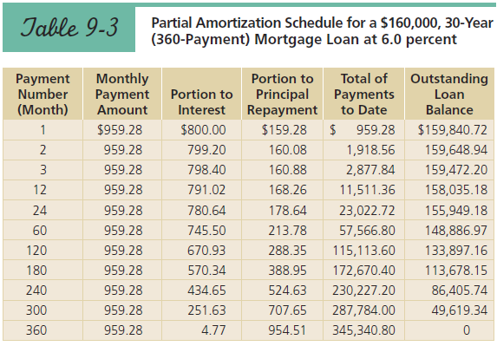

Slide 19
Business Debt
Business start-up
  Down payment
  Business plan
  Good credit
  Collateral
  Line of credit

Slide 20
Debt Repayment Plans
Debt repayment plan– strategy for paying off debt in a way that reduces total interest paid
Student Loan Debt
  Deferred payment loans
  Subsidized/Unsubsidized loans

Slide 21
Debt Repayment Plans
Mortgage Debt
  Balloon payment
Lease/Rent-to-own
  Housing
  Furniture/Appliances/Electronics
Prepayment Penalties

Slide 22
Credit Management
Establish credit
Protect your credit
Billing cycle
The Economy

Slide 23
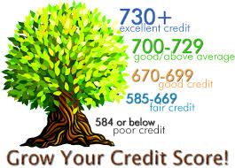
Credit Management
Establish credit
Protect your credit
Billing cycle
The Economy

Slide 24
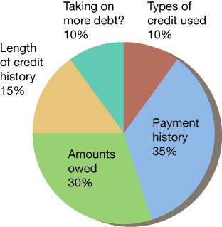
Making Sense of Your Credit Scores

Slide 25

Your Credit Reputation
You can access your credit bureau file for free only at annualcreditreport.com
A recent Federal Trade Commission study found that one in five consumers have an error on at least one of their credit reports.

Slide 26
Credit Management
Credit offers
  Disclosure terms
  Interest rate
  Grace period
  Annual fee
  Minimum finance charge
  Transaction fees
  Cash advance fees
  Late/over limit fees

Slide 27
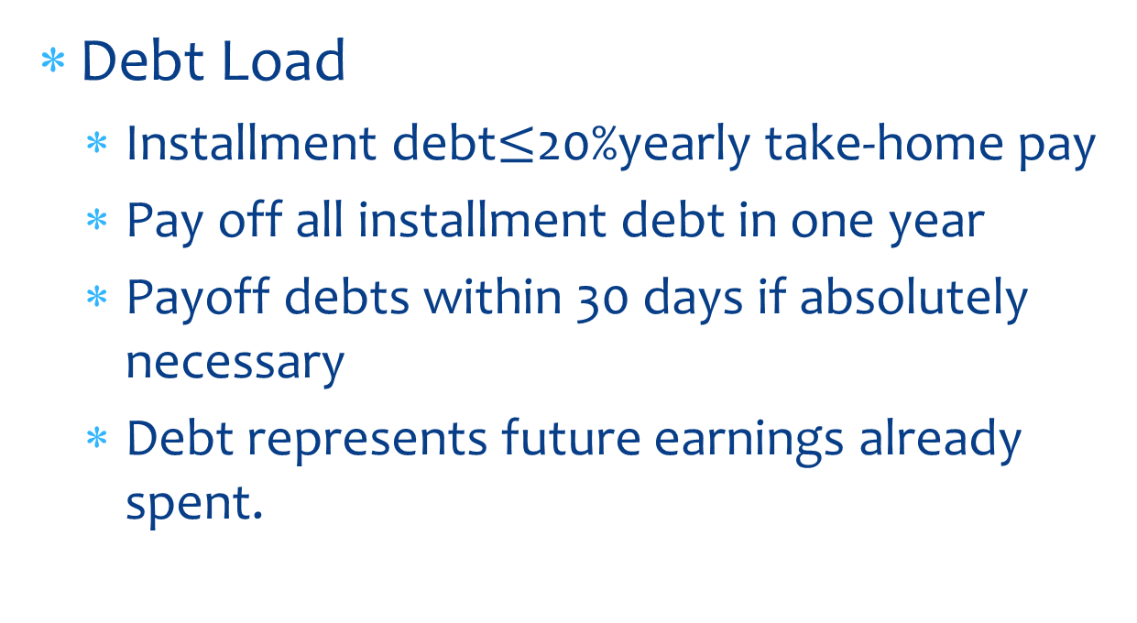
Credit Management
Debt Load
  Installment debt$≤$20%yearly take-home pay
  Pay off all installment debt in one year
  Payoff debts within 30 days if absolutely necessary
  Debt represents future earnings already spent.

Slide 28
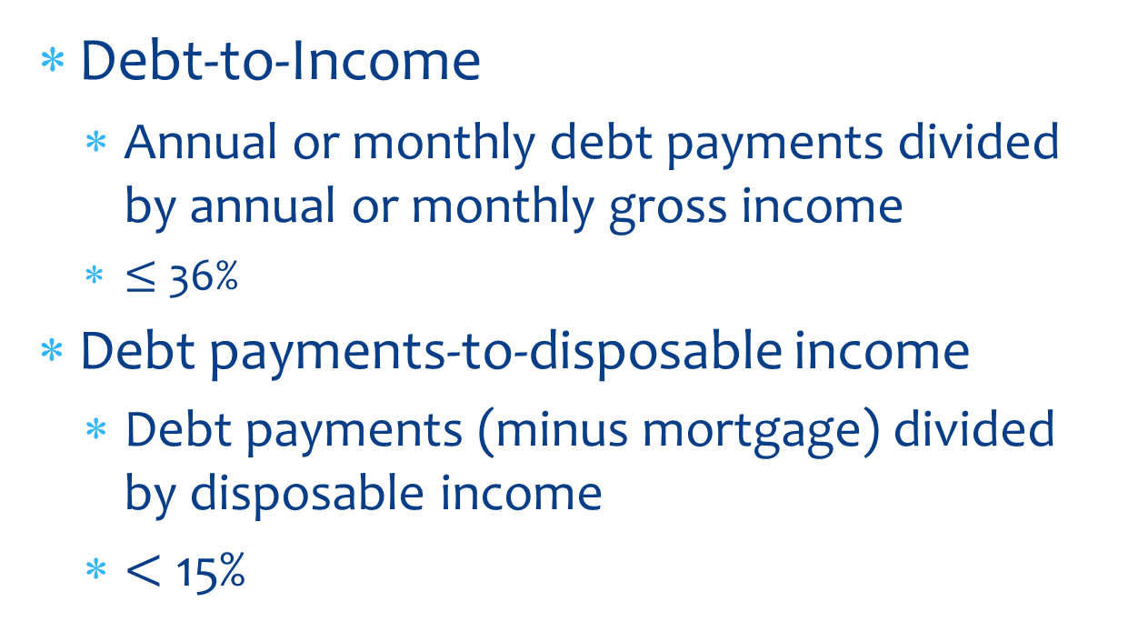
Credit Management
Debt-to-Income
  Annual or monthly debt payments divided by annual or monthly gross income
  $≤$ 36%
Debt payments-to-disposable income
  Debt payments (minus mortgage) divided by disposable income
  $<$ 15%

Slide 29
Reduce/Avoid Credit Costs
Pay cash when able
Reduce number of cards
Shop for credit cards
Take advantage of special deals
  Sales finance company
  Consumer finance company
Sales/rebates/rewards
Timing purchases
Pay on time

Slide 30
Avoid Unethical/High Interest Loan Practices
Usury laws
Loan sharks
Advance-fee loans
Equity stripping
Payday loans
Pawn shops
Car title loans
Refund anticipation loans
Joey from the bar

Slide 31
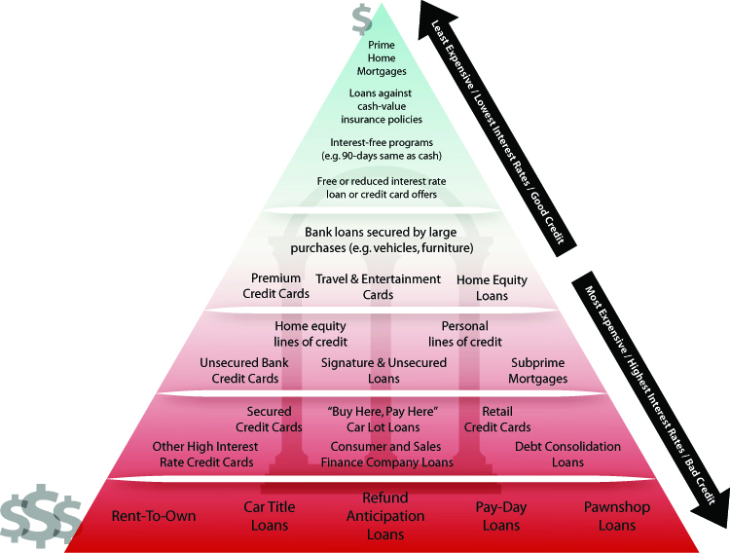
The Credit Pyramid

Slide 32
Reasons For and Against Using Credit
Good uses of credit include
  convenience
  emergencies
  reservations
  owning expensive items sooner
  taking advantage of free credit
  for protection against fraud
  to obtain an education

Slide 33
Reasons For and Against Using Credit
The downside of credit:
  Use of credit reduces financial flexibility
  Interest is costly.
    Finance Charge ($)
    Annual Percentage Rate (%)
  It is tempting to overspend
  Over indebtedness

Slide 34
Reasons For and Against Using Credit
The downside of credit:
  Use of credit reduces financial flexibility
  Interest is costly.
    Finance Charge ($)
    Annual Percentage Rate (%)
  It is tempting to overspend
  Over indebtedness

Slide 35
Unfair Credit Discrimination is Unlawful
Equal Credit Opportunity Act (ECOA)
Unfair discrimination is illegal
The Fair Credit Reporting Act (FCRA) allows you to challenge errors in your credit bureau files.

Slide 36
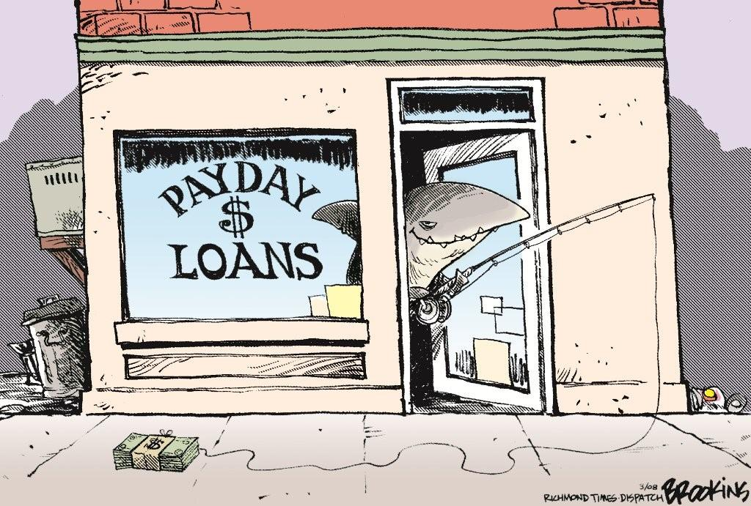
Questions?

Slide 37
Homework
Get a copy of your credit report, go to:
  www.freecreditreport.com
Learn your credit score. Go to:
  www.creditkarma.com
  www.freecreditscore.com
  www.discover.com/free-credit-score/

