Slide 1
Chapter 4
Quality & Performance Excellence, 8th Edition
Tools and Techniques for Quality Improvement

Slide 2
Outline
Explain the philosophy and approaches to continuous improvement
Describe systematic improvement processes
Illustrate the application of a variety of tools for process improvement
Discuss breakthrough improvement and the importance of creativity and innovation.

Slide 3
Process Improvement
Control-identifying and removing causes of variation and maintaining a given level of performance
To improve a process, it must be:
  Repeatable
  Measurable
Many organizations use a variety of approaches, including formal problem-solving methodologies to identify potential improvements, analyze data, and implement solutions.

Slide 4
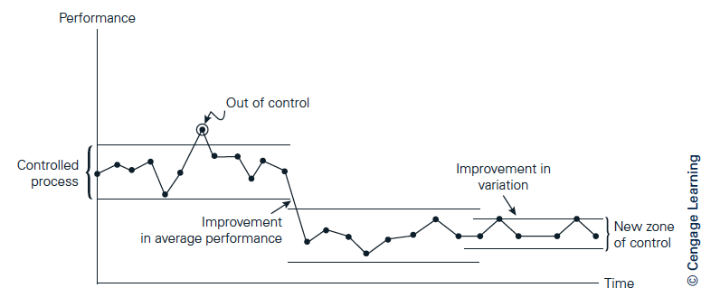
Control vs. Improvement

Slide 5
Kaizen
Kaizen – a Japanese word that means gradual and orderly continuous improvement
Focus on small, gradual, and frequent improvements over the long term with minimum financial investment, and participation by everyone in the organization.

Slide 6
Kaizen Event (Kaizen Blitz)
A kaizen event (kaizen blitz) is an intense and rapid improvement process in which a team or a department throws all its resources into an improvement project over a short time period, as opposed to traditional kaizen applications, which are performed on a part-time basis.

Slide 7
Example: Eastman Chemical Improvement Process
Focus and pinpoint
Communicate
Translate and link
Create a management action plan
Improve processes
Measure progress and provide feedback
Reinforce behaviors and celebrate results

Slide 8
Structured Improvement Processes
Redefine and analyze problems
Generate ideas
Evaluate ideas and select a solution
Implement the solution

Slide 9
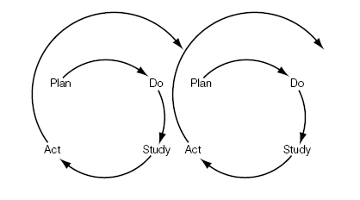
The Deming Cycle
What are we trying to accomplish?
What changes can we make that will result in improvement?
How will we know that a change is an improvement?

Slide 10
Plan (1 of 2)
Define the process: its start, end, and what it does.
Describe the process: list the key tasks performed and sequence of steps, people involved, equipment used, environmental conditions, work methods, and materials used.
Describe the players: external and internal customers and suppliers, and process operators.
Define customer expectations: what the customer wants, when, and where, for both external and internal customers.
Determine what historical data are available on process performance, or what data need to be collected to better understand the process.

Slide 11
Plan (2 of 2)
Describe the perceived problems associated with the process; for instance, failure to meet customer expectations, excessive variation, long cycle times, and so on.
Identify the primary causes of the problems and their impacts on process performance.
Develop potential changes or solutions to the process, and evaluate how these changes or solutions will address the primary causes.
Select the most promising solution(s).

Slide 12
Do
Conduct a pilot study or experiment to test the impact of the potential solution(s).
Identify measures to understand how any changes or solutions are successful in addressing the perceived problems.

Slide 13
Study
Examine the results of the pilot study or experiment.
Determine whether process performance has improved.
Identify further experimentation that may be necessary.

Slide 14
Act
Select the best change or solution.
Develop an implementation plan: what needs to be done, who should be involved, and when the plan should be accomplished.
Standardize the solution, for example, by writing new standard operating procedures.
Establish a process to monitor and control process performance.

Slide 15
Six Sigma DMAIC Methodology
Define
Measure
Analyze
Improve
Control

Slide 16
Define
Describe the problem in operational terms
Drill down to a specific problem statement (project scoping)
Identify customers and CTQs, performance metrics, and cost/revenue implications

Slide 17
Measure
Key data collection questions
  What questions are we trying to answer?
  What type of data will we need to answer the question?
  Where can we find the data?
  Who can provide the data?
  How can we collect the data with minimum effort and with minimum chance of error?

Slide 18
Analyze
Focus on why defects, errors, or excessive variation occur
Seek the root cause
  5-Why technique
Experimentation and verification

Slide 19
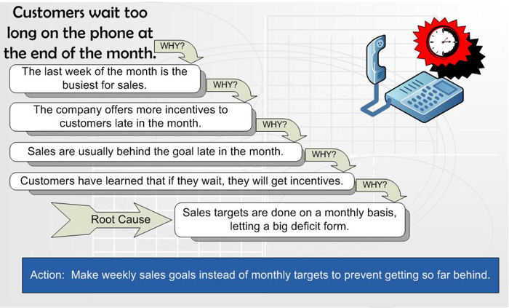

Slide 20
Improve
Idea generation
Brainstorming
Evaluation and selection
Implementation planning

Slide 21
Control
Maintain improvements
Standard operating procedures
Training
Checklist or reviews
Statistical process control charts

Slide 22
The Seven QC Tools
Flowcharts
Check sheets
Histograms
Cause-and-effect diagrams
Pareto diagrams
Scatter diagrams
Control charts

Slide 23
Flowcharts
A flowchart or process map identifies the sequence of activities or the flow of materials and information in a process. Flowcharts help the people involved in the process understand it much better and more objectively by providing a picture of the steps needed to accomplish a task.

Slide 24
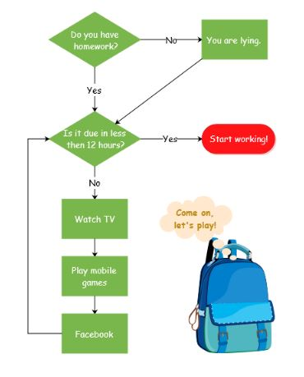

Slide 25
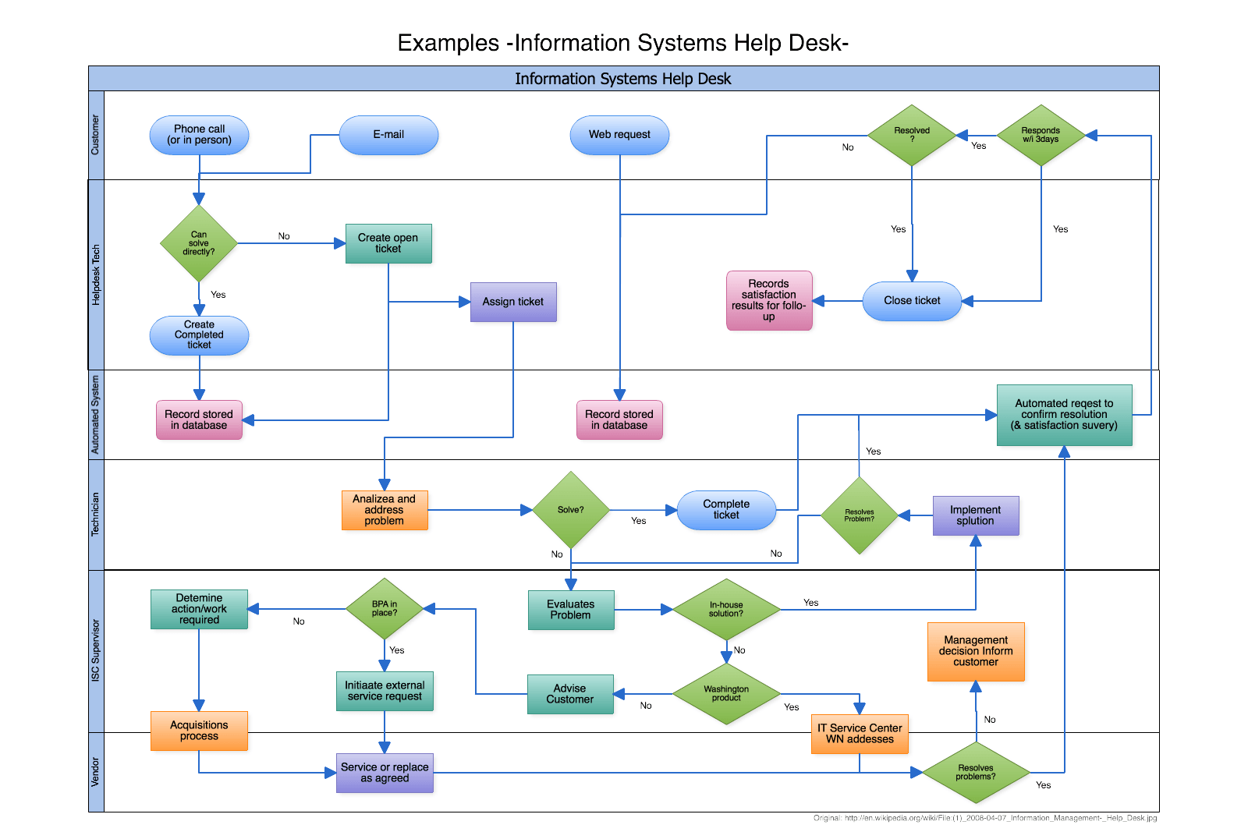

Slide 26
Benefits of Flowcharts
Shows unexpected complexity, problem areas, redundancy, unnecessary loops, and where simplification may be possible
Compares and contrasts actual versus ideal flow of a process
Allows a team to reach agreement on process steps and identify activities that may impact performance
Serves as a training tool

Slide 27
Check Sheets
Check sheets are special types of data collection forms in which the results may be interpreted on the form directly without additional processing.

Slide 28
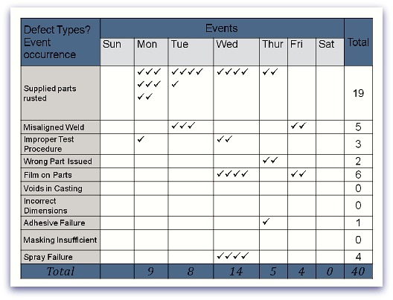

Slide 29
Benefits of Check Sheets
Creates easy-to-understand data
Builds, with each observation, a clearer picture of the facts
Forces agreement on the definition of each condition or event of interest
Makes patterns in the data become obvious quickly

Slide 30
Histograms
Histograms provide clues about the characteristics of the parent population from which a sample is taken. Patterns that would be difficult to see in an ordinary table of numbers become apparent.

Slide 31
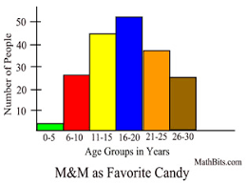

Slide 32
Benefits of Histograms
Displays large amounts of data that are difficult to interpret in tabular form
Shows centering, variation, and shape
Illustrates the underlying distribution of the data
Provides useful information for predicting future performance
Helps to answer “Is the process capable of meeting requirements?”

Slide 33
Pareto Diagrams
A Pareto distribution is one in which the characteristics observed are ordered from largest frequency to smallest.
A Pareto diagram is a histogram of the data from the largest frequency to the smallest.

Slide 34
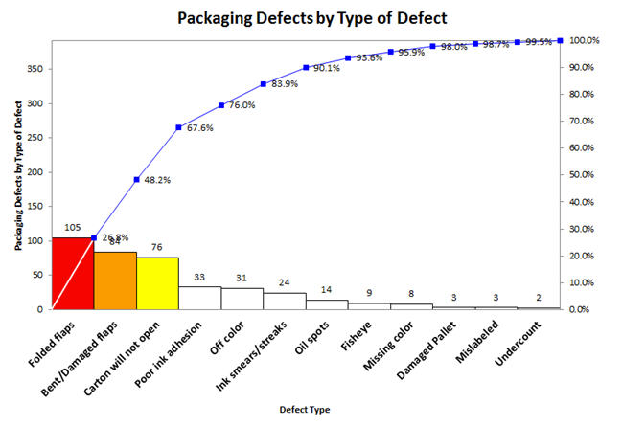

Slide 35
Benefits of Pareto Diagrams
Helps a team focus on causes that have the greatest impact
Displays the relative importance of problems in a simple visual format
Helps prevent “shifting the problem,” where the solution removes some causes but worsens others

Slide 36
Cause-and-Effect Diagrams
A cause-and-effect diagram is a simple graphical method for presenting a chain of causes and effects and for sorting out causes and organizing relationships between variables.

Slide 37
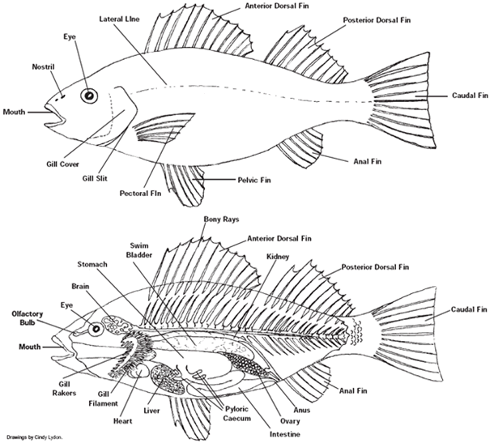

Slide 38
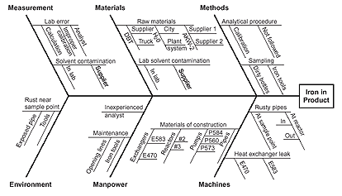

Slide 39
Benefits of Cause and Effect Diagrams
Enables a team to focus on the content of a problem, not on the history of the problem or differing personal interests of team members
Creates a snapshot of collective knowledge and consensus of a team; builds support for solutions
Focuses the team on causes, not symptoms

Slide 40
Scatter Diagrams
A scatter diagram is a plot of the relationship between two numerical variables.

Slide 41
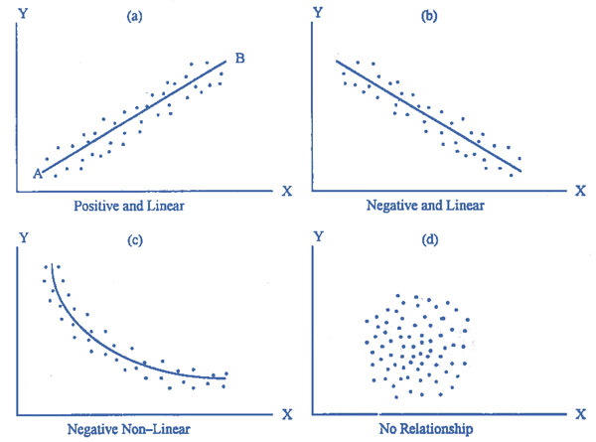

Slide 42
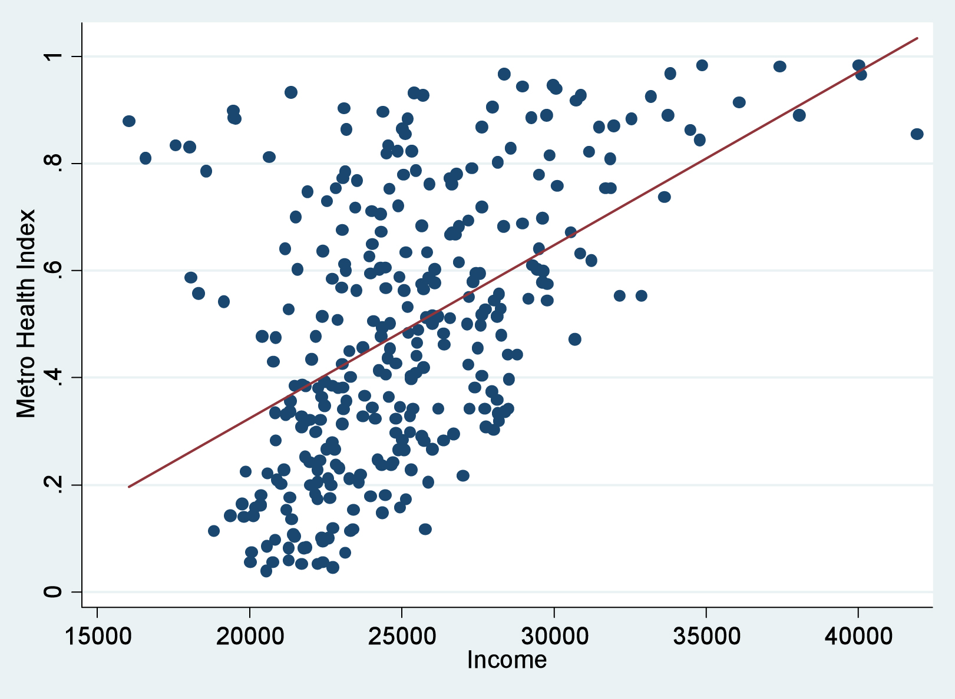

Slide 43
Benefits of Scatter Diagrams
Supplies the data to confirm a hypothesis that two variables are related
Provides both a visual and statistical means to test the strength of a relationship
Provides a good follow-up to cause and effect diagrams

Slide 44
Control Charts
Control charts show the performance and the variation of a process or some quality or productivity indicator over time in a graphical fashion that is easy to understand and interpret. They also identify process changes and trends over time and show the effects of corrective actions.

Slide 45
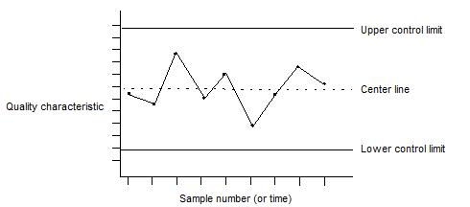

Slide 46
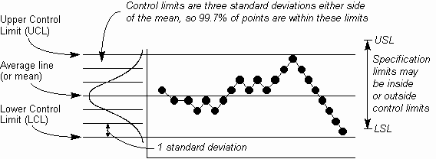

Slide 47
Benefits of Control Charts
Monitors performance of one or more processes over time to detect trends, shifts, or cycles
Distinguishes special from common causes of variation
Allows a team to compare performance before and after implementation of a solution to measure its impact
Focuses attention on truly vital changes in the process

Slide 48
Lean Thinking
Lean is often used to refer to approaches initially developed by the Toyota Motor Corporation that focus on the elimination of waste in all forms, including defects requiring rework, unnecessary processing steps, unnecessary movement of materials or people, waiting time, excess inventory, and overproduction.

Slide 49
Principles of Lean Thinking
Reduce handoffs
Eliminate steps
Perform steps in parallel rather than in sequence
Involve key people early

Slide 50
Lean Tools
The 5S’s: seiri (sort), seiton (set in order), seiso (shine), seiketsu (standardize), and shitsuke (sustain).
Visual controls
Efficient layout and standardized work
Pull production
Single minute exchange of dies (SMED)
Total productive maintenance
Source inspection

Slide 51
Lean Six Sigma (LSS)
LSS can be defined as an integrated improvement approach to improve goods and services, and operations efficiency by reducing defects, variation, and waste.
Merger of Lean and Six Sigma tools
Both focused on customer requirements and real dollar savings

Slide 52
Breakthrough Improvement
Discontinuous, rather than gradual, change
Breakthrough improvements result from innovative and creative thinking; often these are motivated by stretch goals
Facilitated by benchmarking and reengineering

Slide 53
Benchmarking
Benchmarking – “the search of industry best practices that lead to superior performance.”
Best practices – approaches that produce exceptional results, are usually innovative in terms of the use of technology or human resources, and are recognized by customers or industry experts.

Slide 54
Types of Benchmarking
Competitive benchmarking - studying products, processes, or business performance of competitors in the same industry to compare pricing, technical quality, features, and other quality or performance characteristics of products and services.
Process benchmarking – focus on key work processes
Strategic benchmarking – focus on how companies compete and strategies that lead to competitive advantage

Slide 55
Benchmarking Process
Determine what to benchmark
Identify key performance indicators to measure
Identify the best-in-class companies
Measure the performance of best-in-class and compare to your own performance
Define and take actions to meet or exceed the best performance

Slide 56
Reengineering
Reengineering – the fundamental rethinking and radical redesign of business processes to achieve dramatic improvements in critical, contemporary measures of performance, such as cost, quality, service, and speed.

Slide 57
Organizational Issues in Process Improvement
Resistance to change
Top management support
Diversity of human resources
Methodological rigor
Payoffs and benefits

Slide 58
Creativity and Innovation
Creativity and innovation are fundamental to improving both products and processes:
  better respond to customer needs, particularly the “ exciters/delighters” that customers cannot articulate, and to develop the products and services that will position an organization strategically ahead of its competitors.
  support continuous improvement efforts, for example, to identify and refine unique and creative solutions to problems.
  motivate employees more than any extrinsic reward

Slide 59
Fostering Creativity
Remove or reduce obstacles to creativity.
Match jobs to individuals’ creative abilities.
Tolerate failures and establish direction.
Improve motivation to increase productivity and solve problems creatively.
Enhance the self-esteem and build the confidence of organization members.
Improve communication so that ideas can be better shared.
Place highly creative people in special jobs and provide training to take advantage of their creativity.

Slide 60
Process Improvement in Action
General Electric
Froedtert Hospital
Boeing

Slide 61
Outline
Explain the philosophy and approaches to continuous improvement
Describe systematic improvement processes
Illustrate the application of a variety of tools for process improvement
Discuss breakthrough improvement and the importance of creativity and innovation.

Slide 62
Homework
Questions, p 186
  13-15
Case Studies, p 188
  The State University Experience Revisited

