Slide 1
Managing Change and
Innovation
Management
Stephen P. Robbins Mary Coulter
tenth edition
Chapter
12

Slide 2
Learning Outcomes
Follow this Learning Outline as you read and study this chapter.
12.1 The Change Process
  Explain Lewin’s three-step model of the change process.
  Contrast the calm waters and white-water rapids metaphors of change.
12.2 Managing Organizational Change
  Define organizational change.
  Explain how managers might change structure, technology, and people.

Slide 3
Learning Outcomes
12.3 Managing Resistance to Change
  Explain why people resist change and how resistance might be managed.
12.4 Contemporary Issues In Managing Change
  • Explain why changing organizational culture is so
  difficult and how managers can do it.
  • Describe employee stress and how managers can
  help employees deal with stress.
  • Discuss what it takes to make change happen
  successfully.

Slide 4
Learning Outcomes
12.5 Stimulating Innovation
  Explain how creativity and innovation differ from one another.
  Describe the structural, cultural, and human resource variables that are necessary for innovation.

Slide 5
Exhibit 12–1 External and Internal Forces for Change
External
• Changing consumer
needs and wants
• New governmental laws
• Changing technology
• Economic changes
Internal
  • New organizational strategy
  • Change in composition of workforce
  • New equipment
  • Changing employee attitudes

Slide 6
What Is Change?
Characteristics of Change
  Is constant yet varies in degree and direction
  Produces uncertainty yet is not completely unpredictable
  Creates both threats and opportunities
Managing change is an integral part
of every manager’s job.

Slide 7
The Change Process
The Calm Waters Metaphor
  Lewin’s description of the change process as a break in the organization’s equilibrium state
    Unfreezing the status quo
    Changing to a new state
    Refreezing to make the change permanent
White-Water Rapids Metaphor
  The lack of environmental stability and predictability requires that managers and organizations continually adapt (manage change actively) to survive.

Slide 8
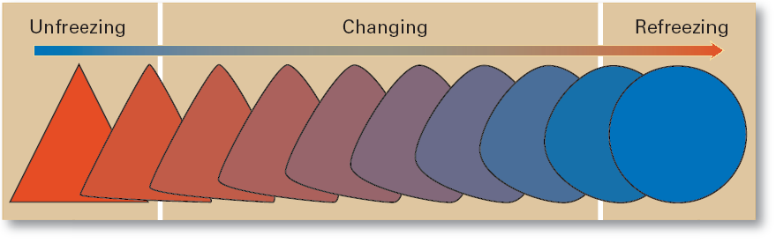
Exhibit 12–2 The Change Process

Slide 9
Organizational Change and Change Agents
Organizational Change
  Any alterations in the people, structure, or technology of an organization
Change Agents
  Persons who act as catalysts and assume the responsibility for managing the change process.
Types of Change Agents
  Managers: internal entrepreneurs
  Nonmanagers: change specialists
  Outside consultants: change implementation experts

Slide 10
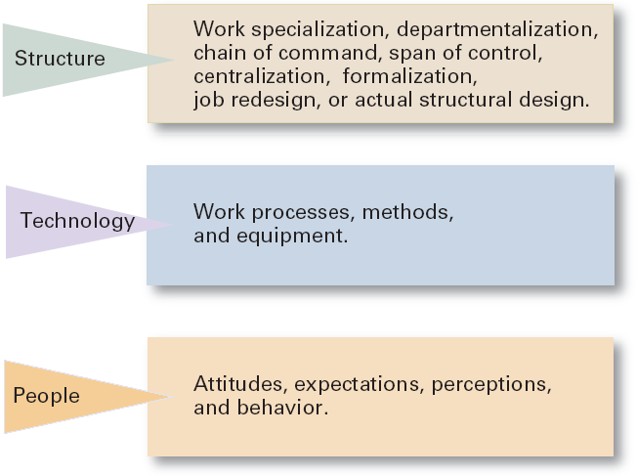
Exhibit 12–3 Three Types of Change

Slide 11
Types of Change
Structure
  Changing an organization’s structural components or its structural design
Technology
  Adopting new equipment, tools, or operating methods that displace old skills and require new ones
    Automation: replacing certain tasks done by people with machines
    Computerization
People
  Changing attitudes, expectations, perceptions, and behaviors of the workforce

Slide 12
Organizational Development
Organizational Development (OD)
  Techniques or programs to change people and the nature and quality of interpersonal work relationships.
Global OD
  OD techniques that work for U.S. organizations may be inappropriate in other countries and cultures.

Slide 13
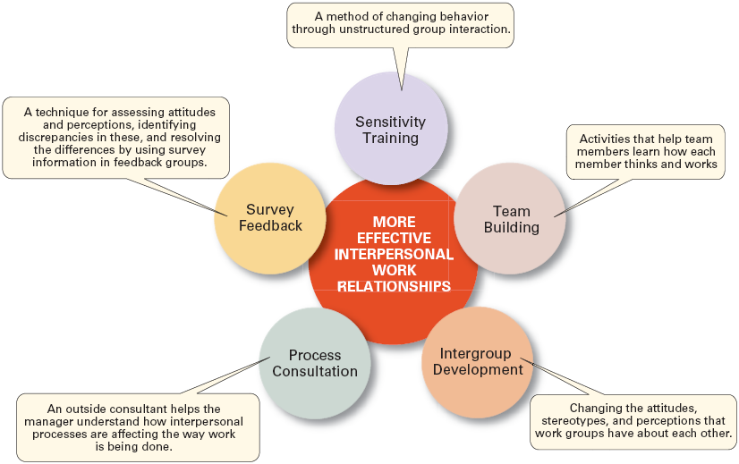
Exhibit 12–4 Popular OD Techniques

Slide 14
Managing Resistance to Change
Why People Resist Change
  The ambiguity and uncertainty that change introduces
  The comfort of old habits
  A concern over personal loss of status, money, authority, friendships, and personal convenience
  The perception that change is incompatible with the goals and interest of the organization

Slide 15
Exhibit 12–5 Reducing Resistance to Change

Slide 16
Issues in Managing Change (cont’d)
Changing Organizational Cultures
  Cultures are naturally resistant to change.
  Conditions that facilitate cultural change:
    The occurrence of a dramatic crisis
    Leadership changing hands
    A young, flexible, and small organization
    A weak organizational culture

Slide 17
Exhibit 12–6 Strategies for Managing Cultural Change
Set the tone through management behavior; top managers, particularly, need to be positive role models.
Create new stories, symbols, and rituals to replace those currently in use.
Select, promote, and support employees who adopt the new values.
Redesign socialization processes to align with the new values.
To encourage acceptance of the new values, change the reward system.
Replace unwritten norms with clearly specified expectations.
Shake up current subcultures through job transfers, job rotation, and/or terminations.
Work to get consensus through employee participation and creating a climate with a high level of trust.

Slide 18
Issues in Managing Change (cont’d)
Handling Employee Stress
  Stress
    The adverse reaction people have to excessive pressure placed on them from extraordinary demands, constraints, or opportunities.
    Functional Stress
      Stress that has a positive effect on performance.
  How Potential Stress Becomes Actual Stress
    When there is uncertainty over the outcome.
    When the outcome is important.

Slide 19
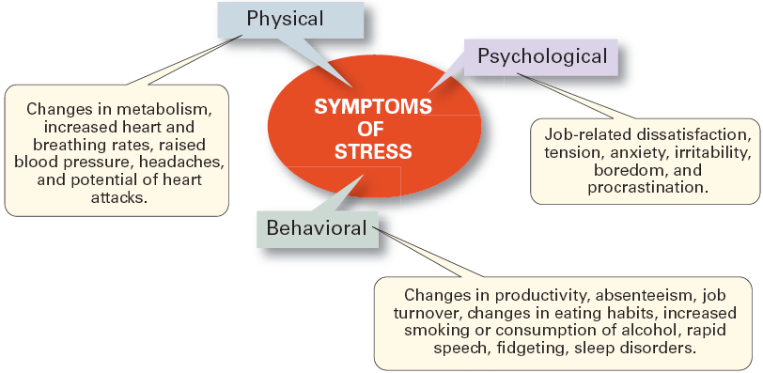
Exhibit 12–7 Symptoms of Stress

Slide 20
Issues in Managing Change (cont’d)
Reducing Stress
  Engage in proper employee selection
  Use realistic job interviews for reduce ambiguity
  Improve organizational communications
  Develop a performance planning program
  Use job redesign
  Provide a counseling program
  Offer time planning management assistance
  Sponsor wellness programs

Slide 21
Issues in Managing Change (cont’d)
Making Change Happen Successfully
  Embrace change—become a change-capable organization.
  Create a simple, compelling message explaining why change is necessary.
  Communicate constantly and honestly.
  Foster as much employee participation as possible—get all employees committed.
  Encourage employees to be flexible.
  Remove those who resist and cannot be changed.

Slide 22
Exhibit 12–8 Characteristics of Change-Capable
Organizations
Link the present and the future.
Make learning a way of life.
Actively support and encourage day-to-day improvements and changes.
Ensure diverse teams.
Encourage mavericks.
Shelter breakthroughs.
Integrate technology.
Build and deepen trust.

Slide 23
Stimulating Innovation
Creativity
  The ability to combine ideas in a unique way or to make an unusual association.
Innovation
  Turning the outcomes of the creative process into useful products, services, or work methods.

Slide 24
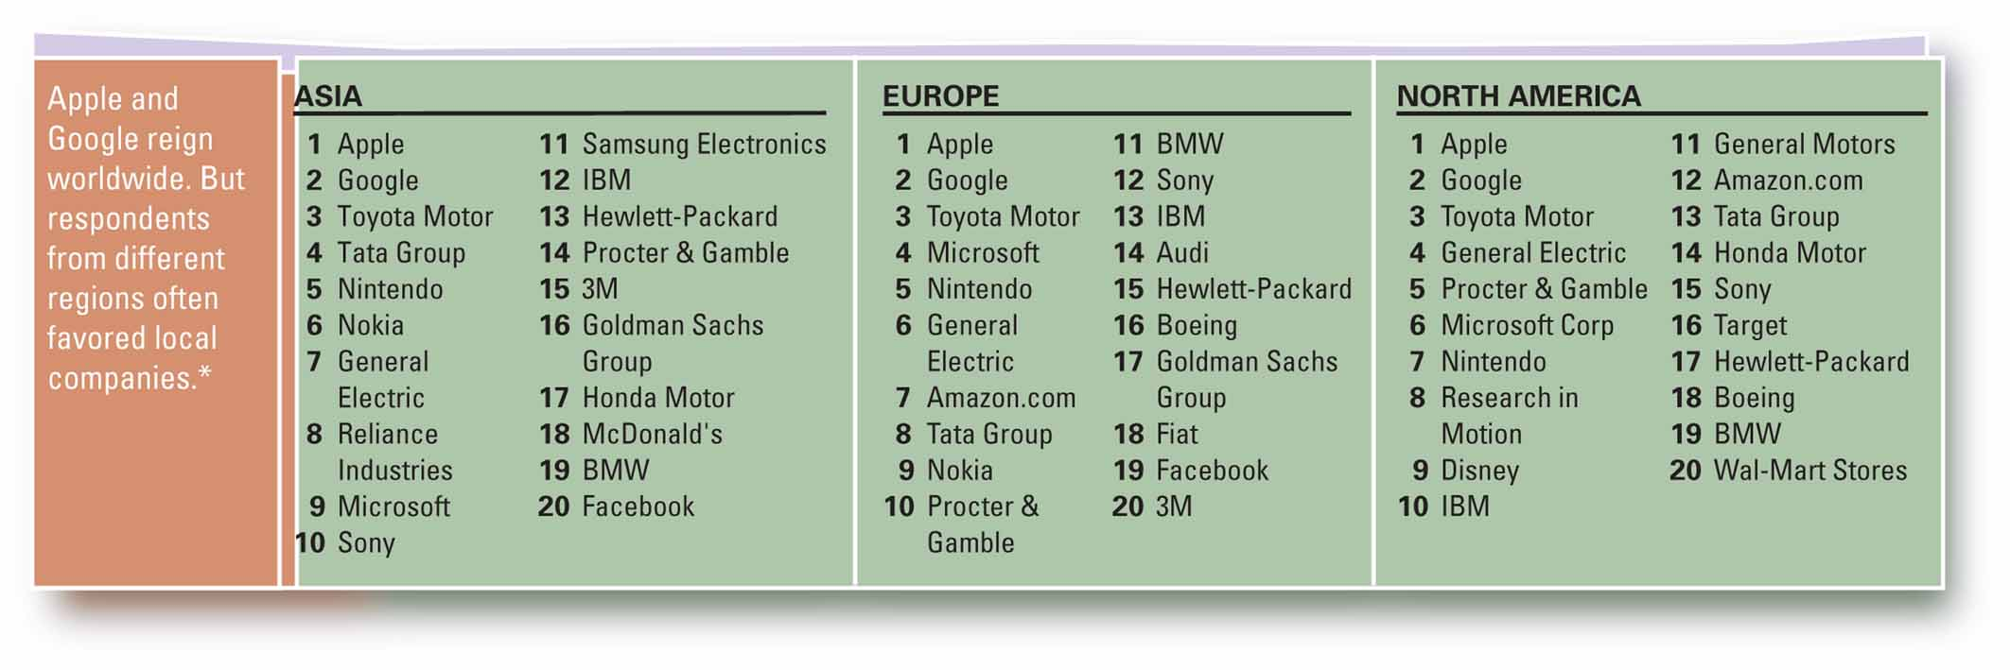
Exhibit 12–9 World’s Most Innovative Companies
Source: “The World’s Most Innovative Companies by Region,” BusinessWeek, BusinessWeekOnline, April 15, 2008, businessweek.com

Slide 25
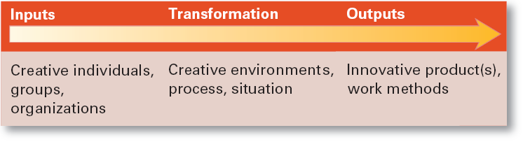
Exhibit 12–10 Systems View of Innovation
Source: Adapted from R.W. Woodman, J.E. Sawyer, and R.W. Griffin, “Toward a Theory of Organizational Creativity,” Academy of Management Review, April 1993, p. 309.

Slide 26
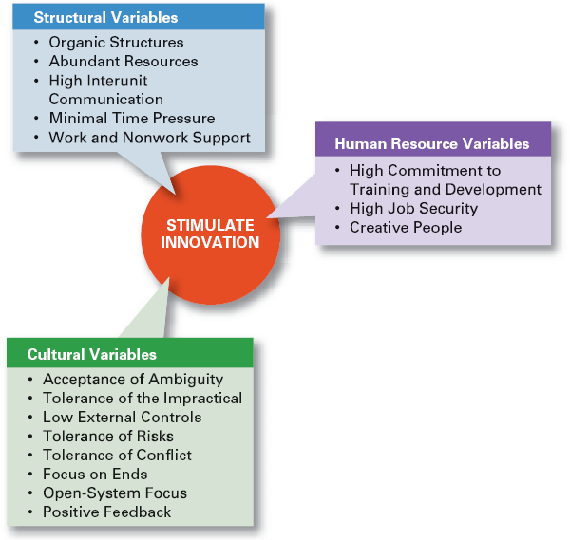
Exhibit 12–11
Innovation Variables

Slide 27
Stimulating Innovation
Structural Variables
  Adopt an organic structure
  Make available plentiful resources
  Engage in frequent inter-unit communication
  Minimize extreme time pressures on creative activities
  Provide explicit support for creativity

Slide 28
Stimulating Innovation (cont’d.)
Cultural Variables
  Accept ambiguity
  Tolerate the impractical
  Have low external controls
  Tolerate risk taking
  Tolerate conflict
  Focus on ends rather than means
  Develop an open-system focus
  Provide positive feedback

Slide 29
Stimulating Innovation (cont’d.)
Human Resource Variables
  Actively promote training and development to keep employees’ skills current.
  Offer high job security to encourage risk taking.
  Encourage individual to be “champions” of change.
Idea Champion
  Dynamic self-confident leaders who actively and enthusiastically inspire support for new ideas, build support, overcome resistance, and ensure that innovations are implemented.

Slide 30
Terms to Know
organizational change
change agent
organizational development (OD)
stress
creativity
innovation
idea champion

