Slide 1
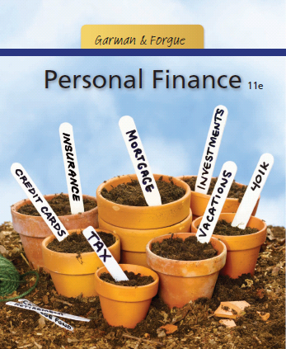
Garman/Forgue
Personal Finance
Eleventh Edition
Chapter 6:
Building and Maintaining Good Credit
PPT slide program prepared by Amy Forgue and Ray Forgue.

Slide 2
Introduction
Credit is any arrangement in which goods, services or money is received in exchange for a promise to repay at a later date.
To succeed financially you need establish and maintain a good credit reputation.
Notes:
You use credit any time you obtain goods, services or money without paying for it immediately. Using credit is an important part of financial responsibility and to succeed financially you will need a good credit reputation.

Slide 3
Your Next Five Years
In the next five years, you can start achieving financial success by doing the following related to building and maintaining good credit:
Protect your credit reputation as carefully as you would safeguard your personal reputation.
2. Determine your own debt limits rather than rely on a lender before deciding to take on any debt.
Notes:
It is important to get off to a good start in your financial life. The first five years are critical and require that you do five things related to building and maintaining good credit.
First, protect your credit reputation carefully.
Second, set you own debt limits rather than let lenders tell you how much you can afford to owe.

Slide 4
Your Next Five Years
3. Obtain copies of your credit bureau reports regularly, and challenge all errors or omissions you find.
4. Never cosign a loan for anyone, including relatives.
5. Always repay your debts in a timely manner.
Notes:
Third, obtain copies of your credit report regularly and challenge all errors.
Fourth, never cosign for a loan.
Fifth, repay all debts on time, every time.

Slide 5
Learning Objective #1
Explain reasons for and against using credit.
Notes:
Learning objective #1 is to explain the reasons for and against the use of credit.

Slide 6
Reasons For and Against Using Credit
Good uses of credit include
  convenience,
  emergencies,
  reservations,
  owning expensive items sooner,
  taking advantage of free credit,
  for protection against fraud,
  to obtain an education.
Notes:
6
There are several good uses of credit. Credit is appropriate in true emergencies, when making reservations, for convenience when you will repay very quickly, to buy certain big ticket items. Using a credit card provides added safeguards against fraud as opposed to using a debt card or cash. Perhaps the best reason for using credit is to get an education—as long as you borrow as little as possible.

Slide 7
Reasons For and Against Using Credit
The downside of credit:
  Use of credit reduces financial flexibility.
  It Is tempting to overspend.
  There’s a possibility of becoming “overstretched”.
Notes:
But credit has some severe downsides. It reduces your financial flexibility until the debt is paid. It is very easy and tempting to overspend.

Slide 8
Reasons For and Against Using Credit
  Interest is costly.
    Interest, Finance Charge, Annual Percentage Rate (or APR)
Notes:
And most importantly, credit use is very costly. Always pay close attention to finance charges including interest and seek the lowest possible APRs.

Slide 9
Concept Check 6.1
Which two good uses of credit seem most reasonable to you? Which do not?
Explain the two downsides of credit that would be most worrisome for you.
Distinguish between the APR and the finance charge on a debt.
Notes:
Assess your understanding by addressing these points.

Slide 10
Learning Objective #2
Establish your own debt limit.
Notes:
Learning objective #2 is to establish your own debt limit.

Slide 11
Setting Debt Limits
You should set your own debt limit.
Debt payments-to-disposable income method uses your debt payments-to-disposable income ratio.
You are overindebted if the ratio is 15% or higher.
Notes:
Always calculate your debt payments-to-disposable income ratio when considering taking on new credit. If the ratio is 15 percent or higher you should take on no new debt. If your ratio is already that high you should focus your finances in paying down your debts.

Slide 12
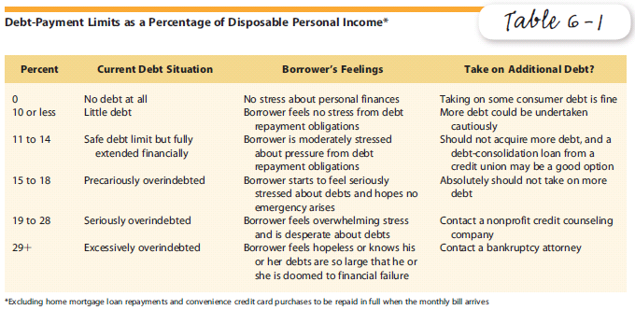
Table 6-1: Debt-Payment Limits as a Percentage of Disposable Income
Notes:
Table 6-1 brackets of disposable income-to-debt payment ratios and the degree to which a borrow is in difficulty for each bracket. The table also indicates whether more debt is a wise course of action for people finding themselves in a particular bracket.

Slide 13
Setting Debt Limits
Ratio of debt-to-equity method uses your Debt-to-Equity Ratio: Ratio of your consumer debt to your assets.
  Equity: Amount by which the value of a person’s assets exceeds debts.
  A ratio of 33% or higher is excessive.
Notes:
Another way to assess your debt limit is by calculating your debt-to-equity ratio. This is the degree to which your total debts exceed your total assets ignoring the impact of home ownership. If your ratio is less than 33 percent you may safely take on additional debt but stay below that limit. If your ratio is already 33 percent or higher focus your financing on debt reduction.

Slide 14
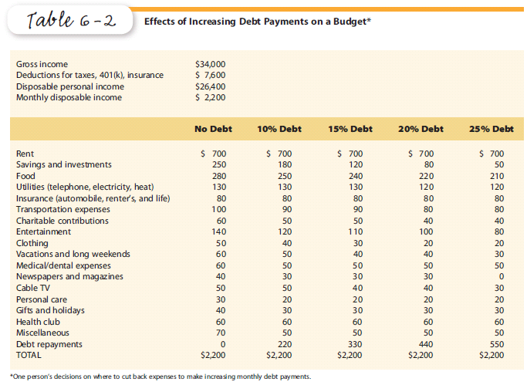
Table 6-2: Effects of Increasing Debt Payments on a Budget
Notes:
Table 6-2 illustrates how taking on additional debt might affect one’s budget. The higher the percentage of debt payments the more likely it is that even nondiscretionary spending will have to be curtailed.

Slide 15
Setting Debt Limits
Continuous-Debt Method: If you are unable to get completely out of debt every four years, you probably lean on debt too heavily.
Dual-earner households should consider lower debt limits rather than a limit based on their combined incomes.
Notes:
Using the continuous-debt method people should be able to get completely out of debts other than their mortgage every four years. If not, they are doomed to a debt lifestyle and years of expensive interest payments.
Dual-earner couples might think they can take on debt levels commensurate with their combined incomes. This can lead to trouble if one of the incomes slows or stops. Lower debt limits are appropriate for these couples.

Slide 16
Managing Student Loan Debt
Choose the most advantageous repayment pattern allowed.
Pay electronically.
Make your repayments on time, every time.
Consolidate your student loans.
If necessary, sign up for the Federal government’s income-based repayment plan.
Notes:
As a college student you may already have heavy levels of debt. Your first step is to focus on taking on as little additional debt as possible. You do not have to take out the full level of loans for which you qualify. Then, once you graduate you should choose a most advantageous initial repayment plan, pay electronically and make all payments on time. As soon as possible you should consolidate your loans into one and pay it off as soon as possible.

Slide 17
Concept Check 6.2
Distinguish among the debt payments-to-disposable income, ratio of debt-to-equity, and continuous-debt methods for setting your debt limit.
Notes:
Assess your understanding by addressing these points.

Slide 18
Concept Check 6.2
What are the threshold levels for both the debt payments-to-disposable income and ratio of debt-to-equity methods that would indicate that a person is carrying too much debt?
Notes:
Assess your understanding by addressing these points.

Slide 19
Concept Check 6.2
Discuss how dual-earner households should consider their ability to carry additional debt.
Notes:
Assess your understanding by addressing these points.

Slide 20
Learning Objective #3
Achieve a good credit reputation.
Notes:
Learning objective #3 is to achieve a good credit reputation.

Slide 21
Credit Approval Process
1. You apply for credit.
  Complete a Credit Application
2. The lender obtains your credit history.
  Credit Report
  Credit Bureau
  Credit Scoring (or Risk Scoring) System
Notes:
21
The credit approval process begins when you apply for credit. You will complete a credit application in writing, orally, or online. Once you apply the lender will likely want to assess your credit history.
Most lenders now use your credit report as the source of your credit history. These reports are maintained by huge national credit bureaus that maintain date bases on millions of consumers. The gather the information from lenders. If you do not have a file with a credit bureau it is likely because you have never used credit in the past.
Credit bureaus also calculate and report credit scores to lenders. These scores provide a lender with a way to measure the likelihood that you will repay the debt to be incurred.

Slide 22
Credit Approval Process
3. The lender decides whether to accept the application and under what terms.
  Credit Agreement
  Promissory Note
  Tiered Pricing
Notes:
The lender makes the actual decision to grant credit—not the credit bureau. When they do so you will sign a contract called a credit agreement if applying for a credit card or a promissory note if applying for a loan. Lenders charge interest rates based on an applicant’s credit score under a policy called tiered pricing. The lower your score, the higher the APR on the debt.

Slide 23
Unfair Credit Discrimination is Unlawful
Equal Credit Opportunity Act (ECOA)
Unfair discrimination is illegal.
Notes:
Lenders do discriminate among applicants. After all they are assessing whether to grant credit and at what price. However, lenders may not “unfairly” discriminate. This means they cannot base their decision on your gender, race, age, where you live or your marital status. Credit scores are not based on such factors and that is why lenders use credit scoring in their decision process.

Slide 24
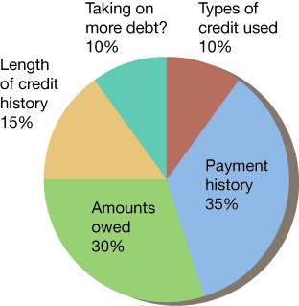
Making Sense of Your Credit Scores
Notes:
24
Five factors are used to calculate your credit score. Under one of the more commonly used scoring systems, the FICO score, the most important factor is your past payment history. Late and missed payments are very harmful. The amounts you now owe account for the second largest component of your credit score. Whether you are taking on more debt, the types of debt used in the past and how long you have been using credit also go into the scores. People who have used credit appropriately for long periods of time will have higher scores.

Slide 25
Your Credit Reputation
Building a credit history:
  Establish both a checking account and a savings account.
  Have your telephone and other utilities billed in your name.
Notes:
Many college students have low credits scores simply because they have not used credit extensively in the past. Ways to build a score include having a checking and savings account in your name and having utility accounts in your name since utilities often report repayment patterns to the credit bureaus.

Slide 26
Your Credit Reputation
  Request, acquire, and use an oil-company credit card.
  Apply for a bank credit card.
  Ask a bank for a small, short-term cash loan.
  Pay off student loans.
Notes:
You can further build your credit reputation by obtain a relatively easy to obtain credit card from an gas and oil company such as Chevron or Conoco. You also may be able to get a bank credit card through your bank or credit union. Using these cards and repaying promptly will build your credit. You do not have carry balances from month to month to build credit. Your credit will be enhanced if you pay off your student loans quickly as doing so brings down your overall debt level.

Slide 27
Your Credit Reputation
You can access your credit bureau file for free only at annualcreditreport.com
The Fair Credit Reporting Act (FCRA) allows you to challenge errors in your credit bureau files.
Notes:
To protect your credit reputation you should obtain your credit report from all three major credit bureaus each year via annualcreditreport.com. Note that this is the only truly free place to obtain a free report. If you find any errors in your reports you should challenge them immediately both with the credit bureau and the lender involved. The Federal Fair Credit Reporting Act allows you to do this and outlines how the process will take place.

Slide 28
Concept Check 6.3
Summarize the basic steps that occur when someone applies for credit.
What is a credit history, and what role do credit bureaus play in the development of your credit history?
Notes:
Assess your understanding by addressing these points.

Slide 29
Concept Check 6.3
What is a credit score, and what five major factors go into its calculation?
Identify five actions you can take to build a good credit reputation.
Summarize the protections provided under the Fair Credit Reporting Act.
Notes:
Assess your understanding by addressing these points.

Slide 30
Learning Objective #4
Describe common sources of consumer credit.
Notes:
Learning objective #4 is to describe the common sources of consumer credit.

Slide 31
Sources of Consumer Loans
Depository institutions lend money to their banking customers.
Sales finance companies lend money to buy consumer products.
Consumer finance companies make small cash loans.
Notes:
Depository institutions—commercial banks, savings banks and credit unions—are the most commonly used sources of consumer loans. For those with high credit scores they are among the lowest cost sources of credit. You can also borrow from sellers through sales finance companies when buying big ticket items such as vehicles, furniture, appliances and electronics. People seeking small cash loans can seek out consumer finance companies. Note that they specialize in lending to people who have somewhat low credit scores.

Slide 32
Sources of Consumer Loans
Stockbrokers lend money to their clients.
Insurance companies lend money to their policyholders.
Choose your source wisely as each tends to charge lower or higher interest rates.
Notes:
You may also be able to borrow money from your stock broker or your life insurance company. Wherever you go to borrow, make sure that you choose a source that will charge you a low rate of interest.

Slide 33
Table 6-3: What It Costs to Borrow $1000 for Five Years
Lender APR Payment
Life insurance company 4 $18.42
Sales finance company 6 $19.33
Credit union 8 $20.28
Commercial bank – S&L 10 $21.25
Bank credit card 18 $25.39
Consumer finance co. 24 $28.77
Notes:
This chart illustrates typical rates for various lenders. Note that life insurance companies are basically loaning you your own money. That is why their rates are so low. The differences in dollar amounts for the monthly payment appear modest. However, borrowing from a credit union costs $217 in finance charges (interest) over the five years whereas borrowing using a bank credit card would result in a finance charge of $523; more than twice as much.

Slide 34
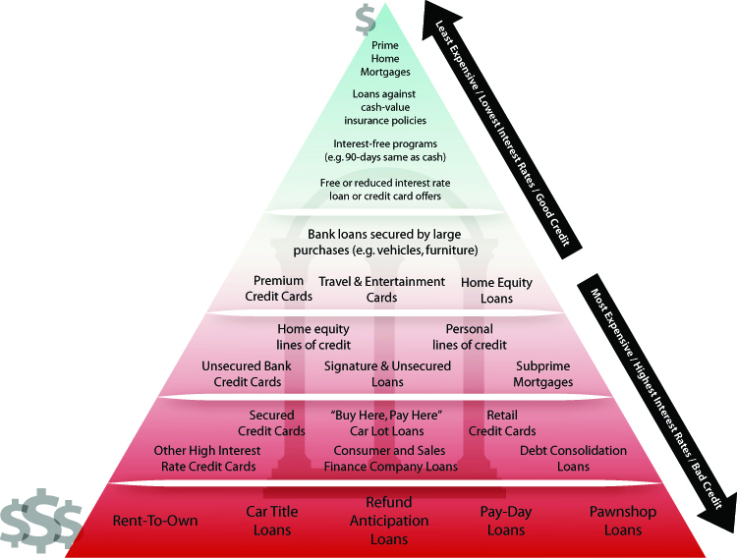
Figure 6-1: The Credit Pyramid
Notes:
Three are many places to borrow money. The credit pyramid has the sources aligned with the most selective lenders at the top. These lenders also charge the lowest rates because they loan only to the most credit worthy applicants. Always borrow from the most selective borrower you can find.

Slide 35
Alternative Lenders
Payday lenders
Rent-to-own program
Pawnshop
Notes:
There are some very high cost lenders in today’s market. They will basically loan money to anybody. They charge very high rates. Avoid these lenders. If such lenders are the only place you can borrow money take that as a signal that you should reconsider the idea of borrowing money in the first place.

Slide 36
Concept Check 6.4
List the four types of depository institutions that are sources of credit for consumers.
Distinguish between a sales finance company and a consumer finance company.
Notes:
Assess your understanding by addressing these points.

Slide 37
Concept Check 6.4
Summarize how stockbrokers and insurance companies serve as sources of consumer credit.
Explain where you would go to obtain credit at the lowest cost.
Notes:
Assess your understanding by addressing these points.

Slide 38
Learning Objective #5
Identify signs of overindebtedness and describe the options that are available for debt relief.
Notes:
Learning objective #5 is to identify the signs of being overly in debt and the options available to you if you need debt relief.

Slide 39
10 Signs of Overindebtedness
Not knowing how much you owe
Running out of money
Paying only the minimum amount due
Exceeding debt limits
Requesting new credit cards and increases in credit limits
Notes:
The are many signs of being overly in debt. Exceeding the earlier described debt limits is the most obvious sign. Simply not knowing how much you owe is a bad sign, as well. If you are paying only the minimum payments on your credit cards you are carrying too much credit card debt. People who regularly opening new credit card accounts or increasing the limits on their cards are probably overly indebted.

Slide 40
10 Signs of Overindebtedness
Paying late or skipping credit payments
Taking add-on loans
Using debt-consolidation loans
Experiencing garnishment
Experiencing repossession or foreclosure
Notes:
If you are regularly paying late or skipping payments you are in debt trouble. Paying off old loans by taking out new loans for higher amounts means you are actually going further into debt. Even debt-consolidation loans, in spite of their benefits, are a sign that you have to much debt. Finally, if your wages are being garnished or items have been repossessed it should be obvious that you are in debt trouble.

Slide 41
Debt Collection
Federal law regulates debt collection practices.
Federal Fair Debt Collection Practices Act (FDCPA)
Debt collection agencies are companies in the business of collecting debts
Notes:
Their practices are governed the Federal Fair Debt Collections Practices Act. This law prohibits the worst abuses but agencies can be very forceful and persistent and still stay within the law. Debt collection agencies specialize in collecting debts owed. Sometimes they are collecting debts owed to other businesses for a fee. Often, they have purchased the debts from the business and are thus collecting it on their own behalf.

Slide 42
Steps to Take to Get Out from Under Excessive Debt
Determine your account balances and the payments required.
Focus your budget on debt reduction.
Contact your creditors.
Notes:
If you find yourself with too much debt, what should you do? The first step is to take stock. Determine how much you owe and to who and exactly what the payments are on the debts. Focus your budget solely on debt reduction. If you find that you are unable to make headway you should contact your creditors to see if there are alternative available to you.

Slide 43
Steps to Take to Get Out from Under Excessive Debt
Take on no new credit.
Refinance.
Avoid bad help.
Find good help.
Notes:
It should be obvious that you should take on no new debt when you already have to much debt. It may be possible to refinance your debts at lower interest rates but do not do so if the rate will be higher. There are lots of companies selling debt reduction services. You should not have to pay for these services.

Slide 44
Bankruptcy
Bankruptcy is a last resort.
After bankruptcy all or a portion of your debts are discharged depending on the type of bankruptcy you obtain.
Notes:
In the worst cases, bankruptcy might be the only option. When you file for bankruptcy, lenders must stop, or stay, credit collection efforts. If you successfully, get through the bankruptcy process any remaining debts not paid will be discharged.

Slide 45
Bankruptcy
Chapter 13 of the Bankruptcy Act: Wage earner or regular income plan whereby a portion of your debts are repaid over 3-5 years.
Notes:
Under Chapter 13 Bankruptcy, the court sets up a plan to have you pay as much as possible of your debts within 3 to 4 years.

Slide 46
Bankruptcy
Chapter 7 of the Bankruptcy Act: Straight bankruptcy whereby most of your assets are sold and applied to your debts.
Notes:
Under Chapter 7 Bankruptcy, most of your assets will be sold and your creditor repaid with the proceeds.

Slide 47
Concept Check 6.5
Identify four signs of overindebtedness.
List the major provisions of the Fair Debt Collection Practices Act.
Notes:
Assess your understanding by addressing these points.

Slide 48
Concept Check 6.5
What services are provided by a credit counseling agency and how might a debt management plan work to provide relief for someone who is having debt problems?
Notes:
Assess your understanding by addressing these points.

Slide 49
Concept Check 6.5
Distinguish between Chapter 7 and Chapter 13 bankruptcy and explain who might be forced to use Chapter 13 rather than Chapter 7.
Notes:
Assess your understanding by addressing these points.

Slide 50
Worst Financial Blunders in Building and Maintaining Good Credit
Based on others’ financial woes, you will make mistakes in personal finance when you:
  1. Fail to regularly check the accuracy of your credit bureau files.
Notes:
Avoid these blunders that are typical for people who are less than successful in their financial planning.
Fail to regularly check the accuracy of your credit bureau files.

Slide 51
Worst Financial Blunders in Building and Maintaining Good Credit
  2. Let a lender’s willingness to grant credit be an indicator that you can afford to repay the debt.
  3. Pay more than 14 percent of your disposable income toward nonmortgage debt payments.
Notes:
Avoid these missteps that are typical for people who are less than successful in their financial planning.
Let a lender’s willingness to grant credit be an indicator that you can afford to repay the debt.
Pay more than 14 percent of your disposable income toward nonmortgage debt payments.

Slide 52
Do It NOW!
You know more about personal finance after reading this chapter, so get started right now by:
1. Obtaining a free copy of your credit report (www.annualcreditreport.com) from one of the three national credit bureaus.
Notes:
You do not have to wait to get started on building and maintaining good credit. Get started today by doing these three things.
Obtain your credit report from at least one of the national credit bureaus.

Slide 53
Do It NOW!
2. Confirming the accuracy of the report and, if there are errors or omissions, challenging them with all three bureaus.
3. Repeating steps two and three every four months staggering the bureaus to ensure that each request is free.
Notes:
Confirm the accuracy of the report and if there are errors challenge them with all three bureaus.
Repeat steps 2 and 3 every four months thereby continually receiving free reports every four months.

Slide 54
What Do You Recommend Now?
Now that you have read this chapter on building and maintaining good credit, what would you recommend Carrie Savarin regarding:
1. Factors she should consider regarding her ability to take on additional debt?
Notes:
You were asked at the beginning of the chapter to provide recommendations in personal financial planning. How would you answer these questions now that you have read the chapter?
Factors she should consider regarding her ability to take on additional debt?

Slide 55
What Do You Recommend Now?
2. The impact of her current debt on her ability to obtain a loan to buy a vehicle?
3. Where she might obtain financing for a vehicle loan?
4. The effect of taking on a loan on her overall financial planning?
Notes:
The impact of her current debt on her ability to obtain a loan to buy a vehicle?
Where she might obtain financing for a vehicle loan?
The effect of taking on a loan on her overall financial planning?

