Slide 1

Garman/Forgue
Personal Finance
Twelfth Edition
Chapter 7:
Credit Cards and Consumer Loans
PPT slide program prepared by Amy Forgue and Ray Forgue.

Slide 2

Debt is the enemy of a person's financial freedom.

Slide 3
Introduction
You cannot borrow your way to financial success, and using any kind of credit requires deliberate thinking and planning. You must;
  consider whether the reason you are borrowing is sound,
  how you will repay the debt,
  and how the fees and interest are calculated.
Notes:
Understand the rules of credit card and consumer loan accounts is essential for maintaining a strong financial status. Likewise, you should understand how the fees and interest are calculated on all accounts.

Slide 4
Your Next Five Years
In the next five years you can start achieving financial success by doing the following related to credit cards and consumer loans:
1. Pay all your credit card balances in full each month, or no longer than two or three months later.
Notes:
It is important to get off to a good start in your financial life. The first five years are critical and require that you do five things related to credit cards and consumer loans.
First, pay all your credit card balances in full each month and certainly no longer than over two or three months.
Second, move any credit card balance you do carry over to the lowest APR card you hold and do not use cards with a balance to make day-to-day convenience purchases.

Slide 5
Your Next Five Years
2. Move credit card balances you do carry to lower-interest accounts and never make convenience purchases on the accounts on which you carry a balance.
Check your monthly billing statements against your receipts for accuracy every month and challenge all discrepancies.
Use only credit cards with chip and pin technology as soon as they become available.
Notes:
Third, check your credit card billing statements for accuracy every month.
Fourth, use student loans for direct education expenses only.
Fifth, choose installment loans based on the lowest APR not the lowest monthly payment.

Slide 6
Your Next Five Years
5. Use student loans for direct education expenses only rather than to maintain a better lifestyle.
6. Choose installment loans based on the lowest annual percentage rate (APR) rather than monthly payment and years to repay.
Notes:
Third, check your credit card billing statements for accuracy every month.
Fourth, use student loans for direct education expenses only.
Fifth, choose installment loans based on the lowest APR not the lowest monthly payment.

Slide 7
Learning Objective #1
Compare the common types of consumer credit, including credit cards and installment loans.
Notes:
Learning objective #1 is to compare the common types of consumer credit.

Slide 8
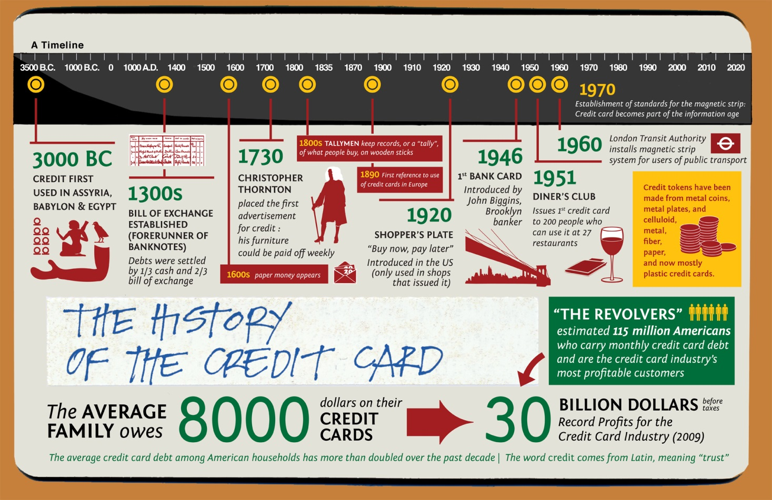

Slide 9
Introduction
Annual Percentage Rate (APR): The cost of credit on a yearly basis stated as a percentage rate.
Finance Charge: The dollar cost of credit for all interest and fees over and above the amount borrowed.
Notes:
The cost of credit is most accurately expressed as the annual percentage rate or APR. The cost of credit expressed in dollars is the finance charge.

Slide 10
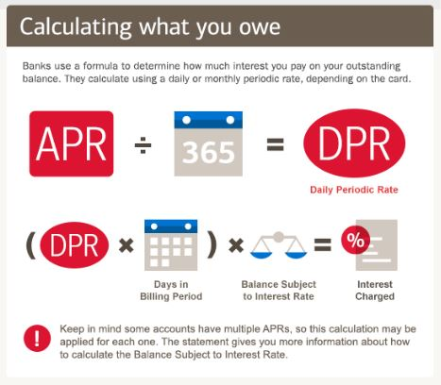

Slide 11
Types of Consumer Credit
Installment credit
  Specified number of equal payments over time
Noninstallment credit
  Single payment
  Open-ended credit (or revolving credit)
    Can borrow up to your Credit limit
    Equal or unequal payments
Notes:
Consumer credit includes installment credit such as loans and noninstallment credit. The most common type of noninstallment credit is open-ended credit such as with credit cards. With this type of credit you can repeatedly borrow money as long as your overall credit limit is not exceeded.

Slide 12
Types of Revolving Accounts
Noninstallment credit
  Credit (or charge) card accounts
    You can make purchases
    Or obtain a Cash advance
  Personal line of credit
  Home-equity line of credit
  Service credit
Notes:
With credit card accounts you can make purchases or obtain cash advances. Similar open-ended accounts are personal lines of credit or home-equity lines of credit for which your home serves as the collateral.

Slide 13
Concept Check 7.1
Distinguish between installment credit and open-ended credit.
Explain the basic features of revolving credit.
Describe how someone might use a personal line of credit.
Notes:
Assess your understanding by addressing these points.

Slide 14
Learning Objective #2
Describe the types and features of credit card accounts.
Notes:
Learning objective #2 is to describe the types and features of credit card accounts.

Slide 15
Credit Card Accounts
Minimum payment
Principal
Default
Notes:
Important aspects of credit card accounts are the minimum payment that must be made each month, the principal or total amount owed and the rules for what constitutes default. Typically you can be in default if you have missed one payment.

Slide 16
Types of Credit Card Accounts
Bank credit cards
  Cash advance (or convenience) checks
  Balance transfer features
Notes:
There are several types of credit card accounts. Bank credit cards are the most common and include opportunities to use cash advance checks and to make balance transfers among cards. Prestige cards are granted when the account has some special feature for more creditworthy card holders. Affinity cards are popular with borrowers who want to have an organization such as their university or charitable organization receive a portion of the interest paid on the account.

Slide 17
Types of Credit Card Accounts
Retail Credit Card accounts: Allow customers to make purchases on credit at any of the outlets of a particular retailer.
Travel and Entertainment (T&E) Cards
Notes:
Retail credit cards are issued by stores such as Target, Kohl’s or Old Navy. Typically, they can only be used at the named retailers outlets. Some people prefer travel and entertainment card such as American Express. Such accounts generally must be paid in full each month.

Slide 18
Aspects of Credit Card Accounts
Preapproved credit card offers
Annual and Transaction Fees
Liability for lost or stolen cards
Notes:
Consumers should understand several key aspects of credit card account.
Preapproved credit card offers only promise that credit will be granted. They say nothing about the interest rate on the card or the credit limit. These are set after the consumer applies for the card.
In addition to interest, account rules can allow the assessment of annual and transaction fees. These can exceed the interest charges themselves.
Consumers are liable for charges made on a lost or stolen card unless they notify the lender of the loss. Notification within 2 days will result in no obligation. After 2 days, your liability is a maximum of $50.

Slide 19
Aspects of Credit Card Accounts
Late-payment, bounced check, and over-the-limit fees are very costly.
Teaser Rate: A temporarily low introductory rate to entice borrowers to apply for a credit card.
Penalty APRs are extremely high.
Notes:
Credit card companies make billions of dollars each year by assessing late-payment, bounced check and over-the-limit fees. These fees can be avoided simply by not violating these rules of the account.
Many credit cards are advertised as have a special low teaser or introductory rate for the first few months. You should also understand the conditions under which the lender will charge a very much higher penalty rate. Such rates can be assessed any time the borrower violates one or more rules associated with any debt through the same lender.

Slide 20
Aspects of Credit Card Accounts
Variable interest rates can easily go up.
Secured credit cards are backed by collateral.
Notes:
Many credit cards carry a variable interest rate. The rate will vary according to some broad measure of interest rates in the economy such as the prime rate.
It is sometimes easier to obtain a credit card backed up by collateral. The collateral in these secured credit cards is typically an amount held in a savings account with the institution that issued the card.

Slide 21
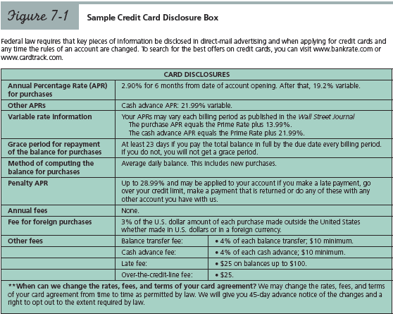
Notes:
The rules of a credit card account are spelled out in a standard format. Figure 7-1 provides an example of such a disclosure statement. Important provisions include the interest rate, how the balance is calculated and how and why fees are assessed.

Slide 22
Credit Card Insurance
Credit Life Insurance: Repays the outstanding loan balance if the borrower dies.
Credit Disability Insurance: Repays the outstanding loan balance if the borrower becomes disabled.
Notes:
Credit card companies also make money by selling credit card insurance. These features provide that the debt will be paid if you become disabled or die. Rather than buy these services you should make sure you simply have adequate disability income and life insurance.
It is sometimes easier to obtain a credit card backed up by collateral. The collateral in these secured credit cards is typically an amount held in a savings account with the institution that issued the card.

Slide 23
Concept Check 7.2
Distinguish among bank credit cards, retail credit cards, and travel and entertainment cards.
What are the differences and similarities between a cash advance and a balance transfer using a bank credit card?
Notes:
Assess your understanding by addressing these points.

Slide 24
Concept Check 7.2
Describe the positive and negative aspects of having a variable interest rate on a credit card.
Briefly describe five common fees assessed on credit card accounts and how they can be avoided.
Notes:
Assess your understanding by addressing these points.

Slide 25
Learning Objective #3
Manage your credit card accounts to avoid fees and finance charges.
Notes:
Learning objective #3 is to manage your credit card accounts to avoid fees and finance charges.

Slide 26
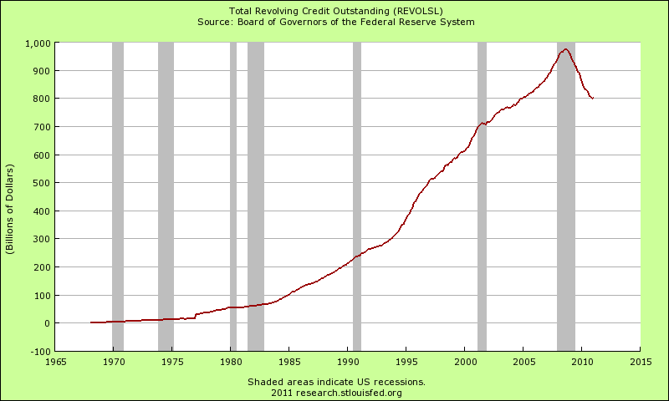

Slide 27
Managing Credit Cards Wisely
Credit (or periodic) statement
Statement (or closing or billing) date
Due date: The specific day by which the credit card company should receive payment from you.
Notes:
Managing your credit cards wisely requires that you read and understand all of the information contained in your monthly periodic statement. All previous balance amounts and new activity on the account since the last statement will be included. Note that the due date is the date by which the payment is to be received not simply sent.

Slide 28
Managing Credit Cards Wisely
Transaction date: The day on which a credit cardholder makes a purchase.
Posting date: The day the credit card company is informed of the transaction and the charge is posted to the account.
Notes:
Each item of activity on the account will be listed on the billing statement, with the transaction date and the posting date to which it was posted to your account.

Slide 29
Managing Credit Cards Wisely
Grace period: Time period between the posting date of a transaction and the payment due date during which no interest accrues.
Minimum payment amount: Lowest allowable monthly payment required by the lender.
Notes:
The best card is one with a grace period. This means that if you paid the balance in full last month between the billing date and the due date, any new charges to the account will not be charged interest for the month. If instead, you make any lower payment, even the allowable minimum payment, all new charges will be assessed interest from their posting dates.

Slide 30
Managing Credit Cards Wisely
Transaction fees
Credit for merchandise returns and errors
Credit receipt: Written evidence of any items returned that notes the specific amount and date of the transaction.
Notes:
When you return an item or there is a correction to your account for an erroneous invalid earlier charge you will receive a credit or subtraction in the amount owed. Always ask for the credit receipt when you return items purchased with a credit as the receipt verifies the credit.

Slide 31
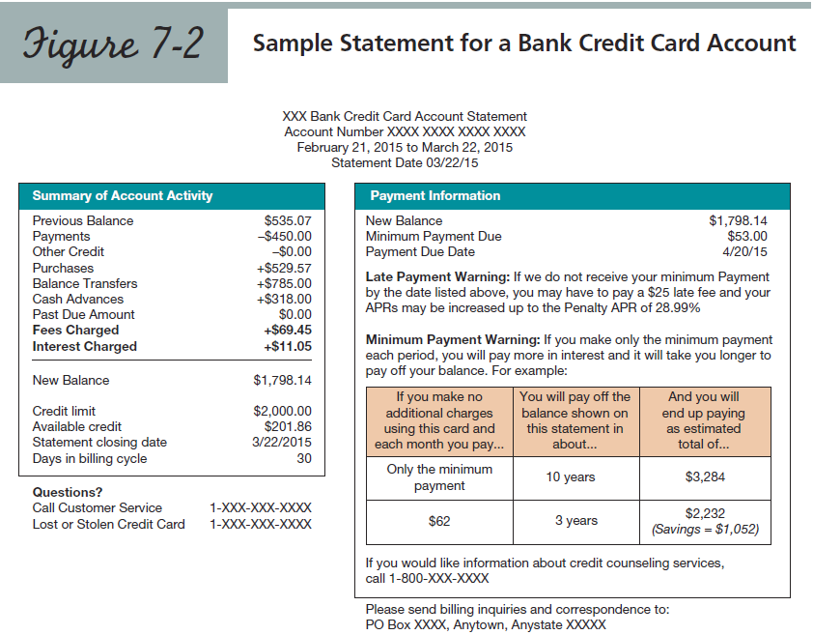
Notes:
Credit card companies provide all of the information about your monthly activity on the credit statement.

Slide 32
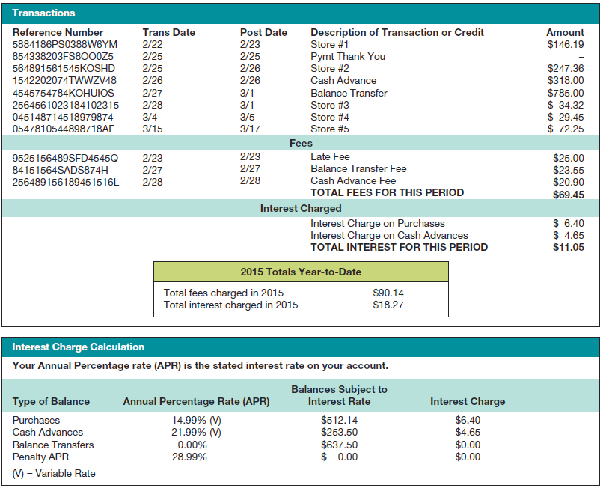

Slide 33
Managing Credit Cards Wisely
Computation of finance charges
  Periodic Rate
  Average Daily Balance
Notes:
The finance charge assessed each month on a credit card account is the APR divided by twelve (the periodic rate) multiplied by balance on the account. The balance is typically called the average daily balance. The average daily balance is calculated by adding up all of the daily balances during the billing period and dividing by the number of days in the billing period.

Slide 34
Managing Credit Cards Wisely
How credit card average daily balances are calculated.
  Average daily balance including new purchases with a grace period.
  Average daily balance excluding new purchases.
  Average daily balance including new purchases with no grace period.
Notes:
The average daily balance can be calculated with or without using the new purchases during the billing period. The most common method includes new purchases only if the balance was not paid in full during the previous cycle. Such accounts are described as having a grace period.

Slide 35
Avoid the Minimum Payment Trap
The minimum payment on a credit card is typically 3-4 percent of the balance and is barely enough to pay the interest for the month.
As a result, paying only the minimum payment will reduce the amount owed only slightly, and perhaps not at all if charges have been made since the billing date.
Notes:
Because the minimum payment on a credit card is so low it is entirely possible to have your balance grow steadily over time if you only make that minimum payment and continue to use the card.

Slide 36
Managing Credit Cards Wisely
Correcting errors on your credit card statement
  Fair Credit Billing Act (FCBA)
  Billing errors
  Goods and services disputes
Notes:
When you find errors on your billing statement you can take steps to have them corrected. The procedures are outline in your rights under the Fair Credit Billing Act. At a minimum, you can withhold payment for and challenge the erroneous item and the lender cannot charge you interest or require payment on the item until they have verified its accuracy.
You can also withhold payment for any item where you have a goods and services dispute with the seller. An example of this type of dispute would be a situation where a product was purchased that proved faulty and the seller refuses to make a proper adjustment.

Slide 37
Concept Check 7.3
Describe how the finance charge is typically calculated on a credit card account.
What is the major benefit of having a credit card with a grace period?
Explain the steps you should take if you find an error on your credit card account billing statement.
Notes:
Assess your understanding by addressing these points.

Slide 38
Learning Objective #4
Describe the important features of consumer installment loans.
Notes:
Learning objective #4 is to describe the important features of consumer installment loans.

Slide 39
Installments Loans
Cash Loans
Purchase Loans (or Sales Credit)
Unsecured Loan (or Signature Loan)
Secured Loans require a cosigner or collateral.
Acceleration Clauses are a common feature of installment loans.
Notes:
Loans can be taken as a cash loan for money or as a purchase loan to buy an item. Some loans are secured with either collateral or a consignor. A secured loan will tend to have lower interest rate.
Almost all loan contracts contain an acceleration clause. This clause states that if any payment is missed all the other remaining payment are immediately due and payable if desired by the lender.

Slide 40
Purchase Loan Installment Contracts
Installment purchase agreements (or collateral installment loans or chattel mortgage loans)
Conditional sales contracts (or financing leases)
Notes:
When you take out a purchase loan you may or may not obtain actual ownership title to the item purchased. With an installment purchase agreement you do receive title. With a conditional sales contract you do not receive title until the debt is fully paid.

Slide 41
Concept Check 7.4
Describe how a cash loan and a purchase loan differ.
Distinguish between a secured and an unsecured loan.
Describe when a lender might enforce an acceleration clause on a loan and explain the impact of such an action by the lender.
Notes:
Assess your understanding by addressing these points.

Slide 42
Concept Check 7.4
Differentiate between an installment purchase agreement and a conditional sales contract.
Notes:
Assess your understanding by addressing these points.

Slide 43
Learning Objective #5
Calculate the interest and annual percentage rate on consumer loans.
Notes:
Learning objective #5 is to calculate the interest and annual percent rate on consumer loans.

Slide 44
Calculating Interest on Consumer Loans
Truth in Lending Act (or TIL) requires disclosure of
  the annual percentage rate of interest (APR)
  the finance charge in dollars
Notes:
The calculation of interest on consumer loans is governed by the Truth in Lending Act. This law states that the lender must clearly disclose the annual percentage rate, APR, and the finance charge in dollars. The finance charge includes the interest and all mandatory charges. The finance charge is used to calculate the APR so the APR reflects the full and true cost borrowing.

Slide 45
Calculating an Installment Loan Payment
Fixed interest-rate loans
Variable-rate (or adjustable-rate) loans
Notes:
Installment loans typically have a set monthly payment for each month for a specified number of years. This is the pattern when the loan as a fixed interest rate. Since the interest rate stays the same, so does the monthly payment. For variable rate loan, the payment will go up and down to reflect changes in the interest rate.

Slide 46
Table 7-1: Monthly Principal and Interest Payment Required to Repay $1000
APR 12 Mo. 36 Mo. 60 Mo.
6 $86.01 $30.42 $19.33
8 $86.99 $31.34 $20.28
10 $87.92 $32.27 $21.25
12 $88.85 $33.21 $22.24
15 $90.26 $24.67 $23.79
18 $91.66 $36.15 $25.39
Notes:
Calculating the monthly payment on a loan can be complicated as it involves time value of money considerations as were discussed in Chapter 1. Table 7-1 can be used to calculate monthly payments amounts. For example, a three-year loan at 12 percent would require a monthly payment $33.21 for every $1000 borrowed. If you borrowed $4000, your monthly payment would be $132.84 which is 4 times $33.21. If you borrowed $4563 you would multiply 4.563 times $33.21 for a monthly payment of $151.54.

Slide 47
The Declining-Balance Method
Periodic Interest Rate: The monthly rate applied to the outstanding balance of the loan.
Amortization
Notes:
Several methods are used to calculate the dollar amount of interest on a loan. With the declining balance method, the periodic interest rate, which is the annual rate divided by 12, is multiplied by the balance owed to determine the interest each month. Since the balance declines each month, the interest will decline as well and the portion of the payment that goes to pay off the loan itself will increase each month. This process is called amortization. Home loans use this method and are thus called mortgage loans.

Slide 48
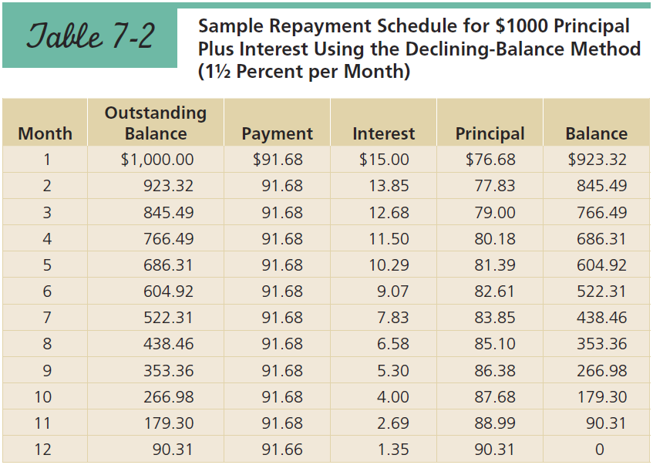
Notes:
Table 7-2 provides a repayment schedule on a declining-balance method loan and illustrates the concept of amortization. As can be seen, the principal portion of each month’s payment increase and the interest portion decreases until in the last month almost all of the payment goes towards the principal and the debt is fully repaid.

Slide 49
Add-On Interest Method
With the Add-On Interest Method the interest is the rate times the amount borrowed times the time in years
I = P x R x T
The interest is added to the principal and divided by the number of payments to arrive at the payment.
Notes:
49
The add-on method is another method used by lenders to calculate the interest on a loan. In this the method the amount borrowed is multiplied by an add-on interest rate and the number of years of the loan. For example, a $4000 loan at 6-percent add-on interest for 3 years would have an interest charge of $720 which is $4000 times .06 times 3. This interest is added to the amount borrowed to arrive at the monthly payment. In this example, $4000 plus $720 divided by the 36 monthly payments would result in a monthly payment of $131.11.

Slide 50
Add-On Interest Method
The add-on interest rate used is not disclosed to the borrower who only sees the APR.
The APR is calculated using the N-Ratio Formula
Notes:
50
Recall our two examples, a declining-balance method loan to borrow $4000 at 12 percent APR for 3 years had a monthly payment of $132.84. Our add-on method loan at 6 percent add-on interest for 3 years had a monthly payment of $131.11. Why are the payments so similar and interest rates so far apart? The is because the add-on rate understates the true rate of interest because it assumes the amount owed stays the same all three years. Because of this issue, lenders cannot disclose the add-on rate to borrowers and must convert the add-on rate into a true APR using the n-ratio method.

Slide 51
Add-On Interest Method
Rule of 78s (or Sum of the Digits): a method for calculating prepayment penalties on add-on interest loans.
Notes:
51
There is another problem with the add-on method. What if you decide to pay your loan off early? The add-on method spreads the interest equally across the life of the loan. Yet, the monthly interest should truly be higher in the early months and lower in the later months. Lenders who offer add-on rate loans will charge you some of the unpaid interest as a prepayment penalty. Most commonly this prepayment penalty is calculated using a calculation called the Rule of 78s method.

Slide 52
The Discount Method
The borrower must repay the full amount of the debt but only receives the amount remaining after the interest is subtracted.
Interest is calculated as
I = P x R x T
The interest is prepaid.
Notes:
The final way a lender might charge interest is the discount method. Here the interest is paid up front thereby reducing the amount you actually receive. An example might be our 3-year, $4000 loan at 6 percent discount interest. The interest is again $720 or $4000 times .06 times 3. The lender subtracts the interest and give the borrower only $3280 but the borrower repays $4000 in 36 equal payments of $111.11.

Slide 53
Concept Check 7.5
Explain how the interest is calculated on a consumer loan that uses the declining-balance method.
Summarize how interest is calculated on a consumer loan that uses the add-on method.
Notes:
Assess your understanding by addressing these points.

Slide 54
Concept Check 7.5
What is the effect of the rule of 78s when a borrower repays an add-on method loan early?
Explain how the interest is calculated on a consumer loan that uses the discount method.
Notes:
Assess your understanding by addressing these points.

Slide 55
Worst Financial Blunders in Credit Cards and Consumer Loans
Based on others’ financial woes, you will make mistakes in personal finance when you:
  1. Fail to shop for the lowest APR on credit cards and consumer loans.
  2. Regularly carry balances on credit card accounts.
Notes:
Avoid these blunders that are typical for people who are less than successful in their financial planning.
Fail to shop for the lowest APR on credit cards and consumer loans.
Regularly carry balances on credit card accounts.

Slide 56
Worst Financial Blunders in Credit Cards and Consumer Loans
  3. Use a credit card rather than lower interest rate installment loans to make expensive purchases.
Notes:
Avoid these blunders that are typical for people who are less than successful in their financial planning.
Use a credit card rather than lower interest rate installment loans to make expensive purchases.

Slide 57
Do It Now!
You know more about personal finance after reading this chapter, so get started right now by:
1. Making a list of all your debts currently outstanding, the amounts owed, to whom, and at what interest rates.
Notes:
You do not have to wait to get started on credit cards and consumer loans. Get started today by doing these three things.
Make a list of all your debts with the amount owed, to whom and the interest rate.

Slide 58
Do It Now!
2. Projecting any money you might borrow between now and graduation.
3. Using the calculator at http://www.bankrate.com/brm/popcalc2.asp to determine your monthly payments if you were to pay off your total debt owed at graduation in 3 years, 5 years, and 10 years.
Notes:
Project how much money you will owe on student loans when your graduate.
Determine the different monthly payments on that debt if you repaid in 3 years, 5 years or 10 years.

Slide 59
What Do You Recommend Now?
Now that you have read this chapter on credit cards and consumer loans, what would you recommend Zachary Cochrane regarding:
1. His approach to using credit cards, including the number of cards he has?
Notes:
You were asked at the beginning of the chapter to provide recommendations in personal financial planning. How would you answer these questions now that you have read the chapter?
His approach to using credit cards, including the number of cards he has?

Slide 60
What Do You Recommend Now?
2. Estimating the credit card interest charges he is paying each month?
3. How he might lower his interest expense each month?
4. Consolidating his credit card debts into one installment loan?
Notes:
Estimating the credit card interest charges he is paying each month?
How he might lower his interest expense each month?
Consolidating his credit card debts into one installment loan?

Slide 61
