Slide 1

Garman/Forgue
Personal Finance
Twelfth Edition
Chapter 9:
Obtaining Affordable Housing
PPT slide program prepared by Amy Forgue and Ray Forgue.

Slide 2
Introduction
Mortgage Loan: Loan to purchase real estate in which the property itself serves as collateral.
Complicated and misunderstood mortgages were a contributor to the foreclosure crisis in 2008-10.
Notes:
The decision to buy or rent housing is both personal and financial. When one buys housing the financial aspects are among the most complicated in personal finances since most people borrow via a mortgage loan when buying a home.
The complexities of mortgage loans were a contributor to the many foreclosures that occurred in recent years.

Slide 3
Your Next Five Years
In the next five years, you can start achieving financial success by doing the following related to obtaining affordable housing:
1. Read your leases and all other real estate contracts thoroughly before signing.
Notes:
It is important to get off to a good start in your financial life. The first five years are critical and require that you do five things related to obtaining affordable housing.
First, read your leases and all other real estate contracts thoroughly before signing.

Slide 4
Your Next Five Years
2. Save the funds for a down payment within a tax-sheltered Roth IRA account.
3. Get your finances in order before shopping for a new home by reducing debt, budgeting better, and clearing up anything that keeps you from having a high credit score.
Notes:
Second, save the funds for a down payment within a tax-sheltered Roth IRA account.
Third, get your finances in order before shopping for a new home by reducing debt, budgeting better, and clearing up anything that keeps you from having a high credit score.

Slide 5
Your Next Five Years
4. Buy a home as soon as it fits your budget and lifestyle so you can take advantage of special income tax deductions and price appreciation over time.
Notes:
Fourth, buy a home as soon as it fits your budget and life-style so you can take advantage of special income tax deductions and price appreciation over time.

Slide 6
Your Next Five Years
5. If you make a down payment of less than 20 percent on a home, cancel private mortgage insurance as soon as the equity in your home pushes the loan-to-value ratio to 80 percent.
Notes:
Fifth, if you make a down payment of less than 20 percent on a home, cancel private mortgage insurance as soon as the equity in your home pushes the loan-to-value ratio to 80 percent.

Slide 7
Learning Objective #1
Decide whether renting or owning your home is better for you.
Notes:
Learning objective #1 is to decide whether renting or owning your home is better for you both financially and personally.

Slide 8
Rented Housing
Rent, deposit, and related expenses
  Rent: Cost charged for using an apartment or other housing space.
  Security Deposit: Ensures that you do not move without paying your rent.
  Damage Deposit: For repairs beyond normal wear and tear.
Notes:
Most people rent their first home. The costs include the monthly rent payment and, typically, a security deposit to ensure that the renter does not move without paying rent and a damage deposit for repairs beyond normal wear and tear.

Slide 9
Rented Housing
Lease agreement and restrictions
  Lease: Contract specifying both tenant and landlord legal responsibilities.
  Periodic Tenancy: Lease agreement can be terminated by either party if they give proper notice in advance.
Notes:
A lease is a contract for the rental of a home. Written leases spell out the rights and responsibilities of both the landlord and the tenant. Some leases—periodic tenancy—can be terminated by either party with proper advance notice. Month-to-month leases are an example.

Slide 10
Rented Housing
Lease agreement and restrictions
  Tenancy for a specific time: The lease expires at the end of the time period unless renewed.
  Subleasing allows a tenant to rent the unit to another party.
Notes:
Other leases—tenancy for a specific time—continue in force for a specified period of time, usually one year, and expire if not renewed.
Subleasing allows a tenant to rent the unit to another party. The original tenant remains responsible for all prior lease requirements, however.

Slide 11
Owned Housing
Single-Family Dwelling: Housing unit that is detached from other units.
Condominiums and cooperatives
  Condominium (or Condo)
  Homeowner’s Association
  Homeowner’s fee
Manufactured housing and mobile homes
Notes:
In the United States, owned housing typically involves purchase of a single-family dwelling that is detached from other housing units.

Slide 12
Renting vs. Buying
Who pays more: Renters or Owners?
  Based on cash flow, renters appear to win.
  After taxes and appreciation, owners usually win.
What does it cost to buy a home?
  Some basic calculations can help you decide.
  Consider the tax consequences of buying your home.
Notes:
Whether to buy or rent is largely a financial decision. The initial costs of owned housing are much higher than for rental units. Owning a home has significant tax advantages over renting.

Slide 13
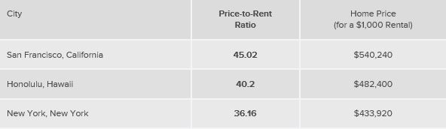
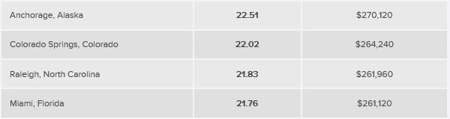
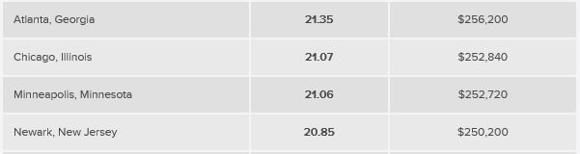


Slide 14
Concept Check 9.1
Explain the purpose and value of a lease for both the renter and the landlord.
Distinguish between periodic tenancy and tenancy for a specific time when renting housing.
Notes:
Assess your understanding by addressing these points.

Slide 15
Concept Check 9.1
Identify three ways that home buyers can save on their income taxes.
Illustrate how housing buyers can pay less than renters when taxes and appreciation of housing values are considered.
Notes:
Assess your understanding by addressing these points.

Slide 16
Learning Objective #2
Explain the up-front and monthly costs of buying a home.
Notes:
Learning objective #2 is to explain the up-front and monthly costs of buying a home.

Slide 17
Up-Front Costs
Most up-front costs are due at the closing.
  Closing costs
Down Payment: Portion of the purchase price that is not borrowed.
Notes:
When you buy a home, all of the final paper work to finance and transfer ownership occurs at a meeting called the closing. At that time the buyer will be required to pay a number of costs referred to as closing costs. The largest cost at the closing will be the down payment which is simply the amount of the purchase price that the buyer must pay to the seller out-of-pocket rather than from a mortgage loan.

Slide 18
Up-Front Costs
Point (or Interest Point): Fee equal to 1 percent of the total mortgage loan amount.
Attorney fees
Title transfer, search, and insurance
Miscellaneous fees: Home inspection, appraisal fee, etc.
Notes:
Closing costs can amount to as much as ten percent of the amount borrowed to buy a home. Some loans require the payment of one or more points. A point is an amount equal to 1 percent of the mortgage loan amount.
Closing costs also can include attorney fees, title transfer, search and insurance, home inspection fees, appraisal fees and more.

Slide 19
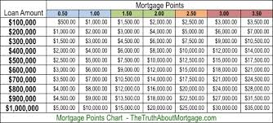

Slide 20
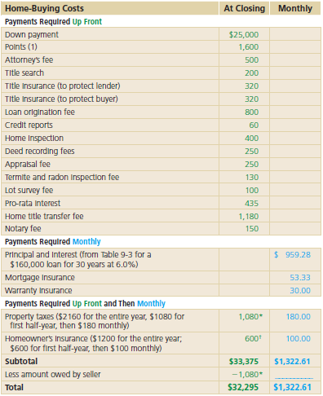
Notes:
Table 9-1 provides an illustration of the various up-front and monthly costs of buying a home. Both types of costs must be affordable. It is not enough to be able to afford just the down payment or just the monthly payment.

Slide 21
Monthly Costs
Monthly costs include both principal and interest.
Mortgage principal and interest are part of PITI—
  Principal
  Interest
  Taxes
  Insurance
Notes:
After the closing, the new owner can expect to pay certain fees monthly until the mortgage loan is paid off. To repay the loan itself the borrower must pay principal and interest each month. The lender will also require that the homeowner pay the real estate property taxes on a monthly basis so that funds will be available to pay that bill when it comes due each year. The same is true for the homeowner’s insurance on the property. Together, the principal, interest, taxes and insurance make up the acronym PITI.

Slide 22
Monthly Costs
Mortgage Insurance may be needed if the Loan-to-Value (or LTV) Ratio is above 80 percent
  Private mortgage insurance (or PMI)
  Federal Housing Administration (FHA)
  Department of Veterans Affairs (VA)
  State/Local Mortgage Assistance Program
Home warranty insurance
Notes:
Lenders desire that borrowers make a down payment of at least 20 percent when buying a home. This percentage translates into a loan-to-value ratio of 80 percent. Many first-time buyers do not have the wherewithal to make such a large down payment. In such cases the lender will require that the borrower also purchase mortgage insurance. This insurance can be paid for in a lump-sum at the closing or, more typically, is paid for monthly with the mortgage loan payment.
Private mortgage insurance can be purchased from a private company.

Slide 23
Misc. Fees
Some costs are paid both up-front and then monthly
  Taxes (T) and Insurance (I)
  Escrow account
Real estate property taxes
Homeowner’s insurance
Notes:
Some funds must be paid both up front and monthly. Taxes and insurance are paid monthly. However, since these are billed annually in advance the buyer may need to reimburse the seller for prior payments that had been made. When billed monthly these fees goes into a special escrow account to build up until needed. Buyers may also need to make a lump-sum payment at the closing to get a head start on building the escrow account.

Slide 24
Concept Check 9.2
What is the standard down payment amount on a mortgage loan?
If you make a down payment that is lower than standard, identify the extra cost you will be required to pay.
Why do lenders use points in home loans, and who is responsible for paying points?
Notes:
Assess your understanding by addressing these points.

Slide 25
Concept Check 9.2
Explain why the down payment and mortgage principal and interest understate the actual up-front and monthly costs of home ownership.
Notes:
Assess your understanding by addressing these points.

Slide 26
Concept Check 9.2
When should you request that private mortgage insurance be canceled if such insurance was required at the time of purchase of a home?
Identify the components of PITI.
Notes:
Assess your understanding by addressing these points.

Slide 27
Learning Objective #3
Describe the steps in the home-buying process.
Notes:
Learning objective #3 is to describe the steps in the home-buying process.

Slide 28
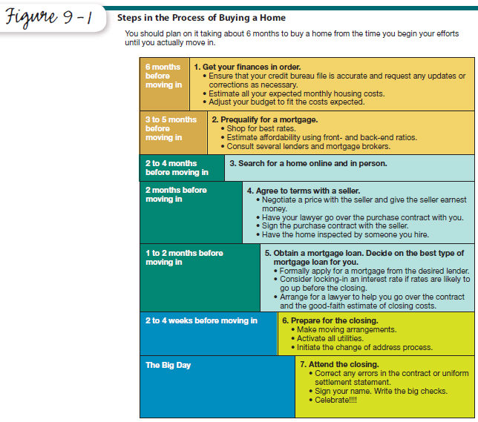
Notes:
Figure 9-1 outlines all of the steps in buying a home. Note that it takes six months or more to complete the entire process. Patience is indeed a virtue when buying a home. You would not want it any other way. Buying housing is the largest single transaction you will ever make.

Slide 29
The Steps of Home Buying
Get your finances in order.
  Check your credit bureau files to clean up your credit history
  Estimate housing costs
  Fit the costs into your budget
Notes:
The first step in buying a home is to get your finances in order. You will want to check your credit bureau files to ensure that they are accurate and up-to-date. All errors and omissions should be corrected.
You should also make an estimate of your monthly housing costs for the type of property in which you are interested. This can be easily done by looking for a home that might meet your desires, estimating is purchase price and determining the amount you could put down and the resulting mortgage amount and monthly payment for principal and interest. You should also add another 30 to 40 percent for taxes, insurance, maintenance and upkeep.
Once you have the monthly amount needed you can adjust your budget, or your housing options, to assess affordability.

Slide 30
Your Credit Score Affects Your Mortgage Interest Rate
Credit Score APR
760–850 4.8%
700–759 5.0%
680–699 5.2%
660–679 5.4%
640–659 5.8%
620–639 6.4%
Below 620 subprime market only
Notes:
The interest rate you will pay for a mortgage will depend largely on your credit score. Interest rates vary over time so the figures in this illustration may change. The key lesson here is the degree to which a less than stellar score can impact the rate you will pay. Because mortgage loans are for such long periods of time, even a one-quarter to one-half percent difference in the rate can mean thousands of dollars over the life of the loan.

Slide 31
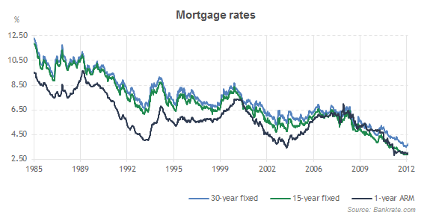

Slide 32
The Steps of Home Buying
Prequalify for a mortgage.
  Front-end ratio
  Back-end ratio
  Mortgage broker: Individual or company that acts as an intermediary between borrowers and lenders.
  www.hud.gov/buying/booklet.pdf
  www.homepath.com/financing.html
Notes:
Before you ever start shopping for a home in earnest you should find out if you could qualify for a mortgage loan in the price range you are seeking. Lenders will be happy to prequalify you using several ratios based on your income. You can also use the services of a mortgage broker to find potential lenders for you. Be aware that unless you pay a mortgage broker for its services the broker will legally be obligated to represent the interests of the lender and may not steer you to the lowest interest rate for which you might qualify.

Slide 33
The Steps of Home Buying
Search for a home online and in person.
You should understand the role of real estate brokers.
  Seller’s agents are paid by and legally must represent the best interests of the seller.
  Buyer’s agents are paid by and legally must represent the best interest of the buyer.
Notes:
Most home buyers find homes with the help of a real estate broker. They often fail to understand that any seller’s agent works for the seller must represent the seller’s best interests. If a buyer wants to be truly well represented they must pay for the services of a buyer’s agent.

Slide 34
The Steps of Home Buying
Agree to terms with the seller.
Make an offer to buy.
  Purchase offer (or offer to purchase): Written offer to purchase real estate.
  Your offer should be accompanied by earnest money.
  Respond to a counteroffer.
  Negotiate and sign a purchase contract (or sales contract) that includes contingency clauses.
Notes:
When you make an offer on a home you should also include a deposit called earnest money to show that you are serious about making a deal.
Do not expect that your initial offer will be accepted by the seller. Instead, the seller will likely respond with a counteroffer for you to consider.
If you are still interested you can continue negotiations and if they are successful you and the seller will sign a purchase contract. Your earnest money will then become your deposit on the purchase.
Your purchase contract should include various contingency clauses that must be satisfied before the contract is binding. At a minimum, you should include a clause stating that your deposit will be returned if you are unable to obtain a mortgage loan to buy the property. You also want one to describe what will happen if the home fails the home inspection.

Slide 35
The Steps of Home Buying
Apply for a mortgage loan.
  Good-faith estimate of all costs
  Loan commitment
  Mortgage lock-in
Notes:
The next step in buying a home is to apply for a mortgage loan on that specific property. Typically, you would do so with a lender that has preapproved you for a loan. When you apply the lender will give you a document called a good-faith estimate that outlines all of the costs that would be associated with the loan.
If you want to accept the loan as described you could request a loan commitment which the lenders promise to grant you the loan. At that point you can decide whether to obtain a mortgage lock-in to set the interest rate or wait to so at the closing. If you expect rates to increase before the closing you would want to lock-in the rate.

Slide 36
The Steps of Home Buying
Prepare for the closing.
  Hire your own inspector.
  Hire an attorney.
Sign your name on closing day.
    Uniform Settlement Statement: Lists all of the costs and fees to be paid at the closing.
Notes:
Once you have been approved for a mortgage loan, it is time to prepare for the closing. You will want to have the home inspected for defects and hire an attorney to represent you at the closing.
On closing day you will sign your name and write lots of big checks. The day before the closing you will receive a uniform settlement statement which is the final description of all of the terms of the purchase and loan. You will want your attorney to go over this document and compare it to the good-faith estimate received earlier. At the closing you can resolve any differences.

Slide 37
Concept Check 9.3
Distinguish between the two rules of thumb that lenders use to assess housing affordability.
What services does a mortgage broker offer?
Notes:
Assess your understanding by addressing these points.

Slide 38
Concept Check 9.3
What services do real estate agents provide for buyers?
Why should a buyer be cautious about working with a seller’s agent?
Explain the benefits of having contingency clauses in a home purchase agreement.
Notes:
Assess your understanding by addressing these points.

Slide 39
Learning Objective #4
Understand the mathematics of mortgage loans and distinguish among the conventional and alternative ways of financing a home and list the advantages and disadvantages of each.
Notes:
Learning objective #4 is to distinguish among the conventional and alternative ways of financing a home and list the advantages and disadvantages of each.

Slide 40
Financing a Home
Amortization schedule lays out the amount of each payment that goes towards principal and interest.
    Interest portion declines each month over the life of the loan.
    Principal portion increases each month over the life of the loan.
Notes:
As described in Chapter 7, mortgage loans use the declining balance method to calculate the payment and interest on the loan. Your mortgage lender will provide you with an amortization schedule that outlines the amount of each payment, how much of each payment is applied to interest and principal and shows the amount still owed after each payment is made.
Each month less and less of your payment will go towards interest and how much toward the principal of the debt.

Slide 41
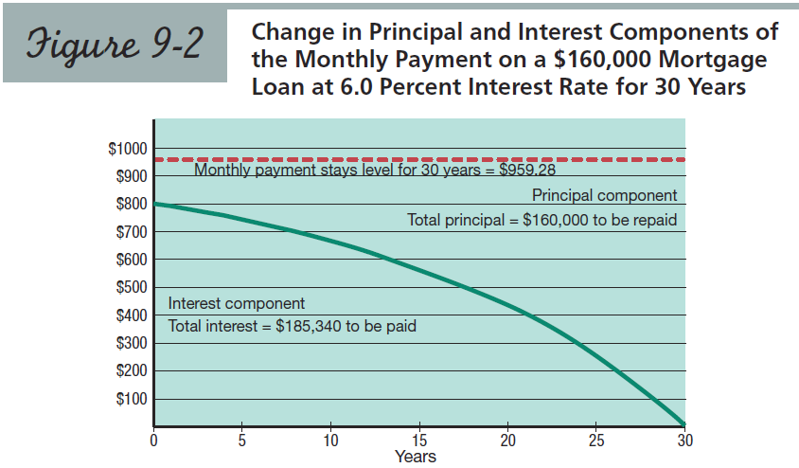
Notes:
Figure 9-2 shows how the monthly payment is applied towards interest and principal over the life a loan. Note how slowly the amount going towards interest declines over time. It may take twenty years of a thirty year mortgage for the principal portion to exceed the monthly interest. The total amount of all interest will likely be one and one-half times higher than the amount borrowed.

Slide 42
Table 9-2: Amortization Effects of a $959.28 Monthly Payment
First Month
$160,000 x 6.0%/12 = $ 800.00 Interest
$959.28 - $800.00 = $159.28 Principal $160,000 - $159.28 = $159,840.72 Balance
Notes:
Table 9-2 provides an illustration of how the amount of your monthly payment is applied toward interest and principal.

Slide 43
Table 9-2: Amortization Effects of a $959.28 Monthly Payment
Second Month
$159,840.72 x 6.5%/12 = $799.20 Interest
$959.28 - $799.20 = $160.08 Principal $159,840.72 - $160.08 = $159,680.64 Balance
Notes:
Since the principal is so high initially and declines so slowly so to does the amount of each payment going towards interest. Nonetheless, the inevitable will occur and in the later years of the mortgage the principal payoff will accelerate each and every month.

Slide 44
Financing a Home
Your equity is the dollar value of the home in excess of the amount owed on it. Equity grows as:
  You pay down the principal
  The value of the home appreciates
If your payment is lower than the monthly interest you will have negative amortization and your equity will decline.
Notes:
Your equity in your home is its dollar value over and above the amount owed on your mortgage. Initially, your equity is equal to your down payment. But equity grows over time. It grows because you are paying down your principal bit by bit each month. But is will likely grow even faster in the early years due to appreciation in the market value of your home.
Note that interest is paid first out of any mortgage payment. If for some reason your payment is less than the interest required you will experience negative amortization. Your equity will go down unless the home is appreciating in value. But worse, the principal amount of your loan will be increasing. The combination of declining equity and increasing principal was the basis for many of the home foreclosures in recent years.

Slide 45
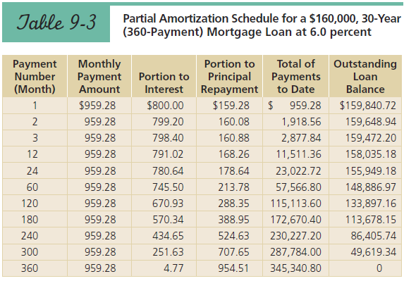
Notes:
Table 9-3 illustrates a portion of a mortgage loan amortization schedule. You receive such a schedule whenever you take out a mortgage loan. You can see the changes in interest portion of each payment, principal portion of each payment and the outstanding balance over time.

Slide 46
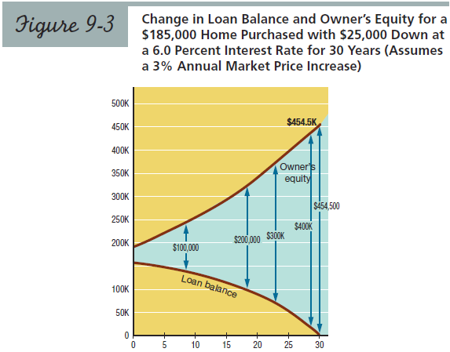
Notes:
Figure 9-3 illustrates the change in equity that occurs over time for a thirty year mortgage. It is based on a three percent increase in home values. This is the historical average but, as you are indeed aware, this rate of increase does fluctuate from year to year. Nonetheless, this chart illustrates why home buyers tend to do better over time than renters.

Slide 47
Financing a Home
The monthly payment depends upon:
  The amount borrowed
  The interest rate
  Length of the loan
Notes:
Like all loans, the monthly payment on a mortgage loan depends on the amount borrowed, the interest rate applied and the length of the loan.

Slide 48
Table 9-4: Estimating Mortgage Loan Payments* for P and I
Rate 15 yrs 20 yrs 25 yrs. 30 yrs
5.0 7.9079 6.5996 5.8459 5.3682
5.5 8.1708 6.8789 6.1409 5.6779
6.0 8.4386 7.1643 6.4430 5.9955
6.5 8.7111 7.4557 6.7521 6.3207
7.0 8.9883 7.7530 7.0678 6.6530
*$ per $1000 borrowed
Notes:
Table 9-4 provides a table that can be used to calculate monthly mortgage payment amounts. For example, a thirty-year loan at 6.0 percent would require a monthly payment $5.9955 for every $1000 borrowed. If you borrowed $160,000, your monthly payment would be $959.28 which is 160 times $5.9955.

Slide 49
Financing a Home
The conventional mortgage loan has a fixed interest rate, fixed-term and fixed payment.
Notes:
The type of loan that have been illustrated thus far is the conventional mortgage. These loans are the traditional loans that have a fixed interest rate, fixed term and fixed payment for the life of the loan. They are very predictable and preferred by most home buyers for that reason.

Slide 50
Financing a Home
The adjustable-rate mortgage loan has an interest rate that varies with interest rates in the broader economy and, thus, does not have a fixed payment.
  Interest Rate Caps
Notes:
50
In contrast, the adjustable-rate mortgage loan has an interest rate that varies with interest rates in the broader economy and, thus, does not have a fixed payment. These loans will require a interest rate that is lower than for a conventional mortgage on the same property and, thus, have a lower payment.
When taking out this type of mortgage you should plan for inevitable rate increases and, in turn, higher monthly payments. Some of these loans can come with a payment cap that restricts how high the payment can go. Though seemingly a good idea, a payment cap can lead to negative amortization should the payment not be enough to cover the higher monthly interest required.

Slide 51
Table 9-5: Monthly Payment and Total Interest On $100,000
5% 6% 7%
30 yrs. $537 $600 $665
93,300 116,000 139,400
25 yrs. 585 644 707
75,500 93,200 112,100
15 yrs. 791 844 899
42,300 51,900 61,800
Notes:
Table 9-5 illustrates the impact of the interest rate and time period on a $100,000 loan. You can see how much difference even one percentage point makes in the monthly payment. Similarly, you can see the impact of a shorter time period. Many people like short time periods because they want to pay their loan off as fast as possible. This is admirable but a better strategy might be to take out a thirty year loan and simply make higher payments whenever possible. In this way you are not locked into a high payment.

Slide 52
Financing a Home
Alternative mortgage loans include:
  Growing-equity mortgage
  Assumable mortgage
  Seller financing
    Land contract (contract for deed)
  Reverse mortgage
Notes:
Alternative loans are fraught with risk as well. This is because at some point in the future the monthly mortgage payment will likely go up and do so significantly.

Slide 53
Financing a Home
Should you refinance an existing mortgage?
The answer depends upon
  The difference between the current and new interest rates
  The length of time you expect to continue to own the home
Notes:
Since mortgage loans typically have no prepayment penalty you can refinance the loan whenever you desire. But will it be financially advantageous? You should do so to lock in a lower rate. But this will only work to your advantage if you plan to live in the house long enough to recover the closing costs associated with the refinancing.

Slide 54
Concept Check 9.4
Explain why the portions of a monthly mortgage payment that are allocated toward interest and toward principal will vary as the loan is repaid.
Distinguish between a conventional mortgage loan and an adjustable-rate loan.
Notes:
Assess your understanding by addressing these points.

Slide 55
Concept Check 9.4
Identify the two ways that home buyers build equity in their property.
Notes:
Assess your understanding by addressing these points.

Slide 56
Learning Objective #5
Identify the key considerations when selling a home.
Notes:
Learning objective #5 is to identify the important aspects of selling a home.

Slide 57
Selling a Home
Should you list with a broker or sell a home yourself as a FSBO: For sale by owner
Selling carries its own costs
  Brokers Commission
  Prepayment Fee
  Real estate transfer taxes
Be wary of seller financing!
Notes:
Selling a home can be almost as complicated as buying one. Your first decision will be whether to sell it your self as a FSBO. Most people engage the services of a real estate broker who will charge a commission based on the selling price of the home. A seller might be required to pay a prepayment fee if paying off a mortgage early. Only the most sophisticated and financially savvy seller should finance the sale of their home.

Slide 58
Concept Check 9.5
List some disadvantages of trying to sell a home yourself.
List one advantage and one disadvantage of using a real estate broker to sell a home.
Describe two costs associated with selling a home in addition to the real estate commission.
Notes:
Assess your understanding by addressing these points.

Slide 59
Worst Financial Blunders in Obtaining Affordable Housing
Based on others’ financial woes, you will make mistakes in personal finance when you:
  1. Take out a mortgage loan with payments that you really cannot afford.
  2. Fail to take steps to increase your credit score in the months prior to applying for a mortgage loan.
Notes:
Avoid these blunders that are typical for people who are less than successful in their financial planning.
Take out a mortgage loan that you really cannot afford.
Pay too much for a home and/or at too high an interest rate.

Slide 60
Worst Financial Blunders in Obtaining Affordable Housing
  3. Fail to request that private mortgage insurance be canceled when the loan-to-value ration drops to 80 percent.
Notes:
Avoid these blunders that are typical for people who are less than successful in their financial planning.
Fail to request that private mortgage insurance be canceled when the loan-to-value ration drops to 80 percent.

Slide 61
Do It NOW!
You know more about personal finance after reading this chapter, so get started right now by:
1. Talking to family members or friends who have bought a home to obtain their insights into the process including any not-so-pleasant surprises.
2. Exploring the housing market at www.realtor.com for the area where you might live if you get a job offer in that location.
Notes:
You do not have to wait to get started on obtaining affordable housing. Get started today by doing these three things.
Talk to family members or friends who have bought a home to obtain their insights into the process including any not-so-pleasant surprises.
Explore the housing market at www.realtor.com for the area where you might live if you get a job offer in that location.

Slide 62
Do It NOW!
3. Setting a reasonable goal for a down payment amount and calculating how much you would have to save per month to reach it at http://partners.leadfusion.com/tools/motleyfool/savings03/tool.fcs
Notes:
Set a reasonable goal for a down payment amount and calculating how much you would have to save per month to reach it at http://partners.leadfusion.com/tools/motleyfool/savings03/tool.fcs.

Slide 63
What Do You Recommend Now?
Now that you have read this chapter on buying housing, what would you recommend to Libby Clark regarding:
1. Buying or renting housing in the Denver area?
2. Steps she should take prior to actively looking at homes?
Notes:
You were asked at the beginning of the chapter to provide recommendations in personal financial planning. How would you answer these questions now that you have read the chapter?
Buying or renting housing in the Denver area?
Steps she should take prior to actively looking at homes?

Slide 64
What Do You Recommend Now?
3. Finding a home and negotiating the purchase?
4. The closing process in home buying?
5. Selecting the type of mortgage to fit her needs?
Notes:
Finding a home and negotiating the purchase?
The closing process in home buying?
Selecting the type of mortgage to fit her needs?

Slide 65
What Do You Recommend Now?
6. Things to consider regarding the sale of her home should she ultimately be promoted to a position in another of the four regions?
Notes:
Things to consider regarding the sale of her home should she ultimately be promoted to a position in another of the four regions?

Slide 66
