Slide 1
VEX Cortex
System Overview

Slide 2
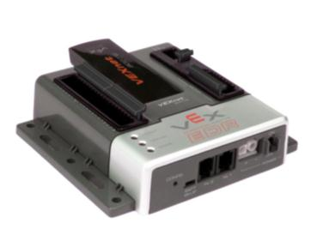
VEX Cortex Microcontroller
VEX Cortex (VEX 2.0)
12 digital ports
  Touch Sensor, Ultrasonic Rangefinder, Shaft Encoders
8 analog inputs
  Light Sensors, Line Tracking Sensors, Potentiometers, Accelerometers, Gyroscope
10 motor ports
  8 standard 3-wire PWM
  2 new 2-wire motor ports
Built-In VEXnet Connection
  Enables Wireless Programming, Wireless Debugging, and Remote Control
Two UART Ports (Serial)
  LCD Screen, Other External Devices
One I2C port
  Will connect to multiple new smart sensors
Notes:
Trainer Notes: Quick overview of the system, for new trainees.
Red = Not in GTT kit

Slide 3
ROBOTC Relevance

Slide 4
Industry Standard Skillsets
Java and C++, along with the Eclipse and Visual Studio IDE’s have been used to program:
  Microsoft Windows
  Mac OSX
  US Navy UAV Drones
  Flight Simulators
  DVD Player Firmware
  Video Games
  Microwaves
  CAT Scanners
  Smart Cars
  Satellites
  Cell Phones
  Electronic Toys
  ROBOTC!
  Much, much more!

Slide 5
ROBOTC Features

Slide 6
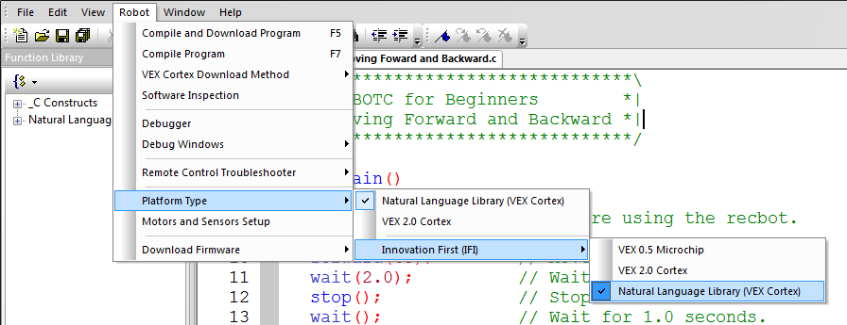
Platform Type
Allows you to toggle ROBOTC’s programming mode between the VEX PIC and VEX Cortex, will enable features and commands for the system
Notes:
Trainer Notes: The next few slides are meant to highlight features in ROBOTC that will help trainees succeed as they program and answer their own questions. When beginning to work with ROBOTC, one of the first things users should check is that their Platform Type matches up with the microcontroller their using. Doing so will enable menu options and ROBOTC commands specifically for that microcontroller.

Slide 7
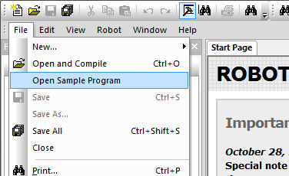
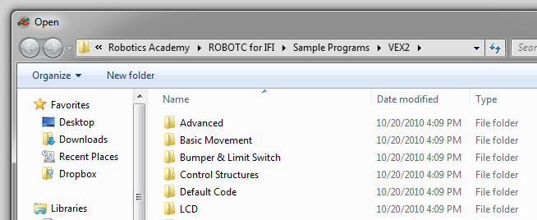
Sample Programs
Over 75 Included ROBOTC Sample programs, organized by robot behavior
Notes:
Trainer Notes: One of the easiest ways to begin programming is to start with existing code, try it out, and then modify it. Mention that all of the ROBOTC sample programs have “comments” that tell how the robot should be configured, and how it will behave when the program runs.

Slide 8
Comments
Comments are used to make notes in code for the human programmers
Every sample program contains comments pertaining to robot configuration, ROBOTC commands, robot behavior, ect
// Single line comment – everything after “//” is ignored by the ROBOTC compiler
/* Multi-line comment*/ - everything between the “/*” and “*/” symbols is ignored by the ROBOTC compiler

Slide 9
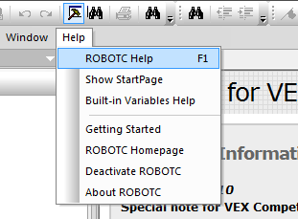
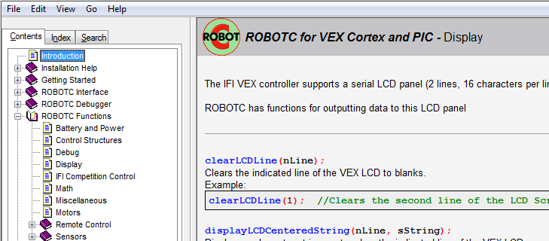
ROBOTC Help
In-depth explanations about the ROBOTC interface, commands, debugger, ect

Slide 10
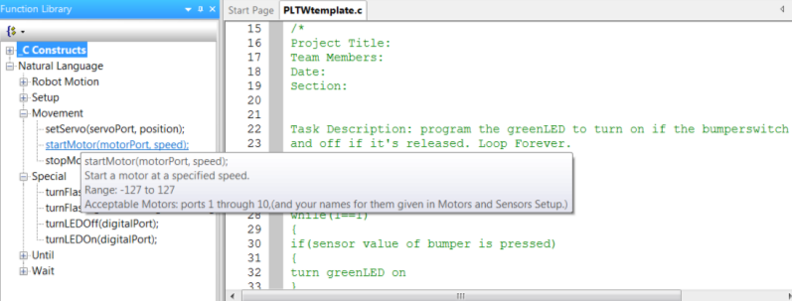
Function Library
Lists the available functions, with a description.
List of available functions will expand or shrink depending on the “Menu Level”

Slide 11
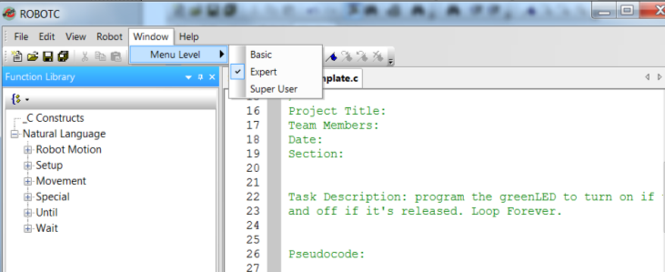
Menu Level
Customizes the ROBOTC interface and Function Library based on the user’s experience level

Slide 12
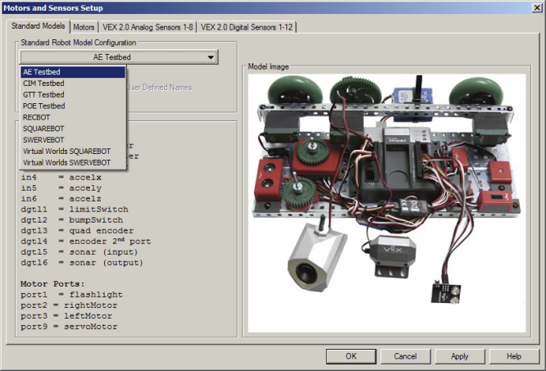
Testbed Motors and Sensor Setup
Configure all Motors and Sensors with one click

Slide 13
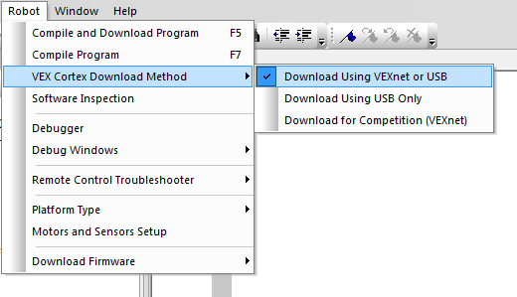
VEX Cortex Download Method
Allows you to specify:
  How programs are downloaded
  Whether the Cortex looks for a VEXnet connection when it starts up
“Download Using VEXnet or USB” is always the safe choice, but the Cortex will look for a VEXnet connection for up to10 seconds before running code.
Use Download Using USB only if not connecting wirelessly.

Slide 14
VEX Cortex Setup / System Configuration
Notes:
Trainer Notes: The following sequence can be skipped if these steps have been followed before the training (which is highly recommended). Full instructions can be found in the VEX Cortex Video Trainer, Setup section.

Slide 15
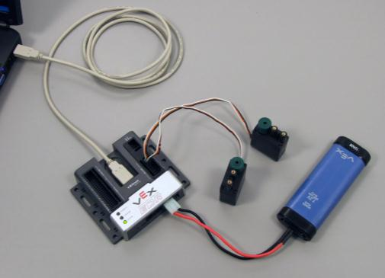
Connect the Cortex
Connect the Cortex to your computer using the USB A-to-A cable.
Connect the
Cortex to
a charged
robot battery
Turn the
Cortex ON
Notes:
The Cortex tries to determine how it’s connected (USB, VEXnet, nothing) when it’s first powered on. The USB connection will power the Cortex enough to create a connection, but not enough to power motors. This makes it important that you connect it to the computer first, then turn the switch to ON.

Slide 16
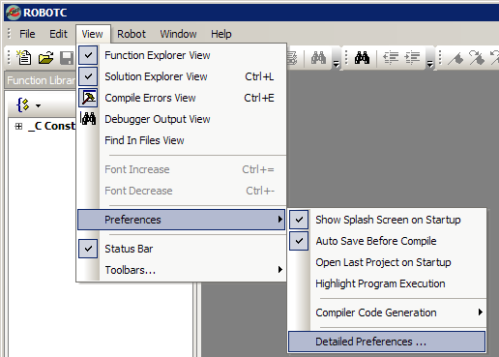
ROBOTC Preferences
4. Go to View >
Preferences >
Detailed
Preferences

Slide 17
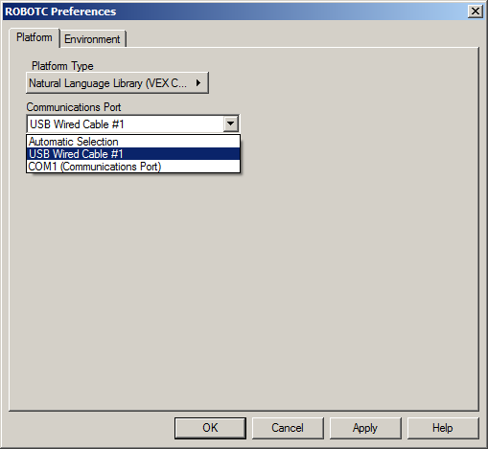
Platform Type
5. Select Natural
Language Library
(VEX Cortex) as
the Platform Type
6. Select “Automatic Selection” as
the Comm Port
7. Press OK to save
your changes
Notes:
Trainer Notes: The Platform type can also be selected from the Robot > Platform Type option in ROBOTC, and ROBOTC should automatically pick the correct port for communication, but going here shows users where to change all of the options at once.

Slide 18
ROBOTC Natural Language
The Natural Language is an additional Platform Type in ROBOTC:

Slide 19
VEX Cortex
Inputs and Outputs

Slide 20
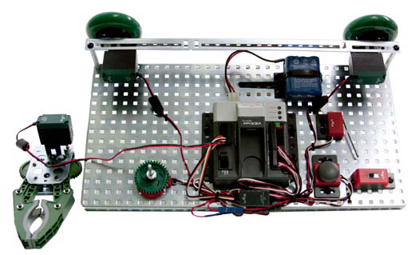
Your GTT Testbed

Slide 21
Your GTT Testbed
1 Claw
  MOTOR Port 1
2 Motors
  MOTOR Ports 2 & 3
1 Limit Switch
  DIGITAL Port 1
1 Bumper Switch
  DIGITAL Port 2
1 Green LED
  DIGITAL Port 12
1 Line Tracking Sensor
  ANALOG Port 1
1 Potentiometer
  ANALOG Port 2
Notes:
Trainer Notes: Make sure that all configurations in the classroom are all the same and working. Differences in motor and sensor port numbers will lead to confusion and delays in the class. Also, quickly explain the different types of sensors and hardware if the trainees are new to the system.

Slide 22
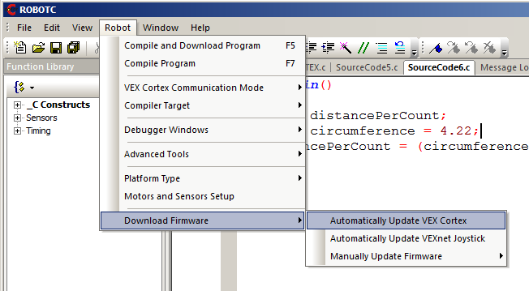
Firmware Up-to-Date?

Slide 23
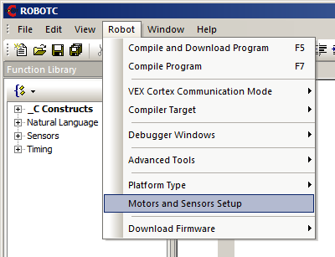
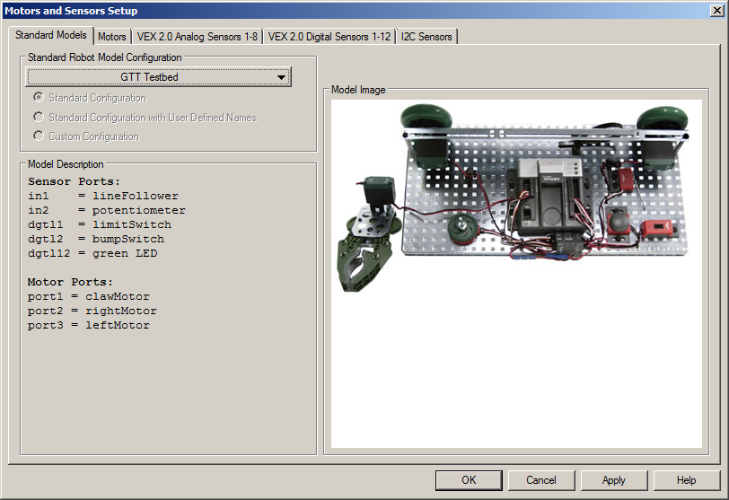
GTT Standard Model
Use the Standard Robot Model Configuration for the GTT Testbed
OR…

Slide 24
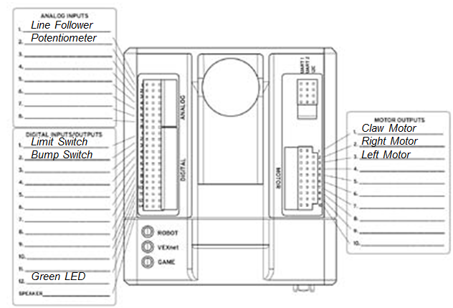
GTT Testbed Wiring Guide
Follow this diagram and the next several slides to configure the Test bed motors and sensors

Slide 25
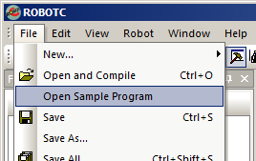
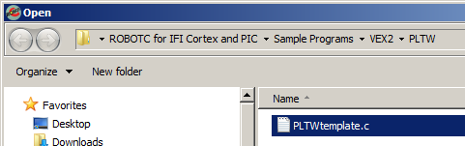
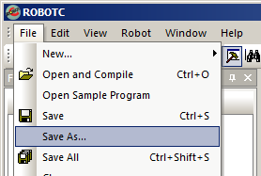
Configuring Inputs and Outputs
Begin by opening the PLTW Template
Then save your program under a new name.

Slide 26
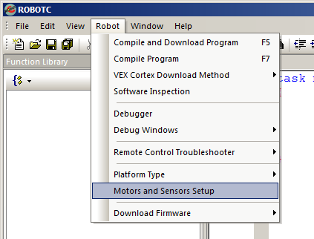
Configuring Inputs and Outputs
Then open the Motors and Sensors Setup Window to configure the motors and sensors connected to your Testbed

Slide 27
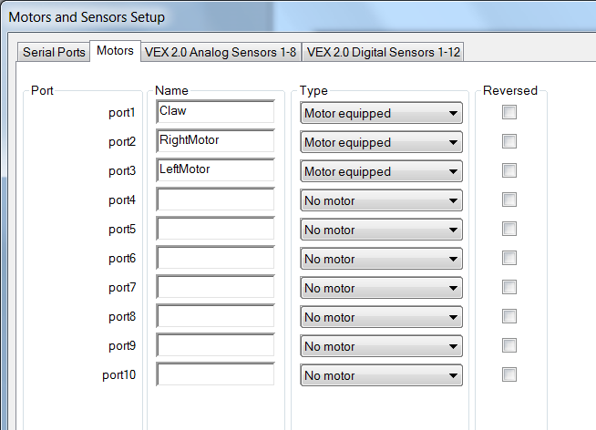
Motors
Notes:
Trainer Notes: Since ROBOTC treats all motors the same way, configuring them here is optional.

Slide 28
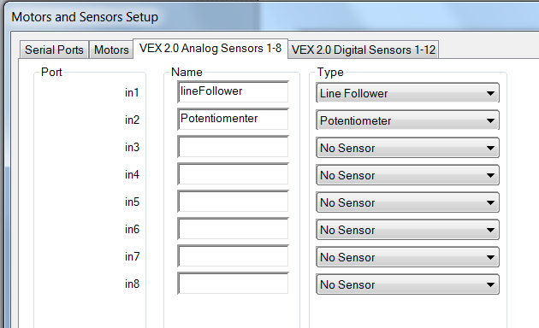
Analog Sensors
Notes:
Trainer Notes: Unlike the motors, because there are so many different types of sensors which provide data that must be interpreted differently, configuring sensors is NOT optional. Sensor and motor names must be all one word, with no special characters, and not already a reserved word in ROBOTC.

Slide 29
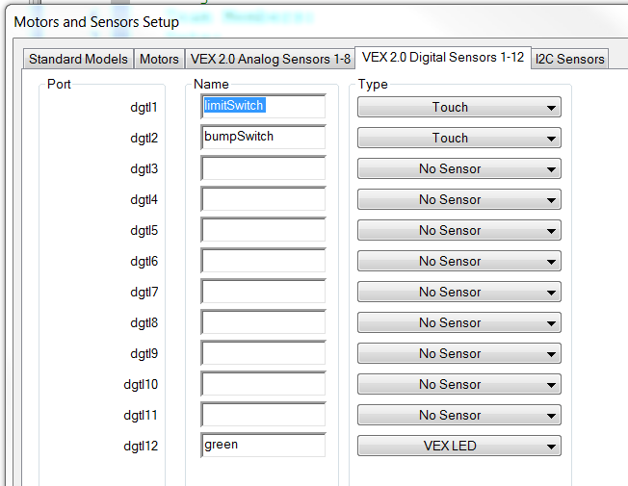
Digital Sensors
Note: Digital Sensors can be configured as both inputs (touch sensors) and outputs (LEDs).
Notes:
Trainer Notes: Unlike the motors, because there are so many different types of sensors which provide data that must be interpreted differently, configuring sensors is NOT optional. Sensor and motor names must be all one word, with no special characters, and not already a reserved word in ROBOTC.

Slide 30
Naming Conventions
The names of your motors and sensors follow the same conventions as variable names (which you will learn more about later on):
  Must be all one word (leftMotor, frontLight, etc.)
  Cannot contain any special characters (%, ^, #, etc.)
  Cannot already be a ROBOTC “Reserved Word (while, motor, task, etc.)

Slide 31
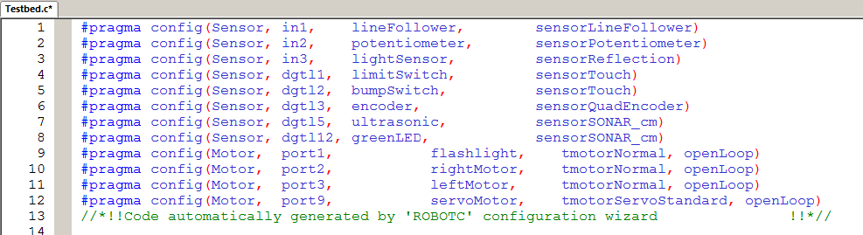
#pragma statements
The Motors and Sensors Setup will automatically generate configuration pragma statements.
Only configuring the motors and sensors you need in a program is generally a good practice.

Slide 32
Using the
ROBOTC Debugger
Notes:
Trainer Note: A debugger reference document is available for this section.

Slide 33
ROBOTC Debugger
The ROBOTC Debugger allows you to view and manipulate all of the values of your motors, sensors, timers, and variables.
Now that we’ve configured the motors and sensors, let’s view their values using the ROBOTC Debugger.

Slide 34
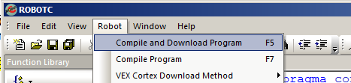
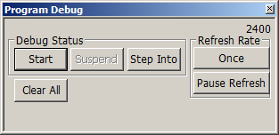
ROBOTC Debugger
Make sure your robot is connected to your computer and turned on, and download the program.
When the Program Debug Window appears, press the Start button and make sure the Refresh Rate is set to Continuous.

Slide 35
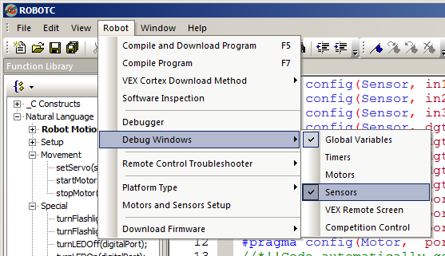
ROBOTC Debugger
Open the Sensor Debug window by going to Robot > Debug Windows > Sensors

Slide 36
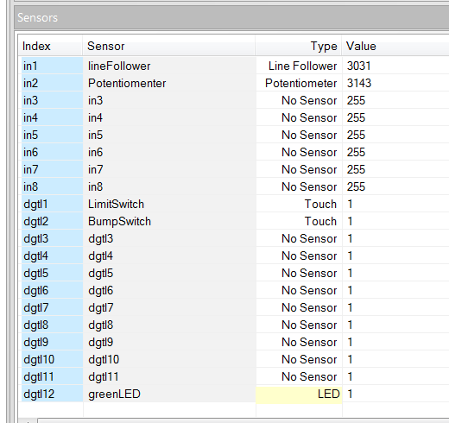
Sensor Debug Window
The Sensor Debug window will appear, and display all of the values of the configured sensors.

Slide 37
Program Planning
Notes:
Trainer Notes: The following slides detail program planning. At this point the Program Planning doc can be distributed or referenced during the training. All group exercises should follow the program planning steps to get in the habit of following it.

Slide 38
Behavior Based Programming
A behavior is anything your robot does:
  turning on a single motor, moving forward, tracking a, navigating a maze
Three main types of behaviors:
  basic behaviors – single commands to the robot (turn on a motor)
  simple behaviors – simple task performed by the robot (move forward, track a line)
  and complex behaviors – robot performs a complex task (solve the maze)
Complex behaviors can always be broken down into simple behaviors, which are then broken down into basic behaviors
Notes:
Trainer notes: Supplementary printouts found in the Fundamentals > Introduction to Programming section can be printed and handed outs.

Slide 39
Pseudocode
Pseudocode is a shorthand notation for programming which uses
  informal programming structures (if touch1 is pressed…)
  verbal descriptions of code (move forward, stop)
Emphasis is placed on expressing the behavior or outcome of each portion of code rather than on correct syntax (it should be reasonable, though).
Your lines of Pseudocode should also be listed in the same order as they will appear in the ROBOTC Program

Slide 40
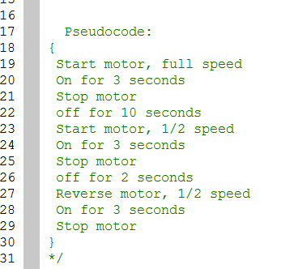
Pseudocode
Sample Pseudocode:

Slide 41
Pseudocode
Additional Details:
  Pseudocode is used to outline a program before translating it into proper syntax.
  Helps in the initial planning of a program, by creating the logical framework and sequence of the code.
  An additional benefit is that it can be translated into different programming languages and is therefore somewhat universal.

Slide 42
Putting it all Together
Effective Program Planning is essential to writing correct code. Carrying out that plan is equally important!
Once you have your plan, don’t try to implement it all at once!
Systematically add sections of code, testing at every step!

Slide 43
ROBOTC
“Natural Language”

Slide 44
ROBOTC Natural Language
New, developed specifically for PLTW
Goal is to lower the barrier of entry into
syntax-based programming by simplifying the code and using more “natural” command names
Lines of code for common robot behaviors are consolidated into single commands
  forward();
  lineTrackforTime();
  stop();
  untilBump();

Slide 45
ROBOTC Natural Language
The Natural Language is an additional Platform Type in ROBOTC:

Slide 46
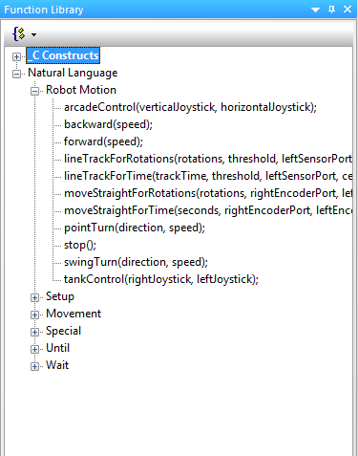
ROBOT Motion
Commands that cause the entire robot to perform a behavior

Slide 47
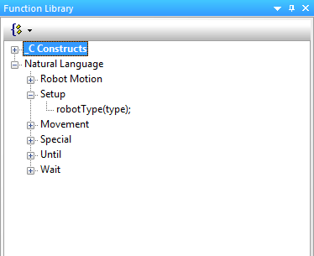
Setup
Allows you to specify what type of robot configuration you have from pre-specified models (RECBOT, Swervebot)
Notes:
Won’t need this in GTT for now…

Slide 48
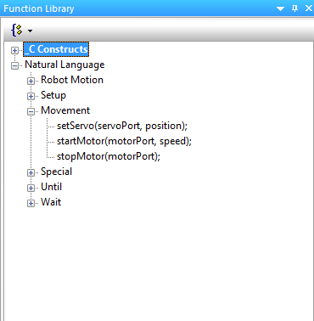
Movement
Commands that allow you to control individual motors

Slide 49
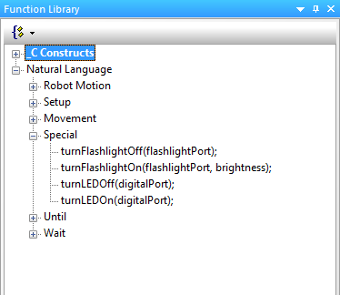
Special
Commands that control the more unique VEX Hardware – LED’s

Slide 50
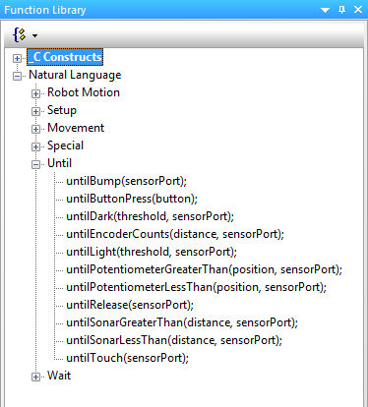
Until
Commands that allow you to create behaviors where the robot acts “until” a certain event
  Button Press
  Line Tracker Value
  Potentiometer Value

Slide 51
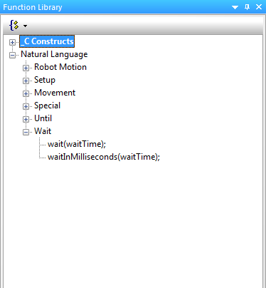
Wait
Commands that wait for an elapsed amount of time in seconds or milliseconds

Slide 52
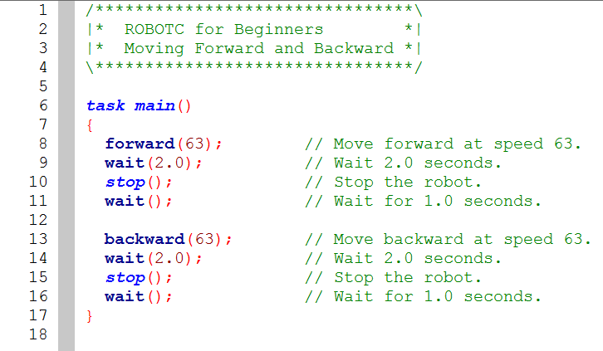
Moving Forward and Backward

Slide 53
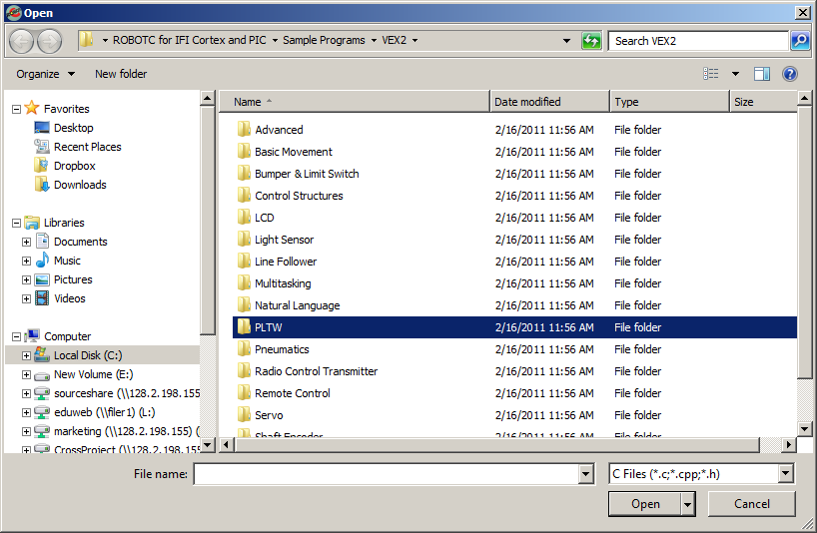
PLTW Template

Slide 54
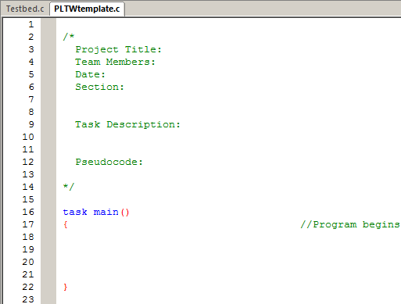
PLTW Template
Top comment section for students to fill their personal information, as well as program planning work.
Beginning and end of a multi-line comment
Section between curly braces is designated for the actual program.

Slide 55
Basic Programming:
Motor and Wait Commands

Slide 56
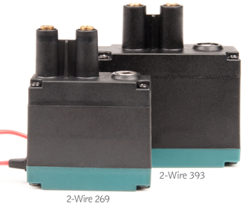
VEX Motors
Main Type:
  2-wire motor 269
  Newer 2-wire motor 269
  Newer 2-wire motor 393
All motors are programmed
the same way in ROBOTC
  Accept values between 127 (full forward) and -127 (full reverse)

Slide 57
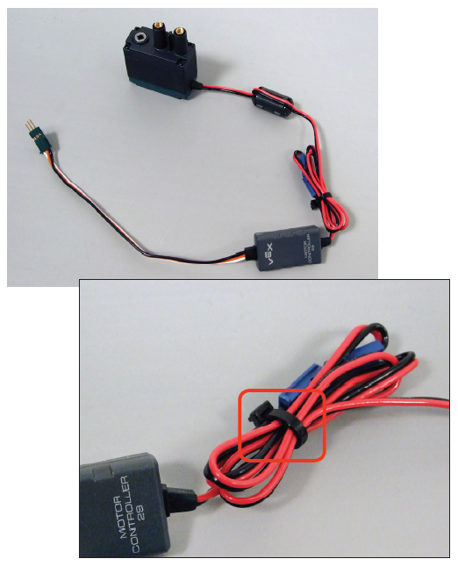
Connecting the Motors
Two-wire motors can be plugged directly into MOTOR ports 1 & 10 on the Cortex, and 2-9 using the Motor Controller 29

Slide 58
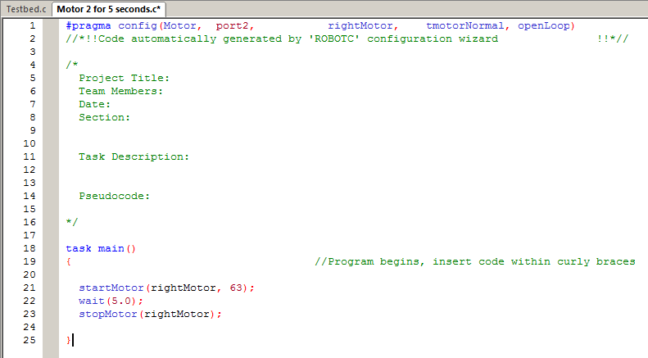
Motor 2 for 5 Seconds

Slide 59
Motor 2 for 5 Seconds
Displays configuration changes from the Motors and Sensors Setup
Defines the “main task” of the robot
All commands belonging to task main must be in-between these curly braces

Slide 60
Motor 2 for 5 Seconds
Turns the port2 rightMotor on at half power forward

Slide 61
Motor 2 for 5 Seconds
Causes the robot to wait here in the program for 5.0 seconds

Slide 62
Motor 2 for 5 Seconds
Stops the port2 rightMotor.
End Result: rightMotor spins for 5.0 seconds.

Slide 63
Quick ROBOTC Exercise
Create a program that runs a motor for 5 seconds at ½ speed and download it to the Robot
  Using the Program Debug Window
Notes:
Trainer Notes: This slide is meant to be a class activity, for trainees to actually get some guided experience with the ROBOTC interface, ROBOTC Commands, Cortex system, ect. The steps should be:
Open ROBOTC
Verify the Platform Type is set to Cortex Natural Language Lilbary
Create the Program
Connect the Cortex to the Computer (via USB or VEXnet)
Turn on the Cortex
Go to Robot > Compile and Download Program
Run the program – Observe the testbed
Turn on Motor Port 3 in the program, after Motor Port 2 and before the wait command
Compile and Download the Program
Run the Program – observe the testbed
Talk about the testbed design, how the motors are mirrored images of one another – even though you gave them the same motor power, they turn in opposite direction. This is something common on actual robots, where they mirror one another.
In ROBOTC, us the Motors and Sensors Setup to reverse the appropriate
Optional – rename the motors in the Motors and Sensors Setup
Download and run the program – observe the motors spinning in the same direction.

Slide 64
Motor Exercises
Turn the rightMotor on forward at half speed for 5 seconds, then stop.
Turn the leftMotor on in reverse at three-fourths speed for 2.5 seconds, then stop.
Turn both motors on at full power, and spinning in the same direction, for 7.25 seconds, then stop.
Notes:
Trainer Notes: Recommend that trainees name their finished programs by the title of the slide, including the number and whether it was a group or individual activity. This will help them refer back to the code later.

Slide 65
Basic Programming:
Until Commands

Slide 66
The Problem with Wait States
Motor Speed is affected by battery power
  If the battery is fully charged, the motors move quickly
  If the battery is running low, the motors move slowly
  Consequently, the robot will not move consistently as the battery power drains
Anyone experience these effects?
Wouldn’t it be better if we could control how much the robot moves, regardless of how long it took to complete?

Slide 67
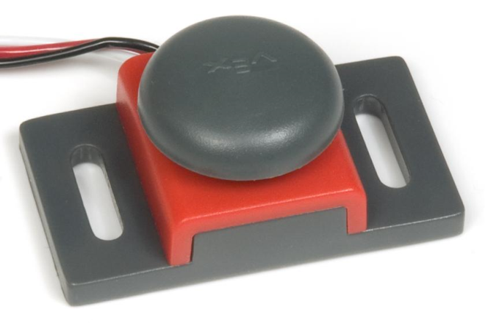
Sensor Information:
Touch Sensors

Slide 68
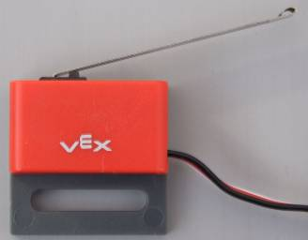
Touch Sensors
Touch Sensor Check
  Plugged into Digital 1 & 2
How they work
  Digital sensor - Pressed or Released
  1 = pressed
  0 = released
Two Types
  Limit Switches
  Bumper Switches
Using them
  The SensorValue[] command
  untilTouch, untilRelease, untilBump
  NL commands

Slide 69

Touch Sensors
Other Properties
  Limit Switch arm can be bent to create a more ideal “hit area”
  Both sensors spring back to “open” position
Limitations
  Watch out for “bouncing”. As the sensor is pressed or released, it may bounce
  between 0 and 1 very briefly and quickly.
  A very brief wait can be inserted after touch sensor related commands to reduce the bouncing effect:

Slide 70
Bump Switch Exercise
Exercise: Program the rightMotor to turn on at half power, until the bump switch is pressed. The motor should then stop.

Slide 71
Limit Switch Exercise
Wait for the limit switch to be touched before the right motor turns on at half power for 5 seconds, then stops.
Wait for the limit switch to be touched before both motors turn on at half power, until the sensor is bumped again. Both motors should then move in reverse at half power for 3.5 seconds.
Notes:
Discuss how the limit and bump switch would be used for Grandmas Chair, Toll booth, Sign, Tekrocks Bridge

Slide 72
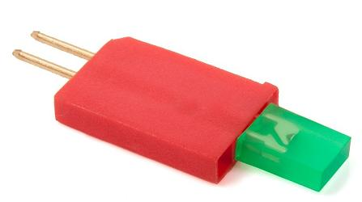
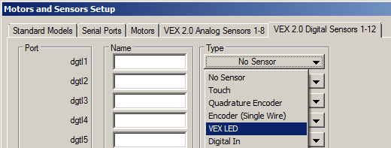
VEX LED
Plugged into DIGITAL Port 12
Set as “VEX LED”
In the debugger 0 is ON and 1 is OFF
Red, Green, and Yellow colors available

Slide 73
VEX LED
Before connecting the LED to the Cortex using an extension cable, first connect it directly to the Cortex to see how it is properly inserted.
  You'll notice that one side is "keyed", which only allows it to be inserted in one direction.
  Plug it in on one of the DIGITAL ports. Notice that the two prongs are inserted toward the center of the Cortex.
  Unplug the LED.
Plug the PWM Extension wire into the desired DIGITAL Port on the VEX Cortex.
  Newer extension wires are keyed in a similar manner to the LED and other VEX sensors; older wires may not be.
  Plug the extension wire in so that the white wire is closest to the center USB port on the Cortex.
Connect the LED to the PWM Extension wire.
  The outer terminal on the LED should be plugged in on the white wire.
  The center terminal on the LED should be plugged in on the red wire.
  The black wire should have nothing connected.

Slide 74
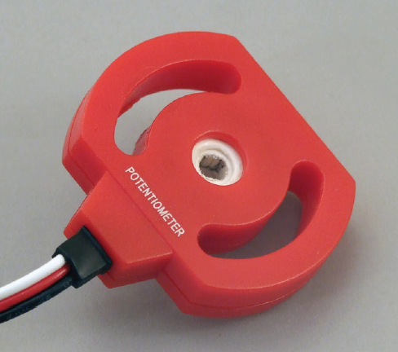
Sensor Information:
Potentiometer

Slide 75
Potentiometers
Potentiometer Check
  Analog Port 2
How they work
  Analog sensor
  Measures rotation of a shaft
  between 0 and ~265 degrees
  Cortex returns values 0 - ~4095
Using them
  The SensorValue[] command
  untilPotentiometerGreaterThan
  untilPotentiometerLessThan

Slide 76
Potentiometers
Other Properties
  Internal mechanical stops prevent the potentiometer from turning a full revolution.
Limitations
  Caution: Excess torque against the internal mechanical stops (can be caused by hand or by a VEX motor) will cause them to wear away. The potentiometer will continue to function, but will have a “dead zone” where the mechanical stops were, where no new values are sent.
  Switching the direction the potentiometer is
  facing will also switch the direction it “counts”.
  For example: counter-clockwise turns will
  count 0 to 4095 on one side; on the other
  counter-clockwise turns
  will count 4095 – 0.

Slide 77
Potentiometer Exercise
Turn on the greenLED until the potentiometer value is greater than 2048. Then the greenLED should turn off, and the leftMotor should turn on for 3.5 seconds.
Turn on the greenLED until the potentiometer value is greater than 2048. Then the greenLED should turn off, and the leftMotor should turn on until the potentiometer is less than 2048.
Notes:
Discuss how LED’s are used in the Toll Booth in conjunction with the Potentiometer

Slide 78
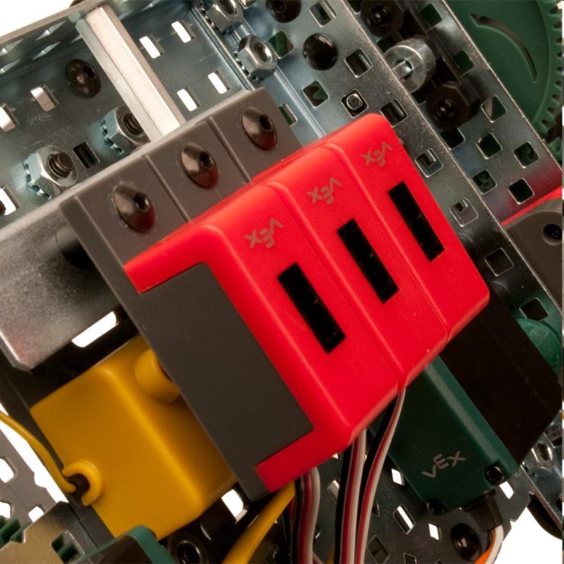
Sensor Information
Line Tracker

Slide 79
Line Tracking
“Active” Light Sensor
Set of 3 Analog Sensors
Sends out a IR beam, and measure how much is reflected back
Each reads values between 0 and 4095
Using them
  The SensorValue[] command
  untilDark, untilLight, lineTrackforDistance, lineTrackforTime

Slide 80
Line Tracking
Other Properties
  The Line Tracker should be kept between 1/4 and 1/8 of an inch of what it’s measuring for the best results.
  Constant, consistent lighting is also very important for achieving repeatable robot behavior.
  In order to use the Line Tracking sensor(s) you must first calculate a threshold that allows it to distinguish light from dark.

Slide 81
Thresholds Overview
A Threshold is a value (usually halfway between) two extremes
  Light and dark (Light sensors)
  Near and Far (Ultrasonic)
Thresholds allow your robot to make decisions via Boolean Comparisons
Line Following Kits come with 3 sensors
  To use all three, you must choose a Threshold that will work with all 3 sensors, or 3 separate Thresholds
  If you are only using one sensor, then you only need to calculate the Threshold for that sensor

Slide 82
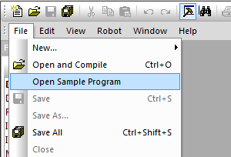

Threshold Calculation
Calculate an appropriate Threshold with the aid of the Sensor Debug Window
  In ROBOTC, open the Line Follower > Triple Sensor Line Tracking.c Sample Program
Notes:
Trainer Notes: The following slides detail the process for determining a threshold.

Slide 83

Threshold Calculation
2. Download the Sample Program to the Robot
3. Open the Sensor Debug Window

Slide 84

Threshold Calculation
4. Verify that the Program Debug Window’s Refresh Rate does not display “Continuous”.
*Press the “Continuous” button if it does.
Notes:
Trainer Notes: Seeing “Continuous” means that the Sensor debug window will not be seeing continuous updates from the sensors.

Slide 85

Threshold Calculation
5. Place one of the line tracking sensors above the white surface.
6. Record the value for that sensor displayed in the Sensors Debug Window.
*values displayed will vary from your values

Slide 86
Threshold Calculation
7. Place the same line tracking sensor above the dark line.
8. Record the value for that sensor displayed in the Sensors Debug Window.
*values displayed will vary from your values

Slide 87
Threshold Calculation
9. Add the two values and divide by two. The result is the threshold for that sensor.
Light reading + Dark Reading
2
= Threshold

Slide 88
Threshold Calculation
10. If needed, repeat steps 1-9 for the other two sensors, identifying a new threshold for each OR verifying that your first threshold will work for each sensor.
11. Use the threshold(s) in your program

Slide 89
Line Tracker Exercise
Open and close the claw by covering and uncovering the line follower.
Turn LED off when hand covers line follower, LED turns on for 5 seconds when hand is removed.

Slide 90
Decision Making: while loops and Boolean Logic

Slide 91

While Loops
A while loop is a structure within ROBOTC which allows a section of code to be repeated as long as a certain condition remains true.
There are three main parts to every while loop.

Slide 92
1. The word “while”
Every while loop begins with the keyword “while”.

Slide 93
2. The Condition
The condition controls how long or how many times a while loop repeats. While the condition is true, the while loop repeats; when the condition is false, the while loop ends and the robot moves on in the program.
The condition is checked every time the loop repeats, before the commands between the curly braces are run.

Slide 94
3. Commands to be Repeated
Commands placed between the curly braces will repeat while the (condition) is true when the program checks at the beginning of each pass through the loop.

Slide 95
The Truth About while() Loops

Slide 96
1. while() Loops do NOT Constantly
Check their Conditions
while() loops check their conditions before running the body of code
After the body of code is run, the while() loop checks the condition again
The condition is NOT checked while the body of code is being run

Slide 97
2. while() Loops do NOT Keep
Programs Running Forever
Exception: Infinite while() loops
Once the while() loop’s condition is met/false, the robot moves past the while loop in the program and does not revisit it
Students often assume that because there is a while() loop in the code, the program keeps on running

Slide 98

3. while() Loops are a Programming
Structure, not a Command
They do not get a semicolon (;) after the condition
Adding a semicolon will cause the while() loop to constantly check the condition, without running the body of code

Slide 99

4. All “until” commands in the NL are actually while() loops
All commands are just a while() loop with a wait command, to hold the “Program Flow” at that spot in the code

Slide 100
Boolean Logic
Decisions robots make must always based on questions which have only two possible answers: yes or no, true or false.
Statements that can be only true or false are called Boolean statements, and their true-or-false value is called a truth value.

Slide 101


Boolean Logic

Slide 102


Slide 103
Boolean Logic:
Multiple Conditions

Slide 104

Logical Operators
Logical Operators allow you to combine two or more full conditions

Slide 105

Logical Operators: OR
When using the Logical OR Operator (II), the entire condition is true if any or all of the individual conditions are true

Slide 106

Logical Operators: AND
When using the Logical AND Operator (&&), the entire condition is true only when all of the individual conditions are true

Slide 107
While Loop Exercise 1
Example: Program the greenLED to repeatedly turn on for 2 seconds, then off for 2 seconds, while the limit switch isn’t pressed.
Individual: Expand the previous program to loop only while the the potentiometer reads less than 2048.
Notes:
Trainer Notes: Recommend that trainees name their finished programs by the title of the slide, including the number and whether it was a group or individual activity. This will help them refer back to the code later.

Slide 108
Timers
More loop control please?
  Question: Where would the wait statement go if we wanted the loop to repeat for a controlled amount of time?
  Answer: Nowhere! We need something else.
Solution: Timers
  Can be thought of as internal stopwatches (4 available)
  Timers should be “cleared” anytime before they are used
    Watch where you clear them!

Slide 109

Timers
In the program below, timer T1 is used as the condition for the while loop, which will run for 30 seconds:

Slide 110
While Loop Exercise 2
Program the greenLED to repeatedly turn on for 2 seconds, then off for 2 seconds, while less than 20 seconds have elapsed.
Program the greenLED to repeatedly turn on for 2 seconds, then off for 2 seconds, forever.
Notes:
Trainer Notes: Recommend that trainees name their finished programs by the title of the slide, including the number and whether it was a group or individual activity. This will help them refer back to the code later.

Slide 111
Decision Making: if, if-else, and Boolean Logic

Slide 112

If Statements
When your robot reaches an if Statement in the program, it evaluates the condition contained between the parenthesis.
  If the condition is true, any commands between the braces are run.
  If the condition is false, those same commands are ignored.
Very similar to how a while loop works, but does not repeat the code!

Slide 113

If-else statements
The if-else Statement is an expansion of the basic if Statement.
  The “if” section still checks the condition and runs the appropriate commands when it evaluates to true
  Using the “else” allows for specific code to be run only when the condition is false.
Either the “if” or the “else” branch is always run; no more, no less.

Slide 114
If-else Exercise 1
Program the greenLED to turn on if the bumperSwitch is pressed, and off if it’s released. Loop Forever.
Convert the previous program to an if-else.

Slide 115
Multiple If-else Statements
Be careful when using two separate if-else statements, particularly when they are used to control the same mechanism.
One branch of each if-else statement is always run, so you may create a scenario where the two sets “fight” each other.

Slide 116

Multiple If-else Statements
In this example, if one of the touch sensors is pressed, the rightMotor will be turned on in one if-else statement, and immediately turned off in the other.

Slide 117

Multiple If-else Statements
This can be corrected by embedding the second if-else within the else branch of the first, so that it only runs if the first condition is false.

Slide 118

If-else Shorthand
An embedded if-else can also be represented as an else if:

Slide 119
Variables

Slide 120

Variables
A variable is a space in your robot’s memory where you can store data, such as whole numbers, decimal numbers, and words.
Variable names follow the same rules as custom motor and sensor names:
  Capitalization, Spelling, Availability
Usefulness
  Can store data to be manipulated by your robot
  Can improve the readability and expandability of your programs

Slide 121
Variables
Data Type | Description | Example | Code
Integer | Positive and negative whole numbers, as well as zero. | -35, -1, 0, 33, 100 | int
Floating Point Number | Numeric values with decimal points (even if the decimal part is zero). | -.123, 0.56, 3.0, 1000.07 | float
Boolean | True or False. Useful for expressing the outcomes of comparisons. | true, false | bool
Character | Individual characters, placed in single quotes. | ‘L’, ‘f’, ‘8’ | char
String | Strings of characters, such as words and sentences placed in double quotes. | “Hello World!”, “asdf” | string

Slide 122
Creating a Variable
To create a variable, you must “declare” a type, which is the type of data it will hold, as well as a name that it can be referenced by:
Variables can be set to different values throughout your program. Giving a variable its initial value is called “initializing” it

Slide 123
Variables Part II

Slide 124

Common Variable Uses
Variables are useful for keeping track of loop iterations
The following code lets the loop run 10x
Note that the side on the right of the equal sign is evaluated first, then set to the variable on the left. This is always the case.

Slide 125

Common Variable Uses
Variables are useful for keeping track of sensor or timer values at different parts of the program

Slide 126

Common Variable Uses
Variables are useful for keeping track of results from complicated equations

Slide 127


Global Variables Window
Displays all of the variables in your program in real-time

Slide 128
Operator Shortcuts
Automatically adds 1 to x
x = x + 1;
Automatically subtracts 1 from x
x = x – 1;
Automatically adds 2 to x
x = x + 2;
Automatically subtracts 2 from x
x = x – 2;

Slide 129
Variables Exercise 1
Program the motors to spin forward until the touch sensor is pressed. Record the elapsed time in an “elapsedTime” integer variable. The motors should spin in reverse for one-half of the elapsed time.
Watch the timer values in the ROBOTC Timers debug window. Watch the variable values in the Global Variables window.
Notes:
Trainer Notes: Recommend that trainees name their finished programs by the title of the slide, including the number and whether it was a group or individual activity. This will help them refer back to the code later.

Slide 130
Variables Exercise 2
Write a program that for any distance, will calculate the number of encoder counts needed. Create variables to:
  Store the desired distance
  Store the circumference of your wheel
  Store the value of PI
  Store the result of your equation
Watch the value of the variables in the Global Variables window

Slide 131
for(;;) Loops

Slide 132

for(;;) Loops
Like a counter-based while() loop

Slide 133

Initial Value
The equivalent of creating an integer counter variable and initializing it to 0

Slide 134
Condition
The condition of the loop to control how many times it iterates

Slide 135
Increment
Specifies how many to increment the value by each iteration of the loop

Slide 136


Comparison
vs.

Slide 137
for(;;) Loop Exercise
Write a program that turns the LED on for 3 seconds and off for 1 second, 5 times using the for(;;) loop.

Slide 138
Troubleshooting

Slide 139
Troubleshooting Questions
Identify the problem. Don't tell me how to fix the problem. Just tell me what it is.
What can we tell about the student because of the problem? What do they know? What don't they know?
What can we tell the student to fix their understanding AND the problem?
Just giving the answer to the student teaches dependence!
This method teaches!

Slide 140
Student: “My program runs when the Cortex
is connected to the computer, but
when it’s not connected it just sits
there doing nothing.”

Slide 141

Student: “My program runs when the Cortex
is connected to the computer, but
when it’s not connected it just sits
there doing nothing.”

Slide 142

Student: “My motor should spin forward for 3
seconds, stop for 2 seconds, then
reverse for 3 seconds, but it never
stops in the middle.”

Slide 143

Troubleshooting
Student: I want my robot to move forward, then turn. I had it moving forward, and added the turn. Now it’s turning, then moving forward.

Slide 144

Troubleshooting
Student: My code won’t compile.

Slide 145

Troubleshooting
Student: I want my robot to move forward, then reverse. I had it moving forward, and added the reverse, but it never actually backs up.

Slide 146

Student: “My program works, but the motors move all jerky.”
Notes:
Problem: The two if-else statements are fighting eachother. One half of each will ALWAYS be run, so one set is turning them on while the other turns it off.

Slide 147

Student: “My program should end when I
press the touch sensor, but
sometimes it keeps running.”
Notes:
Problem: Student could be pressing the touch sensor in the middle of the while loop, but since the condition isn’t being checked then, the loop doesn’t end.

Slide 148

Troubleshooting
Student: My loop should only be running for 1 minute, but it never stops.

Slide 149
Troubleshooting
Student: My code compiles, but I get an error when I try to download it to the robot.
Check:
  Is the robot turned on and sufficiently powered? (blinking green light)
  Is the robot connected to the computer?
  Is the correct platform type selected in ROBOTC?
  Is the correct port selected in ROBOTC?
    Has the driver for the programming cable been installed?
  Has the firmware been loaded on the VEX?
  Does the Master Firmware need re-downloaded?
  Is another ROBOTC window open, using the debugger windows?

Slide 150
Functions

Slide 151
Functions
Functions are used to group together several lines of code, which can then be referenced many times in task main, or even other functions.
Convenient uses for functions in the testbed
  LED on if the bumper is pressed, off if released
  Flashlight on if the lights are off, off if the lights are on
Creating Functions
  Example: LED on if bumper is pressed, off if released
  Function Header (Part1 – The name of the function)
  Function Definition (Part 2 – The code that goes with the function)
Using Functions
  Function Call (Part 3 – Where you want the function code to run)

Slide 152


Slide 153
Function Declaration
Function Declarations (or prototypes) “declare” that there is a function, and what its name is.
Function Declarations are placed above task main, but below any #pragma statements.
They are optional, if the function definition is above task main.

Slide 154

Function Definition
Function Definitions “define” what code belongs to the function.
They can be placed after task main if you include a declaration, or above task main (but still below the #pragma statements).

Slide 155

Function Call
Function Calls “call” the code from the function, and run it.
Function Calls can be placed in task main, and even other functions.
Group activity: Program Tracing

Slide 156
Function Exercise
Recreate the LED Control Function and try it on your testbed.
Notes:
Trainer Notes: Recommend that trainees name their finished programs by the title of the slide, including the number and whether it was a group or individual activity. This will help them refer back to the code later.

Slide 157
Resources

Slide 158

Notes:
Trainer Notes: Introduce the VEX Cortex Video Trainer – Designed to teach behavior based programming using ROBOTC and the VEX Cortex

Slide 159
VEX Cortex Video Trainer (VCVT)
(In Development)
45 tutorial videos (60+ planned) teach step-by-step how to program using ROBOTC and the Cortex system
75+ pages of supplementary “helper guides”
40+ programming challenges
Freely available at www.robotc.net

Slide 160


Notes:
Trainer Notes: This is how you can get to the VEX Cortex Video Trainer

Slide 161


Using Two Software
ROBOTC Programming Software
Use this software to do the actual programming of the robot
VEX Cortex Video Trainer
Use this software to guide your programming, learn about the system, ect

Slide 162

Configuring your System
Notes:
Trainer Notes: You should have the system and ROBOTC pre-configured before the trainees get there. This is important information for when the trainees implement robotics in their own programs.

Slide 163

Behavior Based Programming
Notes:
Trainer Notes: These videos can be watched as a group, with speakers, or at individual stations if there are headphones. Do not have the class watch it at individual stations with speakers – too much noise. ROBOTC Rules Part 1 and 2 can also be watched and are valuable for programming information.

Slide 164

Robot Virtual Worlds
As of ROBOTC 3.0, every copy of ROBOTC comes with a 60-day trial of RVW and a few demo tables. Additional tables online.
Natural Language is
fully supported.
Perfect for practicing
programming without
the hardware!

Slide 165
RVW Demo
Add License
Switch Compiler Target
Select Virtual World to Use
Open Sample Program
Compile and Download
Run!

Slide 166
CMU Resources
ROBOTC.net: http://www.robotc.net/
  The ROBOTC Forum: http://www.robotc.net/forums/
ROBOTC PLTW Page: http:// www.robotc.net/pltw
VEX Cortex Video Trainer
  http://www.education.rec.ri.cmu.edu/products/teaching_robotc_cortex/index.html
Robotics Academy
  http://www.education.rec.ri.cmu.edu/content/vex/index.htm
Notes:
Trainer Notes: It’s recommended that you visit the different pages and show trainees the materials that are there.

