Slide 1
Cold War

Slide 2
When does the Cold War begin?
When does the Cold War end?
Begins at end of WWII
Ends with the collapse of the Soviet Union in 1989
(Berlin Wall also comes down)

Slide 3
Comparing Governments & Economies
United States
Soviet Union
Democracy
Free Market Economy
(Capitalism)
Totalitarian Gov’t (Communism)
Communist economic system (Socialism)

Slide 4
Characteristics of the Truman Doctrine:
“Containment of Communism”
  Not to push communism back where it already existed
  Rather, keep it from spreading
  Resist communist aggression into other countries
Foreign Policy throughout Cold War

Slide 5
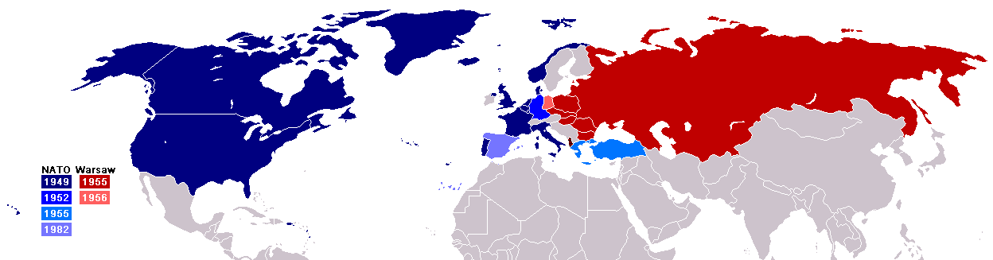
Cold War Alliances

Slide 6
Cold War Alliances
NATO
(North Atlantic Treaty Organization)
Warsaw Pact
Defensive alliance
Among U.S. and Western European Countries
Goal: to prevent a Soviet invasion of western Europe
Defensive alliance
Among Soviet Union and allies in eastern Europe
Goal: to defend against NATO forces

Slide 7
Critical Thinking
What is the one, main result of having NATO and the Warsaw Pact?

Slide 8
One Result of Defense Alliances:
Large military forces facing each other in Europe

Slide 9
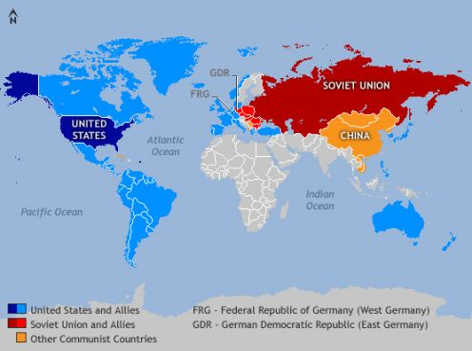
Communism in China

Slide 10
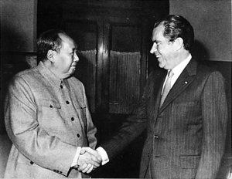
Main Ideas of the Communism in China:
America fears that communism will dominate most of the world
This eventually changes, as the U.S.S.R. and China become rivals, not allies
U.S.S.R. & China become rivals for territory and diplomatic influence
President Nixon successfully takes advantage of rivalry in 1970s

Slide 11
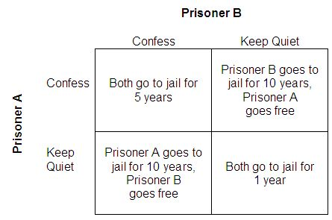
Nuclear Weaponry
Game Theory Activity

Slide 12
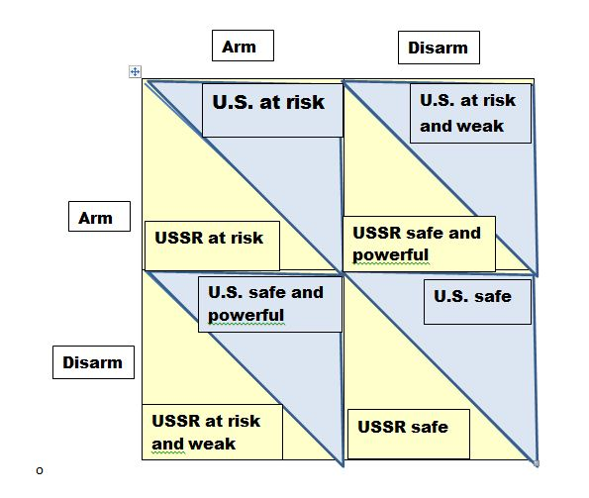
Arms Race Dilemma

Slide 13
Main points about Nuclear Weaponry:
Soviet Union matches U.S. nuclear weaponry in the 1950s
As a result, President Eisenhower adopted a policy of “massive retaliation” to deter any nuclear strike by the Soviet Union
Threat of nuclear warfare always present during the Cold War
Do You Remember: Who are the spies who were convicted for working with the Soviet Union?

Slide 14
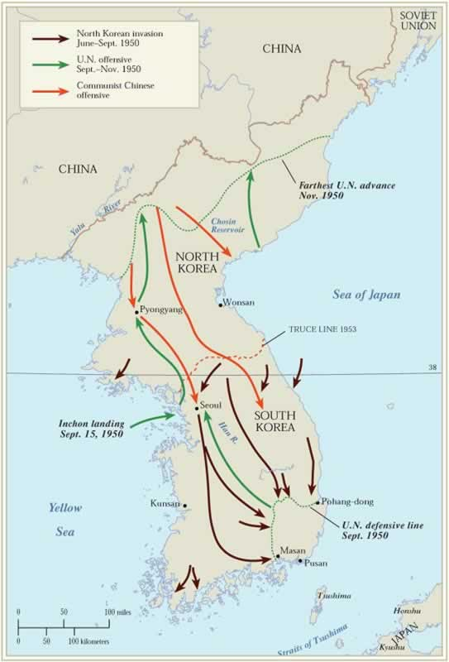
Korean War

Slide 15
What are the Main Points about the Korean War?
Occurred during the 1950s
American involvement
America follows the Policy of Containment (Truman Doctrine)

Slide 16
Korean War
North Korea
South Korea
Communist
Invades S. Korea
China supports N. Korea
Democratic principles
Initially, U.S. pushes Communism back in a counterattack
U.S. supports S. Korea

Slide 17
Result of Korean War
Ends in a Stalemate:
North Korean remains communist
&
South Korean remains democratic
Same today

Slide 18
Conviction of Spies for Soviet Union
Alger Hiss
Julius & Ethel Rosenberg
Accused of providing the S. U. with info
Increased fear of communism

Slide 19
McCarthyism
Joseph McCarthy leads campaign against communism
Recklessly accusing people:
  Educators
  Actors
  Government Officials
No evidence or flimsy evidence

Slide 20
McCarthyism
McCarthyism comes to mean the making of false accusation based on rumor or guilt by association

Slide 21
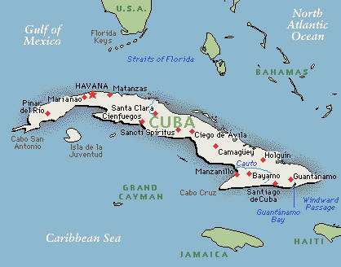
Cuba

Slide 22
When is Cuba overthrown by Communist forces?
What is the event that begins the overthrow of the gov’t?
New Government?
Late 1950s
Communist revolution
Communist control of Cuba
Fidel Castro, leader

Slide 23
Bay of Pigs
Some Cubans flee to Florida
They attempt to invade Cuba & overthrow Castro
This event is called the Bay of Pigs
U.S. supports attempt
Failed attempt, Castro stays in power

Slide 25
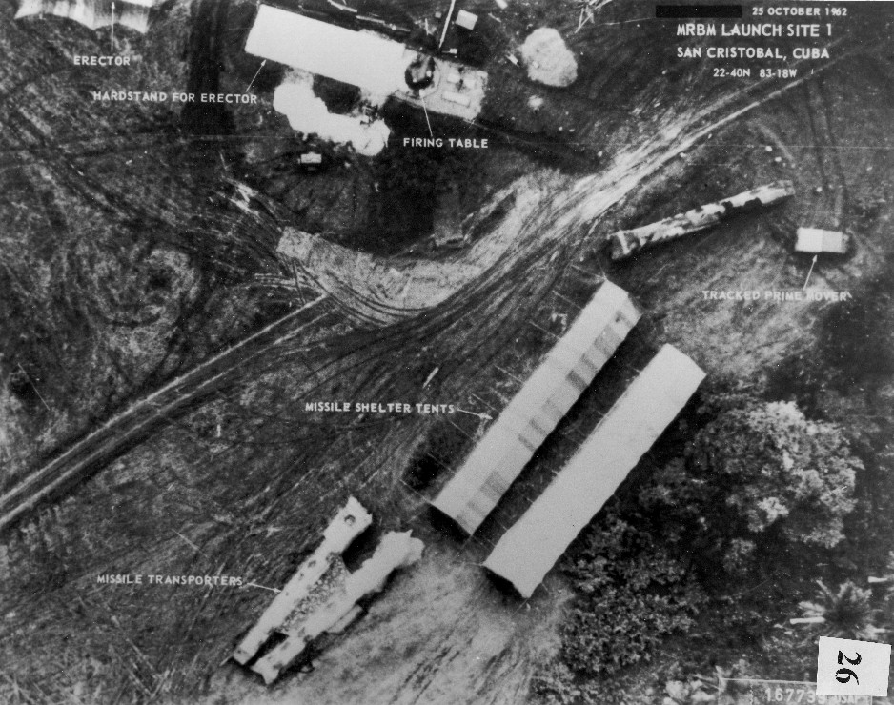
Cuban Missile Crisis (1962)

Slide 26
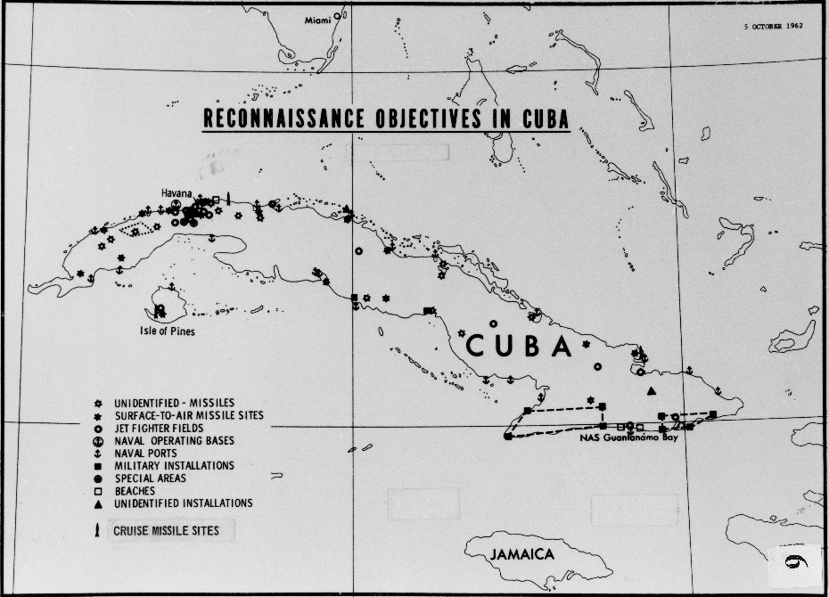
Cuban Missile Crisis (1962)

Slide 27
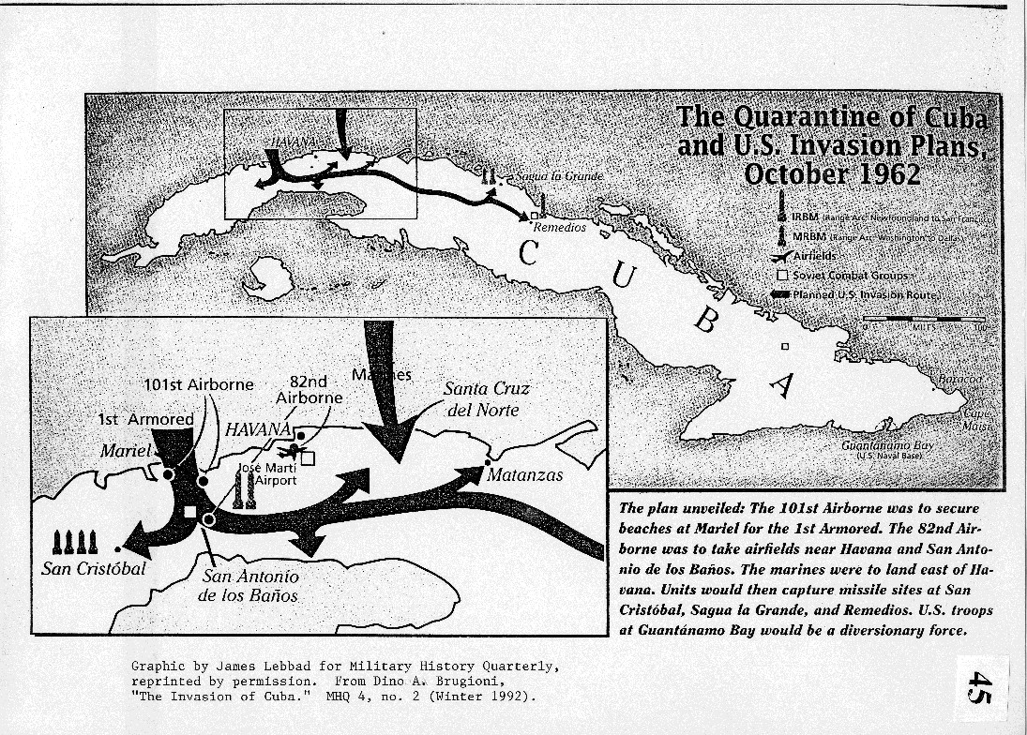
Cuban Missile Crisis (1962)

Slide 28
Cuban Missile Crisis (1962)
Soviet Union
U.S. Response
S.U. sends missiles to Cuba
Soviets make Americans wait several days for a response
Soviets “blinked” and removed their missiles
Kennedy orders the Soviets to remove missiles
Americans & world brace for a nuclear
Kennedy had agreed to remove American missiles in Turkey

Slide 29
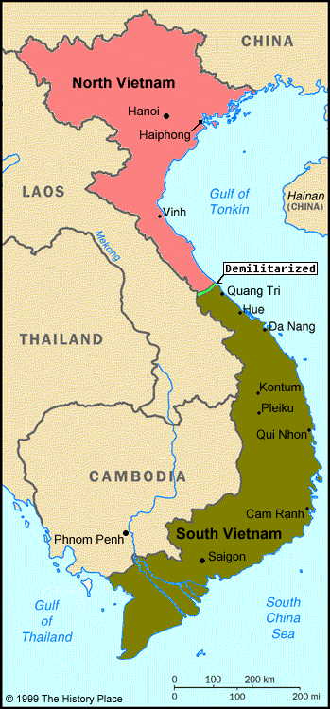
Vietnam War

Slide 30
When does the Vietnam War begin?
Why does the U.S. get involved?
Time Frame: 1960s for invasion
1950s music
U.S. follows the Policy of Containment

Slide 31
Vietnam War
North Vietnam Attacks
United States Response
Communist North Vietnam tries to install, by force, a communist gov’t in South Vietnam
Soviet Union supplies North
Vietnam
U.S. helps South Vietnam
American military build-up begins with President Kennedy
Kennedy is assassinated
President Lyndon Johnson continues plan, in fact, intensifies the war
Scale of combat in Vietnam grew larger in 1960s

Slide 32
President Kennedy
Is president for beginning of Vietnam War

Slide 33
Kennedy’s Inaugural Address
The U. S. would “pay any price, bear any burden, meet any hardship, support any friend, oppose any foe, in order to assure the survival and the success of liberty.”
“Ask not what your country can do for you; ask what you can do for your country.”

Slide 34
Kennedy’s Assassination
Kennedy was a WWII veteran
Assassinated in Dallas, TX in 1963
Impact on Americans:
  Shakes nation’s confidence
  Begins a period of internal strife & divisiveness over U.S. involvement in Vietnam

Slide 35
Change of Presidents
Johnson (LBJ) takes over as president
  Declines to seek reelection to second full term
President Nixon is next president
  Nixon pledges to end war if elected

Slide 36
American Reaction to War at Home
(country becomes bitterly divided)
Supporters
Those Opposed
Actively showed opposition
College campuses very active with anti war demonstration
Kent State

Slide 37
American Strategy in War
American military repeatedly defeated the North Vietnamese in the field
Nonetheless, American forces cannot force a favorable end to the war
Problem: Americans fighting a limited war

Slide 38
Vietnamization
  Withdrawal of American troops from South Vietnam
  Replace them with South Vietnamese troops
  Also, continuing military aid to South Vietnam

Slide 39
Thinking Point
Is Nixon’s plan, Vietnamization, successful?
Why or why not?

Slide 40
Outcome of Vietnam War
Vietnamization fails
North Vietnam invades South Vietnam
(Remember: the North has Soviet Union help)
By 1975, North and South Vietnam become one country: communist country
End of Vietnam War

Slide 41
Veterans of Vietnam Return Home
Return often to indifference or outright hostility
Not hailed like WWII veterans who were received by a grateful & supportive nation
Not until several years after war that the “wounds” of the war begin to heal
Vietnam veterans recognized & honored for service & sacrifices a little late

Slide 42
Nixon’s Presidency

Slide 43
Watergate Scandal
Nixon is forced from office (he resigns)
Watergate scandal: illegal wiretapping

Slide 44
Internal Problems of the Soviet Union
Increasing Soviet military expenses to compete with the United States
Rising nationalism in Soviet republics
Fast-paced reforms—market economy
Economic inefficiency
Gorbachev’s glasnost and perestroika (openness and economic restructuring)

Slide 45
Role of President Ronald Reagan
Challenged moral legitimacy of the Soviet Union
  For example, in a speech at the Berlin Wall:
  ― “Mr. Gorbachev, tear down this wall!”
Increased United States military and economic pressure on the Soviet Union

Slide 46
American Ideals of Democracy
Prevail Over Soviet Union
As a result of their service, the United States and American ideals of democracy and freedom ultimately prevailed in the Cold War struggle with Soviet
Cold War Ends

Slide 47
Impact of the Cold War at Home
Fear of Communism & Threat of Nuclear Attack
Schools ran drills in 1950s and 1960s in case of attack (duck and cover)
American citizens were urged by the gov’t to build bomb shelters (basements)

Slide 48
Impact on Military
Cold war major topic for foreign policy for every president through end of Cold War
Heavy military expenditures benefited
  Virginia in general more than other state
  Hampton Roads: naval bases and air
  Northern VA: Pentagon & private companies contracting with military

