Slide 1
Warm-up: October 11
Can you think of an incident which could be described as a “witch hunt”?
Hint: Think of a time when accusations were made but testimony was coerced or falsified, and no corroborating evidence existed

Slide 2
Examples of “Witch Hunts”
Identifying care givers who abused children (1980s-1990s)
  “Coercive interviewing techniques were used”
  “the girls further accused defense witnesses”
  “the convictions relied entirely on testimony from the children that had been coerced by dubious interrogation techniques, with no corroborating evidence”
  http://en.wikipedia.org/wiki/Day_care_sex_abuse_hysteria

Slide 3
Quick Facts About Salem Witch Trials
Giles Corey was pressed to death
The following were hanged:
Bridget Bishop
George Burroughs
Martha Carrier
Martha Corey
Mary Easty
Sarah Good
Elizabeth Howe
George Jacobs, Sr. Susannah Martin
Rebecca Nurse
Alice Parker
Mary Parker
John Proctor
Ann Pudeator
Wilmott Redd
Margaret Scott
Samuel Wardwell
Sarah Wildes
John Willard

Slide 4
Quick Facts About Salem Witch Trials
Increase Mather, father of Cotton Mather, helped put an end to the Salem Witch Hunt
Salem Witch Trials
John Proctor was in his 60s and he never cheated on his wife
Abigail was only 11 years old
Elizabeth really was pregnant—this saved her life

Slide 5
Three Regions
New England, Middle, and the Southern Colonies

Slide 6
Geographies

Slide 7
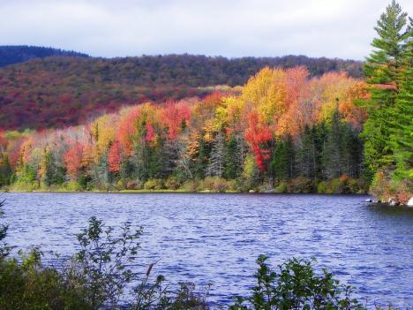
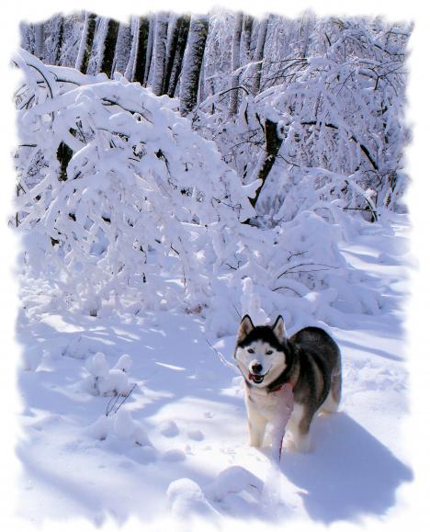
New England
Rocky Terrain
Severe Winters
New England Photos

Slide 8
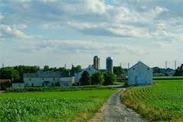
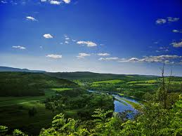
The Middle Colonies
Good Soil
Moderate Climate

Slide 9
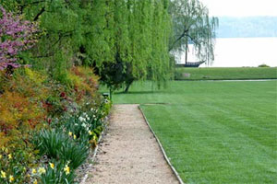
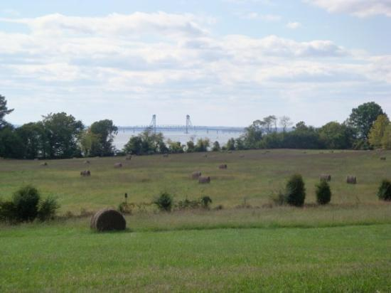
The South
River system important
Warm climate
Tidewater area especially good for growing certain crops

Slide 10
Economies

Slide 11
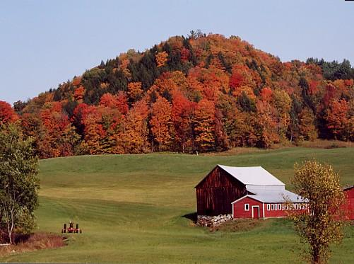
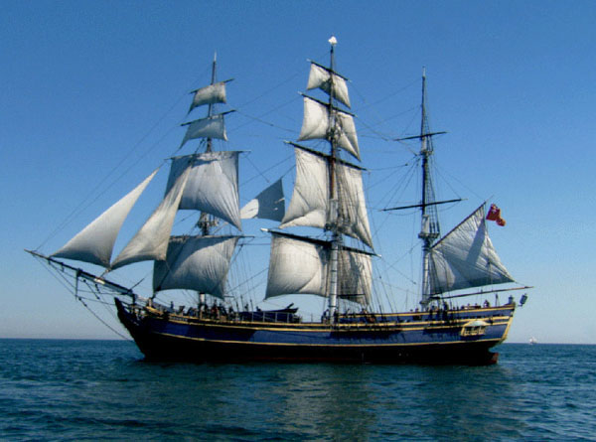
New England
Maritime activities (shipbuilding, fishing)
Lumbering
Subsistence farming
Eventually manufacturing
Major Cities: Boston

Slide 12
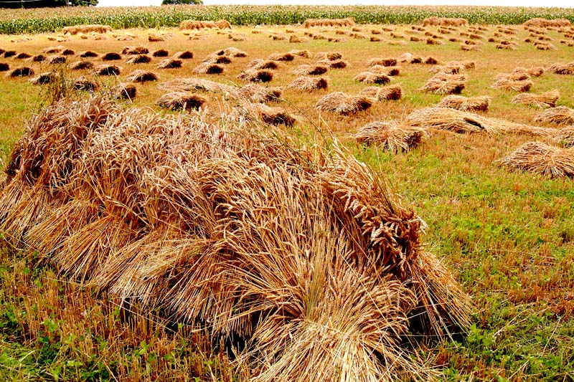
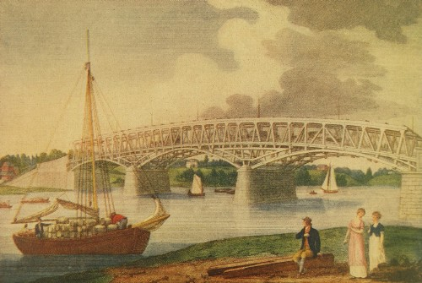
The Middle Colonies
Shipbuilding
Farming
Trading
Artisans
Commercial centers such as New York and Philadelphia

Slide 13
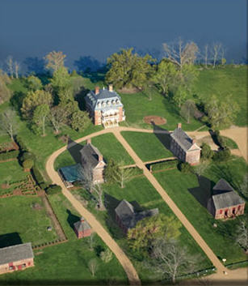
The South
Eastern lowlands:
  large plantations
  that grew cash crops such as tobacco, rice, and indigo for export
Appalachian foothills:
  Subsistence farming
  Hunting, trading

Slide 14
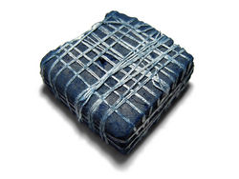
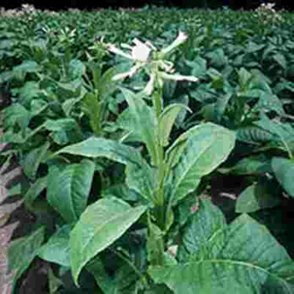
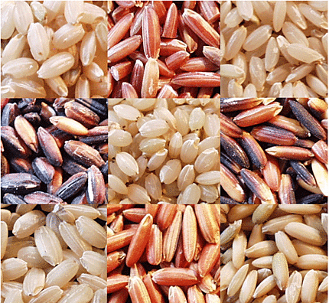
Cash Crops
tobacco
rice
indigo

Slide 15
Society

Slide 16
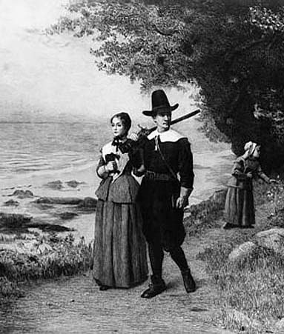
New England
Based on religious standing
Puritans were intolerant of dissenters who challenged the church/state.
Colonies like RI, CT, NH founded by dissenters fleeing Massachusetts.

Slide 17
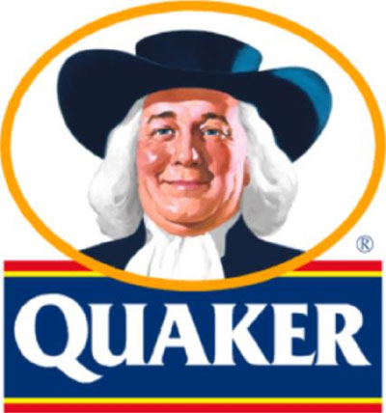
Middle Colonies
Religious tolerance
Multiple religious groups:
  PA: Quakers
  NY: Huguenots and Jews
  NJ: Presbyterians
Flexible social structures
Middle class of artisans, entrepreneurs (business owners), and small farmers

Slide 18
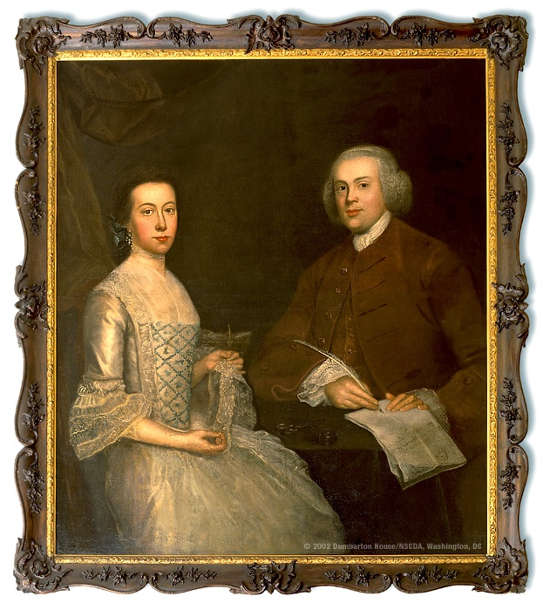
The South
Based on family status and land
Large landowners controlled government and had close ties to England and Church of England.
Further west were small-scale farmers and traders

Slide 19
Government

Slide 20
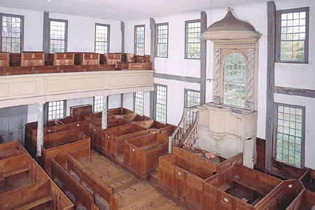
New England
Town meetings – a form of direct democracy
Early meetinghouse
A type of theocracy
in early times

Slide 21
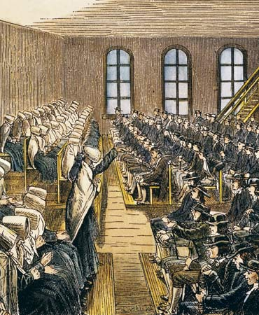
Middle Colonies
Included democratic principles
Tolerant of other religions

Slide 22
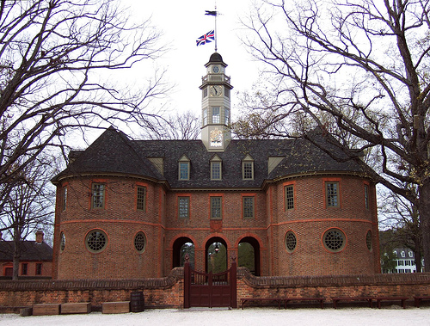
The South
Strong ties to England
Planters play a large role in representative government
House of Burgesses
  First form of representative gov’t in colonies

Slide 23
Homework Review
Define mercantilism.
What role did the American colonies play in the British economy? (Basically, why did the British want colonies? What were the colonies supposed to do for Britain?)

Slide 24
Mercantilism
“theory that a country’s ultimate goal was self-sufficiency and that all countries were in a competition to acquire the most gold and silver.” (p. 66)
What does that mean?
How do the colonies factor into this theory?

Slide 25
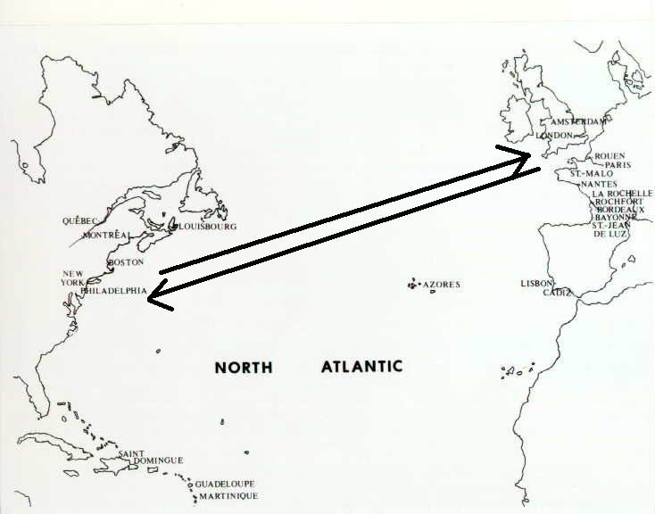
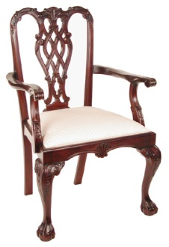
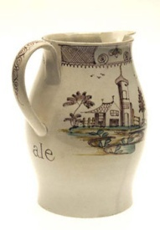
Mercantilism
Mercantilism
Raw materials
Finished products

Slide 26
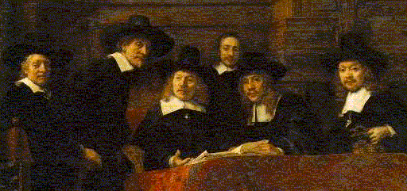

Slide 27
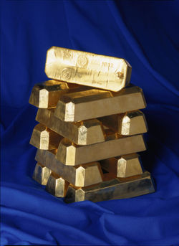

Slide 28
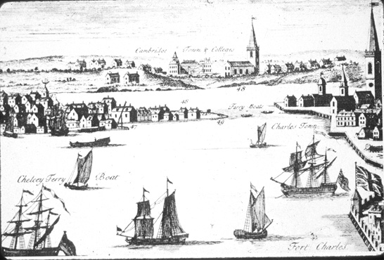

Slide 29
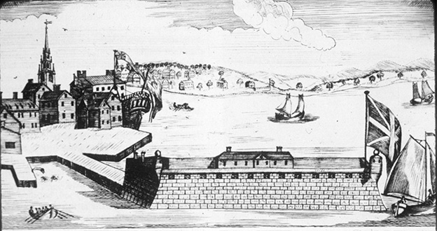

Slide 30
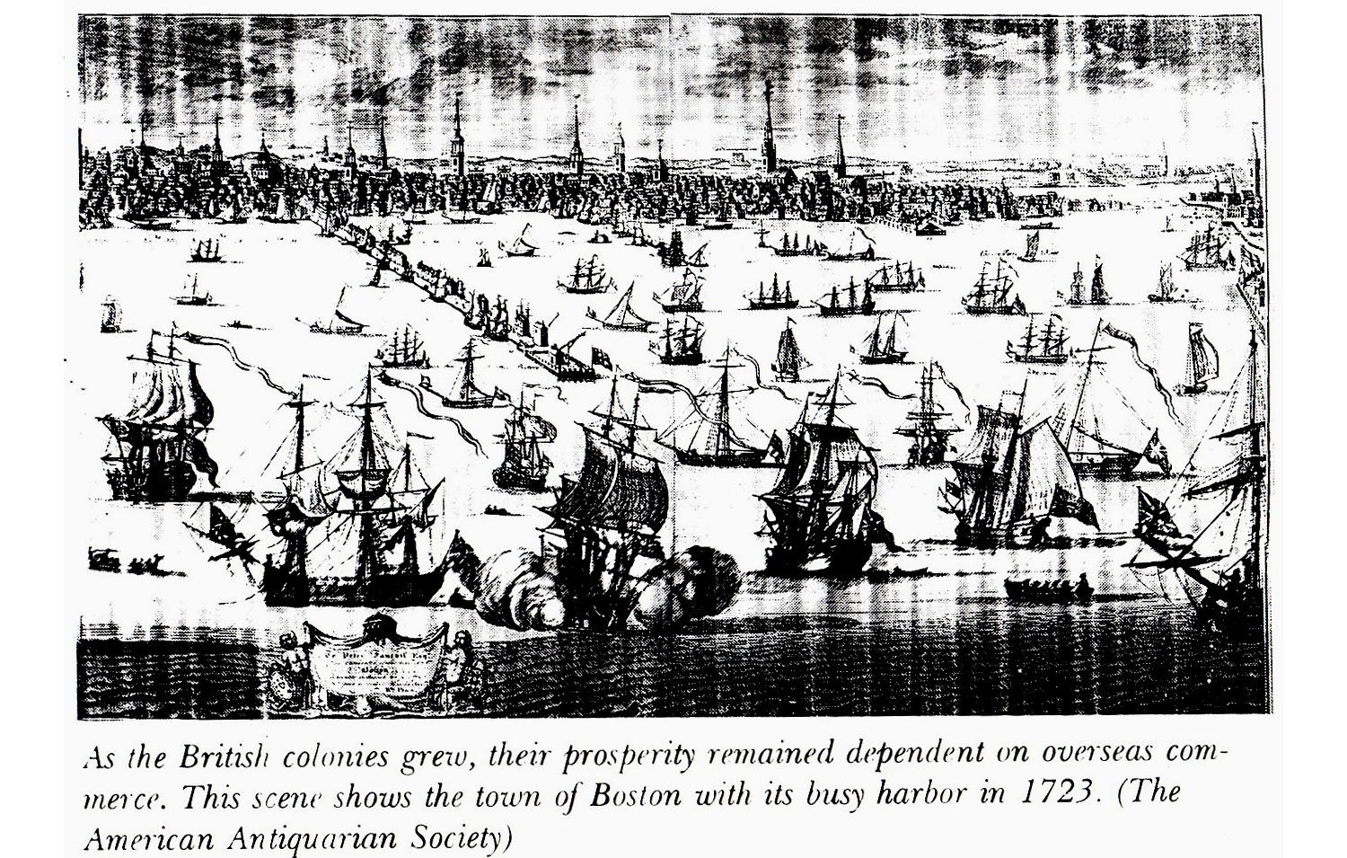

Slide 31
Exit Pass
Summarizes key differences among the colonies.
Explain the practice of mercantilism.
Hint: define the term
explain how it impacted the colonies & England
what unintended outcome did it have?

