Slide 1
Jamestown
Why did the English come to Jamestown?
Economic opportunity
Who sponsored the colonists to come to the New World?
The Virginia London Company – received a royal charter from the king
When was Jamestown settled?
1607 – English reach Virginia and establish the Jamestown settlement
Notes:
Colonists name their settlement Jamestown in honor of their king ----Emphasize the Royal Charter – the king has control over them under this item.
- Ask as a question in class

Slide 2

The People of Jamestown
What type of English people came to the New World?
English nobility
What are these early settlers called?
The Cavaliers

Slide 3
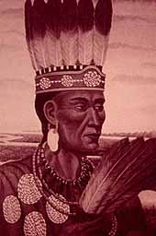
Near Failure at Jamestown
Disease
Hunger
Poor work ethic
Weather
Clashes with the Powhatan
Painting of Chief Powhatan

Slide 4
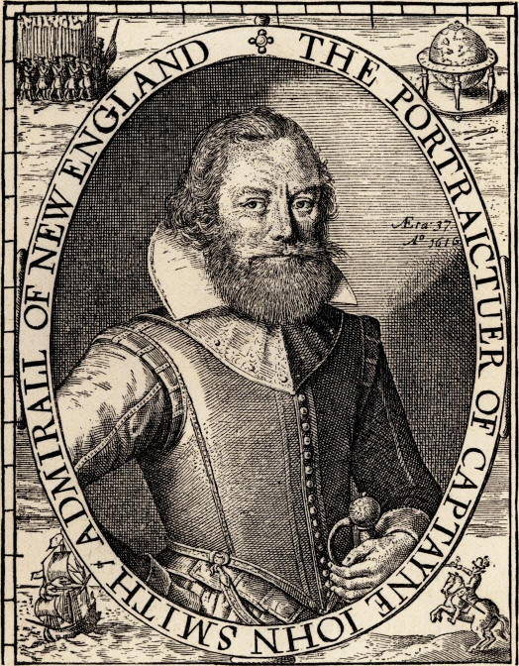
“Starving Time”
Who was the leader of Jamestown?
John Smith
He makes “peace” with the Powhatan.
More colonists come and the Powhatan begin to retaliate against the colonists
By winter, Jamestown reached a point of famine
Notes:
1609: 600 new colonists arrive from England. Powhatan become upset begin to retaliate---Killed colonists’ livestock----Burned colonists’ farms
By winter, Jamestown reached the point of famine, Only 60 survived the winter

Slide 5
Pocahontas
Pocahontas (1995) Trailer - YouTube

Slide 6
Jamestown’s Economy
Why did the English come to Jamestown?
Economic opportunity/Business venture
Who sponsored the colonists to come to the New World?
The Virginia Company
Are they happy with the way Jamestown is running? Why/why not?
No, they want to make a profit off of Jamestown, and right now it is not making any money.
Notes:
Tobacco as saving the economy – tie to va company

Slide 7
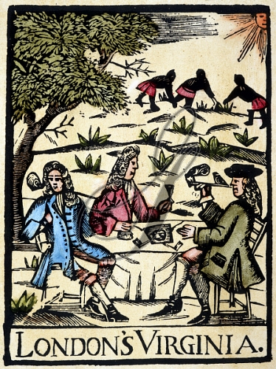
Jamestown’s Savior
What saves Jamestown from bankruptcy/failure?
Tobacco!
Tobacco is a labor-intensive crop
Creates a need for field laborers

Slide 8
Laborers of Jamestown
Indentured Servants
Members of the English lower class who came to work in the New World
Colonist paid for trip to New World & provided shelter/food; in turn servants work for colonist (4-7 years)
Native Americans
Colonists tried to employ them, but they refused to use English work techniques
Africans
First brought to VA in 1619 as indentured servants
Became more popular over time because they were inexpensive, and worked for life
Used sparingly because they knew the land so it was easy for them to escape

Slide 9
Jamestown’s Government
What is the name of Jamestown’s government?
Virginia House of Burgesses
What is a Burgess?
A representative
What is the purpose of the Virginia House of Burgesses?
To make laws
**The House of Burgesses is the first elected assembly in the New World**

Slide 10
Members of the House of Burgesses
Governor
(appointed by officials of the VA Company)
Council
(6 members appointed by the Governor)
Representatives
(15 members representing different VA localities, voted on by the colonists)
*ALL were white land owning males

Slide 11
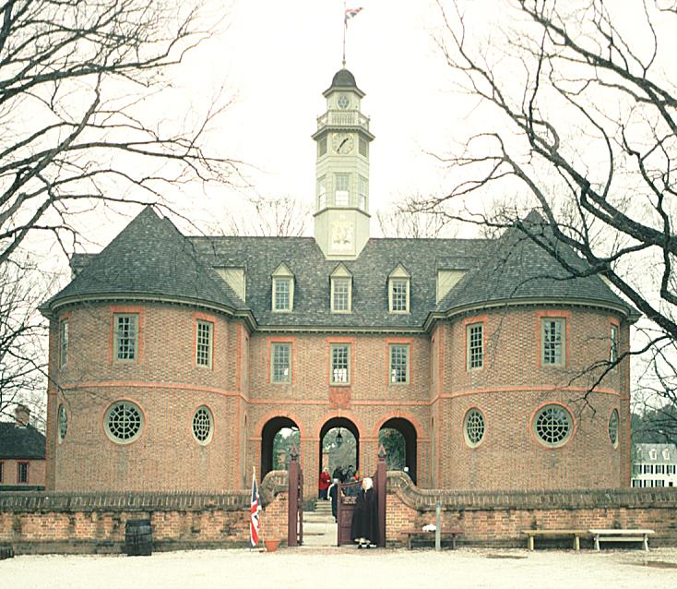
General Assembly of Virginia
The VA House of Burgesses still exists today
It is called the General Assembly of Virginia
The restored Capitol Building
in Williamsburg, VA
Notes:
Moved to Williamsburg in 1698
One day each year, the Virginia General Assembly assemble at the Capitol Building in Williamsburg

Slide 12
Clashes with the Powhatan
Tension from the “starving time” still exists
1622: Powhatan revolt and kill more than 340 colonists
Result:
  VA Company nearly bankrupt
  Jamestown becomes a royal colony

Slide 13
Jamestown in the 1670’s
Remember the Indentured Servants?
  They are now free but they are poor and have no land
  They work as small farmers or artisans
  Live on the outskirts of the colony, known as the Shenandoah Valley
    Run into violent clashes with the Native Americans
What do the frontier settlers do?
Notes:
Frontier Settlers

Slide 14
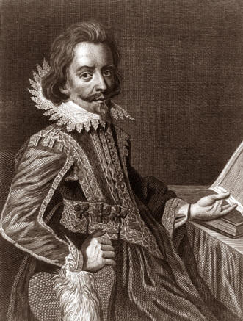
Bacon’s Rebellion
English noble in Jamestown
HATED Native Americans
Created an army to fight the Native Americans
Led a violent march on Jamestown, forcing the government to flee
Brought the frustrations of the poor people to the front of the political scene

