Slide 1
Unit 1: Contact to Settlements

Slide 2
Massachusetts Bay Colony

Slide 3
Massachusetts Bay Colony
Society with families
What is a colony?

Slide 4
Massachusetts Bay Colony
Escape religious persecution
(NOT FOR RELIGIOUS FREEDOM)
Why did they come to the Americas?

Slide 5
Massachusetts Bay Colony
Puritans, Pilgrims
Who came over?

Slide 6
Massachusetts Bay Colony
Strict
No whistling while you work
Read only the Bible
What was society
like?

Slide 7
Massachusetts Bay Colony
Covenant agreement (compact)
What is the Mayflower Compact?

Slide 8
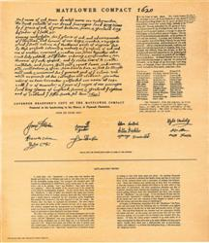

Slide 9
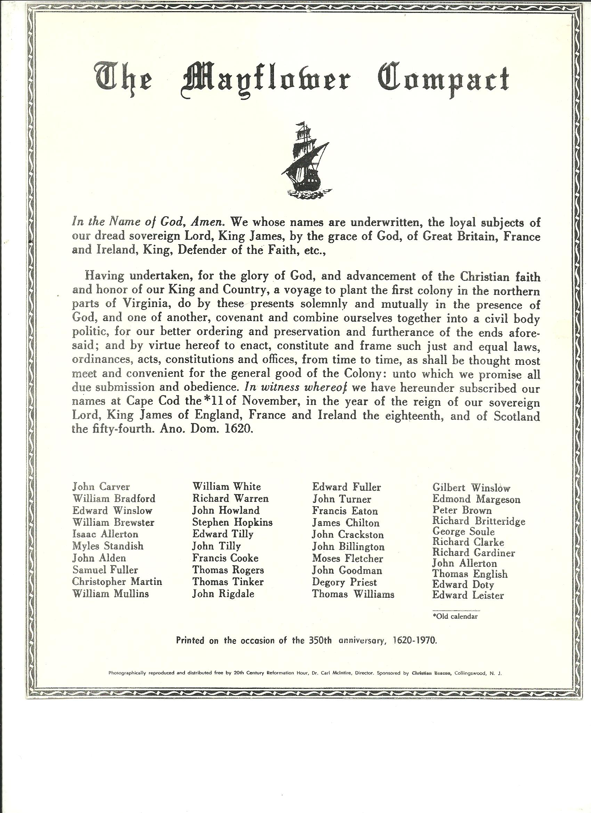

Slide 10
Mayflower Compact
What can you tell me about the people who signed the Mayflower Compact? Why is this important?
What kind of wording do they use in this government document that might surprise you? Why?

Slide 11
Massachusetts Bay Colony
Agreement with God
What is a covenant?

Slide 12
Massachusetts Bay Colony
Covenant community
“Ideal” community
Intolerant of those not sharing
their religion
What kind of community do the Puritans establish?

Slide 13
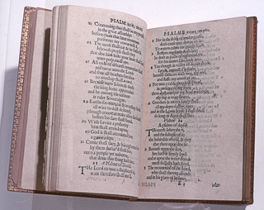
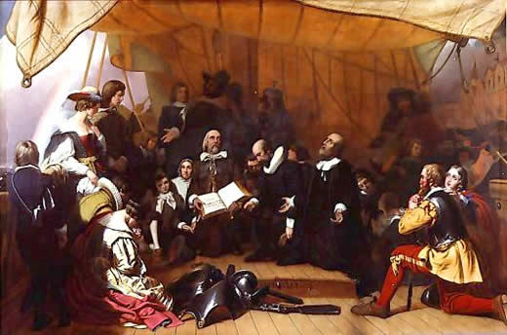

Slide 14
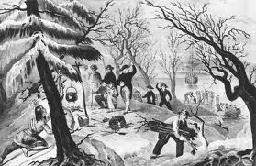

Slide 15
Massachusetts Bay Colony
A form of government voting
Example: “yeah” or “Nay”
Example: “show of hands”
What is direct
democracy?

Slide 17
Massachusetts Bay Colony
Court house
Law-making building
Place for religious meetings
Acted like a theocratic gov’t
What is a meetinghouse?

Slide 18
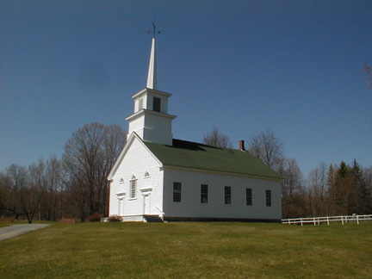

Slide 19
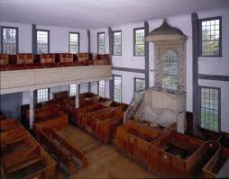

Slide 20
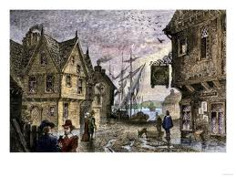

Slide 21

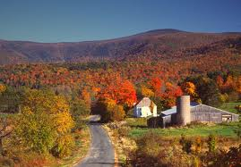

Slide 22
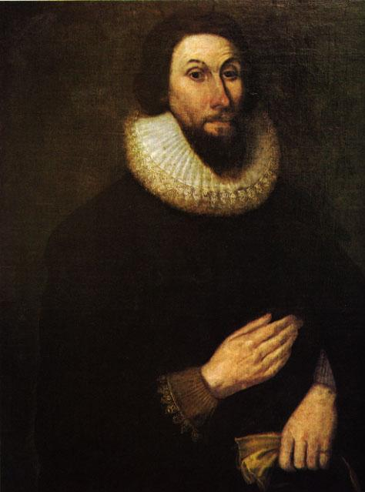

Slide 23
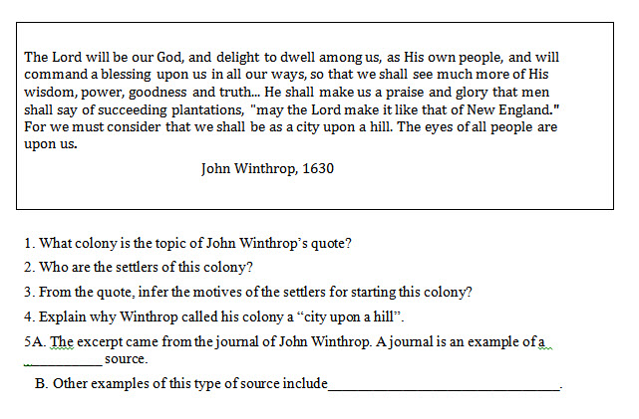

Slide 24
