Slide 1
World War II Unit

Slide 2
The Beginning of WWII--Europe
German Aggression in Europe
Invasion of Poland—Europe goes to War
United States Takes a Neutral Stance
Plight of France & Britain
Germany Invades Russia
Map of Europe during WWII

Slide 3
What event marks the start of WWII?
Germany (Hitler) invades Poland in 1939

Slide 4
What countries did the Soviet Union invade shortly afterwards?
Poland
Baltic countries

Slide 5
What was the official position of the
United States during the first two years of the war?
Neutrality

Slide 6
In the meantime, what two major countries did Germany invade?
France
Britain

Slide 7
What happened to France?
Germany overruns France

Slide 8
What happened Britain?
Germany tries to invade Britain—but not successful!
Airstrikes –called the Battle of Britain

Slide 9
In the middle of 1941, what
Country did Germany invade?
Soviet Union (Russia)!
Why?
Germany failed to take Britain.
Thought that they could conquer the Soviet Union which was already weak from a civil war.
If they conquered the Soviet Union, Germany figured that Britain would just give-up.

Slide 10
Map Work
Use map provided (Europe in WWII)

Slide 11
Despite strong isolationist sentiment at home, how did the U.S. help in the war effort?
Gave Britain war supplies and old naval warships in return for military bases in Bermuda and the Caribbean
Lend-Lease Act gave the president authority to sell or lend equipment to countries to defend themselves against the Axis powers
  Franklin Roosevelt compared it to “lending a garden hose to a next-door neighbor whose house is on fire”

Slide 12
The War in Asia
Japanese Aggression in Asia
U.S. Response—Embargo & Negotiations
Japan Attacks Pearl Harbor
Roosevelt Addresses Congress
Germany Declares War on the U.S.
United States in WWII

Slide 13
During the 1930s, what two, main Asian countries did Japan invade?
China
Manchuria
Imperial Powers Map 1939
Totalitarian Aggression & Militaristic
Why?

Slide 14
What was the response by the U.S.?
U.S. put an embargo on oil and steel
Negotiations between U.S. and Japan followed

Slide 15
Negotiations begin, but what happens in the middle of these negotiations?
Japan attacks Pearl Harbor—air attack
  Suddenly, and without warning
Pearl Harbor is a naval base in Hawaii
Nat’l Geo: video
Nat’l Geo Simulation

Slide 16
On what date does Japan attack Pearl Harbor?
December 7, 1941

Slide 17
Describe the devastation to Military power and loss of lives at Pearl Harbor
The attack destroyed much of the American Pacific fleet
AND
Killed several thousand Americans.

Slide 18
What is the famous quote by Roosevelt to Congress right after the attack on
Pearl Harbor?
“a date that will live in infamy”
Roosevelt was asking Congress to declare war on Japan

Slide 19
Why does Germany declare war on the United States?
It was honoring a pact with Japan
Because Germany knew the U.S. would get involved in the war anyway
So it wanted to control the time and place the U.S. got involved

Slide 20
What happens to feelings of isolationism in America?
People realize that they must go to war
Patriotism increases

Slide 21
What is the United States' position now in WWII?
United States is now at war
The War Goes Global interactive map

Slide 22
Allied Power War Strategies
Europe & Pacific
(Britain, France, Soviet Union)
Europe
Pacific Campaign (Asia)
“Defeat Hitler First” strategy
Most American military resources were targeted for Europe
“island hopping” campaign:
Seizing islands closer and closer to Japan and using them as bases for air attacks on Japan
cutting off Japanese supplies through submarine warfare against Japanese shipping

Slide 23
Axis Power War Strategies
Europe & Pacific
(Germany, Italy, Japan)
Germany
Japan
Germany hoped to defeat the Soviet Union quickly
Gain control of Soviet oil fields
Force Britain out of the war through a bombing & submarine warfare
Before America’s industrial and military strength could
turn the tide!
Following Pearl Harbor, Japan invaded the Philippines and Indonesia and planned to invade both Australia and Hawaii
Her leaders hoped that America would then accept Japanese predominance in Southeast Asia and the Pacific, rather than conduct a bloody and costly war to reverse Japanese gains

Slide 24
Minority Participation in WWII
Segregated Military Units
Non-Segregated Military Units
Contribution of Navaho Code Talkers
Women
General War Effort

Slide 25
Segregated Military Units
In general, African Americans units
Ex.: Tuskegee Airmen (African American) served in Europe with distinction
Nisei regiments (Asian American)
  earned a high number of decorations.

Slide 26
Non-Segregated Military Units
Navajo:
Communication codes of the Navaho used Oral, not written language
Impossible for the Japanese to break!
Mexican Americans

Slide 27
Women
Typically participated in noncombat military roles

Slide 28
General War Effort
In general, African Americans served in
segregated military units and noncombat roles: But demanded the right to serve in combat rather than support roles
Minority units suffered high casualties and won numerous unit citations and individual medals for bravery in action

Slide 29
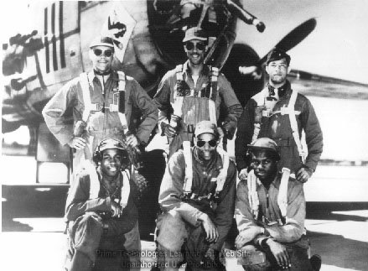
Minorities in WWII

Slide 30
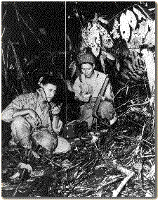
Slide #2
Click on the link below.
Navajo Code Talkers

Slide 31
Navajo Code Talkers
The Code used by the Navajo Code Talkers created messages by first translating Navajo words into English, then using the first letter of each English word to decipher the meaning. Because different Navajo words might be translated into different English words for the same letter, the code was especially difficult to decipher. For example, for the letter "A," the Code Talker could use "wol-la-chee" (ant), "be-la-sana," (apple), or "tse-nill" (ax.) Some military terms that had no equivalent in Navajo were assigned their own code word. The word America, for example, was "Ne-he-mah" (Our mother). Submarine became "besh-lo" (iron fish).

Slide 32
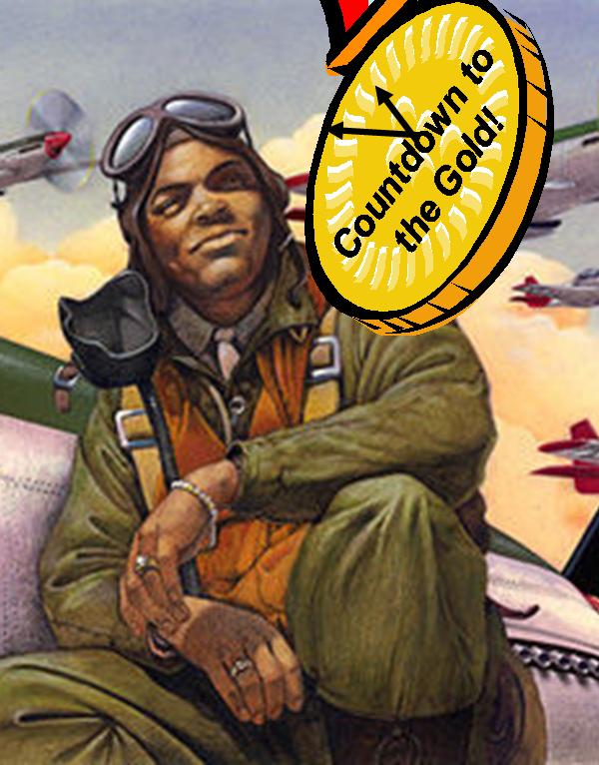
Tuskegee Airmen
Click on the
link below.
http://www.tuskegeeairmen.org/Tuskegee_Airmen_History.html

Slide 33
Nisei Regiment
Click on the link below. Press pause after the clip is finished.
http://ezinearticles.com/?Bravest-of-Brave---World-War-II-Nisei-Hero&id=310011

Slide 34
Mexican Americans
Click on the link below. Press pause after the clip is finished
http://www.hsp.org/files/mexicanamericansandworldwarii.pdf

Slide 35
The Home Front:
America during WWII

Slide 36
Economic Resources

Slide 37

Industry Response
United States government and industry forged a close working relationship to allocate resources effectively
Example:
Car industry retooled to make tanks for war

Slide 38
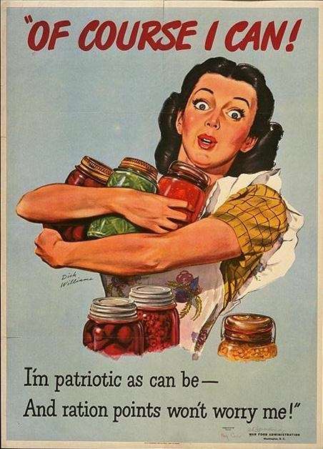
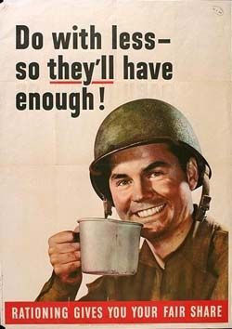
Analyze the posters below:

Slide 39
Rationing
Used to maintain supply of essential products to the war effort

Slide 40
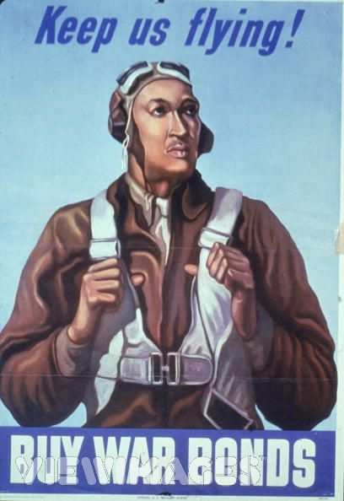
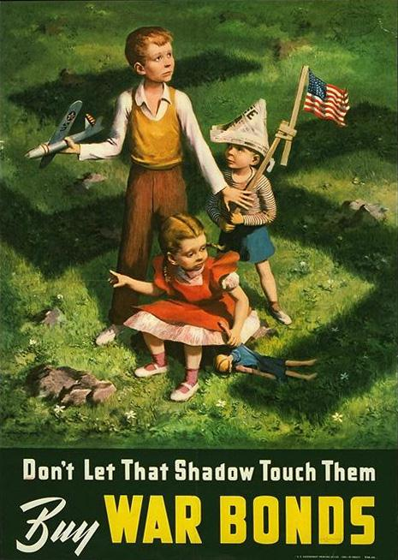
Analyze the posters below:

Slide 41

Financing the War
How else does the government get

Slide 42
Financing the War
War bonds and income tax were used for financing the war.

Slide 43
Human Resources

Slide 44
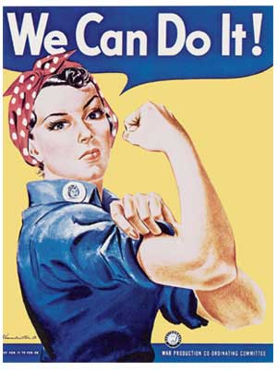
Analyze the Poster:
Rosie the Riveter

Slide 45
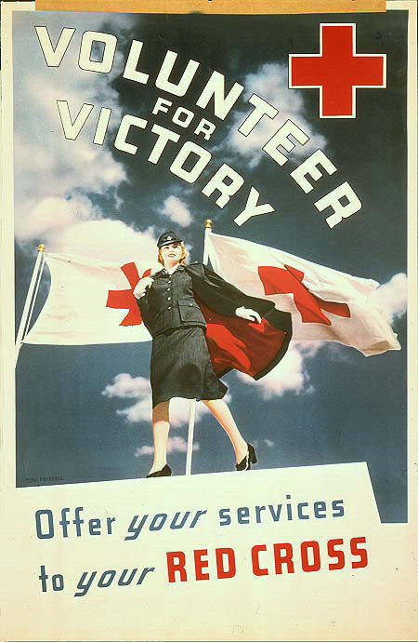
Analyze the Poster:

Slide 46
Women & Minorities
More women and minorities entered the labor force.
Citizens volunteered in support of the war effort.
African Americans migrated to cities in search of jobs in war plants
Campaigned for victory in war and equality at home

Slide 47
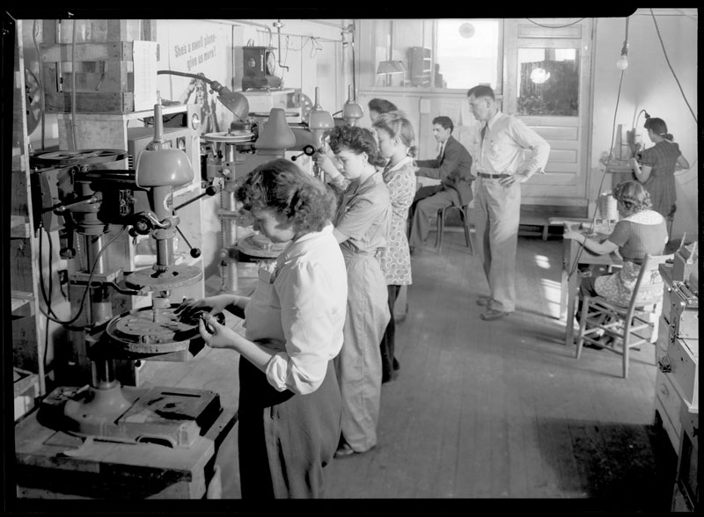
Women & Minorities

Slide 48
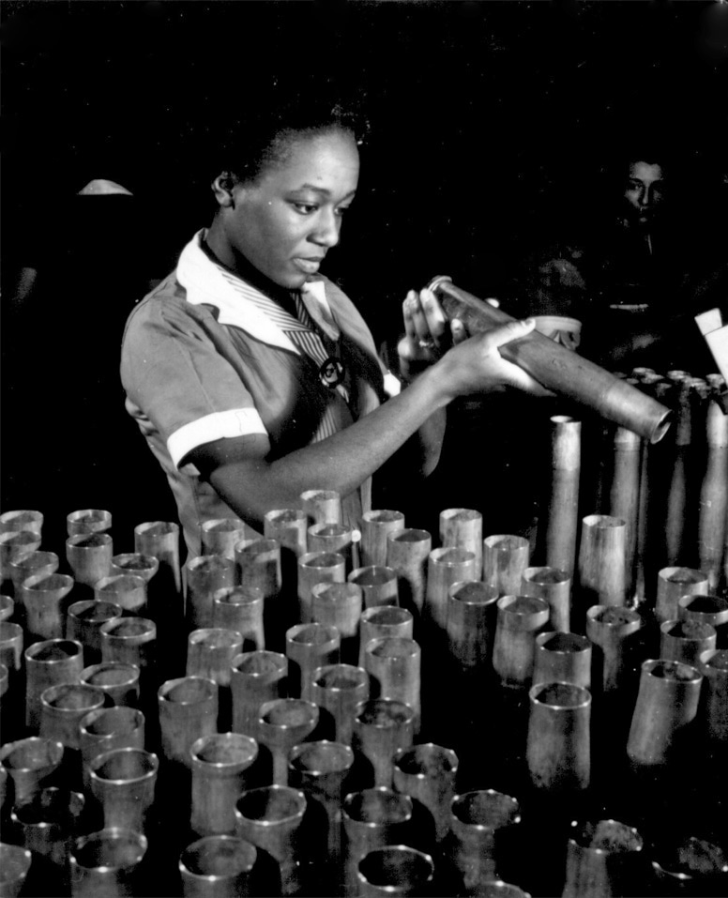
Women & Minorities

Slide 49
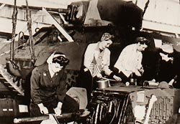
Women & Minorities

Slide 50
Answer the Question Below:
Consider the following: Women entered into previously male job roles; more African Americans gained jobs in industry and the armed forces.
What impact will this have at the end of WWII?

Slide 51
Military Resources

Slide 52
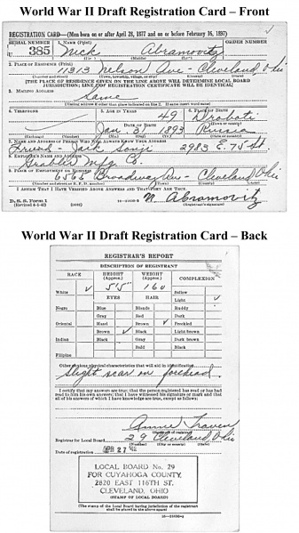
The Draft (Selective Service)

Slide 53
Answer the Question Below:
How did Americans feel a strong sense of nationalism as a result of these war efforts on the homefront?

Slide 54
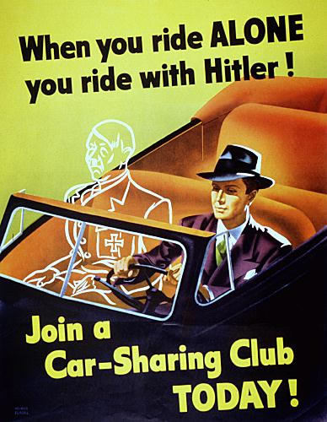
Other WWII Posters
Analyze the poster below:

Slide 55
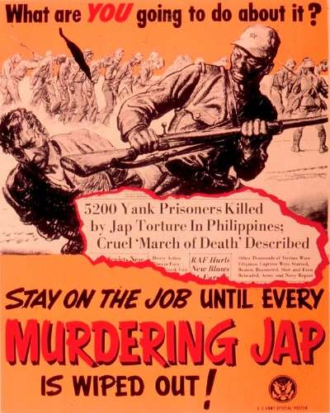
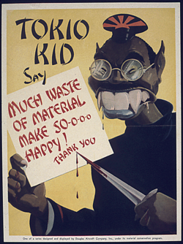
Other WWII Posters
Analyze the slides below:

Slide 56
Media and Communications Assistance

Slide 57
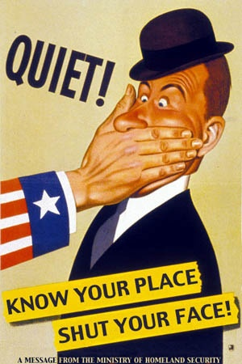
Censorship
Analyze the poster below:
The U.S. government
maintained strict
censorship of the war.

Slide 58
Censorship
The United States government maintained strict censorship of reporting of the war

Slide 59
Censorship
Which Amendment is limited during war time?
Is this constitutional?
Why was freedom of speech & press limited during war time?

Slide 60
Public Morale & Ad Campaigns
Kept Americans focused on the war effort
Which of the previous posters best demonstrates an effort to keep public morale high?
Who had the posters published?

Slide 61
Entertainment Industry
Produced movies, plays, and shows that boosted morale and patriotic support for the war effort
And portrayed the enemy in stereotypical ways
What do you think the effect was on Americans?

Slide 62
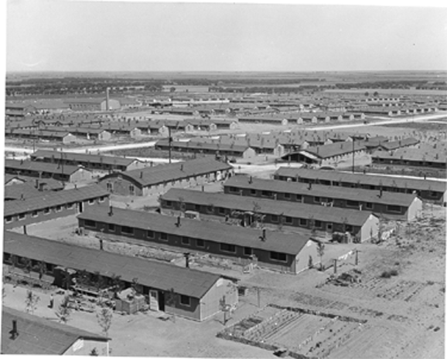
Japanese Internment

Slide 63
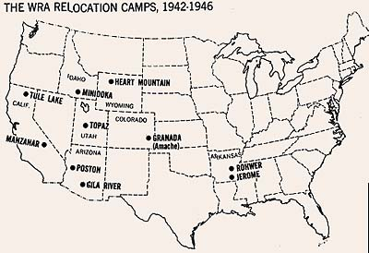
Japanese Internment

Slide 64
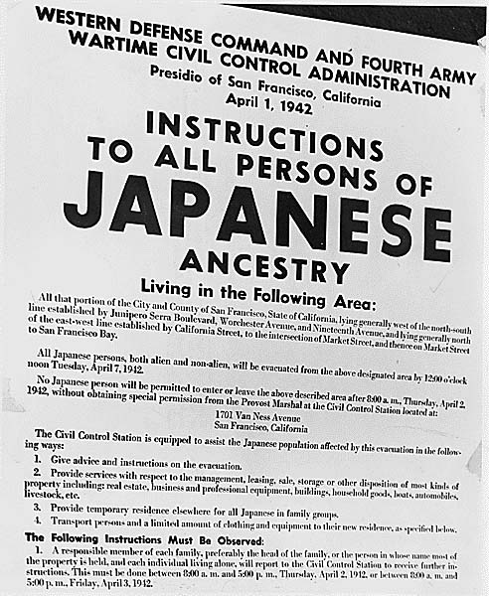
Japanese Internment

Slide 65
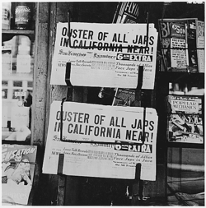
Japanese Internment

Slide 66
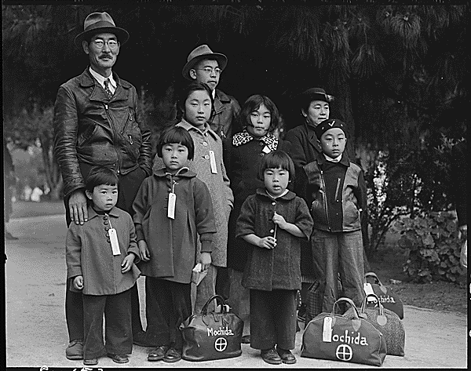
Japanese Internment

Slide 67
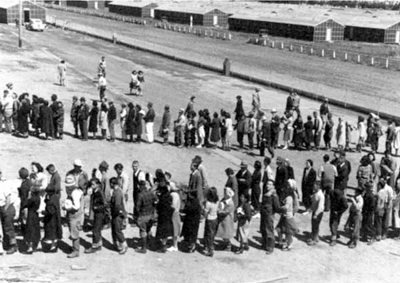
Japanese Internment

Slide 68
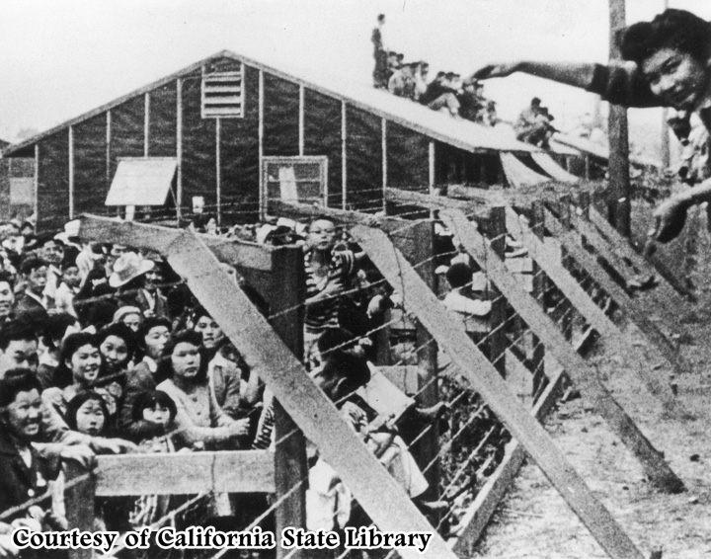
Japanese Internment

Slide 69
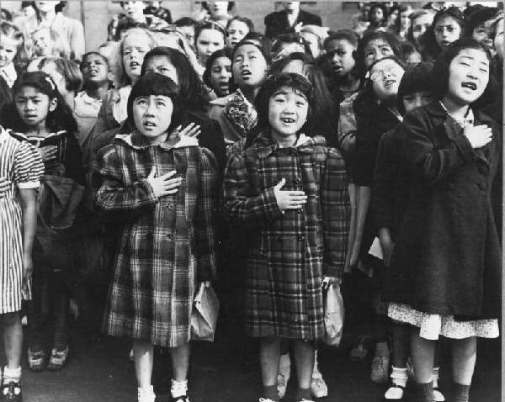
Japanese Internment

Slide 70
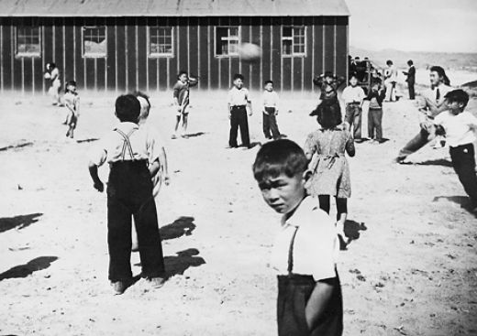
Japanese Internment

Slide 71
Reasons for Internment of Japanese Americans
Strong anti-Japanese prejudice on the West Coast
False belief that Japanese Americans were aiding the enemy

Slide 72
Internment Camps: Description
Japanese Americans were relocated to internment camps
Internment affected Japanese American populations along the West Coast

Slide 73
Government Response
The Supreme Court upheld the government’s right to act against Japanese Americans living on the West Coast of the United States
A public apology was eventually issued by the United States government, and financial payment was made to survivors

Slide 74
Answer the Question Below:
What is the vocabulary term you learned that means payment for war damages?
Do you think the government acted correctly by allowing Japanese-Americans to be placed in internment camps?
Would the government act the same way today in a similar situation?

Slide 75
The Holocaust

Slide 76
Terms to Know
Genocide:
The systematic and purposeful destruction of a racial, political, religious, or cultural group
Final Solution:
Germany’s decision to exterminate all Jews

Slide 77
Affected Groups
Jews
Poles
Slavs
Gypsies
―Undesirables‖ (homosexuals, the mentally ill, political dissidents)

Slide 78
Post-WWII
Nuremberg Trials:
Nazi leaders and others were convicted of war crimes

Slide 79
Post-WWII
Significance of Nuremburg Trials:
The Nuremberg trials emphasized individual responsibility for actions during a war, regardless of orders received.
The trials led to increased demand for a Jewish homeland.

Slide 80
Major Battles and Turning Points in WWII: North Africa & Europe

Slide 81
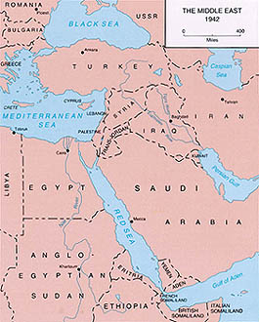
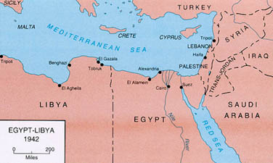
El Alamein

Slide 82
El Alamein
Where did it take place?
What happened?
Significance?

Slide 83
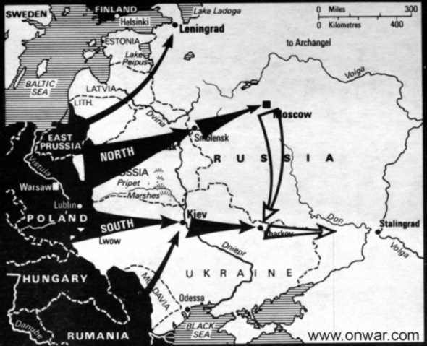
Stalingrad

Slide 84
Stalingrad
Where did it take place?
What happened?
Significance?

Slide 85
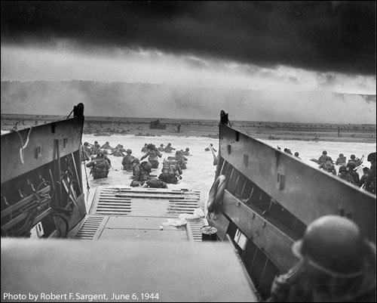
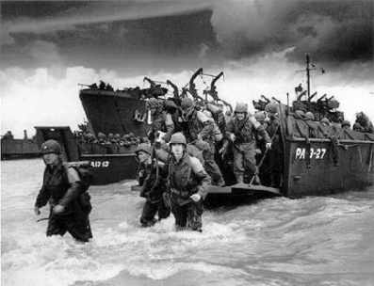
D-Day (Normandy Landings)

Slide 86
D-Day (Normandy Landings)
Where did it take place?
What happened?
Significance?

Slide 87
Major Battles and Turning Points in WWII: Pacific Campaign

Slide 88
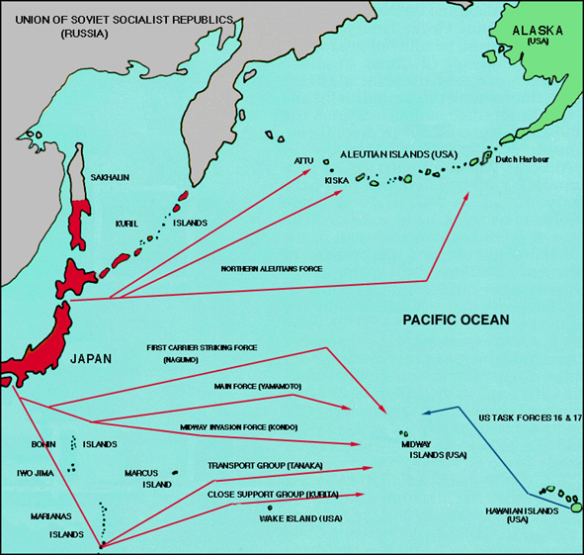
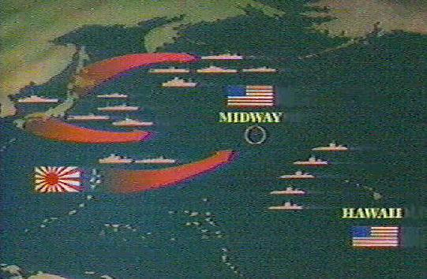
Battle of Midway
“Miracle of Midway”

Slide 89
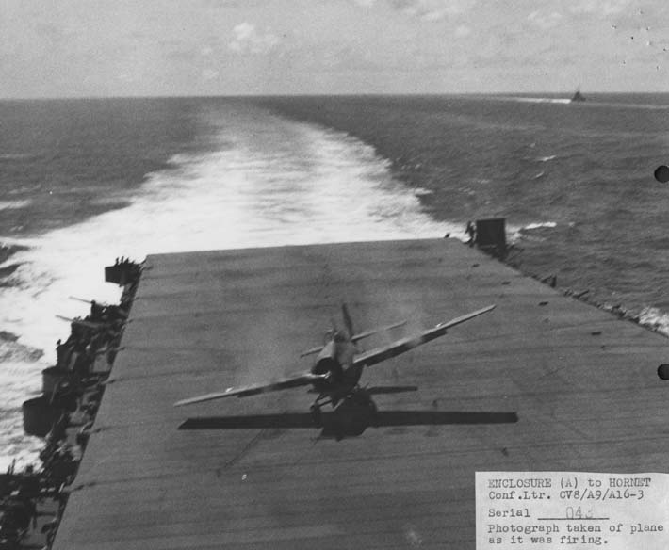
Battle of Midway
“Miracle of Midway”

Slide 90
Battle of Midway
“Miracle of Midway”
Where did it take place?
What happened?
Significance?

Slide 91
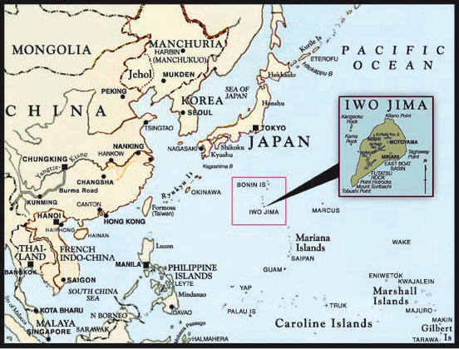
Iwo Jima & Okinawa

Slide 92
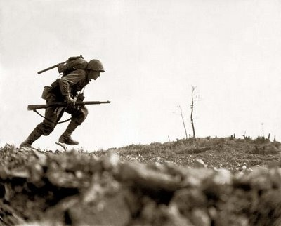
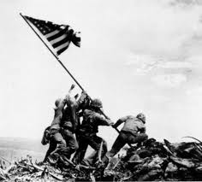
Iwo Jima & Okinawa

Slide 93
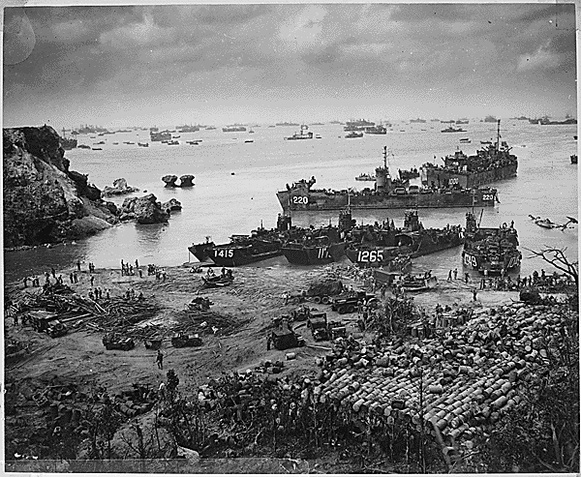
Iwo Jima & Okinawa

Slide 94
Iwo Jima & Okinawa
Where did it take place?
What happened?
Significance?

Slide 95
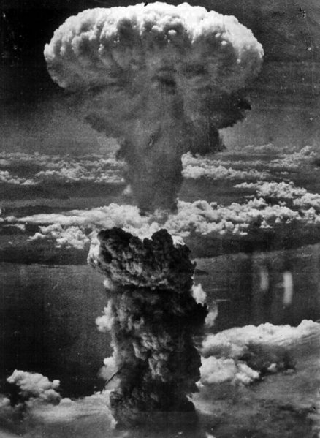
Atomic Bomb

Slide 96
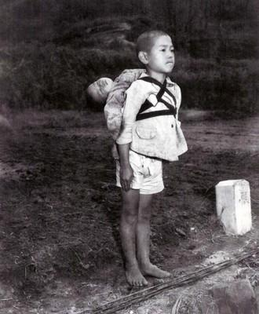
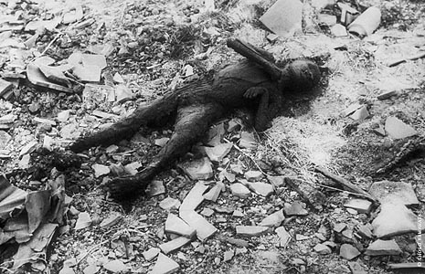
Atomic Bomb

Slide 97
Atomic Bomb
Where did it take place?
What happened?
Significance?

Slide 98
The Geneva Convention
Attempted to ensure the humane treatment of prisoners of war by establishing rules to be followed by all nations.

Slide 99
The Geneva Convention
Germany
Japan
The treatment of prisoners of war in Europe more closely followed the ideas of the Geneva Convention.
The treatment of prisoners of war in the Pacific Theater often reflected the savagery of the fighting there
Example:
Bataan Death March

Slide 100
Bataan Death March
American POWs suffered brutal treatment by the Japanese after surrender of the Philippines.

Slide 101
Post WWII Outcomes

Slide 102
Post WWII Outcomes
Germany
Japan
Two partitions of Germany:
Occupied by:
Two Governments Emerge in Germany:
Occupied by:
What kind of government emerges?
Why is this important to the U.S.?

Slide 103
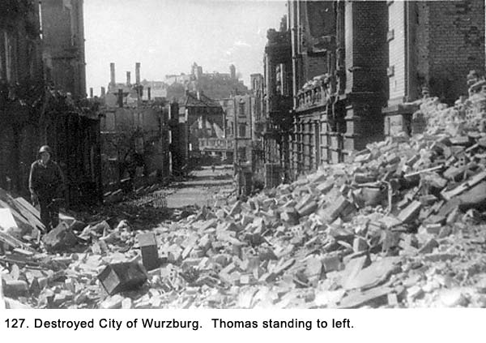

Slide 104
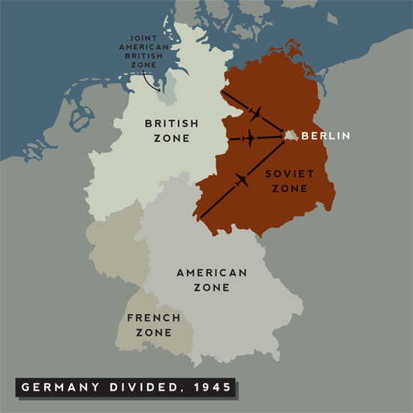

Slide 105
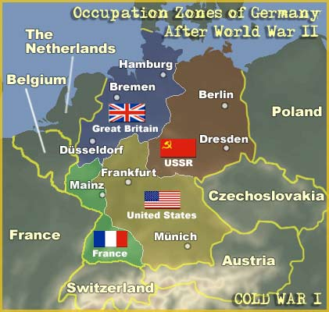

Slide 106
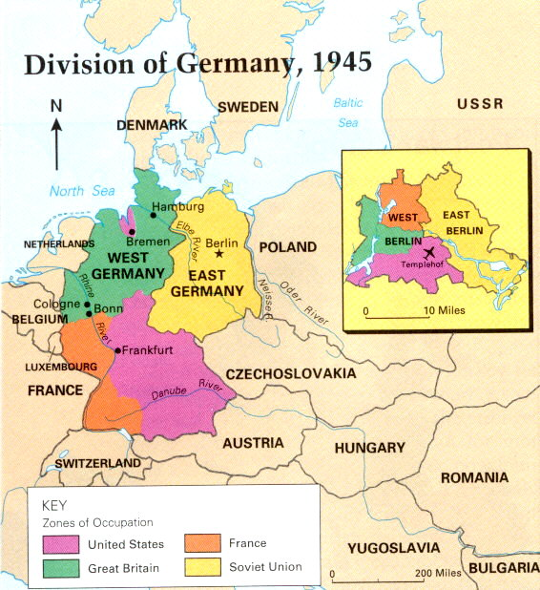

Slide 107
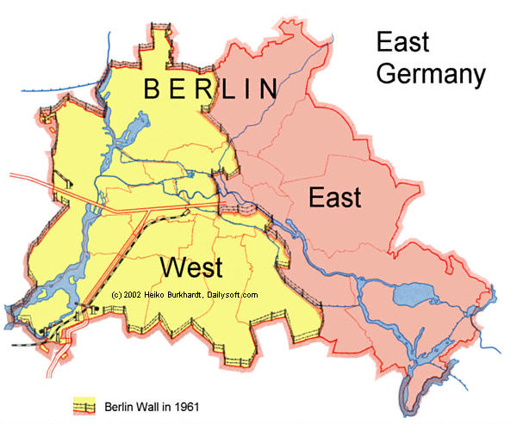

Slide 108
Soviet Union (Russia)
Which countries did the Soviet Union occupy?
What type of government was it?

Slide 109
Post WWII Outcomes in Europe
What is the Marshall Plan?
Why did the U.S. implement the Marshall Plan?

Slide 110
Post WWII Outcomes in Europe
What is the United Nations?
Peace keeping organization
(precursor was the League of Nations)

