Slide 1
Golden Age of Greece
On Your Map, Locate the Following:
  Aegean Sea
  Mediterranean Sea
  Black Sea
  Dardanelles
  Balkan Peninsula
  Peloponnesus Peninsula
  Asia Minor
  Athens
  Sparta
  Troy
  Macedonia

Slide 2
Geography
Which empire that we studied is on the southeastern- most region on the European continent?
Ancient Greece

Slide 3
Geography
Greece is surrounded on three sides by water. Identify those bodies of water.
How did deep bays and natural harbors along the coastline impact Greece’s culture?
Aegean Sea
Mediterranean Sea
They facilitated trade
Lead to a strong navy (Athens)

Slide 4
Geography
How did the mountainous areas impact culture in Ancient Greece?
Mountains acted as natural barriers and boundaries
Mountains prevented large-scale farming

Slide 5
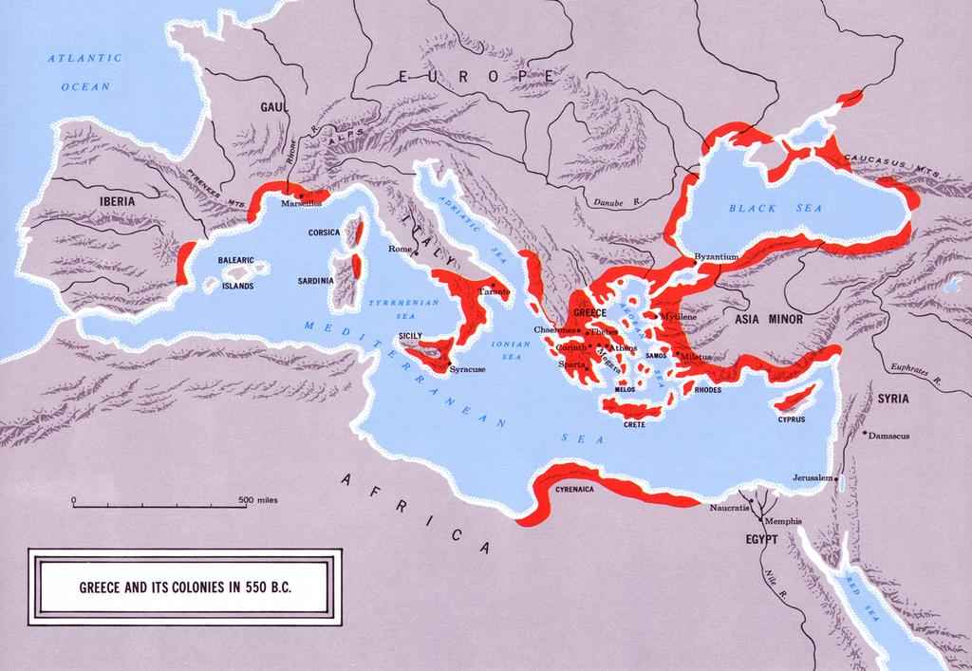
Why Greek Colonization?

Slide 6
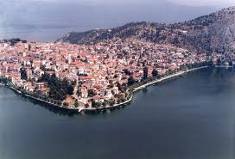
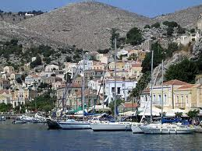
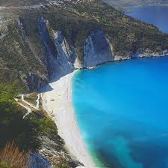
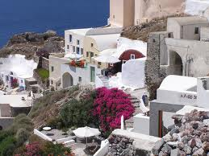

Slide 7
Colonization
Overpopulation
Arable land limited
Increase trade
Why did Greeks colonize?

Slide 8
Greek Mythology
More than one god
Stories that explain:
  natural phenomena,
  human qualities,
  and life events
What examples did you learn?
Polytheistic Religion
What is a myth?

Slide 9
Greek Gods & Goddess
Zeus
Hera
Apollo
Artemis
Athena
Aprohodite
Refer to your electronic portfolio on gods and goddess

Slide 10
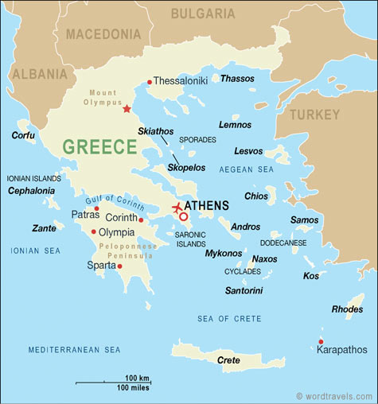
Similarities of Greek City-States (Athens & Sparta)

Slide 11
Society
City-state
Greek polis

Slide 12
Society
Only free adult males
Only free adult males
Citizenship & Political Rights
Civic Responsibility & Participation in Government

Slide 13
Society
Women, foreigners & slaves had no political rights
No political rights

Slide 14
Athens

Slide 15
Athens
Government Evolution:
  1) Monarchy (kings & queens)
  2)Aristocracy (the wealthy)
  3)Tyranny (one ruler)
  4)Democracy (people vote)
Evolution of Government

Slide 16
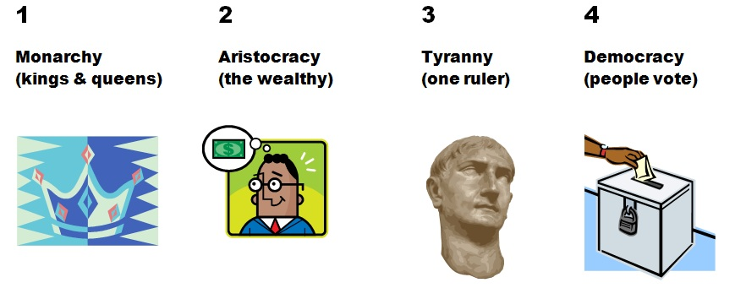

Slide 17
Athens: Tyranny
Draco
Solon
They worked for reform
Can you provide an example of a reform?
Famous Tyrants
Why were they famous?

Slide 18
Athens: Democracy
Athens
Where did the origins (beginnings of) democracy take place ?

Slide 19
Athens & Characteristics of Democracy
Direct voting (yea or nay)
What is direct democracy?

Slide 20
Athens & Characteristics of Democracy
Discussion of issues with two sides (pro or con)
What is public debate?

Slide 21
Athens & Characteristics of Democracy
To Vote
What are the duties of the citizen?

Slide 22
Sparta

Slide 23
Sparta
  Oligarchy (ruled by a few)
Describe Sparta’s Government

Slide 24
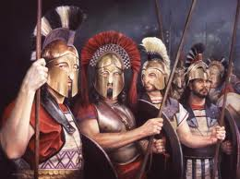
Sparta
Rigid class structure
Militaristic and aggressive
Where else have you learned about a society that has a rigid class structure?
Describe Sparta’s society

Slide 25
Compare
Athens
Sparta
Why would you want to live in Athens?
Why would you want to live in Sparta?

Slide 26
Persian Wars
(499-449 B.C.E.)
Attacks by the Persian Empire on the Greek city-states
They united (joined forces) against Persia
What were the Persian Wars?
How did Athens and Sparta respond to the Persian threat?

Slide 27
Persian Wars
(499-449 B. C. E.)
Marathon
Salamis
Aegean Sea
Why is control of the Aegean Sea important?
Athenian Victories against Persia
What strategic area did the Greeks control as a result of the victories?

Slide 28
Athens

Slide 29
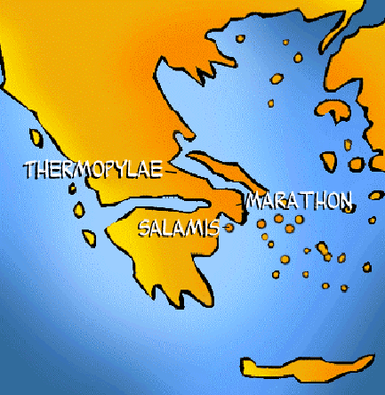
Battle of Salamis

Slide 30
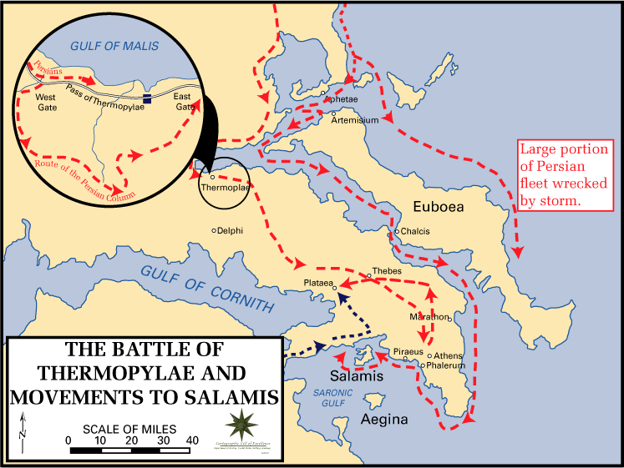
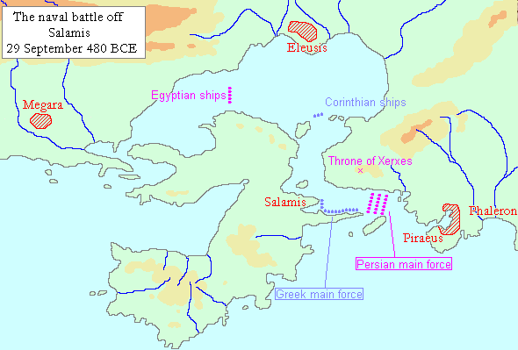
Battle of Salmis

Slide 31
Result of
Persian Wars
Preserved its independence
Allowed Athens government to develop (especially democracy)
Allowed Greek culture to develop
(Hellenistic culture)
What might have happened to Greek government & culture if Persia won?
Impact on Athens

Slide 32
Golden Age
Ushered in after the Persian Wars
Famous leader of Athens
Rebuilt Athens
Parthenon built at this time
What is the Golden Age?
Who is Pericles?
What did he do?

Slide 33
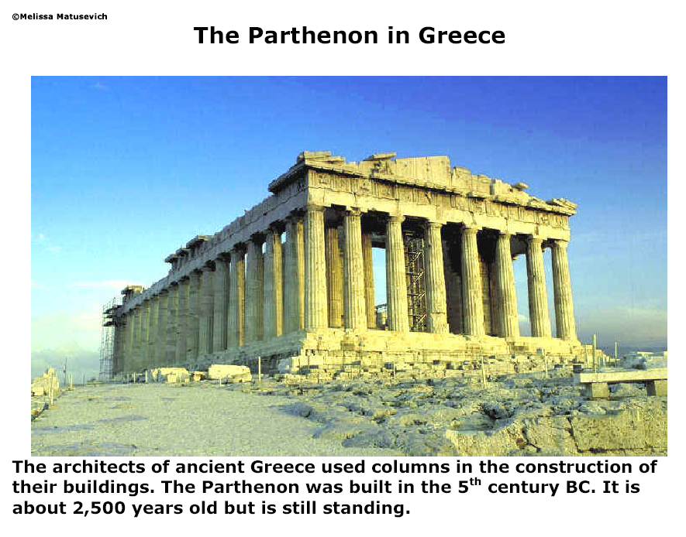
The famous Greek temple is called the Parthenon.
.
.

Slide 34
Greek Religion & Mythology
A temple
Built in honor of gods and goddesses
Built during Golden Age of Greece.
Parthenon

Slide 36
Contributions of Greek Culture to Western Civilization
Refer to your electronic portfolio
Cultural Contributions

Slide 37
Contributions of Greek Culture to Western Civilization
Aeschylus
Sophocles
Drama

Slide 38
Contributions of Greek Culture to Western Civilization
Homer
Iliad & Odyssey
Poetry
Famous Works

Slide 39
Contributions of Greek Culture to Western Civilization
Herodotus
Thucydides
History

Slide 40
Contributions of Greek Culture to Western Civilization
Phidias
Sculpture

Slide 41
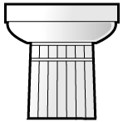
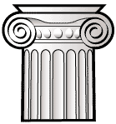

Greek Architecture
Types of columns
What type is used on the Parthenon?
.
DORIC
IONIC
CORINTHIAN

Slide 42
Impact of Greek Culture
University of Virginia
Richmond’s Capital Building
Washington D.C.
Why is understanding Greek architecture important today?

Slide 43
Contributions of Greek Culture to Western Civilization
Archimedes
Hippocrates
Science

Slide 44
Contributions of Greek Culture to Western Civilization
Euclid
Pythagoras
Mathematics

Slide 45
Contributions of Greek Culture to Western Civilization
Socrates
Plato
Aristotle
Philosophy

Slide 46
More Fun Stuff
The Olympics
1. Began as way of honoring Gods/Goddesses.
2. Games held every 4 years in honor of Zeus in Olympia.
3. Events included hippodrome, javelin, discuss, wrestling,
boxing, pentathlon
Theatre
1. Greek theatre developed from religious festivals to honor
Dionysus.
2. Grew from one man plays to very complex tragedies.

Slide 47
Peloponnesian War (431-404 B. C. E.)
Athens & the Delian League
vs.
Sparta & the Peloponnesian League
Who fought in this war:
What is a league?

Slide 48
Peloponnesian War
Each wanted control of the Greek world
How would this control give them an advantage?
Why did Athens and Sparta fight against each other?

Slide 49
Peloponnesian War
Instability at home
Less time for cultural advances
Political power weakens
What impact does the war have on Athens and Sparta?

