Slide 1
Golden Age of Greece
On Your Map, Locate the Following:
Aegean Sea
Mediterranean Sea
Black Sea
Dardanelles
Balkan Peninsula
Peloponnesus Peninsula
Asia Minor
Athens
Sparta
Troy
Macedonia

Slide 2
Geography
Which empire that we studied is on the southeastern- most region on the European continent?
Ancient Greece

Slide 3
Geography
Greece is surrounded on three sides by water. Identify those bodies of water.
How did deep bays and natural harbors along the coastline impact Greece’s culture?
Aegean Sea
Mediterranean Sea
They facilitated trade
Lead to a strong navy (Athens)

Slide 4
Geography
How did the mountainous areas impact culture in Ancient Greece?
Mountains acted as natural barriers and boundaries
Mountains prevented large-scale farming

Slide 5
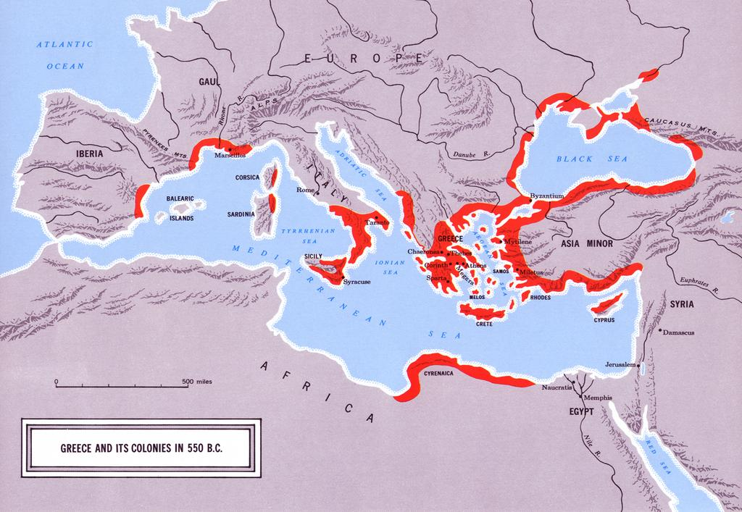
Why Greek Colonization?

Slide 6
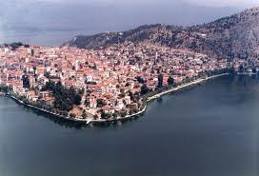
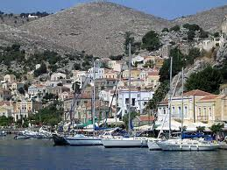
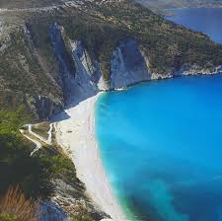
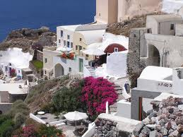

Slide 7
Colonization
Overpopulation
Arable land limited
Increase trade
Why did Greeks colonize?

Slide 8
Greek Mythology
More than one god
Stories that explain:
natural phenomena,
human qualities,
and life events
What examples did you learn?
Polytheistic Religion
What is a myth?

Slide 9
Greek Gods & Goddess
Zeus
Hera
Apollo
Artemis
Athena
Aphrodite
Refer to your electronic portfolio on gods and goddess

Slide 10
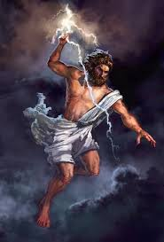
Zeus
Ruler of all (Olympian) gods
Ruler of sky and rain

Slide 11
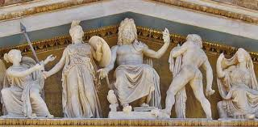
Hera
Wife of Zeus
Goddess of marriage and
family

Slide 12
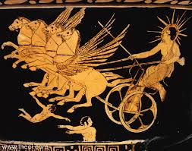
Apollo
Son of Zeus
God of Sun and
Light
Artemis is
his twin sister

Slide 13
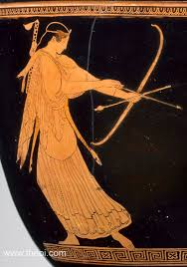
Artemis
Daughter of Zeus
God of the Moon
and Hunt
Apollo is
her twin brother

Slide 14
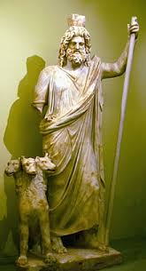
Hades
God of the Underworld
Brother of Zeus

Slide 15
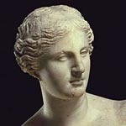
Aphrodite
Goddess of sexual love
and beauty

Slide 16
Greek Mythology in Western Literature & Art
Literature
Art
Architecture
Renaissance books, poetry
Allusions
Speeches
Renaissance Art
Dance
Drama
Torch of Olympic Flames
Blind Lady of Justice

Slide 17
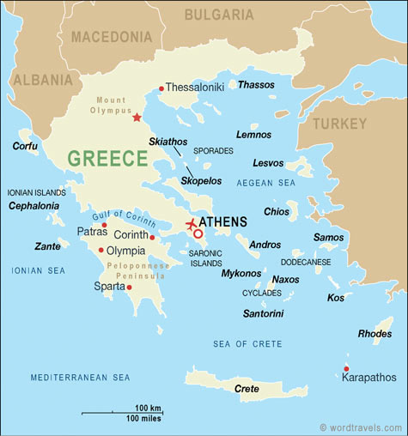
Similarities of Greek City-States (Athens & Sparta)

Slide 18
Society
A “body of citizens”
Today knowns as the City-state
Metropolis
(Today: Minneapolis)
What does Greek polis mean?
What city did Superman protect?

Slide 19
Society
Promoted civic life
Promoted commercial activities
Examples?
What was the purpose of these Greek city-states (polis)?

Slide 20
Society
Only free adult males
Only free adult males
Citizenship & Political Rights
Civic Responsibility & Participation in Government

Slide 21
Society
Women, foreigners & slaves had no political rights
No political rights

Slide 22
Slavery
By being captured as a prisoner in war
Born to enslaved parents
Failure to repay a debt (loan)
Most families owned slaves
Slaves were used as household servants or laborers
How did someone become a slave?
Who owned slaves?

Slide 23
Athens

Slide 24
Athens
Government Evolution:
1) Monarchy (kings & queens)
2)Aristocracy (the wealthy)
3)Tyranny (one ruler)
4)Democracy (people vote)
Evolution of Government

Slide 25
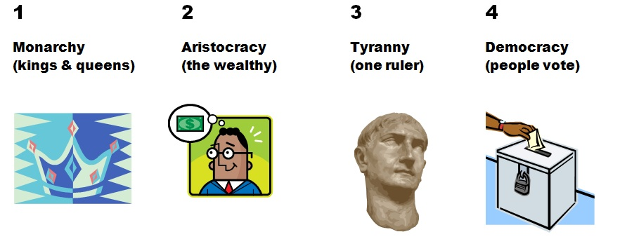

Slide 26
Athens: Tyranny
Draco
Solon
They worked for reform
Can you provide an example of a reform?
Famous Tyrants
Why were they famous?

Slide 27
Athens: Democracy
Athens
Where did the origins (beginnings of) democracy take place ?

Slide 28
Athens & Characteristics of Democracy
Direct voting (yea or nay)
What is direct democracy?

Slide 29
Athens & Characteristics of Democracy
Discussion of issues with two sides (pro or con)
What is public debate?

Slide 30
Athens & Characteristics of Democracy
To Vote
What are the duties of the citizen?

Slide 31
Sparta

Slide 32
Sparta
Oligarchy (ruled by a few)
Describe Sparta’s Government

Slide 33
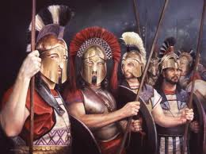
Sparta
Rigid class structure
Militaristic and aggressive
Where else have you learned about a society that has a rigid class structure?
Describe Sparta’s society

Slide 34
Compare
Athens
Sparta
Why would you want to live in Athens?
Why would you want to live in Sparta?

Slide 35
Persian Wars (499-449 B.C.E.)
Attacks by the Persian Empire on the Greek city-states
They united (joined forces) against Persia
What were the Persian Wars?
How did Athens and Sparta respond to the Persian threat?

Slide 36
Persian Wars (499-449 B. C. E.)
Marathon
Salamis
Aegean Sea
Why is control of the Aegean Sea important?
Athenian Victories against Persia
What strategic area did the Greeks control as a result of the victories?

Slide 37
Athens

Slide 38
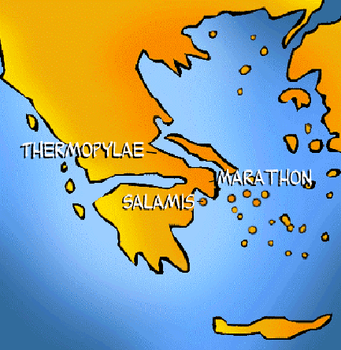
Battle of Salamis

Slide 39
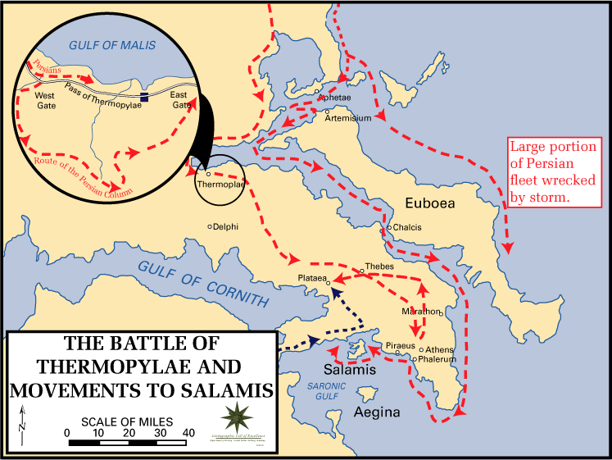
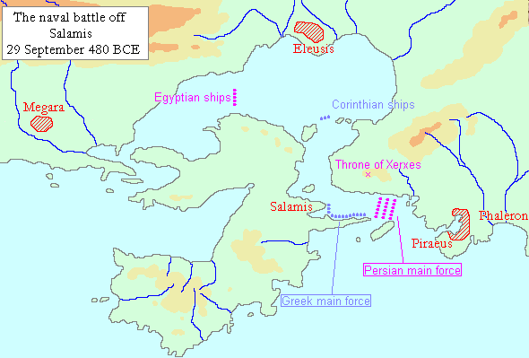
Battle of Salamis

Slide 40
Result of Persian Wars
Preserved its independence
Allowed Athens government to develop (especially democracy)
Allowed Greek culture to develop
(Hellenistic culture)
What might have happened to Greek government & culture if Persia won?
Impact on Athens

Slide 41
Golden Age
Ushered in after the Persian Wars
Famous leader of Athens
Rebuilt Athens
Parthenon built at this time
What is the Golden Age?
Who is Pericles?
What did he do?

Slide 42
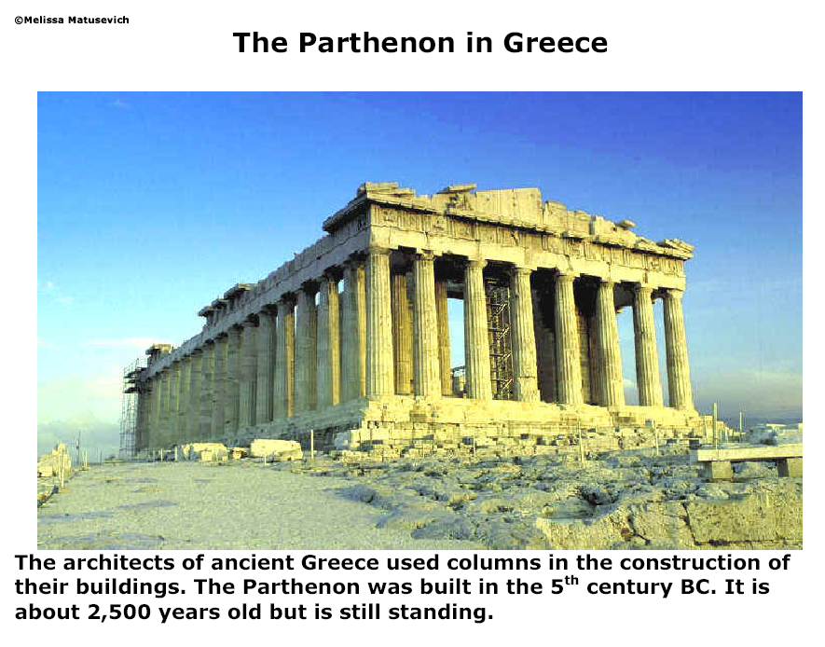
The famous Greek temple is called the Parthenon.
.
.

Slide 43
Greek Religion & Mythology
A temple
Built in honor of gods and goddesses
Built during Golden Age of Greece.
Parthenon

Slide 45
Contributions of Greek Culture to Western Civilization
Refer to your electronic portfolio
Cultural Contributions

Slide 46
Contributions of Greek Culture to Western Civilization
Aeschylus
Sophocles
Drama

Slide 47
Contributions of Greek Culture to Western Civilization
Homer
Iliad & Odyssey
Poetry
Famous Works

Slide 48
Contributions of Greek Culture to Western Civilization
Herodotus
Thucydides
History

Slide 49
Contributions of Greek Culture to Western Civilization
Phidias
Sculpture

Slide 50
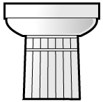
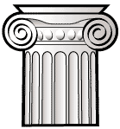

Greek Architecture
Types of columns
What type is used on the Parthenon?
.
DORIC
IONIC
CORINTHIAN

Slide 51
Impact of Greek Culture
University of Virginia
Richmond’s Capital Building
Washington D.C.
Why is understanding Greek architecture important today?

Slide 52
Contributions of Greek Culture to Western Civilization
Archimedes
Hippocrates
Science

Slide 53
Contributions of Greek Culture to Western Civilization
Euclid
Pythagoras
Mathematics

Slide 54
Contributions of Greek Culture to Western Civilization
Socrates
Plato
Aristotle
Philosophy

Slide 55
More Fun Stuff
The Olympics 1. Began as way of honoring Gods/Goddesses.
2. Games held every 4 years in honor of Zeus in Olympia.
3. Events included hippodrome, javelin, discuss, wrestling,
boxing, pentathlon
Theatre
1. Greek theatre developed from religious festivals to honor
Dionysus.
2. Grew from one man plays to very complex tragedies.

Slide 56
Peloponnesian War (431-404 B. C. E.)
Athens & the Delian League
vs.
Sparta & the Peloponnesian League
Who fought in this war:
What is a league?

Slide 57
Peloponnesian War
Each wanted control of the Greek world
How would this control give them an advantage?
Why did Athens and Sparta fight against each other?

Slide 58
Peloponnesian War
Instability at home
Less time for cultural advances
Political power weakens
What impact does the war have on Athens and Sparta?

