Slide 1
Ancient Rome
700 B.C.E. – 500 C.E.
Geography

Slide 2
Geographic Features
Rome is centrally located in the Mediterranean Basin
Distant from eastern Mediterranean powers
  Who are we talking about here?
Located on the Italian Peninsula

Slide 3
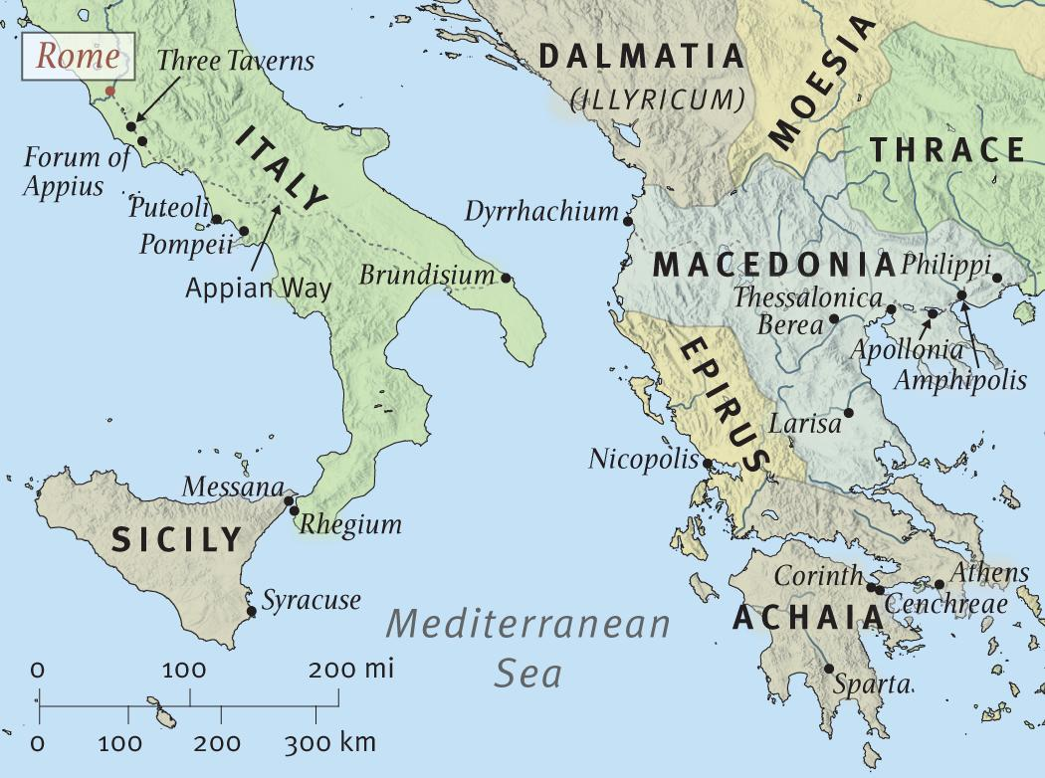
Map!

Slide 4
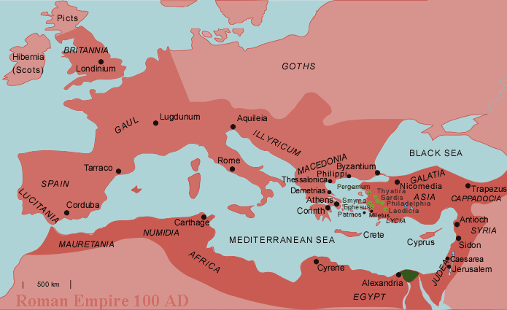

Slide 5
Which geographic features surround early Ancient Rome?
How would this geographic location help Rome to develop?
Mediterranean Sea, The Alps
Protection from invasion, seaborne commerce

Slide 6
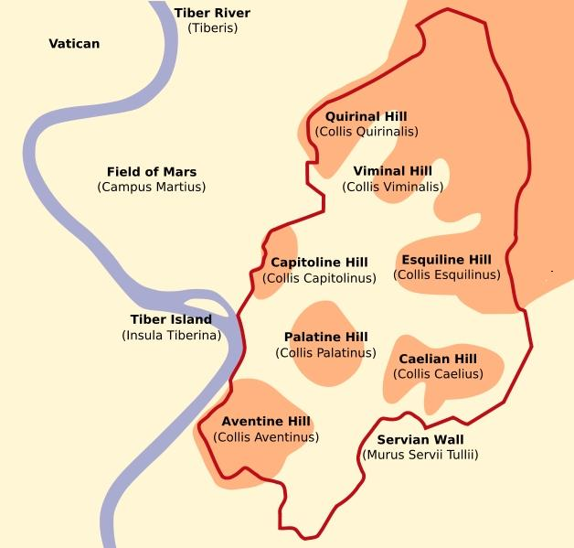
The Seven hills of Rome

Slide 7
Palatine Hill
Rome originated here
  People have been living on Palatine since 1000 B.C.E.
Mythology - The location of the cave where Romulus and Remus were raised by a wolf.

Slide 8
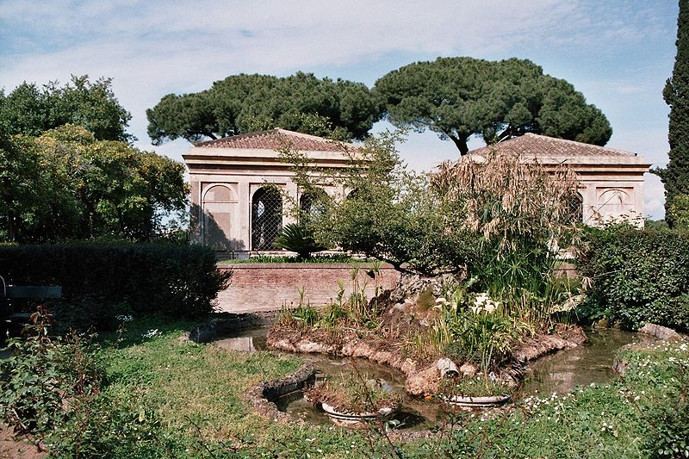
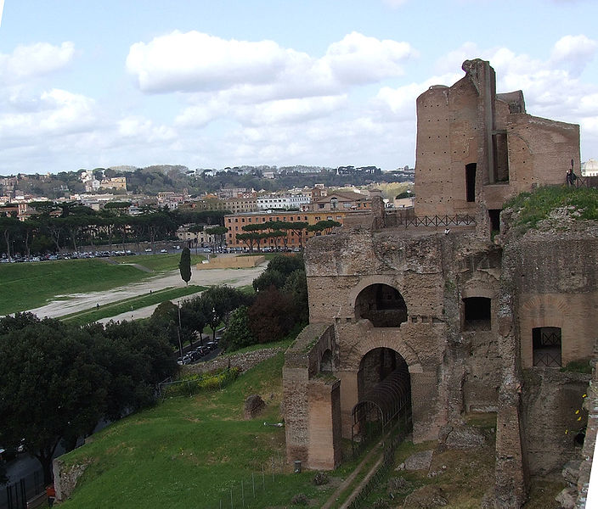
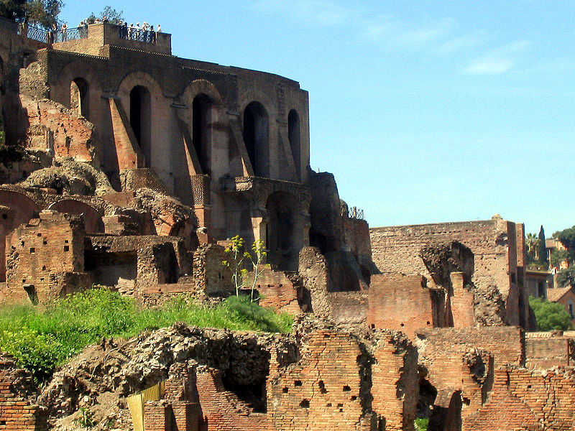
Palatine hill

Slide 9
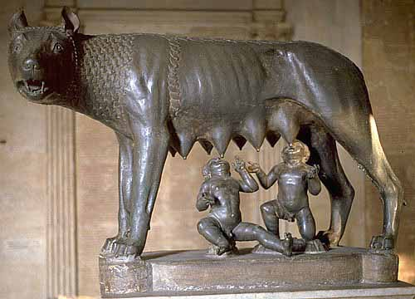
Romulus and Remus
Romulus and Remus are part of the foundation myth of Rome.
Rome is named for Romulus.

Slide 10
Social structure in rome
Patricians
Plebeians
Slaves
Powerful nobility (few in number)
Majority of the population
Not based on race; slaves were all conquered peoples

Slide 11
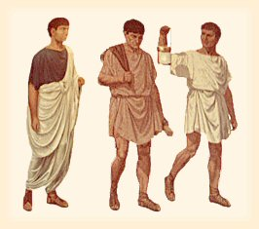
Citizenship
Only patrician and plebian men
Selected foreigners
Citizenship required the payment of taxes as well as military service.

Slide 12
Features of Democracy
Representative democracy
Assemblies
The Senate
Consuls
Twelve Tables
  The Laws of Rome

Slide 13
Just to clear things up
The city of Rome was founded in 753 B.C.E.
  We’re talking Romulus here
The Roman Republic was established in 509 B.C.E.

Slide 14
Rome’s Government Structure
Who was in control of Rome’s executive and legislative branches?
What was Rome’s executive branch?
What was Rome’s legislative branch?
The Patricians
  Were the Plebeians ok with this?
Consuls
  Two Patrician officials elected for one year terms
The Assembly
The Senate

Slide 15
More Government
The Assembly
  Citizens of Rome met here to vote for Consuls, Magistrates, and Tribunes
    Included Patricians and Plebeians
Consuls
  Elected by the Assembly for one year and could not serve again until 10 years passed.
  Governed Rome and had to agree on all decisions

Slide 16
Even more Government
Magistrates
  Officials who were elected to be judges and to look after the city’s finances.
  Retired Magistrates become Senators.
Tribunes
  Made sure that ordinary people were treated fairly

Slide 17
And the senate…
The Senate
  300 Patrician men who were retired magistrates and served for life
  Advised the Consuls
  Had A LOT of power
    Foreign Policy
    Lawmaking
    Defense
    Roads

Slide 18
Plebeians vs. Patricians
Plebeians were upset they did not have much power in the republic.
Refused to fight in the army if the Patricians did not change things.
  This threat made the Patricians agree to reform
  The Tribunes were given more power as well as the Plebeian Assembly.

Slide 19
More Reforms
Plebeians and Patricians were now allowed to marry!
Most significant victory for Plebeians:
  The Twelve Tables
    Written law code
    Was set in the Forum all to see
    Basis for all future Roman law

Slide 20
Technology!
The Romans were great at building roads
  Sound familiar?
The Appian Way was constructed in the 300s B.C.E. and connected Rome to southeastern Italy.
  Later, during the Empire, roads were built connecting all parts of the Empire.
    50,000 miles of road!

Slide 21
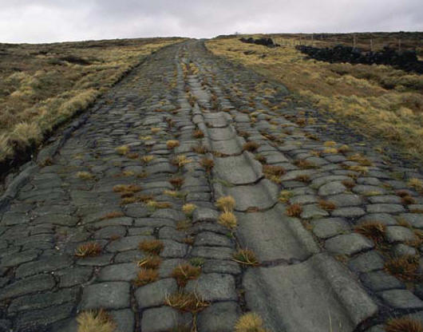
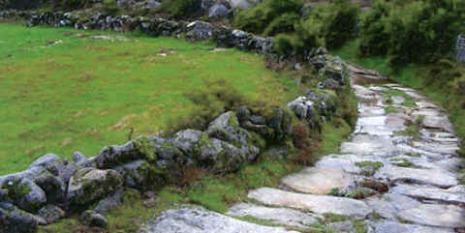
Roman Roads

Slide 22
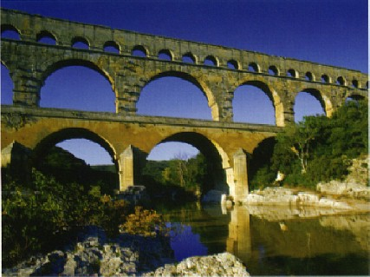
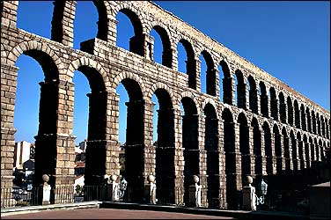
Aqueducts
Artificial channels for carrying water
A Roman-built aqueduct is still in use in Spain today! 1900 years after it was built!

