Slide 1
The Punic Wars!
264-146 B.C.E.

Slide 2
Causes of War
Rome and Carthage were in competition for trade
Carthage already controlled much of Western Europe, but Rome was looking to expand.

Slide 3
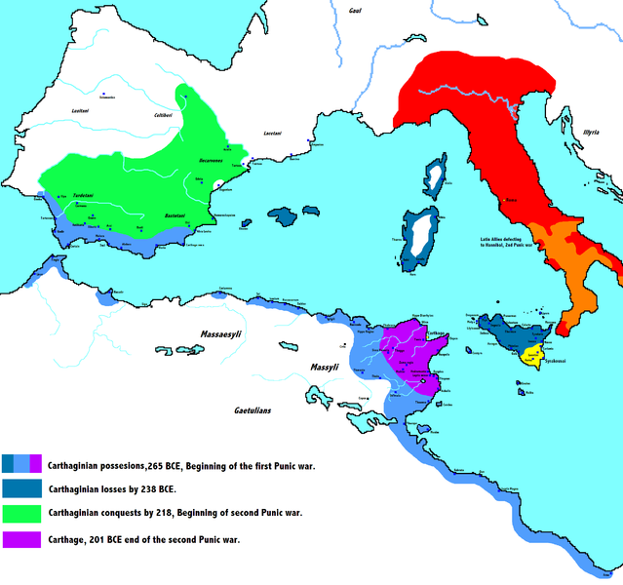

Slide 4
The Players
Carthage – The descendents of the Phoenicians.
Remember them?
Had a great deal of power, wealth, and population
Carthage had a better Navy than Rome, but did not have a standing Army

Slide 5
The Players Con’t
Rome
By 264 B.C.E. Rome controlled much of the Italian Peninsula
Even though the Romans had a standing army, they did not have a navy until tensions with Carthage began to rise.

Slide 6
There Were Three Punic Wars…
The First – Rome and Carthage fought over the straight between Sicily and the Italian Peninsula
The Second – Hannibal invades a Roman ally in Spain and marches on Rome

Slide 7
Hannibal!
He marched an army, which included war elephants, from Iberia over the Pyrenees and the Alps into northern Italy.
Had to return to Carthage when the Romans attacked

Slide 8
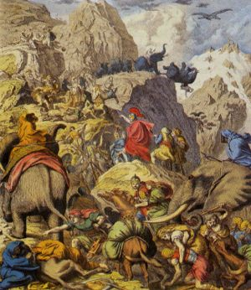

Slide 9
And the Last War..
The Third – Romans conquer Carthage by demolishing the city and selling each citizen into slavery.
Carthage never surrendered

Slide 10
The Results…
Expanded trade and wealth for Rome
The spread of Roman culture throughout the Mediterranean Basin.

