Slide 1
Byzantine Empire

Slide 2
Geography of Byzantine Empire
Locate on your maps the following geographical features:
Byzantine Empire
Locate Constantinople
Italian Peninsula
Mediterranean Sea

Slide 3
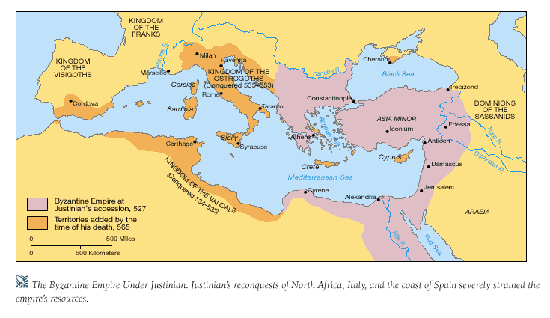
Byzantine Empire Retrieved from: http://wps.ablongman.com/wps/media/objects/262/268312/art/figures/KISH_07_149.gif

Slide 4
Critical Thinking
How is Constantinople situated in a strategic and advantageous location?

Slide 5
Location of Constantinople
• Protection of the eastern frontier
• Distance from Germanic invasions in the western empire
• Crossroads of trade
• Easily fortified site on a peninsula bordering natural harbors
How is Constantinople situated in a strategic and advantageous location?

Slide 6
Critical Thinking
How did Constantinople play an important role in the Byzantine Empire?

Slide 7
Role of Constantinople
• Seat of the Byzantine Empire until Ottoman conquest
• Preserved classical Greco-Roman culture
• Center of trade
How did Constantinople play an important role in the Byzantine Empire?

Slide 8
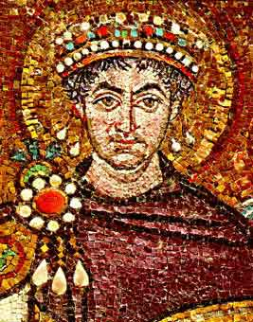
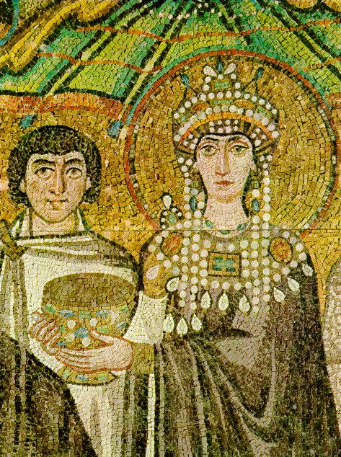
Emperor Justinian http://www.mlahanas.de/Greeks/Medieval/Bio/Justinian.jpg and http://www2.hawaii.edu/~kjolly/151/images/theodora.jpg

Slide 9
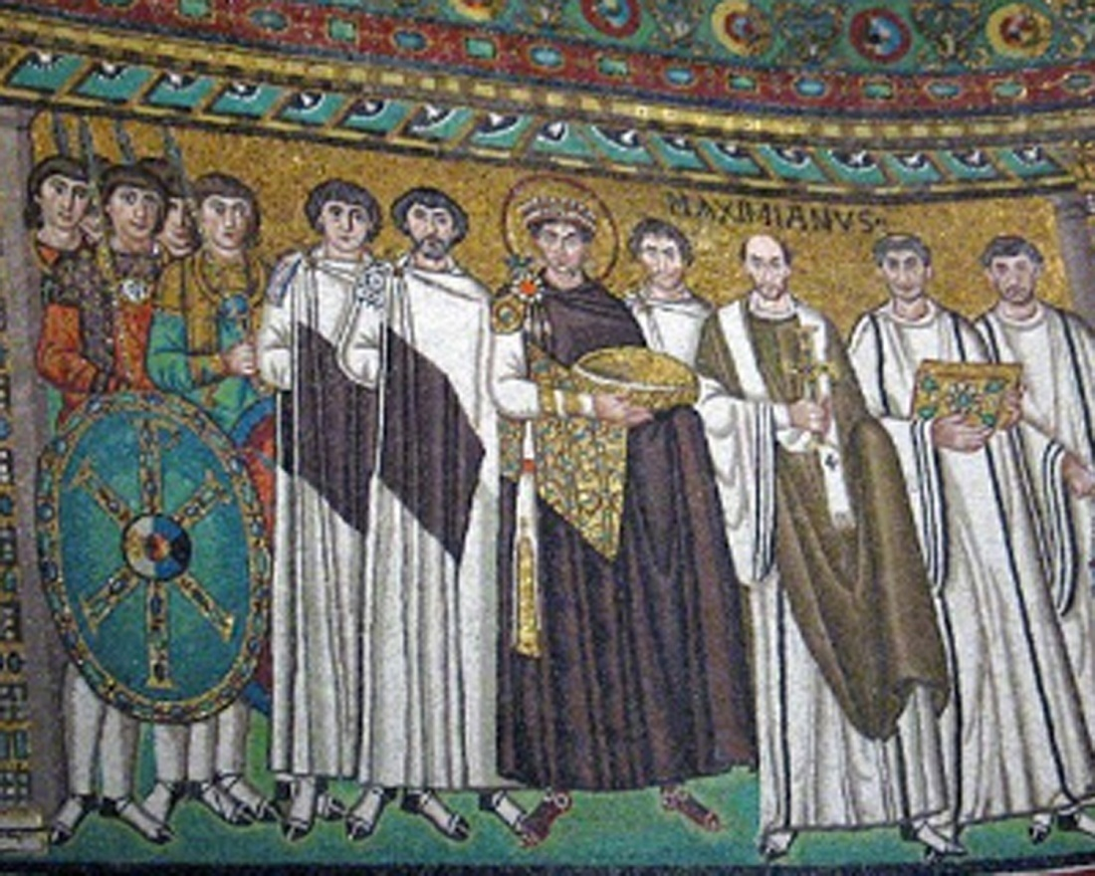
Emperor Justinian
http://songsforpraise.com/EmperorJustinian.jpg

Slide 10
Byzantine Emperor Justinian
• Codification of Roman law (impact on European legal codes)
• Reconquest of former Roman territories
• Expansion of trade
What were the accomplishments of Emperor Justinian?

Slide 11
Summary of Reign of Justinian
How would you describe the Byzantine Empire under Justinian?

Slide 12
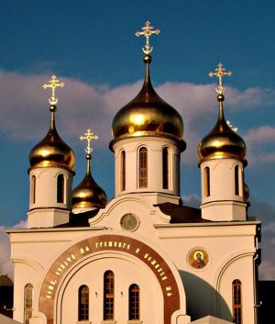
Schism (Divide of the Church)

Slide 13
Eastern Church
• Centered in Constantinople
• Close to seat of power after Constantinople became capital
• Use of Greek language in the liturgy
What were characteristics of the Eastern Church?

Slide 14
Western Church
• Centered in Rome
• Farther from seat of power after Constantinople became capital
• Use of Latin language in the liturgy
What were the characteristics of the Western Church?

Slide 15
Critical Thinking
What do you think may have caused the schism?

Slide 16
Division between Western and Eastern Churches
• Authority of the Pope eventually accepted in the West
• Authority of the Patriarch accepted in the East
• Practices such as celibacy eventually accepted in the West
How did the two solve their differences?

Slide 17
Art & Architecture

Slide 18
Art & Architecture
Greek Orthodox Christianity and Imperial Patronage
How did the Byzantine Empire afford to build and create art?
What does Patronage mean?

Slide 19
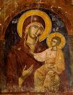
Byzantine achievements in art and architecture
Religious images
Icons

Slide 20
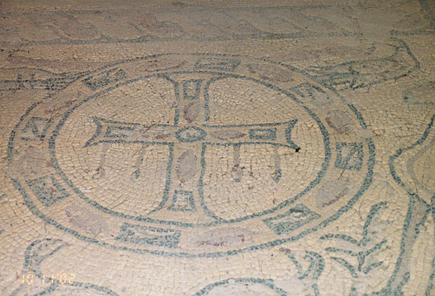
Byzantine achievements in art and architecture
In public
and
Religious structures
Mosaics
http://galen-frysinger.com/North%20Africa/libya16.jpg

Slide 21
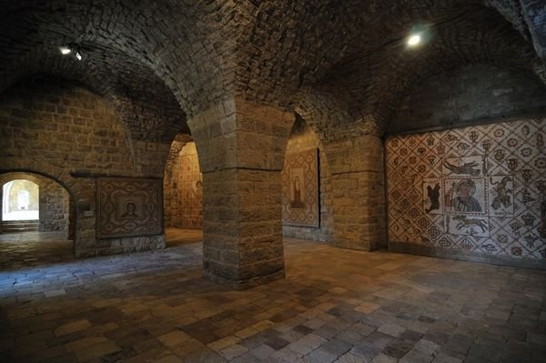
Mosaic Walls of Church (Lebanon)

Slide 22

Byzantine achievements in art and architecture
A Byzantine domed church
Hagia Sophia

Slide 23
Byzantine Culture
What do you think are some characteristics of Byzantine Culture?

Slide 24
Byzantine Culture
• Continued flourishing of Greco-Roman traditions
• Greek language (as contrasted with Latin in the West)
Characteristics of Byzantine Culture

Slide 25
Byzantine Culture
• Greek Orthodox Christianity
• Greek and Roman knowledge preserved in Byzantine libraries
Characteristics of Byzantine Culture

Slide 26
Influence of Byzantine culture on Eastern Europe and Russia
How do you think Byzantine culture influences Eastern Europe and Russia?
What cultural influences do you think you would find?

Slide 27
Influence of Byzantine culture on Eastern Europe and Russia
• Trade routes between Black Sea and Baltic Sea
How did Byzantine culture spread?

Slide 28
Influence of Byzantine culture on Eastern Europe and Russia
Adoption of Orthodox Christianity by Russia and much of Eastern Europe
• Adoption of Greek alphabet to the Slavic languages by St. Cyril (Cyrillic alphabet)
• Church architecture and religious art
What characteristics of Byzantine culture were adopted by others?

