Slide 1
Byzantine Empire

Slide 2
Geography of Byzantine Empire
Locate on your maps the following geographical features:
Byzantine Empire
Locate Constantinople
Italian Peninsula
Mediterranean Sea

Slide 3
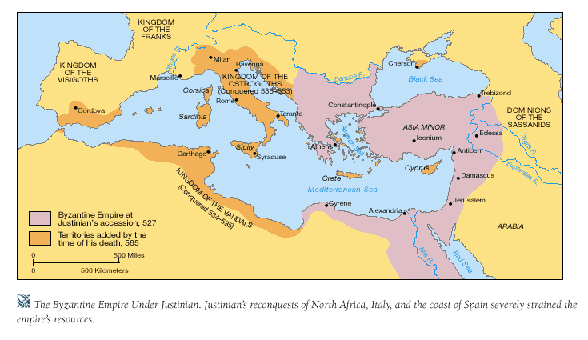
Byzantine Empire
Retrieved from: http://wps.ablongman.com/wps/media/objects/262/268312/art/figures/KISH_07_149.gif

Slide 4
Critical Thinking
How is Constantinople situated in a strategic and advantageous location?

Slide 5
Location of Constantinople
• Protection of the eastern frontier
• Distance from Germanic invasions in the western empire
• Crossroads of trade
• Easily fortified site on a peninsula bordering natural harbors
How is Constantinople situated in a strategic and advantageous location?

Slide 6
Critical Thinking
How did Constantinople play an important role in the Byzantine Empire?

Slide 7
Role of _______________
• ______ of the _________ until____________ __________________
•_____________________
•______________________
How did _____________play an important role in the_______________________?

Slide 8
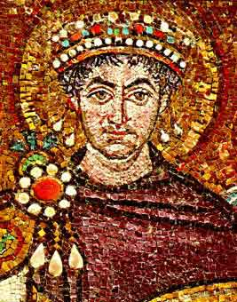
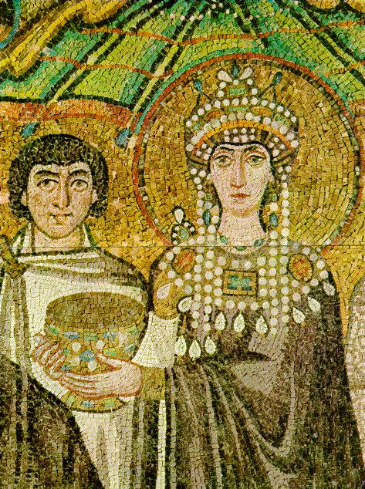
Emperor Justinian http://www.mlahanas.de/Greeks/Medieval/Bio/Justinian.jpg and http://www2.hawaii.edu/~kjolly/151/images/theodora.jpg

Slide 9
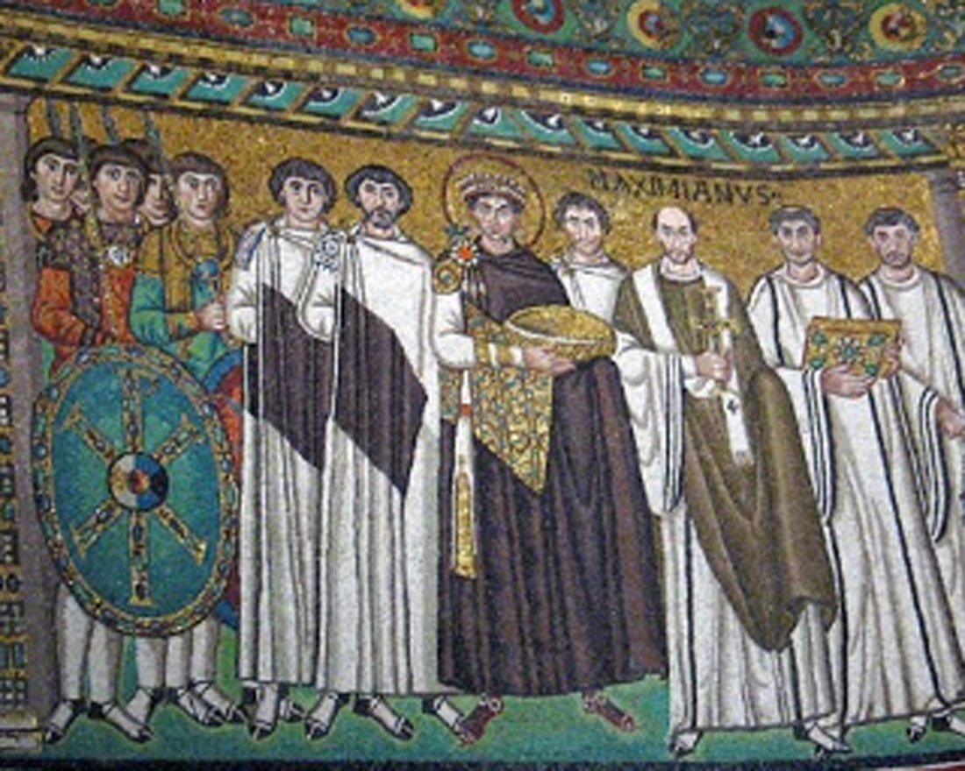
Emperor Justinian
http://songsforpraise.com/EmperorJustinian.jpg

Slide 10
Byzantine Emperor Justinian
•
•
•
_______________________________
_______________________________
______________________________
_______________________________

Slide 11
Summary of Reign of Justinian
How would you describe the Byzantine Empire under Justinian?

Slide 12
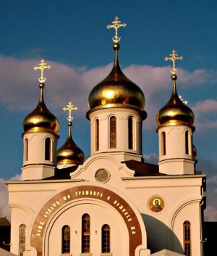
___________(_______of the______)

Slide 13
________Church
• _________in____________
• Close to ___________after ____________ became __________
• Use of ___________ in the ____________
What were characteristics of the__________?

Slide 14
________ Church
•
•
•
What were the
___________ of the _____________
___________?

Slide 15
Critical Thinking
What do you think may have caused the schism?

Slide 16
Division between Western and Eastern Churches
• ___________of the _________ eventually ___________ in the _______
• _________ of the __________
_____________ in the_______
• ___________ such as ________ eventually ________ in the West

Slide 17
Art & Architecture

Slide 18
Art & Architecture
_________________________ and
_________________________
What does ___________ mean?

Slide 19
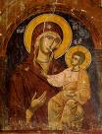
Byzantine achievements in art and architecture
_____________________
_____________________________

Slide 20
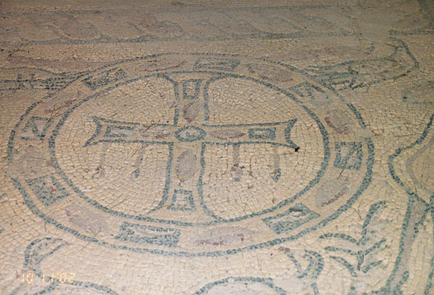
Byzantine achievements in art and architecture
In________________
and
___________ __________
____________
http://galen-frysinger.com/North%20Africa/libya16.jpg

Slide 21
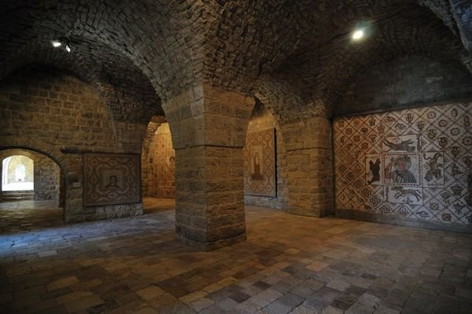
Mosaic Walls of Church
(Lebanon)

Slide 22

Byzantine achievements in art and architecture
______________________
______________________
__________________________
__________________________

Slide 23
Byzantine Culture
What do you think are some characteristics of Byzantine Culture?

Slide 24
Byzantine Culture
•
•

Slide 25
Byzantine Culture
•
•
Characteristics of ___________
_____________

Slide 26
Influence of Byzantine culture on Eastern Europe and Russia
How do you think Byzantine culture influences Eastern Europe and Russia?
What cultural influences do you think you would find?

Slide 27
Influence of Byzantine culture on Eastern Europe and Russia
•

Slide 28
Influence of Byzantine culture on Eastern Europe and Russia
●
•
•
What characteristics of______________
_______________
_______________
______________?

