Slide 1
Byzantine Empire

Slide 2
Geography of Byzantine Empire
Locate on your maps the following geographical features:
Byzantine Empire
Locate Constantinople
Italian Peninsula
Mediterranean Sea
Identify the borders of the Byzantine Empire at its height of expansion.

Slide 3
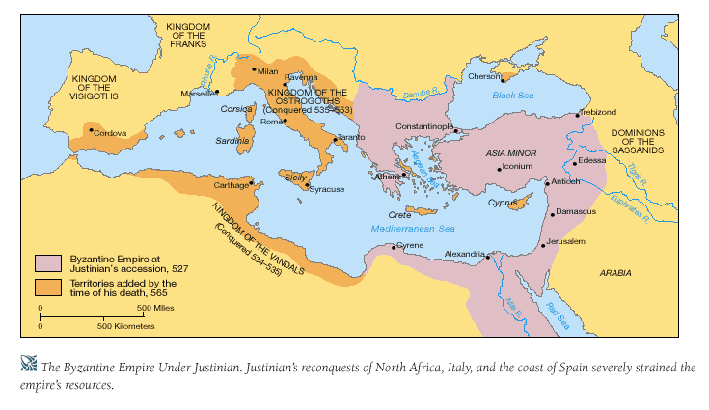
Byzantine Empire Retrieved from: http://wps.ablongman.com/wps/media/objects/262/268312/art/figures/KISH_07_149.gif

Slide 4
Critical Thinking
How is Constantinople situated in a strategic and advantageous location?
Try to develop 3-5 good reasons based on geography and your knowledge of the history of the area to date.

Slide 5
Location of Constantinople
•
•
•
•
How is Constantinople situated in a strategic and advantageous location?

Slide 6
Critical Thinking
How did Constantinople play an important role in the Byzantine Empire?
Try to develop 2-3 reasons that explain the importance of Constantinople to the Byzantine Empire.

Slide 7
Role of Constantinople
•
•
•
How did Constantinople play an important role in the Byzantine Empire?

Slide 8
Emperor Justinian
Analyze the pictures provided.
What religion did Justinian adopt?
How do you know?

Slide 9
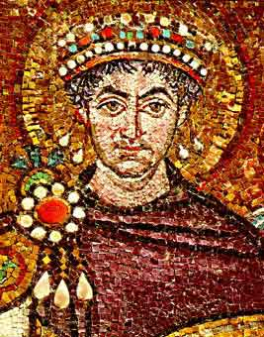
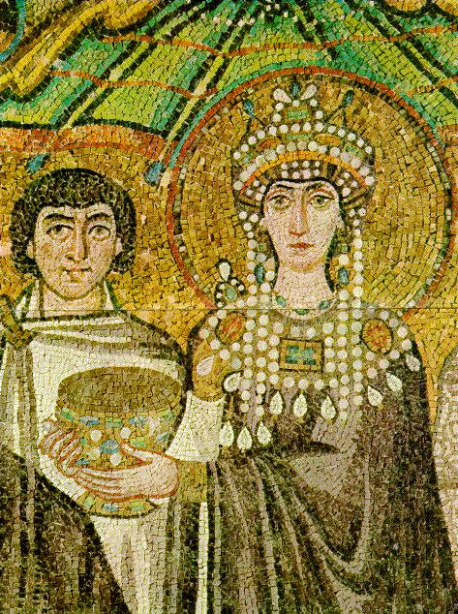
Emperor Justinian (and his wife) http://www.mlahanas.de/Greeks/Medieval/Bio/Justinian.jpg and http://www2.hawaii.edu/~kjolly/151/images/theodora.jpg

Slide 10
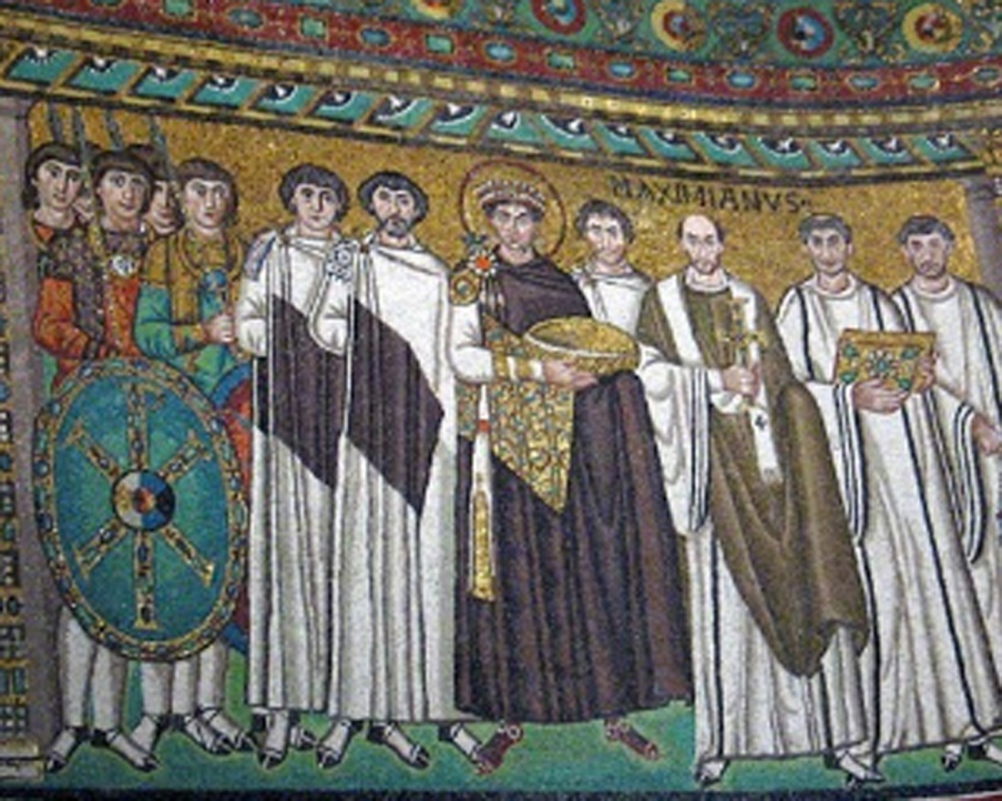
Emperor Justinian
http://songsforpraise.com/EmperorJustinian.jpg

Slide 11
Byzantine Emperor Justinian
•
•
•
What are three major achievements of Emperor Justinian for the Byzantine Empire?

Slide 12
Summary of Reign of Justinian
How would you describe the Byzantine Empire under Justinian?

Slide 13
Religion in the Byzantine Empire

Slide 14
Eastern Church
Where was it centered?
How was its location considered powerful?
What language was used in the liturgy?

Slide 15
Western Church
•
Where was it centered?
How was it location considered less powerful than that of the Eastern Church?
What language was used in the liturgy?

Slide 16
Critical Thinking
Explain the division between the Western and Eastern Churches—what caused the schism?

Slide 17
Schism
Who was accepted as the highest authority figure for the Western Church?
Who was accepted as the highest authority figure for the Eastern Church?
The practice of celibacy was adopted by which Church?

Slide 18
Art & Architecture

Slide 19
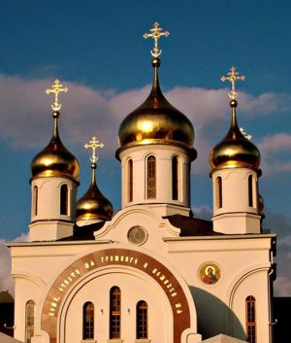
Is this church located in the Eastern or Western part of the empire? How do you know?

Slide 20
Art & Architecture
What is an icon?
What is a mosaic?
Define and provide a picture of each.

Slide 21
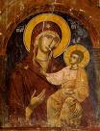
Byzantine Achievements in Art and Architecture
What does the picture represent?

Slide 22
Byzantine Achievements in Art and Architecture
What do the pictures represent?

Slide 23
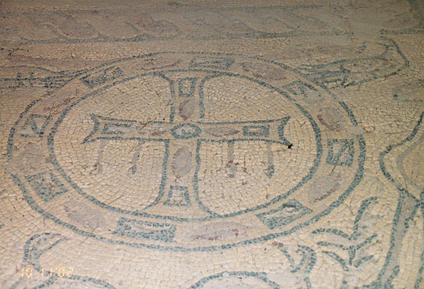
Byzantine Achievements in Art and Architecture
____________
http://galen-frysinger.com/North%20Africa/libya16.jpg

Slide 24
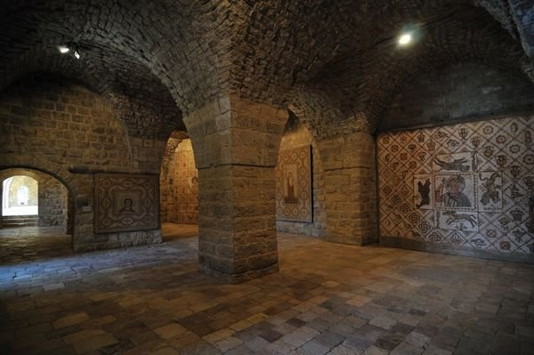
Mosaic Walls of Church (Lebanon)

Slide 25

Byzantine achievements in art and architecture
What is the best title for this picture?
(Hint: it is a famous
church)

Slide 26
Byzantine Culture
Describe some characteristics of the Byzantine culture (in the East).
What other culture or traditions did it adopt?
What language was spoken?
What religion did it adopt?

Slide 27
Influence of Byzantine culture on Eastern Europe and Russia
How do you think Byzantine culture influences Eastern Europe and Russia?
What cultural influences do you think you would find?

Slide 28
Influence of Byzantine culture on Eastern Europe and Russia
Trade routes
Religion
Alphabet
Architecture and Art

Slide 29
Influence of Byzantine culture on Eastern Europe and Russia
●
•
•
What characteristics of______________
_______________
_______________
______________?

