Slide 1
Other Early Civilizations (about 2000 to 500 B.C.E.)

Slide 2
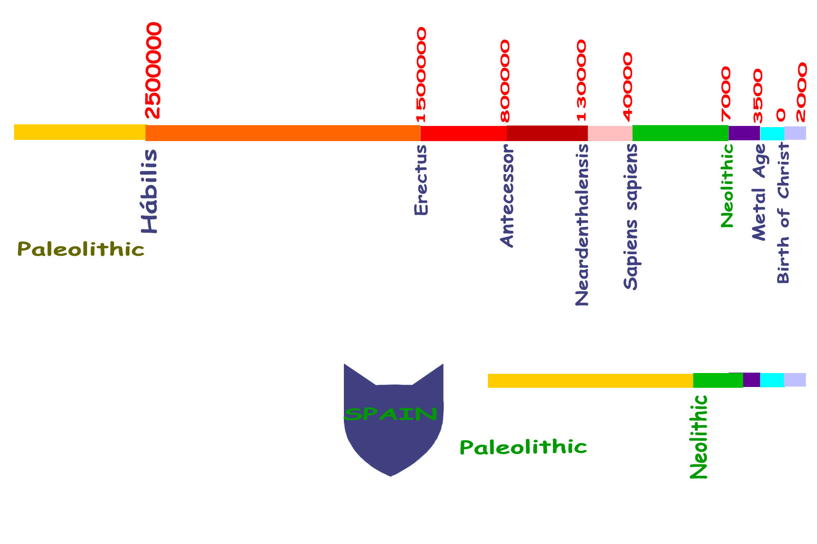

Slide 3
Other Early Civilizations (about 2000 to 500 B.C.E.)
Hebrews Settlement
Phoenician Settlement

Slide 4
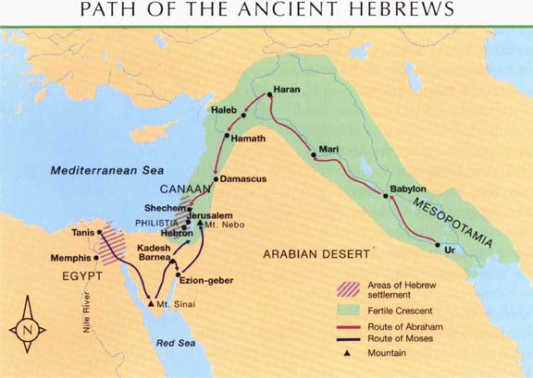
Hebrews

Slide 5
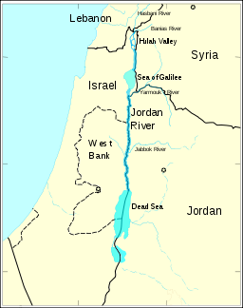
Israel

Slide 6
Map Activity
Lightly shade the area of the early Hebrew civilization.
Label the following geographic features:
Mediterranean Sea
Red Sea
Egypt
Jordan River Valley
Is it in the Fertile Crescent?
What continent is the Jordan River Valley in?

Slide 7
Hebrews
What religion did the Hebrews practice?
Monotheistic
or
Polytheistic?
Judaism
Monotheistic (one God)

Slide 8
Hebrews & Judaism
Founder
Holy City
Abraham
All Jews are descendents of Abraham
Jerusalem

Slide 9
Hebrews & Judaism
What is the name of the sacred book?
Torah
Contains the written
records (like their history) and beliefs

Slide 10
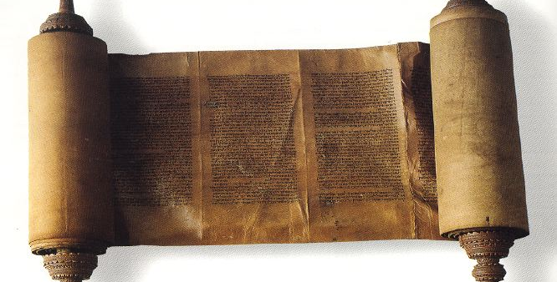
The Torah
Jewish Holy Book

Slide 11
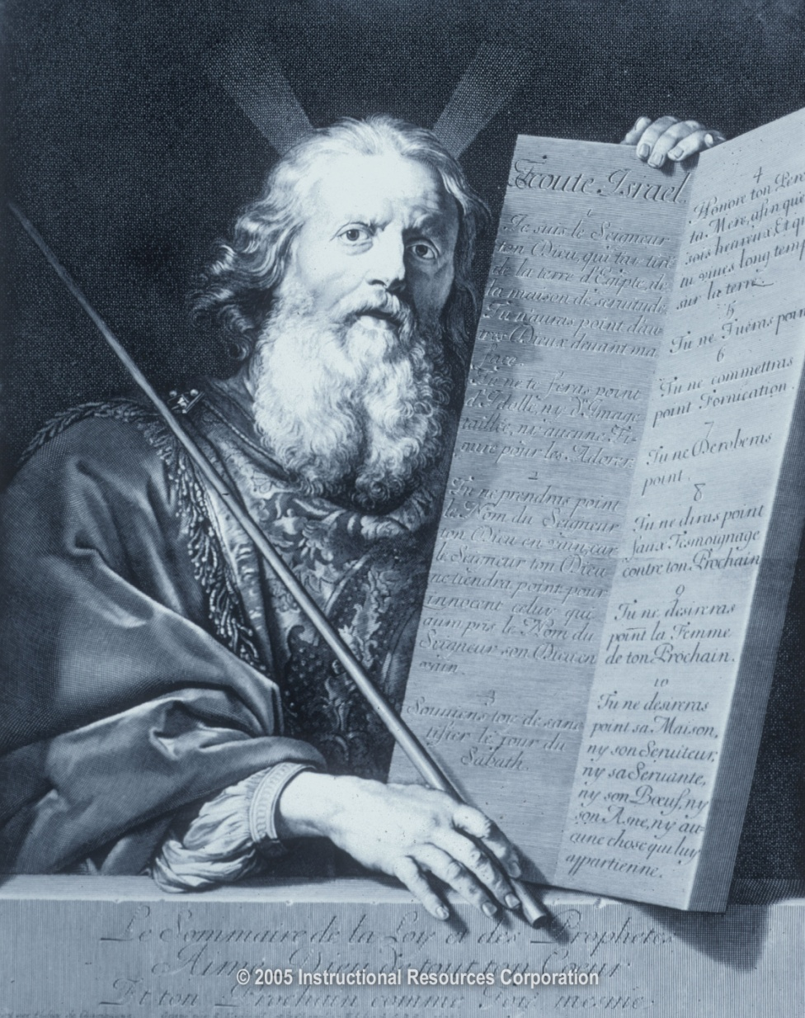
Judaism
Ten Commandments
Moses
What are the Laws (or tenets)?
Who gives the Ten Commandments to the Jews?

Slide 12
Judaism
What are examples of the Ten Commandments?
“Thou shalt not steal”
All men are equal-- no man is above the law

Slide 13
Class Activity Questions
How did the Jews’ belief that all men are created equal pose a conflict with outside rulers?
What might happen to the Jews if they were conquered?

Slide 14
Answers to Class Activity Questions
Outside rulers, rulers whose faith is not Judaism, may feel threatened by people who believe all men are equal. Many rulers of early civilizations believed that they were the gods’ chosen one to rule, so they felt they were better than the common people. They did not think that man’s laws always applied to them.
If the Jews were conquered, the Hebrews may have faced unfair treatment by the rulers and society.

Slide 15
Hebrews & Judaism
What happened to the Jewish settlement around Jerusalem?
What happened as a result?
Jewish settlement was broken up
Jews scattered--called
Diaspora
Jews were exiled
Judaism spread

Slide 16
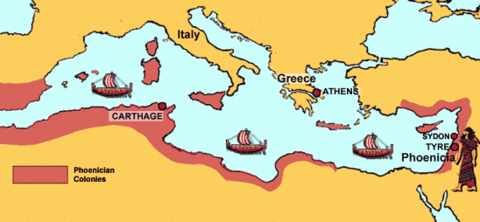
Phoenicia

Slide 17
Map Activity
Lightly shade the area of Phoenicia.
Label the following geographic features:
Mediterranean Sea
Red Sea
Egypt
Anatolia (Asia Minor)
Fertile Crescent
What continent is the Phoenician settlement in that also resides in the Fertile Crescent?

Slide 18
Phoenicia
Where was Phoenicia located?
By the Mediterranean coast
It was in part of the Fertile Crescent
In Southwest Asia

Slide 19
Phoenicia
What economic activities were the Phoenicians well-known for?
Trade
Along rivers and by sea (Mediterranean Sea)
Shipbuilding

Slide 20
Phoenician Written Language
Alphabet

Slide 21
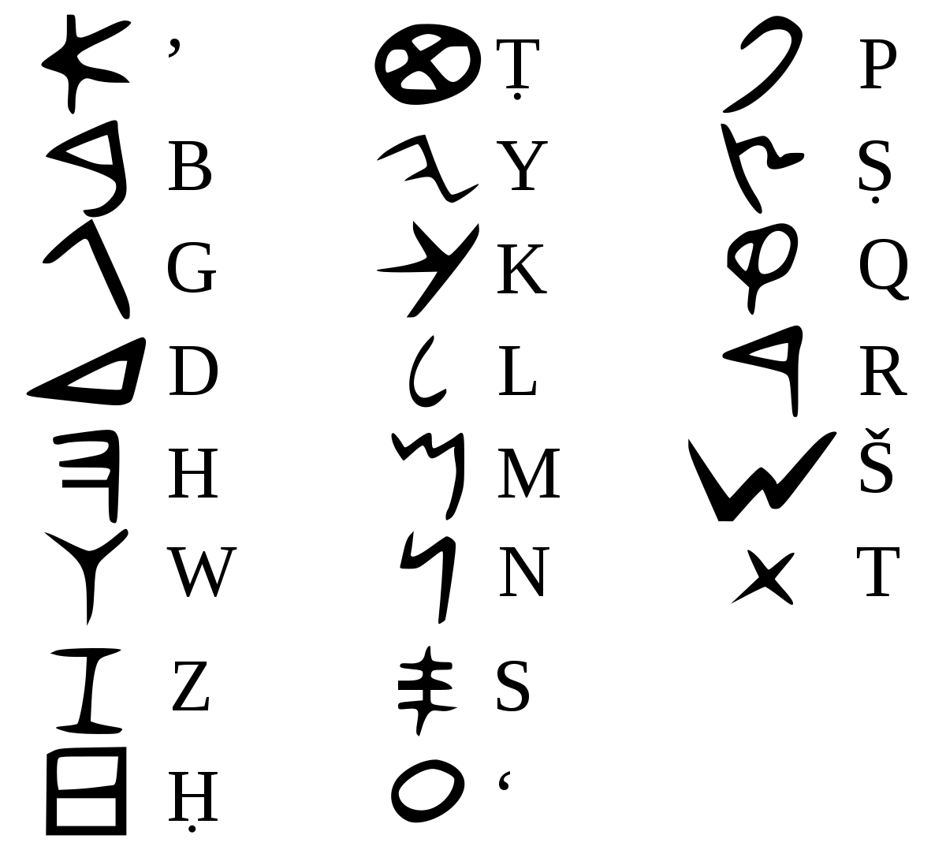

Slide 22
Nubia
In Africa (Egypt)
Located along Nile River
On the Upper Nile (southern part of Nile River)

Slide 23
Commonalities of River Valley Civilizations
Society
Economy
Government (Political Systems)

Slide 24
Activity
Analyze the chart entitled “Common Themes in History”
What are three most common themes?
Why is geography and technology listed separately?
Look at the theme, Economy. Organize the examples into two categories: General Examples and Specific Examples
Could an example that appears under the theme, Economy, also appear under the theme, Society? Explain your answer.

Slide 25
Development of Social Patterns

Slide 26
Development of Social Patterns
What type of rulers were there-- Hereditary rulers:
How was society structured?
Dynasties of kings & pharaohs
(Rule within single family line over several
generations)
Rigid class system
Slavery was accepted

Slide 27
Development of Political Patterns

Slide 28
Development of Political Patterns
First States
What is a city-state?
For example:
City-states
Kingdoms
Empires
Independent city-states (the size of a city):
Have their own laws
Have their own ruler
Have their own army
Have their own currency

Slide 29
Development of Political Patterns
Centralized government
Often based on religious authority
What was a common characteristic of a government?

Slide 30
Activity Questions
What is a “centralized government?”
What might be a very good way of convincing the public that power belongs to the ruler—not the people?
Give an example of a ruler who ruled based on religious
authority.

Slide 31
Answer to Activity Questions
A centralized government is one in which the ruler has most of the power (not the people)
A very good way of convincing the public that power belongs to the ruler—not the people, may be to tell the people that the gods want the ruler to have power.
A Pharaoh is a good example of a ruler who ruled based on
religious authority.

Slide 32
Development of Political Patterns
What written law codes were developed?
Code of Hammurabi
Ten Commandments

Slide 33
Development of Economic Patterns

Slide 34
Development of Economic Patterns
What were tools and weapons made from?
Use of metal tools and weapons
Made out of: bronze & iron

Slide 35
Development of Economic Patterns
Better tools, plows, & irrigation
Increasing agricultural surplus
How did farming techniques change?
What did this result in?

Slide 36
Development of Economic Patterns
Where did trade most heavily develop?
Along rivers and by sea
Especially by the Phoenicians

Slide 37
Activity Question
Why did trade develop so well around the water routes?
(Why not land routes?)
Answer:
Water routes were faster, easier, and cheaper.
It was difficult to haul large loads over land.
It was easier to get robbed on land than by sea.

Slide 38
Development of Economic Patterns
Trade encouraged the growth of _______?
What social ranks existed?
Development of the world’s first cities
Development of the practice of slavery

Slide 39
Development of Religious Traditions

Slide 40
Development of Religious Traditions
What was a common characteristic of most early religions?
Did the Jews believe in one God or many gods?
Polytheism was practiced by most peoples
Monotheism was practiced by the Hebrews

Slide 41
Language and Writing

Slide 42
Language and Writing
Pictograms
Hieroglyphics
Cuneiform
Alphabet
What were the earliest written symbols called?
What was the writing system of the Egyptians called?
What was the writing system developed in Sumer called?
What writing system did the Phoenicians develop?

Slide 43
Language and Writing
Sanskrit
Oracle bone script
What was the writing system developed in India called?
What writing system did the Chinese develop?

