Slide 1
River Valley Civilizations
(about 3500-500 B.C.E.)
Mesopotamia, Nile River Valley, Indus River Valley, Huang He Valley

Slide 2
Mesopotamia
Locate and the area known as Mesopotamia on the map provided. Then, label the following:
  Tigris River
  Euphrates River
  Red Sea
  Sumer
  Mediterranean Sea
  Persian Gulf

Slide 3
Mesopotamia
What does Mesopotamia mean?
In which continent is the area located?

Slide 4
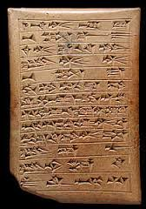
Key Cultural Characteristics
What writing system did Sumer develop?

Slide 5
Key Cultural Characteristics
Who developed the Code of Hammurabi?
What was the Code of Hammurabi?

Slide 6
Concept Questions
Why would early civilizations develop a writing system?
Why did Hammurabi feel the need to write down (codify) the laws?

Slide 7
Nile River Valley Civilization
On the map provided, located the following places or geographic features:
  Nubia
  Nile River
  Nile Delta
  Red Sea
  Mediterranean Sea

Slide 8
Other Early Civilizations
Where was Nubia located?

Slide 9
Nile River Valley Civilization
In which continent is the area located?

Slide 10
Key Cultural Characteristics
Who were the rulers of Ancient Egypt?
How much power did these rulers have?
How did these rulers obtain their power?

Slide 11
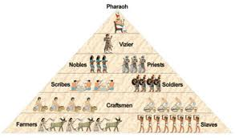
Key Cultural Characteristics
Describe how other people lived in Egyptian societies.
What classes of people existed?

Slide 12
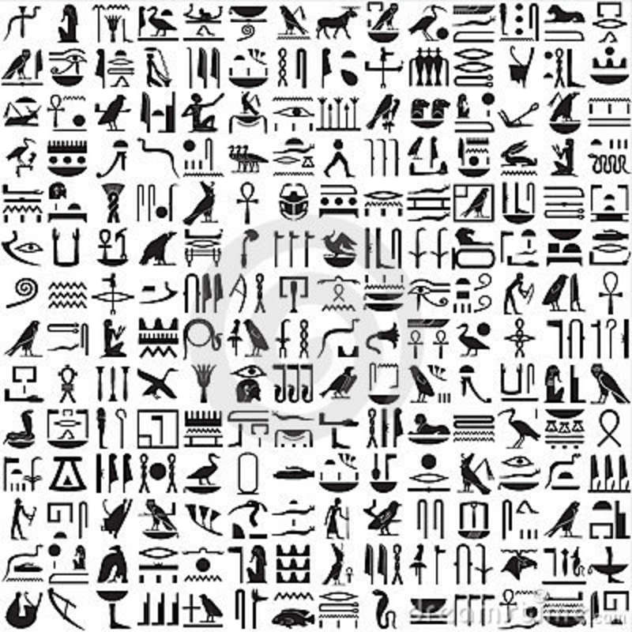
Key Cultural Characteristics
What writing system was used by the Egyptians?

Slide 13
Indus River Valley Civilization
On the map provided, located the following places or geographic features:
  Indus River
  Harappa
  Mohenjo-Daro
  Hindu Kush Mountains
  Himalayan Mountains
  Indian Ocean

Slide 14
Indus River Valley Civilization
In which continent is the area located?

Slide 15
Indus River Valley Civilization
Critical Thinking
How can the geographic features benefit the civilization?
How can the geographic features negatively impact the civilization?
In which continent is the area located?

Slide 16
Huang He Valley Civilization
On the map provided, locate the following places or geographic features:
  Huang He River

Slide 17
Huang He Valley Civilization
In which continent is the area located?

Slide 18
Other Early Civilizations
When?
  about 2000 to 500 B.C.E.
Who?
  Hebrews
  Phoenicians

Slide 19
Hebrews: Map Work
On the map provided, locate the following places or geographic features:
  Mediterranean Sea
  Jordan River
  Jordan River Valley
  Fertile Crescent
In which continent is the area located?

Slide 20
Other Early Civilizations
Where did the Hebrews settle?
What was the name of the written code of laws the Hebrews established?

Slide 21
Hebrew Religion
What is the name of the religion of the Hebrews?
Who were the key leaders of the religion?

Slide 22
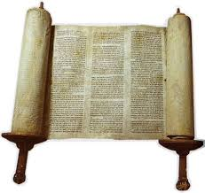
Hebrew Religion
What does monotheism mean?
What is the holy book of the Jews?
What is written in the holy book?
What are the Ten Commandments?

Slide 23
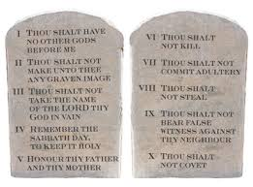
Hebrew Religion
What are the Ten Commandments?

Slide 24
Hebrew Religion
What is the religious city of the Hebrews?

Slide 25
Other Early Civilizations
How was the religion of the Hebrews different from other religions of the time?

Slide 26
Phoenicians : Map Work
On the map provided, locate the following places or geographic features:
  Mediterranean Sea
  Phoenician settlements along Mediterranean Sea coast
  Fertile Crescent
In which continent is the area located?

Slide 27
Other Early Civilizations
Where did the Phoencians settle?
What type of work were the Phoenicians best known for?

Slide 28
Other Early Civilizations
What special good did the Phoenicians trade?
What was the name of the writing system developed by the Phoenicians?

Slide 29
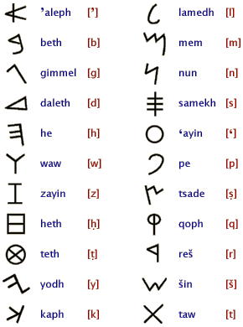
Other Early Civilizations: Phonenicians
Why did the Phoenicians develop an alphabet writing system?

